Slide 1

NUNAVUT WATER BOARD (NWB or Board)
Institution of Public Government (IPG)
Created under the Nunavut Agreement Article 13

Slide 2
Outline
The Nunavut Water Board officially started as a Board in 1996.
Board members nominated by the signatories to the Nunavut Agreement – Nunavut Tunngavik Inc. (NTI), Government of Nunavut (GN), Government of Canada (CA)
Notes:
The Nunavut Water Board began operations in 1996.
The Board is made up of 9 members, all appointed by the Federal Minister responsible for Indigenous Affairs (currently CIRNAC). 2 of those members are nominated by the Government of Nunavut, 4 nominated by Nunavut Tunngavik, 2 directly appointed by the Government of Canada. The Chair is appointed by the Minister and is generally based on a nomination from the NWB membership.

Slide 3
Outline
The Board has the powers of a Tribunal
The Board provides annual budget (core and public hearings)
The Board provides annual report
The Board attends various conferences and meetings
The Board holds meetings (in-person and teleconferences) and workshops
Notes:
The NWB has the same powers as a Tribunal. It makes decisions on its own which are not tied to any of the nominating parties or appointing agency. The NWB holds public hearings, reviews license applications, reviews technical reports, issues permits and licenses which includes renewals, amendments and cancellations.
The NWB is funded annually by the Federal government under a contribution agreement. Funding for core operations (standard day to day operations) is funded annually while public hearing funding is provided on an as and when needed basis under a separate budget. Annual reporting must be provided as a condition of this funding.
The NWB staff and members attend job relevant conferences and meetings and meet in person to conduct Board business a minimum of 3 times per year.

Slide 4
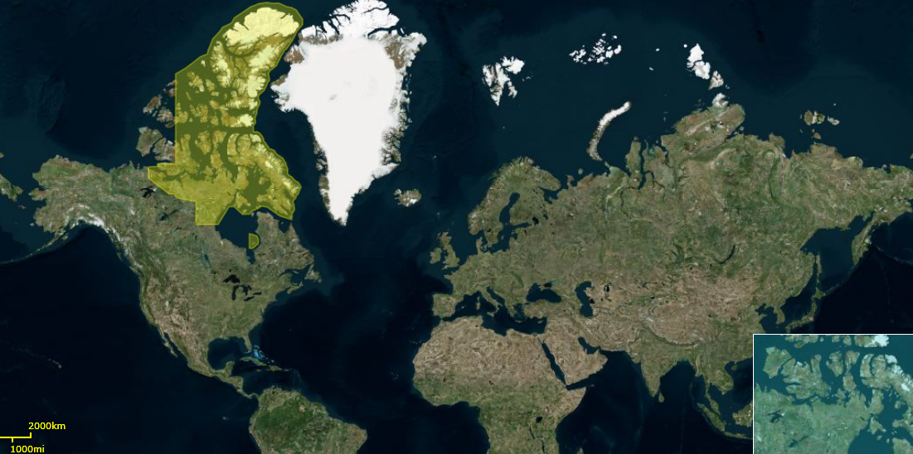
NWB as a Tribunal
Geographic scope of Jurisdiction
Notes:
The NWB jurisdiction spans the entire Nunavut Settlement Area as seen here in yellow.

Slide 5
NWB Authorities
Legal Authorities under
Nunavut Agreement (1993)
Nunavut Land Claims Agreement Act (1993)
Nunavut Act (1993)
Nunavut Waters and Nunavut Surface Rights Tribunal Act (2002)
Nunavut Waters Regulations (2013)
Notes:
The NWB draws its responsibilities and authority from the Nunavut Agreement, the Nunavut Waters and Nunavut Surface Rights Tribunal Act, the Nunavut Waters Regulations and most recently the Nunavut Planning and Project Assessment Act.

Slide 6
NWB as a Tribunal
Mandate of the NWB (Nunavut Agreement, Article 13)
“shall have responsibilities and powers over the regulation, use and management of waters in the Nunavut Settlement Area”
Section 13.7.1 of Nunavut Agreement
“With the exception of domestic or emergency use of waters as defined in Section 5 of the Northern Inland Water Act, no person may use water or deposit waste into water without the approval of the Board”.
Notes:
The Nunavut Agreement, Article 13 says the the NWB shall have responsibilities and powers over the regulation, use and management of waters in the Nunavut Settlement Area. Specifically, no person may use water or deposit waste into water without the approval of the Board unless it is for domestic or emergency use as defined in Section 5 of the Northern Inland Water Act.

Slide 7
No NWB Jurisdiction
No NWB Licence/Approval required associated with the use of waters
for a domestic purpose, or
for the purpose of extinguishing a fire or, on an emergency basis, controlling or preventing a flood; or
for the use of waters in a national park.
Notes:
No approval or license is required for water use for single domestic use purposes, for the purpose of putting out a fire, controlling or preventing a flood, for emergency use or for use in a national park.

Slide 8
NWB Licenses/Approvals
NWB licensing/approving of Use of waters and Deposit of waste through:
Type “A” Licences – “large” undertakings
Usually involves a public hearing
i.e. large operational mine (>300 m³/day)
Type “B” Licences – “small” undertakings
May involve a public hearing
i.e. exploration camp (<300 m³/day)
Authorized use Without a Licence
New category (April 18, 2013)
i.e. short-term researcher (<50 m³/day)
Notes:
The NWB issues 3 types of authorizations. These include:
Type “A” licenses which are generally for large undertakings. These usually involve a public hearing. For example, a large operational mine using more than 300 cubic meters of water per day
Type “B” licenses which are generally for small undertakings. These may involve a public hearing, if there were public concerns identified during the notice period. For example, a mine exploration camp using less than 300 cubic meters of water per day.
Authorized use Without a License which are typically for very low impact activities. These do not generally involve a public hearing. For example, a short term research project using less than 50 cubic meters of water per day.

Slide 9
NWB Notice for Licence Applications
Section 55 (1) of Nunavut Waters and Nunavut Surface Rights Tribunal Act requires
The Board shall give notice of every application in relation to a licence to the council of each municipality in the area affected by the application and shall publish the notice in a newspaper of general circulation in the area affected or, if there is no such newspaper, in such other manner as the Board considers appropriate. The notice shall invite interested persons to make representations within a specified period and shall advise them of the consequences, as provided in section 59 and subsection 60(2), of any failure to respond to the notice.
Public can provide written representations or call the NWB Office, if not able to make written representations.
All application submissions and public representations are made available by NWB at its FTP site: ftp://ftp.nwb-oen.ca/
Notes:
As per section 55(1) of the Nunavut Waters and Nunavut Surface Rights Tribunal Act, the NWB must give notice of every application for a license to the municipal council in the area affected by the application. The Board must also advertise in the newspaper and by any other means possible should newspaper not be an option. This notice invites people to comment on an application within a certain period of time.
The public can provide comments in writing or orally by calling the office. This interagency working group could ask to be included on the NWB’s distribution list for projects in the Baker Lake area and could provide comments if they wished to do so.
All application submissions are posted publicly to the Board’s FTP site.

Slide 10
NWB Public Hearings
A Public Hearing is required before issuing a water licence
for Type “A” Licences;
for Type ”B” Licences, if public concerns are expressed.
Section 13.7.2 of Nunavut Agreement requires that
The NWB hold a public hearing before approving any application for water use. If no public concern is expressed after public notice of the application has been given, the NWB may waive the requirement for a public hearing.
Notes:
All Type A license applications require a public hearing.
Public hearings can be waived for Type B applications if no public concerns are raised during the comment period.

Slide 11
NWB Public Hearings
Section 13.3.14 of Nunavut Agreement requires
Prior to the holding of public hearings on any water application, the NWB shall take all steps necessary by way of notice, dissemination of information and scheduling and location of hearings to provide and promote public awareness in such public hearings.
Section 13.3.5 of Nunavut Agreement requires
Within a reasonable period of time prior to the commencement of any public hearing, the information provided to the NWB in relation to any water application shall be made available to the public.
Section 13.3.6 of Nunavut Agreement requires
In the conduct of public reviews, the NWB shall hold hearings in the communities most affected by the water application.
Notes:
The NWB must actively advertise and distribute information related to public hearings including the time and date of the meetings as well as the specific location within a community. Promoting public awareness is important to help ensure that public concerns and feedback are noted on the public record.
Reasonable time will be given to review documents and provide feedback to the Board.
Hearings are conducted in the closest affected communities. For some projects, where impacts may extend beyond a single community, representatives from other communities may be flown in to participate and their expenses are covered by the NWB (airfare, accommodations, per diem)

Slide 12
Classification of Undertakings
The following Undertakings are licensed by the NWB:
1. Industrial Undertakings
Manufacturing processes, hydrostatic testing, quarrying and gravel washing, petroleum and gas exploration, the production, processing, refining or storage of petroleum products or gas, food, the restoration of the site of an industrial undertaking and any other industrial activity etc.
2. Mining Undertakings
Exploration or prospecting — including bulk sampling — for minerals other than petroleum or gas, the operation of a mine, the processing of minerals other than petroleum or gas, the restoration of the site of a mine and any other mining activity
3. Municipal Undertakings
A waste disposal or water system for a municipality
Notes:
There are 8 classes of undertakings that the Board licenses. These are:
1. Industrial (example – quarrying)
Mining (example – mine operations)
Municipal (example - community water use and waste disposal)

Slide 13
Classification of Undertakings (Cont.)
The following Undertakings could be licensed by NWB:
4. Power Undertakings
Authorized hydro, geothermal or nuclear electrical generation
5. Agricultural Undertakings
Nourishing crops or providing water for livestock
6. Conservation Undertakings
Works for the preservation, protection or improvement of the natural environment
7. Recreational Undertakings
commercial or public recreational development, including camps and tourist lodges
8. Other Undertakings
Research projects and any undertaking other than an undertaking set out in any of items 1 to 7
Notes:
Power (example – hydro generation)
Agricultural (example – watering crops or livestock)
Conservation (example – protection of the natural environment)
Recreational (example – commercial hunting or fishing lodge)
Other (example – research)

Slide 14
Relationship with DIAND
NWB does not enforce the Licences it issues
DIAND (CIRNAC or INAC previously) Inspectors have the legislative responsibility to enforce Water Licences issued by the NWB
Inspectors receive their Authority under the Nunavut Waters and Nunavut Surface Rights Tribunal Act
Notes:
The NWB issues licenses for the various applications received which include terms and conditions under which an applicant must operate. It is the responsibility of Federal inspectors to enforce these authorizations, not the NWB. These inspectors get their authority under the Nunavut Waters and Nunavut Surface Rights Tribunal Act.

Slide 15
NWB Office Contact Information
Nunavut Water Board
15 Inukshuk Road
P. O. Box 119
Gjoa Haven, Nunavut X0B 1J0
Web-site: www.nwb-oen.ca
Phone: (867) 360 -6338
Fax: (867) 360-6369

