Slide 1
Cullaton Lake Mine
Closure and Reclamation Plan (2017)
Presentation April 27, 2018

Slide 2
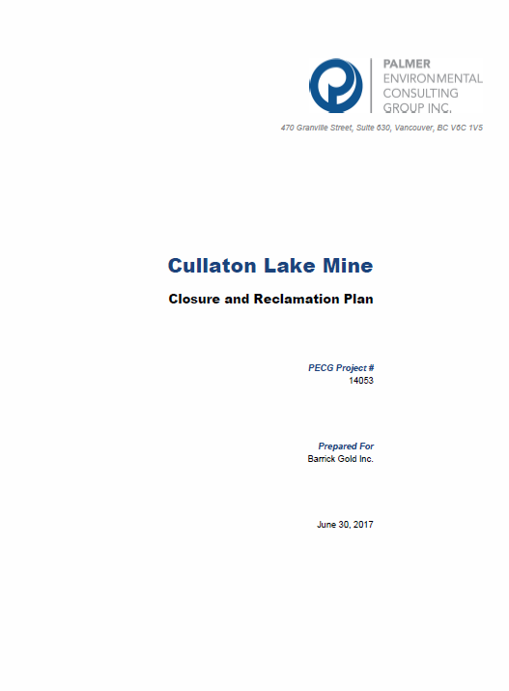
Meeting agenda
Chair: Paul Brugger
Present 2017 CRP: Rob Marsland / Rick Palmer
  Work completed to date and timeline
  Effects of current conditions on receiving environment
  Projected loadings
  Monitoring Plan
  Cost Estimate of monitoring
Present review of CRP: Arcadis
Discussions: ALL
  Arcadis comments on CRP
  Long term monitoring plans
    Type of monitoring, frequency, number of sites, monitoring reduction schedule

Slide 3
Introductions
Paul Brugger (Barrick)
Allison Brown (Barrick)
Michael McCarthy (Barrick)
Charles Kazaz, (Blake, Cassels & Graydon)
Rob Marsland (Palmer Environmental)
Rick Palmer (Palmer Environmental)
Ian Parsons (AADNC/AANDC)
Karén Kharatyan (NWB)
Assol Kubeisinova (NWB)

Slide 4
Timeline of events – Cullaton Lake Mine closure
Cullaton Lake mine operations – early 1981-1985 (processed <400,000 t of ore)
Abandonment & Restoration Plan – draft developed by Trow in 1991
Revised A&R Plan by Homestake in 1996, accepted
Closure activities commenced in 1991; completed by 2002
Barrick acquired Homestake in 2003
Indigenous and Northern Affairs Canada (INAC) commissioned BGC Engineering in 2006 to assess Barrick’s progress toward achieving the objectives of the Final A&R Plan
Barrick commissioned AECOM to conduct an Ecological Risk Assessment in 2008
AANDC requested Barrick update the 1996 A&R Plan in 2014
Additional aquatic (benthic invertebrate, sediment, water quality) field work conducted by PECG in 2016
Updated mass loadings assessment conducted by PECG in 2015 and 2016
Closure and Reclamation Plan completed by PECG in 2017
Post-closure water quality monitoring, submission of annual reports to the NWB, 2005-2017 (and ongoing)

Slide 5
Closure and reclamation plan (CRP) 2017 report
Prepared by Palmer Environmental Consulting Group Inc. (PECG) and submitted on June 30, 2017
Update to the Final Abandonment and Restoration (A&R) Plan (Homestake, 1996) and includes:
  BGC, 2007: Cullaton Lake Mine – 2006 Site Inspection Report and Mine Closure Review
  AECOM, 2009: Existing Conditions Report and Screening Level Aquatic Ecological Risk Assessment for the Cullaton Lake Mine Site
  Lorax, 2009: Geochemical Considerations of Tailings and Waste Rock – Cullaton Lake Mine
  PECG, 2015: Cullaton Lake Mine Mass Loading Model
  PECG, 2017: Cullaton Lake Mine 2016 Aquatic Monitoring Report & Adaptive Management Plan

Slide 6
Current conditions
kognak river, Tailings area, shear lake

Slide 7
Kognak river
Water quality

Slide 8
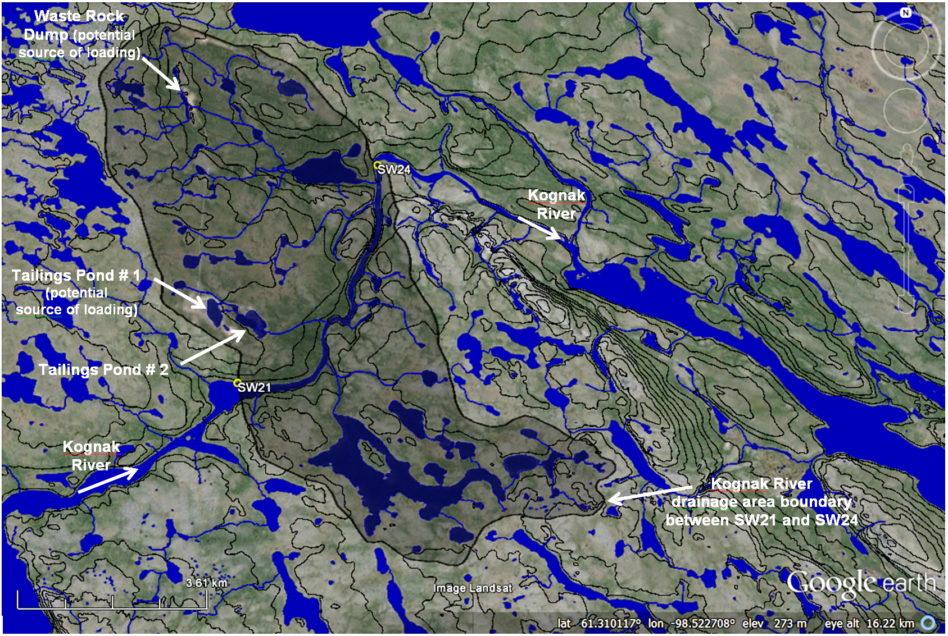
Overview

Slide 9
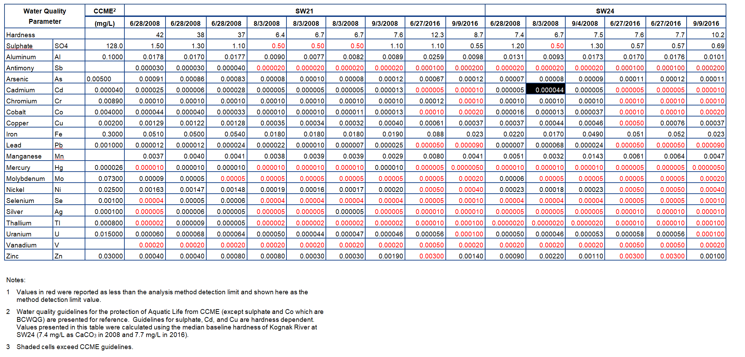
Kognak River Water Quality
The mine site does not appear to have any discernable influence on the water quality in Kognak River for most water quality parameters.
Concentrations of water quality parameters of potential interest do not appear to be increasing with time.
Other than for a single sample in August 2008, and only for cadmium in that one sample, CCME guidelines were never exceeded in Kognak River water quality dataset.
Notes:
Water quality Guidelines for the protection Aquatic Life from CCME (except for sulphate and Co which are BCWQG). Guidelines for sulphate, Cd and Cu are hardness dependent. Values presented in this table were calculated using
The median harness in the Kognak River at SW24 (7.4 mg/L as CaCO3 in 2008, and 7.7 mg/L in 2016)

Slide 10
Tailings area
overview

Slide 11
Tailings Area – Closure Considerations
Total quantity of tailings <400,000 tonnes, covering an area of
~5 ha
Geochemical stability
  Shear Zone tailings have potential to generate acid
  B-zone tailings are lower acid generation potential, and less metal leaching
  Best Practice is to keep PAG tailings saturated (water cover) or ensure they remain frozen
Geotechnical stability
  Dam has a very low consequence of failure
  no evidence of physical distress of the dam (e.g., cracking, settlement, or displacement of material)
  Subject to typical weathering mechanisms which warrant monitoring and infrequent maintenance
Water Management
  Spillway is adequate to route IDF
  Needs monitoring and infrequent maintenance

Slide 12
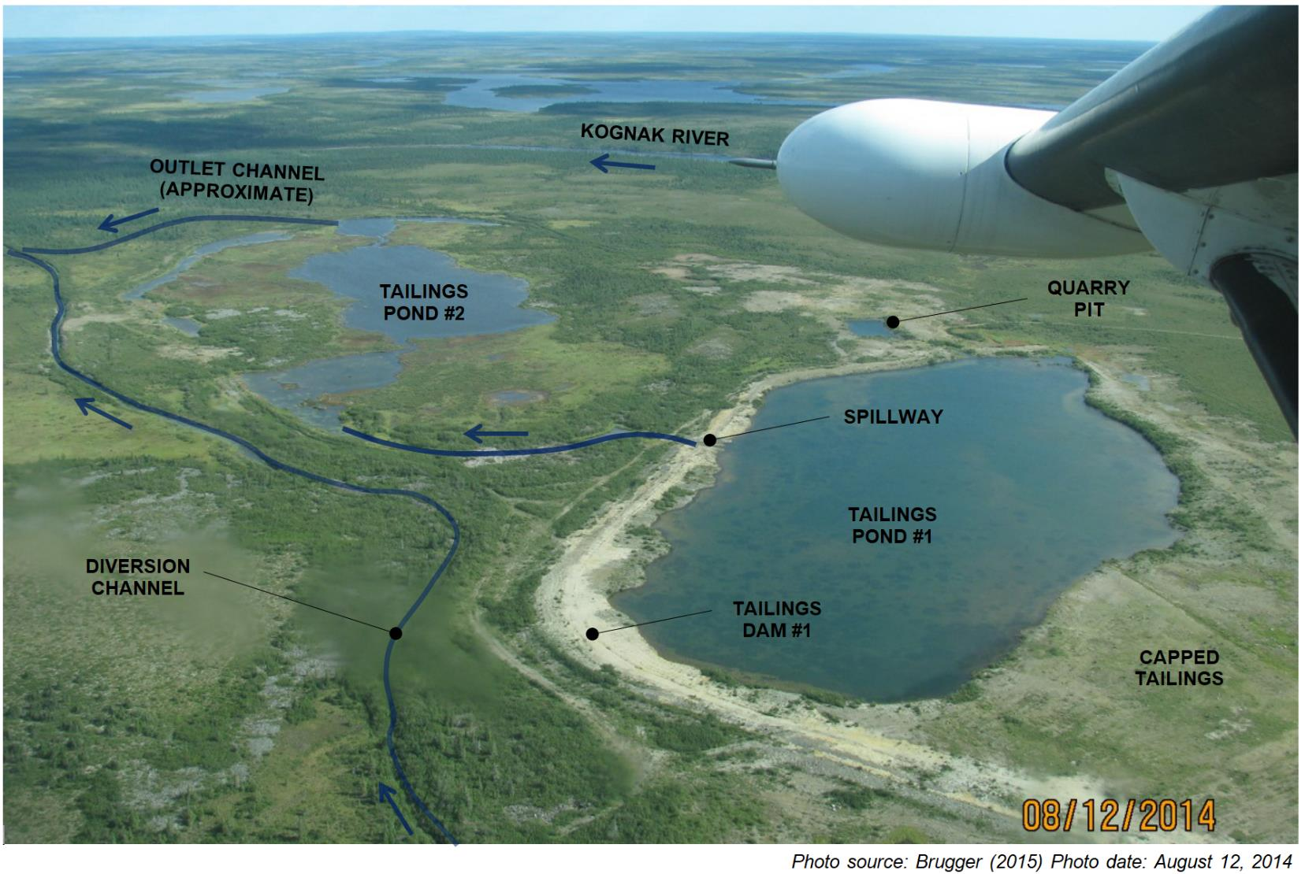
Tailings Area – looking southeast

Slide 13
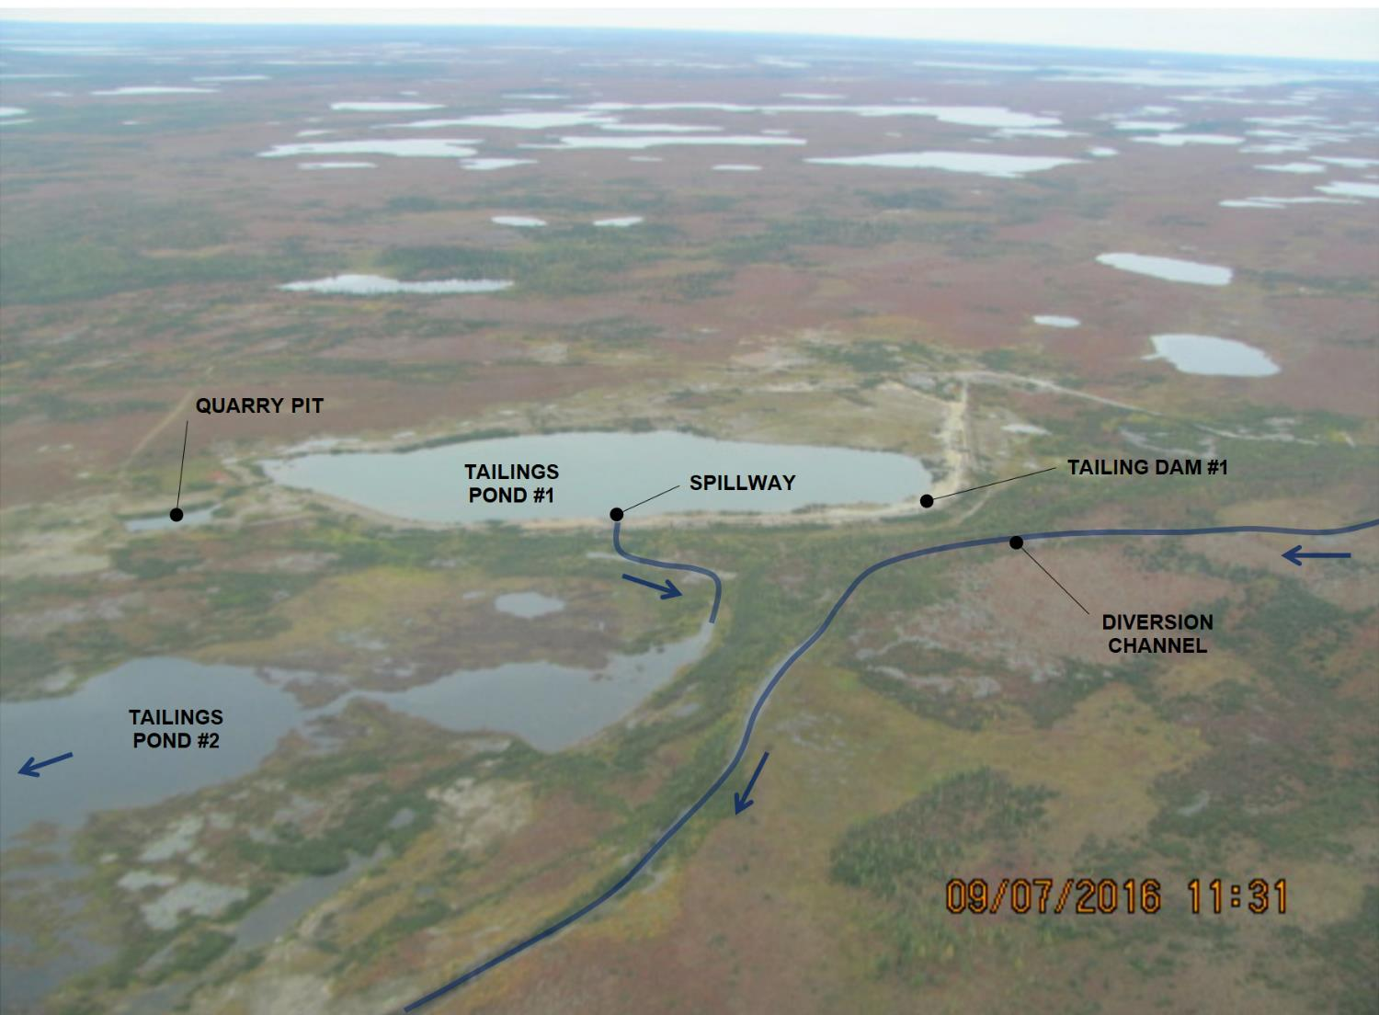
Tailings Area – Looking West
Photo source: Brugger (2017)
Photo date: September 7, 2016

Slide 14
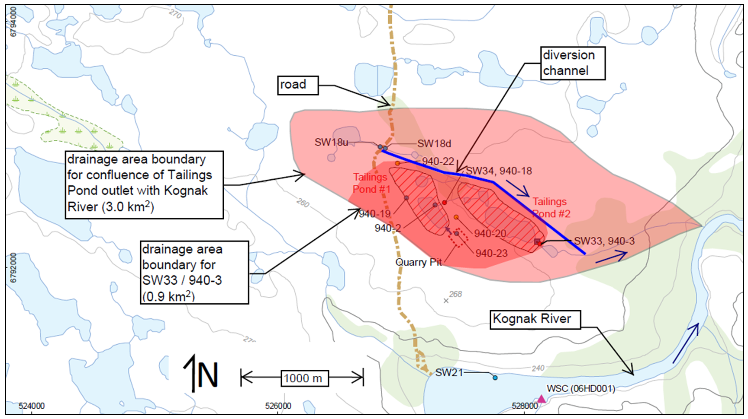
Tailings Area – Drainage Basin Boundaries

Slide 15
Tailings area
Permafrost monitoring

Slide 16
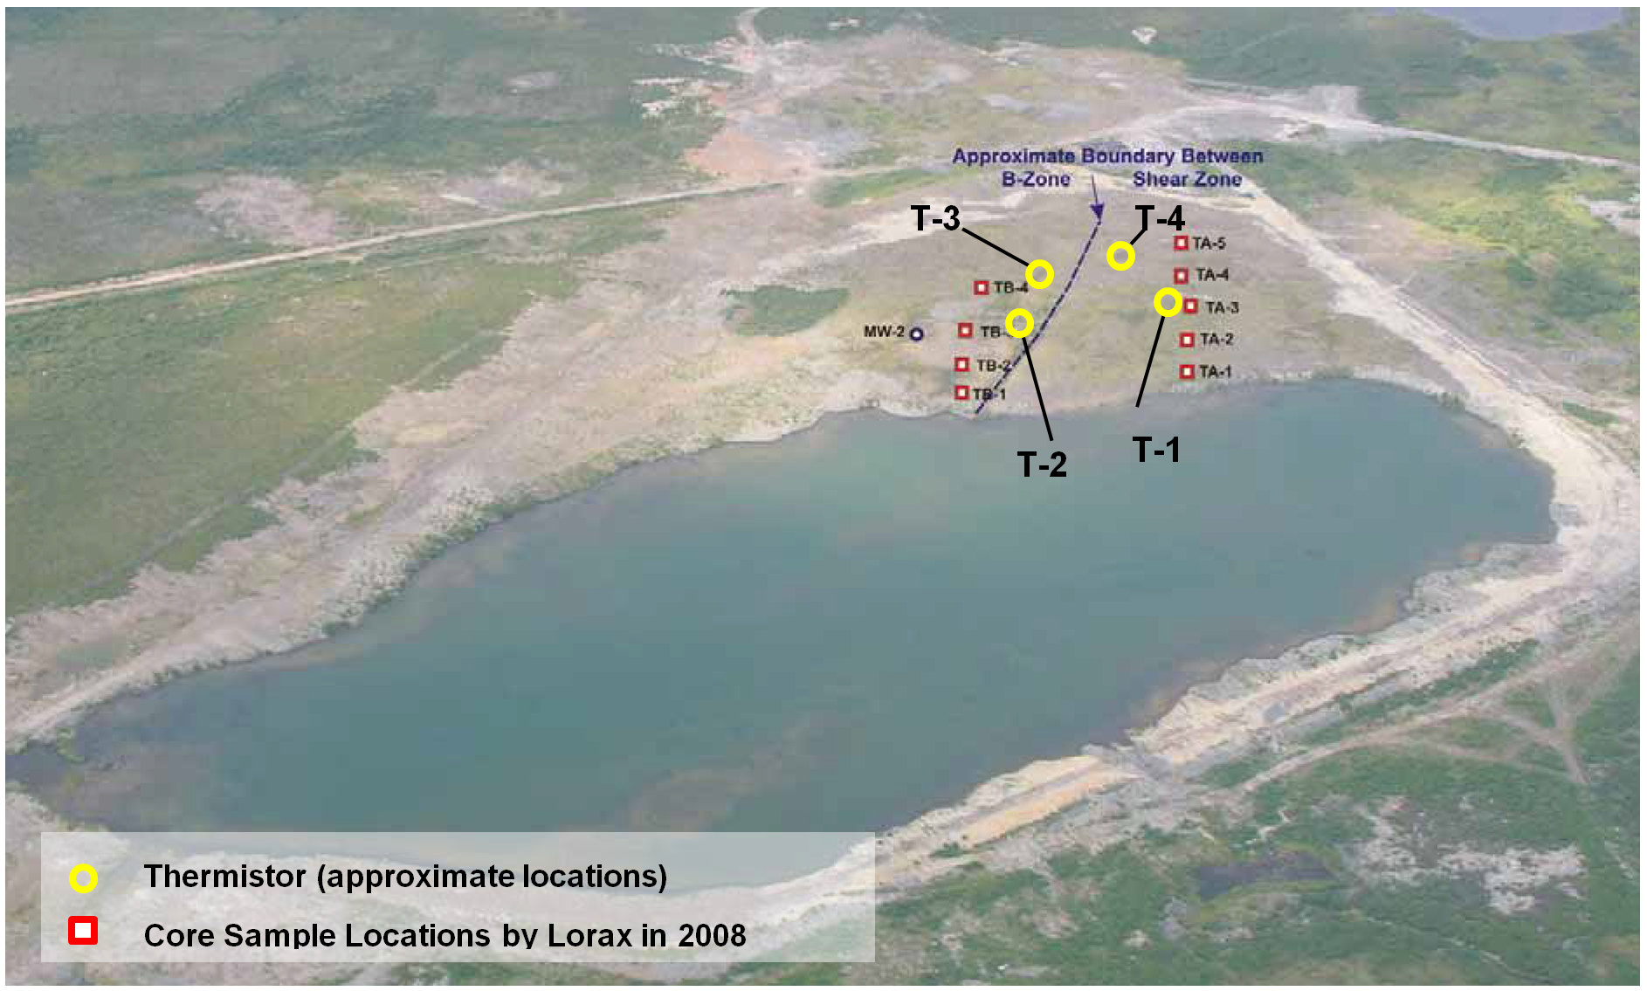
Tailings Area – Permafrost Monitoring

Slide 17
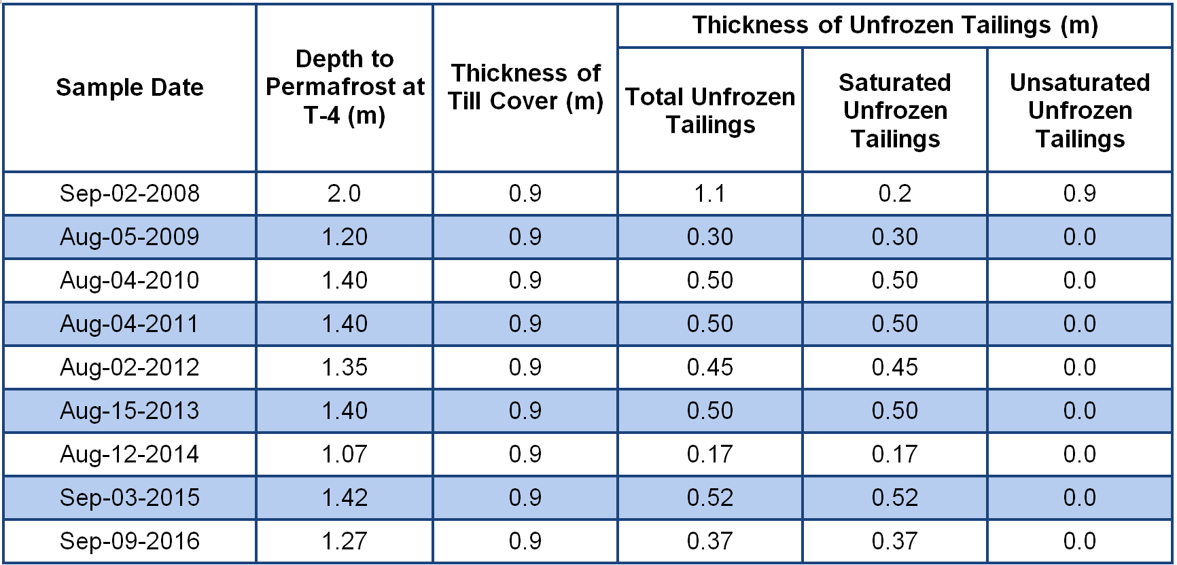
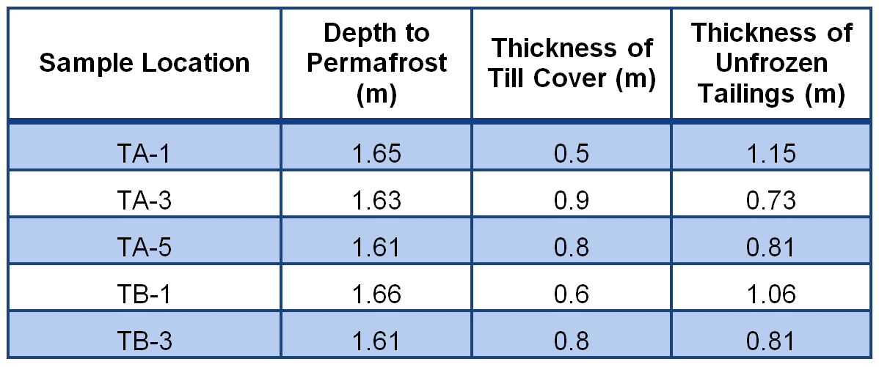
Tailings Area – Permafrost Monitoring
Annual depth to permafrost near Thermistor T-4
Depth to permafrost was measured to be about 2.3 m in the mid-1990s when cover was initially placed.
Recent depth to permafrost measurements have generally shown about a 1.4 m thick depth to permafrost with about 0.5 m thick layer of unfrozen tailings.
Manual test pits have shown that the layer of unfrozen tailings has been saturated (with exception of 2008).
Depth to permafrost measured by Lorax in 2008
Notes:
While some of the near-surface tailings have thus been observed to be unfrozen during the summer months, the depth to permafrost has been notably shallower than the earlier measurements made immediately following cover placement in the mid-1990’s which observed frozen conditions at approximately 2.3 m depth. In addition, the manual test pits have shown that the layer of unfrozen tailings has been saturated, with the exception of a 0.9 m thick unsaturated zone measured in 2008.

Slide 18
Tailings area
Water quality

Slide 19
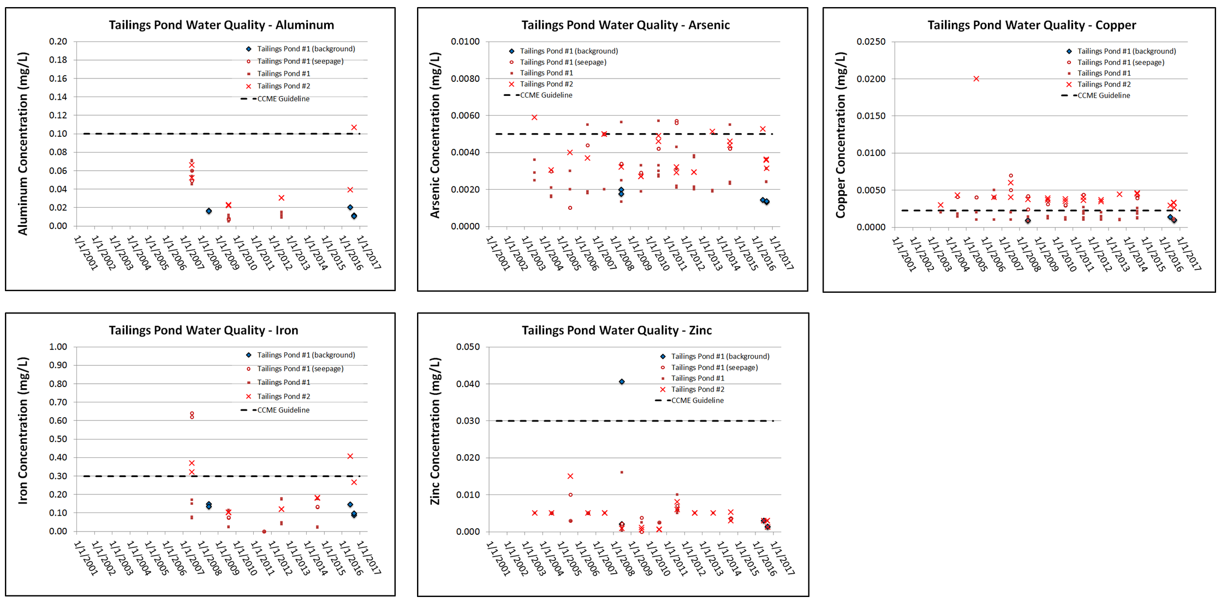
Tailings Pond – Water Quality
Concentrations of water quality parameters of potential interest do not appear to be increasing with time.
Notes:
Water quality parameters of potential interest at the tailings area were identified as those which have exceeded CCME guidelines at some point at monitoring station 940-3 (or SW33) at the outlet of Tailings Pond #2 and included Al, As, Cu, Fe. The time series plots for those parameters are presented on Figure 4. Zn was added to Figure 4 because water quality in the background exceeded CCME for one sample. No discernable trend in concentrations with time could be observed, as seen in the plots provided on Figure 4. The mildly elevated Al and Fe concentrations are most likely associated with the presence of low levels (<8 mg/L) of TSS.
Dilution calculations (Table 9) indicated that CCME for those parameters would likely be met in the creek downstream from Tailings Pond #2 prior to its confluence with the Kognak River. Tailings drainage basin areas are presented on Figure 6.

Slide 20
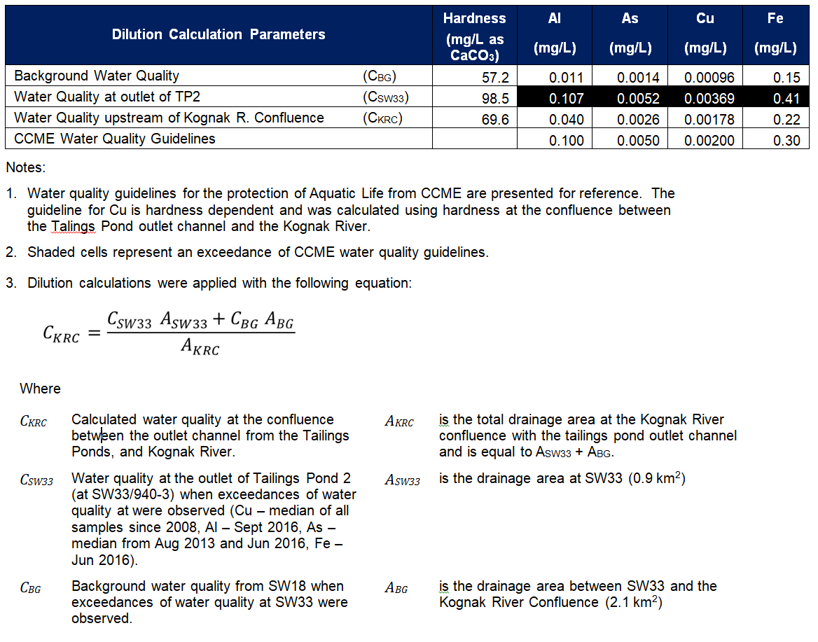
Water Quality Downstream from Tailings Area
Dilution calculations suggest that concentrations downstream from the Tailings Area will be below CCME prior to discharge into the Kognak River.

Slide 21
Tailings area
Benthic Invertebrates and Sediment Quality

Slide 22
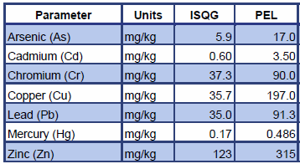
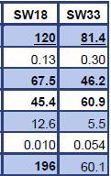

Tailings Area - Sediment Quality
Sediment results from 2016 sampling do not show clear effects from tailings pond seepage, may be related to sediment heterogeneity in stream environments

Slide 23
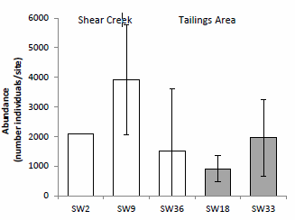
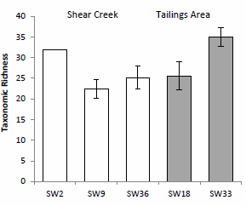
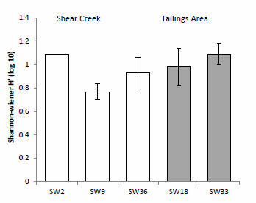
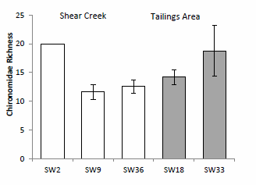
Tailings Area – Benthic Invertebrates
Benthic invertebrate community more diverse in this area than Shear Creek area
Higher EPT organisms at SW18 indicative of a healthier benthic community upstream of the tailings pond
SW33, downstream of the tailings pond had higher proportion of Oligochaeta than SW18, which are typically more tolerant of organic pollution

Slide 24
Shear lake area
Water quality

Slide 25
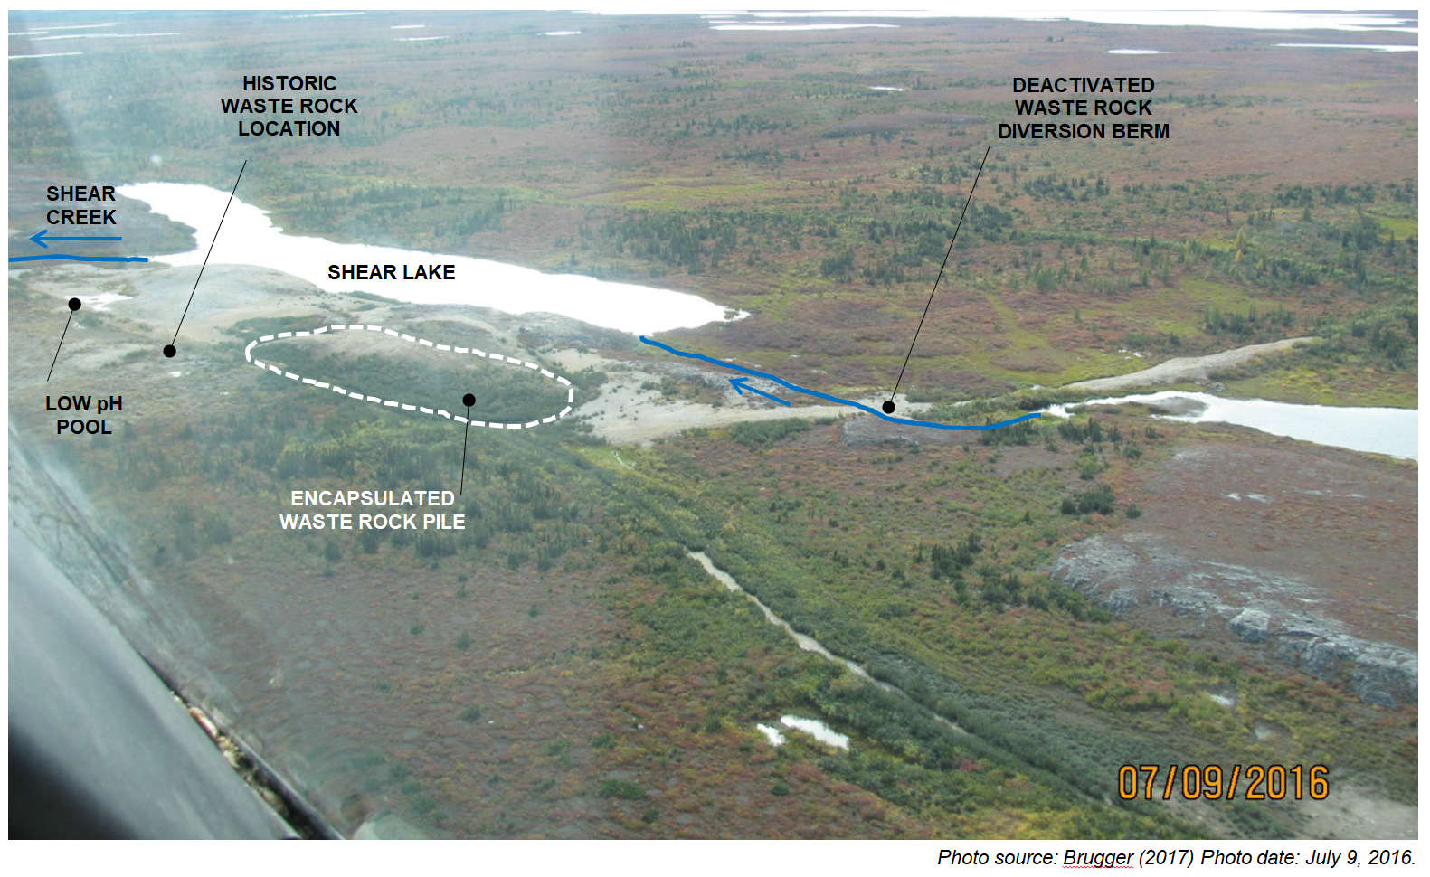
Shear Lake - Overview

Slide 26
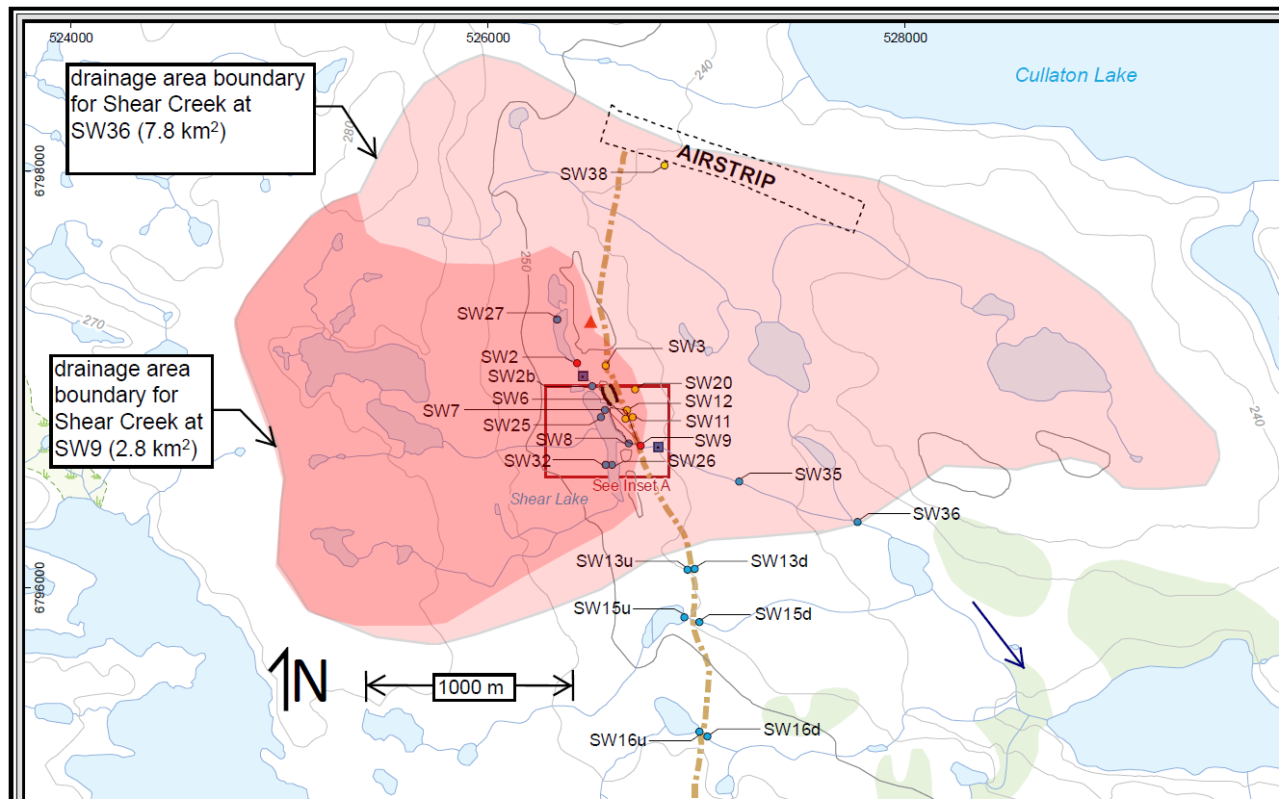
Shear Lake Area

Slide 27
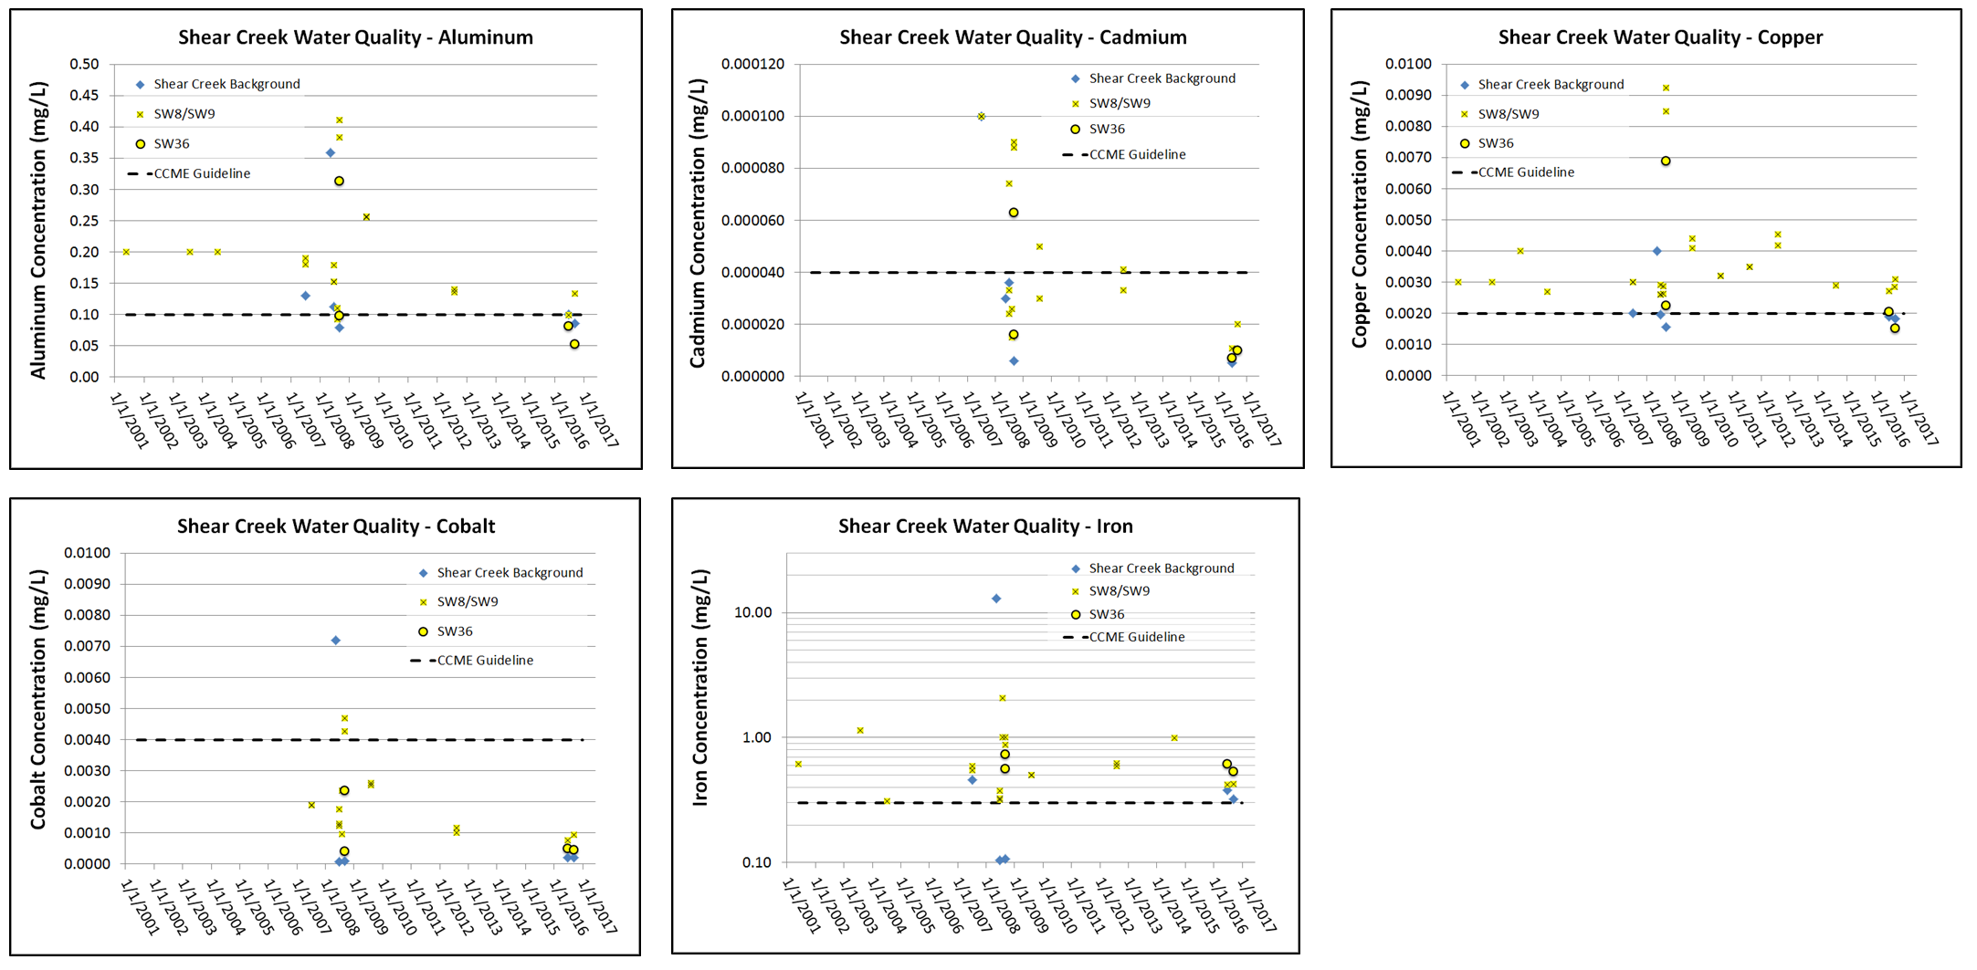
Shear Creek Water Quality
Water quality monitoring in Shear Creek, downstream from the waste rock pile, suggests that Shear Creek water quality returns to nearly background concentration by station SW36.

Slide 28
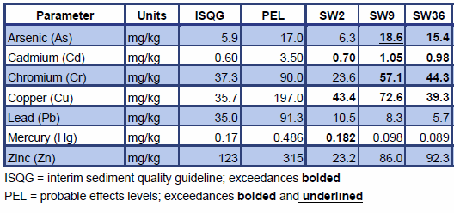
Shear Lake Area - Sediment Quality
Elevated levels of metals in sediment at SW9 in Shear Creek, downstream of waste rock pile, compared with SW2 background
Elevated metals appear to be reflective of waste rock pile (except for Hg)
Metal concentrations decreased further downstream at SW36

Slide 29
Shear Lake Area – Benthic Invertebrates
SW2 site – only 1 replicate was obtained
No statistical difference in abundance between SW9 and SW36
Benthic invertebrate community mostly chironomids with no statistical differences in various metrics of richness and diversity
However, Shannon-Wiener diversity significant higher at SW36, and slightly higher at SW2, providing some indication that community composition is more diverse at SW2 upstream of the waste rock pile

Slide 30
Summary of Effects on receiving environment
Tailings Pond
  Concentrations of water quality parameters of potential interest do not appear to be increasing with time at the outlet of TP2
  Seepage is limited to brief period post-freshet; quantity and quality assimilated within ultimate receiving environment of Kognak River
  Dilution calculations suggest that concentrations downstream from the Tailings Area will be below CCME prior to discharge into the Kognak River.
Shear Lake
  Arctic grayling and Lake chub healthy with normal length/weight relationships; does not appear to be impacted by environmental conditions
  Diversity of benthic invertebrate community similar to undisturbed sites in Nunavut
Shear Creek
  Water quality monitoring in Shear Creek, downstream from the waste rock pile, suggests that Shear Creek water quality returns to nearly background concentration by station SW36
  Absence of sulphides remaining in residual waste rock indicates water quality of the waste rock drainage unlikely to get worse over time
  Loadings considerably lower than prior to the 2002 reclamation efforts
Kognak River
  No discernable influence from the mine, concentrations not increasing with time, CCME guidelines not exceeded*
*Exception is one Aug 2008 Cd sample

Slide 31
Long term monitoring
Plan and costs

Slide 32
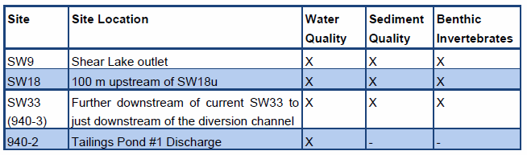
Adaptive Monitoring
Long-term monitoring is based on an Adaptive Monitoring Plan proposed in PECG’s 2017 Report (2016 Aquatic Monitoring Report)
Focuses on parameters which would reflect ecological effects at sites close to potential mine influence – ensures early detection of changes
3 sediment & benthic invertebrate sites (SW9, SW18, SW33)
4 water quality sites (SW9, SW18, SW33, 940-2)

Slide 33
Long term monitoring plan
Geotechnical
  Currently – annual inspection of tailings dams indicate dams are stable with low consequence of failure, risk based approach recommended by Thurber
  Proposed – Formal inspection every two years
  Monitor condition of dam at wet spots and seeps
  Monitor Dam No.1 spillway channel for erosion
  Monitor thickness of active layer within tailings layer – thermistors will be reinstalled in 2018 (cost not included in post-closure program)
Water Quality – Modification to current Water License monitoring
  Reduction in locations from 9 to 4 (addresses redundancy and dry sites)
  Modification of parameters to support water quality monitoring of Kognak River
  Reduction of monitoring frequency from annual to bi-annual
Aquatic Biology
  Adaptive monitoring approach to include surface water quality, sediment quality and benthic invertebrates
  3 monitoring sites
  Every 4 years

Slide 34
Summary of long-term monitoring
Component | Parameters/Metrics | Frequency | Timing | Methodology
Geotechnical | Condition of dam and spillway channel Stability of till cap of Shear Lake waste rock Active layer thickness in till cap of tailings Infrastructure and Water Management System | Every 2 years | Early September | Inspection by qualified geotechnical inspector
Water Quality | 940-2, SW33 (940-3), SW9, SW18 Physical parameters (e.g., conductivity, pH) Anions and nutrients Total Metals | Every 2 years | Early September | Sample collection and in situ measurements
Sediment Quality | SW33 (940-3), SW9, SW18 Physical parameters (grain size) Leachable anions and nutrients Total Metals | Every 4 years | Early September | Sample collection in depositional area
Benthic Invertebrates | SW33 (940-3), SW9, SW18 Benthic Community Composition and Descriptors | Every 4 years | Early September | Kick-net sampling

Slide 35
Closure cost estimate
Total cost for first 10 years of monitoring is $431,000, which includes $50,000 for spillway/rip-rap maintenance scheduled for every 20 years and $100,400 one time contingency fund for unexpected maintenance or supplemental monitoring
Incremental cost for next 10 years, considering a 3% discount rate is $217,200
Barrick has proposed 10-year bond amount consistent with duration of Water Licence, but is open to discussing other time frames

Slide 36
Closure cost estimate – Annual Breakdown

Slide 37
Wrap-Up
Barrick to retain control and ownership of the site
Closure and reclamation works are complete
  Thermistors will be re-installed later this year
No significant residual risks
  Continuing slow oxidation of tailings below till cap is acceptable
Monitoring and maintenance will continue to ensure no unexpected changes at site
Barrick will provide bond adequate to ensure continued site monitoring

Slide 38
Questions?

Slide 39
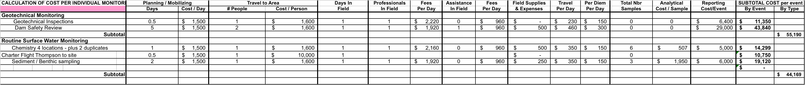
Closure cost estimate – detailed monitoring costs

