Slide 1
Kitikmeot Inuit Association
Summary of Technical Issues
Hope Bay Project Phase 2
Type A Water License
Notes:
Hello, I am John Roesch, the Senior Hope Bay Project Officer for the Department of Lands and Environment for the Kitikmeot Inuit Association. I am responsible for project oversite for the KIA and provide input into the regulatory process on the Hope Bay Project to both the NWB and NIRB. In performing this role, I make use of KIA’s consultants who are subject matter experts in the areas of hydrology, hydrogeology, fisheries, aquatic environment, and geotechnical engineering.

Slide 2
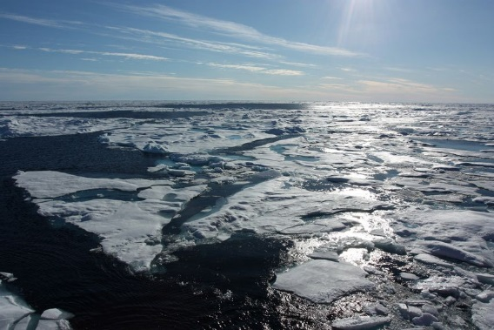

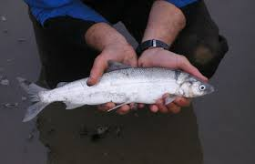
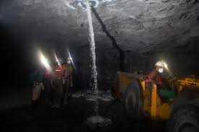
Technical Overview
This presentation provides an overview of concerns & recommendations made by the KIA during the review, with regard to:
    Fish and Fish Habitat and Hydrogeology
    Arsenic, AEMP, Metal Effluent Regulations, and
    Water Quality Monitoring
Notes:
This presentation will cover issues raised by KIA in the area’s of fish and fish habitat, hydrogeology, Arsenic, Aquatic Effects Monitoring Program, Metal Effluent Regulations, and Water Quality monitoring. KIA has 8 issues identified with the application for the Type A Water License for the Hope Bay Project Phase 2 (Boston mine site). Most of these issues have been resolved in discussions with TMAC Resources Inc., some are resolved pending updates to reports and plans. Two are unresolved.

Slide 3
Fish and Fish Habitat
(KIA-NWB-01 & 02)
A. Concern:
  Fisheries offsetting.
  Aquatic Effects Monitoring Plan (AEMP).
B. Recommendations:
  TMAC should provide preliminary gain calculations for potential fisheries offsetting.
  Include lake surface elevation in monitoring Imniagut, Glenn, Ogama, and PO Lake in AEMP.
  C. TMAC Response:
  01 TMAC will work with DFO, KIA, and IEAC to develop community based offsetting. Both potential losses and gains have been calculated.
  02 TMAC will monitor water levels in fish bearing lakes that are impacted by the project. These being Wolverine, Patch, P.O., Ogama, Doris, Little Roberts, Glenn, Windy, and Aimaokatolok.
Notes:
These issue have been resolved.

Slide 4
Fish and Fish Habitat
(KIA-NWB-03)
A. Concern:
  Water withdrawal Potential Alteration and/or Destruction of Fish habitat (PAD) calculations.
B. Recommendations:
  Indicate whether additional mitigation through offsetting will be applied when high groundwater sensitivity is likely and habitat losses are greater than those reported in the FEIS.
  C. TMAC Response:
  03 TMAC will apply adaptive management during monitoring. Should a high groundwater sensitivity case result in habitat losses that exceed predicted, TMAC will apply an offsetting plan.
Notes:
This issue has been resolved.

Slide 5
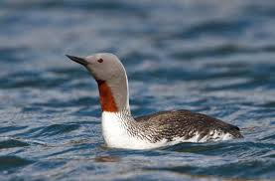
Arsenic and AEMP
(KIA-NWB-04 & 05)
A. Concern:
  Arsenic Site-Specific Water Quality Objective (SSWQO).
  Aquatic Effects Monitoring Plan (AEMP) water quality sampling frequency.
B. Recommendations:
  TMAC adopt a long-term total arsenic SSWQO of 0.019 mg/L for application throughout the freshwater environment.
  Water quality sampling should be conducted during freshet as well as under ice and in open water season through the AEMP.
C. TMAC Response:
  04 TMAC will adopt SSWQO of 0.019 mg/L if arsenic levels increase significantly overtime in a project lake relative to it reference condition.
  05 TMAC will conduct sampling once during under-ice season, three times during open-water season and at MMER-specific sampling sites twice annually.
Notes:
Issues 04 and 05 are resolved based on a review of the updated AEMP.

Slide 6

AEMP and Metal
Effluent Regulations
(KIA-NWB-06 & 07)
A. Concern:
  Aquatic Effects Monitoring Plan (AEMP) Parameter Suite.
  Preparation for Metal and Diamond Mine Effluent Regulations (MDMER).
B. Recommendations:
  The AEMP parameter suite should be updated to include weak acid dissociable cyanide and total cyanide under CCME and MDMER.
  TMAC update the Water License and FEIS applications to reflect the discharge criteria under MDMER.
C. TMAC Response:
  06 TMAC agrees to add free cyanide and total cyanide to the AEMP parameter suite.
  07 TMAC will be able to meet MMER and MDMER guidelines. Mine effluents were compared to both MMER and proposed MDMER guidelines.
Notes:
These issues are resolved.

Slide 7
Water Quality
Monitoring
(KIA-NWB-08)
A. Concern:
  Confirmation of Model Predictions – Water Quality.
B. Recommendations:
  TMAC include ongoing water quality monitoring through the AEMP in all modelled lakes in which impacts from project activities are predicted.
  The AEMP should be amended to include water quality monitoring of Windy lake in addition to already proposed lakes.
C. TMAC Response:
  08 Windy lake will be sampled during construction and two years of operations through the AEMP. The greatest changes to Windy lake are predicted more than 20 years into the future. Predicted changes are below CCME guidelines.
Notes:
This issue is resolved, TMAC has agreed with our request. Windy Lake will be sampled during construction and for two years of operations through the AEMP.

