Slide 1
TMAC Resources Ltd.
Water Licence Applications for the Hope Bay Phase 2 Project
Renewal/Amendment #2 for 2AM-DOH1323 and New for 2AM-BOS----
Nunavut Water Board Technical Meeting
Cambridge Bay, May 14-15, 2018

Slide 2
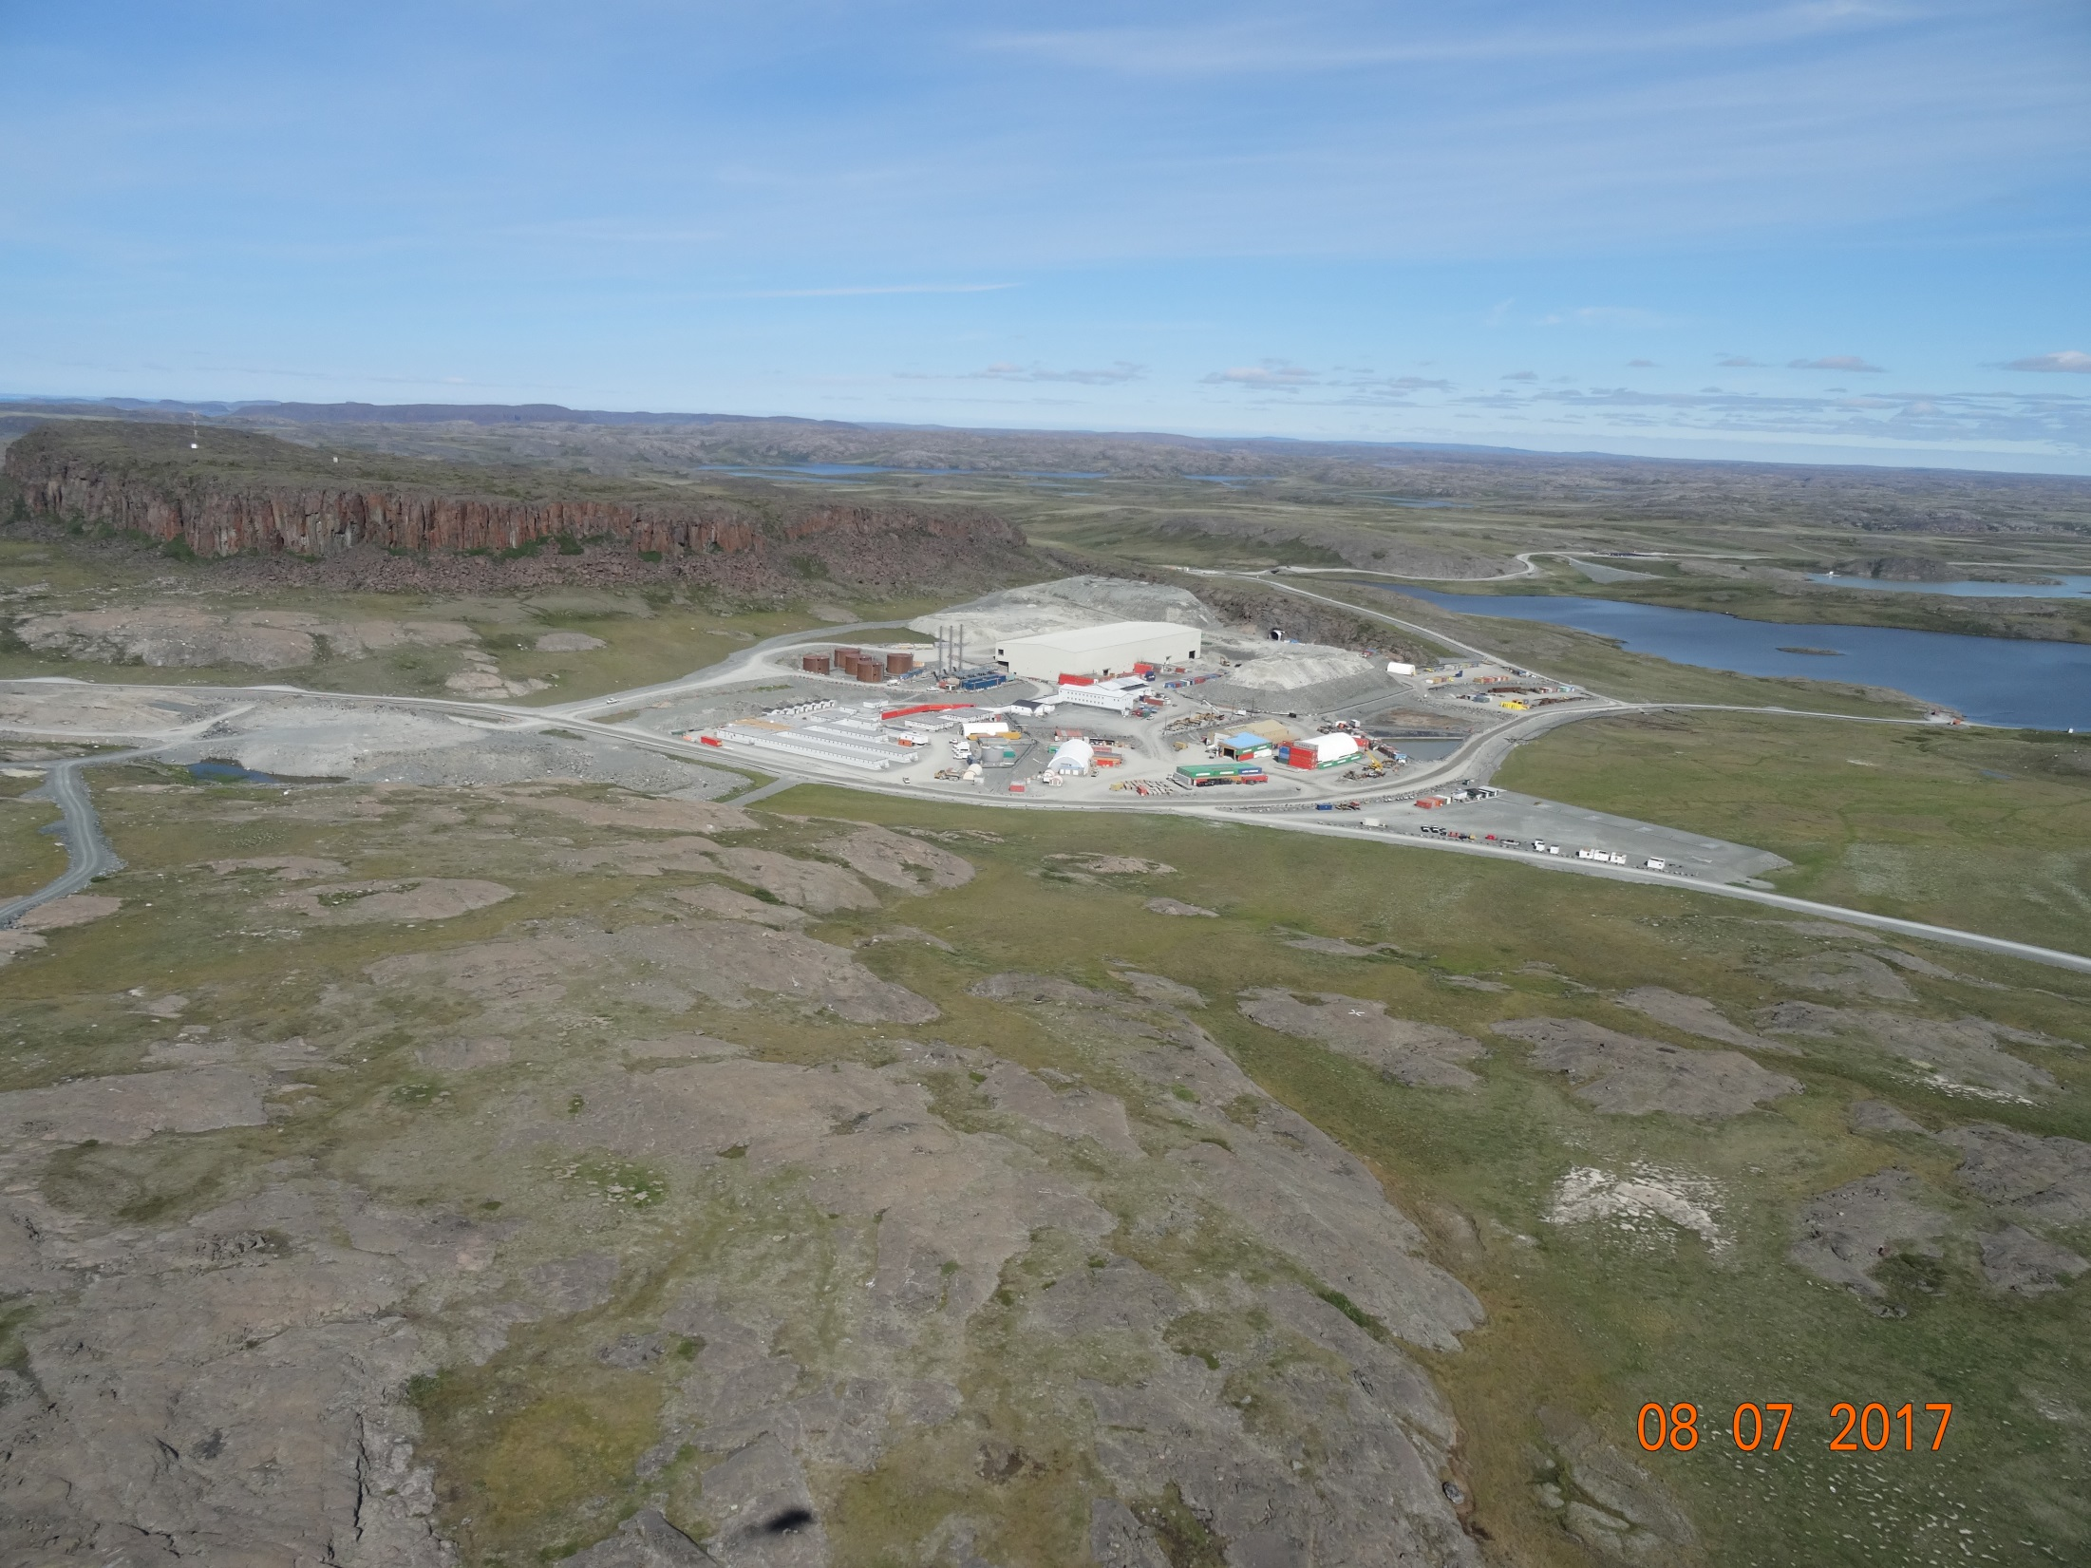

Slide 3
Outline
Roles and responsibilities
Contributions to the application review
Topics discussed:
    Site water management
    Tailings management
    Waste management
    Closure & reclamation
    Additional components
Closing

Slide 4
Roles and responsibilities
Indigenous and Northern Affairs Canada’s (INAC) responsibilities, mandate, and obligations stem from the following:
Department of Indian Affairs and Northern Development Act
Nunavut Agreement
Nunavut Land Claims Agreement Act
Nunavut Waters and Nunavut Surface Rights Tribunal Act and the associated regulations
Nunavut Planning and Project Assessment Act
Territorial Lands Act and the associated regulations
Arctic Waters Pollution Prevention Act

Slide 5
Contributions to the application review
INAC made the following submissions to the Nunavut Water Board:
February 14, 2018 – Preliminary completeness review
March 29, 2018– Technical review comments with information requests and recommendations

Slide 6
1. Site water management
Boston water treatment plant effluent quality (comment #4)
Release of saline minewater to tundra through pipeline failure (comment #7)
Industrial water treatment plant at Doris (comment #9)
Water & load balance model validation (comment #10)
Contact water pond design (comment #12)

Slide 7
1. Site water management (continued)
Maximum camp size at Doris (comment #14)
Requested water volumes (comment #15)
Minewater at Boston (comment #18)
Madrid minewater transport (comment #19)
Effect of saline water in tailings impoundment area on frozen core dam (comment #21)

Slide 8
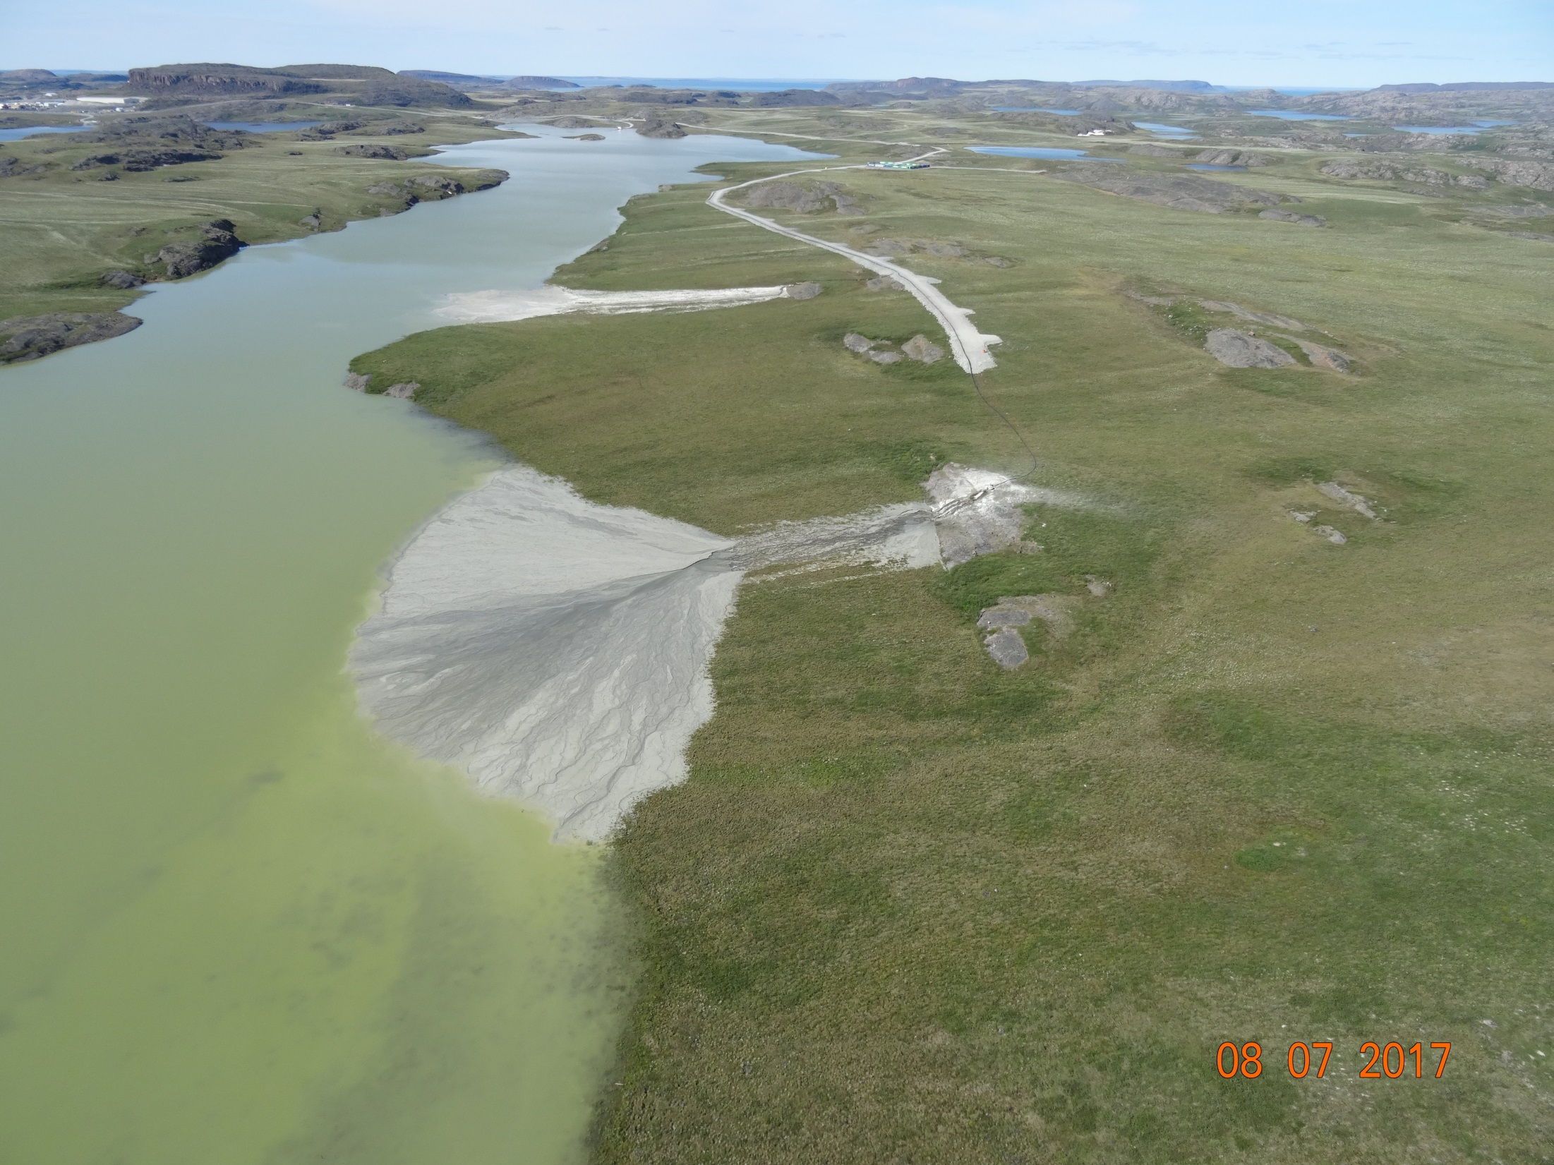
2. Tailings management

Slide 9
2. Tailings management
Doris tailings impoundment area closure plan (comment #1)
Boston tailings management area seepage post-closure (comment #2)
Backfill materials (comment #5)
Waste rock volumes in relation to void volumes (comment #16)
Detoxified tailings deposition at Madrid (comment #17)

Slide 10
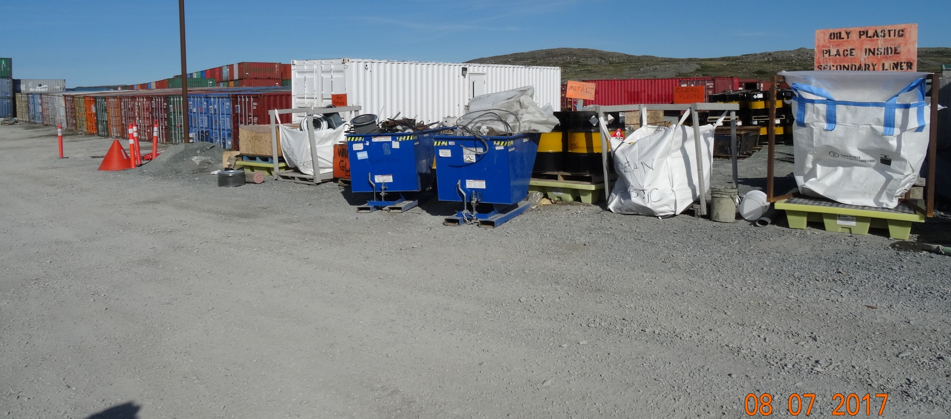
3. Waste management
Non-hazardous waste disposal (comment #20)

Slide 11
4. Closure & reclamation
Closure planning and requirements (comment #3)
Long term climate change effects (comment #6)

Slide 12
5. Additional components
Water licences for Hope Bay Belt (comment #8)
Aquatic effects monitoring plans (comment #11)
Cyanide testing (comment #13)
Reclamation cost estimate

Slide 13
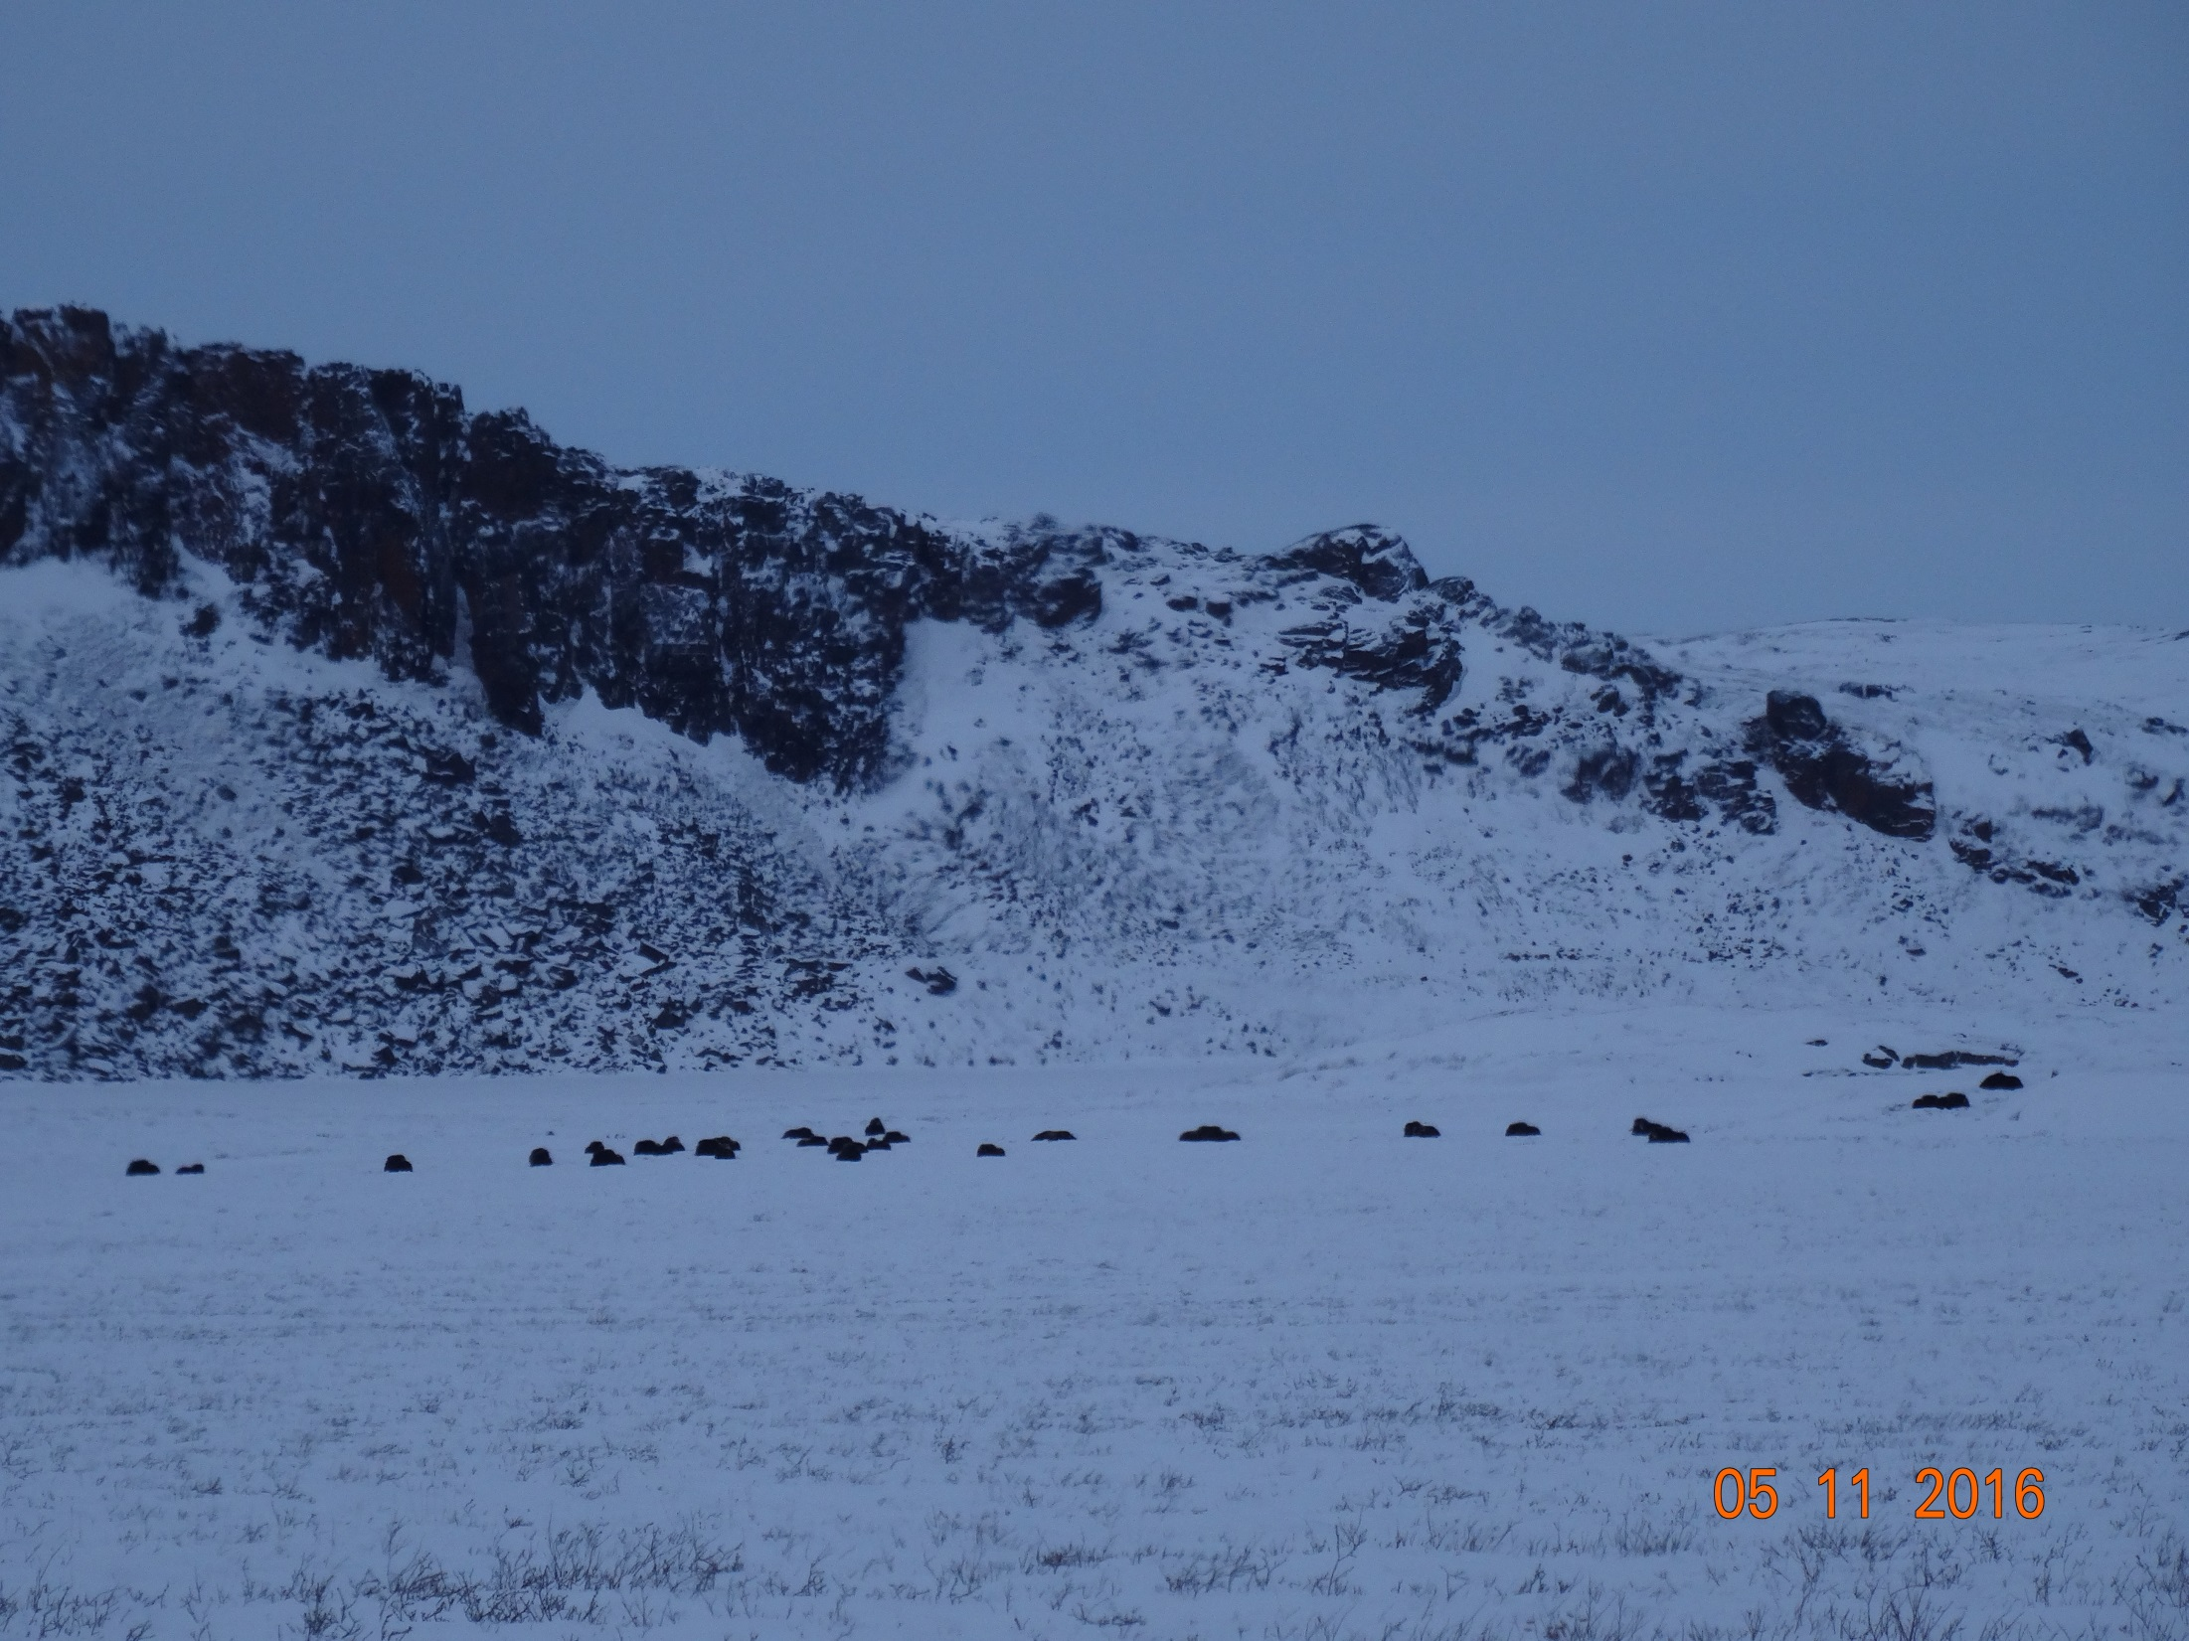

Slide 14
Closing
The department is confident that concerns brought forward can and will be addressed by TMAC to the satisfaction of the department before a Public Hearing.
The department will be submitting further evidence to the Board regarding reclamation closure costs following further discussions with all parties.

Slide 15
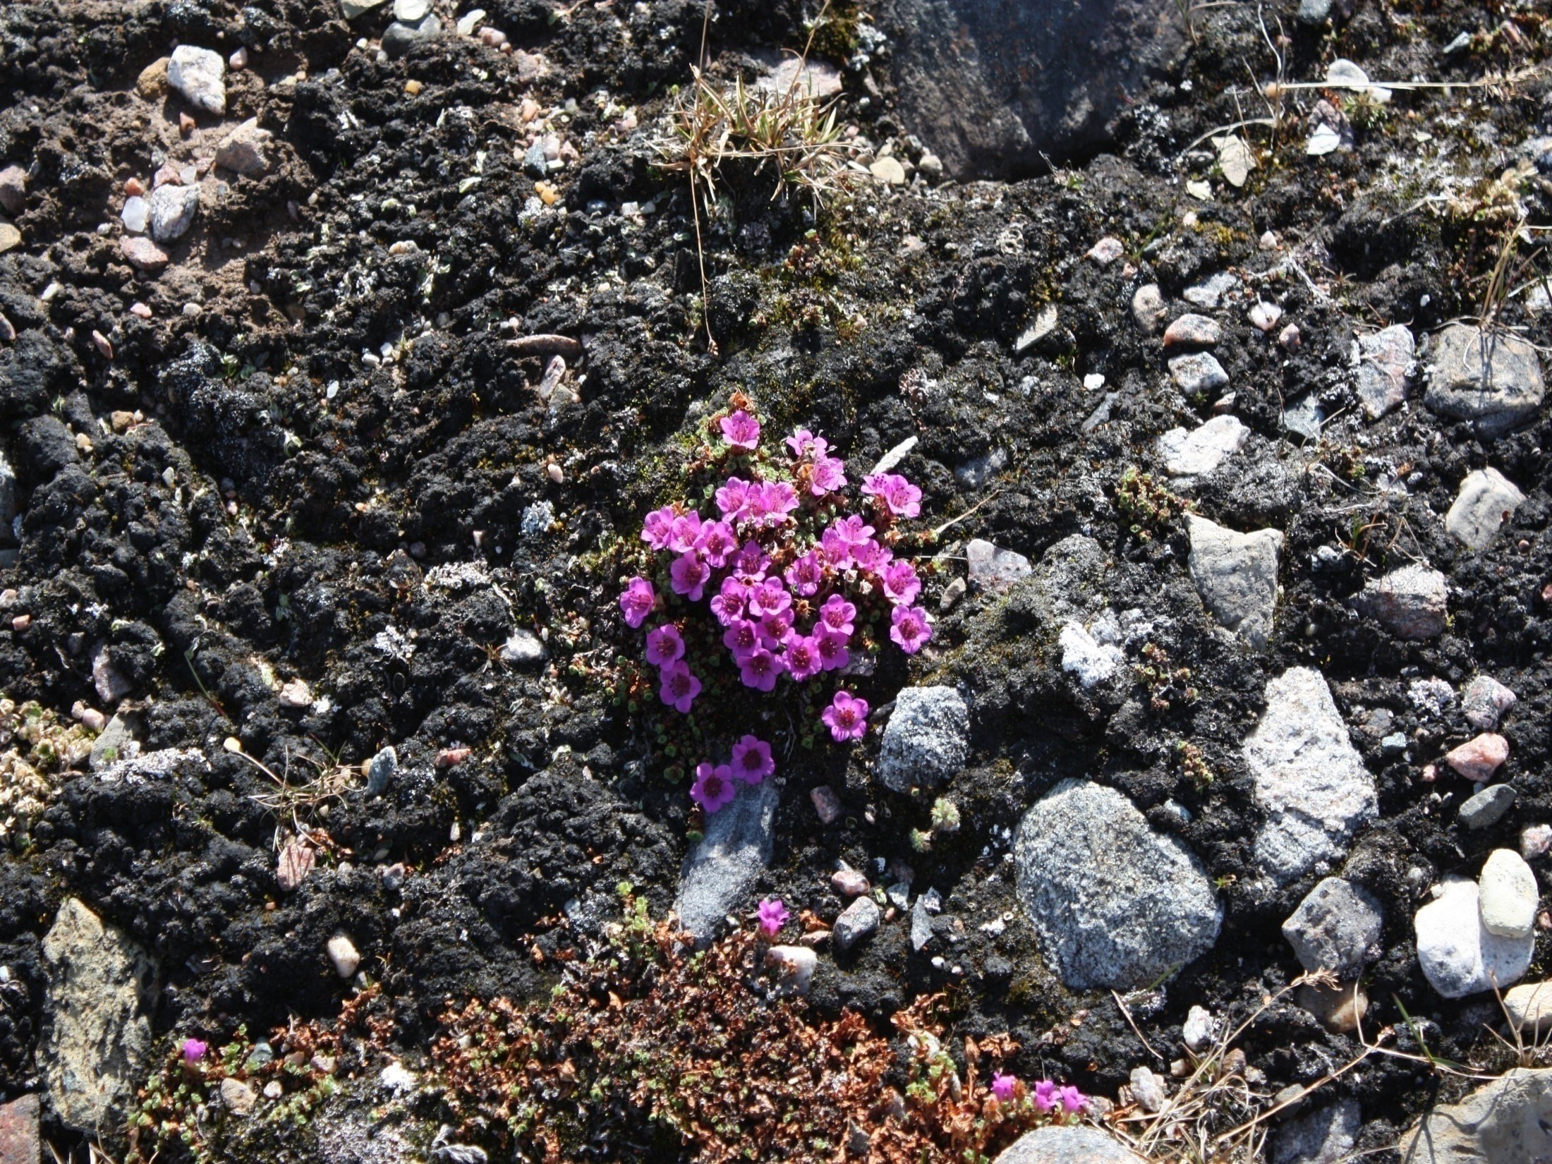
Nakurmiik
Thank you
ᓇᑯᕐᒦᒃ
Merci

