Slide 1
Kitikmeot Inuit Association
KIA Technical Review of Hope Bay Project Phase 2 Type A Water License
Notes:
Hello everyone, I am John Roesch, the Senior Hope Bay Project Officer for the Department of Lands and Environment for the Kitikmeot Inuit Association. I am responsible for project oversite for the KIA and provide input into the regulatory process on the Hope Bay Project to both the NWB and NIRB. In performing this role, I make use of KIA’s consultants who are subject matter experts in the areas of wildlife, fisheries, aquatic environment, and geotechnical engineering.

Slide 2
Purpose of Presentation
Present a summary of KIA’s Technical Review of TMAC Resources Inc.’s Hope Bay Project Phase 2 Type A water license application.
KIA conducted a thorough review in the areas of fish and fish habitat, aquatic environment, and water quality monitoring.
8 Issues for Technical Meeting.
Notes:
The purpose of this presentation is to provide a brief summary of our technical review of the Hope Bay Phase 2 Type A water license application. Our review covered fish and fish habitat, aquatic environment, and water quality monitoring. KIA conducted the review in a collaborative manner with TMAC Resources out of which we brought forward 8 issues to be resolved either prior or at the Technical Meeting or through further consultation.

Slide 3
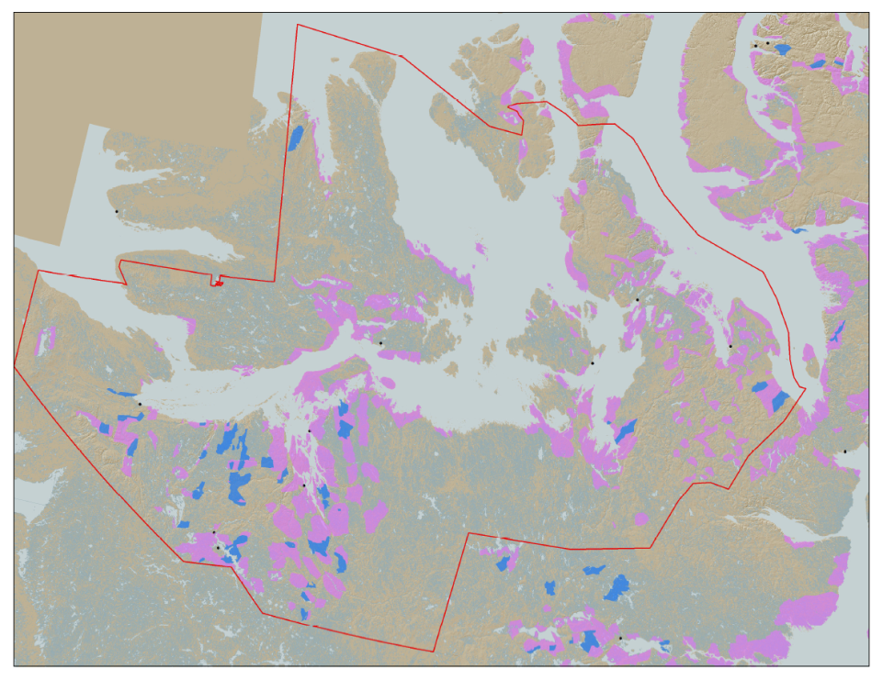

KIA’s Mandate
KIA’s Mandate is to represent the interests of Kitikmeot Inuit by protecting and promoting their social, cultural, political, environmental, and economic well-being.
KIA owns 106,360 km² of surface land: A significant opportunity if managed properly.
Hope Bay Project
Notes:
KIA’s mandate is to manage Kitikmeot Inuit lands and resources, and to protect and promote the social, cultural, political, environmental and economic well-being of Kitikmeot Inuit. The Kitikmeot Region is generally within the red boundary. The Pink and Blue lands are lands which KIA owns the surface rights.
Kitikmeot Inuit Association is a democratically elected not-for-profit society that represents the Inuit of the Kitikmeot Region of Nunavut.
As a result of the Nunavut Agreement, Inuit are one of the largest private landowners in the world. Much of this privately owned land is in areas with high potential for mineral development. This land is a significant opportunity for Inuit if it is managed properly. We must optimize opportunities and manage liabilities that are inherent with being a private landowner. If not, we will affect the well-being of our Kitikmeot Inuit membership.
The Hope Bay Project is located on the mainland near the coast and approximately in the middle of the region.

Slide 4
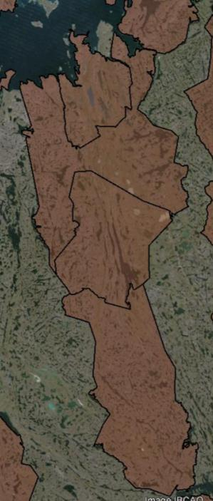
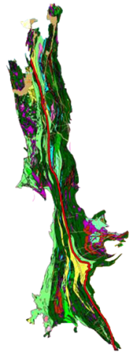

The Hope Bay Project
Doris
BB-60
Madrid
Located on 4 parcels of Inuit Owned Land.
The Hope Bay greenstone belt has had significant exploration since 1965.
Vast exploration potential remains
TMAC took over development of the project in 2012
BB-58
120 km
BB-57
Boston
BB-56
Notes:
When the Inuit Owned Land was selected for the NLCA, Inuit knew that the Hope Bay Area was highly prospective for mineral development. A 120 Km length of surface lands that include some mineral rights were selected in the area. The brown areas are surface lands owned by KIA. BB-56, 57, 58, and 60 include our agreement with TMAC for the Hope Bay Project.
The Hope Bay greenstone belt has been explored since 1965. Within this greenstone belt, over 850Km of drilling has occurred since 1965. Most of the drilling has been focused around Doris, Madrid and Boston. This project has changed ownership many times. Prior to TMAC, the last company to operate the Hope Bay Project was Newmont, who failed to develop a profitable business case for the development of the project. TMAC took over the project in 2012.
On the Map you can see the location of some of the highest priority development sites in the belt: Doris, Madrid and Boston.

Slide 5
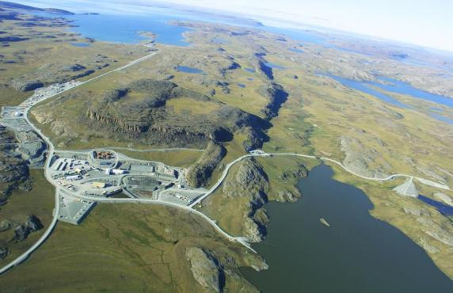
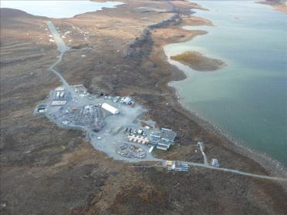
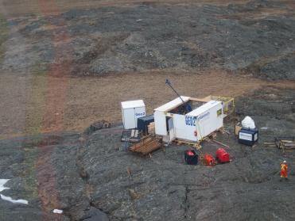
The Hope Bay Project
Doris North Mine
Boston Advanced Exploration Camp
Exploratory Drilling
Notes:
So much exploration has occurred since 1965, that people know that there are many development opportunities in the belt. The Hope Bay Greenstone Belt is unique because it demonstrates the capacity to hold several mining operations across the belt in the different stages of development, operated by one company. In another more developed part of the world, it could be that several different companies would have exploration and mining proposals in a Greenstone belt such as this.
This greenstone belt includes a permitted mine at Doris North, several advanced exploration targets such as the Boston Project which has preliminary mine plans developed, and many other identified high quality exploration targets. There is also vast exploration potential. TMAC has rights to all the minerals in this area. Once an operating mine is established, the efficiencies of belt-wide exploration will increase.

Slide 6
Fisheries and Aquatic Environment Issues
Fisheries offsetting.
Aquatic Effects Monitoring Plan (AEMP).
Water withdrawal Potential Alteration and/or Destruction of Fish habitat (PAD) calculations.
Arsenic Site-Specific Water Quality Objective (SSWQO).
Notes:
As indicated previously, 8 issues were brought to the technical meeting with the NWB pertaining to the Phase 2 Type A water license application. These four issues concern the fish, fish habitat, and the aquatic environment. We raised concerns about the need to calculate potential gains in fisheries for fish offsetting, the monitoring of lake surface levels in the Aquatic Effects Monitoring Plan, the calculations for lost fish habitat due to water with drawl, and the setting of site-specific water quality objectives for total arsenic in all water bodies affected by the project. KIA considers these issues to be of high and medium importance.
TMAC has responded to our recommendations and these issues are resolved.

Slide 7
Aquatic Environment & Water Quality Issues
Aquatic Effects Monitoring Plan (AEMP) water quality sampling frequency.
Aquatic Effects Monitoring Plan (AEMP) Parameter Suite.
Preparation for Metal and Diamond Mine Effluent Regulations (MDMER).
Confirmation of Model Predictions – Water Quality.
Notes:
These four issues concern sampling frequency during freshet, under ice, and open water season for the Aquatic Effects Monitoring Plan (AEMP), the inclusion of dissociable cyanide and total cyanide in AEMP parameters to meet Canadian Council of Ministers of the Environment (CCME) and Metal and Diamond Mine Effluent Regulations (MDMER) guidelines, preparation for use of new MDMER guidelines in monitoring water quality, and confirmation of water quality model predictions. The KIA considers these to be of high and medium importance.
TMAC has taken our recommendations under consideration and these issues are resolved.

Slide 8
Conclusion
KIA believes that all remaining technical issues identified can be successfully resolved through continued cooperation between KIA and TMAC Resources Inc. at the Technical Meeting and on an on-going basis.
Thank You
Questions?
Notes:
The KIA believes that the technical issues brought forward to the Technical Meeting can be successfully resolved with TMAC through our on-going collaboration.
We thank you for listening and we are open to any questions.

