Slide 1
TMAC Resources Ltd.
Water Licence Applications for the Hope Bay Phase 2 Project
Renewal/Amendment #2 for 2AM-DOH1323 and New for 2AM-BOS----
Nunavut Water Board Technical Meeting
Cambridge Bay, May 14-15, 2018
TMAC-kut Immaqmik Aturiagani Laisiuyunik Tuukhaqtuutit Kapihiliktumi
Havaaq 2-mi
Nutaaguqtiqniganik Nahautaani 2 ukunani 2AM-DOH1323-mi Nutaaqlu uvani
2AM-BOS----mi
Nunavumi Immaliqiyit Katimayit Nutauniqhanik Katimanigani
Iqaluktuutiami, May 14-mit 15-mut 2018-mi

Slide 2
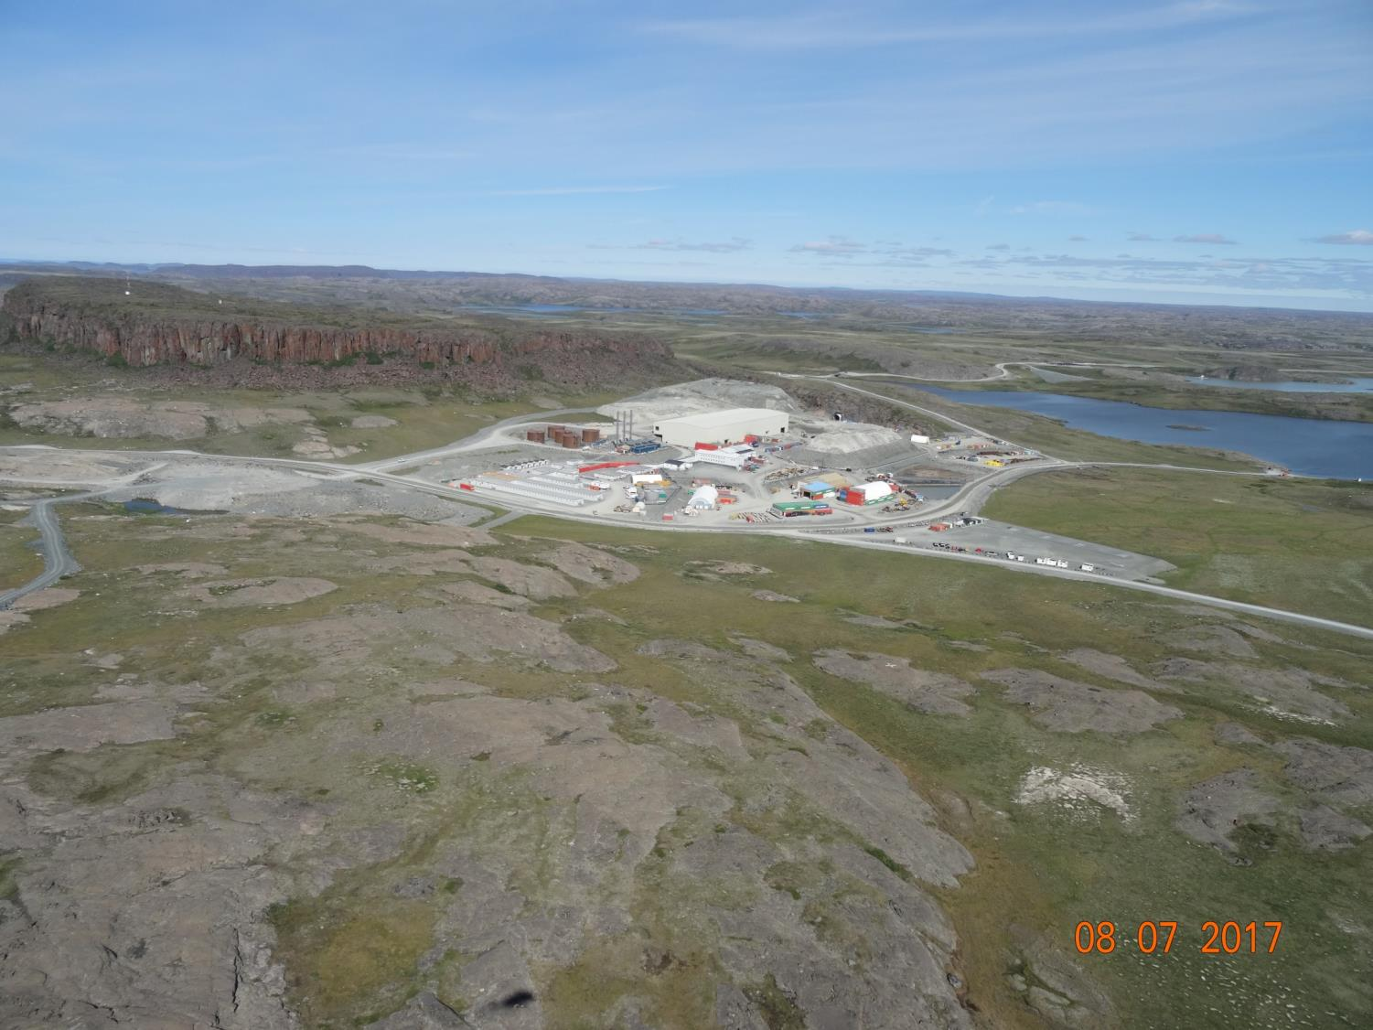

Slide 3
Outline
Qanuriniga
Roles and responsibilities
Contributions to the application review
Topics discussed:
    Site water management
    Tailings management
    Waste management
    Closure & reclamation
    Additional components
Closing
Ilaunigit havaakhalu
Ilaliutiniginik atuqtumi ihivriuqhijutimi
Ukua uqauhiuyuut:
    Igluqpaqaqvikmi immaq munarinigagut
    Ataguut munariniganik
    Iqagunik Munariniganik
    Umiktiqniganik kiklimaktiqnigalu
    Ilagiarutit ilagiyainik
Iniqtirutit

Slide 4
Roles and responsibilities
Ilaunigit havaakhalu
Indigenous and Northern Affairs Canada’s (INAC) responsibilities, mandate, and obligations stem from the following:
Department of Indian Affairs and Northern Development Act
Nunavut Agreement
Nunavut Land Claims Agreement Act
Nunavut Waters and Nunavut Surface Rights Tribunal Act and the associated regulations
Nunavut Planning and Project Assessment Act
Territorial Lands Act and the associated regulations
Arctic Waters Pollution Prevention Act
Nunaqaqaqtut Ukiuqtaqtumilu Havaat Kanatami (INAC) havaagit, havaak-hitaunigit, aturiaqaqtailu pihimayut ukunanga:
Havakviuyuq Itqilrit Pijutigivlugit Havaat Ukiuqtaqtumilu Pivalianiginik Maligaqyuamit
Nunavumi Agiqatiriigunmit
Nunavumi Nunataaqnikut Agiqatigiirunmik Maligayuamit
Nunavumi Immaliriqiyit Nunavumilu Nunap Qaaginik Ihumaqhuutinik Naalaktitinikut Maliqaqyuaq ilagiyailu maliraugakhat
Nunavumi Upalugaiyainikut Havaaniklu Ilituqhainikut Maligaqyuaq
Ukiuqtaqtumi Nunaliqinikut Maligaqyuaq ilagiyailu maliruagakhat
Ukiuqtaqtumi Immauyut Halumaigitaagani Maligaqyuaq

Slide 5
Contributions to the application review
Ilaliutiyut tuuqhiqtuutauyumik ihivriuqnigagut
INAC made the following submissions to the Nunavut Water Board:
February 14, 2018 – Preliminary completeness review
March 29, 2018– Technical review comments with information requests and recommendations
INAC-kut ukuniga tunihijutiqaqtut Nunavumi Immaliqiyit Katimayiinut:
February 14-mi 2018-mi Hivuani iniqtauniganik ihivriuqniganik
March 29-mi 2018-mi Nutauniqhanik ihivriuqnigagut uqauhiuyunik hivuniqhijutikhani tuukhiqhuti atuliqutauyuniklu

Slide 6
1. Site water management
1. Igluqpaqaqvikmi immaqnik munarinigagut
Boston water treatment plant effluent quality (comment #4)
Release of saline minewater to tundra through pipeline failure (comment #7)
Industrial water treatment plant at Doris (comment #9)
Water & load balance model validation (comment #10)
Contact water pond design (comment #12)
Boston-mi immaqmik halumaqhivik ataguut 4-mi)
Kuuktinigit taqyuqnitut uyaraqtaq-vikmit immavaluit maniqamut tuuqhuak ahiruqat (uqauhiq 7-mi)
Havakviknit immaqmik halumaq-hijutit Doris-mi (uqauhiq 9-mi)
Immaqmik immiqtagat naamaknigi-nut atuqtuq itqumaniga (uqauhiq 10-mi)
Immaqnik atuqhimayunik ataguuqmik qanurituuniga (uqauhiq 12-mi)

Slide 7
1. Site water management (continued)
1. Igluqpaqaqvikmi immaqnik munarinigagut (ilagiyaa)
Maximum camp size at Doris (comment #14)
Requested water volumes (comment #15)
Minewater at Boston (comment #18)
Madrid minewater transport (comment #19)
Effect of saline water in tailings impoundment area on frozen core dam (comment #21)
Aginiqhaq igluqpaqaqviuyuq Doris-mi (uqauhiq 14-mi)
Tuukhigauyuq immaqnik atuqnikhainik (uqauhiq 15-mi)
Uyaraqtaqvikmit immauyut Boston-mi (uqauhiq 18-mi)
Madrid-mi uyaraqtaqvikmit immauyut akyaqniginik (uqauhiq 19-mi)
Aktuqnigit taqyuqnitut immait ataguuqvikmi nunami qiqumaniganik himiqtuutauyumik (uqauhiq 21-mi)

Slide 8
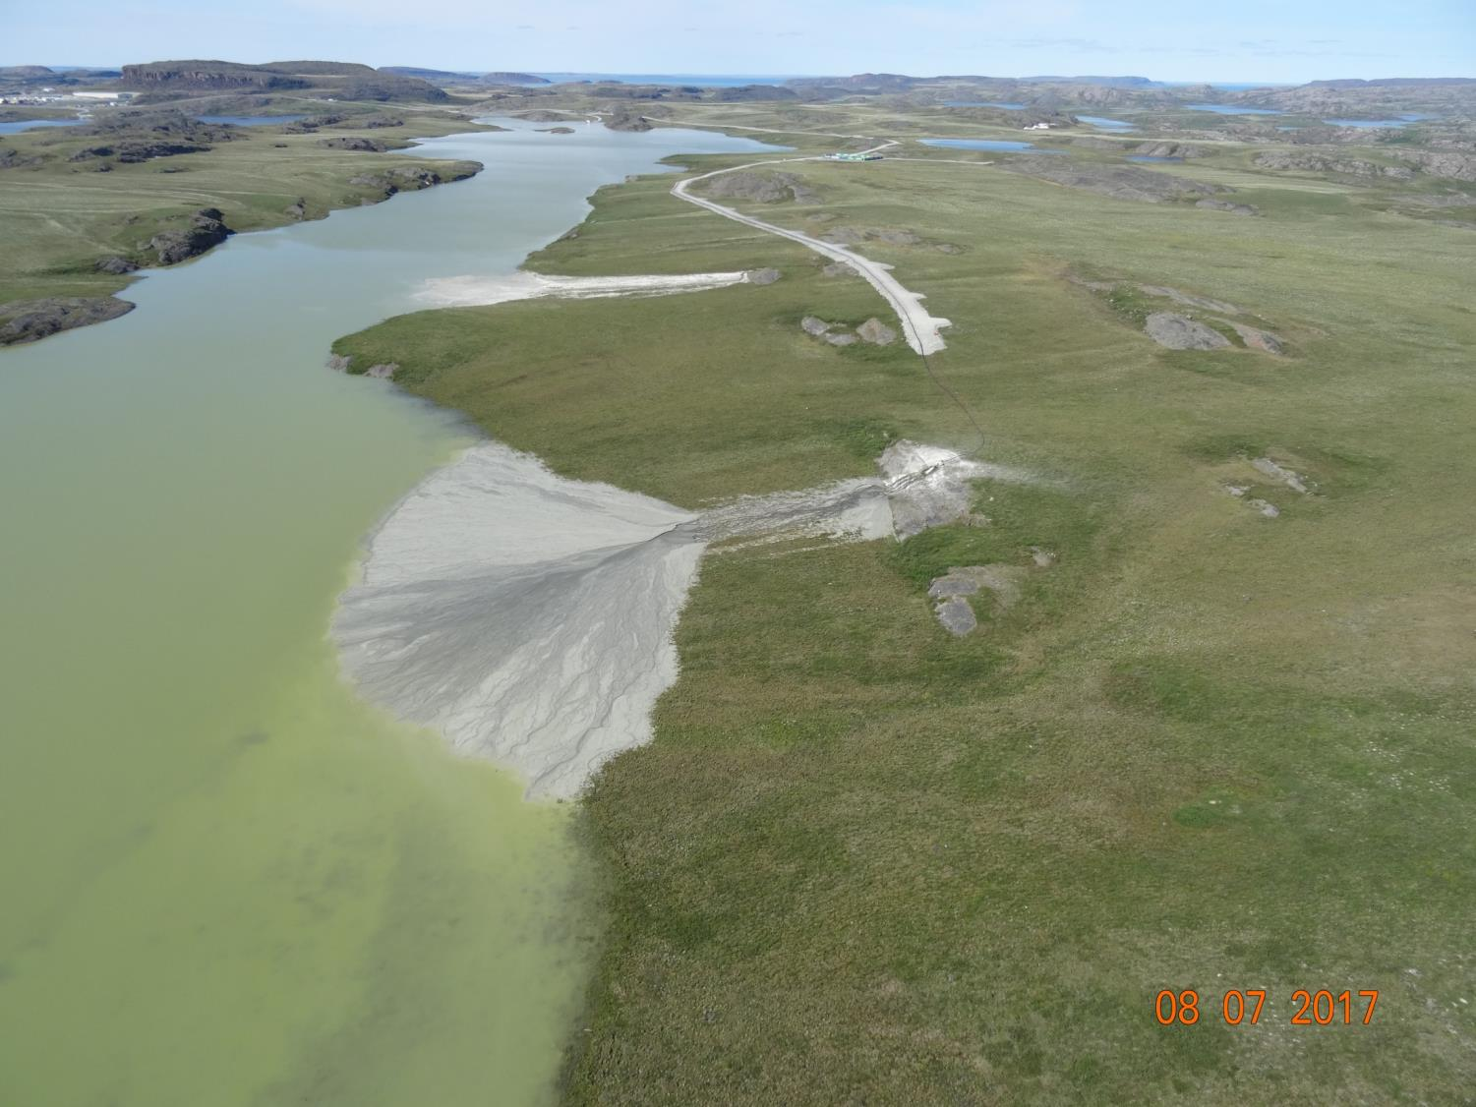
2. Tailings management
2. Ataquut munarinigagut

Slide 9
2. Tailings management
2. Ataquut munarinigagut
Doris tailings impoundment area closure plan (comment #1)
Boston tailings management area seepage post-closure (comment #2)
Backfill materials (comment #5)
Waste rock volumes in relation to void volumes (comment #16)
Detoxified tailings deposition at Madrid (comment #17)
Doris-mi ataguuqvik nuna umikvikhaagut upalugaiyaut (uqauhiq 1-mi)
Boston-mi ataguuqvik munariniga-gut nunami kuuknigit umiktautaaqat uyaraqtaqvik (uqauhiq 2-mi)
Hauhijutikhat hunaliqaa (uqauhiq 5-mi)
Iqaguut uyaqat amigainigit nalunaiqlugit hunaqagitut amigainigit (uqauhiq 16-mi)
Aaniarutaulaiyaqhimayut ataguut qanurinigit Madrid-mi (uqauhiq 17-mi)

Slide 10
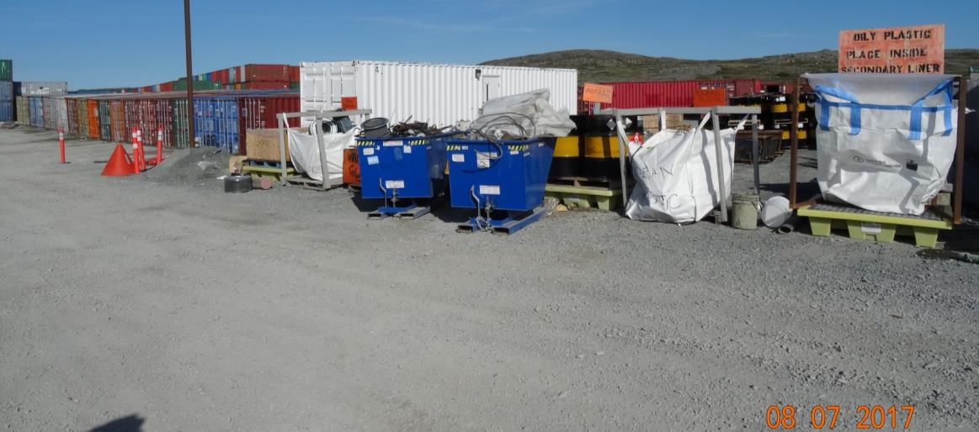
3. Waste management
3. Iqagunik munarinigagut
Non-hazardous waste disposal (comment #20)
Aaniqnaitunik iqaguuqnigit (uqauhiq 20-mi)

Slide 11
4. Closure & reclamation
4. Umikniganik kiklimaktiqnigagulu
Closure planning and requirements (comment #3)
Long term climate change effects (comment #6)
Umiktiqnigagut upalugaiyaqniq aturiaqaqtulu (uqauhiq 3-mi)
Hivunikhami hilap aalaguniganit aktuqnigit (uqauhiq 6-mi)

Slide 12
5. Additional components
5. Ilariarutikhat hunaliqaa
Water licences for Hope Bay Belt (comment #8)
Aquatic effects monitoring plans (comment #11)
Cyanide testing (comment #13)
Reclamation cost estimate
Immaqmik aturiagani laisiuyuq Kapihiliktuumi Uyaraqtaqvikmi (uqauhiq 8-mi)
Immavaluknit aktuqniginik amirinigagut upalugaiyautit (uqauhiq 11-mi)
Aaniarutaulaaqniganik ilituqhaqniq (uqauhiq 13-mi)
Kiklimaktiqnigagut akituniganik nalautaarut

Slide 13
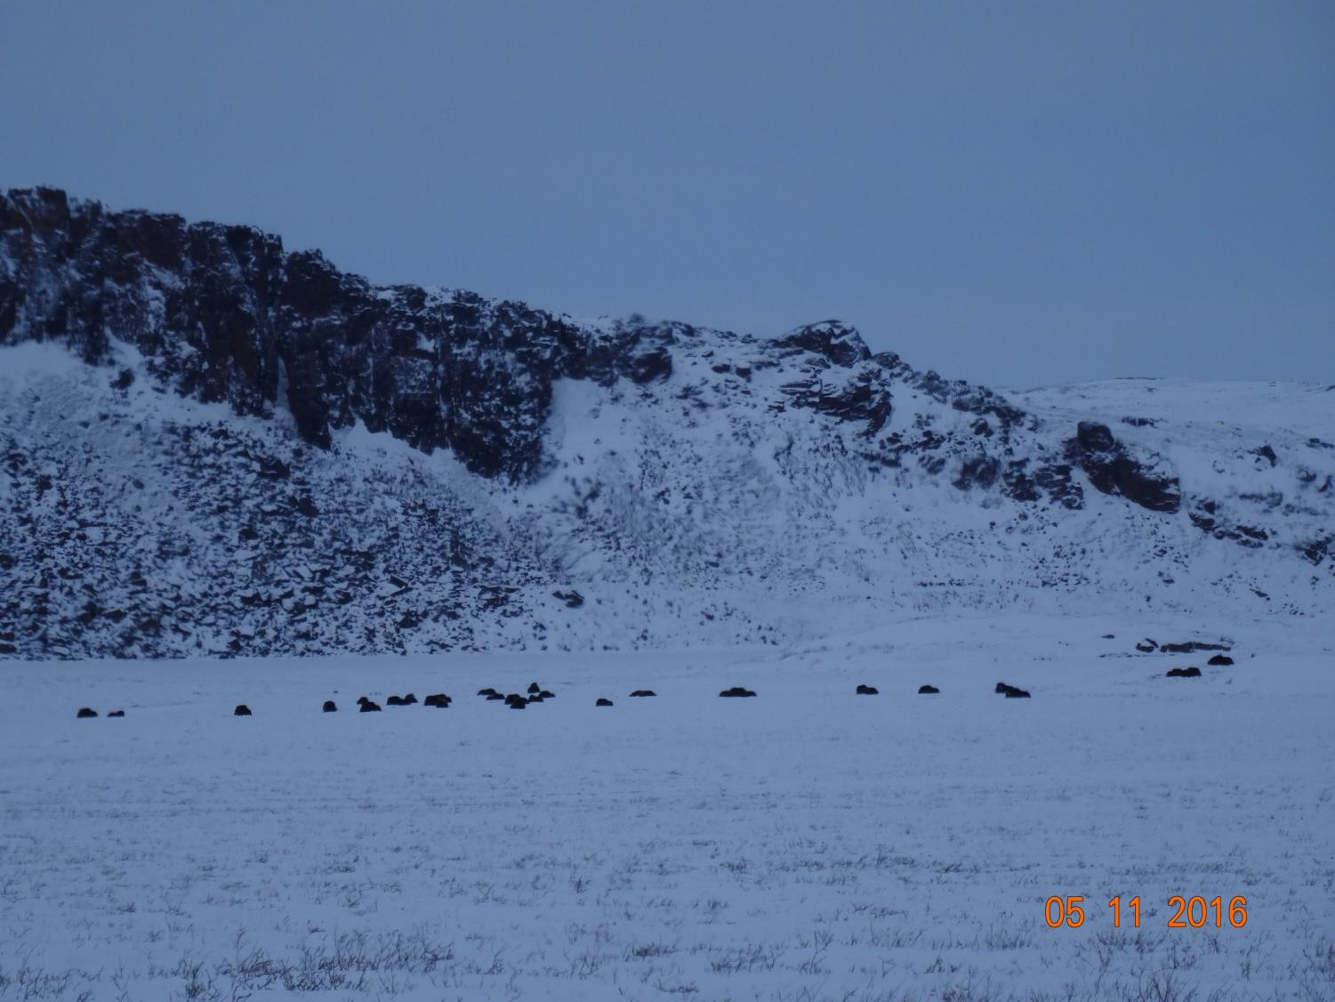

Slide 14
Closing
Iniqtirutit
The department is confident that concerns brought forward can and will be addressed by TMAC to the satisfaction of the department before a Public Hearing.
The department will be submitting further evidence to the Board regarding reclamation closure costs following further discussions with all parties.
Havakviuyuq ukpiruhuktut ukua ihumaaluutauyut uqautauyut ihuaqhilaaqtait ihuaqhaqniaqait TMAC-kut namagiyauliqniginut havakviuyumit Inuknik Naalaktititinagit.
Havakviuyuq tunihiniaqtuq naunaiqpaalirutikhanik Katimayinut kiklimaktinigagut umikpat akituniginik kiguani uqaqatigitaaqata tamaita ilauyut.

Slide 15
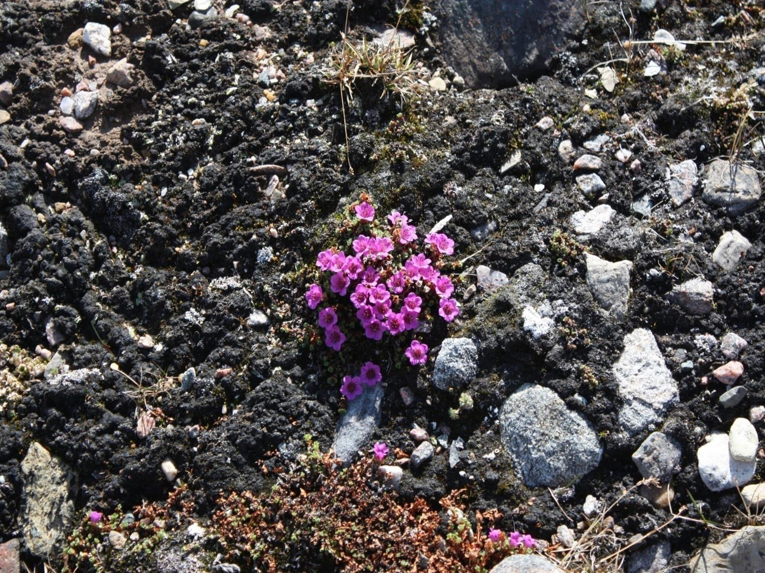
Quanaqutit Nakurmiik
Thank you
ᓇᑯᕐᒦᒃ
Merci

