Slide 1
Kitikmeot Inuit Association
KIA Technical Review of Hope Bay Project Phase 2 Type A Water License
Notes:
Hello everyone, I am John Roesch, the Senior Hope Bay Project Officer for the Department of Lands and Environment for the Kitikmeot Inuit Association. I am responsible for project oversite for the KIA and provide input into the regulatory process on the Hope Bay Project to both the NWB and NIRB. In performing this role, I make use of KIA’s consultants who are subject matter experts in the areas of wildlife, fisheries, aquatic environment, and geotechnical engineering.

Slide 2
Purpose of Presentation
Present a summary of KIA’s Technical Review of TMAC Resources Inc.’s Hope Bay Project Phase 2 Type A water license application.
KIA conducted a thorough review in the areas of fish and fish habitat, aquatic environment, and water quality monitoring.
8 Issues for Technical Meeting in May 2018.
Notes:
The purpose of this presentation is to provide a brief summary of our technical review of the Hope Bay Phase 2 Type A water license application. Our review covered fish and fish habitat, aquatic environment, and water quality monitoring. KIA conducted the review in a collaborative manner with TMAC Resources out of which we brought forward 8 issues to be resolved either prior or at the Technical Meeting or through further consultation.

Slide 3
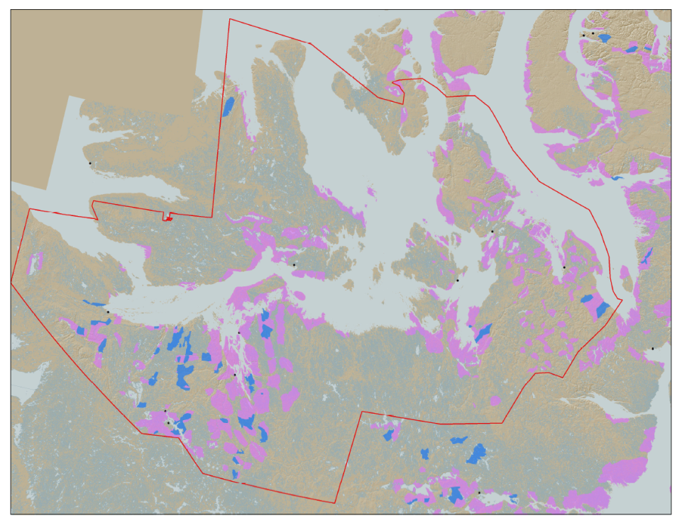

KIA’s Mandate
KIA’s Mandate is to represent the interests of Kitikmeot Inuit by protecting and promoting their social, cultural, political, environmental, and economic well-being.
KIA owns 106,360 km² of surface land: A significant opportunity if managed properly.
Hope Bay Project
Notes:
KIA’s mandate is to manage Kitikmeot Inuit lands and resources, and to protect and promote the social, cultural, political, environmental and economic well-being of Kitikmeot Inuit. The Kitikmeot Region is generally within the red boundary. The Pink and Blue lands are lands which KIA owns the surface rights.
Kitikmeot Inuit Association is a democratically elected not-for-profit society that represents the Inuit of the Kitikmeot Region of Nunavut.
As a result of the Nunavut Agreement, Inuit are one of the largest private landowners in the world. Much of this privately owned land is in areas with high potential for mineral development. This land is a significant opportunity for Inuit if it is managed properly. We must optimize opportunities and manage liabilities that are inherent with being a private landowner. If not, we will affect the well-being of our Kitikmeot Inuit membership.
The Hope Bay Project is located on the mainland near the coast and approximately in the middle of the region.

Slide 4
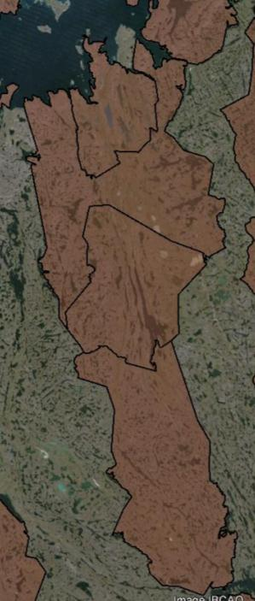
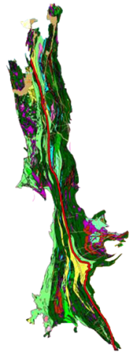

The Hope Bay Project
Doris
BB-60
Madrid
Located on 4 parcels of Inuit Owned Land.
The Hope Bay greenstone belt has had significant exploration since 1965.
Vast exploration potential remains
TMAC took over development of the project in 2012
BB-58
120 km
BB-57
Boston
BB-56
Notes:
When the Inuit Owned Land was selected for the NLCA, Inuit knew that the Hope Bay Area was highly prospective for mineral development. A 120 Km length of surface lands that include some mineral rights were selected in the area. The brown areas are surface lands owned by KIA. BB-56, 57, 58, and 60 include our agreement with TMAC for the Hope Bay Project.
The Hope Bay greenstone belt has been explored since 1965. Within this greenstone belt, over 850Km of drilling has occurred since 1965. Most of the drilling has been focused around Doris, Madrid and Boston. This project has changed ownership many times. Prior to TMAC, the last company to operate the Hope Bay Project was Newmont, who failed to develop a profitable business case for the development of the project. TMAC took over the project in 2012.
On the Map you can see the location of some of the highest priority development sites in the belt: Doris, Madrid and Boston.

Slide 5
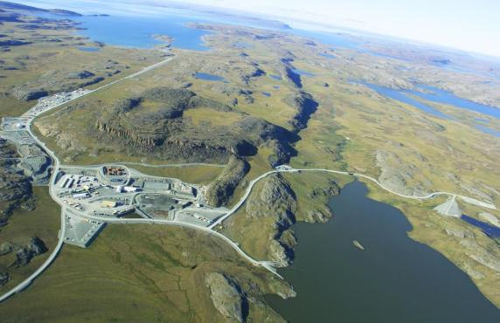
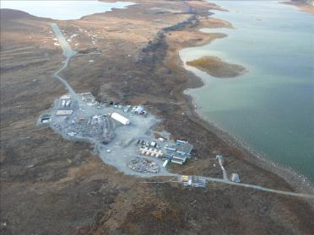
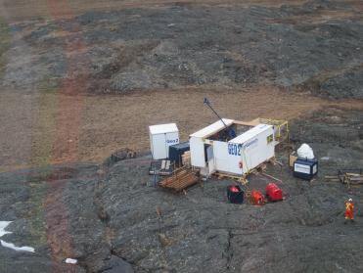
The Hope Bay Project
Doris North Mine
Boston Advanced Exploration Camp
Exploratory Drilling
Notes:
So much exploration has occurred since 1965, that people know that there are many development opportunities in the belt. The Hope Bay Greenstone Belt is unique because it demonstrates the capacity to hold several mining operations across the belt in the different stages of development, operated by one company. In another more developed part of the world, it could be that several different companies would have exploration and mining proposals in a Greenstone belt such as this.
This greenstone belt includes a permitted mine at Doris North, several advanced exploration targets such as the Boston Project which has preliminary mine plans developed, and many other identified high quality exploration targets. There is also vast exploration potential. TMAC has rights to all the minerals in this area. Once an operating mine is established, the efficiencies of belt-wide exploration will increase.

Slide 6
Fisheries and Aquatic Environment Issues
Fisheries offsetting.
Aquatic Effects Monitoring Plan (AEMP).
Water withdrawal Potential Alteration and/or Destruction of Fish habitat (PAD) calculations.
Arsenic Site-Specific Water Quality Objective (SSWQO).
Notes:
As indicated previously, 8 issues were brought to the technical meeting with the NWB pertaining to the Phase 2 Type A water license application. These four issues concern the fish, fish habitat, and the aquatic environment. We raised concerns about the need to calculate potential gains in fisheries for fish offsetting, the monitoring of lake surface levels in the Aquatic Effects Monitoring Plan, the calculations for lost fish habitat due to water with drawl, and the setting of site-specific water quality objectives for total arsenic in all water bodies affected by the project. KIA considers these issues to be of high and medium importance.
TMAC has responded to our recommendations and these issues are resolved.

Slide 7
Aquatic Environment & Water Quality Issues
Aquatic Effects Monitoring Plan (AEMP) water quality sampling frequency.
Aquatic Effects Monitoring Plan (AEMP) Parameter Suite.
Preparation for Metal and Diamond Mine Effluent Regulations (MDMER).
Confirmation of Model Predictions – Water Quality.
Notes:
These four issues concern sampling frequency during freshet, under ice, and open water season for the Aquatic Effects Monitoring Plan (AEMP), the inclusion of dissociable cyanide and total cyanide in AEMP parameters to meet Canadian Council of Ministers of the Environment (CCME) and Metal and Diamond Mine Effluent Regulations (MDMER) guidelines, preparation for use of new MDMER guidelines in monitoring water quality, and confirmation of water quality model predictions. The KIA considers these to be of high and medium importance.
TMAC has responded to our recommendations and these issues are resolved.

Slide 8
Proposed Split of IOL and Crown Land & Water Security
KIA agreed with TMAC on total security of $61,174,597 for the Doris-Madrid Type A water license.
KIA agreed with TMAC on total security of $36,712,621 for the Boston Type A water license.
KIA requested 85% for IOL and 15% for Crown Land & Water for Doris-Madrid security.
KIA requested 23% for IOL and 77% for Crown Land and Water for Boston security.
Notes:
The KIA had agreed with TMAC on $61.2 million for the Doris-Madrid security with a split of 85% and 15% split for IOL and Crown Land and Water, respectively. KIA also agreed with TMAC on $36.7 million for the Boston security with a split of 23% and 77% split for IOL and Crown Land and Water. Our review of reclamation security was conducted by our geotechnical engineering consultant and the split of IOL and Crown Land and Water was based on 100% allocation of specified mine site components to either land or water as per TMAC’s request to facilitate execution of reclamation work.
The KIA is open to the receipt of staged security from TMAC subject to particular water license conditions. TMAC has provided both KIA and CIRNA with a proposed staged split of security for the Hope Bay Project Phase2. KIA has had discussions with TMAC and CIRNA on the overall reclamation security for Doris-Madrid and Boston, the split in land and water for each water license and the staging of security.

Slide 9
Proposed Split of IOL and Crown Land & Water Security
CIRNAC has calculated a total amount of security for Doris-Madrid of $65,774,448 and $40,543,869 for Boston.
CIRNAC has determined a security split of 56.2% land and 43.8% water for Doris-Madrid and a split of 50.2% land and 49.8% water for Boston.
No three-way agreement has been arrived at on security in terms of the total amount or land and water split.
TMAC has proposed staged security to which KIA has reviewed and agrees with.
Notes:
CIRNAC proposes $65.8 million in total security for Doris-Madrid and $40.5 million for Boston. This represents a difference of $4.6 million and $4.2 million respectively between CIRNAC’s Doris-Madrid and Boston total security amounts and those put forward by TMAC and KIA.
CIRNAC’s land and water split of security is 56.2% and 43.8% for Doris-Madrid and 50.2% and 49.8% for Boston which is substantially different from KIA and TMAC’s land and water split. CIRNAC only applied 100% allocation of security to a select few mine site components and not to all components.
Currently there is no three-way agreement on either the total amount of security or the split between land and water.
TMAC has proposed staged security for Doris-Madrid and Boston, which KIA reviewed and agrees with. The tranches for staged security meet KIA’s requirements for receiving staged security for major mine site components on geographical basis with a planned construction schedule.

Slide 10
Conditions for Stage Security for Hope Bay Phase 2
KIA is open to receiving staged security under particular water license conditions.
KIA must receive security for construction phases 60 days prior to construction.
Staged security is subject to NWB process.
TMAC provides annual summary reports on construction progress.
Reclamation costs be updated periodically and reviewed.
Additional security provided within 60 days of review and determination by NWB.
Notes:
As stated previously, the KIA is open to receiving security using the proposed staged split under particular water license conditions.
The KIA must receive security 60 days prior to construction for each phase of construction for a defined set of major mine site components and infrastructure on a geographic basis. The receipt of staged security is subject to the NWB process where TMAC is required to provide proof of security being issued.
The reclamation costs must be updated periodically and reviewed by KIA and CIRNA and provided to the NWB. If additional security is determined to be required by the NWB, Sabina must provide it within 60 days of the determination.
The KIA has discussed these conditions with both TMAC and CIRNA.

Slide 11
Conclusion
KIA believes that with all technical issues being successfully resolved between KIA and TMAC Resources Inc. the issue of reclamation security can be fully resolved with all parties.
Thank You
Questions?
Notes:
The KIA believes that with all technical issues being successfully resolved the final issue of staged security and particular water license conditions can be concluded with both TMAC and CIRNA through further discussion and cooperation.
Given this and the substantial benefits that will be obtained for Inuit from the Hope Bay Project Phase 2 and its IIBA, we believe that the issuing of the Type A Water licences for Doris-Madrid and Boston is warranted and in the best interest of the Inuit people.
We thank you for listening and we are open to any questions.

