Slide 1
TMAC Resources Ltd.
Water Licence Applications for the Hope Bay Phase 2 Project
Renewal/Amendment #2 for 2AM-DOH1323 and New for 2AM-BOS----
Nunavut Water Board Technical Meeting
Cambridge Bay, May 14-15, 2018

Slide 2
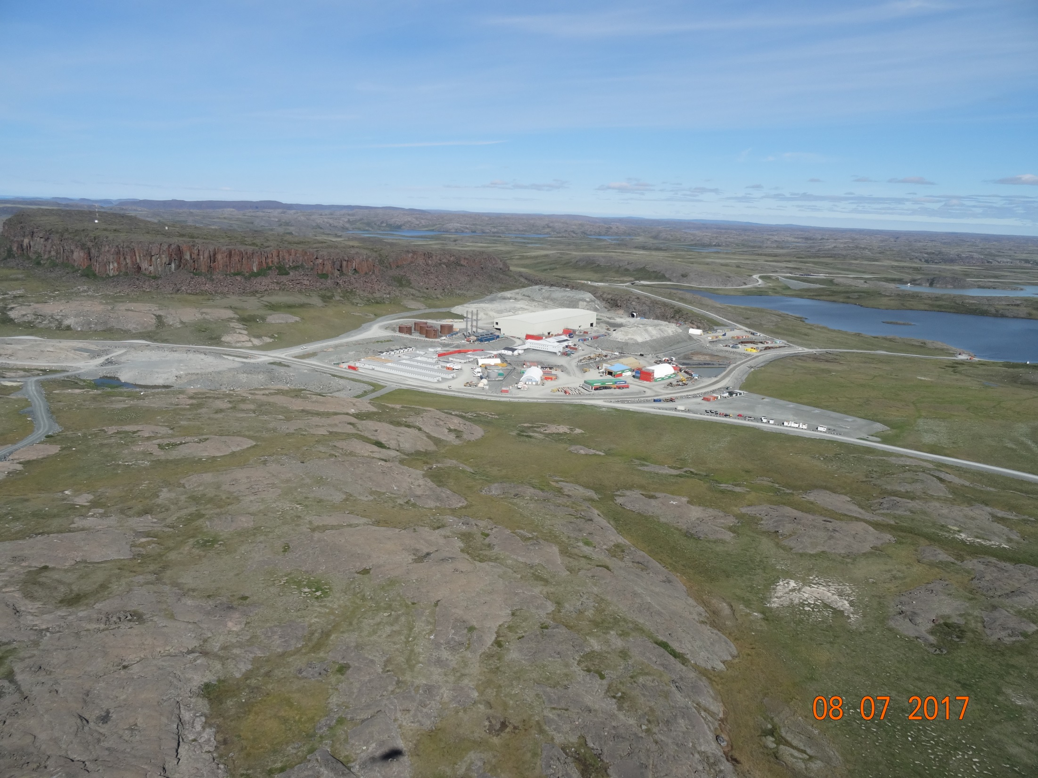

Slide 3
Outline
Roles and responsibilities
Contributions to the application review
Topics discussed:
    Site water management
    Tailings management
    Waste management
    Closure & reclamation
    Additional components
Closing

Slide 4
Roles and responsibilities
Indigenous and Northern Affairs Canada’s (INAC) responsibilities, mandate, and obligations stem from the following:
Department of Indian Affairs and Northern Development Act
Nunavut Agreement
Nunavut Land Claims Agreement Act
Nunavut Waters and Nunavut Surface Rights Tribunal Act and the associated regulations
Nunavut Planning and Project Assessment Act
Territorial Lands Act and the associated regulations
Arctic Waters Pollution Prevention Act

Slide 5
Contributions to the application review
INAC made the following submissions to the Nunavut Water Board:
February 14, 2018 – Preliminary completeness review
March 29, 2018– Technical review comments with information requests and recommendations

Slide 6
1. Site water management
Most of our technical comments pertain to water management
Topics discussed include:
  Amount of water to be used
  Handling and treatment of minewater
  Design of water containment structures

Slide 7
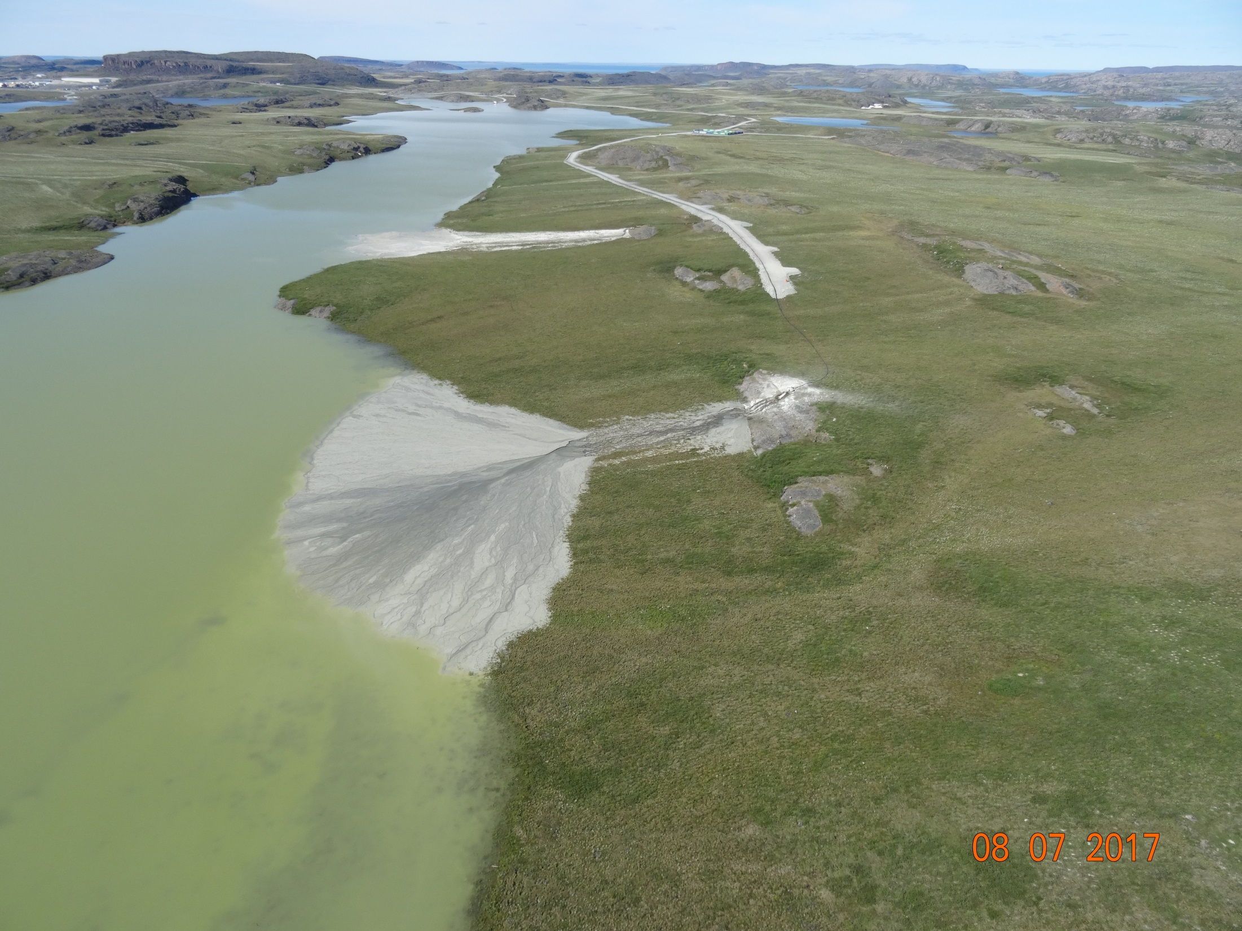
2. Tailings management

Slide 8
2. Tailings management
Topics discussed include:
  Closure and post-closure performance of Doris tailings impoundment area & Boston tailings management area
  Placement of tailings in the underground mines

Slide 9
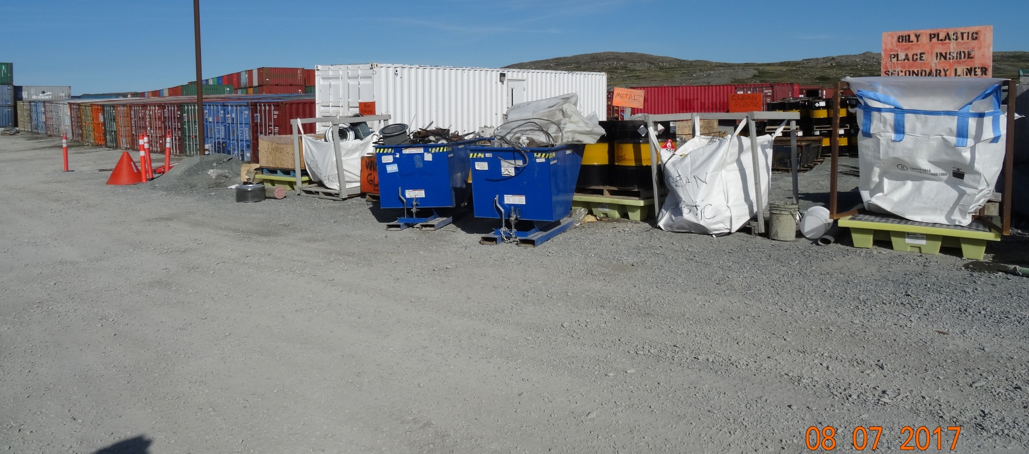
3. Waste management
Timing of landfill construction

Slide 10
4. Closure & reclamation
Topics discussed include:
  Requirements of closure plan
  Effects of climate change on closed site in the long term

Slide 11
5. Additional components
Topics discussed include:
  Administrative issues, such as the number of water licences for Hope Bay Belt
  Monitoring plans
  Reclamation cost estimate, which is used to set security under the water licences

Slide 12
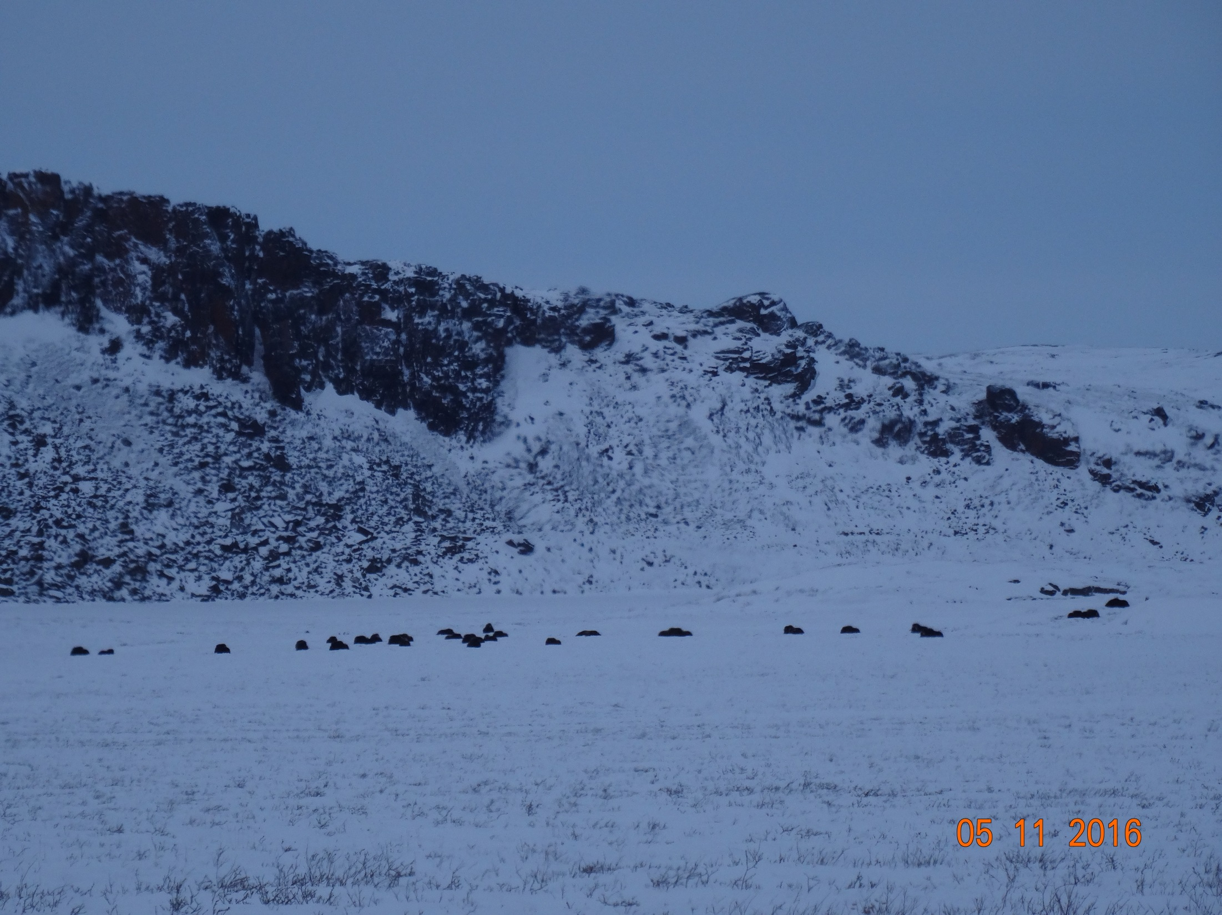

Slide 13
Closing
The department is confident that concerns brought forward can and will be addressed by TMAC to the satisfaction of the department before a Public Hearing.
The department will be submitting further evidence to the Board regarding reclamation closure costs following further discussions with all parties.

Slide 14
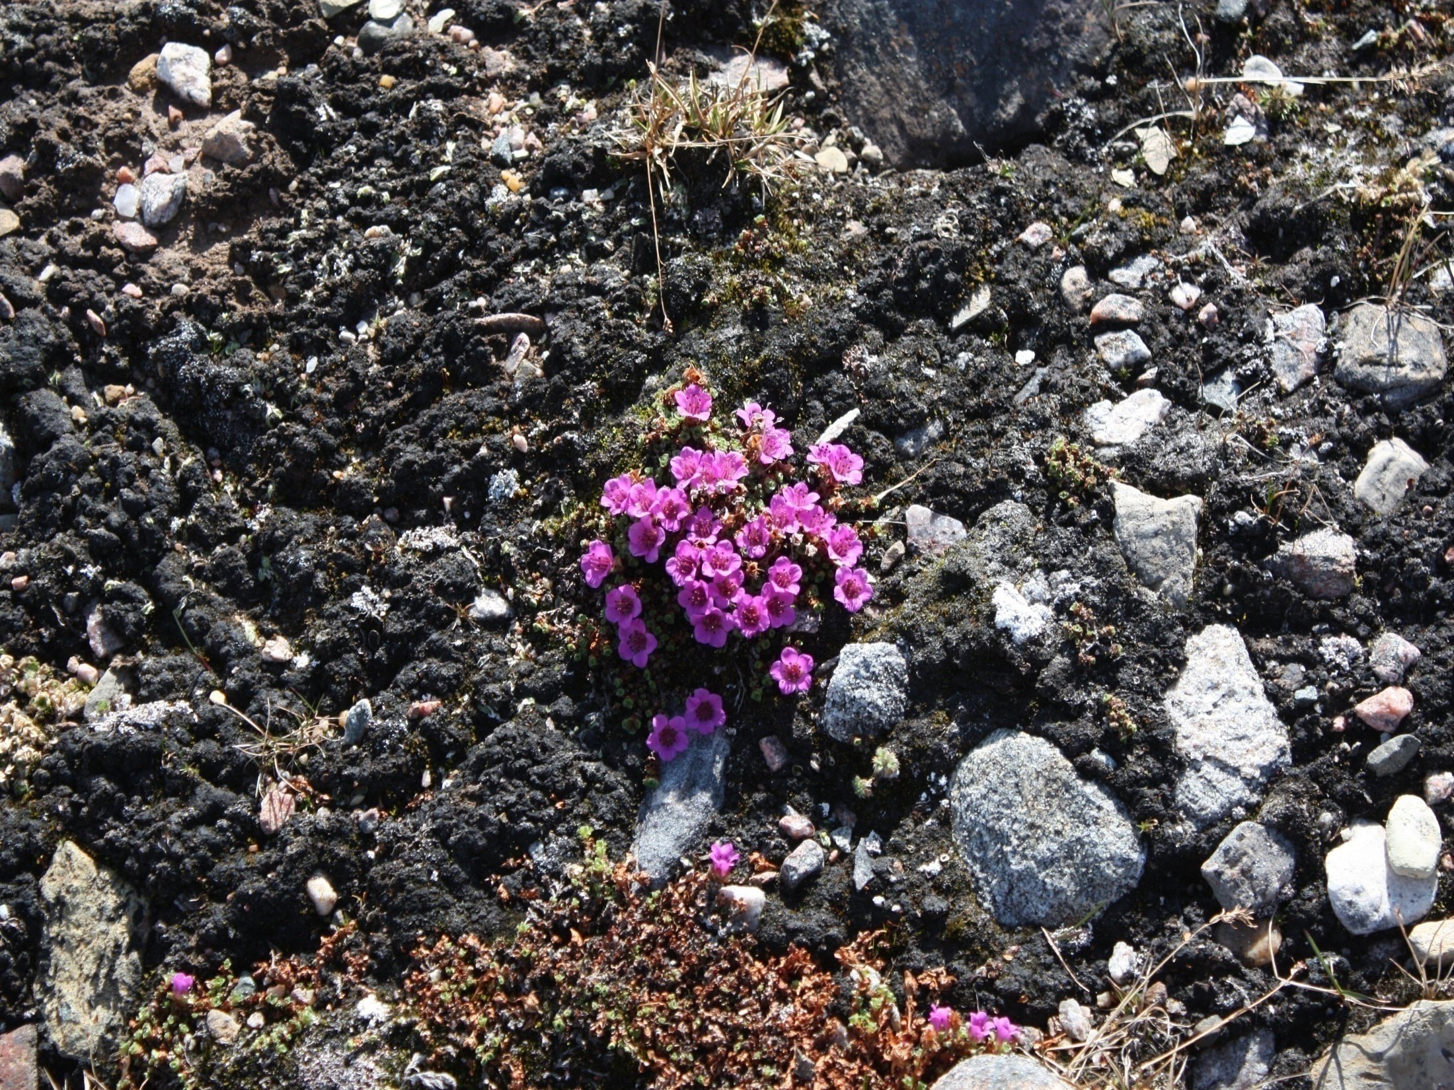
Nakurmiik
Thank you
ᓇᑯᕐᒦᒃ
Merci

