Slide 1
Environment and Climate Change Canada’s Presentation to the Nunavut Water Board Concerning the TMAC Resources Inc. Hope Bay Phase 2 Project Type A Water Licence Amendment & Application Technical Review
2AM-BOS---- & 2AM-DOH1323
Nunavut Water Board Community Session
Cambridge Bay, NU
May 14, 2018
Gabriel Bernard-Lacaille
A/Senior Environmental Assessment Coordinator

Slide 2
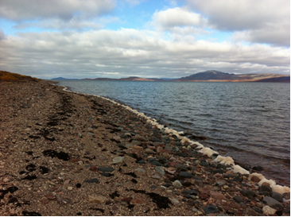
Overview
ECCC Mandate
Relevant Acts and Legislation
ECCC Recommendations

Slide 3
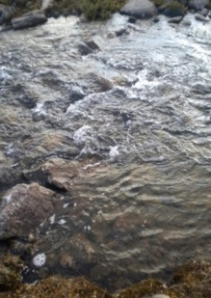
ECCC Mandate
Preserve and enhance the quality of the natural environment
Conserve Canada’s renewable resources
Conserve and protect Canada’s water resources
Forecast daily weather conditions and warnings
Enforce rules relating to boundary waters
Coordinate environmental policies and programs for the federal government

Slide 4
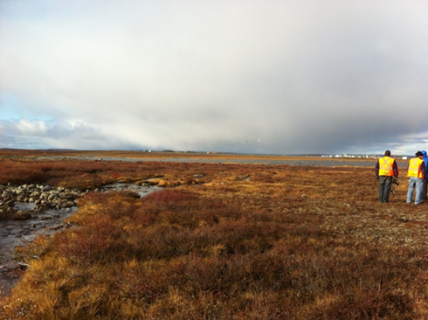
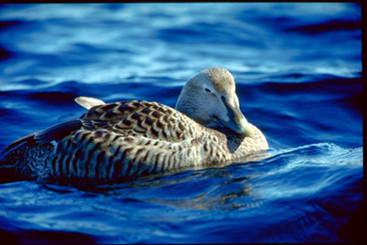
Relevant Acts and Regulations
Department of the Environment Act
Canadian Environmental Protection Act
Fisheries Act – Pollution Prevention Provisions & Metal Mining Effluent Regulations

Slide 5
Environment and Climate Change Canada’s Participation
Environment and Climate Change Canada provides scientific expertise within our mandate to the Nunavut Water Board
Freshwater Environment

Slide 6
Environment and Climate Change Canada’s Participation continued
Environment and Climate Change Canada has participated in all phases of this review process thus far
This presentation summarizes Environment and Climate Change Canada’s recommendations
Environment and Climate Change Canada has reviewed the Proponent’s responses.

Slide 7
Seepage Recommendations
Seepage from Tailings and Waste Rock Areas
ECCC asked if TMAC considered climate change for dry stack tailings seepage
TMAC confirms climate change and permafrost distribution was taken into account for tailings seepage
ECCC asked for seepage surveys at Waste Rock Areas
TMAC provided seepage survey information. ECCC is satisfied with this response and the information provided.

Slide 8
Wastewater Recommendations
Wastewater Treatment Plant upgrades to handle capacity
ECCC has asked the Proponent to provide more information regarding the capacity of the wastewater treatment plant to account for the increase in camp size.
TMAC has provided more information and confirmed that the treatment plant is modular and can be expanded to accommodate an increase in camp size.

Slide 9
Water Management Ponds Recommendations
Ensure water ponds do not impact the receiving environment
ECCC has asked if contact water ponds have been designed to retain water
TMAC confirmed their intent to manage these ponds as dry facilities, and also confirmed the ponds can hold water.
ECCC asked for clarification in regards to the dewatering and monitoring of water management ponds
TMAC responded that water management ponds will be discharged to an approved location on the tundra if needed and that water management ponds will be monitored appropriately.

Slide 10
Acid Rock Drainage in Quarries Recommendation
Ensure that Acid Rock Drainage does not enter the environment
ECCC asked the Proponent to provide justification for the use of high Acid Rock Drainage potential quarries
TMAC responded that all quarries with rock that have potential for Acid Rock Drainage will only be used as mine backfill.

Slide 11
Water Quality Modelling Recommendation
ECCC noted inconsistencies in the Proponent’s Water and Load Balance Model and asked the Proponent to update and calibrate their model with data acquired during operations.
TMAC has not provided details on the model calibration frequency, but has provided additional information on the inconsistencies from their model.

Slide 12
In-Water Works Mitigation and Aquatic Effects Monitoring Plan Recommendations
Ensure that there are no negative impacts to water quality from sedimentation and erosion during in-water works.
ECCC has asked for the Proponent to provide a sedimentation management plan.
Aquatics Effects Monitoring Plan
ECCC is working in collaboration with TMAC in regards to the technical review of their Aquatics Effects Monitoring Program.

Slide 13
Tailings Pipeline Catch Basins Recommendation
Ensure that tailings entering the catch basins does not enter the receiving environment
ECCC has asked details surrounding the use of these catch basins
TMAC responded that these basins are required if the tailings pipeline requires repairs and needs to be drained.

Slide 14
Water Quality Recommendations
Management of Copper, Arsenic and Nitrite
Ensure that the receiving environment is not impacted.
ECCC has asked the Proponent to provide more information regarding water quality objectives.
TMAC has provided more information and has provided satisfactory answers to ECCC’s concerns for Copper and Arsenic

Slide 15
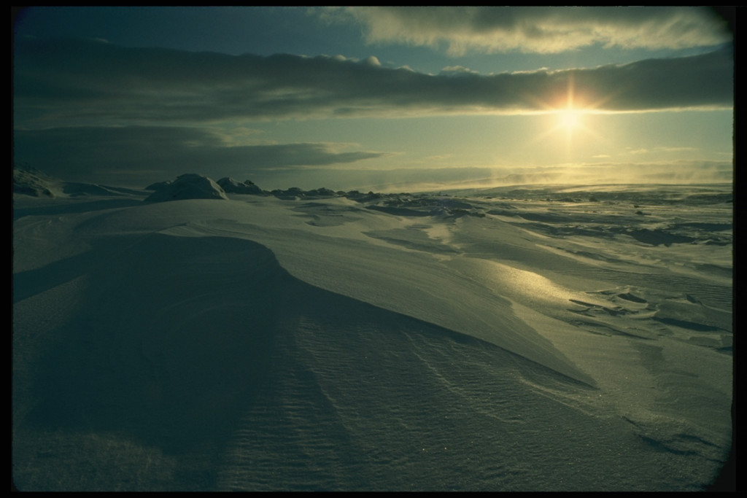
Thank you!
ECCC would like to say thank you for the opportunity to participate in this water licencing process

