Slide 1
Environment and Climate Change Canada’s Presentation to the Nunavut Water Board Concerning TMAC Resources Inc. Hope Bay Phase 2 Project Type A Water Licence Amendment & Application Technical Review
2AM-BOS---- & 2AM-DOH1323
Nunavut Water Board Technical Meeting
Cambridge Bay, NU
May 14-15, 2018
Gabriel Bernard-Lacaille
A/Senior Environmental Assessment Coordinator
Meagan Tobin
Water Quality Project Officer

Slide 2
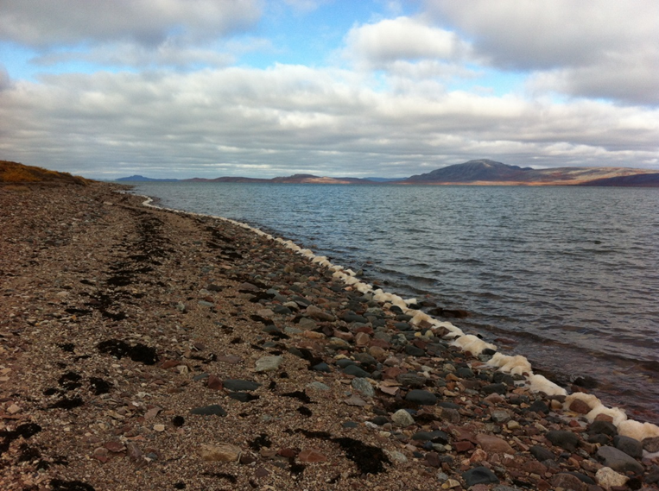
Overview
ECCC Mandate
Relevant Acts and Legislation
ECCC Recommendations

Slide 3

ECCC Mandate
Preserve and enhance the quality of the natural environment
Conserve Canada’s renewable resources
Conserve and protect Canada’s water resources
Forecast daily weather conditions and warnings
Enforce rules relating to boundary waters
Coordinate environmental policies and programs for the federal government

Slide 4
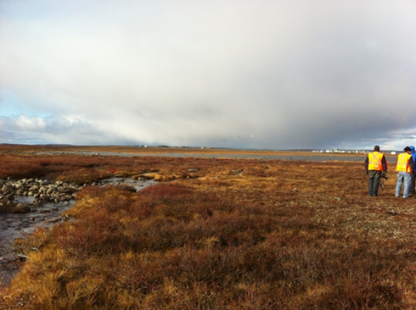
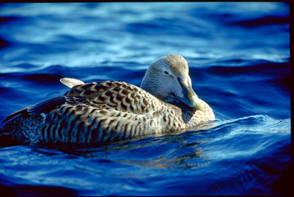
Relevant Acts and Regulations
Department of the Environment Act
Canadian Environmental Protection Act
Fisheries Act – Pollution Prevention Provisions & Metal Mining Effluent Regulations

Slide 5
Environment and Climate Change Canada’s Participation
Environment and Climate Change Canada provides scientific expertise within our mandate to the Nunavut Water Board
  Freshwater Environment

Slide 6
Environment and Climate Change Canada’s Participation continued
Environment and Climate Change Canada has participated in all phases of this review process thus far
This presentation summarizes Environment and Climate Change Canada’s recommendations
Environment and Climate Change Canada has reviewed the Proponent’s responses.

Slide 7
ECCC#1 – Seepage Collection
ECCC#1 –
ECCC Recommendation
  ECCC recommends that the Proponent develop a contingency plan to account for the potential impacts of climate change on structures like dry stack tailings post closure, and the increase to seepage that may occur should permafrost distribution change in the long-term.

Slide 8
ECCC#1 – Seepage Collection continued
ECCC#1 –
Proponent’s Response
  The Tailings Management Area has been designed taking climate change into account.
  A thermal analysis to estimate active layer thickness and the water load and balance model concluded that a High Density Polyethylene line would limit infiltration.
  Analysis confirms that long-term post-closure seepage is not a concern.
Follow-up ECCC Response
  ECCC is satisfied with the response and considers this technical comment resolved.

Slide 9
ECCC#2 – Seepage Surveys
ECCC#2 –
ECCC Recommendation
  ECCC recommends that the Proponent develop a Seepage Survey plan (either as a separate document or as a section of the Water Management Plan) for all waste rock storage areas and tailings management areas. This should include, at a minimum, spring and fall surveys.

Slide 10
ECCC#2 – Seepage Surveys continued
ECCC#2 –
Proponent’s Response
  Freshet seepage monitoring is found in Annex V1-7, and is consistent with the waste rock seepage monitoring program.
  Contact Water Ponds will be monitored as part of the Surveillance Network Program and a seepage monitoring program in the late fall is not warranted.
  Boston Tailings Management Area will be visually inspected each day for seepage which could trigger maintainance or operational actions
Follow-up ECCC Technical Comments
  ECCC is satisfied with the response and considers this technical comment resolved

Slide 11
ECCC#3 – Wastewater Treatment Plant – Contingency and Required Upgrades
ECCC#3 –
ECCC Recommendations
ECCC recommends that the Proponent
  Describe upgrades and modifications that are proposed for the Doris Water Treatment Plant, such that it has the capacity to treat the increase in camp capacity by 120 people.
  Describe any additional contingency measures for the Doris Camp Water Treatment Plant that may be needed to account for the additional capacity.
  Describe the contingency measures for the Boston Camp Water Treatment Plant that will be available to mitigate adverse effects to the aquatic environment.

Slide 12
ECCC#3 – Wastewater Treatment Plant – Contingency and Required Upgrades continued
ECCC#3 –
Proponent’s Response
  The sewage treatment plant is modular and additional modules will be added to treat the additional waste.
  The Proponent’s primary contingency for periods of prolonged downtime of the treatment plant is trucking and discharging the untreated water in the Doris TIA.
Follow-up ECCC Technical Comments
  ECCC is satisfied with the response and considers this technical comment resolved.

Slide 13
ECCC#4 – Boston Contact Water Pond #2 & Surge Pond
ECCC#4 –
ECCC Recommendations
ECCC recommends that the Proponent
  Provide additional clarification on the water management at Contact Water Pond 2. Specifically, whether the intent is to operate Contact Water Pond #2 and the Surge Pond as dry facilities.
  Clarify whether Contact Water Pond #2 has been designed to retain water for increased residence times and describe the potential for seepage through the berms.

Slide 14
ECCC#4 – Boston Contact Water Pond #2 & Surge Pond continued
ECCC#4 –
Proponent’s Response
  The Proponent acknowledges that Contact Water Pond 1 will pump to the lined surge pond, not Contact Water Pond 2.
  The Proponent clarified its intent to operate all ponds as dry facilities.
  The surge pond may hold water longer than other ponds and the holding capacity is 2 days of average treatment plant flow.
  The surge pond is a fully lined facility and water containment is not dependent on the frozen foundation condition.
Follow-up ECCC Technical Comments
  ECCC is satisfied with the response and considers this technical comment resolved.

Slide 15
ECCC#5 – Water Management Ponds – Monitoring and Dewatering
ECCC#5 –
ECCC Recommendations
ECCC recommends that the Proponent
  Clarify dewatering procedures for Contact Water Pond #1, Madrid North Contact Water Pond and the Madrid South Primary and Secondary Contact Water Ponds. If dewatering to the tundra is proposed, a description of location, monitoring and erosion control measures should be included.
  Discuss proposed frequency of water quality monitoring at the Boston Tailings Management Area Contact Water Ponds.
  Discuss water quality monitoring downstream of the Non-Contact Water Pond, prior to discharge into Stickleback Lake.
  Discuss contingency options in the event that TSS in the Non-Contact Water Pond exceeds criteria and cannot be discharged via the overflow culvert.

Slide 16
ECCC#5 – Water Management Ponds – Monitoring and Dewatering continued
ECCC#5 –
Proponent’s Response
  If water meets the designed criteria for discharge, it may be discharged to the tundra at an approved location. Water samples will be collected twice annually or prior to discharge.
  Early signs of erosion at the discharge point will be monitored and mitigations measures will be implemented if necessary.
  A field Total Suspended Solids test will be conducted at the same time as the water quality sample is collected from the Non-Contact Water Pond.
  No additional contingencies considered for Total Suspended Solids.
Follow-up ECCC Technical Comments
  ECCC is satisfied with the response and considers this technical comment resolved

Slide 17
ECCC#6 – Quarries with High Risk of Acid Rock Drainage (ARD)
ECCC#6 –
ECCC Recommendations
ECCC recommends that the Proponent
  Provide justification for the use of high Acid Rock Drainage (ARD) potential quarries for use as mine backfill
  Discuss mitigation measures to prevent Acid Rock Drainage from high Acid Rock Drainage potential rock stored in the waste rock piles and for the exposed quarry walls.

Slide 18
ECCC#6 – Quarries with High Risk of Acid Rock Drainage (ARD) continued
ECCC#6 –
Proponent’s Response
  The 3 quarries that are not suitable for construction will be used as mine backfill. All runoff from the contact pad will be managed as contact water.
  Drainage from the waste rock stockpiles is collected and monitored.
Follow-up ECCC Response

Slide 19
ECCC#7 – Aquatic Effects Monitoring Program
ECCC#7 –
ECCC Recommendations
  ECCC recommends that development of the Aquatics Effects Monitoring Program be actioned as soon as possible, to allow lead time for any 2018 field work that may be required.
Follow-up ECCC Response

Slide 20
ECCC#8 – Post-Audit of Water Quality Monitoring
ECCC#8 –
ECCC Recommendations
  ECCC recommends that effluent and water quality audits be completed for Roberts Bay and Aimaokatalok Lake at specific time intervals relating to major milestones in the Madrid-Boston Project. ECCC recommends that modelling audits be completed at a minimum every 3-5 years.
Proponent’s Response
  The Proponent maintains that updating of predictive models will be used as adaptive management and states that requirements of the update will be determined in the water licencing stage.
Follow-up ECCC Response

Slide 21
ECCC#9 – Mitigation and Monitoring for in Water Works
ECCC#9 –
ECCC Recommendations
ECCC recommends that the Proponent
  Develop a Sedimentation Management Plan which outlines details of mitigation measures for sediment and erosion control and in-water works, including development of a turbidity-Total Suspended Solids (TSS) relationship and action levels for monitoring of TSS during construction and in-lake activities.
  Identify mitigation measures for sediment and erosion control during construction of stream crossings.
Follow-up ECCC Response

Slide 22
ECCC#10 – Tailings Pipeline Catch Basins
ECCC#10 –
ECCC Recommendations
ECCC recommends that the Proponent
  Clarify the circumstances that would require the use of the tailings catch basins
  Describe the process of cleaning out and disposing of tailings deposited in the catch basins

Slide 23
ECCC#10 – Tailings Pipeline Catch Basins continued
ECCC#10 –
Proponent’s Response
  Catch basins are required if the tailings pipeline requires repairs and needs to be drained
  The cleaning up process would be through re-slurrying the tailings and pumping into a truck and disposal in the Tailings Impoundment Area.
Follow-up ECCC Response

Slide 24
ECCC#11 – Copper
ECCC#11 –
ECCC Recommendations
ECCC recommends that the Proponent
  Quantify and discuss the drivers behind the differences between observed baseline and predicted baseline in Stickleback Lake and Windy Lake.
  Provide rationale and discussion on the certainty associated with the predicted base case copper concentrations.
  Provide rationale for the necessity of a SSWQO given the additional details provided in the first two points

Slide 25
ECCC#11 – Copper continued
ECCC#11 –
Proponent’s Response
  Because of low observed copper concentrations in Wolverine and Stickleback Lake, the Proponent will not adopt a Site Specific Water Quality Objective for Copper and will instead monitor potential changes to Copper in the Aquatic Effects Monitoring Program.
Follow-up ECCC Response
  ECCC is satisfied with the response and considers this technical comment resolved

Slide 26
ECCC#12 – Arsenic
ECCC#12 –
ECCC Recommendations
ECCC recommends
  that the SSWQO of 0.028 mg/L be reconsidered as ECCC notes that it is higher than accepted values at comparable projects.
  that the Proponent adopt a reasonably achievable SSWQO compared to predicted concentrations given that the proposed SSWQO is over 2x higher than the maximum predicted arsenic concentration.
  that the Proponent discuss how closure objectives will be achieved given the exceedances that are predicted during the post-closure period as well as discuss potential mitigation measures that could reduce the arsenic concentrations prior to closure and during the post-closure phase

Slide 27
ECCC#12 – Arsenic continued
ECCC#12 –
Proponent’s Response
  The Proponent will not adopt a Site Specific Water Quality Objective for Arsenic and will instead monitor potential changes to Arsenic in the Aquatic Effects Monitoring Program.
  The Proponent anticipates that closure objectives can be met based on predictions and project-specific information will confirm if closures objectives can be met.
Follow-up ECCC Response
  ECCC is satisfied with the response and considers this technical comment resolved.

Slide 28
ECCC#13 – Water Quality Predictions
ECCC#13 –
ECCC Recommendations
ECCC recommends that the Proponent
  Explain the inconsistencies of the water quality model
  Identify options to refine and/or calibrate the model
Proponent’s Response
  The Proponent acknowledges the inconsistencies, but has provided updated information in an Appendix to address these.
Follow-up ECCC Response

Slide 29
ECCC#14 – Nitrite
ECCC#14 –
ECCC Recommendations
  ECCC recommends that the Proponent review the input values used for nitrite and revise the Water and Load Balance model as appropriate.
Proponent’s Response
  The Proponent stated that the model incorporates conservatism and therefore utilizes the minimum process guarantee for nitrite, which means it likely overestimates the actual concentration of nitrite in the effluent.
  The Proponent does not believe it is necessary to use realistic lower nitrite source terms in the water and load balance model
Follow-up ECCC Response

Slide 30

Thank you!
ECCC would like to say thank you for the opportunity to participate in this water licencing process

