Slide 1
TMAC Resources Ltd.
Water Licence Applications for the Hope Bay Phase 2 Project
Renewal/Amendment #2 for 2AM-DOH1323 and New for 2AM-BOS----
Nunavut Water Board Technical Meeting
Cambridge Bay, May 14-15, 2018
TMAC-kut Immaqmik Aturiagani Laisiuyunik Tuukhaqtuutit Kapihiliktumi
Havaaq 2-mi
Nutaaguqtiqniganik Nahautaani 2 ukunani 2AM-DOH1323-mi Nutaaqlu uvani
2AM-BOS----mi
Nunavumi Immaliqiyit Katimayit Nutauniqhanik Katimanigani
Iqaluktuutiami, May 14-mit 15-mut 2018-mi

Slide 2
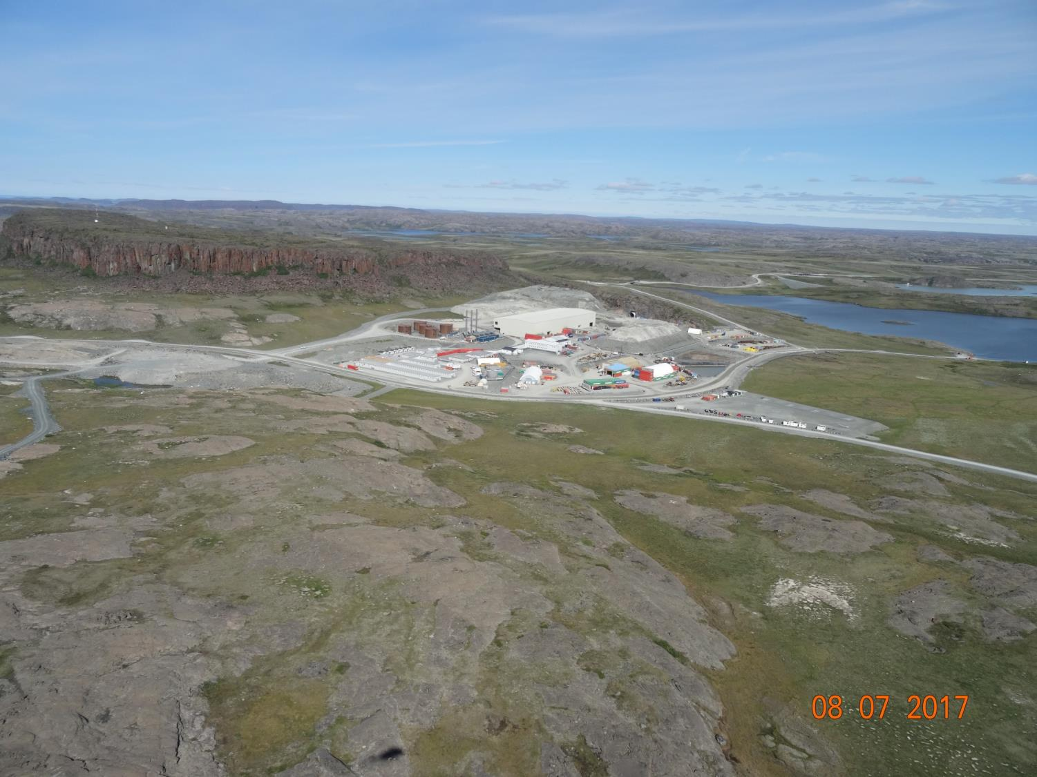

Slide 3
Outline
Qanuriniga
Roles and responsibilities
Contributions to the application review
Topics discussed:
Site water management
Tailings management
Waste management
Closure & reclamation
Additional components
Closing
Ilaunigit havaakhalu
Ilaliutiniginik atuqtumi ihivriuqhijutimi
Ukua uqauhiuyuut:
Igluqpaqaqvikmi immaq munarinigagut
Ataguut munariniganik
Iqagunik Munariniganik
Umiktiqniganik kiklimaktiqnigalu
Ilagiarutit ilagiyainik
Iniqtirutit

Slide 4
Roles and responsibilities
Ilaunigit havaakhalu
Indigenous and Northern Affairs Canada’s (INAC) responsibilities, mandate, and obligations stem from the following:
Department of Indian Affairs and Northern Development Act
Nunavut Agreement
Nunavut Land Claims Agreement Act
Nunavut Waters and Nunavut Surface Rights Tribunal Act and the associated regulations
Nunavut Planning and Project Assessment Act
Territorial Lands Act and the associated regulations
Arctic Waters Pollution Prevention Act
Nunaqaqaqtut Ukiuqtaqtumilu Havaat Kanatami (INAC) havaagit, havaak-hitaunigit, aturiaqaqtailu pihimayut ukunanga:
Havakviuyuq Itqilrit Pijutigivlugit Havaat Ukiuqtaqtumilu Pivalianiginik Maligaqyuamit
Nunavumi Agiqatiriigunmit
Nunavumi Nunataaqnikut Agiqatigiirunmik Maligayuamit
Nunavumi Immaliriqiyit Nunavumilu Nunap Qaaginik Ihumaqhuutinik Naalaktitinikut Maliqaqyuaq ilagiyailu maliraugakhat
Nunavumi Upalugaiyainikut Havaaniklu Ilituqhainikut Maligaqyuaq
Ukiuqtaqtumi Nunaliqinikut Maligaqyuaq ilagiyailu maliruagakhat
Ukiuqtaqtumi Immauyut Halumaigitaagani Maligaqyuaq

Slide 5
Contributions to the application review
Ilaliutiyut tuuqhiqtuutauyumik ihivriuqnigagut
INAC made the following submissions to the Nunavut Water Board:
February 14, 2018 – Preliminary completeness review
March 29, 2018– Technical review comments with information requests and recommendations
INAC-kut ukuniga tunihijutiqaqtut Nunavumi Immaliqiyit Katimayiinut:
February 14-mi 2018-mi Hivuani iniqtauniganik ihivriuqniganik
March 29-mi 2018-mi Nutauniqhanik ihivriuqnigagut uqauhiuyunik hivuniqhijutikhani tuukhiqhuti atuliqutauyuniklu

Slide 6
1. Site water management
1. Igluqpaqaqvikmi immaqnik munarinigagut
Most of our technical comments pertain to water management
Topics discussed include:
Amount of water to be used
Handling and treatment of minewater
Design of water containment structures
Amigainiqhat nutauniqhanik uqauhivut pijutiqaqtut immaqmik munarinigagut
Uqautauyut ilaqaqtut ukuniga:
Qanuraaluk immaqmik atuqniganik
Qanuriliuruhiinik halumaqtiqnigagulu uyaraqtaqvikmit immauyut
Qanurituunigit immaqaqaviuyut hanayauniginik

Slide 7
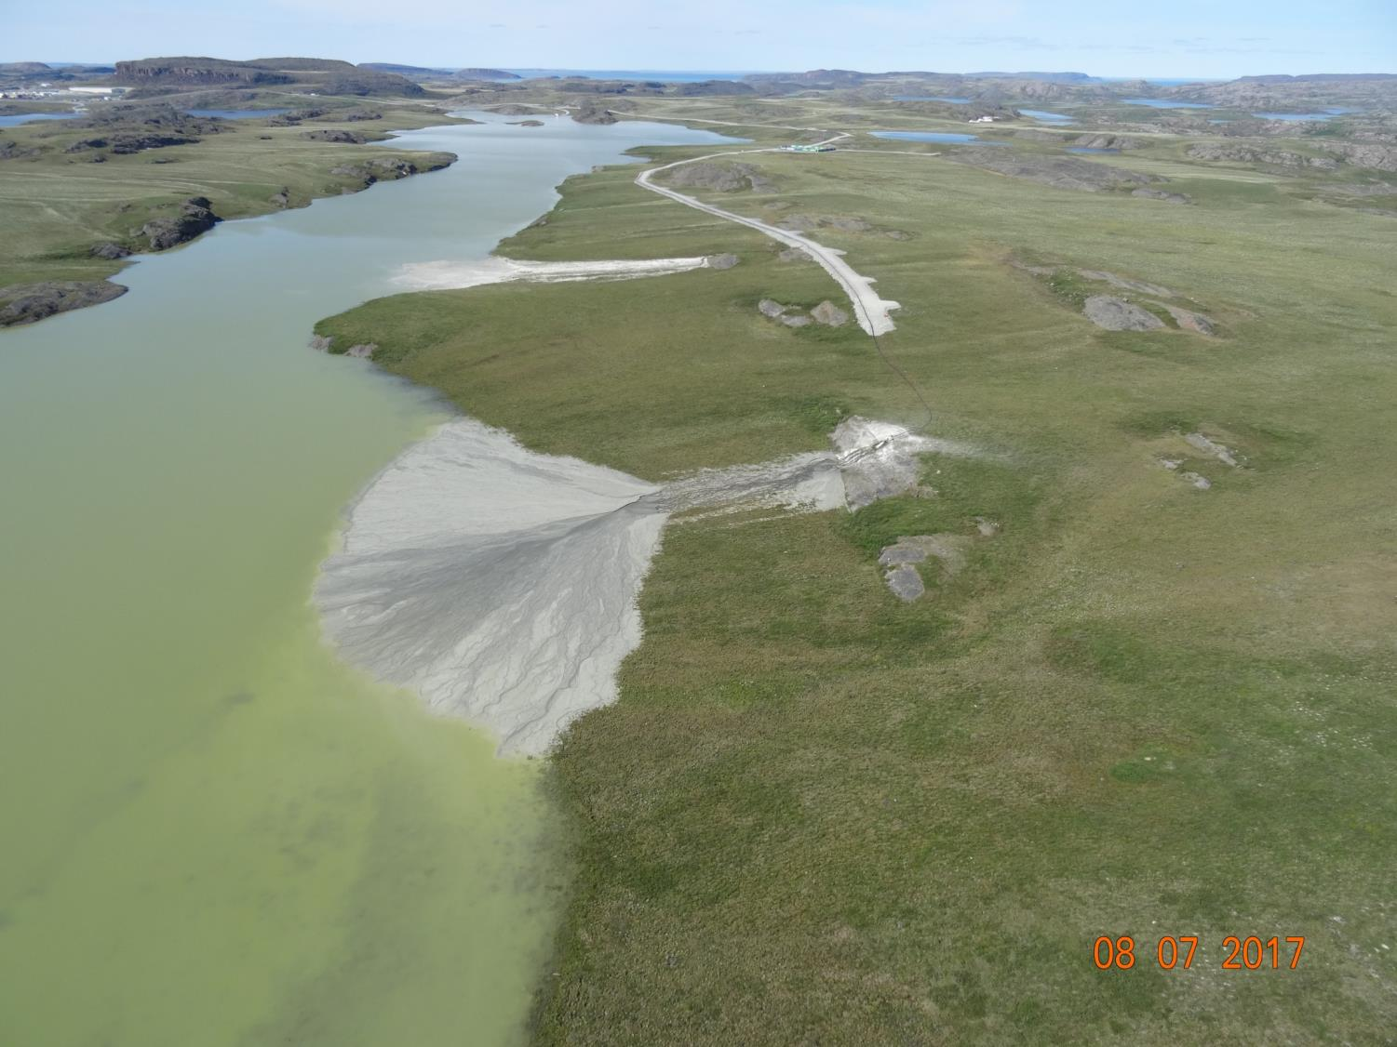
2. Tailings management
2. Ataquut munarinigagut

Slide 8
2. Tailings management
2. Ataquut munarinigagut
Topics discussed include:
Closure and post-closure performance of Doris tailings impoundment area & Boston tailings management area
Placement of tailings in the underground mines
Uqautauyut ilaqaqtut ukuniga:
Umiknigani kiguanilu umikniganit qanurilivalianiga Doris-mi ataguuqviuyuq nuna Boston-milu ataguuqvik munairnigagut nuna
Iliuraqnigit ataguut nunap iluani uyaraqtaqviknut

Slide 9
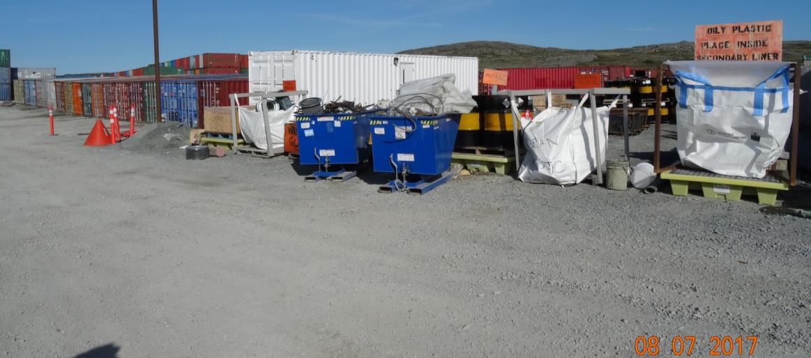
3. Waste management
3. Iqagunik munarinigagut
Timing of landfill construction
Hunauliqat hauyivikhaq hanagauniaqnigani

Slide 10
4. Closure & reclamation
4. Umikniganik kiklimaktiqnigagulu
Topics discussed include:
Requirements of closure plan
Effects of climate change on closed site in the long term
Uqauhiuyut ilaqaqtut ukuniga:
Piqariaqaqnigani umiknigagut upalugaiyaunmik
Aktuqnigit hilaap aalaguqpalianiganit umikhimayumi igluqpaqaqvikmik hivunikhami

Slide 11
5. Additional components
5. Ilariarutikhat hunaliqaa
Topics discussed include:
Administrative issues, such as the number of water licences for Hope Bay Belt
Monitoring plans
Reclamation cost estimate, which is used to set security under the water licences
Uqauhiuyut ilaqaqtut ukuniga:
Aulanigagut ihumagiyauyut, ajikutainik qafiuniginik immaqnik aturiagani laisiuyut Kapihiliktumi Uyaraqtaqvikmi
Amirijutinut upalugaiyautit
Kiklimaktiqnigagut akituniganik nalautagauyuq, atuqtauyuq qulaqnaiyautikhamik ilagani immaqnik aturiami laisiuyuni

Slide 12
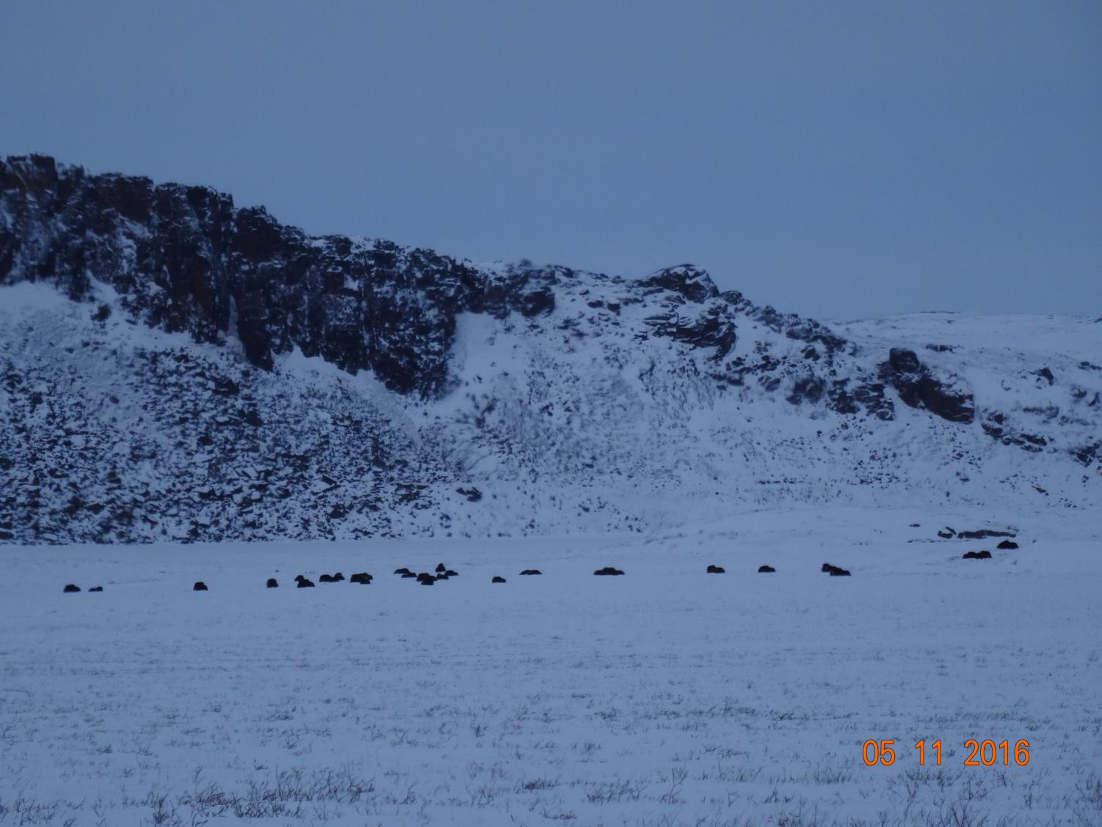

Slide 13
Closing
Iniqtirutit
The department is confident that concerns brought forward can and will be addressed by TMAC to the satisfaction of the department before a Public Hearing.
The department will be submitting further evidence to the Board regarding reclamation closure costs following further discussions with all parties.
Havakviuyuq ukpiruhuktut ukua ihumaaluutauyut uqautauyut ihuaqhilaaqtait ihuaqhaqniaqait TMAC-kut namagiyauliqniginut havakviuyumit Inuknik Naalaktititinagit.
Havakviuyuq tunihiniaqtuq naunaiqpaalirutikhanik Katimayinut kiklimaktinigagut umikpat akituniginik kiguani uqaqatigitaaqata tamaita ilauyut.

Slide 14
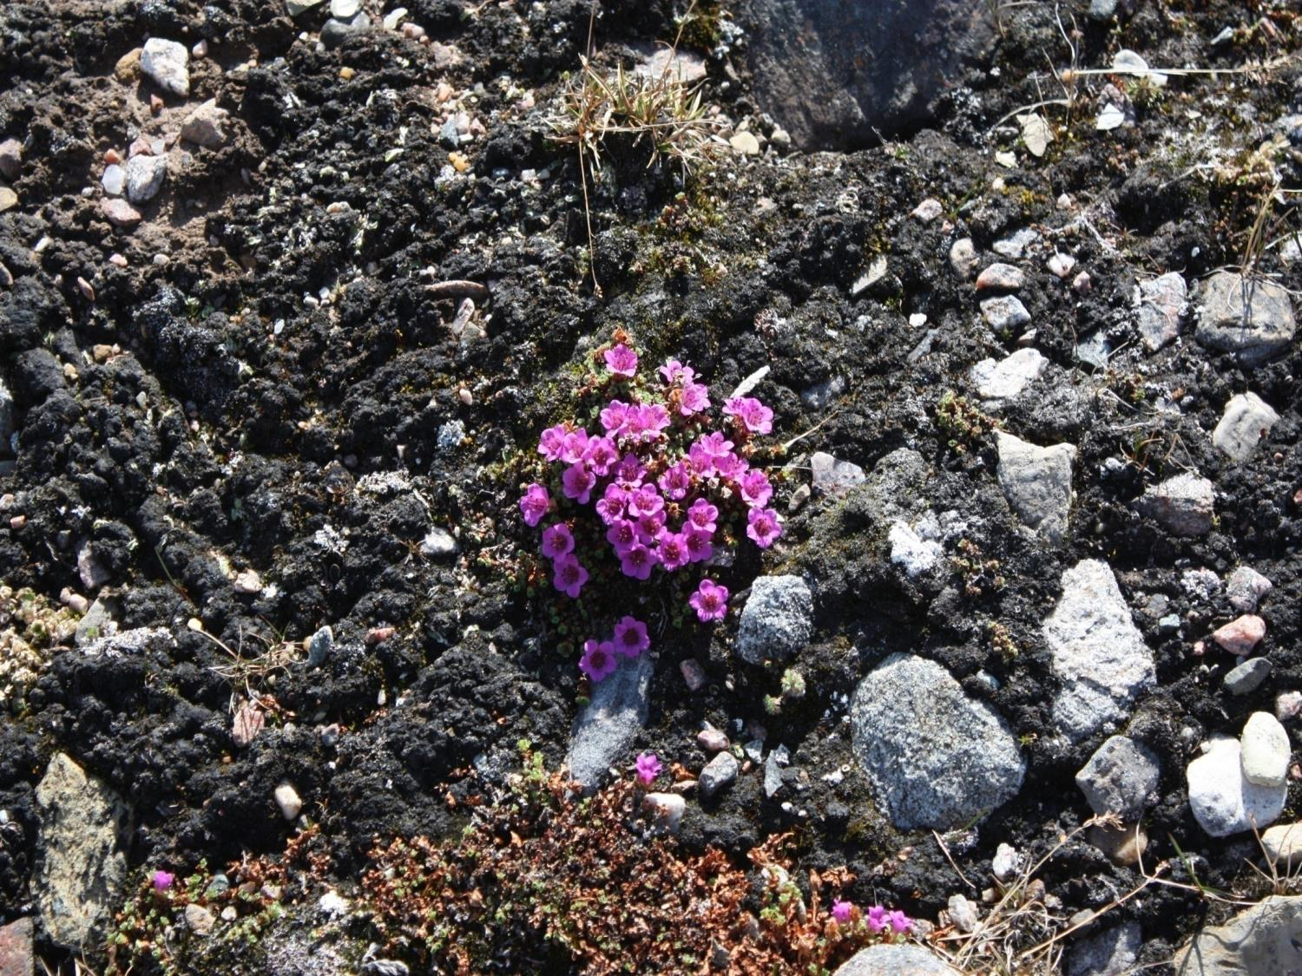
Quanaqutit Nakurmiik
Thank you
ᓇᑯᕐᒦᒃ
Merci

