Slide 1
TMAC Resources Ltd.
Water Licence Applications for the Hope Bay Phase 2 Project
Renewal/Amendment #2 for 2AM-DOH1323 and
New for 2AM-BOS----
Nunavut Water Board Technical Meeting
Cambridge Bay, May 14-15, 2018
ᑖᒃᑯᐊ ᐱᓕᕆᔪᑦ TMAC Resources Ltd. TECHNICAL
ᐃᒪᕐᒧᑦ ᓚᐃᓴᓐᓯᑕᕋᓱᐊᕐᓂᕐᒧᑦ ᑕᑕᑎᕆᐊᓖᑦ Hope Bay,ᒥ ᑐᓪᓕᕆᓕᕐᑕᖓᓂ ᐱᓕᕆᐊᒧᑦ
ᓄᑕᐅᓕᕐᑎᑦᓯᓂᖅ/ᐋᖅᑭᒃᓱᐃᒋᐊᕐᓂᖅ #2 for 2AM-DOH1323 ᐊᒻᒪ ᓄᑖᑦ ᐆᒧᖓ 2AM-BOS----
ᓄᓇᕗᒻᒥ ᐃᒪᓕᕆᓂᕐᒧᑦ ᑲᑎᒪᔨᐅᔪᑦ ᑲᑎᒪᓂᖓ
ᐃᖃᓗᑦᑑᑦᑎᐊᖅ, ᒪᐃ 14-15, 2018

Slide 2
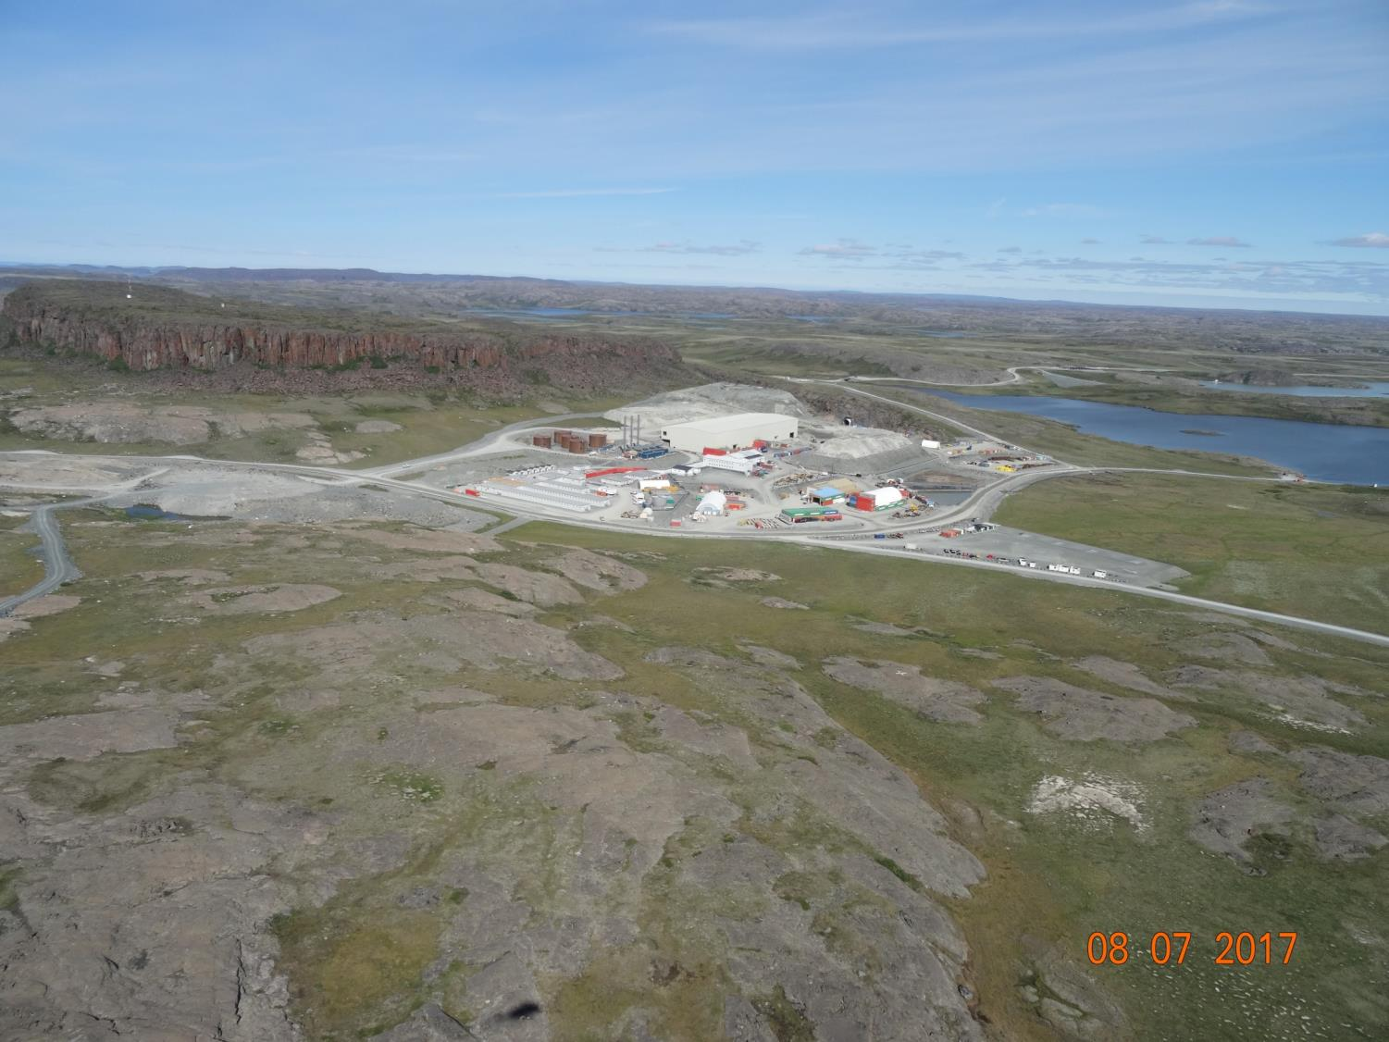

Slide 3
Outline
ᐃᓗᓕᖏᑦ
Roles and responsibilities
Contributions to the application review
Topics discussed:
Site water management
Tailings management
Waste management
Closure & reclamation
Additional components
Closing
ᓱᓕᕆᔪᒃᓴᐅᓂᖏᑦ ᐊᒻᒪ ᐱᓕᕆᐊᒃᓴᖏᑦ
ᐃᑲᔫᑏᑦ ᓄᑖᕐᓂ ᑕᑕᒥᕆᐊᓕᓂᓪᓗᕿᒥᕐᕈᓂᕐᒧᑦ
ᐅᓂᒃᑳᕐᑕᐅᓂᐊᖅᑐᑦ
ᐃᒪᕐᒥᑦ ᒥᐊᓂᕐᓯᓂᖅ
ᒪᕐᓗᑯᓂ ᒥᐊᓂᖅᓯᓂᖅ
ᐃᒪᑐᖃᕐᓂᖅ ᒥᐊᓂᕐᓯᓂᖅ
ᒪᑐᓂᖓ ᐊᒻᒪ ᐅᑎᕐᑎᑕᐅᓂᖓ
ᐊᓯᖏᑦ ᐱᓕᕆᐊᑦ
ᒪᑐᓂᖅ

Slide 4
Roles and responsibilities
ᓱᓕᕆᔭᒃᓴᖏᑦ ᐊᒻᒪ ᐱᓕᕆᐊᒃᓴᖏᑦ
Indigenous and Northern Affairs Canada’s (INAC) responsibilities, mandate, and obligations stem from the following:
Department of Indian Affairs and Northern Development Act
Nunavut Agreement
Nunavut Land Claims Agreement Act
Nunavut Waters and Nunavut Surface Rights Tribunal Act and the associated regulations
Nunavut Planning and Project Assessment Act
Territorial Lands Act and the associated regulations
Arctic Waters Pollution Prevention Act
ᐃᓄᓕᕆᔨᑐᖃᒃᑯᑦᑦ ᐱᓕᕆᐊᒃᓴᖏᑦ, ᐱᓂᐊᕐᓂᖓ, ᐊᑐᕆᐊᖃᕐᑕᖏᑦ ᐅᑯᓇᖓᑦ:
ᐃᓄᓕᕆᔨᑐᖃᒃᑯᑦ ᐱᖁᔭᖓᑦ
ᓄᓇᕗᑦᑕᕐᓯᒪᓂᕐᒧᑦ ᐊᖏᖃᑎᒌᒍᑎᒃ
ᓄᓇᕗᑦᑖᕐᓯᒪᓂᕐᒧᑦ ᐊᖏᖃᑎᒌᒍᑎᒧᑦ ᐱᖁᔭᖅ
ᓄᓇᕗᒻᒥ ᐃᒪᓕᕆᓂᕐᒧᑦ ᐊᒻᒪ ᓄᓇᕗᒻᒥ ᐱᕙᓪᓕᐊᔪᓄᑦ ᐱᔪᓐᓇᐅᑎᓄᑦ ᐱᖁᔭᖅ ᐊᒻᒪ ᐊᓯᖏᑦ ᒪᓕᒐᐃᑦ
ᓄᓇᕗᒻᒥ ᐸᕐᓇᐃᓂᕐᒧᑦ ᐊᒻᒪ ᐱᓕᕆᐊᓂᐊᒃ ᕿᒥᕐᕈᓂᕐᒧᑦ ᐱᖁᔭᖅ
ᐅᑭᐅᕐᑕᕐᑐᒥ ᓄᓇᓄᑦ ᐱᖁᔭᖅ ᐊᒻᒪ ᐊᓯᖏᑦ ᒪᓕᒐᐃᑦ
ᐃᒪᕐᒧᑦ ᓱᕈᔪᑐᖃᕐᑕᐃᓕᓂᕐᒧᑦ ᐱᖁᔭᖅ

Slide 5
Contributions to the application review
ᐃᑲᔪᕈᑎᑦᓴᐃᑦ ᑕᑕᑎᕆᐊᓕᓐᓂᒃ ᕿᒥᕐᕈᓂᕐᒧᑦ
INAC made the following submissions to the Nunavut Water Board:
February 14, 2018 – Preliminary completeness review
March 29, 2018– Technical review comments with information requests and recommendations
ᐃᓄᓕᕆᔨᑐᖃᒃᑯᑦ ᐅᑯᓂᖓ ᑐᓂᓯᓯᒪᒧᑦ ᓄᓇᕗᒻᒥ ᐃᒪᕐᒥᐅᑕᓕᕆᓂᕐᒧᑦ ᑲᑎᒪᔨᓄᑦ:
ᕕᕗᐊᕆ 14, 2018 – ᓯᕗᓪᓕᕐᒥ ᐱᐊᓂᑦᑕᐅᔪᓂᒃ ᕿᒥᕐᕈᓂᖅ
ᒪᕐᔨ 29, 2018– Tᕿᒥᕐᕈᓂᖅ ᐅᖃᐅᓯᐅᓯᒪᔪᓂᒃ ᑐᑭᓯᒋᐊᕐᕕᒃᓴᓂᒃ ᑐᒃᓯᕋᕐᑕᐅᓯᒪᔪᓂᒃ ᐊᒻᒪ ᐊᑐᓕᖁᔨᕗᖔᕈᑏᑦ

Slide 6
1. Site water management
1. ᐃᒪᕐᒥᒃ ᒥᐊᓂᕐᓯᓂᖅ
Most of our technical comments pertain to water management
Topics discussed include:
Amount of water to be used
Handling and treatment of minewater
Design of water containment structures
ᐅᖃᐅᓰᑦ ᑕᕝᕙᓂ ᐊᑐᖅᑕᐅᔪᐃᑦ ᑐᑭᓕᐊᕐᓂᕐᓴᐃᑦ ᖃᐅᔨᒪᔪᓄᑦ ᐃᒪᕐᒥ ᒥᓂᐊᓂᕐᓯᓂᕐᒥᑦ
ᐅᓂᒃᑳᕐᑕᐅᓂᐊᖅᑐᑦ:
ᐊᖏᓂᖓᑕ ᐃᒪᐅᑉ ᐊᑐᕐᑕᐅᓂᐊᕐᑑᑉ
ᒥᐊᓂᕐᓯᓂ ᐅᔭᕋᖅᓂᐊᕐᕕᒻᒥ ᐃᒪᐅᔪᓂ
ᓴᓇᓂᕐᒧᑦ ᐃᒪᕐᓗᒥ ᓴᓗᒻᒪᖅᓴᓂᒥ

Slide 7
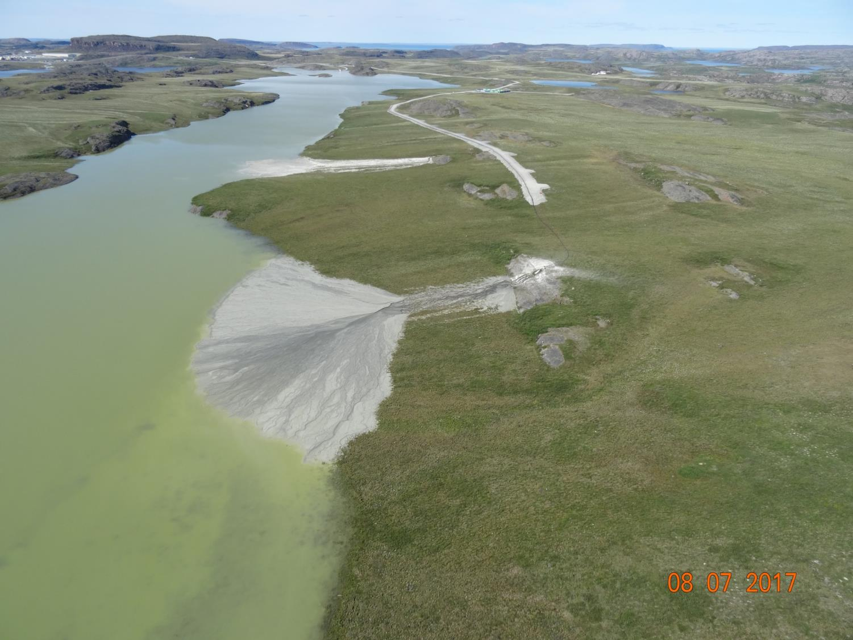
2. Tailings management
2. ᒪᕐᓗᑯᓂᒃ ᒥᐊᓂᕐᓯᓂᖅ

Slide 8
2. Tailings management
2. ᒪᕐᓗᑯᓂᒃ ᒥᐊᓂᕐᓯᓂᖅ
Topics discussed include:
Closure and post-closure performance of Doris tailings impoundment area & Boston tailings management area
Placement of tailings in the underground mines
ᐅᓂᒃᑳᕐᑕᐅᓂᐊᖅᑐᑦ:
ᒪᑐᔭᐅᒐᔭᕐᓂᖏᓐᓄᑦ ᐊᒻᒪᓗ ᒪᑐᔭᐅᓂᖓᓄᑦ ᐸᕐᓇᐃᓂᖅ Doris,ᒥ ᒪᕐᓗᑯᐃᑦ ᐊᒻᒪᓗ Boston,ᒥ ᒪᕐᓗᑯᐃᑦ
ᐃᓕᔭᐅᓂᖏᑦ ᒪᕐᓗᑯᐃᑦ ᐅᔭᕋᕐᓂᐊᕐᕕᐅᑉ ᐊᑖᓂ

Slide 9
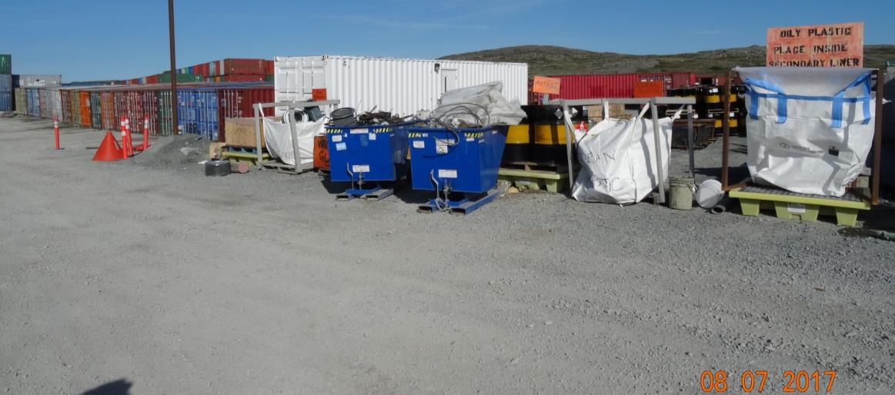
3. Waste management
3. ᓱᕈᓂᒃ ᒥᐊᓂᕐᓯᓂᖅ
Timing of landfill construction
ᐊᑦᑕᓇᖏᑦᑐᓂᒃ ᓱᕈᓂᖅ ᒪᕐᓗᑯᖃᕕᒃ

Slide 10
4. Closure & reclamation
4. ᒪᑐᓂᖓ ᐊᒻᒪ ᐅᑎᕐᑎᑕᐅᓂᐊ
Topics discussed include:
Requirements of closure plan
Effects of climate change on closed site in the long term
ᐅᓂᒃᑳᕐᑕᐅᓂᐊᖅᑐᑦ:
ᐸᕐᓇᓐᓂᖅ ᒪᑐᓂᐊᓄᑦ ᐊᒻᒪ ᓱᓕᕆᒋᐊᖃᓂᖅ
ᐊᑯᓂᐅᔪᒧᑦ ᓯᓚᐅᑉ ᐊᓯᔾᔨᕐᐸᓪᓕᐊᓂᐊᓄᑦ ᐊᒃᑐᕐᑕᐅᓂᖅ

Slide 11
5. Additional components
5. ᐊᓯᖏᑦ ᐱᓕᕆᐊᒃᓴᑦ
Topics discussed include:
Administrative issues, such as the number of water licences for Hope Bay Belt
Monitoring plans
Reclamation cost estimate, which is used to set security under the water licences
ᐅᓂᒃᑳᕐᑕᐅᓂᐊᖅᑐᑦ:
ᐊᓪᓚᑦᑕᐅᓯᒪᓂᖏᑦᑕ ᓈᒻᒪᖏᓐᓂᖏ, ᐆᑦᑑᑎᒋᓗᒍ ᐃᒪᕐᒧᑦ ᓚᐃᓴᓐᓯᑕᕋᓱᐊᖅᓯᒪᓂᖏᑦ Hope Bay Belt,ᒥ
ᖃᐅᔨᓴᕐᓂᖅ ᓱᕈᔪᓐᓇᕐᑐᓂᒃ
ᐅᑎᕐᑎᑦᓯᓂᕐᒧᑦ ᐊᑭᒋᒐᔭᕐᑕᖓᓂᒃ ᓇᓚᐅᒃᓵᕐᓂᖅ

Slide 12
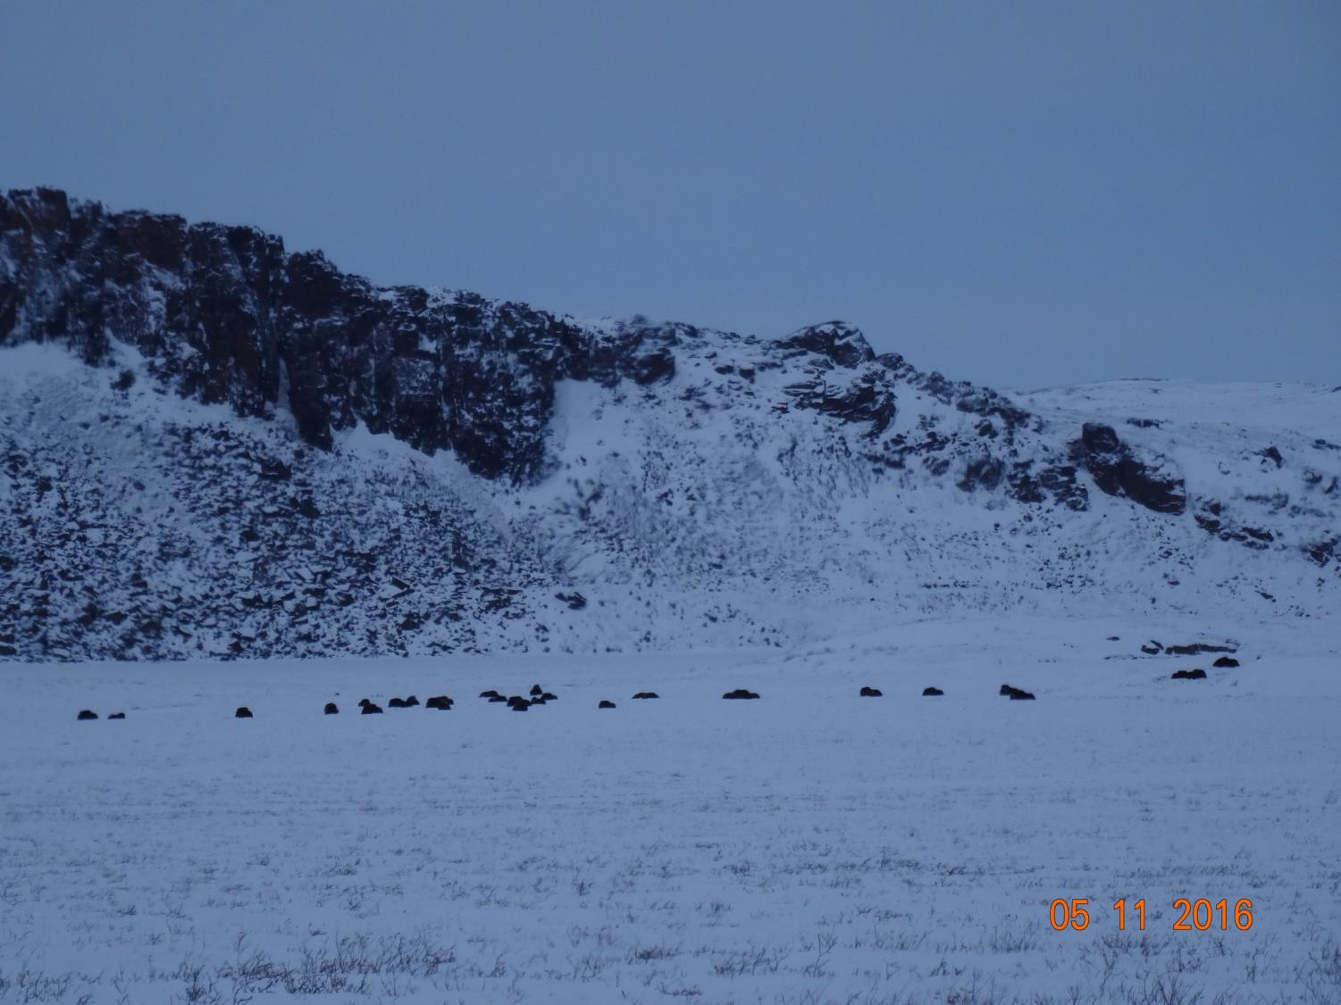

Slide 13
Closing
ᒪᑐᓂᖅ
The department is confident that concerns brought forward can and will be addressed by TMAC to the satisfaction of the department before a Public Hearing.
The department will be submitting further evidence to the Board regarding reclamation closure costs following further discussions with all parties.
ᐃᓄᓕᕆᔨᑐᖃᒃᑯᑦ ᐅᒃᐱᕈᓱᑦᑐᑦ ᐃᓱᒫᓗᒍᑕᐅᔪᒃ ᑲᒪᒋᔭᐅᒐᔭᕐᓂᖏᓐᓂᒃ TMAC,ᑯᓐᓄᑦ ᐸᕐᓇᑦᓯᒪᑦᓯᐊᖁᓪᓗᒋᑦ ᑲᑎᒪᑎᑦᓯᓚᐅᖏᓐᓂᖏᓐᓂ ᐃᓄᓐᓂᒃ.
ᐃᓄᓕᕆᔨᑐᖃᒃᑯᑦ ᑐᓂᓯᒐᔭᕐᑐᑦ ᖃᐅᔨᔭᐅᕙᓪᓕᐊᔪᓂᒃ ᑲᑎᒪᔨᓄᑦ ᐅᑎᕐᑎᑦᓯᓂᐅᑉ ᒪᑐᔭᐅᒃᐸᑦ ᐊᑭᒋᒐᔭᕐᑕᖏᑕ ᒥᒃᓵᓄᑦ ᐃᓱᒪᒃᓴᕐᓯᐅᕈᑎᒋᔭᐅᖅᑳᓚᐅᕐᑎᓪᓗᒍ ᑕᒪᐃᓐᓄᑦ ᐱᓕᕆᖃᑎᒌᑦᑐᓄᑦ.

Slide 14
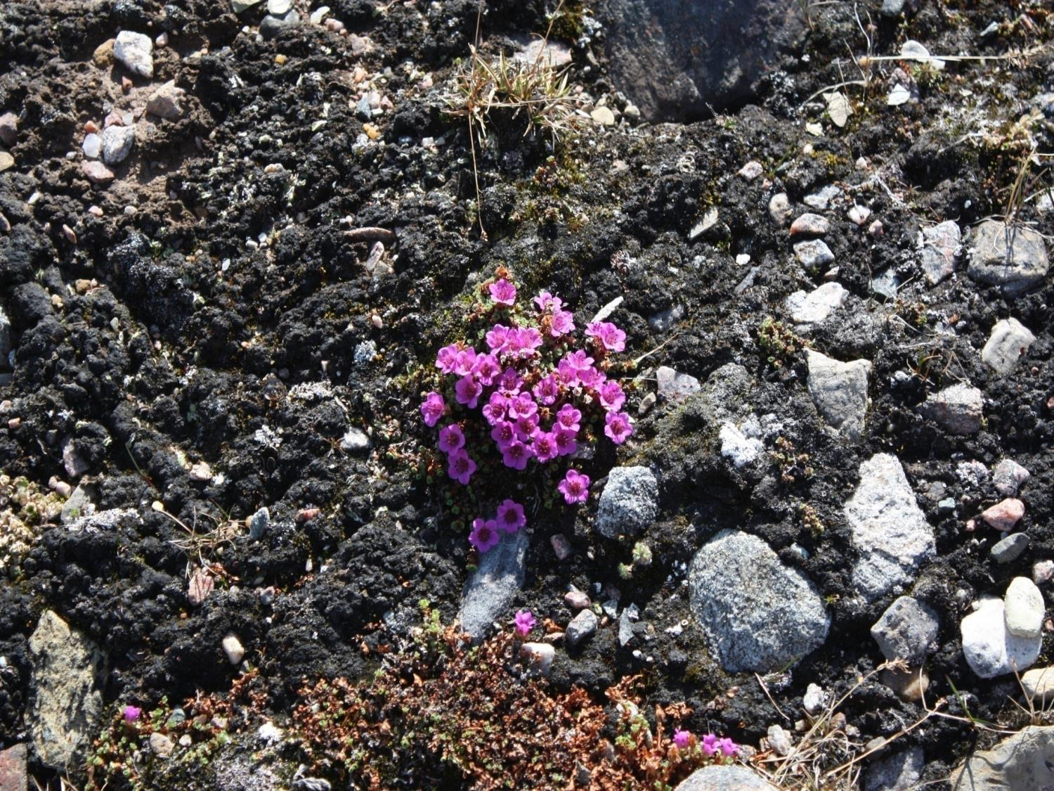
Nakurmiik
Thank you
ᓇᑯᕐᒦᒃ
Merci

