Slide 1
TMAC Resources Ltd.
Water Licence Applications for the Hope Bay Phase 2 Project
Renewal/Amendment #2 for 2AM-DOH1323 and
New for 2AM-BOS----
Nunavut Water Board Technical Meeting
Cambridge Bay, May 14-15, 2018
ᑖᒃᑯᐊ ᐱᓕᕆᔪᑦ TMAC Resources Ltd. TECHNICAL
ᐃᒪᕐᒧᑦ ᓚᐃᓴᓐᓯᑕᕋᓱᐊᕐᓂᕐᒧᑦ ᑕᑕᑎᕆᐊᓖᑦ Hope Bay,ᒥ ᑐᓪᓕᕆᓕᕐᑕᖓᓂ ᐱᓕᕆᐊᒧᑦ
ᓄᑕᐅᓕᕐᑎᑦᓯᓂᖅ/ᐋᖅᑭᒃᓱᐃᒋᐊᕐᓂᖅ #2 for 2AM-DOH1323 ᐊᒻᒪ ᓄᑖᑦ ᐆᒧᖓ 2AM-BOS----
ᓄᓇᕗᒻᒥ ᐃᒪᓕᕆᓂᕐᒧᑦ ᑲᑎᒪᔨᐅᔪᑦ ᑲᑎᒪᓂᖓ
ᐃᖃᓗᑦᑑᑦᑎᐊᖅ, ᒪᐃ 14-15, 2018

Slide 2
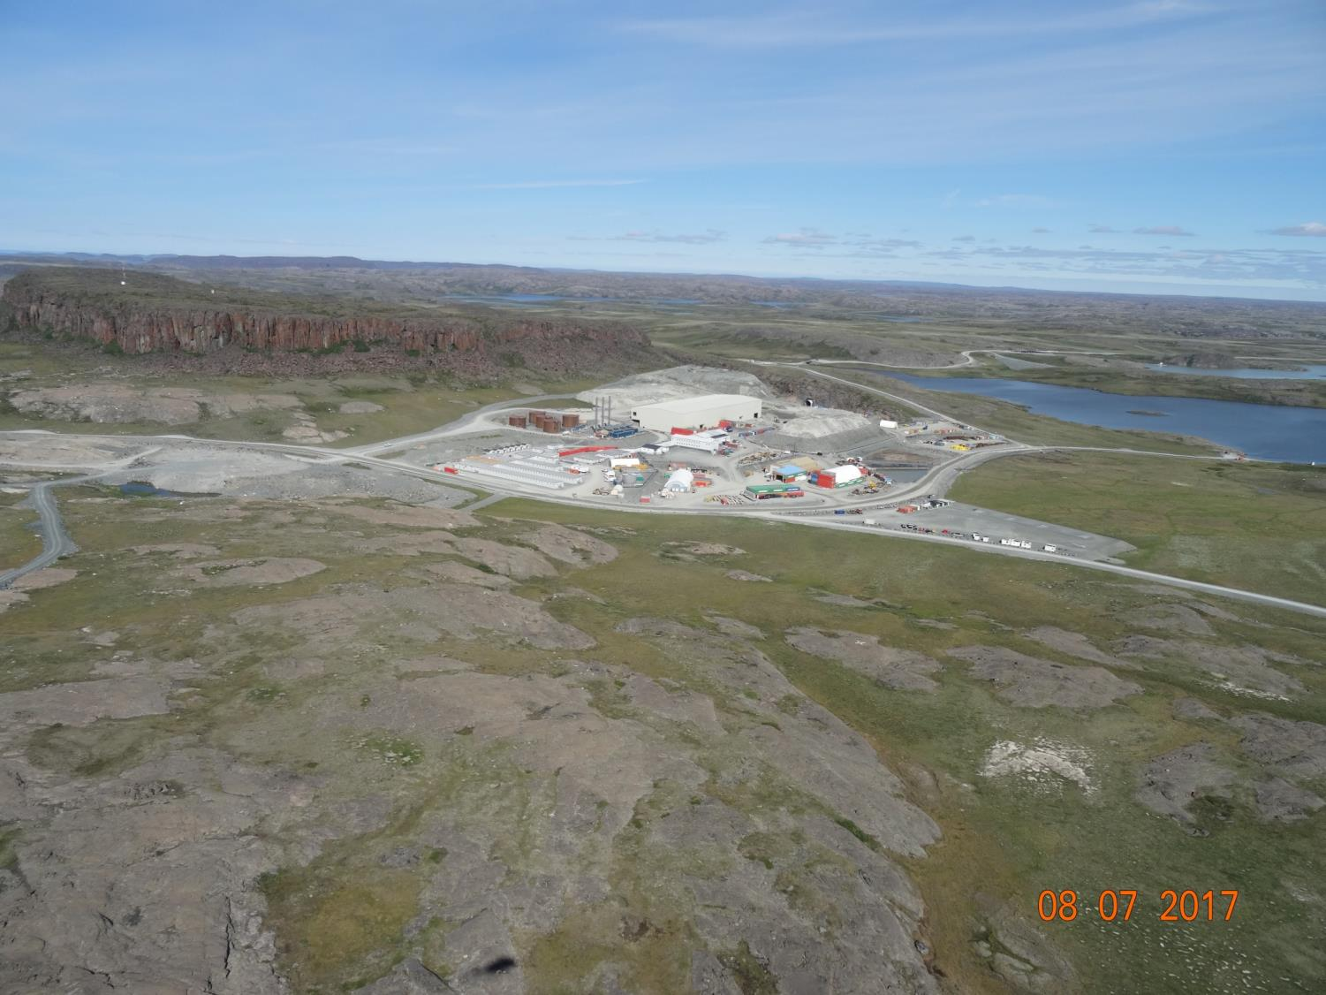

Slide 3
Outline
ᐃᓗᓕᖏᑦ
Roles and responsibilities
Contributions to the application review
Topics discussed:
    Site water management
    Tailings management
    Waste management
    Closure & reclamation
    Additional components
Closing
ᓱᓕᕆᔪᒃᓴᐅᓂᖏᑦ ᐊᒻᒪ ᐱᓕᕆᐊᒃᓴᖏᑦ
ᐃᑲᔫᑏᑦ ᓄᑖᕐᓂ ᑕᑕᒥᕆᐊᓕᓂᓪᓗᕿᒥᕐᕈᓂᕐᒧᑦ
ᐅᓂᒃᑳᕐᑕᐅᓂᐊᖅᑐᑦ
  ᐃᒪᕐᒥᑦ ᒥᐊᓂᕐᓯᓂᖅ
  ᒪᕐᓗᑯᓂ ᒥᐊᓂᖅᓯᓂᖅ
  ᐃᒪᑐᖃᕐᓂᖅ ᒥᐊᓂᕐᓯᓂᖅ
  ᒪᑐᓂᖓ ᐊᒻᒪ ᐅᑎᕐᑎᑕᐅᓂᖓ
  ᐊᓯᖏᑦ ᐱᓕᕆᐊᑦ
ᒪᑐᓂᖅ

Slide 4
Roles and responsibilities
ᓱᓕᕆᔭᒃᓴᖏᑦ ᐊᒻᒪ ᐱᓕᕆᐊᒃᓴᖏᑦ
Indigenous and Northern Affairs Canada’s (INAC) responsibilities, mandate, and obligations stem from the following:
Department of Indian Affairs and Northern Development Act
Nunavut Agreement
Nunavut Land Claims Agreement Act
Nunavut Waters and Nunavut Surface Rights Tribunal Act and the associated regulations
Nunavut Planning and Project Assessment Act
Territorial Lands Act and the associated regulations
Arctic Waters Pollution Prevention Act
ᐃᓄᓕᕆᔨᑐᖃᒃᑯᑦᑦ ᐱᓕᕆᐊᒃᓴᖏᑦ, ᐱᓂᐊᕐᓂᖓ, ᐊᑐᕆᐊᖃᕐᑕᖏᑦ ᐅᑯᓇᖓᑦ:
ᐃᓄᓕᕆᔨᑐᖃᒃᑯᑦ ᐱᖁᔭᖓᑦ
ᓄᓇᕗᑦᑕᕐᓯᒪᓂᕐᒧᑦ ᐊᖏᖃᑎᒌᒍᑎᒃ
ᓄᓇᕗᑦᑖᕐᓯᒪᓂᕐᒧᑦ ᐊᖏᖃᑎᒌᒍᑎᒧᑦ ᐱᖁᔭᖅ
ᓄᓇᕗᒻᒥ ᐃᒪᓕᕆᓂᕐᒧᑦ ᐊᒻᒪ ᓄᓇᕗᒻᒥ ᐱᕙᓪᓕᐊᔪᓄᑦ ᐱᔪᓐᓇᐅᑎᓄᑦ ᐱᖁᔭᖅ ᐊᒻᒪ ᐊᓯᖏᑦ ᒪᓕᒐᐃᑦ
ᓄᓇᕗᒻᒥ ᐸᕐᓇᐃᓂᕐᒧᑦ ᐊᒻᒪ ᐱᓕᕆᐊᓂᐊᒃ ᕿᒥᕐᕈᓂᕐᒧᑦ ᐱᖁᔭᖅ
ᐅᑭᐅᕐᑕᕐᑐᒥ ᓄᓇᓄᑦ ᐱᖁᔭᖅ ᐊᒻᒪ ᐊᓯᖏᑦ ᒪᓕᒐᐃᑦ
ᐃᒪᕐᒧᑦ ᓱᕈᔪᑐᖃᕐᑕᐃᓕᓂᕐᒧᑦ ᐱᖁᔭᖅ

Slide 5
Contributions to the application review
ᐃᑲᔪᕈᑎᑦᓴᐃᑦ ᑕᑕᑎᕆᐊᓕᓐᓂᒃ ᕿᒥᕐᕈᓂᕐᒧᑦ
INAC made the following submissions to the Nunavut Water Board:
February 14, 2018 – Preliminary completeness review
March 29, 2018– Technical review comments with information requests and recommendations
ᐃᓄᓕᕆᔨᑐᖃᒃᑯᑦ ᐅᑯᓂᖓ ᑐᓂᓯᓯᒪᒧᑦ ᓄᓇᕗᒻᒥ ᐃᒪᕐᒥᐅᑕᓕᕆᓂᕐᒧᑦ ᑲᑎᒪᔨᓄᑦ:
ᕕᕗᐊᕆ 14, 2018 – ᓯᕗᓪᓕᕐᒥ ᐱᐊᓂᑦᑕᐅᔪᓂᒃ ᕿᒥᕐᕈᓂᖅ
ᒪᕐᔨ 29, 2018– Tᕿᒥᕐᕈᓂᖅ ᐅᖃᐅᓯᐅᓯᒪᔪᓂᒃ ᑐᑭᓯᒋᐊᕐᕕᒃᓴᓂᒃ ᑐᒃᓯᕋᕐᑕᐅᓯᒪᔪᓂᒃ ᐊᒻᒪ ᐊᑐᓕᖁᔨᕗᖔᕈᑏᑦ

Slide 6
1. Site water management
1. ᐃᒪᕐᒥᒃ ᒥᐊᓂᕐᓯᓂᖅ
Boston water treatment plant effluent quality (comment #4)
Release of saline minewater to tundra through pipeline failure (comment #7)
Industrial water treatment plant at Doris (comment #9)
Water & load balance model validation (comment #10)
Contact water pond design (comment #12)
Boston,ᒥ ᐃᒪᕐᒧᑦ ᓴᓗᒻᒪᕐᓴᐃᑦᔪᑕᐅᑉ ᖃᓄᐃᓐᓂᖓ (ᐅᖃᐅᓯᖅ #4)
ᓴᖅᑭᑎᑦᓯᓂᖅ ᓴᓗᒻᒪᕐᓴᐃᔾᔪᑎᒥᒃ ᐅᔭᕋᓐᓂᐊᕐᓂᕐᒧᑦ ᐃᒪᕐᓗᒻᒥᒃ ᓄᓇᒧᑦ ᓱᓪᓗᑯᑖᒃᑯ ᖃᓄᐃᓕᔪᓂᕐᐸᑦ (ᐅᖃᐅᓯᖅ #7)
ᐱᓕᕆᓂᕐᒧᑦ ᐃᒪᕐᓗᒻᒥᒃ ᓴᓗᒻᒪᕐᓴᐃᔾᔪᑎᒃ Doris,ᒥ (ᐅᖃᐅᓯᖅ #9)
ᐃᒪᖅ ᐊᒻᒪ ᖃᓄᐃᓪᓕᐊᕐᓂᖓᓂᒃ ᓇᓗᓇᐃᕐᓯᓂᖅ (ᐅᖃᐅᓯᖅ #10)
ᐱᓕᕆᓂᖅ ᐃᒪᕐᒥᒃ ᑕᓯᕐᒥ (ᐅᖃᐅᓯᖅ #12)

Slide 7
1. Site water management (continued)
1. ᐃᒪᕐᒥᒃ ᒥᐊᓂᕐᓯᓂᖅ (ᓱᓕ)
Maximum camp size at Doris (comment #14)
Requested water volumes (comment #15)
Minewater at Boston (comment #18)
Madrid minewater transport (comment #19)
Effect of saline water in tailings impoundment area on frozen core dam (comment #21)
ᐊᖏᓂᖓ ᐱᓕᕆᕕᐅᑉ Doris,ᒥ (ᐅᖃᐅᓯᖅ t #14)
ᖃᓄᐃᓪᓗᐊᕐᓂᖓ ᐃᒪᐅᑉ (ᐅᖃᐅᓯᖅ #15)
ᐅᔭᕋᓐᓂᐊᓂᕐᒧᑦ ᐃᒪᖅ Boston,ᒥ (ᐅᖃᐅᓯᖅ #18)
Madrid,ᒥ ᐃᒪᖅ ᐊᔾᔭᕐᑕᐅᔭᑦᑐᖅ (ᐅᖃᐅᓯᖅ #19)
ᐊᒃᑐᐃᓂᖓ ᐃᒪᕐᒥᒃ ᓴᓗᒻᒪᕐᓴᐃᒍᑎᐅᑉ ᒪᕐᓗᑯᓂᒃ ᖁᐊᖑᑎᓪᓗᒋᑦ ᐅᕝᕙᓘᓐᓃᑦ ᕿᐅᒃᑲᖓᑎᓪᓗᒋᑦ (ᐅᖃᐅᓯᖅ #21)

Slide 8
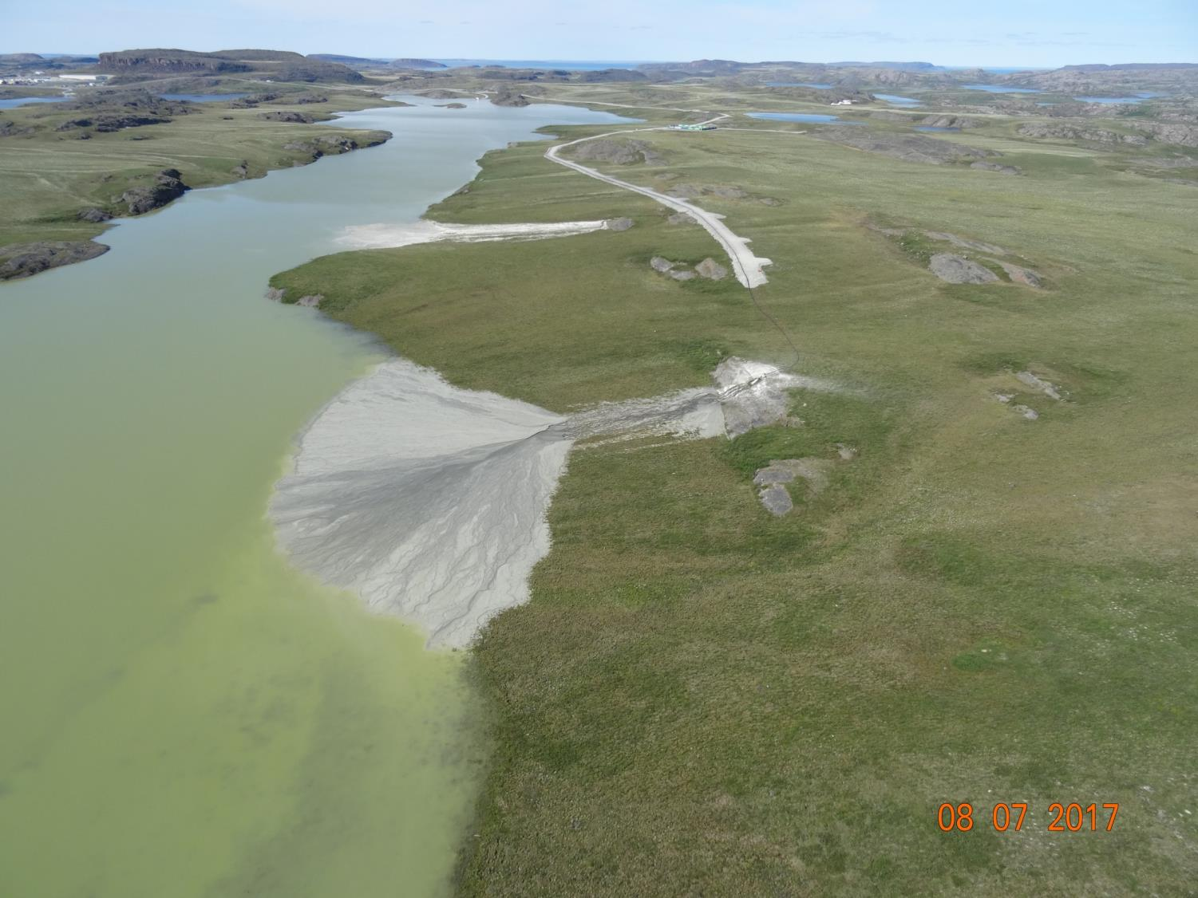
2. Tailings management
2. ᒪᕐᓗᑯᓂᒃ ᒥᐊᓂᕐᓯᓂᖅ

Slide 9
2. Tailings management
2. ᒪᕐᓗᑯᓂᒃ ᒥᐊᓂᕐᓯᓂᖅ
Doris tailings impoundment area closure plan (comment #1)
Boston tailings management area seepage post-closure (comment #2)
Backfill materials (comment #5)
Waste rock volumes in relation to void volumes (comment #16)
Detoxified tailings deposition at Madrid (comment #17)
Doris,ᒥ ᒪᕐᓗᑯᐃᑦ ᒪᑐᔭᐅᒐᔭᕐᓂᖏᓐᓄᑦ ᐸᕐᓇᐃᓂᖅ (ᐅᖃᐅᓯᖅ #1)
Boston,ᒥ ᒪᕐᓗᑯᐃᑦ ᒥᐊᓂᕆᔭᐅᒐᔭᕐᓂᖏᑦ ᒪᑐᔭᐅᒃᐸᑦ (ᐅᖃᐅᓯᖅ #2)
ᓴᐅᔨᓂᖅ ᒪᕐᓗᑯᓂᒃ (ᐅᖃᐅᓯᖅ #5)
ᐅᔭᕋᐃᑦ ᒪᕐᓗᑯᐃᑦ ᐊᖏᓂᖏᑦ (ᐅᖃᐅᓯᖅ #16)
ᓴᓗᒻᒪᕐᓴᐃᓂᖅ ᒪᕐᓗᑯᓂᒃ ᐃᒋᑕᒃᓴᓂᒃ (ᐅᖃᐅᓯᖅ #17)

Slide 10
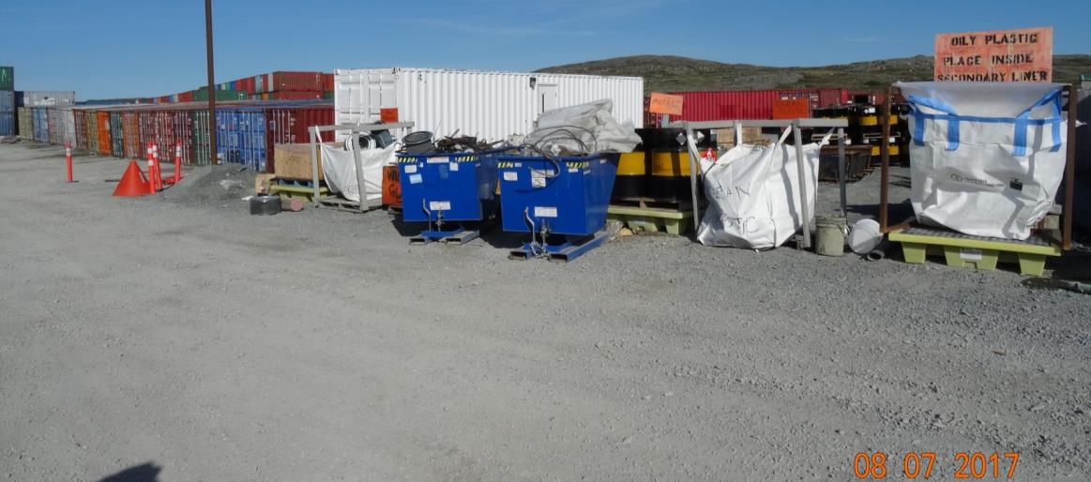
3. Waste management
3. ᓱᕈᓂᒃ ᒥᐊᓂᕐᓯᓂᖅ
Non-hazardous waste disposal (comment #20)
ᐊᑦᑕᓇᖏᑦᑐᓂᒃ ᓱᕈᓂᖅ ᒪᕐᓗᑯᖃᕕᒃ (ᐅᖃᐅᓯᖅ #20)

Slide 11
4. Closure & reclamation
4. ᒪᑐᓂᖓ ᐊᒻᒪ ᐅᑎᕐᑎᑕᐅᓂᐊ
Closure planning and requirements (comment #3)
Long term climate change effects (comment #6)
ᐸᕐᓇᓐᓂᖅ ᒪᑐᓂᐊᓄᑦ ᐊᒻᒪ ᓱᓕᕆᒋᐊᖃᓂᖅ (ᐅᖃᐅᓯᖅ #3)
ᐊᑯᓂᐅᔪᒧᑦ ᓯᓚᐅᑉ ᐊᓯᔾᔨᕐᐸᓪᓕᐊᓂᐊᓄᑦ ᐊᒃᑐᕐᑕᐅᓂᖅ (ᐅᖃᐅᓯᖅ #6)

Slide 12
5. Additional components
5. ᐊᓯᖏᑦ ᐱᓕᕆᐊᒃᓴᑦ
Water licences for Hope Bay Belt (comment #8)
Aquatic effects monitoring plans (comment #11)
Cyanide testing (comment #13)
Reclamation cost estimate
ᐃᒪᓕᕆᓂᕐᒧᑦ ᓚᐃᓴᓐᓯᑦ Hope Bay Belt,ᒥ (ᐅᖃᐅᓯᖅ #8)
ᐃᒪᕐᒥᐅᑕᓂᒃ ᐆᒪᔪᓂᒃ ᒥᐊᓂᕐᓯᓂᕐᒧᑦ ᐸᕐᓇᒃᑕᐅᔪᑦ (ᐅᖃᐅᓯᖅ #11)
ᖃᐅᔨᓴᕐᓂᖅ ᓱᕈᔪᓐᓇᕐᑐᓂᒃ (ᐅᖃᐅᓯᖅ #13)
ᐅᑎᕐᑎᑦᓯᓂᕐᒧᑦ ᐊᑭᒋᒐᔭᕐᑕᖓᓂᒃ ᓇᓚᐅᒃᓵᕐᓂᖅ

Slide 13
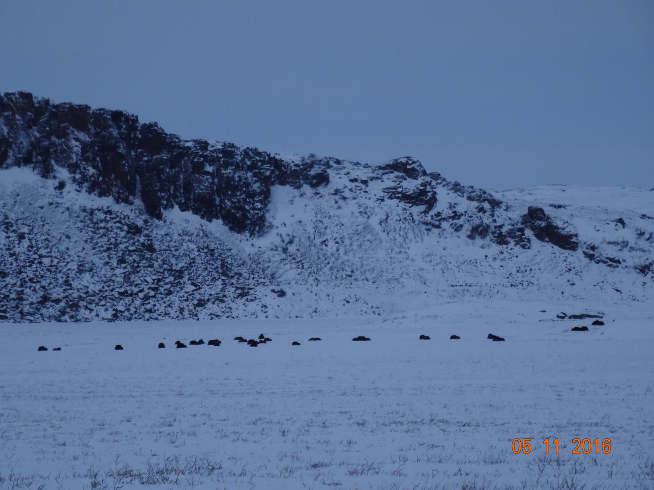

Slide 14
Closing
ᒪᑐᓂᖅ
The department is confident that concerns brought forward can and will be addressed by TMAC to the satisfaction of the department before a Public Hearing.
The department will be submitting further evidence to the Board regarding reclamation closure costs following further discussions with all parties.
ᐃᓄᓕᕆᔨᑐᖃᒃᑯᑦ ᐅᒃᐱᕈᓱᑦᑐᑦ ᐃᓱᒫᓗᒍᑕᐅᔪᒃ ᑲᒪᒋᔭᐅᒐᔭᕐᓂᖏᓐᓂᒃ TMAC,ᑯᓐᓄᑦ ᐸᕐᓇᑦᓯᒪᑦᓯᐊᖁᓪᓗᒋᑦ ᑲᑎᒪᑎᑦᓯᓚᐅᖏᓐᓂᖏᓐᓂ ᐃᓄᓐᓂᒃ.
ᐃᓄᓕᕆᔨᑐᖃᒃᑯᑦ ᑐᓂᓯᒐᔭᕐᑐᑦ ᖃᐅᔨᔭᐅᕙᓪᓕᐊᔪᓂᒃ ᑲᑎᒪᔨᓄᑦ ᐅᑎᕐᑎᑦᓯᓂᐅᑉ ᒪᑐᔭᐅᒃᐸᑦ ᐊᑭᒋᒐᔭᕐᑕᖏᑕ ᒥᒃᓵᓄᑦ ᐃᓱᒪᒃᓴᕐᓯᐅᕈᑎᒋᔭᐅᖅᑳᓚᐅᕐᑎᓪᓗᒍ ᑕᒪᐃᓐᓄᑦ ᐱᓕᕆᖃᑎᒌᑦᑐᓄᑦ.

Slide 15
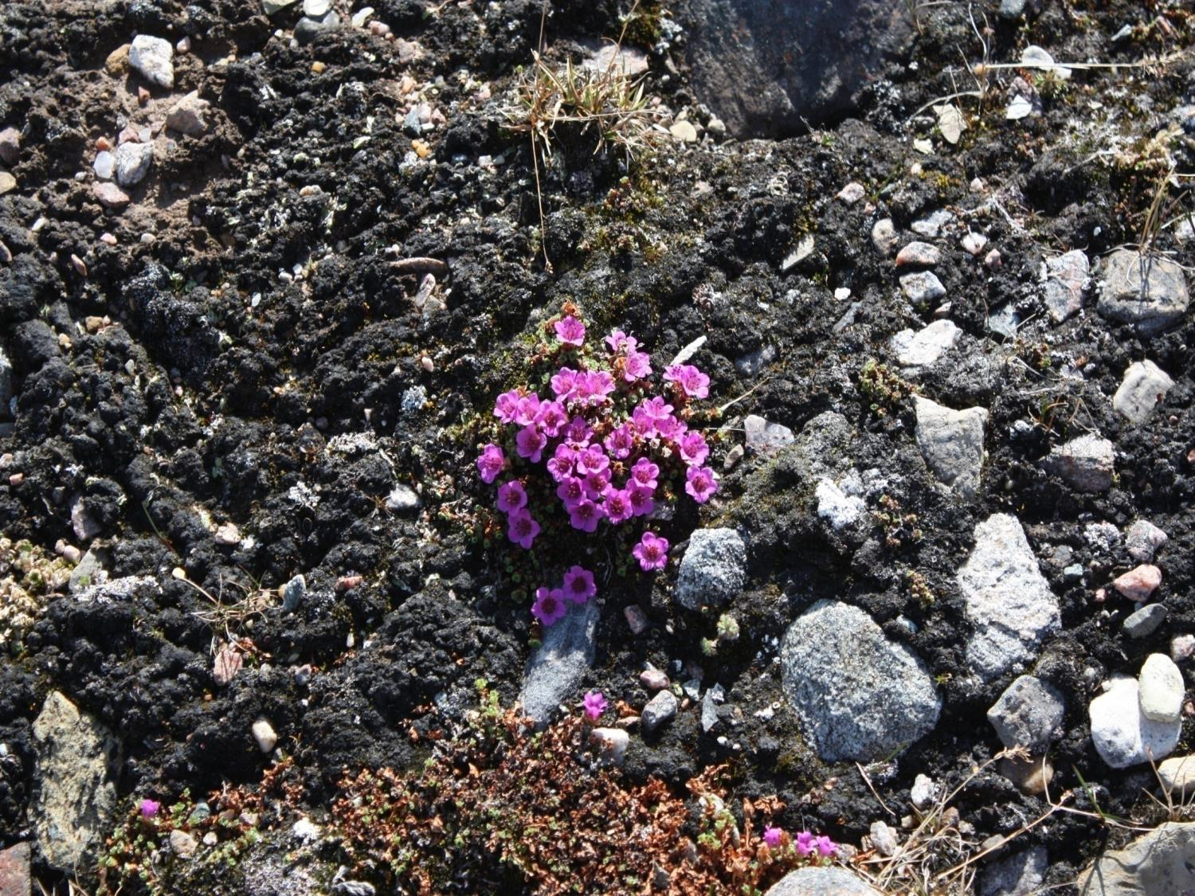
Nakurmiik
Thank you
ᓇᑯᕐᒦᒃ
Merci

