Slide 1
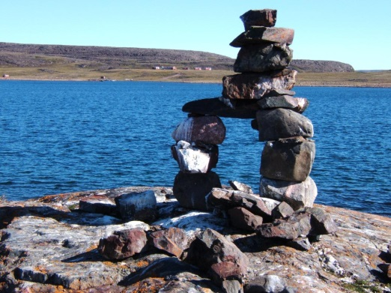

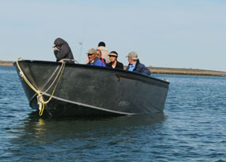
Nunavut Water Board (NWB) Nunavut Imaligiyit Katimayit
Community Session
Presentation
Type “A” Water Licence Applications
Amendment No. 2 to 2AM-DOH1323
and 2AM-BOS----.
by TMAC Resources Inc.
Nunaliuyuni Katimaniq
Hatqiqtitat
Qanugittunia “A” Imaqmun Laisa Tukhigautit
Ihuaqhigiagut Nappaa 2 taphumunga 2AM-DOH1323
Tanalu 2AM-BOS----
tapkunanga TMAC Risuasis Nanminiliknit

Slide 2

List of Topics Titiqat Pityutinut
NWB Background Info.
Authorizations NWB may Issue
NWB Type “A” Licensing
Process
Licences Issued to the Project
Phase 2 Hope Bay Belt Project Overview
Scope of Application
Application Status
Next Steps
NWB Contact Info
NWB-kut Unniqtutai Tuhaqhit
Pilagutit NWB-kut tunilaqtai
NWB-kut Qanugittunia “A” Laisaliqutit Pityuhit
Laisauyut Tuniyai Havanguyumun
Tukligit 2 Hope Bay Qiminga Havanguyuq Tamaat Takunia
Havakhait Tukhigautip
Tukhigaut Qanugitnia
Tukliit Atuqtakhat
NWB-kut Tugagutai Tuhaqhit

Slide 3
NWB Background Info NWB-kut Unniqtutai Tuhaqhitit
Institution of Public Government (IPG) established under Article 13 of the Nunavut Agreement Responsibilities and powers over the regulation, use, and management of freshwater in the Nunavut Settlement Area… Article 13.2.1 Nunavut Land Claims Agreement | Kavamagiyauqatauyut Inungnut (IPG-kut) pinguqtauyut malikhugit Nakataani 13 tapkunani Nunavut Angigutit Havalgit Hakugiknilgitlu maligainut, atuqni, aulataunilu imigaulat imait Nunavutagauyup Iluani …

Slide 4
NWB Background Info (Cont.)
Objects of the NWB are to: Provide for the conservation and utilization of waters in Nunavut, except in national parks, in a manner that provides optimum benefit for the residents of Nunavut in particular and Canadians in general. Sec.35 Nunavut Waters And Nunavut Surface Rights Tribunal Act | Pinahuaqtai NWB-kut tapkuat : Piqaqtitni nunguttailininut atuqtauninutlu imait Nunavutmi, kihimiungittuq nunaqyuap minnguiqhivini, piplugit piqaqtitini nakuuniapamik ihuaqutaunit nunaliuyunut Nunavutmi piluaqtumik Kanatamiunutlu tamaitnut. Nakataani.35 Nunavut Imaliqutit Nunavutlu Nunap Qangani Piyungnautiligiyit Apiqhuiyigalaat Piquyat

Slide 5
Authorizations NWB may Issue Pilagutit NWB-kut Tunilaqtai
Based on its mandate, the NWB may issue any of the following authorizations to regulate the use of water and/or the deposit of waste for activities or undertakings occurring within Nunavut Settlement Area: Approval Without a Licence | Piplugu havagiyait, tapkuat NWB-kut tunihilat kitunikliqak tahapkuninga pilagutinik aulaninut atuqnit imait tamnalu/tamnaluniit iqaqni iqakut huliniqnut havanguyutluniit atuqtauyut Nunavutagauyup Iluani: Angigut Laisaittumik

Slide 6
Authorizations NWB may Issue (Cont.) Pilagutit NWB-kut Tunilaqtai (Huli)
Type “B” Water Licence Type “A” Water Licence This week’s Technical Meeting and Community Session are for two Type “A” water licence applications: 2AM-DOH1323 Amendment No. 2 2AM-BOS---- New Application | Qanugittunia “B” Imaqmun Laisa Qanugittunia “A” Imaqmun Laisa Uumani havaguhiup Pitquhiliqutit Katimaniq Nunaliuyunutlu Katimaniq malguknut Qanugittunia “A” imaqmun laisa tukhigautiknut: 2AM-DOH1323 Ihuaqhigiagut Nappaa 2 2AM-BOS---- Nutaq Tukhigaut

Slide 7






NWB Type “A” Licensing Process NWB-kut Qanugittuni “A” Laisanut Pityuhit
Application Received
Tukhigaut
Piyauyuq
Concordance and Preliminary Technical Review
Malikhaqnianut Hivullitlu Pitquhit Naunaiyaqni
Notice of Application
and Request for Tech Review
Tuhaqhit Tukhigautmun Tukhiqnilu Pitquhit Naunaiyaqni
We are here
Hamanittugut
Parties submit written representations
Piqatauyut tuniyai titigaqhimayut hatqiqtitnit
Technical Meeting
Pitquhit Katimanit
Community Meeting
Nunaliuyut Katimani
…

Slide 8




Type “A” Licensing Process Qanugittunia “A” Laisanut Pityuhi
…
Pre-Hearing Conference
Naalaktitiniahaqtitlugit Katimaniq
If directed in PHC Decision applicant provides additional info
Tiliuqtaukpat Naalaktitiniahaqtitlugit Ihumaliugutmi tukhigaqtuq piqaqtitiyuq ilagiagutinik tuhagakhat
PHC Decision Issued
Naalatitiniahaqtitlugit Ihumaliugut Tuniyat
Notice of Public Hearing
(60 days minimum)
Tuhaqhit Naalakvikmik (60 ublut ikitniahamik)
Parties exchange written interventions
Piqatauyut himmiqtautai titigaqhimayut pityutit
…

Slide 9




Type “A” Licensing Process Qanugittunia “A” Laisanut Pityuhi
…
NWB holds Public Hearing
NWB-kut atuqtitat Inungnik Naalakvik
NWB issues decision to approve Application and a draft licence to Minister
NWB-kut tuniyat ihumaliugut angiqtauyanga Tukhigaut uuktutlu laisa Minihitauyumun
NWB issues decision not to approve Application with reasons to Minister
NWB-kut tuniyat ihumaliugut angingitnianik Tukhigaut pityutailu Minihitauyumun
Minister approves (or does not) the issuance of the WL
Minihitauyuq angiqta (angingita) tuniyaunia Imaqmun Laisaittumik
Minister approves (or does not) NWB Decision
Minihitauyuq angiqta (angingita) NWB-kut Ihumaliuguta

Slide 10
Licences Issued to the Project Laisauyut Tuniyauyut Havanguyumun
2AM-DOH0713 Issued by the NWB on September 19, 2007 expired on September 30, 2013 Authorized use of Water of 480,000 m³/year and the deposit of Waste in support of a Mining and Milling undertaking Three Amendments: No. 1 relocation of the Explosives Mixing and Storage Facility No. 2 infrastructure expansion, set new monitoring stations No.3 conditions applying to waste rock management | 2AM-DOH0713 Tuniyauyuq tapkunanga NWB-kut talvani Saptaipa 19, 2007 nunguttuq talvani Saptaipa 30, 2013 Pilaqtitauyuq atuqnia imaq 480,000 cm/ukiumun iqaqnilu Iqakut ikayuqtuqhugu Uyagakhiurniq Havikhaliurniqlu havagiyauni Pingahut angiqtauhimayut Ihuaqhigiagutit : No. 1 nuktigutit Qagaqtautinut Akuttivik Tutqumaviklu Havagutit No. 2 Havagutit attaqtuhivalliqni, ihuaqhini nutat munaqhityutit havakvit No.3 ayugakhat atuqnilgit iqakunut uyaqat aulataunit

Slide 11
Licences Issued to the Project (Cont.) Laisauyut Tuniyauyut Havanguyumun (Huli)
2AM-DOH1323 Issued by the NWB on August 16, 2013 will expiry on August 15, 2023 Authorizes the use of Water of 480,000 m³/year and Waste disposal A mining rate of 720 tonnes per day of ore The subaqueous deposition of tailings into the Tail Lake (TIA as per Schedule 2 of MMER) The controlled discharge of effluent to Doris Creek from the TIA Security furnished $13.090 million | 2AM-DOH1323 Tuniyauyuq tapkunanga NWB-kut talvani Aagasi 16, 2013 nungutniaq talvani Aagasi 15, 2023 Pilagutit atuqninut 480,000 cm tapkuat imaq/ukiumun Iqakutlu iqaqni Uyagakhiurniqmun aktilat 720 tonnes ubluqmun havikhanik Tapkuat immap iluani ilauqaqnit uyagaktaqnikut talvunga Uyagaktaqnikut Tahiq (TIA-nga Atugakhalianga 2 tapkunani MMER) Tamna munagiyauyuq kuvittaqvit imaqtait halumaittut talvunga Doris Kuugauyaq talvanga TIA-nga Nautiumatit pipkaqtat $13.090 milian

Slide 12
Licences Issued to the Project (Cont.) Laisauyut Tuniyauyut Havanguyumun (Huli)
2AM-DOH1323 Amendment No. 1 Approved November 4, 2016 Surface infrastructure expansion Increase mining rate to 2,000 tonnes/day, and the addition of a mill Subaerial deposition of floating tailings in the TIA Discharge of TIA effluent to Doris Creek (pre tailings deposition) and Roberts Bay (post tailing deposition) | 2AM-DOH1323 Ihuaqhigiagut Nappaa 1 Angiqtauyuq Nuvipa 4, 2016 Nunap qangani Havagut ilagiaqnia Ilagiaqnia uyagakhiurniq aktilanga talvunga 2,000 tonnesit/ubluq, ilagiaqnialu havikhaliuqvik Qangatayaqni kuvigaqni puktalaqtut uyagaktarnikunik kuvigaivik talvani Kuvigaivukmi Kuvititaunia tamna Kuvigaivik halumaittuq imaqtanga talvunga Doris Kuugauyaq (uyagaktaqnikunik kuvigaiviuniahaqtitlugu) tamnalu Roberts Bay (kuvigaiviuliqaqtitlugu uyagaktaqnikunik)

Slide 13
Licences Issued to the Project (Cont.) Laisauyut Tuniyauyut Havanguyumun (Huli)
2BB-MAE1727 Bulk sampling/Advanced exploration at Madrid site 2BB-BOS1727 Bulk sampling/Advanced exploration at Boston site 2BE-HOP1222 Exploration: drilling activities, bulk fuel storage, etc. Doris and Windy camps and infrastructure Temporary potable water for Doris camp | 2BB-MAE1727 Angiyunik naunaiyainiq/Atukhaqni havikhaqhiurniq talvani Madrid havakviani 2BB-BOS1727 Angiyunik naunaiyainiq/Atukhaqni havikhaqhiurniq talvani Boston havakviani 2BE-HOP1222 Havikhaqhiurniq: ikuutarniqmun huliniit, angiyunik uqhukhat tutqumani, ahiilu. Doris tamnalu Windy hiniktaqvit havagutailu Atulakni imigaulat imait taphumunga Doris hiniktaqvik

Slide 14
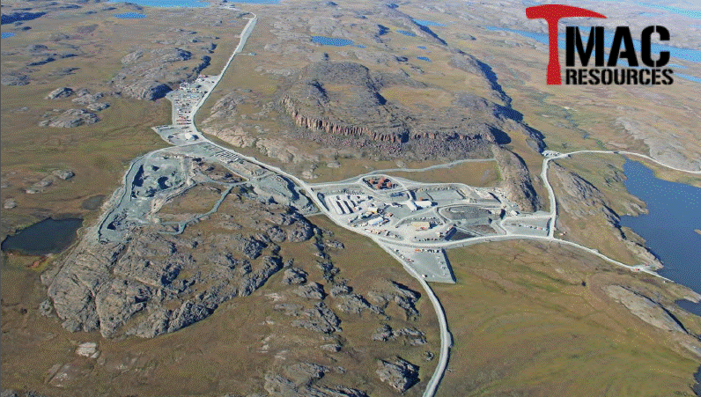
Phase 2 Hope Bay Belt Project / Tukligit 2 Hope Bay Qiminga Havanguyuq Doris-Madrid-Boston

Slide 15
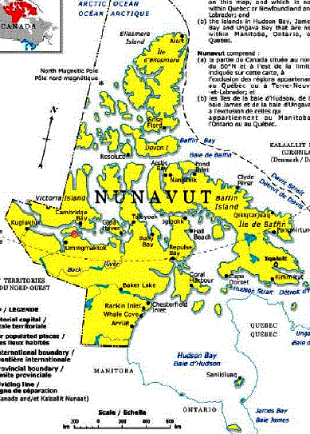
Project Location Havap Inigiya
Doris North Project
Doris North Havanga

Slide 16
Project Overview Havanguyuq Tamaat Takunia
Location:
The project is located on IOL in the Kitikmeot region extending South from Robert’s Bay
~ 150 km SW of Cambridge Bay on the way to Bay Chimo (Umingmaktok)
General Description:
Underground gold mines: 1 operational, 3 applied for
Current Life of Mine (LOM) is 3 years
Plan to extend production from 2021 to 2032; adds 11 years
Water sources: Doris, Windy, and Aimaokatalok Lakes
Cyanide leaching process
Gold Dore bars final product
Inigiya:
Tamna havanguyuq inilik Inuit Nunani Nanminiani Kitikmeotni uiguplugu Nigianut talvanga Robert’s Bay
~ 150 kilaamitat Nigiata Pingangnaani Ikaluktutiak mikhaanut Bay Chimo (Umingmaktok)
Tamaitnut Unniqtutit:
Nunap iluani guulinut uyagakhiuqvit: 1 aulayuq, 3 tuhigutauyut
Tatya Atuqni Uyagakhiuqvik (LOM) 3 ukiut
Parnaut uigunia hanayauvia talvanga 2021 tikitlugu 2032; ilayat 11 ukiut
Imiqtaqviuyut: Doris, Windy, tamnalu AimaokatalokTahiit
Cyanide maqininut pityuhit
Guulit Kikagiknit kingulliqpaq hanayat

Slide 17
Project Overview (Cont.) Havanguyuq Tamaat Takunia (huli)
Recent History of the Project:
The Project was under C&M (temporary closure) 2015
April 2015, TMAC provided the NWB notification to re-start
Construction begins in summer 2015
Operations started in 2017
December 20, 2017; TMAC applies for two Type “A” Licences:
Amendment No. 2 – 2AM-DOH1323
New 2AM-BOS----
Tatya qanugitni Havanguyup:
Tamna Havanguyuq maliktai Munagiyauyuq Ihuaqhihimanitlu (umikhimallakni) 2015
Aipurumi 2015, TMAC piqaqtitai Imaligiyit tuhaqhitninik pigiaphaqniaqhimanianik
Hanayaunia atulitqiktuq auyaani 2015
Aulataunia pigiaqtukhaq 2017mi
Tisaipa 20, 2017; TMAC tukhirtuq malguknik Qanugittunia “A” Laisauyunik:
Ihuaqhigiagut Nappaa 2 – 2AM-DOH1323
Nutaq 2AM-BOS----

Slide 18

Application Scope Tukhigaut Havangi
Proposed Changes: 2AM-DOH1323 Amendment No. 2
Extend Licence to 2037
Expand Doris TIA from 2.5 to 18 million tonnes
Expand Doris camp from 280 to 400 persons
Increase water use from ½ million m³/year to 4 million m³/year (Doris and Windy Lakes)
Start commercial mining at Madrid North and Madrid South, processed at Doris site
Expand additional infrastructure at Doris and Madrid
Build a cargo dock in Roberts Bay
Build an all weather road 50 km south to Boston
Uuktutit Ahianguqnit: 2AM-DOH1323 Ihuaqhigiagut Nappaa 2
Uigunia Laisa talvunga 2037
Attaqtuhigiaqnia Doris TIA talvanga 2.5 tikitlugu 18 milian tonnesit
Attaqtuhigiaqnia Doris hiniktaqvik talvanga 280 tikitlugu 400 inungnik
Ilagiaqnia imaq atuqnia talvanga ½ milian m³/ukiumun talvunga 4 milian m³/ukiumun (Doris tamnalu Windy tahiit)
Pigiaqnia maniliugutinut uyagakhiurniq talvani Madrid Ungala tam,nalu Madrid Nigia, hanayaulutik talvani Doris havakviani
Attaqtuhigiaqnia ilagiagut havagutit talvani Doris tamnalu Madrid
Hanania uhigiyauyut tulakvia talvani Roberts Bay
Hanania ukiuq tamaat apqut 50 kilaamitat nigiani Boston

Slide 19
Application Scope Tukhigaut Havakhai
Proposed for 2AM-BOS----:
Start comercial mining
Water use of ½ million m³/year
Build 300 person camp and facilities
Construct a 2,400 tpd processing plant
Dry stack tailings (TMA sized for 5.1 million tonnes)
Water source and discharge points are Aimaokatalok Lake
Effluent Discharge:
MMER-compliant at end of pipe
CCME PAL-compliant in the receiving environment
Uuktugut taphumunga 2AM-BOS----:
Pigiaqnia maniliugut uyagakhiurniq
Imaq atuqnia taphuminga ½ milian m³/ukiumun
Hanania 300 inungnut hiniktaqvik havagutailu
Hanayaunia tamna 2,400 tonnesit ubluqmun havikhaliuqvik
Paniumavik hiqluaq kuvigaiviknut (TMA aktilanga taphumunga 5.1 milian tonnesit)
Imiqtaqviuyuq kuvigaivitlu inai tapkuat Aimaokatalok tahiq
Halumattut imaqtai kuvigaqni:
MMER-malikhaqtut ihuani hublup
CCME PAL-malikhaqtut kuukviuninut avatigiyai

Slide 20
Application Procedural History (Cont.) Tukhigaut Pitquhit Atuqhimani (Huli)
Current Status of the Application
On February 23, 2018 the NWB provided notice that TMAC submissions to the Board had complied with the NWB requirements
As a result, the NWB commenced the technical review period for the public that ended on March 29, 2018
Details of the submissions received for the application were provided during the technical meeting today
Tatya Qanugitni Tukhigautip
Talvani Fibruari 23, 2018 tapkuat NWB-kut piqaqtitat tuhaqhitauniaTMAC tuniyai Katimayinut malikhaqtut tapkununga NWB atugiaqaqtitainut
Piplugu, tapkuat NWB-kut pigiaqtat pitquhiliqutit naunaiyaqni pivikha inungnut nunguttuq talvani Matyi 29, 2018
Unniqtuttiaqni tuniyauninut piyauyut tukhigautimun piqaqtitauyut atuqtitlugu tamna pitquhiliqutinut katimaniq ublumi
Unniqtuttiaqni tuniyauyut piyauni tukhigautmun piqaqtitauyut atuqtitlugu tamna pitquhiqnut katimaniq ublumi

Slide 21
Interveners’ Participation Pityutilgit Piqatauni
All submission are available on the NWB’s FTP site
Throughout the review process the Applicant, KIA, INAC, ECCC and DFO have all contributed in assisting the NWB moving the application to this stage of the process
The NWB recognizes and appreciates the participation of the various parties and request that they continue to do so and work together for the remaining stages of the process
Tamaita tuniyauyut piyaulat talvani NWB-kut FTP qagitauyakkuviani
Atuqtitlugu naunaiyaqnia pityuhit tapkuat Tukhigaqtut, KIA-kut, INAC-kut, EC-kut tapkuatlu DFO-kut tamaqmik tunihiyut ikayutinik tapkununga NWB-kut nutitnia tukhigaut uumunga atugakhanut pityuhit
Tapkuat NWB-kut ilittugiyai quyagiyailu piqatauni allatqit piqatauyut taimainginaquplugitlu havaqatigiknit iniqhalugu tamna pityuhiq

Slide 22
Public Participation Inungnit Piqatauni
This meeting is for the Board to obtain feedback and comments related to the application from members of the community
The NWB encourages everyone in attendance to ask questions about the application and related issues
If you would like to provide your questions in written form, please contact Ida Porter (ida.porter@nwb-oen.ca)
Una katimaniq piyuq Katimayit pitaqninik kiutyutit uqauhiuyutluis tugangayut tukhigautmun ilauyunit nunaliuyuni
Tapkuat NWB-kut pinahuaquyai tamaita piqatauyut apiqhuiniq apiqutinik taphumunga tukhigautmun tugangayutlu pityutit
Piqaqtitiyumaguvit apiqutinik titiqatigut, tugaqvigilugu Ida Porter (ida.porter@nwb-oen.ca)

Slide 23
Next Steps – NWB Process Tukliit Atuqtakhat – NWB-kut Pityuhi
With respect to the NIRB and NWB coordinated technical review approach, until the NIRB process is complete the NWB will not proceed beyond this technical review stage of the Application
The NWB will await the completion of the NIRB consideration of the Project Certificate before proceeding to the next step in the NWB’s processing of the Application: the scheduling of the Pre – Hearing Conference
Piplugu tapkuat NIRB-kut tapkuatlu NWB-kut ikayuqtigikhutik pitquhiliqutit naunaiyaqni pityuhiq, utaqilugulu tamna NIRB-kut pityuhiat iniqaqtitlugu tapkuat NWB-kut kayuhilaittut avataanut uuma pitquhiqnut naunaiyainiq Tukhigautmik
Tapkuat NWB-kut utaqiniaqtat tamna iniqtaunia tamna NIRB-kut ihumagitqikhania tamna Havanguyumun Titigaqtaq Ihuaqhigiagut kayuhiniahaqlutik tuklikhanut atuqtakhat tapkunani NWB-kut pityuhit Tukhigautmun: tamna atugakhaliat Naalaktitiniahaqlutik Katimaniq

Slide 24
Next Steps – NWB Process (Cont.) Tukliit Atuqtakhat – NWB-kut Pityuhi ( Huli)
Should the NIRB and/or the Minister conclude that the Project Certificate not be issued/amended, the process for the Water Licence would be suspended and would not proceed to the next stage
Pikpata tapkuat NIRB-kut tamnalu/tamnaluniit Minihitauyuq ihumaliuqagu tamna Havanguyuq Titigartaq tunitqungitnia/ihuaqhigiaqunia, tamna pityuhiq Imaqmun Laisaliqutit nuqagatlakniaq kayuhilaittuqlu tuklikhainut atuqtakhat

Slide 25
NWB Staff Contact Information NWB-kut Havkti Tugagutai Tuhaqhit
Stephanie Autut - Executive Director/Ataniq Hivuliqti
stephanie.autut@nwb-oen.ca
Karén Kharatyan - Director of Technical Services/Hivuliqti Pitquhiliqutit Kivgaqtutit
Karen.kharatyan@nwb-oen.ca
Derek Donald - Technical Advisor/Pitquhiliqutit Uqauyiyi
derek.donald@nwb-oen.ca
Ben, Kogvik Director of Board Adminstration and Communication/Hivuliqti Katimayit Aulatyutai Tuhaumatyutitlu
ben.kogvik@nwb-oen.ca
Ida Porter Licensing Administrator/Laisaliqutinut Aulattiyi
ida.porter@nwb-oen.ca

Slide 26
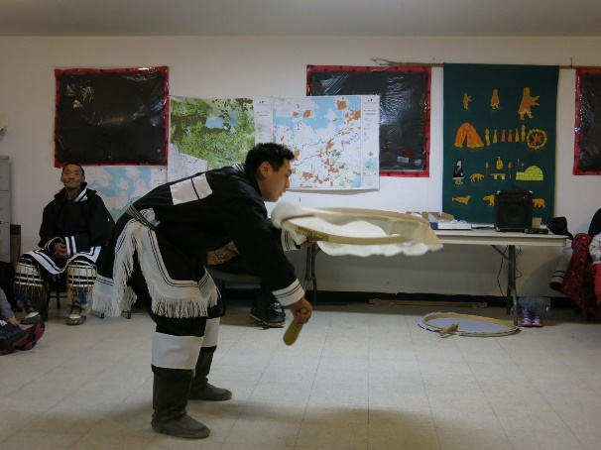
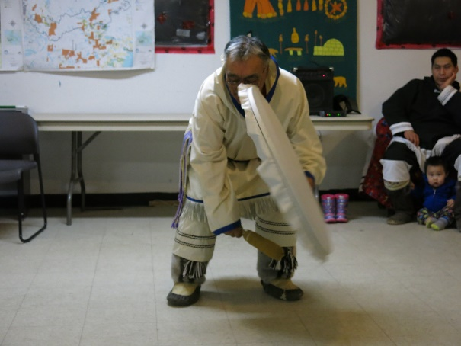
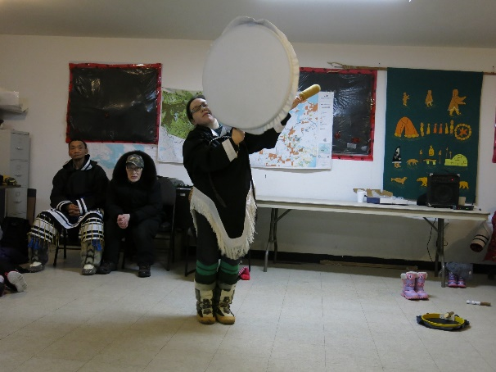
Any Questions or Comments?
Kitutliqak Apiqutit Uqauhitluniit?
THANK YOU!
QUANAQUTIN !

