Slide 1
Environment and Climate Change Canada’s Presentation to the Nunavut Water Board Respecting TMAC Resources Inc. Application for a Type “A” Water Licence and Type “A” Water Licence Amendment
2AM-BOS---- / 2AM-DOH1323
Final Hearing
Cambridge Bay, NU
October 24 and 25, 2018

Slide 2
Overview
Mandate
Relevant Acts and Legislation
Environment and Climate Change Canada’s Recommendations Pertain to:
Aquatic Effects Monitoring Program
Effluent Quality Criteria
Mitigation and Monitoring of In-water Construction Activities

Slide 3
Environment and Climate Change Canada’s Mandate
The preservation and enhancement of the quality of the natural environment, including water, air and soil quality, and the coordination of the relevant policies and programs of the Government of Canada
Renewable resources, including migratory birds and other non-domestic flora and fauna
Meteorology
The enforcement of rules and regulations.
Notes:
Under the Department of the Environment Act, the powers, duties and functions of the Minister of Environment and Climate Change extend to matters such as:

Slide 4

Relevant Acts and Regulations
Department of the Environment Act
Canadian Environmental Protection Act
Fisheries Act – Pollution Prevention Provisions
Migratory Birds Convention Act
Species at Risk Act

Slide 5
ECCC #1 Aquatic Effects Monitoring Program
ECCC noted some details missing in the AEMP such as finalizing details for the study design, data analysis, aquatic response framework and baseline sampling
Recommendation:
ECCC recommended that the AEMP be submitted for Board approval following the issuance of the water licence, prior to construction.
Proponent Response:
TMAC submitted a final draft of the AEMP and requested approval as part of the water licencing process

Slide 6
ECCC #2 Effluent Quality Criteria
TMAC primarily compares predicted effluent quality to the authorized limits for deleterious substances that are regulated under the MDMER; however, it is unclear whether TMAC is proposing any additional effluent quality criteria. The MDMER include national minimum standards for effluent quality monitoring. They would not reflect site specific considerations, such as the sensitive nature of Northern aquatic ecosystems.

Slide 7
ECCC #2 Effluent Quality Criteria
Recommendation:
Given the sensitive nature of the local aquatic ecosystems, ECCC suggested that lower limits than those set by the MDMER be considered. This is consistent with what has been indicated to be achievable by TMAC’s modelling. ECCC also suggested that TMAC consider including additional water quality parameters.
Proponent Response:
TMAC feels that the MDMER limits as proposed are acceptable

Slide 8
ECCC# 3 Mitigation and Monitoring of In-water Construction Activities
Based on discussions at the technical sessions, TMAC has provided a preliminary draft of an Environmental Protection Plan that outlines the components that will be included in this plan. However, specific monitoring/management requirements are not stated.

Slide 9
ECCC# 3 Mitigation and Monitoring of In-water Construction Activities
Recommendation:
ECCC recommended that a design-specific in-water construction plan be submitted to the Nunavut Water Board for approval prior to any in-water construction. The plan should include the components outlined in the TMAC’s commitment to ECCC-WL-4.1.9.
Proponent Response:
TMAC has stated that these details will be finalized in the Environmental Protection Plan submitted to the NIRB

Slide 10
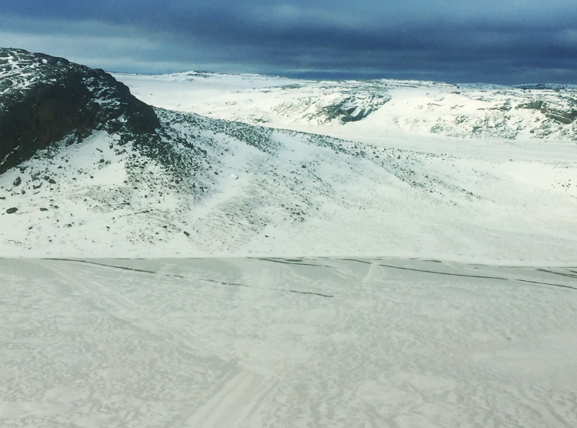
Thank you
Notes:
Add picture

