Slide 1
Kitikmeot Inuit Katojikatigiigit
KIA-kot Ayongnaktotigut Okaotaoyut
Kapihiliktoomi Oyagakhiovik Aippa Havaagoniaktuk
Imaituk A Emaktigut Laisioyuk
Notes:
Hello everyone, I am John Roesch, the Senior Hope Bay Project Officer for the Department of Lands and Environment for the Kitikmeot Inuit Association. I am responsible for project oversite for the KIA and provide input into the regulatory process on the Hope Bay Project to both the NWB and NIRB. In performing this role, I make use of KIA’s consultants who are subject matter experts in the areas of wildlife, fisheries, aquatic environment, and geotechnical engineering.

Slide 2
Onipkaagoyuk
Okaotigiyaat nailihimayuk KIA-kot Ayongnaktotigut Naonaiyaotigiyait TMAC-kot Oyagaghakhioktiinik Kapihiliktoomi Aipaa havaagoyoghap imaktigot Laisiniogomataoyomik.
KIA-kot naonaiyaiyut tamatkiktikhogo takoogiyut ekaloknik ekalokaknikniklo, emangmiotaniklo , immatlo kanoginmagaagita kinggoknakhikmagaagitalooniit. Takoogijotigiyaat.
8 Miitiotigiplogit okaotigiyait.
Notes:
The purpose of this presentation is to provide a brief summary of our technical review of the Hope Bay Phase 2 Type A water license application. Our review covered fish and fish habitat, aquatic environment, and water quality monitoring. KIA conducted the review in a collaborative manner with TMAC Resources out of which we brought forward 8 issues to be resolved either prior or at the Technical Meeting or through further consultation.

Slide 3
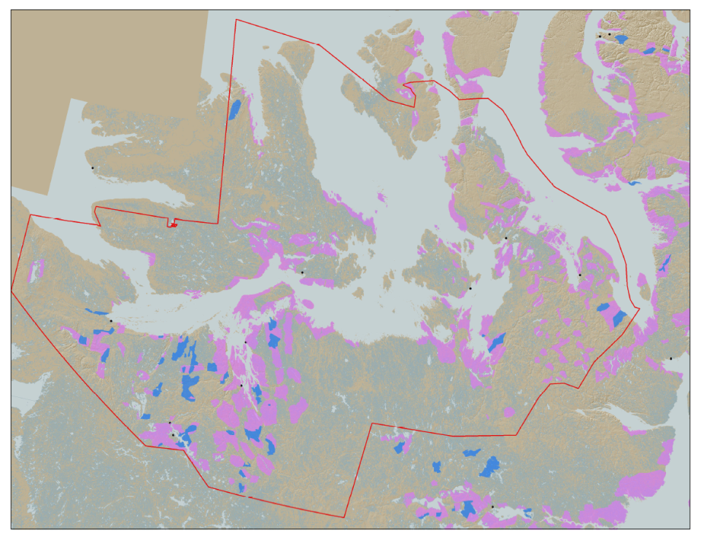

KIA-kot Havaagiyaghait
KIA-kot Havaagiyait kivgaktokhogit ehomagiloakpaktainik Kitikimeoni Inuinnait hapomminahoakhogit hivomokpaliajotigiyaghaitigollo enoohikmikni, pitkohiitigollo, kavamaliginighaitigollo, manikaohighatigollo enoohigitiaknighaitigollo. mighaanot
KIA-kot nanminigiyaat aktilaakakhoni imaa 106,360 km-goyuk² nunap kaangani: Nakoatookhonggoyuk ona monagiyaotiakat.
Hope Bay Project
Notes:
KIA’s mandate is to manage Kitikmeot Inuit lands and resources, and to protect and promote the social, cultural, political, environmental and economic well-being of Kitikmeot Inuit. The Kitikmeot Region is generally within the red boundary. The Pink and Blue lands are lands which KIA owns the surface rights.
Kitikmeot Inuit Association is a democratically elected not-for-profit society that represents the Inuit of the Kitikmeot Region of Nunavut.
As a result of the Nunavut Agreement, Inuit are one of the largest private landowners in the world. Much of this privately owned land is in areas with high potential for mineral development. This land is a significant opportunity for Inuit if it is managed properly. We must optimize opportunities and manage liabilities that are inherent with being a private landowner. If not, we will affect the well-being of our Kitikmeot Inuit membership.
The Hope Bay Project is located on the mainland near the coast and approximately in the middle of the region.

Slide 4
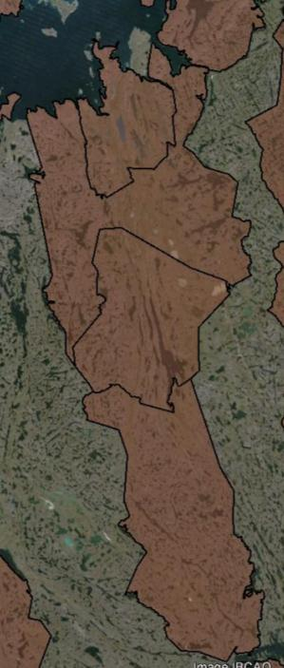
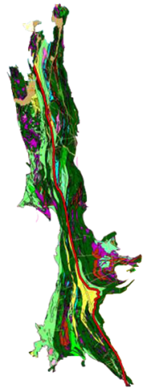

Kapihiliktoomi Oyagakhiokvik
Doris
BB-60
Madrid
Oyagakhiokvik ittuk hitamani nunami Inuinnait Nunaotaini.
Kapihiliktoomi nalvaakviohimaliktuk kiniktaoyonik oyakanik taimangga 1965-gotillogo
Holi anggiyuk tahani nuna nalvaakhiokvioyongnaktok
TMAC-kot pihimaliktaat Oyagakhiokvik okiokmi 2012-gotillogo
BB-58
120 km
BB-57
Boston
BB-56
Notes:
When the Inuit Owned Land was selected for the NLCA, Inuit knew that the Hope Bay Area was highly prospective for mineral development. A 120 Km length of surface lands that include some mineral rights were selected in the area. The brown areas are surface lands owned by KIA. BB-56, 57, 58, and 60 include our agreement with TMAC for the Hope Bay Project.
The Hope Bay greenstone belt has been explored since 1965. Within this greenstone belt, over 850Km of drilling has occurred since 1965. Most of the drilling has been focused around Doris, Madrid and Boston. This project has changed ownership many times. Prior to TMAC, the last company to operate the Hope Bay Project was Newmont, who failed to develop a profitable business case for the development of the project. TMAC took over the project in 2012.
On the Map you can see the location of some of the highest priority development sites in the belt: Doris, Madrid and Boston.

Slide 5
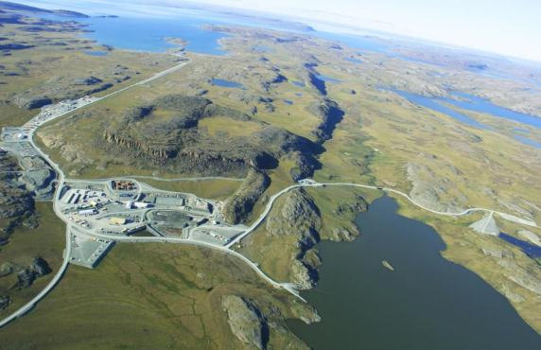
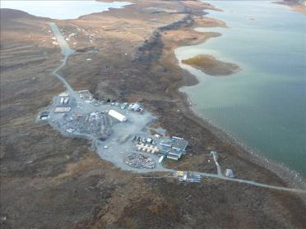
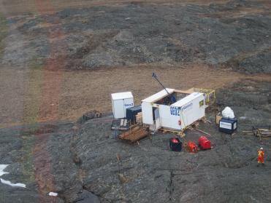
Kapihiliktoomi Oyagaghiokvik
Doris North-mi Oyagakhiokvik
Aimaokataakni eklokpakavik oyagakhiokviop-lonilo
Nalvaakhioktut Ekootakviat
Notes:
So much exploration has occurred since 1965, that people know that there are many development opportunities in the belt. The Hope Bay Greenstone Belt is unique because it demonstrates the capacity to hold several mining operations across the belt in the different stages of development, operated by one company. In another more developed part of the world, it could be that several different companies would have exploration and mining proposals in a Greenstone belt such as this.
This greenstone belt includes a permitted mine at Doris North, several advanced exploration targets such as the Boston Project which has preliminary mine plans developed, and many other identified high quality exploration targets. There is also vast exploration potential. TMAC has rights to all the minerals in this area. Once an operating mine is established, the efficiencies of belt-wide exploration will increase.

Slide 6
Ekaloliginik EmangmiottaliginikolloEhomaalotaoyut
Ekaloliginik pitjotigiplogo.
Emangmiotatigot kanogilijotaoniaktonik Naonaiyaotigiyaghamingnik Hoyagiigotighat (AEMP-gonigaktaoyuk).
Imaiyainighamot kanok Alanggotaoyongnaktut ovaloniit ekalokangginot hoonggiotiniakat naonaiyagialik.
Atoktaghat Tokonakakmata immap kanogijohiagot Arsenic Site-Specific Water Quality piyaghat.
Notes:
As indicated previously, 8 issues were brought to the technical meeting with the NWB pertaining to the Phase 2 Type A water license application. These four issues concern the fish, fish habitat, and the aquatic environment. We raised concerns about the need to calculate potential gains in fisheries for fish offsetting, the monitoring of lake surface levels in the Aquatic Effects Monitoring Plan, the calculations for lost fish habitat due to water with drawl, and the setting of site-specific water quality objectives for total arsenic in all water bodies affected by the project. KIA considers these issues to be of high and medium importance.
TMAC has responded to our recommendations and these issues are resolved.

Slide 7
Emangmiotat Nunagiyait ovalo Immat Kanogilijotiginiaktaitigot Ehomaalotaoyut.
Emakmiotatigot kinggoknakhitiyoghamik Naonaiyaotigiyaghamingnik Hoyagiigotighat (AEMP) naonaiyainikmik takoogokataktothaoyut.
Emakmiotatigot kinggoknakhitiyoghamik Naonaiyaotigiyaghamingnik Hoyagiigotighat Pitjotaoyoghat
Opalonggaiyagiiklotik Havigayakniklo Kipliktoniklo Oyagakhioktonit Makiyokaohiitigot Maligaghaliokhimayot (MDMER-gonigaktaoyut).
Okpiknaiklgo Kanogijohiitigot Kanogilijotigiyaghainot – Immat Kanogijohiit.
Notes:
These four issues concern sampling frequency during freshet, under ice, and open water season for the Aquatic Effects Monitoring Plan (AEMP), the inclusion of dissociable cyanide and total cyanide in AEMP parameters to meet Canadian Council of Ministers of the Environment (CCME) and Metal and Diamond Mine Effluent Regulations (MDMER) guidelines, preparation for use of new MDMER guidelines in monitoring water quality, and confirmation of water quality model predictions. The KIA considers these to be of high and medium importance.
TMAC has taken our recommendations under consideration. Issues 6 and 7 are resolved. Issues 5 and 8 are unresolved but may be resolved through updates to the AEMP.

Slide 8
Eniktigotit
KIA-kot okpigiyaat tamaitagook nalonaktotigot ehomaalootaovaktonik elittogimayaoyut ayoghaotaolimaitut ehoaghiyaolaatut ekayoktigiikhimmaaklotik havaagigomiko okoak KIA-kollo TMAC-kollo miitiotigilatal;ogo.
Koana
Apikotighat?
Notes:
The KIA believes that the technical issues brought forward to the Technical Meeting can be successfully resolved with TMAC through our on-going collaboration.
We thank you for listening and we are open to any questions.

