Slide 1
Environment and Climate Change Canada’s Presentation to the Nunavut Water Board Respecting the Back River Project Type A Water License Amendment Application by Sabina Gold and Silver Corp.
ᐊᕙᑎᓕᕆᓂᕐᒥᑦ ᐊᒻᒪ ᓯᓚᒥᒃ
ᐊᓯᔾᔨᖅᐸᓪᓕᐊᓂᕐᒧᑦ ᑲᓇᑕᒥ
2AM-BRP1831 – Technical Meeting
March 23-24, 2021

Slide 2
Overview
Mandate
Relevant Acts and Regulations
Status of Environment and Climate Change Canada’s Concerns
Technical Comments and Recommendations
Technical Comments on the Hydrodynamic Model
ᐊᕙᑎᓕᕆᓂᕐᒥᑦ ᐊᒻᒪ ᓯᓚᒥᒃ
ᐊᓯᔾᔨᖅᐸᓪᓕᐊᓂᕐᒧᑦ ᑲᓇᑕᒥ

Slide 3
Environment and Climate Change Canada’s Mandate
The preservation and enhancement of the quality of the natural environment, including water, air and soil quality, and the coordination of the relevant policies and programs of the Government of Canada
Renewable resources, including migratory birds and other non-domestic flora and fauna
Meteorology
The enforcement of rules and regulations
ᐊᕙᑎᓕᕆᓂᕐᒥᑦ ᐊᒻᒪ ᓯᓚᒥᒃ
ᐊᓯᔾᔨᖅᐸᓪᓕᐊᓂᕐᒧᑦ ᑲᓇᑕᒥ

Slide 4
Relevant Acts and Regulations
Department of the Environment Act
Canadian Environmental Protection Act
Fisheries Act – Pollution Prevention Provisions
Migratory Birds Convention Act
Species at Risk Act
ᐊᕙᑎᓕᕆᓂᕐᒥᑦ ᐊᒻᒪ ᓯᓚᒥᒃ
ᐊᓯᔾᔨᖅᐸᓪᓕᐊᓂᕐᒧᑦ ᑲᓇᑕᒥ

Slide 5
ECCC-Technical Comment 1
Tailings Production and Storage
Three small streams and four ponds are located within the Tailings Storage Facility footprint.
ECCC requested the Proponent confirm the three streams and four ponds have been assessed for listing in Schedule II of the Metal and Diamond Mining Effluent Regulations (MDMER). This comment was resolved.
ᐊᕙᑎᓕᕆᓂᕐᒥᑦ ᐊᒻᒪ ᓯᓚᒥᒃ
ᐊᓯᔾᔨᖅᐸᓪᓕᐊᓂᕐᒧᑦ ᑲᓇᑕᒥ

Slide 6
ECCC-Technical Comment 2
Tailings Storage Facility
The Proponent indicated that during the 2015 drill program small zones of fractured bedrock (2-3m thick) were found in some of the drill holes, and may provide a pathway for seepage through the foundation of the dam.
The Proponent intends to complete packer testing in select drill-holes to evaluate bedrock hydraulic conductivity.
ECCC requested the Proponent provide clarification as to:
Whether packer testing will provide a determination of hydraulic conductivity of the 2-3m fracture zone.
Additional information on how the bulk fill prevents flow through the 2-3m fracture zone.
ᐊᕙᑎᓕᕆᓂᕐᒥᑦ ᐊᒻᒪ ᓯᓚᒥᒃ
ᐊᓯᔾᔨᖅᐸᓪᓕᐊᓂᕐᒧᑦ ᑲᓇᑕᒥ

Slide 7
ECCC-Technical Comment 3
Waste Rock Storage Area Design
The Proponent indicates that one small stream and two ponds are located within (or immediately upstream of) the Umwelt Waste Rock Storage Area.
Additionally, three small streams and four ponds are located within the footprint of the Tailings Storage Facility Waste Rock Storage Area.
ECCC requested confirmation that the Proponent has assessed the streams and ponds and determined whether or not they are water bodies frequented by fish. This comment was resolved.
ᐊᕙᑎᓕᕆᓂᕐᒥᑦ ᐊᒻᒪ ᓯᓚᒥᒃ
ᐊᓯᔾᔨᖅᐸᓪᓕᐊᓂᕐᒧᑦ ᑲᓇᑕᒥ

Slide 8
ECCC-Technical Comment 4
Changes to Outputs of the Water and Load Balance
The Proponent provided a table outlining changes in model assumptions from the 2015 model to the 2020 Modification Package.
Additional information was requested in order to understand how the changes to the mine plan and corresponding changes to assumptions in the Water and Load Balance have resulted in changes to water quality on site.
ECCC recommended the Proponent provide a comparison of changes in outputs from the water and load balance as a result of the changes to model assumptions.
ᐊᕙᑎᓕᕆᓂᕐᒥᑦ ᐊᒻᒪ ᓯᓚᒥᒃ
ᐊᓯᔾᔨᖅᐸᓪᓕᐊᓂᕐᒧᑦ ᑲᓇᑕᒥ

Slide 9
ECCC-Technical Comment 5
Establishment of Meromixis in Umwelt Reservoir
It is unclear how changes to the Approved Project, including the volume of saline water that would be deposited into the Umwelt Reservoir, will impact the potential to develop meromixis.
It is not discussed whether the thickness of the freshwater cap over the thickness of saline layer assessed for the Llama Pit continues to be applicable to the Umwelt Pit.
ECCC recommended that the Proponent:
Provide a discussion of how the changes to the initial conditions and reduced annual freshwater inputs may impact the development of meromixis in Umwelt pit as compared to Llama pit.
Provide information on the final ratio of freshwater to saline water in Umwelt Pit as compared to Llama Pit.
ᐊᕙᑎᓕᕆᓂᕐᒥᑦ ᐊᒻᒪ ᓯᓚᒥᒃ
ᐊᓯᔾᔨᖅᐸᓪᓕᐊᓂᕐᒧᑦ ᑲᓇᑕᒥ

Slide 10
ECCC-Technical Comment 6
Hydrodynamic Modelling and Water Quality in Goose Lake
The Proponent has identified that the location within Goose Lake where quality will meet water quality guidelines (CCME and site-specific water quality objectives (SSQWO)) has not yet been determined and will be proposed based on results of ongoing hydrodynamic modelling and mixing zone assessment.
The Proponent committed to submitting an updated hydrodynamic model in advance of technical meetings.
ECCC agreed that the updated model would aid in interpretation of modelling results and understanding of the extent of aquatic impacts within the Project Area.
ᐊᕙᑎᓕᕆᓂᕐᒥᑦ ᐊᒻᒪ ᓯᓚᒥᒃ
ᐊᓯᔾᔨᖅᐸᓪᓕᐊᓂᕐᒧᑦ ᑲᓇᑕᒥ

Slide 11
ECCC-Technical Comment 7
Inconsistencies in Water and Load Balance
ECCC identified several inconsistencies in the data presented in Appendix D of the Water and Load Balance Modelling
ECCC recommended that the Proponent review the outputs of the water balance model presented in Attachment IR-C to ensure accuracy.
ᐊᕙᑎᓕᕆᓂᕐᒥᑦ ᐊᒻᒪ ᓯᓚᒥᒃ
ᐊᓯᔾᔨᖅᐸᓪᓕᐊᓂᕐᒧᑦ ᑲᓇᑕᒥ

Slide 12
ECCC-Technical Comment 8
Updated Modelling Predictions and Comparison to Water Quality Guidelines
Modelling predicted that PN03 water quality will exceed several CCME water quality guidelines and is of concern with respect serious effects to aquatic life.
ECCC recommended the Proponent:
Model nodes intended to meet specific criteria (CCME, SSWQO, MDMER, etc.) and provide a comparison of modelled water quality to guidelines and criteria.
Discuss sources of exceedances of CCME Water Quality Guidelines for the Protection of Aquatic life and whether assumptions used in the model have resulted in accurate predictions for water quality
Discuss modelled exceedances of CCME Water Quality Guidelines for the Protection of Aquatic Life at PN03 and other relevant nodes, and potential impacts to aquatic life if these concentrations are realized.
ᐊᕙᑎᓕᕆᓂᕐᒥᑦ ᐊᒻᒪ ᓯᓚᒥᒃ
ᐊᓯᔾᔨᖅᐸᓪᓕᐊᓂᕐᒧᑦ ᑲᓇᑕᒥ

Slide 13
Hydrodynamic Model ECCC-Technical Comment 1
Predictions at the Outlet of Goose Lake
Several of the water quality parameters are predicted to exceed CCME guidelines and/or site specific water quality objectives at the outlet of Goose Lake.
Modelling was not conducted within Goose Lake, in the vicinity of discharges.
ECCC recommended the Proponent:
Provide a rationale for the selection of PN03 to assess potential impacts to water quality in the model.
Provide a discussion of the potential impacts to aquatic life within Goose Lake given the modelling predictions, and predicted exceedances.
Provide a discussion on the extent of the mixing zones from PN04 and PN05 and provide modelled concentrations at the edge of the proposed mixing zones.
ᐊᕙᑎᓕᕆᓂᕐᒥᑦ ᐊᒻᒪ ᓯᓚᒥᒃ
ᐊᓯᔾᔨᖅᐸᓪᓕᐊᓂᕐᒧᑦ ᑲᓇᑕᒥ

Slide 14
Hydrodynamic Model ECCC-Technical Comment 2
Model Calibration
The Proponent calibrated the model using measured temperature and total dissolved solids (TDS) concentrations to match measured and predicted thermal and transport behavior in Goose Lake.
ECCC noted that small sample sizes at the monitoring stations was used to calibrate the model.
ECCC recommended the Proponent provide a discussion of the minimal data used to calibrate the model and how outcomes of the model have been impacted, and may be impacted in future iterations.
ᐊᕙᑎᓕᕆᓂᕐᒥᑦ ᐊᒻᒪ ᓯᓚᒥᒃ
ᐊᓯᔾᔨᖅᐸᓪᓕᐊᓂᕐᒧᑦ ᑲᓇᑕᒥ

Slide 15
Hydrodynamic Model ECCC-Technical Comment 3
Uncertainty and Limitations
The Proponent identifies a number of uncertainties related to the modelling, including the use of average conditions and no climate variations.
ECCC acknowledges this is an early model iteration, but recommends that model updates include additional sensitivity scenarios to reduce model uncertainty.
ᐊᕙᑎᓕᕆᓂᕐᒥᑦ ᐊᒻᒪ ᓯᓚᒥᒃ
ᐊᓯᔾᔨᖅᐸᓪᓕᐊᓂᕐᒧᑦ ᑲᓇᑕᒥ

Slide 16
Hydrodynamic Model ECCC-Technical Comment 4
Comparison of Model Results to Background Concentrations
The Proponent compares modelled concentrations at PN03 to site-specific water quality objectives and CCME guidelines, but not to natural background concentrations of Goose Lake.
ECCC recommends providing a comparison of modelled water quality in Goose Lake to natural background concentrations in order to detect changes to water quality conditions in Goose Lake.
ᐊᕙᑎᓕᕆᓂᕐᒥᑦ ᐊᒻᒪ ᓯᓚᒥᒃ
ᐊᓯᔾᔨᖅᐸᓪᓕᐊᓂᕐᒧᑦ ᑲᓇᑕᒥ

Slide 17
Hydrodynamic Model ECCC-Technical Comment 5
Chromium Water Quality Guideline Exceedances at PN03
The Model Results note that concentrations of several parameters are predicted to exceed chronic water quality benchmarks, including chromium.
ECCC noted that the concentrations of chromium provided in Table 8 did not indicate any exceedances of the guidelines.
ECCC recommends the Proponent provide further clarification on potential chromium exceedances.
ᐊᕙᑎᓕᕆᓂᕐᒥᑦ ᐊᒻᒪ ᓯᓚᒥᒃ
ᐊᓯᔾᔨᖅᐸᓪᓕᐊᓂᕐᒧᑦ ᑲᓇᑕᒥ

Slide 18
Hydrodynamic Model ECCC-Technical Comment 6
Predicted Water Quality at Goose Lake
Hydrodynamic and water quality modelling predicts exceedances of water quality benchmarks (closure and post-closure), and ECCC noted that limited information on potential mitigation measures were provided to reduce effects in Goose Lake.
ECCC recommends the Proponent provide clarification on when water quality at PN03 and within Goose Lake expect to meet guidelines and that modelling may need to be extended further into the post-closure timeframe.
ECCC notes that additional years of post-closure monitoring may be required given predictions of guideline exceedances late into post-closure.
While the Proponent provides several potential approaches to manage concentrations in order to meet guidelines, it is necessary to develop a clear path forward to manage water quality.
ECCC recommends providing feasible options for management of site water quality such that impacts to Goose Lake are minimized.
ECCC recommends providing a timeline of proposed model updates to further refine the model
ᐊᕙᑎᓕᕆᓂᕐᒥᑦ ᐊᒻᒪ ᓯᓚᒥᒃ
ᐊᓯᔾᔨᖅᐸᓪᓕᐊᓂᕐᒧᑦ ᑲᓇᑕᒥ

Slide 19
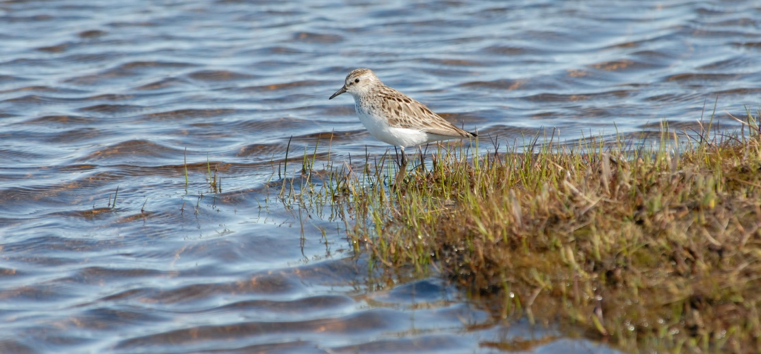
Thank You
ᐊᕙᑎᓕᕆᓂᕐᒥᑦ ᐊᒻᒪ ᓯᓚᒥᒃ
ᐊᓯᔾᔨᖅᐸᓪᓕᐊᓂᕐᒧᑦ ᑲᓇᑕᒥ

