Slide 1
Kitikmeot Inuit Association
KIA Technical Review of Back River Project Modifications
Notes:
Hello everyone, I am John Roesch, the Senior Hope Bay Project Officer for the Department of Lands and Environment for the Kitikmeot Inuit Association. I am responsible for project oversite for the KIA and provide input into the regulatory process on the Back River Project to both the NWB and NIRB. In performing this role, I make use of KIA’s consultants who are subject matter experts in the areas of hydrology, hydrogeology, fisheries, aquatic environment, and geotechnical engineering.

Slide 2
Purpose of Presentation
Present a summary of KIA’s Technical Review of Sabina Gold & Silver Corp’s proposed modifications to Back River Project.
KIA conducted a thorough review in the areas of hydrology, hydrogeology, fisheries, aquatic environments, water quality and monitoring.
2 Issues for Technical Meeting.
Notes:
The purpose of this presentation is to provide a brief summary of our technical review of the Back River Project Type A water license application. Our review covered hydrology, hydrogeology, fisheries, aquatic environments, water quality, and monitoring. KIA conducted the review in a collaborative manner with Sabina Gold & Silver out of which we brought forward 2 issues to be resolved at the Technical Meeting or through further consultation.

Slide 3
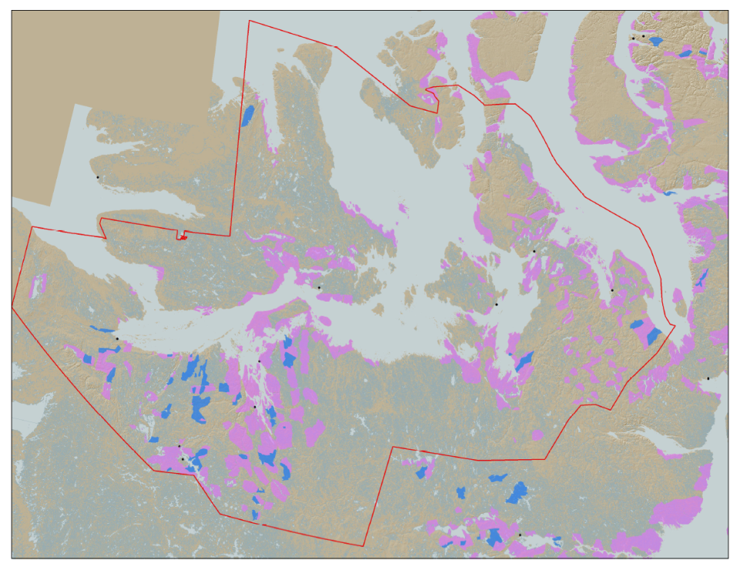

KIA’s Mandate
KIA’s Mandate is to represent the interests of Kitikmeot Inuit by protecting and promoting their social, cultural, political, environmental, and economic well-being.
KIA owns 106,360 km² of surface land: A significant opportunity if managed properly.
Hope Bay Project
Bathurst Inlet
Marine Laydown Area (MLA)
Goose Lake Mine Site
Notes:
KIA’s mandate is to manage Kitikmeot Inuit lands and resources, and to protect and promote the social, cultural, political, environmental and economic well-being of Kitikmeot Inuit. The Kitikmeot Region is generally within the red boundary. The Pink and Blue lands are lands which KIA owns the surface rights.
Kitikmeot Inuit Association is a democratically elected not-for-profit society that represents the Inuit of the Kitikmeot Region of Nunavut.
As a result of the Nunavut Agreement, Inuit are one of the largest private landowners in the world. Much of this privately owned land is in areas with high potential for mineral development. This land is a significant opportunity for Inuit if it is managed properly. We must optimize opportunities and manage liabilities that are inherent with being a private landowner. If not, we will affect the well-being of our Kitikmeot Inuit membership.
The Back River Project, composed of the Marine Laydown Area, winter road, and Goose Lake mine site is located on the mainland south of Bathurst Inlet and in the southern part of the region.

Slide 4
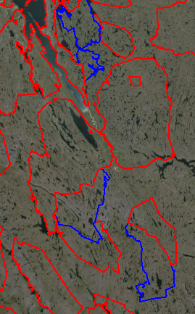
The Back River Project
Located on 5 parcels of Inuit Owned Land.
The Back River Project’s Marine Lay Down Area (MLA), winter road, and Goose Lake are on:
BB-02, BB-13, BB-15, BB-16, and BB-27
Exploration potential at George site on BB-15
Sabina took over development of the project in 2009
MLA
BB-27
120 km
BB-16
BB-15
George Site
BB-02
BB-13
Goose Lake
Notes:
The Back River Project composed of the Marine Laydown Area (MLA), winter ice road, and the Goose Lake mine site reside on five Inuit Owned Land parcels. These being BB-02, BB-13, BB-15, BB-16, and BB-27.
The MLA is located in BB-27 and the Goose Lake mine site is in BB-13. The winter ice road runs from the MLA to Goose Lake through all the parcels.
Exploration camps currently exist at Goose Lake and George sites. The George site is a potential area of future exploration and development. It is currently closed and will not be developed into a mine site in the immediate future.
On the Map you can see the locations of some of the highest priority development sites are the MLA and Goose Lake.

Slide 5
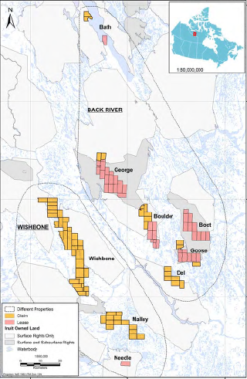
Sabina Mineral Claims in the Kitikmeot Region
Notes:
This map shows the Back River and Wishbone mineral claims held by Sabina with the MLA near the top of the map and Goose Lake in the south-east area of the map. Only the MLA, winter ice road, and Goose Lake are developed at the present time.

Slide 6
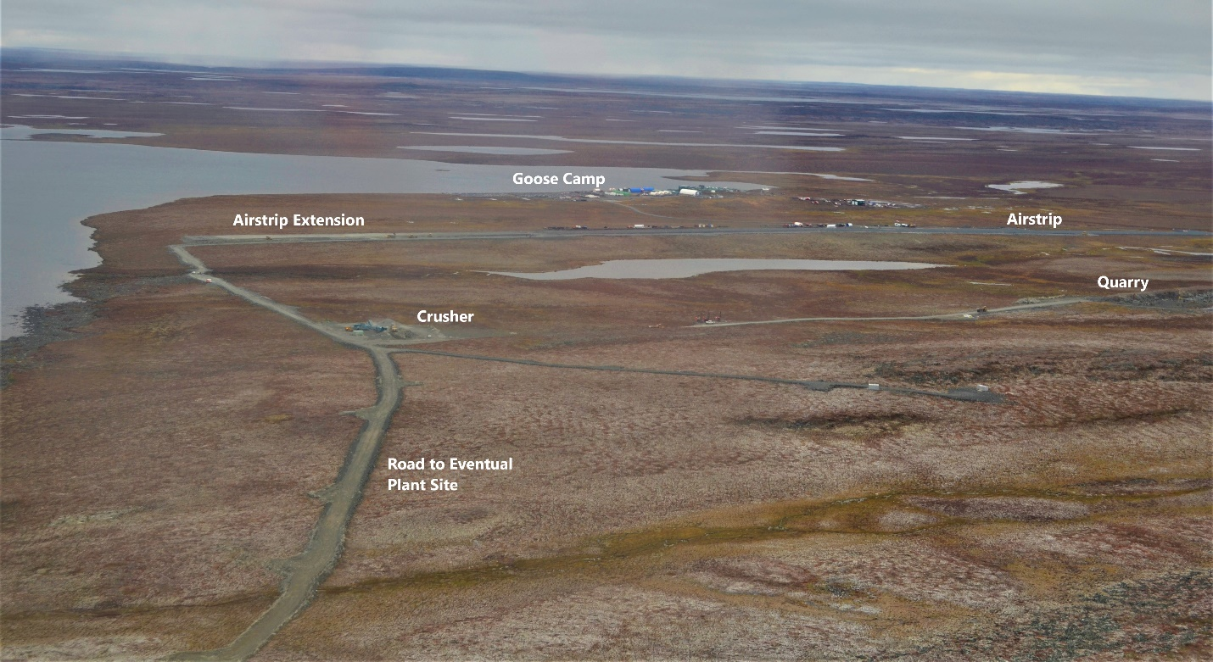
The Back Rover Project
Goose Lake Camp, September 2020
Notes:
This picture is of the existing Goose Lake exploration camp in September 2020. The Goose Lake mine site will be developed at this location and will have four mining areas within it. The mines will be both open pit and underground mines for each of the Goose Lake deposits. These being Umwelt, Llama, Goose Main, and Echo.
The mine will operate for about ten years producing 350,000 ounces of gold. The mill will process about 6,000 tonnes of ore per day and the Tailings Storage Area (TSA) will be located on Crown land. The doré bars produced at site will be flown out on aircraft.

Slide 7
Hydrodynamic Model Technical Issues
The six issues and recommendations from the hydrodynamic model review are:
Divergence from FEIS predicted impacts to Goose Lake.
Change in discharge period to include two years of the operational period.
Water quality predictions and defining the mixing zone.
Clarifying the model warm up period.
Water quality inputs into the hydrodynamic model.
Model calibration
KIA has reviewed Sabina’s response. Four issues are resolved while two issues are unresolved.
Notes:
The KIA’s aquatic and water quality consultant had reviewed the hydrodynamic model for Goose Lake. Six issues were raised with associated recommendations these being: 1. Divergence from FEIS predicted impacts to Goose Lake, 2. Change in discharge period to include two of the operational period, 3. Water quality predictions and defining the mixing zone, 4. Clarifying the model warm up period, 5. Water quality inputs into the hydrodynamic model, and 6. model calibration.
KIA has reviewed Sabina’s response to our six issues and recommendations. Four of the issues are resolved while two are unresolved.
The four resolved issues are 2. the change in discharge period, 4. the model warm up period, 5. the water quality inputs, and 6. model calibration.
The two unresolved issues are 1. Divergence from FEIS predicted impacts to Goose Lake, and 3. Water quality predictions and defining the mixing zone.

Slide 8
Hydrodynamic Model Technical Issues
The two issues and recommendations from the hydrodynamic model review that are unresolved are:
Divergence from FEIS predicted impacts to Goose Lake, and
Water quality predictions and defining the mixing zone.
For these two issues, the preliminary hydrodynamic model predicted impacts are higher than what is in the FEIS.
KIA is concerned about Sabina’s ability to constrain impacts to FEIS levels. The KIA would like updated model predictions prior to issuing of water license.
Sabina has acknowledged that they will update model.
Notes:
The two issues and recommendations that are unresolved are: Divergence from FEIS predicted impacts to Goose Lake, and Water quality predictions and defining the mixing zone.
The KIA is concerned about Sabina’s ability to constrain impacts to FEIS levels. The KIA would like updated model predictions prior to issuing of the water license. The KIA believes it is necessary to see what predicted impacts are to Goose Lake and the extent of the mixing zone due to the proposed mine site modifications. The potential of an expanded mixing zone in Goose Lake may require that Goose Lake be added to Schedule 2 of Metal and Diamond Mining Effluent Regulations (MDMER) listing of water bodies frequented by fish as Tailing Impoundment Areas (TIA). This would also necessitate the negotiation of water compensation for Goose Lake.
Sabina has acknowledged that they will update the model. The KIA wants to discuss and potentially resolve this issue at the Technical Hearing and to be provided with the updated hydrodynamic model prior to the Public Hearing. This may necessitate teleconferences or video conferences with Sabina after the Technical Meeting.
These issues are of high concern to the KIA.

Slide 9
Conclusion
KIA believes that all remaining technical issues identified can be successfully resolved through continued cooperation between KIA and Sabina Gold & Silver Corp. at the Technical Meeting and on an on-going basis.
Thank You
Questions?
Notes:
The KIA believes that the technical issues brought forward to the Technical Meeting can be successfully resolved with Sabina through our on-going collaboration.
We thank you for listening and we are open to any questions.

