Slide 1
Kitikmeot Inuit Katuyikatigit
KIA-kut Avatilikinikut Ihivgiokutaitnik Hanningayokmik havagiyaoyot Alangutaitnik
Notes:
Halokaffi tamaffi, attiga John Roesch, Atanguyaolunga Kapihiliktomi havagiyaoyomi Havakaktunga Havakviatni Nunalikiyiit Avatilikiyiitlo ukkua Kitikmeot Inuit Katuyikatigit. Munagiyatka hapkua havagiyaoyot kivgaktogit KIA-kut okaotjiyiovlunga hapkuninga maligagiyaoyughanik tahapkunani Hanningayokmik havagiyaoyot kiotjutighanik tahapkununga NWB-kunot NIRB-kunotlo. Tahamna havagivlugo, ikkayoktigikataka ukkua KIA-kut ayungitut ikkayoktigiyait hapkua ayungitot hunanik hannatjutighanik make use of KIA’s consultants who are subject matter experts in the areas of hydrology, hydrogeology, fisheries, aquatic environment, and geoAvatilikinikut engineering.

Slide 2
Hunanik Onipkagiakakat
Nainaaklugo onipkagiyagiakaktaat ukkua KIA-kut Avatilikinikut Ihivgiokutaitnik hapkua Sabina Gold & Silver Timingata toghiktotat Alangutighaitnik tatvani Hanningayokmi havagiyaoyonik.
KIA-kut havagihimayaat hiviitoyomik Ihivgiotighogit hapkua havagiyaoyonik immalikinikut, nunnap ikkiangani immakakninganik, ikaluklikinikut, immakmiotalikinikut, immap kanogininganik tatvalo kimiluginnik.
Malgoknik Ihomalotaoyonik Avatilikinikut Katimaniat.
Notes:
The purpose of this presentation is to provide a brief summary of our AvatilikinikutIhivgiokutaitnik of the Hanningayokmik havagiyaoyot Type A water license application. OurIhivgiokutaitnik covered hydrology, hydrogeology, fisheries, aquatic environments, water quality, and monitoring. KIA conducted theIhivgiokutaitnik in a collaborative manner with Sabina Gold & Silver out of which we brought forward 2 issues to be resolved at the Avatilikinikut Meeting or through further consultation.

Slide 3
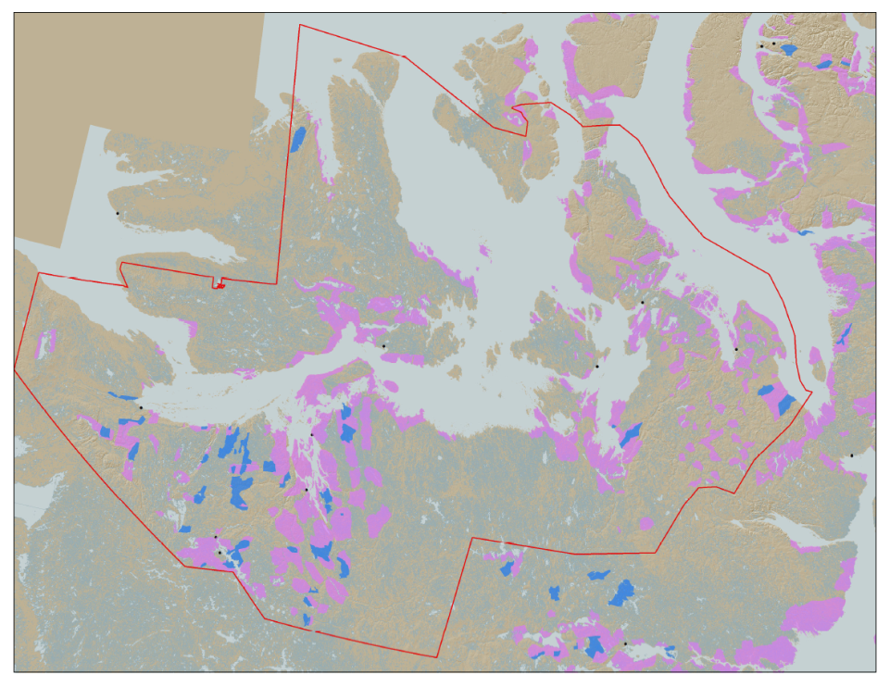

KIA-kut Havagiyait
KIA-kut Havagiyait kivgaktogiakaghuhit hapkua piyomayaitnik Kitikmeoni Inuit munagiyagiakhugit tatvalo ihomagiyaovalikuvlugit hapkua inulikinikut, iliitkohilikinikut, kavamalikinikut, avatilikinikut tatvalo pivalialikinikutlo.
KIA-kut nanminikaktot imaatot 106,360 km² kanganitonik nunanik: Angiyok oktotighak oktotighatiavaknik munagiyaotiagomi.
Kapihiliktomi havagiyaoyot
Kingaok
Tagiokmi Tulaktakvighat Ummiat (MLA)
Goose Lake-mi Uyagaghiokvikhak
Notes:
KIA’s mandate is to manage Kitikmeot Inuit lands and resources, and to protect and promote the social, cultural, political, environmental and economic well-being of Kitikmeot Inuit. The Kitikmeot Region is generally within the red boundary. The Pink and Blue lands are lands which KIA owns the surface rights.
Kitikmeot Inuit Katuyikatigit is a democratically elected not-for-profit society that represents the Inuit of the Kitikmeot Region of Nunavut.
As a result of the Nunavut Agreement, Inuit are one of the largest private landowners in the world. Much of this privately owned land is in areas with high potential for mineral development. This land is a significant opportunity for Inuit if it is managed properly. We must optimize opportunities and manage liabilities that are inherent with being a private landowner. If not, we will affect the well-being of our Kitikmeot Inuit membership.
The Hanningayokmik havagiyaoyot, composed of the Marine Laydown Area, winter road, and Goose Lake mine site is located on the mainland south of Bathurst Inlet and in the southern part of the region.

Slide 4
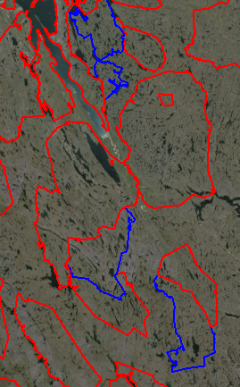
Hapkua Hanningayokmi havagiyaoyot
Kanganiitok tahaffuma talimat tittikniliokhimayaitnik Inuit Nanminigiyaita Nunaotaitni.
Una Hanningayomi havagiyaoyot Tagiomi Tullaktakvighat Umiitjat, (MLA), ukkiukmi apkuhioktaokataktot, tatvalo Goose Lake-mi nunaoyami tittighimayot hapkua:
BB-02, BB-13, BB-15, BB-16, tatvalo BB-27
Nalvaghiokvighaotiaktok tatvani George-mi tittikniatni BB-15
Sabina-kut havagiloagiliktaat hamna havagiyaoyot tatvani 2009-mi
MLA
BB-27
120 km
BB-16
BB-15
George Site
BB-02
BB-13
Goose Lake
Notes:
The Hanningayokmik havagiyaoyot composed of the Marine Laydown Area (MLA), winter ice road, and the Goose Lake mine site reside on five Inuit Owned Land parcels. These being BB-02, BB-13, BB-15, BB-16, and BB-27.
The MLA is located in BB-27 and the Goose Lake mine site is in BB-13. The winter ice road runs from the MLA to Goose Lake through all the parcels.
Exploration camps currently exist at Goose Lake and George sites. The George site is a potential area of future exploration and development. It is currently closed and will not be developed into a mine site in the immediate future.
On the Map you can see the locations of some of the highest priority development sites are the MLA and Goose Lake.

Slide 5
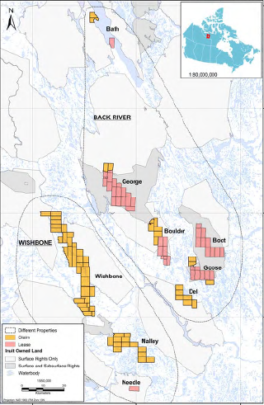
Sabina-kut Haviktaliit Nalvakvigihimayait iloani Kitikmeoni Aviktokhimayoni
Notes:
This map shows the Hanningayokmik and Wishbone mineral claims held by Sabina with the MLA near the top of the map and Goose Lake in the south-east area of the map. Only the MLA, winter ice road, and Goose Lake are developed at the present time.

Slide 6
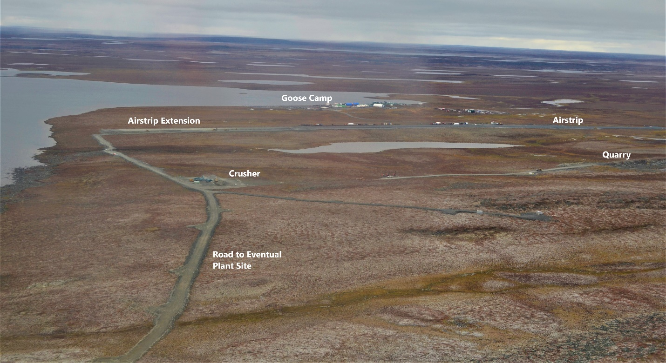
Una Hanningayomi havagiyaoyok
Goose Lake Camp, September 2020
Notes:
This picture is of the existing Goose Lake exploration camp in September 2020. The Goose Lake mine site will be developed at this location and will have four mining areas within it. The mines will be both open pit and underground mines for each of the Goose Lake deposits. These being Umwelt, Llama, Goose Main, and Echo.
The mine will operate for about ten years producing 350,000 ounces of gold. The mill will process about 6,000 tonnes of ore per day and the Tailings Storage Area (TSA) will be located on Crown land. The doré bars produced at site will be flown out on aircraft.

Slide 7
Immalikinikut Noanaipkutaitnik Avatilikinikut Ihomalotait
Hapkua 6-sioyot ihomalotaoyot tatvalo ihoaghaotigitkuyait immalikinikut naonaiyaotaitnik Ihivgiokutaitnik hapkuanguvut:
Ilikuakutait alanganinganik tatvanga FEIS-gitnik itkuniakutaitik kanogininganik ikpigiyakaknaikninnganik Goose Lake-mi.
Aangotaitnik koviogakninani ilaliotilogik malgoknik okionik tahamna havagiyaovalialikat aolaninganik.
Immagingninganik itkukiagotaitnik tatvalo naonaiyaklogit avugikninganik immaotaita kukloakninanik.
Naonaiyakpaliklugit hapkua naonnaipkutait hila hunnaghivaliatitlugo.
Immagingninganik kukluakviokataktonik tavunga immalikinikut naonaipkutaitnun.
Kanogitonik naonaiyaotaita haakugingninganik
KIA-kut Ihivgioghimaliktaat Sabina-kut kiotjutait. Hitamat hapkua ihomalotaohimayot ihoaghiyaoyot malgok ukkua ihomalotaoyok huli ihoaghiyaohimangitok.
Notes:
The KIA’s aquatic and water quality consultant hadIhivgiokutaitniked the hydrodynamic model for Goose Lake. Six issues were raised with associated recommendations these being: 1. Divergence from FEIS predicted impacts to Goose Lake, 2. Change in discharge period to include two of the operational period, 3. Water quality predictions and defining the mixing zone, 4. Clarifying the model warm up period, 5. Water quality inputs into the hydrodynamic model, and 6. model calibration.
KIA hasIhivgiokutaitniked Sabina’s response to our six issues and recommendations. Four of the issues are resolved while two are unresolved.
The four resolved issues are 2. the change in discharge period, 4. the model warm up period, 5. the water quality inputs, and 6. model calibration.
The two unresolved issues are 1. Divergence from FEIS predicted impacts to Goose Lake, and 3. Water quality predictions and defining the mixing zone.

Slide 8
Immalikinikut kinipaninganik Naonaipkutat Avatilikinikut Ihomalotaoyot
Ukkua malgok ihomalotaoyok tatvalo oktotaotkoyaoyot tatvanga Immalikinikut Kinipaninganik naonaipkutatnik Ihivgiokutaitnik hapkua ihogiyaohimangitot huli tatvaovut:
Aivatjutaoyot hapkua FEIS-nik itkoktaohimayot ikpigiyaohimayot tatvani Goose Lake-mi, tatvalo
Immagiikninganik itkuniakutait tatvalo naonaiyakpalianinganik avvugigiikatakninganik hapkua avatigiyaitnik.
Ukkua malgok ihomalotaoyok, ukkua hivollioyok immalikinkut kinipaninganik naonaipkutaitnik itkuniakutaita ikpigiyaoyot kulvahikpalaktot taffumaninganik FEIS.
KIA-kut ihomalotigiyaat ukkua Sabina-kut piyunagiaghaita ukkua kanogiliyokakninata ikpigiyaoninganik hapkua FEIS-nik immaokaninganik. ukkua KIA-kut tohaktitaokatagomayot hapkuninga naonaipkutaita itkungniakutaitnik tonihiitinatik ukkua immap laisighaktakutaitnik.
Sabina-kut okkagighimaliktot notanik tohaktitikataklotik naonaipkutaitnik.
Notes:
The two issues and recommendations that are unresolved are: Divergence from FEIS predicted impacts to Goose Lake, and Water quality predictions and defining the mixing zone.
The KIA is concerned about Sabina’s ability to constrain impacts to FEIS levels. The KIA would like updated model predictions prior to issuing of the water license. The KIA believes it is necessary to see what predicted impacts are to Goose Lake and the extent of the mixing zone due to the proposed mine site Alangutaitniks. The potential of an expanded mixing zone in Goose Lake may require that Goose Lake be added to Schedule 2 of Metal and Diamond Mining Effluent Regulations (MDMER) listing of water bodies frequented by fish as Tailing Impoundment Areas (TIA). This would also necessitate the negotiation of water compensation for Goose Lake.
Sabina has acknowledged that they will update the model. The KIA wants to discuss and potentially resolve this issue at the Avatilikinikut Hearing and to be provided with the updated hydrodynamic model prior to the Public Hearing. This may necessitate teleconferences or video conferences with Sabina after the Avatilikinikut Meeting.
These issues are of high concern to the KIA.

Slide 9
Inniktikutait
KIA-kut okpigiyaat tatva tamaita aolangitot Avatilikinikut ihomalotaoyot naonaiyaktaohimayot ihoaghaktaoyungnaktot huli ikkayokatigighimaagomik ukkua KIA-kut tatvalo and Sabina Gold & Silver Timingat tatvani Avatilikinikut Katimaniaktitlogit tatvalo huli katimakatigihimaaklotik hivunighami.
Koanakuhi
Appikutighakakihi?
Notes:
The KIA believes that the Avatilikinikut issues brought forward to the Avatilikinikut Meeting can be successfully resolved with Sabina through our on-going collaboration.
We thank you for listening and we are open to any questions.

