Slide 1
Sabina’s Type A Water Licence Application 2AM-BRP – Back River Project
Nunavut Water Board Public Hearing for Water Licence 2AM-BRP – Back River Project, Cambridge Bay, Nunavut August 8-9, 2018

Slide 2
Outline
Roles and responsibilities
Contributions to the application review
Issues Resolved
Issues Remaining:
Tailing Storage Facility
Saline Water Management
Closure Cost Estimate
Closing

Slide 3
Roles and responsibilities
Crown-Indigenous Relations and Northern Affairs Canada’s (CIRNAC) responsibilities, mandate and obligations stem from the following:
Department of Indian Affairs and Northern Development Act
Nunavut Agreement
Nunavut Waters and Nunavut Surface Rights Tribunal Act and the associated regulations
Nunavut Planning and Project Assessment Act
Territorial Lands Act and the associated regulations
Arctic Waters Pollution Prevention Act

Slide 4
Contributions to the application review
CIRNAC made the following submissions to the Nunavut Water Board:
January 22, 2018 – Completeness Assessment with information requests and recommendations
April 4, 2018 – Technical Review comments with recommendations
July 9, 2018 – Final written submission

Slide 5
Issues Resolved to Date
CIRNAC originally had 27 concerns, 19 had previously been resolved through the Nunavut Water Board technical review process. These primarily included:
Site Water Management
Mine Waste Management
An additional 6 concerns have been resolved since the technical meeting. This include:
Site Water Management
Mine Waste Management
Closure Plan

Slide 6
Unresolved Issue #1
Drainage of the Tailings Storage Facility
Initially
Operation
Post-Closure

Slide 7
Unresolved Issue #2
Sizing of Saline Water Management Ponds
One-day Storm event
Embankments

Slide 8
Closure Cost Estimate (Financial Security)
CIRNAC initially estimated the global reclamation costs for the site to be $53,118,087
However, based on progressive reclamation and discussions with both Sabina and the KitIA, CIRNAC agrees that security to be held for the Project should be set at $43,189,351. This security will be furnished at different stages throughout the life of mine.
The Water Licence should allow for the security to be held by the following parties:
Kitikmeot Inuit Association – $13,820,593
CIRNAC Lands – $11,244,782
CIRNAC through Water License - $18,296,266
This approach has been agreed to by CIRNAC, KitIA and Sabina.

Slide 9
Closing
The department is confident that the issues/concerns brought forward today can and will be addressed by Sabina to the satisfaction of CIRNAC.
CIRNAC is confident that the closure cost estimate and the subsequent phasing of security for the project ensures that the project will not, at any time, be under secured or become a liability to the crown.

Slide 10
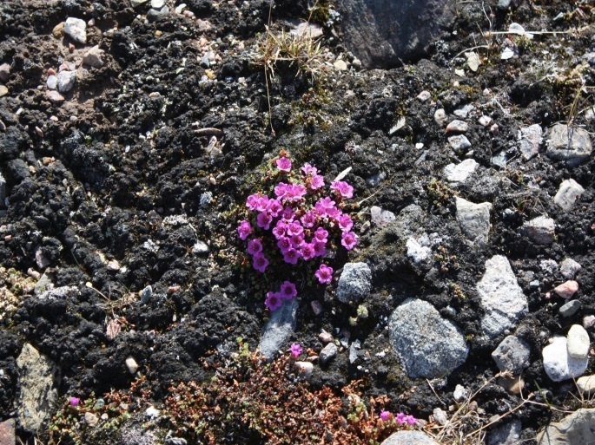
Thank you
Koana
Qujannamiik
Merci
ᖁᔭᓐᓇᒦᒃ

