Slide 1
Environment and Climate Change Canada’s Presentation to the Nunavut Water Board Concerning the Sabina Gold & Silver Corp. Back River Gold Mine Project Type A Water Licence Final Hearing Avatiliqinirnut Hilaup Uunnakpallianingit Kanata’p Takugakhainit uvunga Nunavut Imaliriyit Katimayit Ihumaaluutigiyangit uvunga Sabina Kulu unalu Havigalik Kuapuriisan Hanningayuk Kuugaa Kuulu Uyaraqtarvik Havaaq Tukinga A Imaq Laisikhaat Iniqpiaqhimayumi Naalagvikhangit
2AM-BRP----
Nunavut Water Board Final Hearing
Nunavut Imaliriyit Katimayit Iniqpiaqhimayumik Naalagvikhangit
Cambridge Bay, NU
Iqaluktuutiaq, NU
August 8-9, 2018
Niqiliqivik 8-9, 2018
Anne Wilson Hivulliqtiuyuq Imaliriyit Nakuudjuhia Gabriel Bernard-Lacaille
Himmauhiriyangit Angayuqqaanguyuq Avatiliqinirnut Ihivriurnikhainnut Aulapkaiyi

Slide 2
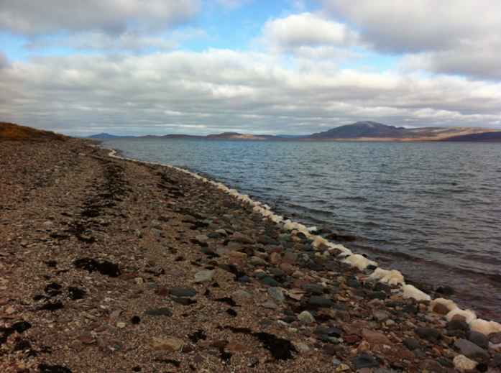
Overview Nainaarutaat
ECCC Mandate
Relevant Acts and Legislation
ECCC Recommendations
ECCC Maliktakhangani
Nalaumayangit Maligait Maligautingillu
ECCC Pitquyangit

Slide 3
ECCC Mandate ECCC Maliktakhangani
Preserve and enhance the quality of the natural environment
Conserve Canada’s renewable resources
Conserve and protect Canada’s water resources
Forecast daily weather conditions and warnings
Enforce rules relating to boundary waters
Coordinate environmental policies and programs for the federal government
Nunguttailinahuaqtut pidjarikhinahuarlugulu nakuudjuhinga ilitquhiita avatingit
Hapummilugit Kanatam nunguyuittut avatimiuttat
Hapummilugit huruqhiqtaililugillu Kanatam imaup avatimiuttat
Kangiqhinahuarlugit ubluq tamaat anuringa qanurilinganingit naunaiqtaaqhimalugit
Pilimmakharlugit maliktakhait ilagiyangit kigliliuqtauhimayut imat
Aulapkailugit avatimiuttat atuagait piliriakhait haffumani kavamatuqangit kavamaita

Slide 4
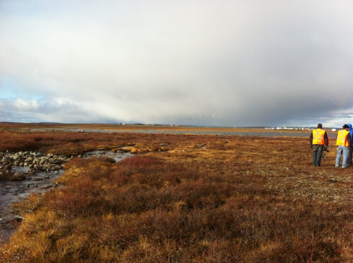
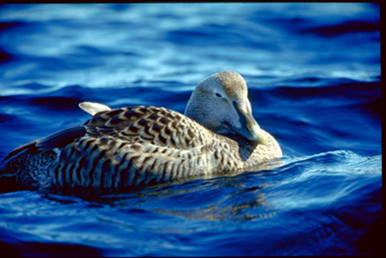
Relevant Acts and Regulations Nalaumattiaqtut Maligait Maliguarutingillu
Department of the Environment Act
Canadian Environmental Protection Act
Fisheries Act – Pollution Prevention Provisions & Metal and Diamond Mining Effluent Regulations
Avatiliriyiitkunnit Maliganga
Kaanatami Avatiliriniqmut Hukhaungiqtailiniq Maligaq
Iqalungnut Maligaq – Huruqtailinahuaqtut Pittailinahuarningit Ilaliutingit unalu Havigalik Qiplariktuq Uyaraqtarviuyut Halumaittut Maliguarutingit

Slide 5
Environment and Climate Change Canada’s Participation Avatiliqiniq Hilaup Uunnakpallianingit Kanata’p Ilauqtauhimayut
Environment and Climate Change Canada provides scientific expertise within our mandate to the Nunavut Water Board
Freshwater Environment
Monitoring, Mitigation and Management Plans
Avatiliqiniq Hilaup Uunnakpallianingit Kanata ilaliutivagaat qauyiharnikhainut ayuinningit iluani maligautivut uvunga Nunavut Imaliriyit Katimayit
Halumayumik imaq Avatingit
Muaqhiiyangit, Ingattaqhittailinahuarnikkut Munaqhiiyangillu Upalungaiyautit

Slide 6
Environment and Climate Change Canada’s Participation continued Avatiliqiniq Hilaup Uunnakpallianingit Kanata’p Ilauqtauhimayut aulanngittut
Environment and Climate Change Canada has participated in all phases of this review process thus far.
This presentation summarizes Environment and Climate Change Canada’s recommendations.
Environment and Climate Change Canada has reviewed the Proponent’s responses.
Avatiliqiniq Hilaup Uunnakpallianingit Kanata ilauqatauhimagaluaqtut iluani tamainnit ilanganit haffumani qimilrurningit piliriakhat taimaa.
Una takugakhangit nainaaqhimayauyut Avatiliqiniq Hilaup Uunnakpallianingit Kanata’p kiutquiyangit
Avatiliqiniq Hilaup Uunnakpallianingit Kanata qimilruqhimayaraluangit Havaakhaliuqtunut kiuvingit.

Slide 7
Environment and Climate Change Canada’s Resolved Issues Avatiliqiniq Hilaup Uunnakpallianingit Kanata’p Ihuaqhihimayangit Akihautaa
During the Technical Review, the Department provided comments on
Mitigation for in-water works
Ore stockpile Metal Leaching and Acid Rock Drainage
Waste Rock Storage Freeze Back
Dissolved versus total fractions of metals
Seep Surveys
Post-Closure monitoring
Arsenic Site Specific Water Quality Objective
These issues were resolved prior to and during the Technical Meeting held in Cambridge Bay on May 1-2, 2018.
Qauyiharnikkut Qimilruqhutik, Havagviata ilaliutihimayangit kiuviniit ukunanngat
Ingattaqhittailinikkut haffumani iluani-imaq havaangit
Uyaraq illirihimayangit Havigalik Maqihimayut unalu Hivuuranaqtumik Uyaqqat Imaiyaqhimayut
Aturuiqhimayut Uyaraq Tutquumayangit Qiqiffaarmiyukhaq
Nunguttallianingit ukunanngat atauttimut ilainnaatigut havigalingnit
Maqihimayut Nalunaiyaiyut
Iniqpiaqhimayuq-Umigutaat munaqhiiyangit
Hivuuranaqtut Havagviat Ihumagivluniuk Imaq Nakuudjuhia Ilittupkainiq
Tahapkuat akihautaat ihuaqhiffaaqhimayauyut pinahuaqtinnagu uvunga pivlutiktauq Qauyiharnikkut Katimavlutik Iqaluktuuttiaq uvani Qiqaiyaluarvia 1 mit 2 mut, 2018 mi

Slide 8
ECCC#1 – Closure Objectives and Criteria : Receiving Water Quality ECCC#1 – Umigutaanit Ilitturnikhainut Qanurilinganingit: Tuniyauhimayut Imaq Nakuudjuhingit
The Proponent proposes to meet Site Specific Water Quality Objectives or the Metal and Diamond Mining Effluent Regulations criteria at final discharge points during closure and proposes to defer discussions until a better understanding of water quality at the site is obtained.
ECCC#1 Recommendation
ECCC recommends that the Proponent, in future iterations of the Interim Closure and Reclamation Plan, include explicit statements on receiving water quality objectives, as well as clarify discharge points and where objectives are to be met.
Una Havaakhaliuqtunut tukhiutigiyangit tikinnahuaqhugu Havagviat Ihumagiyauyut Imaq Nakuudjuhingit Ilitturnikhainut uuminngaluuniit Havigalik unalu Qiplariktumik Uyaraqtarviuyut Halumaitigut Maliguarutingit qanurilinganingit uvani iniqpiaqhimayumik unguvaqhimayangit tiliugait uvani umigutaanit tukhiutigiyangillu nuuttukhauyut niplautigiyangit kangiqhittiaryuummiriangani haffumani imaq nakuudjuhingit havagvianut pigiaqaqhutik.
ECCC#1 Pitquyangit
ECCC kiutquiyangit taamna Havaakhaliuqtunut, hivunngani kiuffaarmigiaqaqtangit haffumani Atullakhimayangit Umigutaanit Ihuaqhaffaarmiyakhangillu Upalungaiyautingit, ilaliutihimayangit tutqittiarnaqtumik kiuviniit tuniyauhimayangit imaq nakuudjuhingit ilitturnikhainut, uuminngalu tutqittiarnaqtumik ahivaiyaqhimayangit tiliugait humiliqaak ilitturnikhainut katilviuhimayauyut.

Slide 9
ECCC#2 – Saline Water Pond Closure Site Specific Water Quality Objective ECCC#2 – Taryulik Imaq Tahiraq Umigutaanit Havagviat Ihumagiyauyut Imaq Nakuudjuhingit Ilitturnikhainut
Due to chloride in sediment pore water at the bottom of the Saline Water Pond, chloride may be of concern when reconnecting Umwelt Lake to surface waters. The target chloride concentration proposed by the Proponent is 120 mg/L.
ECCC#2 Recommendation
ECCC recommends that the Proponent include in their Saline Water Management Plan provisions for tracking sediment pore water chloride concentrations for the Saline Water Pond in order to ensure appropriate water quality for the reconnection of Umwelt Lake to surface waters.
Ilaurutiqaramik hiuralingnit imarmi ataaniittut haffumani Taryulik Imaq Tahiraq, ilaurutilik ihumaaluutauhimayuq katilviuffaarumik uvani Umwelt Tahiq qulaaniittut imat. Hivumuuqhimayangit ilaurutik hakugingnia tukhiutigiyangit ukunanngat Havaakhaliuqtunut hamnauyuq 120 mg/L.
ECCC#2 Pitquyangit
ECCC kiutquiyangit taamna Havaakhaliuqtuq ilaliutigiyakhaat iluaniittumi Taryulik Imaq Munaqhiiyakhat Upalungaiyautingit ilaliutiniit naunaiqhimagiangani hiuralingnit imaq ilaurutilik hakugingningit haffumani Taryulik Imaq Tahiraq pidjarikhigiami nalaumayumik imaq nakuudjuhingit katilviuffaariangani haffumani Umwelt Tahiq qulaaniittut imat..

Slide 10
ECCC#3 – Nitrite ECCC#3 – Naitrait
The Department had concerns with the predicted levels of nitrite in surface waters and seeks clarification on nitrite inputs to the water and load balance model.
ECCC#3 Recommendation
ECCC recommends that the Proponent clarify nitrite inputs for rock sources and identify the reasons for reductions in predicted nitrite concentrations.
Una Havagviat ihumaaluutiqaqhutik kangiqhihimayauyut qaffiuningit naitraitmik qulaaniittut imat tutqiqhimayumik qiniqhiavluik naitrait iluaniittut imarnut illiriyauyut uuktuutigiyangit maliktangit.
ECCC#3 Pitquyangit
ECCC kiutquiyangit taamna Havaakhaliuqtuq tutqiqhigiaqaqtut naitrait ilaliutauhimayut uyararnit aallatqiit nalunaiqhiiyangillu hungmangaat nailiyauhimayut kangiqhuutigiyangit naitrait atuqhimayangit

Slide 11
ECCC#4 – Aquatic Effects Management Plan ECCC#4 – Imarmiuttat Atuliqtauningit Munaqhiiyangit Upalungaiyautit
The Proponent has made progress on the design of the Aquatics Effects Management Plan, in consultation with ECCC. ECCC notes that there is further work to be done with respect to the study design and characterization of natural variability, and acknowledges the Proponent’s ongoing work in this regard with further monitoring in 2018.
ECCC#4 Recommendation
ECCC recommends that an updated version of the Aquatics Effects Management Plan be submitted for approval following the issuance of a water licence and looks forward to ongoing work the Aquatics Effects Management Plan.
Una Havaakhaliuqtuq nakuuyumik pivalliayukhat tiliyauhimayunit haffumani Imarmiuttat Atuliqtauningit Munaqhiiyangit Upalungaiyautit, katimadjutigivlugit ukunani ECCC nit. ECCC nalunaiqhiiyangit hivuani havaakhaqaqhutik ihumagivluniuk ilittuqhiiyangit tiliugait unalu ilitquhiita nanminiriyangit aallatqiinguyut, ilitarivlugulu hamna Havaakhaliuqtu’p havaraaqhimaningit uvanngat amiqhiraariaqaqtangit uvani 2018 mi.
ECCC#4 Pitquyangit
ECCC kiutquiyangit nutaannguqtiqhimalugit numikhimayunit haffumani Imarmiuttat Atuliqtauningit Munaqhiiyangit Upalungaiyautit tuniyaugiaqaqtuq angiqtaugiaqaqhuni malikhugillu haffumani titirariiqhimayumik imaq laisikhaat hivumuurilugulu aturaaqtakhainit havaangit haffumani Imarmiuttat Atuliqtauningit Munaqhiiyangit Upalungaiyautit.

Slide 12
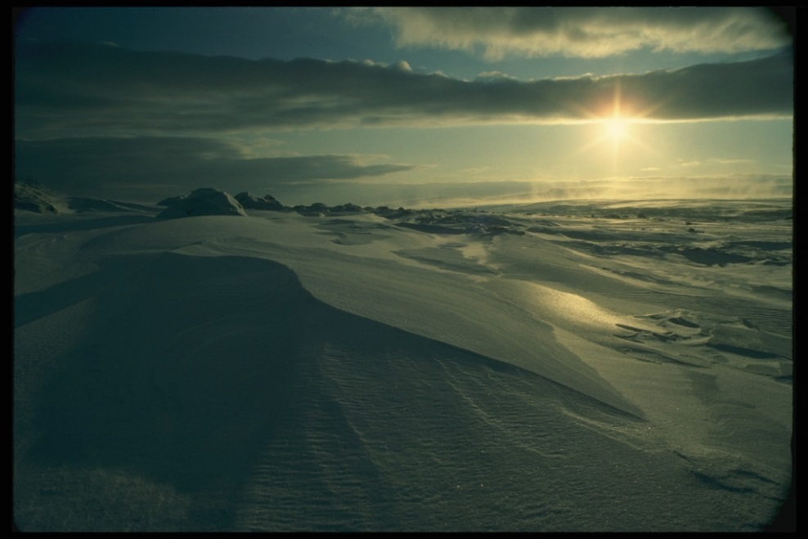
Thank you! Quanaqutin !
ECCC would like to say thank you for the opportunity to participate in this water licencing process
ECCC quyagiyumayangit ilingnut angmaumayumik ilauqataugavit uvani imaq laisikhaanut piliriakhaq.

