Slide 1
Environment and Climate Change Canada’s Presentation to the Nunavut Water Board Concerning the Sabina Gold & Silver Corp. Back River Gold Mine Project Type A Water Licence Final Hearing ᐊᕙᑎᓕᕆᔨᒃᑯᑦ ᐊᒻᒪᓗ ᓯᓚᐅᑉ ᐊᓯᔾᔨᖅᐸᓪᓕᐊᓂᖓ ᑲᓇᑕᒥ ᓴᖅᑭᑕᖏᑦ ᓄᓇᕗᑦ ᐃᒪᓕᕆᔨᑦ ᑲᑎᒪᔨᖏᓐᓄᑦ ᐱᔾᔪᑎᒋᓪᓗᒍ ᓴᐱᓇᐅᑉ ᒎᓗᒧᑦ ᐊᒻᒪᓗ ᓴᕕᒐᔭᑦᑎᐊᕙᖕᒧᑦ ᑯᐊᐸᕇᓴᖓᑕ ᓴᓐᓂᖓᔪᖅ ᑰᒐᕐᒥ ᒎᓗᒥᒃ ᐅᔭᕋᖕᓂᐊᕐᓂᕐᒧᑦ ᐱᓕᕆᐊᒃᓴᖅ ᖃᓄᐃᑦᑑᓂᖓ A ᐃᒪᕐᒧᑦ ᐱᔪᓐᓇᐅᑎᒧᑦ ᑭᖑᓪᓕᕐᒥ ᓈᓚᒋᐊᖅᑐᕐᓂᖅ
2AM-BRP----
Nunavut Water Board Final Hearing
ᓄᓇᕗᑦ ᐃᒪᓕᕆᔨᑦ ᑲᑎᒪᔨᑦ ᑭᖑᓪᓕᕐᒥ ᓈᓚᒋᐊᖅᑐᕐᓂᖏᑦ
Cambridge Bay, NU
ᐃᖃᓗᒃᑑᑦᑎᐊᖅ, ᓄᓇᕗᑦ
August 8-9, 2018
ᐋᒐᓯ 8-9, 2018
Anne Wilson ᐋᓐ ᐅᐃᓪᓴᓐ, ᑲᑎᙵᐅᖅᑐᓄᑦ ᓯᕗᓕᖅᑎ ᐃᒪᐅᑉ ᐱᐅᑎᒋᓂᖓᓄᑦ Gabriel Bernard-Lacaille
ᒑᐳᐃᐊᓪ ᐱᕐᓈ-ᓚᑲᐃ, ᐊᖓᔪᖅᑲᐅᑕᐅᓚᐅᑲᒃᑐᖅ ᐊᕙᑎᒥᒃ ᖃᐅᔨᓴᕐᓂᕐᒧᑦ ᑲᒪᔨ

Slide 2
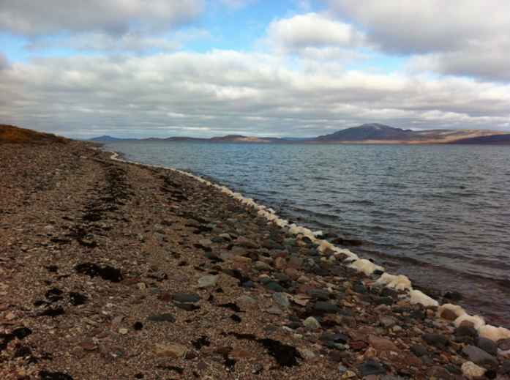
Overview ᐅᖃᐅᓯᕆᔭᐅᔪᒃᓴᑦ
ECCC Mandate
Relevant Acts and Legislation
ECCC Recommendations
ᐊᕙᑎᓕᕆᔨᒃᑯᑦ ᐊᒻᒪᓗ ᓯᓚᐅᑉ ᐊᓯᔾᔨᖅᐸᓪᓕᐊᓂᖓ ᑲᓇᑕᒥ ᐱᔭᕆᐊᖃᖅᑕᖏᑦ
ᐊᒃᑐᐊᔪᑦ ᐱᖁᔭᑦ ᒪᓕᒐᐃᓪᓗ
ᐊᕙᑎᓕᕆᔨᒃᑯᑦ ᐊᒻᒪᓗ ᓯᓚᐅᑉ ᐊᓯᔾᔨᖅᐸᓪᓕᐊᓂᖓ ᑲᓇᑕᒥ ᐊᑐᓕᖁᔭᖏᑦ

Slide 3
ECCC Mandate ᐊᕙᑎᓕᕆᔨᒃᑯᑦ ᐊᒻᒪᓗ ᓯᓚᐅᑉ ᐊᓯᔾᔨᖅᐸᓪᓕᐊᓂᖓ ᑲᓇᑕᒥ ᐱᔭᕆᐊᖃᖅᑕᖏᑦ
Preserve and enhance the quality of the natural environment
Conserve Canada’s renewable resources
Conserve and protect Canada’s water resources
Forecast daily weather conditions and warnings
Enforce rules relating to boundary waters
Coordinate environmental policies and programs for the federal government
ᐱᐅᖅᓱᐊᕐᓂᖅ ᑲᓇᑕᐅᑉ ᓄᓇᒥᙶᖅᑐᖁᑎᖏᑦ ᐊᑐᓕᖅᑭᒍᓐᓇᖅᑐᑦ
ᐱᐅᖅᓱᐊᕐᓂᖅ ᓴᐳᒻᒥᓂᕐᓗ ᑲᓇᑕᐅᑉ ᐃᒪᖏᑦ
ᒥᒃᓴᐅᓴᕐᓂᖅ ᖃᐅᔨᒃᑲᐃᓂᕐᓗ ᓯᓚᐅᑉ ᖃᓄᐃᓕᖓᓂᐊᕐᓂᖓᓂᒃ ᐅᓪᓗᑕᒫᑦ
ᒪᓕᒃᑎᑦᑎᓂᖅ ᒪᓕᒃᑕᐅᔭᕆᐊᓕᖕᓂᒃ ᐱᔾᔪᑎᒋᓪᓗᒋᑦ ᑭᒡᓕᒋᔭᐅᓪᓗᑎᒃ ᐃᒪᐃᑦ
ᑲᒪᒋᓗᒋᑦ ᐊᕙᑎᓕᕆᓂᕐᒧᑦ ᐊᑐᐊᒐᐃᑦ ᐱᓕᕆᐊᒃᓴᓪᓗ ᒐᕙᒪᑐᖃᒃᑯᓐᓄᑦ

Slide 4
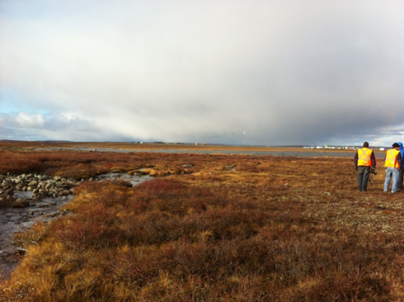
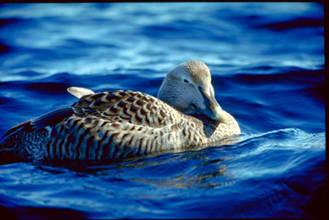
Relevant Acts and Regulations ᐊᒃᑐᐊᔪᑦ ᐱᖁᔭᑦ ᒪᓕᒐᐃᓪᓗ
Department of the Environment Act
Canadian Environmental Protection Act
Fisheries Act – Pollution Prevention Provisions & Metal and Diamond Mining Effluent Regulations
ᐊᕙᑎᓕᕆᔨᒃᑯᓐᓄᑦ ᐱᖁᔭᖅ
ᑲᓇᑕᒥ ᐊᕙᑎᒥᒃ ᓴᐳᒻᒥᓂᕐᒧᑦ ᐱᖁᔭᖅ
ᐃᖃᓗᓕᕆᓂᕐᒧᑦ ᐱᖁᔭᖅ – ᓱᕈᖅᑕᐃᓕᑎᑦᑎᓂᕐᒧᑦ ᐱᑕᖃᖅᑎᑕᐅᔪᑦ & ᓴᕕᕋᔭᒃᓴᓂᑦ ᐊᓕᒎᔭᕐᓂᓪᓗ ᐅᔭᕋᖕᓂᐊᕐᕕᖕᒥᑦ ᐃᒪᕐᓗᖕᒧᑦ ᒪᓕᒃᑕᐅᔭᕆᐊᓖᑦ

Slide 5
Environment and Climate Change Canada’s Participation ᐊᕙᑎᓕᕆᔨᒃᑯᑦ ᐊᒻᒪᓗ ᓯᓚᐅᑉ ᐊᓯᔾᔨᖅᐸᓪᓕᐊᓂᖓ ᑲᓇᑕᒥ ᐃᓚᐅᖃᑕᐅᓂᖏᑦ
Environment and Climate Change Canada provides scientific expertise within our mandate to the Nunavut Water Board
Freshwater Environment
Monitoring, Mitigation and Management Plans
ᐊᕙᑎᓕᕆᔨᒃᑯᑦ ᐊᒻᒪᓗ ᓯᓚᐅᑉ ᐊᓯᔾᔨᖅᐸᓪᓕᐊᓂᖓ ᑲᓇᑕᒥ ᑐᓂᓯᕙᒃᑐᑦ ᖃᐅᔨᓴᖅᑐᓕᕆᓂᒃᑯᑦ ᖃᐅᔨᒪᔭᐅᒻᒪᕆᒃᑐᓂᒃ ᐱᔭᕆᐊᖃᖅᑕᖏᑎᒍᑦ ᓄᓇᕗᒻᒥ ᐃᒪᓕᕆᔨᑦ ᑲᑎᒪᔨᓄᑦ
ᐃᒪᑦᑎᐊᕙᐅᑉ ᐊᕙᑎᖓ
ᓇᐅᑦᑎᖅᓱᕐᓂᕐᒧᑦ, ᐋᖅᑭᒋᐊᖅᑎᑦᑎᓂᕐᒧᑦ ᐊᒻᒪᓗ ᐊᐅᓚᑦᑎᓂᕐᒧᑦ ᐸᕐᓇᐅᑎᑦ

Slide 6
Environment and Climate Change Canada’s Participation continued ᐊᕙᑎᓕᕆᔨᒃᑯᑦ ᐊᒻᒪᓗ ᓯᓚᐅᑉ ᐊᓯᔾᔨᖅᐸᓪᓕᐊᓂᖓ ᑲᓇᑕᒥ ᐃᓚᐅᖃᑕᐅᓂᖏᑦ ᑲᔪᓯᔪᖅ
Environment and Climate Change Canada has participated in all phases of this review process thus far.
This presentation summarizes Environment and Climate Change Canada’s recommendations.
Environment and Climate Change Canada has reviewed the Proponent’s responses.
ᐊᕙᑎᓕᕆᔨᒃᑯᑦ ᐊᒻᒪᓗ ᓯᓚᐅᑉ ᐊᓯᔾᔨᖅᐸᓪᓕᐊᓂᖓ ᑲᓇᑕᒥ ᐃᓚᐅᖃᑕᐅᓯᒪᔪᑦ ᓇᐅᒃᑯᓘᒃᑖᖅ ᑕᒪᑐᒪᓂ ᕿᒥᕐᕈᓂᕐᒥ ᐅᓪᓗᒥᒧᑦ.
ᑖᓐᓇ ᓴᖅᑭᑕᐅᔪᖅ ᓇᐃᒡᓕᑎᒋᐊᖅᑎᑦᑎᓪᓗᓂ ᐊᕙᑎᓕᕆᔨᒃᑯᑦ ᐊᒻᒪᓗ ᓯᓚᐅᑉ ᐊᓯᔾᔨᖅᐸᓪᓕᐊᓂᖓ ᑲᓇᑕᒥ ᐊᑐᓕᖁᔭᖏᓐᓂᒃ
ᐊᕙᑎᓕᕆᔨᒃᑯᑦ ᐊᒻᒪᓗ ᓯᓚᐅᑉ ᐊᓯᔾᔨᖅᐸᓪᓕᐊᓂᖓ ᑲᓇᑕᒥ ᕿᒥᕐᕈᓯᒪᔭᖏᑦ ᐆᒃᑐᖅᑑᑉ ᑭᐅᔾᔪᑎᖏᑦ

Slide 7
Environment and Climate Change Canada’s Resolved Issues ᐊᕙᑎᓕᕆᔨᒃᑯᑦ ᐊᒻᒪᓗ ᓯᓚᐅᑉ ᐊᓯᔾᔨᖅᐸᓪᓕᐊᓂᖓ ᑲᓇᑕᒥ ᐋᖅᑭᒃᑕᐅᓯᒪᔪᑦ ᐱᔾᔪᑎᑦ
During the Technical Review, the Department provided comments on
Mitigation for in-water works
Ore stockpile Metal Leaching and Acid Rock Drainage
Waste Rock Storage Freeze Back
Dissolved versus total fractions of metals
Seep Surveys
Post-Closure monitoring
Arsenic Site Specific Water Quality Objective
These issues were resolved prior to and during the Technical Meeting held in Cambridge Bay on May 1-2, 2018.
ᐃᓗᓕᖃᐅᖅᑐᓂᒃ ᕿᒥᕐᕈᑎᓪᓗᒋᑦ, ᐱᓕᕆᕝᕕᒃ ᑐᓂᓯᓚᐅᖅᑐᖅ ᐅᖃᐅᓯᒃᓴᒥᓂᒃ ᐅᑯᓂᖓ
ᐋᖅᑭᒋᐊᖅᑎᑦᑎᓂᖅ ᐃᒪᕐᒥ ᖃᓄᐃᓕᐅᕐᓂᕆᔭᐅᔪᓄᑦ
ᐅᔭᕋᖕᓂᐊᖅᑕᐅᔪᑦ ᑲᑎᖅᓱᖅᓯᒪᔪᑦ ᓴᕕᕋᔭᒃᓴᓂᒃ ᐃᔅᓴᒃᑐᑦ ᐊᒻᒪᓗ ᐆᑕᕐᓇᖅᑐᓂᒃ ᐅᔭᖅᑲᓂᒃ ᑯᕕᔪᑦ
ᐅᔭᖅᑲᑦ ᑐᖅᑯᖅᑕᐅᔪᑦ ᕿᕿᑎᑕᐅᓪᓗᑎᒃ
ᓄᖑᓴᖅᑕᐅᓯᒪᔪᑦ ᐊᓯᐊᒍᖔᕐᓗ ᑕᒪᒃᑭᖅᖢᒋᑦ ᒥᑭᒃᑑᑎᑦ ᓴᕕᕋᔭᐃᑦ
ᑯᕕᕙᓪᓕᐊᔪᓂᒃ ᑭᒡᓕᓯᓂᐊᖅᑕᐅᔪᑦ
ᒪᑐᔭᐅᓯᒪᓕᖅᑎᓪᓗᒍ ᓇᐅᑦᑎᖅᓱᕐᓂᖅ
ᑐᖁᓐᓇᖅᑕᒥᒃ ᐅᔭᕋᖕᓂᐊᕐᕕᖕᒧᓪᓗᐊᑕᐅᑉ ᐃᒪᐅᑉ ᐱᐅᑎᒋᓂᖓᓄᑦ ᑐᕌᒐᕆᔭᐅᔪᖅ
ᑖᒃᑯᐊ ᐱᔾᔪᑕᐅᔪᑦ ᐋᖅᑭᒃᑕᐅᓚᐅᖅᑐᑦ ᐃᖃᓗᒃᑑᑦᑎᐊᕐᒥ ᐃᓗᓕᖃᐅᖅᑐᓄᑦ ᑲᑎᒪᑎᓪᓗᒋᑦ ᓯᕗᓂᐊᓂᓗ ᒪᐃ 1-2, 2018ᒥ.

Slide 8
ECCC#1 – Closure Objectives and Criteria : Receiving Water Quality ᑲᓇᑕᒥ#1 – ᑕᑐᔭᐅᓂᖓᓄᑦ ᑐᕌᕆᔭᐅᔪᑦ ᖃᓄᐃᓕᖓᔭᕆᐊᓖᓪᓗ: ᐱᑎᑕᐅᓂᖅ ᐅᒪᐅᑉ ᐱᐅᑎᒋᓂᖓᓂᒃ
The Proponent proposes to meet Site Specific Water Quality Objectives or the Metal and Diamond Mining Effluent Regulations criteria at final discharge points during closure and proposes to defer discussions until a better understanding of water quality at the site is obtained.
ECCC#1 Recommendation
ECCC recommends that the Proponent, in future iterations of the Interim Closure and Reclamation Plan, include explicit statements on receiving water quality objectives, as well as clarify discharge points and where objectives are to be met.
ᐆᒃᑐᖅᑐᖅ ᑎᑭᐅᑎᓛᕋᓱᒃᑐᖅ ᐅᔭᕋᖕᓂᐊᕐᕕᖕᒧᓪᓗᐊᑕᐅᑉ ᐃᒪᐅᑉ ᐱᐅᑎᒋᓂᖓᓄᑦ ᑐᕌᒐᕆᔭᐅᔪᓂᒃ ᓴᕕᕋᔭᒃᓴᓂᑦ ᐊᓕᒎᔭᕐᓂᓪᓗ ᐅᔭᕋᖕᓂᐊᕐᕕᖕᒥᑦ ᐃᒪᕐᓗᖕᒧᑦ ᒪᓕᒃᑕᐅᔭᕆᐊᓕᖕᓂᒃ ᑭᖑᓪᓕᕐᒥ ᐊᓂᐅᕋᖅᐸᓪᓕᐊᕝᕕᖕᓂᒃ ᒪᑐᔭᐅᓯᒪᑎᓪᓗᒍ ᐅᖓᕙᕆᐊᖅᑎᑦᑐᒪᓪᓗᓂᒋᓪᓗ ᐅᖃᐅᓯᕆᔭᐅᓂᖓ ᑐᑭᓯᔭᐅᕚᓪᓕᕐᔫᒥᓚᐅᖅᑎᓐᓇᒋᑦ ᐃᒪᐅᑉ ᐱᐅᑎᒋᓂᖓᓂᒃ ᐅᔭᕋᖕᓂᐊᕐᕕᖕᒥ ᖃᐅᔨᓚᐅᖅᑎᓐᓇᒋᑦ.
ᐊᕙᑎᓕᕆᔨᒃᑯᑦ ᐊᒻᒪᓗ ᓯᓚᐅᑉ ᐊᓯᔾᔨᖅᐸᓪᓕᐊᓂᖓ ᑲᓇᑕᒥ#1 ᐊᑐᓕᖁᔭᖓ
ᐊᕙᑎᓕᕆᔨᒃᑯᑦ ᐊᒻᒪᓗ ᓯᓚᐅᑉ ᐊᓯᔾᔨᖅᐸᓪᓕᐊᓂᖓ ᑲᓇᑕᒥ ᐆᒃᑐᖅᑐᓂᒃ, ᓯᕗᓂᒃᓴᒥ ᐅᖃᐅᓯᕆᔭᐅᒃᑲᓐᓂᖅᑎᓪᓗᒍ ᒪᑐᔭᐅᓚᐅᑲᖕᓂᖓᓄᑦ ᓴᓗᒻᒪᖅᓴᖅᑕᐅᓂᖓᓄᓪᓗ ᐸᕐᓇᐅᑎ, ᐅᖃᖅᓯᒪᓪᓚᑦᑖᖁᓪᓗᓂᒋᑦ ᐱᓂᕐᒥᒃ ᐃᒪᐅᑉ ᐱᐅᑎᒋᓂᖓᓄᑦ ᑐᕌᕆᔭᐅᔪᓂᒃ, ᐊᒻᒪᓗ ᓇᓗᓇᐃᖅᓯᑦᑎᐊᖁᓪᓗᓂᒋᑦ ᐊᓂᐅᕋᖅᐸᓪᓕᐊᕝᕕᖏᓐᓂᑦ ᓇᐅᒃᑯᓪᓗ ᑐᕌᕆᔭᐅᔪᑦ ᑎᑭᐅᑎᔭᐅᔭᕆᐊᖃᕐᒪᖔᑕ.

Slide 9
ECCC#2 – Saline Water Pond Closure Site Specific Water Quality Objective ᑲᓇᑕᒥ#2 – ᑕᕇᖅᑕᐅᔪᖅ ᑕᓯᕋᓛᖅ ᒪᑐᔭᐅᓂᖓᓄᑦ ᐅᔭᕋᖕᓂᐊᕐᕕᖕᒧᓪᓗᐊᑕᐅᑉ ᐃᒪᐅᑉ ᐱᐅᑎᒋᓂᖓᓄᑦ ᑐᕌᒐᕆᔭᐅᔪᖅ
Due to chloride in sediment pore water at the bottom of the Saline Water Pond, chloride may be of concern when reconnecting Umwelt Lake to surface waters. The target chloride concentration proposed by the Proponent is 120 mg/L.
ECCC#2 Recommendation
ECCC recommends that the Proponent include in their Saline Water Management Plan provisions for tracking sediment pore water chloride concentrations for the Saline Water Pond in order to ensure appropriate water quality for the reconnection of Umwelt Lake to surface waters.
ᑯᓘᕋᐃᑦᑕᖃᕐᓂᖓᓄᑦ ᕿᒪᒃᑯᓂᒃ ᑕᕇᖅᑕᐅᔫᑉ ᑕᓯᕋᓛᑉ ᐊᖅᑲᖓᓂ, ᑯᓘᕋᐃᑦ ᐃᓱᒫᓗᒍᑕᐅᑐᐃᓐᓇᕆᐊᖃᖅᑐᖅ ᐊᒻᐅᐃᓪᑦ ᑕᓯᖓ ᑲᑎᑎᑕᐅᒃᑲᓐᓂᖅᑎᓪᓗᒍ ᐃᒪᐅᑉ ᖄᖓᓄᑦ. ᐆᒃᑐᖅᑐᖅ ᑯᓘᕋᐃᑦᑕᖃᕈᓐᓇᖅᑎᑦᑎᓇᓱᒃᑐᑦ 120ᒥᓗᒍᓛᒻ/ᐊᑐᓂ ᓖᑕᓄᑦ.
ᑲᓇᑕᒥ#2 ᐊᑐᓕᖁᔭᖓ
ᐊᕙᑎᓕᕆᔨᒃᑯᑦ ᐊᒻᒪᓗ ᓯᓚᐅᑉ ᐊᓯᔾᔨᖅᐸᓪᓕᐊᓂᖓ ᑲᓇᑕᒥ ᐆᒃᑐᖅᑐᒥᒃ ᐃᓚᐅᖃᑕᐅᖁᔨᔪᑦ ᑕᕇᖅᑕᐅᔪᒧᑦ ᐃᒪᕐᒧᑦ ᐊᐅᓚᑦᑎᓂᕐᒧᑦ ᐸᕐᓇᐅᑎᒥᓂ ᓇᓗᓇᐃᖅᓯᔪᓐᓇᐅᑎᓂᒃ ᕿᒪᒃᑯᓂᒃ ᐃᒪᕐᒥ ᑯᓘᕋᐃᑦᑕᖃᖅᑎᒋᓂᖓᓂᒃ ᑕᕇᖅᑕᐅᔪᖅ ᑕᓯᕋᓛᕐᒧᑦ ᐃᒪᐅᑉ ᐱᐅᑎᒋᓂᖓ ᖃᓄᐃᓛᙱᒻᒪᑦ ᑲᑎᑎᑕᐅᒃᑲᓐᓂᕐᓂᖓᓄᑦ ᐊᒻᐅᐃᓪᑦ ᑕᓯᖓ ᐃᒪᐅᑉ ᖄᖓᓄᑦ.

Slide 10
ECCC#3 – Nitrite ᑲᓇᑕᒥ#3 – ᓇᐃᑐᐃᑦ
The Department had concerns with the predicted levels of nitrite in surface waters and seeks clarification on nitrite inputs to the water and load balance model.
ECCC#3 Recommendation
ECCC recommends that the Proponent clarify nitrite inputs for rock sources and identify the reasons for reductions in predicted nitrite concentrations.
ᐱᓕᕆᕝᕕᒃ ᐃᓱᒫᓘᑎᖃᓚᐅᖅᑐᑦ ᐱᑕᖃᖅᑎᒋᓇᓱᒋᔭᐅᓛᕐᓂᖓᓂᒃ ᓇᐃᑐᐃᑦᒥᒃ ᐃᒪᐅᑉ ᖄᖓᓂ ᓇᓗᓇᐃᖅᓯᒃᑲᓐᓂᖁᔨᓪᓗᑎᒡᓗ ᓇᐃᑐᐃᑦᒥᒃ ᐃᒪᕐᒧᐊᖅᑐᖃᓛᕐᓂᖓᓄᑦ ᒥᒃᓵᓄᑦ ᐊᒻᒪᓗ ᓇᓕᒧᒌᒃᑎᑦᑎᓂᕐᒧᑦ ᐃᒃᑕᕐᓂᖃᖅᑐᓂᒃ ᓴᖅᑭᔮᕈᑎ.
ᑲᓇᑕᒥ#3 – ᐊᑐᓕᖁᔭᖓ
ᐊᕙᑎᓕᕆᔨᒃᑯᑦ ᐊᒻᒪᓗ ᓯᓚᐅᑉ ᐊᓯᔾᔨᖅᐸᓪᓕᐊᓂᖓ ᑲᓇᑕᒥ ᐆᒃᑐᖅᑐᓂᒃ ᓇᓗᓇᐃᖅᓯᑦᑎᐊᖁᔨᔪᑦ ᓇᐃᑦᑐᐃᑦᒥᒃ ᐱᑕᖃᖅᑐᑦ ᐅᔭᖅᑲᓄᑦ ᐊᒻᒪᓗ ᓇᓗᓇᐃᖅᑕᐅᓗᑎᒃ ᑭᓱᒧᑦ ᑲᑦᑐᖅᓯᒋᐊᕐᒪᖔᑕ ᓇᐃᑐᐃᑦᑕᖃᖅᑎᒋᔭᐅᓇᓱᒋᔪᑦ

Slide 11
ECCC#4 – Aquatic Effects Management Plan ᑲᓇᑕᒥ#4 - ᐃᒪᐅᑉ ᐊᒃᑐᖅᑕᐅᓂᖓᓄᑦ ᐊᐅᓚᑦᑎᓂᕐᒧᑦ ᐸᕐᓇᐅᑎ
The Proponent has made progress on the design of the Aquatics Effects Management Plan, in consultation with ECCC. ECCC notes that there is further work to be done with respect to the study design and characterization of natural variability, and acknowledges the Proponent’s ongoing work in this regard with further monitoring in 2018.
ECCC#4 Recommendation
ECCC recommends that an updated version of the Aquatics Effects Management Plan be submitted for approval following the issuance of a water licence and looks forward to ongoing work the Aquatics Effects Management Plan.
ᐆᒃᑐᖅᑐᖅ ᑲᔪᓯᑦᑎᐊᖅᓯᒪᔪᖅ ᐋᖅᑭᒃᑕᐅᕙᓪᓕᐊᓂᖓᓄᑦ ᐃᒪᐅᑉ ᐊᒃᑐᖅᑕᐅᓂᖓᓄᑦ ᐊᐅᓚᑦᑎᓂᕐᒧᑦ ᐸᕐᓇᐅᑎ, ᖃᐅᔨᒋᐊᕐᕕᒋᕙᒃᖢᓂᒋᑦ ᐊᕙᑎᓕᕆᔨᒃᑯᑦ ᐊᒻᒪᓗ ᓯᓚᐅᑉ ᐊᓯᔾᔨᖅᐸᓪᓕᐊᓂᖓ ᑲᓇᑕᒥ. ᐊᕙᑎᓕᕆᔨᒃᑯᑦ ᐊᒻᒪᓗ ᓯᓚᐅᑉ ᐊᓯᔾᔨᖅᐸᓪᓕᐊᓂᖓ ᑲᓇᑕᒥ ᓇᓗᓇᐃᖅᓯᔪᑦ ᖃᓄᐃᓕᐅᖅᑐᖃᒃᑲᓐᓂᕆᐊᖃᕐᓂᖓᓂᒃ ᐱᔾᔪᑎᒋᓪᓗᒍ ᖃᐅᔨᓴᕐᓂᕐᒧᑦ ᐸᕐᓇᐅᑎ ᐊᒻᒪᓗ ᑲᔪᓯᑦᑎᐊᕐᓂᕆᓇᔭᖅᑕᖓᑕ ᖃᓄᐃᓕᖓᓂᖓ, ᐃᓕᓴᖅᓯᓪᓕᑎᒡᓗ ᐆᒃᑐᖅᑑᑉ ᑲᒪᒋᔭᖃᐃᓐᓇᕐᓂᖏᓐᓂᒃ ᑕᒪᑐᒪ ᒥᒃᓵᓄᑦ ᓇᐅᑦᑎᖅᓱᒃᑲᓐᓂᓛᖅᖢᑎᒡᓗ 2018ᒥ.
ᑲᓇᑕᒥ#4 ᐊᑐᓕᖁᔭᖓ
ᐊᕙᑎᓕᕆᔨᒃᑯᑦ ᐊᒻᒪᓗ ᓯᓚᐅᑉ ᐊᓯᔾᔨᖅᐸᓪᓕᐊᓂᖓ ᑲᓇᑕᒥ ᑐᓂᓯᖁᔨᕗᑦ ᓄᑖᕈᕆᐊᖅᓯᒪᔪᒥᒃ ᐃᒪᐅᑉ ᐊᒃᑐᖅᑕᐅᓂᖓᓄᑦ ᐊᐅᓚᑦᑎᓂᕐᒧᑦ ᐸᕐᓇᐅᑎᒥᒃ ᐊᖏᖅᑕᐅᓛᕐᒪᑦ ᑐᓂᔭᐅᕌᓂᒃᓯᒪᓕᖅᐸᑦ ᐃᒪᕐᒧᑦ ᐱᔪᓐᓇᐅᑎ ᓂᕆᐅᒃᖢᑎᒡᓗ ᑲᒪᒋᔭᐅᖏᓐᓇᕐᓂᐊᕐᓂᖓᓂᒃ ᐃᒪᐅᑉ ᐊᒃᑐᖅᑕᐅᓂᖓᓄᑦ ᐊᐅᓚᑦᑎᓂᕐᒧᑦ ᐸᕐᓇᐅᑎ.

Slide 12
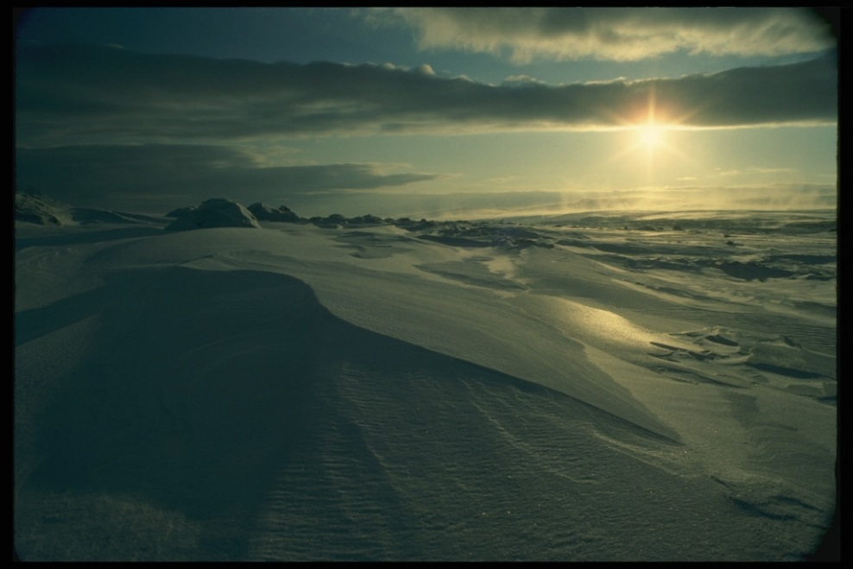
Thank you! ᖁᐊᓇᖅᑯᕼᐃ!
ECCC would like to say thank you for the opportunity to participate in this water licencing process
ᐊᕙᑎᓕᕆᔨᒃᑯᑦ ᐊᒻᒪᓗ ᓯᓚᐅᑉ ᐊᓯᔾᔨᖅᐸᓪᓕᐊᓂᖓ ᑲᓇᑕᒥ ᖁᔭᓐᓇᒦᓚᔪᒪᔪᑦ ᐃᓚᐅᖃᑕᐅᑎᑕᐅᓂᕐᒥᓄᑦ ᑕᒪᑐᒪᓂ ᐃᒪᕐᒧᑦ ᐱᔪᓐᓇᐅᑎᑖᕐᓂᕐᒧᑦ ᐊᑐᖅᑕᐅᔪᒥᒃ.

