Slide 1
Kitikmeot Inuit Association
KIA Technical Review of Back River Project Type A water License Application
Notes:
Hello everyone, I am John Roesch, the Senior Hope Bay Project Officer for the Department of Lands and Environment for the Kitikmeot Inuit Association. I am responsible for project oversite for the KIA and provide input into the regulatory process on the Hope Bay Project to both the NWB and NIRB. I am currently covering the Back River Project as well in the review of Sabina’s Type A water license application. In performing this role, I make use of KIA’s consultants who are subject matter experts in the areas of hydrology, hydrogeology, fisheries, aquatic environment, and geotechnical engineering.

Slide 2
Purpose of Presentation
Present a summary of KIA’s Technical Review of Sabina Gold & Silver Corp’s Back River Project Type A Water license application to the NWB
KIA conducted a thorough review in the areas of hydrology, hydrogeology, fisheries, aquatic environments, water quality and monitoring.
32 Issues were resolved before and at the Technical Meeting in May 2018.
Notes:
The purpose of this presentation is to provide a brief summary of our technical review of the Back River Project Type A water license application. Our review covered hydrology, hydrogeology, fisheries, aquatic environments, water quality, and monitoring. KIA conducted the review in a collaborative manner with Sabina Gold & Silver out of which we brought forward 32 issues to be resolved prior and at the Technical Meeting.

Slide 3
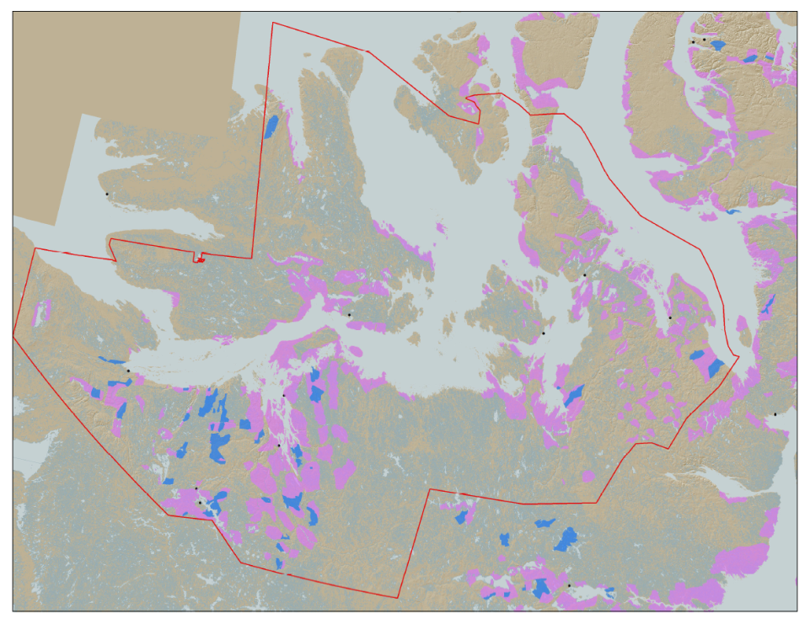

KIA’s Mandate
KIA’s Mandate is to represent the interests of Kitikmeot Inuit by protecting and promoting their social, cultural, political, environmental, and economic well-being.
KIA owns 106,360 km² of surface land: A significant opportunity if managed properly.
Hope Bay Project
Bathurst Inlet
Marine Laydown Area (MLA)
Goose Lake Mine Site
Notes:
KIA’s mandate is to manage Kitikmeot Inuit lands and resources, and to protect and promote the social, cultural, political, environmental and economic well-being of Kitikmeot Inuit. The Kitikmeot Region is generally within the red boundary. The Pink and Blue lands are lands which KIA owns the surface rights.
Kitikmeot Inuit Association is a democratically elected not-for-profit society that represents the Inuit of the Kitikmeot Region of Nunavut.
As a result of the Nunavut Agreement, Inuit are one of the largest private landowners in the world. Much of this privately owned land is in areas with high potential for mineral development. This land is a significant opportunity for Inuit if it is managed properly. We must optimize opportunities and manage liabilities that are inherent with being a private landowner. If not, we will affect the well-being of our Kitikmeot Inuit membership.
The Back River Project, composed of the Marine Laydown Area, winter road, and Goose Lake mine site is located on the mainland south of Bathurst Inlet and in the southern part of the region.

Slide 4
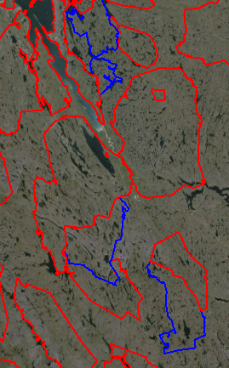
The Back River Project
Located on 5 parcels of Inuit Owned Land.
The Back River Project’s Marine Lay Down Area (MLA), winter road, and Goose Lake are on:
BB-02, BB-13, BB-15, BB-16, and BB-27
Exploration potential at George site on BB-15
Sabina took over development of the project in 2009
MLA
BB-27
120 km
BB-16
BB-15
George Site
BB-02
BB-13
Goose Lake
Notes:
The Back River Project composed of the Marine Laydown Area (MLA), winter ice road, and the Goose Lake mine site reside on five Inuit Owned Land parcels. These being BB-02, BB-13, BB-15, BB-16, and BB-27.
The MLA is located in BB-27 and the Goose Lake mine site is in BB-13. The winter ice road runs from the MLA to Goose Lake through all the parcels.
Exploration camps currently exist at Goose Lake and George sites. The George site is a potential area of future exploration and development. It is currently closed and will not be developed into a mine site in the immediate future.
On the Map you can see the locations of some of the highest priority development sites are the MLA and Goose Lake.

Slide 5
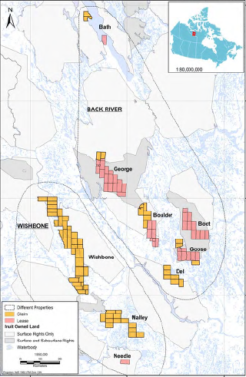
Sabina Mineral Claims in the Kitikmeot Region
Notes:
This map shows the Back River and Wishbone mineral claims held by Sabina with the MLA near the top of the map and Goose Lake in the south-east area of the map. Only the MLA, winter ice road, and Goose Lake are going to be developed at the present time.

Slide 6
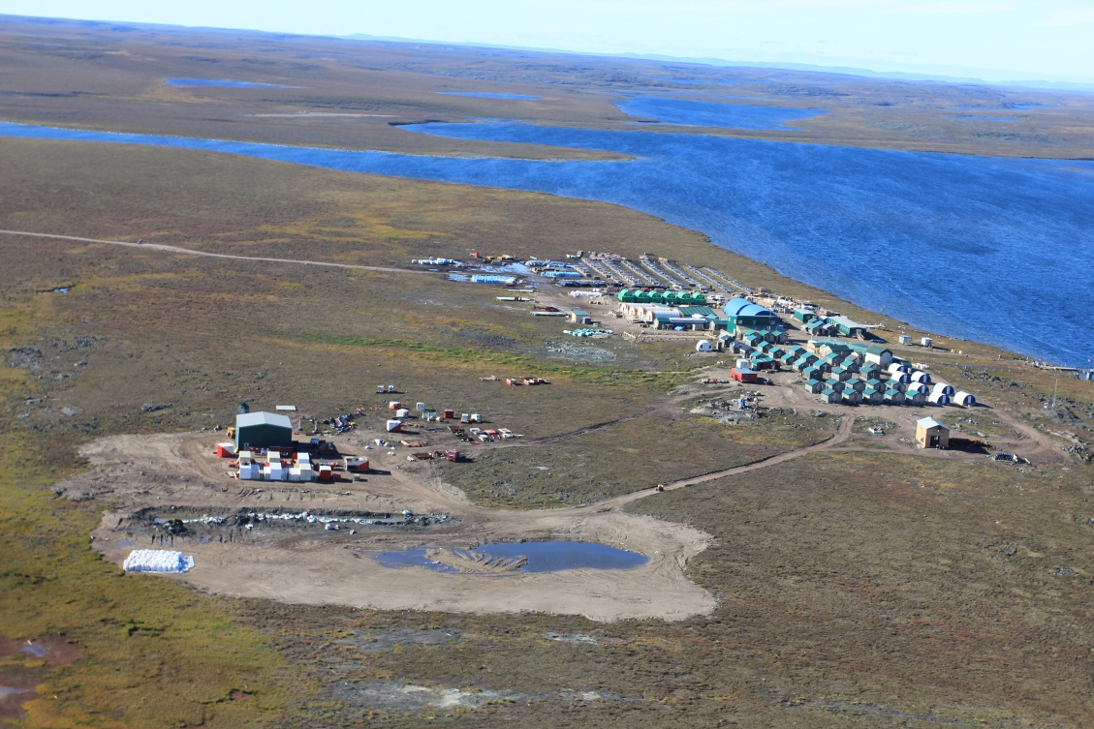
The Back Rover Project
Goose Lake Camp
Notes:
This picture is of the existing Goose Lake exploration camp. The Goose Lake mine site will be developed at this location and will have four mining areas within it. The mines will be both open pit and underground mines for each of the Goose Lake deposits. These being Umwelt, Llama, Goose Main, and Echo.
The mine will operate for about ten years producing 350,000 ounces of gold. The mill will process about 6,000 tonnes of ore per day and the Tailings Storage Area (TSA) will be located on Crown land. The doré bars produced at site will be flown out on aircraft.

Slide 7
Hydrology and Hydrogeology Issues
Sensitivity of mine inflows to presence of Enhanced Permeability Zones (EPZ).
Sensitivity of mine inflows to location of permafrost boundaries.
Consideration of total concentrations in mine effluents.
Monitoring of seepage from Tailings Storage Facility (TSF) dam.
Effect of increase in temperature in climate.
Discrepancy in mine flows reported in submitted documents.
Notes:
As indicated previously, 32 issues were brought to the technical meeting with the NWB pertaining to the Type A water license application. These six issues concern the sensitivity of mine water flows into Enhanced Permeability Zones (EPZ) and areas of permafrost, the concentration of Total Suspended Solids (TSS) in mine effluents in meeting CCME guidelines, the monitoring of potential seepage through the TSF dam, and the effects of climate change on water management of infrastructure. There are also some minor discrepancies in the reporting of mine water flows in the submitted documents.
These issues of high, medium, and low concern to KIA.
Sabina has responded to our recommendations and all issues have been resolved.

Slide 8
Fisheries & Aquatic Environments Issues
Frequency of biological monitoring for Aquatic Environmental Monitoring Program (AEMP).
Notes:
These issue concerns the conducting of biological monitoring through the Aquatic Environmental Monitoring Program for the dewatering of Llama and Umwelt lakes to Goose lake through each phase of the project. The KIA recommended annual monitoring until the areas are recovered.
This issue is of high concern to KIA.
Sabina has responded to our recommendations and this issue is resolved.

Slide 9
Water Quality and Monitoring Issues
Winter ice road melt management.
Marine Laydown Area (MLA) PAG rock storage.
Borrow pit and quarry contact water discharges.
Seep and runoff seep surveys.
Ore stockpile runoff management.
Notes:
These five issues concern the preventing of the winter ice road fill from entering water bodies upon melting, the storage of Potentially Acid Generating (PAG) rock at the MLA, quarry contact water overflowing containment ponds, the monitoring of seepage and water runoff from quarries and waste rock piles into the environment, and water run-off from ore stock piles into the environment.
These issues are all of medium concern to KIA.
Sabina has responded to our recommendations and these issues are resolved.

Slide 10
Water Quality and Monitoring Issues
Ore storage runoff metal monitoring.
Tailing Storage Facility (TSF) seepage.
Construction related dust fall management.
Ash and asbestos management.
Hazardous materials water management at Marine Laydown Area (MLA).
Notes:
These five issues concern runoff discharge from ore storage not meeting metals criteria, seepage form the TSF affecting waterbodies in the immediate area, the management of dust from construction and its entry into the watershed, the disposal of asbestos and ash into the landfill, and the handling of hazardous materials contact water at the MLA.
These issues are of high, medium, and low concern to the KIA.
Sabina has responded to our recommendations and these issues are resolved.

Slide 11
Water Quality and Monitoring Issues
Hazardous material storage.
Risk assessment and evaluation.
Bulk fuel storage discharge criteria - lead.
Sewage spill response.
Bulk fuel volumes.
Quarry PAG bedrock cover at closure.
Notes:
These six issues concern practises for storing hazardous materials at site, risk management and response to identified hazards at the mine site, the discharge criteria for water pooling at the bulk fuel storage area, the response to contaminated ice and snow from untreated sewage, discrepancies found for the bulk fuel storage volumes, and the thickness of NPAG rock covering the quarry PAG bedrock at closure.
This issues are of medium and low concern to KIA.
Sabina has responded to our recommendations and these Issues are resolved.

Slide 12
Water Quality and Monitoring Issues
Length of water license.
Deviations from original mine design plans.
Phosphorous enrichment.
Water Quality monitoring results.
Load balance for Marine Laydown Area (MLA)
Notes:
These five issues concern the length of the mine’s water license, deviations from the original mine design made by in field engineering decisions, the impact of phosphorous in effluent from the waste water treatment plant, the results of water quality modelling for water treatment, and the inclusion of source terms and inputs into the hydrological water and load balance at the MLA.
These issues are of high, medium, and low concern to the KIA.
Sabina has responded to our recommendations and these Issues are resolved.

Slide 13
Water Quality and Monitoring Issues
Water quality models results.
Saline water management plan.
Flooded pit water management.
Freshet monitoring.
Notes:
These four issues are about “upper case” scenarios in hydrological water and load balance and flows for the mine site, the management of saline water at site, long-term water quality for the flooded pits meeting CCME guidelines and Site Specific Water Quality Objectives, and the need for annual freshet monitoring of water flow due to melting of snow and ice.
The issues are considered to be of high and medium concern by KIA.
Sabina has responded to our recommendations and these issues are resolved.

Slide 14
Proposed Split of IOL and Crown Land & Water Security
KIA agrees with Sabina on total security of $43,189,351 for the Back River Project
KIA originally requested 30% of total security for IOL and 70% for Crown Land & Water.
KIA, CIRNA, and Sabina agreed to a security split of 32% IOL and 68% Crown Land & Water.
Sabina has proposed staged security to which KIA has provided a proposed staged split of security.
Notes:
The KIA agrees with Sabina on a total security of $43.2 million for the Back River Project and a split of 32% and 68% split for IOL and Crown Land and Water reclamation security, respectively. Our review of reclamation security was conducted by our geotechnical engineering consultant.
The KIA is open to the receipt of staged security from Sabina subject to particular water license conditions. The KIA has provided both Sabina and CIRNA with a proposed staged split of security for the Back River Project. KIA has had discussions with Sabina and CIRNA on staged security.

Slide 15
Conditions for Stage Security at Back River
KIA is open to receiving staged security under particular water license conditions.
KIA must receive security for construction phases 60 days prior to construction.
Staged security is subject to NWB process.
Sabina provides quarterly summary reports on construction progress.
Reclamation costs be updated periodically and reviewed.
Additional security provided within 60 days of review and determination by NWB.
Notes:
The KIA is open to receiving security using the proposed staged split under particular water license conditions.
The KIA must receive security 60 days prior to construction for each phase of construction for a defined set of major mine site components and infrastructure on a geographic basis. The receipt of staged security is subject to the NWB process where Sabina is required to provide proof of security being issued.
The reclamation costs must be updated periodically and reviewed by KIA and CIRNA and provided to the NWB. If additional security is determined to be required by the NWB, Sabina must provide it within 60 days of the determination.
The KIA has discussed these conditions with both Sabina and CIRNA.

Slide 16
Conclusion
KIA believes that with all technical issues being successfully resolved between KIA and Sabina Gold & Silver Corp. the issue of reclamation security can be fully resolved with all parties.
Thank You
Questions?
Notes:
The KIA believes that the remaining security issues brought forward to the Public Hearing can be successfully resolved with Sabina and CIRNA through our on-going collaboration.
We thank you for listening and we are open to any questions.

