Slide 1
ᕿᑎᕐᒥᐅᑦ ᐃᓄᐃᑦ ᑲᑐᔾᔨᖃᑎᒌᖏᑦ
ᕿᑎᕐᒥᐅᑦ ᐃᓄᐃᑦ ᑲᑐᔾᔨᖃᑎᒌᖏᑦ ᐱᔭᕐᓂᖏᑦᑐᓕᕆᓂᕐᒧᑦ ᕿᒥᕐᕈᔭᐅᓂᖏᑦ ᓴᓐᓂᖓᔪᖅ ᑰᖓᓂ ᐱᓕᕆᐊᖃᕈᒪᓂᕐᒧᑦ Type A-ᒥᒃ ᐃᒥᓕᕆᓂᕐᒧᑦ ᓚᐃᓴᓐᓯᑖᕈᒪᓂᕐᒧᑦ ᑐᒃᓯᕋᐅᑎᖓᑦ
Notes:
Hello everyone, I am John Roesch, the Senior Hope Bay Project Officer for the Department of Lands and Environment for the Kitikmeot Inuit Association. I am responsible for project oversite for the KIA and provide input into the regulatory process on the Hope Bay Project to both the NWB and NIRB. I am currently covering the Back River Project as well in the review of Sabina’s Type A water license application. In performing this role, I make use of KIA’s consultants who are subject matter experts in the areas of hydrology, hydrogeology, fisheries, aquatic environment, and geotechnical engineering.

Slide 2
ᐱᔾᔪᑎᖓ ᐅᓂᒃᑳᓕᐊᑦ
ᑐᓂᔭᐅᓗᑎᒃ ᐅᓂᒃᑳᖏᑦ ᕿᑎᕐᒥᐅᑦ ᐃᓄᐃᑦ ᑲᑐᔾᔨᑎᒌᖏᑦ ᐱᔭᕐᓂᖏᑦᑐᓄᑦ ᕿᒥᕐᕈᓚᐅᖅᑎᓪᓗᒋᑦ ᐅᓂᒃᑳᓕᐊᖏᓐᓂᒃ ᓴᐲᓇ ᒎᓗᓯᐅᖅᑎᑦ ᐊᒻᒪ ᓯᐅᕐᕙᕆᓯᐅᖅᑎᑦ ᑯᐊᐳᕇᓴᖓᑦᑕ ᓴᓐᓂᖓᔪᑉ ᑰᖓᓂ ᐱᓕᕆᐊᖃᕈᒪᑎᓪᓗᒋᑦ Type A-ᒥᒃ ᐃᒥᓕᕆᓂᕐᒧᑦ ᓚᐃᓴᓐᓯᑖᕈᒪᓂᕐᒧᑦ ᑐᒃᓯᕋᐅᑎᖓᑦ ᓄᓇᕗᒥ ᐃᒥᓕᕆᔨᒃᑯᑦ ᑲᑎᒪᔨᖏᓐᓄᑦ
ᕿᑎᕐᒥᐅᑦ ᐃᓄᐃᑦ ᑲᑐᔾᔨᑎᒌᖏᑦ ᕿᒥᕐᕈᓇᑦᓯᐊᓚᐅᖅᑐᑦ ᑰᖃᕐᓂᖏᓐᓂᒃ, ᓄᓇᐅᑉ ᐃᓗᐊᒍᑦ ᐃᒪᐃᑦ ᐃᖏᕐᒃᕋᓂᖏᓐᓂᒃ, ᐃᖃᓗᖃᕐᓂᖏᓐᓂᒃ, ᐃᒪᕐᒥᐅᑕᑦ ᐊᕙᑎᖏᓐᓂᒃ, ᐃᒥᐅᑉ ᐱᐅᓂᖓᓂᒃ ᐊᒻᒪᓗ ᓇᐅᑦᑎᖅᓱᐊᖃᕐᓂᖏᓐᓂᒃ.
32-ᖑᔪᓂᒃ ᐃᓱᒫᓘᒍᑎᐅᔪᓂᒃ ᐋᖅᑭᒡᓯᓚᐅᖅᑐᑦ ᓯᕗᕐᖓᒍᑦ ᐊᒻᒪᓗ ᑕᐃᑲᓂ ᐱᔭᕐᓂᖏᑦᑐᓕᕆᓂᕐᒧᑦ ᑲᑎᒪᓂᖃᖅᑎᓪᓗᒋᑦ ᒪᐃ 2018-ᖑᑎᓪᓗᒍ.
Notes:
The purpose of this presentation is to provide a brief summary of our technical review of the Back River Project Type A water license application. Our review covered hydrology, hydrogeology, fisheries, aquatic environments, water quality, and monitoring. KIA conducted the review in a collaborative manner with Sabina Gold & Silver out of which we brought forward 32 issues to be resolved prior and at the Technical Meeting.

Slide 3
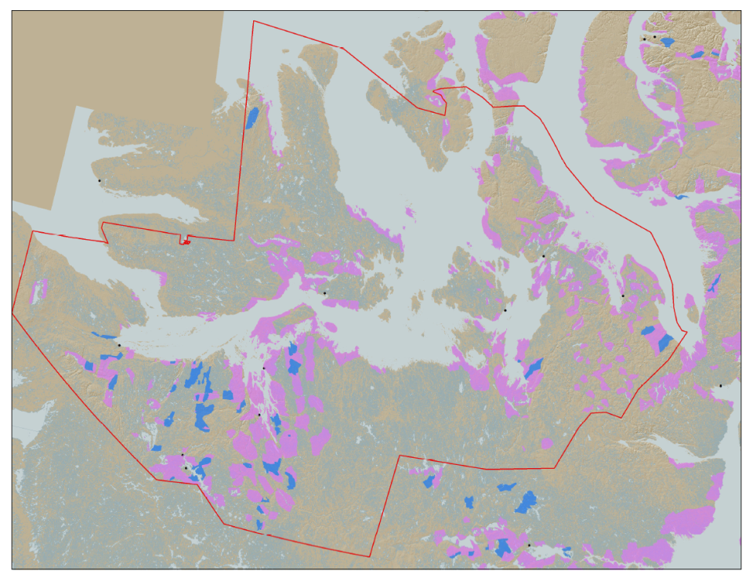

KIA-ᑯᑦ ᐱᓕᕆᐊᒃᓴᕆᓂᐊᕐᓗᒍ ᑎᓕᔭᐅᓯᒪᔾᔪᑎᖏᑦ
KIA-ᑯᑦ ᐱᓕᕆᐊᒃᓴᕆᓂᐊᕐᓗᒍ ᑎᓕᔭᐅᓯᒪᔾᔪᑎᖃᖅᐳᑦ ᑭᒡᒐᖅᑐᐃᖁᔭᐅᓪᓗᑎᒃ ᐊᑲᐅᓛᖑᔪᒃᑯᑦ ᕿᑎᕐᒥᐅᑦ ᐃᓄᖁᑎᖏᓐᓄᑦ ᓴᐳᒻᒥᒡᓯᖁᓪᓗᒋᑦ ᐊᒻᒪ ᑲᔪᖏᖅᓴᐅᑎᖃᖁᓪᓗᒋᑦ ᐃᓅᓯᕐᒧᑦ, ᐃᓕᖅᑯᓯᕐᒧᑦ, ᒐᕙᒪᓕᕆᓂᕐᒧᑦ, ᐊᕙᑎᓕᕆᓂᕐᒧᑦ, ᐊᒻᒪᓗ ᑮᓇᐅᔭᓕᐅᕋᓱᐊᕐᓂᕐᒧᑦ ᖃᓄᐃᖏᑦᓯᐊᖁᓪᓗᒋᑦ.
KIA-ᑯᑦ ᓇᖕᒥᓂᖃᖅᐳᑦ ᐊᒃᑎᒋᓂᖃᖅᑐᒥᒃ 106,360 km² ᓄᓇᐅᑉ ᖄᖓᓃᑦᑐᓂᒃ: ᐊᖏᔪᑲᓪᓚᒻᒪᕆᒃ ᐱᕕᒃᓴᐅᔪᑦ ᒥᐊᓂᕆᔭᐅᑦᓯᐊᖅᐸᑦ.
Hope Bay Project
Bathurst Inlet
Marine Laydown Area (MLA)
Goose Lake Mine Site
Notes:
KIA’s mandate is to manage Kitikmeot Inuit lands and resources, and to protect and promote the social, cultural, political, environmental and economic well-being of Kitikmeot Inuit. The Kitikmeot Region is generally within the red boundary. The Pink and Blue lands are lands which KIA owns the surface rights.
Kitikmeot Inuit Association is a democratically elected not-for-profit society that represents the Inuit of the Kitikmeot Region of Nunavut.
As a result of the Nunavut Agreement, Inuit are one of the largest private landowners in the world. Much of this privately owned land is in areas with high potential for mineral development. This land is a significant opportunity for Inuit if it is managed properly. We must optimize opportunities and manage liabilities that are inherent with being a private landowner. If not, we will affect the well-being of our Kitikmeot Inuit membership.
The Back River Project, composed of the Marine Laydown Area, winter road, and Goose Lake mine site is located on the mainland south of Bathurst Inlet and in the southern part of the region.

Slide 4
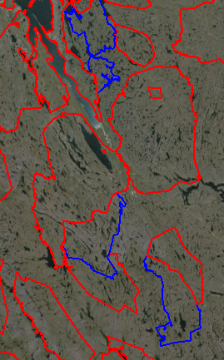
ᓴᓐᓂᖓᔪᑉ ᑰᖓᓂ ᐱᓕᕆᐊᖅ
ᐃᓂᑲᖅᑐᑦ ᑕᓪᓕᒪᐅᔪᓂᒃ ᐊᒡᒍᖅᑐᖅᓯᒪᐅᖅᑐᓂ ᐃᓄᐃᑦ ᓄᓇᖁᑎᖏᑕ ᐃᓗᐊᓂ.
ᓴᓐᓂᖓᔪᑉ ᑰᖓᓂ ᐱᓕᕆᐊᖅ ᐅᒥᐊᕐᔪᐊᑦ ᓂᐅᕋᐃᕕᖓ ᕿᖓᐅᒻᒥ (MLA), ᐅᑭᐅᒃᑯᑦ ᐋᖅᑯᑎ, ᐊᒻᒪᓗ Goose Lake ᑕᓯᐊᓃᖅᑐᑦ ᐅᑯᐊ:
BB-02, BB-13, BB-15, BB-16, ᐊᒻᒪᓗ BB-27
ᕿᓂᕈᓐᓇᕋᔭᕐᒥᔪᑦ ᑕᐅᕙᓂ George-ᒥ BB-15-ᒥ
ᓴᐲᓇᒃᑯᑦ ᑎᒍᓯᓚᐅᖅᑦᑐᑦ ᐱᕙᓪᓕᐊᑎᑦᓯᓂᕐᒧᑦ ᐱᓕᕆᐊᒥᒃ ᐊᕐᕌᒍᐊᓂ 2009
MLA
BB-27
120 km
BB-16
BB-15
George Site
BB-02
BB-13
Goose Lake
Notes:
The Back River Project composed of the Marine Laydown Area (MLA), winter ice road, and the Goose Lake mine site reside on five Inuit Owned Land parcels. These being BB-02, BB-13, BB-15, BB-16, and BB-27.
The MLA is located in BB-27 and the Goose Lake mine site is in BB-13. The winter ice road runs from the MLA to Goose Lake through all the parcels.
Exploration camps currently exist at Goose Lake and George sites. The George site is a potential area of future exploration and development. It is currently closed and will not be developed into a mine site in the immediate future.
On the Map you can see the locations of some of the highest priority development sites are the MLA and Goose Lake.

Slide 5
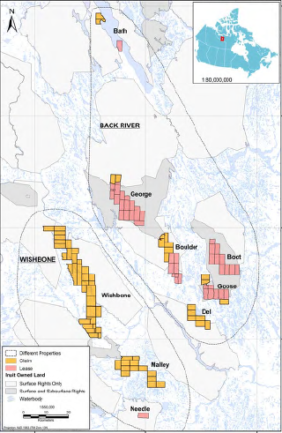
Sabina Mineral-ᑯᑦ ᐅᔭᕋᖕᓂᐊᕐᕕᒋᔪᒪᓪᓗᒋᑦ ᓇᓗᓇᐃᖅᓯᒪᔭᖏᑦ ᓇᑉᐸᖅᑐᐃᕕᒋᓯᒪᓪᓗᒋᑦ ᕿᑎᕐᒥᐅᑦ ᓄᓇᖁᑎᖓᓐᓂ
Notes:
This map shows the Back River and Wishbone mineral claims held by Sabina with the MLA near the top of the map and Goose Lake in the south-east area of the map. Only the MLA, winter ice road, and Goose Lake are going to be developed at the present time.

Slide 6
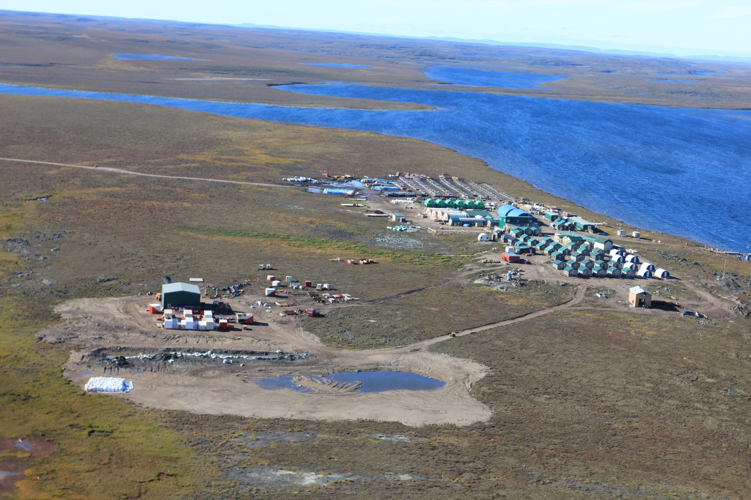
ᓴᓐᓂᖓᔪᑉ ᑰᖓᓂ ᐱᓕᕆᐊᖅ
Goose Lake Camp
Notes:
This picture is of the existing Goose Lake exploration camp. The Goose Lake mine site will be developed at this location and will have four mining areas within it. The mines will be both open pit and underground mines for each of the Goose Lake deposits. These being Umwelt, Llama, Goose Main, and Echo.
The mine will operate for about ten years producing 350,000 ounces of gold. The mill will process about 6,000 tonnes of ore per day and the Tailings Storage Area (TSA) will be located on Crown land. The doré bars produced at site will be flown out on aircraft.

Slide 7
ᖃᐅᔨᓴᖅᑕᐅᓂᖓᓄᑦ ᑰᑉ ᐃᖏᕐᕋᓂᖓᑕ ᐊᒻᒪᓗ ᓄᓇᐅᑉ ᐃᓗᐊᒍᑦ ᑰᖕᓂᖓᓄᑦ ᐃᓱᒫᓗᒍᑕᐅᔪᑦ
ᐃᒃᐱᒋᔭᐅᓪᓚᕆᖕᒪᑕ ᐅᔭᕋᖕᓂᐊᕐᕕᖕᒥᓐᖔᖅᑐᓂᑦ ᑰᒃᐸᓪᓕᐊᕕᐅᔪᑦ ᓄᓇᒥ (EPZ).
ᐃᒃᐱᒋᔭᐅᓪᓚᕆᖕᒪᑕ ᐅᔭᕋᖕᓂᐊᕐᕕᖕᒥᓐᖔᖅᑐᑦ ᑰᒃᐸᓪᓕᐊᕕᐅᔪᑦ ᓄᓇᐅᑉ ᐊᑖᓂ ᓯᑯᐃᑦ ᖁᐊᖑᐃᓐᓇᐅᔭᖅᑐᑦ ᑭᒡᓕᖏᑦ.
ᐃᓱᒪᒃᓴᖅᓯᐅᖁᑕᐅᑦᓯᐊᕐᓗᑎᒃ ᐅᔭᕋᖕᓂᐊᕐᕕᖕᒥᑦ ᐃᕐᖓᓗᒃᑯᕕᒃ.
ᓇᐅᑦᑎᖅᓱᐊᕆᔭᐅᓂᖓ ᐃᕐᖓᓕᖏᒃᑲᓗᐊᕐᒪᖔᑦ ᑯᕕᓕᕐᓗᓂ ᐅᔭᕋᒃᓴᓂᒃ ᓴᓗᒻᒪᒻᓴᐃᔾᔪᑎᕕᓂᕐᓄᑦ ᓄᐊᑦᓯᕕᒃ (TSF) ᐃᒪᕐᓗᒃᑯᕕᒃ.
ᐊᒃᑐᐃᓂᕆᔪᓐᓇᖅᑕᖓ ᓯᓚᐅᑉ ᐅᖅᑰᓯᕙᓪᓕᐊᓂᖓ.
ᐊᔾᔨᒌᖏᓐᓂᖏᑦ ᐅᔭᕋᖕᓂᐊᕐᕕᖕᒥ ᑰᒃᐸᓪᓕᐊᓂᖓᓄᑦ ᐅᓂᒃᑳᓕᐊᕆᔭᐅᔪᖅ ᑐᓂᔭᐅᔪᓂ ᑎᑎᖅᑲᓂ.
Notes:
As indicated previously, 32 issues were brought to the technical meeting with the NWB pertaining to the Type A water license application. These six issues concern the sensitivity of mine water flows into Enhanced Permeability Zones (EPZ) and areas of permafrost, the concentration of Total Suspended Solids (TSS) in mine effluents in meeting CCME guidelines, the monitoring of potential seepage through the TSF dam, and the effects of climate change on water management of infrastructure. There are also some minor discrepancies in the reporting of mine water flows in the submitted documents.
These issues of high, medium, and low concern to KIA.
Sabina has responded to our recommendations and all issues have been resolved.

Slide 8
ᐃᒪᕐᒥᐅᑕᓄᑦ ᐊᒻᒪ ᐃᒪᕐᒥᐅᑕᑦ ᐊᕙᑎᖓᓐᓄᑦ ᐃᓱᒫᓗᒍᑎᑦ
ᐊᑯᑦᑐᓂᖓ ᐊᑯᓐᓂᐊ ᐊᕙᑎᒥᐅᑕᑦ ᐃᒪᕐᒥᐅᑕᑦ ᓇᐅᑦᑎᖅᓱᐊᕆᔭᐅᓂᖓᓄᑦ ᐱᓕᕆᐊᖑᖃᑦᑕᕋᔭᕐᓂᖓ (AEMP).
Notes:
These issue concerns the conducting of biological monitoring through the Aquatic Environmental Monitoring Program for the dewatering of Llama and Umwelt lakes to Goose lake through each phase of the project. The KIA recommended annual monitoring until the areas are recovered.
This issue is of high concern to KIA.
Sabina has responded to our recommendations and this issue is resolved.

Slide 9
ᐃᒥᖅ ᐱᐅᖕᒪᖔᑦ ᓇᐅᑦᑎᖅᓱᐊᖃᕐᓂᖅ ᐊᒻᒪ ᓇᐅᑦᑎᖅᓱᐊᖃᕐᓂᖅ ᐃᓱᒫᓗᒍᑕᐅᔪᓂᒃ
ᓯᖁᒥ ᐊᖅᑯᑎᓕᐊᖑᓯᒪᔪᖅ ᐊᐅᒃᐸᓪᓕᐊᓂᖓ
ᐅᒥᐊᕐᔪᐊᑦ ᓂᐅᕋᐃᕕᖓ ᕿᖓᐅᒻᒥ (MLA) PAG ᐆᓐᓇᖅᑐᓄᑦ ᐅᔭᕋᖕᓄᑦ ᓄᐊᑦᓯᕕᒃ.
ᐃᑎᖅᓴᓕᐊᕆᓯᒪᔪᒥᑦ ᐊᒻᒪᓗ ᐅᔭᕋᖕᓂᐊᕐᕕᖕᒥ ᐲᔭᐃᕕᖕᒥᑦ ᐃᒥᖅ ᑰᒃᐸᓪᓕᐊᔪᖅ.
ᐃᕐᖓᕐᓂᖓᓄᑦ ᐊᒻᒪ ᑰᒃᐸᓪᓕᐊᕕᖏᓐᓄᑦ ᖃᐅᔨᓴᐃᓃᑦ.
ᐅᔭᕋᒃᓴᖅ ᓄᐊᑕᐅᓯᒪᔪᑉ ᑰᒡᕕᖓ ᒥᐊᓂᕆᔭᐅᓂᖓ.
Notes:
These five issues concern the preventing of the winter ice road fill from entering water bodies upon melting, the storage of Potentially Acid Generating (PAG) rock at the MLA, quarry contact water overflowing containment ponds, the monitoring of seepage and water runoff from quarries and waste rock piles into the environment, and water run-off from ore stock piles into the environment.
These issues are all of medium concern to KIA.
Sabina has responded to our recommendations and these issues are resolved.

Slide 10
ᐃᒥᐅᑉ ᐱᐅᓂᖓᓄᑦ ᐊᒻᒪᓗ ᓇᐅᑦᑎᖅᓱᐊᖃᕐᓂᕐᒧᑦ ᐃᓱᒫᓗᒍᑕᐅᔪᑦ
ᐅᔭᕋᒃᓴᓂᒃ ᓄᐊᑦᓯᕕᖕᒥ ᐃᕐᖓᕐᓂᖓ ᓴᕕᕋᔭᒃᓴᖅ ᓇᐅᑦᑎᖅᓱᐊᕆᔭᐅᓂᖓ.
ᐅᔭᕋᒃᓴᓂᒃ ᓴᓗᒻᒪᖅᓴᐃᔾᔪᑎᕕᓂᕐᓂᒃ ᐃᒪᕐᓗᑯᒃᑯᕕᖕᒥ (TSF) ᐃᕐᖓᕐᓂᖓ.
ᓴᓇᔭᐅᓂᖓ ᐳᔪᕐᓗᖕᒥᒃ ᒥᐊᓂᖅᓯᓂᕐᒧᑦ ᑲᒪᔾᔪᑕᐅᓂᐊᖅᑐᑦ.
ᐊᕐᔭᖓ ᐊᒻᒪᓗ asbestos ᐅᓗᕆᐊᓇᖅᑐᖅ ᑲᒪᒋᔭᐅᓂᖓ.
ᐅᓗᕆᐊᓇᖅᑐᓂᒃ ᒥᐊᓂᖅᓯᔾᔪᑎᖃᕐᓂᖅ ᐃᒪᕐᒥ ᖃᓂᔭᖓᓂ ᐅᒥᐊᕐᔪᐊᑦ ᐅᓯᖏᐊᕐᕕᖓᓐᓂ ᓄᐊᑦᓯᕕᖕᒥ (MLA).
Notes:
These five issues concern runoff discharge from ore storage not meeting metals criteria, seepage form the TSF affecting waterbodies in the immediate area, the management of dust from construction and its entry into the watershed, the disposal of asbestos and ash into the landfill, and the handling of hazardous materials contact water at the MLA.
These issues are of high, medium, and low concern to the KIA.
Sabina has responded to our recommendations and these issues are resolved.

Slide 11
ᐃᒥᐅᑉ ᐱᐅᓂᖓᓄᑦ ᐊᒻᒪᓗ ᓇᐅᑦᑎᖅᓱᐊᖃᕐᓂᕐᒧᑦ ᐃᓱᒫᓗᒍᑕᐅᔪᑦ
ᐅᓗᕆᐊᓇᖅᑐᓄᑦ ᓄᐊᑦᓯᕕᒃ.
ᐊᑦᑕᕐᓇᕐᓂᖓᓄᑦ ᕿᒥᕐᕈᓇᖕᓂᖅ ᐊᒻᒪ ᖃᐅᔨᓴᐃᓂᖅ.
ᐅᖅᓱᐊᓗᖃᐅᑎᑦ ᐊᖏᔫᑎᑦ ᑯᕝᕕᕕᐊᓄᑦ ᒪᓕᒐᖅ - lead.
ᐃᒪᕐᓗᒃᑯᕕᒃ ᑯᕕᓐᓂᖅᐸᑦ ᑭᐅᓯᔾᔪᑎᑦ ᐱᓕᕆᔾᔪᑎᒃᓴᑦ.
ᐅᖅᓱᐊᓗᐃᑦ ᐃᓗᐃᑦᑑᐊᓘᓗᑎᒃ ᐊᖏᔫᑕᐅᓂᖏᑦ.
ᐃᑎᖅᓴᓕᐊᕆᓯᒪᔪᖅ ᓄᓇᒥ ᓴᐅᔭᐅᓂᖓ ᒪᑐᑎᓪᓗᒍ ᐅᔭᕋᖕᓂᐊᕐᕕᒃ.
Notes:
These six issues concern practises for storing hazardous materials at site, risk management and response to identified hazards at the mine site, the discharge criteria for water pooling at the bulk fuel storage area, the response to contaminated ice and snow from untreated sewage, discrepancies found for the bulk fuel storage volumes, and the thickness of NPAG rock covering the quarry PAG bedrock at closure.
This issues are of medium and low concern to KIA.
Sabina has responded to our recommendations and these Issues are resolved.

Slide 12
ᐃᒥᐅᑉ ᐱᐅᓂᖓᓄᑦ ᐊᒻᒪᓗ ᓇᐅᑦᑎᖅᓱᐊᖃᕐᓂᕐᒧᑦ ᐃᓱᒫᓗᒍᑕᐅᔪᑦ
ᐊᑯᓂᐅᓂᖓ ᐃᒥᕐᒧᑦ ᓚᐃᓴᓐᓯᖓᑦᑕ.
ᐱᔭᐅᔪᑦ ᓯᕗᓪᓕᕐᒥ ᐅᔭᕋᖕᓂᐊᕐᕕᒃᓴᐅᑉ ᐋᖅᑭᒡᓯᒪᓂᕆᒐᔭᖅᑕᖓᓄᑦ ᑎᑎᕋᐅᔭᖅᓯᒪᔪᑦ ᐸᕐᓇᐅᑏᑦ.
ᑐᖁᓐᓇᖅᑐᑦ ᐳᔪᕐᓗᒃ ᐱᕚᓪᓕᖅᑎᑕᐅᒐᔭᕐᓂᖓ.
ᐃᒥᐅᑉ ᐱᐅᓂᖓᓂᒃ ᓇᐅᑦᑎᖅᓱᐊᖃᕐᓂᕐᒥᑦ ᖃᐅᔨᔭᐅᔪᑦ.
ᐅᓯᔭᐅᔪᒃᓴᑦ ᐃᒡᓗᕙᓯᒋᐊᖃᖏᓐᓂᖏᑦ ᐃᓗᐊᓂ Marine Laydown Area (MLA)
Notes:
These five issues concern the length of the mine’s water license, deviations from the original mine design made by in field engineering decisions, the impact of phosphorous in effluent from the waste water treatment plant, the results of water quality modelling for water treatment, and the inclusion of source terms and inputs into the hydrological water and load balance at the MLA.
These issues are of high, medium, and low concern to the KIA.
Sabina has responded to our recommendations and these Issues are resolved.

Slide 13
ᐃᒥᐅᑉ ᐱᐅᓂᖓᓄᑦ ᐊᒻᒪᓗ ᓇᐅᑦᑎᖅᓱᐊᖃᕐᓂᕐᒧᑦ ᐃᓱᒫᓗᒍᑕᐅᔪᑦ
ᐃᒥᐅᑉ ᐱᐅᓂᖓᓂᒃ ᖃᐅᔨᓴᐃᓂᕐᒥᑦ ᖃᐅᔨᔭᐅᔪᑦ.
ᐃᒥᕐᒥᒃ ᐱᐊᒃᓯᑦᑕᐃᓕᒪᑎᑦᓯᓂᕐᒧᑦ (ᑕᕆᓕᖅᓯᑦᑕᐃᓕᒪᓂᕐᒧᑦ) ᐸᕐᓇᐅᑎ.
ᐃᑎᖅᓴᓕᐊᕆᓯᒪᔪᖅ ᐃᒻᒥᖅᐸᑦ ᑲᒪᒋᔭᐅᓂᖓ.
ᓱᒃᑲᔪᒃᑯᑦ ᐃᒻᒥᖅᐸᓪᓕᐊᓂᖓᓄᑦ ᓇᐅᑦᑎᖅᓱᐊᖃᕐᓂᖅ.
Notes:
These four issues are about “upper case” scenarios in hydrological water and load balance and flows for the mine site, the management of saline water at site, long-term water quality for the flooded pits meeting CCME guidelines and Site Specific Water Quality Objectives, and the need for annual freshet monitoring of water flow due to melting of snow and ice.
The issues are considered to be of high and medium concern by KIA.
Sabina has responded to our recommendations and these issues are resolved.

Slide 14
ᐊᕕᒃᑕᐅᔪᒪᓪᓗᓂ ᐃᓄᐃᑦ ᓄᓇᖁᑎᖏᓐᓂ ᐊᒻᒪ ᒐᕙᒪᒃᑯᑦ ᓄᓇᖁᑎᖏᓐᓂ ᐃᒥᕐᒥᒃ ᓴᓗᒻᒪᖅᓴᐅᑎᒃᓴᓂᒃ ᑮᓇᐅᔭᓂᒃ ᓴᓂᕐᕙᐃᓯᒪᓂᖅ
ᕿᑎᕐᒥᐅᑦ ᐃᓄᐃᑦ ᑲᑐᔾᔨᑎᒌᖏᑦ ᐊᖏᖃᑎᖃᖅᑐᑦ ᓴᐲᓇᒃᑯᓐᓂᒃ ᑲᑎᓪᓗᒋᑦ $43,189,351-ᖑᒐᔭᕐᓂᖓᓂ ᓴᓐᓂᖓᔪᑉ ᑰᖓᓂ ᐱᓕᕆᐊᒧᑦ ᐊᑐᖅᑕᐅᒐᔭᖅᑐᑦ ᓴᓗᒻᒪᖅᓴᐅᑎᒃᓴᑦ.
ᕿᑎᕐᒥᐅᑦ ᐃᓄᐃᑦ ᑲᑐᔾᔨᑎᒌᖏᑦ ᓯᕗᓪᓕᕐᒥ ᑐᒃᓯᕋᓚᐅᖅᓯᒪᔪᑦ 30 ᐳᓴᓐᖓᓂᒃ ᑲᑎᓪᓗᒋᑦ ᓴᓂᕐᕙᐃᔪᒪᓪᓗᑎᒃ ᐃᓄᐃᑦ ᓄᓇᖁᑎᖏᓐᓄᑦ ᐊᒻᒪ 70 ᐳᓴᓐᒥᒃ ᒐᕙᒪᒃᑯᑦ ᓄᓇᖁᑎᖏᓐᓄᑦ ᐊᒻᒪ ᐃᒥᖁᑎᖏᓐᓄᑦ.
ᕿᑎᕐᒥᐅᑦ ᐃᓄᐃᑦ ᑲᑐᔾᔨᑎᒌᖏᑦ, CIRNA, ᐊᒻᒪᓗ ᓴᐲᓇᒃᑯᑦ ᐊᖏᖃᑎᖃᖅᐳᑦ ᓴᓂᕐᕙᒃᑕᐅᔪᓂᒃ ᐊᕕᒃᓯᔪᒪᓪᓗᑎᒃ ᐃᒪᓐᓇ 32 ᐳᓴᓐ ᐃᓄᐃᑦ ᓄᓇᖁᑎᖏᓐᓄᑦ ᐊᒻᒪᓗ 68 ᐳᓴᓐ ᒐᕙᒪᒃᑯᑦ ᐃᒪᖁᑎᖏᓐᓄᑦ ᐊᒻᒪ ᐃᒥᖁᑎᖏᓐᓄᑦ.
ᓴᐲᓇᒃᑯᑦ ᑐᒃᓯᕋᐅᑎᓕᐅᖅᑐᑦ ᒪᓕᒃᑕᐅᖁᓪᓗᒍ ᐱᕙᓪᓕᐊᓂᕆᔭᖓ ᓴᓂᕐᕙᐃᕙᓪᓕᐊᓗᑎᒃ ᕿᑎᕐᒥᐅᑦ ᐃᓄᐃᑦ ᑲᑐᔾᔨᖃᑎᒌᖏᑦ ᑐᓂᓯᓯᒪᓕᖅᑐᑦ ᑐᒃᓯᕋᐅᑎᒥᒃ ᒪᓕᒃᑕᐅᖁᓪᓗᒍ ᐱᕙᓪᓕᐊᓂᕆᔭᖓ ᐊᕕᒃᑕᐅᓯᒪᓗᓂ ᑮᓇᐅᔭᑦ ᓴᓂᕐᕙᒃᑕᐅᓯᒪᔪᑦ ᓴᓗᒻᒪᖅᓴᐅᑎᒃᓴᑦ.
Notes:
The KIA agrees with Sabina on a total security of $43.2 million for the Back River Project and a split of 32% and 68% split for IOL and Crown Land and Water reclamation security, respectively. Our review of reclamation security was conducted by our geotechnical engineering consultant.
The KIA is open to the receipt of staged security from Sabina subject to particular water license conditions. The KIA has provided both Sabina and CIRNA with a proposed staged split of security for the Back River Project. KIA has had discussions with Sabina and CIRNA on staged security.

Slide 15
ᒪᓕᒐᖏᑦ ᐊᕕᒃᑐᖅᑕᐅᓯᒪᓗᑎᒃ ᐱᕙᓪᓕᐊᓂᖓ ᒪᓕᒡᓗᒍ ᓴᓂᕐᕙᐃᕙᓪᓕᐊᓂᖅ ᑮᓇᐅᔭᓂᒃ ᓴᓗᒻᒪᖅᓴᐃᔾᔪᑎᒃᓴᓂᒃ ᓴᓐᓂᖓᔪᑉ ᑰᖓᓂ
ᕿᑎᕐᒥᐅᑦ ᐃᓄᐃᑦ ᑲᑐᔾᔨᑎᒌᖏᑦ ᒪᑐᐃᖓᔪᑦ ᑐᓂᔭᐅᖃᑦᑕᕈᓐᓇᕐᓗᑎᒃ ᐊᒡᒍᖅᑐᖅᓯᒪᓗᒍ ᐱᕙᓪᓕᐊᓂᖓ ᒪᓕᒡᓗᒍ ᓴᓂᕐᕙᒃᑕᐅᓯᒪᔪᓂᒃ ᒪᓕᒡᓗᒍ ᓇᓗᓇᐃᖅᑕᐅᓯᒪᓂᖓ ᐃᒥᓕᕆᓂᕐᒧᑦ ᓚᐃᓴᓐᓯᑦ ᐃᓗᓕᖏᑦ.
ᕿᑎᕐᒥᐅᑦ ᐃᓄᐃᑦ ᑲᑐᔾᔨᑎᒌᖏᑦ ᑐᓂᔭᐅᖅᑳᕆᐊᖃᖅᑐᑦ ᓴᓂᕐᕙᒃᑕᐅᔪᓂᒃ ᑮᓇᐅᔭᓂᒃ ᓴᓇᔾᔪᑕᐅᓂᐊᖅᑐᓂᒃ ᐊᒡᒍᖅᑐᖅᓯᒪᐅᕐᓗᒋᑦ 60-ᓄᑦ ᐅᓪᓗᓄᑦ ᓯᕗᕐᖓᒍᑦ ᓴᓇᒋᐊᕐᓂᖅ ᐱᒋᐊᓚᐅᖅᑳᖅᑎᓐᓇᒍ.
ᐊᒡᒍᖅᑐᖅᓯᒪᐅᖅᑐᑦ ᓴᓂᕐᕙᒃᑕᐅᕙᓪᓕᐊᔪᑦ ᒪᓕᒃᓯᒪᔭᕆᐊᖃᖅᑐᑦ ᓄᓇᕗᒥ ᐃᒥᓕᕆᔨᒃᑯᑦ ᑲᑎᒪᔨᖏᑕ ᒪᓕᒐᖏᓐᓂᒃ.
ᓴᐲᓇᒃᑯᑦ ᑐᓂᓯᖃᑦᑕᕐᓗᑎᒃ ᑕᖅᑭᑦ ᐱᖓᓱᑕᒫᓐ ᐅᓂᒃᑳᓕᐊᓂᒃ ᓴᓇᔭᐅᓂᖓᑕ ᐱᕙᓪᓕᐊᓂᕆᔭᖓᑕ.
ᓴᓗᒻᒪᖅᓴᐃᓂᕐᒧᑦ ᐊᑭᖏᑦ ᐅᓪᓗᒥᓯᐅᑎᕈᖅᑕᐅᖃᑦᑕᕐᓗᑎᒃ ᐊᒻᒪᓗ ᕿᒥᕐᕈᓇᒃᑕᐅᖃᑦᑕᕐᓗᑎᒃ.
ᑐᓂᓯᒃᑲᓐᓂᕐᓗᑎᒃ ᓴᓂᕐᕙᒃᑕᐅᓯᒪᔪᓂᒃ ᑮᓇᐅᔭᓂᒃ ᓴᓗᒻᒪᖅᓴᐃᔾᔪᑎᒃᓴᓂᒃ ᐃᓗᐊᓂ 60 ᐅᓪᓗᑦ ᕿᒥᕐᕈᓇᓚᐅᖅᑎᓪᓗᒋᑦ ᐊᒻᒪ ᐃᓱᒪᓕᐅᓚᐅᖅᑎᓪᓗᒋᑦ ᐃᒥᓕᕆᓂᕐᒧᑦ ᑲᑎᒪᔩᑦ.
Notes:
The KIA is open to receiving security using the proposed staged split under particular water license conditions.
The KIA must receive security 60 days prior to construction for each phase of construction for a defined set of major mine site components and infrastructure on a geographic basis. The receipt of staged security is subject to the NWB process where Sabina is required to provide proof of security being issued.
The reclamation costs must be updated periodically and reviewed by KIA and CIRNA and provided to the NWB. If additional security is determined to be required by the NWB, Sabina must provide it within 60 days of the determination.
The KIA has discussed these conditions with both Sabina and CIRNA.

Slide 16
ᐃᓱᐊ
ᕿᑎᕐᒥᐅᑦ ᐃᓄᐃᑦ ᑲᑐᔾᔨᑎᒌᖏᑦ ᐅᒃᐱᕈᓱᒃᐳᑦ ᐃᓘᓐᓇᖏᑦ ᐱᔭᕐᓂᖏᑦᑐᓄᑦ ᐃᓱᒫᓗᒍᑕᐅᔪᑦ ᓯᕗᒧᐊᑦᓯᐊᖅᑐᒃᑯᑦ ᐋᖅᑭᒡᑕᐅᓯᒪᓕᕐᓂᖏᓐᓂᒃ ᕿᑎᕐᒥᐅᑦ ᐃᓄᐃᑦ ᑲᑐᔾᔨᖃᑎᒌᖏᓐᓄᑦ ᐊᒻᒪᓗ ᓴᐲᓇ ᒎᓗᓯᐅᖅᑎᑦ ᓯᐅᕙᕆᓯᐅᖅᑎᑦ ᑯᐊᐳᕇᓴᖓᑦ ᐱᔾᔪᑎᒋᓪᓗᒍ ᓴᓗᒻᒪᖅᓴᐃᔾᔪᑎᒃᓴᓄᑦ ᑮᓇᐅᓂᒃ ᓴᓂᕐᕙᐃᓂᖅ ᐋᖅᑭᒡᑕᐅᔪᓐᓇᖅᓯᖕᒪᑦ ᐃᓘᓐᓇᖏᓐᓄᑦ ᐃᓚᒋᔭᐅᔪᓄᑦ.
ᖁᐊᓇ
ᐊᐱᖅᑯᑎᒃᓴᑦ?
Notes:
The KIA believes that the technical issues brought forward to the Technical Meeting can be successfully resolved with Sabina through our on-going collaboration.
We thank you for listening and we are open to any questions.

