Slide 1
Sabina-kut Qanugittunia A Imaqmun Laisa Tukhigaut 2AM-BRP – Hanningayuq Kuugaq Havanguyuq
Nunavut Imaligiyit Katimayit Inungnik Naalakvik taphumunga Imaqmun Laisa 2AM-BRP – Hanningayuq Kuugaq Havanguyuq, Ikaluktutiak, Nunavut Aagasi 8-9, 2018

Slide 2
Outline
Naunaipkutai
Roles and responsibilities
Contributions to the application review
Issues Resolved
Issues Remaining:
Tailing Storage Facility
Saline Water Management
Closure Cost Estimate
Closing
Havanguyut havagiyailu
Tuniyaunit tukhigautmun naunaiyaqni
Pityutit Ihuaqhiyut
Pityutit Amiakut:
Uyagaktaqnikut Tutqumavia Havaguta
Tagiulik Imaq Aulataunia
Umiknianut Akitunit Mikhautni
Umiknia

Slide 3
Roles and responsibilities
Havanguyut havagiyailu
Crown-Indigenous Relations and Northern Affairs Canada’s (CIRNAC) responsibilities, mandate and obligations stem from the following:
Department of Indian Affairs and Northern Development Act
Nunavut Agreement
Nunavut Waters and Nunavut Surface Rights Tribunal Act and the associated regulations
Nunavut Planning and Project Assessment Act
Territorial Lands Act and the associated regulations
Arctic Waters Pollution Prevention Act
QUinguyuq-Nunaqaqaqtut Piqatigikni Ukiurtaqtumilu Havaktit Kanataup (CIRNAC-kut) havanguyut, havagiyauyut atugialgitlu pihimayut tahapkunanga :
Timinga Inuligiyituqatkut Ukiurtaqtumilu Pivaliatitni Piquyat
Nunavut Angigutit
Nunavut Imait tamnalu Nunavut Nunap Qangani Piyungnautiligiyit Apiqhuiyigalaat Piquyat piqatailu maligait
Nunavut Parnainiqmun Havanguyutlu Naunaiyaqni Piquyat
Nunatagauyumi Nunat Piquyat piqatailu maligait
Ukiurtaqtumi Imait Halumaiqtailini Piquyat

Slide 4
Contributions to the application review
Tuniyaunit tukhigautimun naunaiyaqninut
CIRNAC made the following submissions to the Nunavut Water Board:
January 22, 2018 – Completeness Assessment with information requests and recommendations
April 4, 2018 – Technical Review comments with recommendations
July 9, 2018 – Final written submission
CIRNAC-kut tunihimayai tahapkuat tapkununga Nunavut Imaligiyit Katimayit:
Januari 22, 2018 – Tamatkiumayakhai Naunaiyaqni tuhagakhat tukhiqni atugahuaqunilu
Aipuru 4, 2018 – Pitquhiliqutit Naunaiyaqni uqauhit atugahuaqunilu
Julai 9, 2018 – Kingulliqpat titigaqhimayut tuniyauni

Slide 5
Issues Resolved to Date
Pityutit Ihuaqhiyut Ublumimun
CIRNAC originally had 27 concerns, 19 had previously been resolved through the Nunavut Water Board technical review process. These primarily included:
Site Water Management
Mine Waste Management
An additional 6 concerns have been resolved since the technical meeting. This include:
Site Water Management
Mine Waste Management
Closure Plan
CIRNAC-kut piqaqhimayugaluit 27-nik ihumaalutit, 19 ihuaqhiyautaqtut atuqhugit tapkuat Nunavut Imaligiyit Katimayit pitquhiliqutinut naunaiyaqni pityuhit. Tahapkuat ilaqarnqihat:
Havakvikmi Imaq Aulatauni
Uyagakhiuqvik Iqakut Aulatauni
Ilagiagutit 6 ihumaalutit ihuaqhiyut taimangat pitquhiliqutinut katimaniqmin. Una ilalgit:
Havakvikmi Imaq Aulatauni
Uyagakhiuqvik Iqakut Aulatauni
Umiknianut Parnaut

Slide 6
Unresolved Issue #1
Ihuaqhihimaittuq Pityut #1
Drainage of the Tailings Storage Facility
Initially
Operation
Post-Closure
Kukvia taphuma Uyagaktaqnikut Tutqumavia Havaguta
Hivulliqmik
Aulataunia
Umikhimaliqaqtitlugu

Slide 7
Unresolved Issue #2
Ihuaqhihimaittuq Pityut #2
Sizing of Saline Water Management Ponds
One-day Storm event
Embankments
Aktilanga Tagiulik Imaq Aulatauni Tahigait
Atauhiq-ubluq Hilalukpiaqnia atuqnia
Hinaagiyai

Slide 8
Closure Cost Estimate (Financial Security)
Umikniani Akituni Mikhautni (Kiinauyat Nautiumatit)
CIRNAC initially estimated the global reclamation costs for the site to be $53,118,087
However, based on progressive reclamation and discussions with both Sabina and the KitIA, CIRNAC agrees that security to be held for the Project should be set at $43,189,351. This security will be furnished at different stages throughout the life of mine.
The Water Licence should allow for the security to be held by the following parties:
Kitikmeot Inuit Association – $13,820,593
CIRNAC Lands – $11,244,782
CIRNAC through Water License - $18,296,266
This approach has been agreed to by CIRNAC, KitIA and Sabina.
CIRNAC-kut mikhauttilgaqtut tamaitnut halumaqtigauni akitunit havakvikmun tamnaunia $53,118,087
Kihimik, piplugu atuguiqpaliayut halumaqtigauni uqauhiginilu tamatkiknit Sabina-kut KitIA-kutlu, CIRNAC-kut angiqtai tapkuat nautiumatit tigumiaqni Havanguyumun piyukhaq $43,189,351. Una nautiumat tuniyauniaq tukligikninut atqutitlugu uyagakhiuqvik.
Tamna Imaqmun Laisa pipkagakhaq nautiumatinut tigumiaqni tahapkunanga piqatauyunit:
Kitikmeot Inuit Katutyiqatigit – $13,820,593
CIRNAC-kut Nunat– $11,244,782
CIRNAC-kut atuqhugu Imaqmun Laisa - $18,296,266
Una pityuhiq angiqtauyuq tapkunanga CIRNAC-kut, KitIA-kut Sabina-kutlu.

Slide 9
Closing
Umiktiqnia
The department is confident that the issues/concerns brought forward today can and will be addressed by Sabina to the satisfaction of CIRNAC.
CIRNAC is confident that the closure cost estimate and the subsequent phasing of security for the project ensures that the project will not, at any time, be under secured or become a liability to the crown.
Tamna timing nalungittuq tapkuat pityutit/ihumaalutithatqiqtitauyut ublumi hugiaqtauniat tapkunanga Sabina-kut naamagiliqninut tapkuat CIRNAC-kut.
CIRNAC-kut nalungitai tapkuat umiktiqnianut akitunit mikhautni kinguagutlu tukligikhat nautiumatit havanguyumun atuqpiaqtitniagai tamna havanguyuq pilaittuq, qangaliqak, nautiumatai amigaqtitni atugakhaqaliqtaililugit.

Slide 10
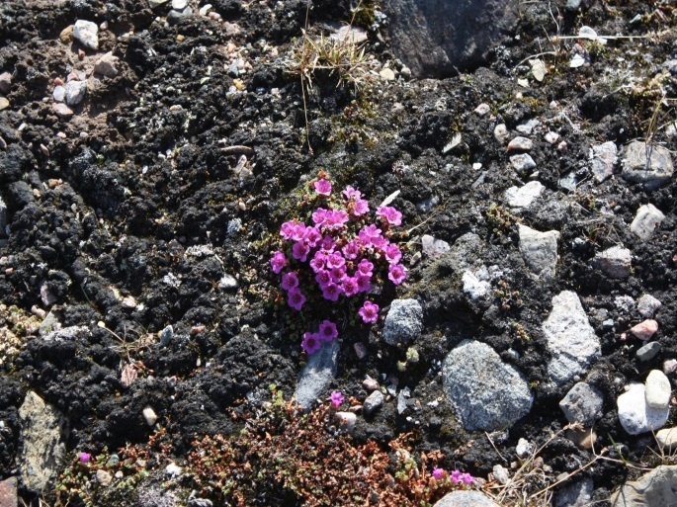
Thank you
Koana
Qujannamiik
Merci
ᖁᔭᓐᓇᒦᒃ

