Slide 1
Kitikmeot Inuit Association
KIA Public Hearing of Back River Project Modifications
Notes:
Hello everyone, I am John Roesch, the Senior Hope Bay Project Officer for the Department of Lands and Environment for the Kitikmeot Inuit Association. I am responsible for project oversite for the KIA and provide input into the regulatory process on the Back River Project to both the NWB and NIRB. In performing this role, I make use of KIA’s consultants who are subject matter experts in the areas of hydrology, hydrogeology, fisheries, aquatic environment, and geotechnical engineering.

Slide 2
Purpose of Presentation
Present a summary of KIA’s Technical Review of Sabina Gold & Silver Corp’s proposed modifications to Back River Project.
KIA conducted a thorough review in the areas of hydrology, hydrogeology, fisheries, aquatic environments, water quality and monitoring.
17 issues were identified and resolved through information requests.
6 issues were identified for the hydrodynamic model which are now resolved.
Notes:
The purpose of this presentation is to provide a brief summary of our technical review of the Back River Project Type A water license application. Our review covered hydrology, hydrogeology, fisheries, aquatic environments, water quality, and monitoring. KIA conducted the review in a collaborative manner with Sabina Gold & Silver out of which we brought forward 17 issues through Information Requests. These issues were resolved. Six (6) issues were identified through the review of the hydrodynamic model of Goose Lake, four of which were resolved prior to the technical meeting in March. Two (2) outstanding issues from the technical meeting were resolved through the update of the hydrodynamic model and discussions with Sabina.

Slide 3
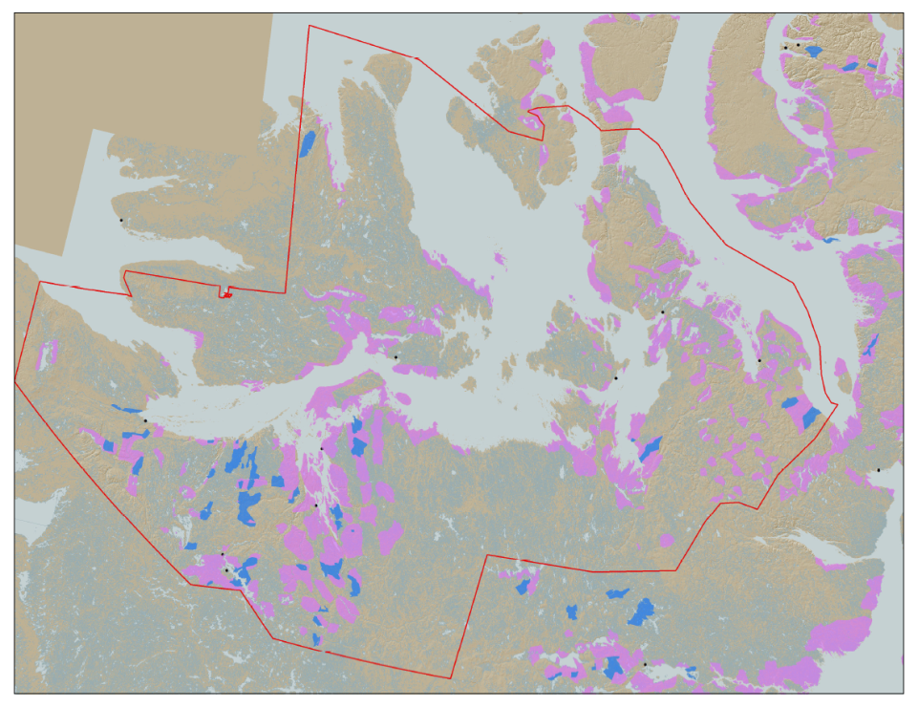

KIA’s Mandate
KIA’s Mandate is to represent the interests of Kitikmeot Inuit by protecting and promoting their social, cultural, political, environmental, and economic well-being.
KIA owns 106,360 km² of surface land: A significant opportunity if managed properly.
Hope Bay Project
Bathurst Inlet
Marine Laydown Area (MLA)
Goose Lake Mine Site
Notes:
KIA’s mandate is to manage Kitikmeot Inuit lands and resources, and to protect and promote the social, cultural, political, environmental and economic well-being of Kitikmeot Inuit. The Kitikmeot Region is generally within the red boundary. The Pink and Blue lands are lands which KIA owns the surface rights.
Kitikmeot Inuit Association is a democratically elected not-for-profit society that represents the Inuit of the Kitikmeot Region of Nunavut.
As a result of the Nunavut Agreement, Inuit are one of the largest private landowners in the world. Much of this privately owned land is in areas with high potential for mineral development. This land is a significant opportunity for Inuit if it is managed properly. We must optimize opportunities and manage liabilities that are inherent with being a private landowner. If not, we will affect the well-being of our Kitikmeot Inuit membership.
The Back River Project, composed of the Marine Laydown Area, winter road, and Goose Lake mine site is located on the mainland south of Bathurst Inlet and in the southern part of the region.

Slide 4
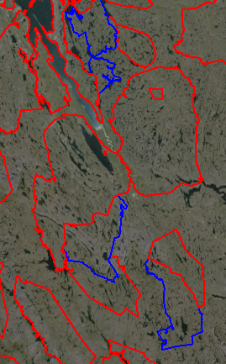
The Back River Project
Located on 5 parcels of Inuit Owned Land.
The Back River Project’s Marine Lay Down Area (MLA), winter road, and Goose Lake are on:
  BB-02, BB-13, BB-15, BB-16, and BB-27
  Exploration potential at George site on BB-15
Sabina took over development of the project in 2009
MLA
BB-27
120 km
BB-16
BB-15
George Site
BB-02
BB-13
Goose Lake
Notes:
The Back River Project composed of the Marine Laydown Area (MLA), winter ice road, and the Goose Lake mine site reside on five Inuit Owned Land parcels. These being BB-02, BB-13, BB-15, BB-16, and BB-27.
The MLA is in BB-27 and the Goose Lake mine site is in BB-13. The winter ice road runs from the MLA to Goose Lake through all the parcels.
Exploration camps currently exist at Goose Lake and George sites. The George site is a potential area of future exploration and development. It is currently closed and will not be developed into a mine site in the immediate future.
On the Map you can see the locations of some of the highest priority development sites are the MLA and Goose Lake.

Slide 5
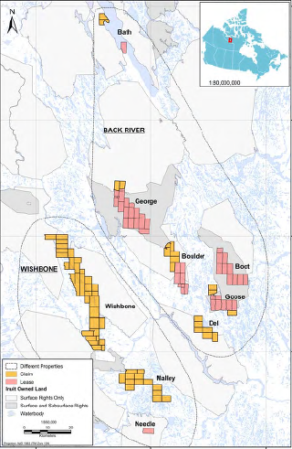
Sabina Mineral Claims in the Kitikmeot Region
Notes:
This map shows the Back River and Wishbone mineral claims held by Sabina with the MLA near the top of the map and Goose Lake in the south-east area of the map. Only the MLA, winter ice road, and Goose Lake are developed at the present time.

Slide 6
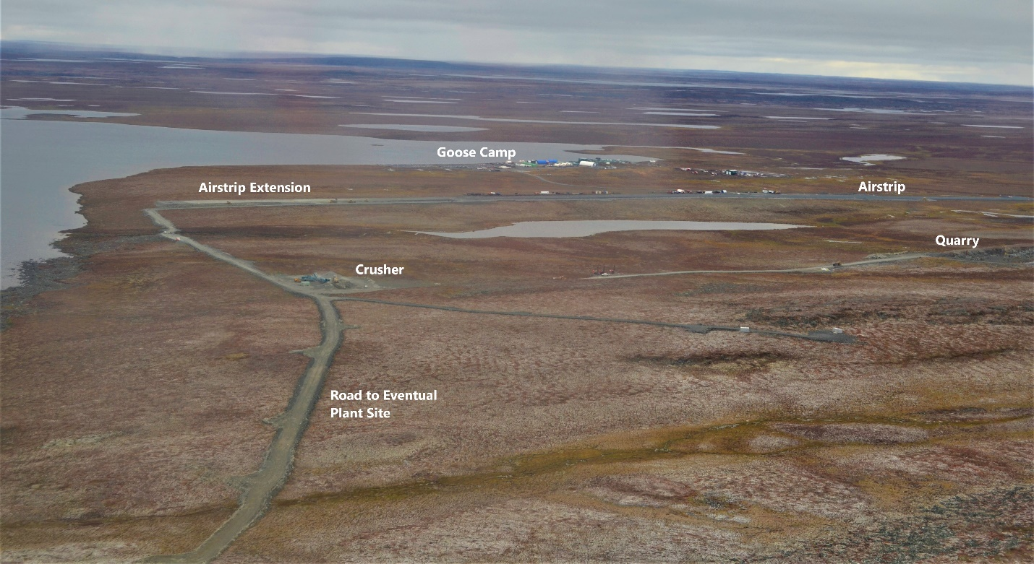
The Back Rover Project
Goose Lake Camp, September 2020
Notes:
This picture is of the existing Goose Lake exploration camp in September 2020. The Goose Lake mine site will be developed at this location and will have four mining areas within it. The mines will be both open pit and underground mines for each of the Goose Lake deposits. These being Umwelt, Llama, Goose Main, and Echo.
The mine will operate for about ten years producing 350,000 ounces of gold. The mill will process about 6,000 tonnes of ore per day and the Tailings Storage Area (TSA) will be located on Crown land. The doré bars produced at site will be flown out on aircraft.

Slide 7
Hydrodynamic Model Technical Issues
The six issues and recommendations from the hydrodynamic model review are:
  Divergence from FEIS predicted impacts to Goose Lake.
  Change in discharge period to include two years of the operational period.
  Water quality predictions and defining the mixing zone.
  Clarifying the model warm up period.
  Water quality inputs into the hydrodynamic model.
  Model calibration
KIA has reviewed Sabina’s response. Four issues are resolved prior to the technical meeting in March, while two issues are resolved afterwards.
Notes:
The KIA’s aquatic and water quality consultant had reviewed the hydrodynamic model for Goose Lake. Six issues were raised with associated recommendations these being: 1. Divergence from FEIS predicted impacts to Goose Lake, 2. Change in discharge period to include two of the operational period, 3. Water quality predictions and defining the mixing zone, 4. Clarifying the model warm up period, 5. Water quality inputs into the hydrodynamic model, and 6. model calibration.
KIA had reviewed Sabina’s response to our six issues and recommendations. Four of the issues are resolved prior to the technical meeting while two were resolved afterward through the updating of the hydrodynamic model and discussions with Sabina.
The four resolved issues prior to the technical meeting were 2. the change in discharge period, 4. the model warm up period, 5. the water quality inputs, and 6. model calibration.
The two issues resolved after the technical meeting were 1. Divergence from FEIS predicted impacts to Goose Lake, and 3. Water quality predictions and defining the mixing zone.

Slide 8
Conclusion
KIA believes that with all identified technical issues being resolve resolved, the KIA, Sabina Gold & Silver Corp. and CIRNAC can conclude their discussions on updating the security for the Back River Project.
Thank You
Questions?
Notes:
The KIA believes that with all identified technical issues resolved, the KIA, Sabina Gold & Silver Corp., and CIRNAC can conclude their discussions on updating the security for the Back River Project.
We thank you for listening and we are open to any questions.

