Slide 1
Water Licence Amendment And Renewal Application from Type “A” Water Licence 2 AM-DOH1335
Nunavut Water Board Technical Meeting and Pre-hearing Conference
July 16-17, 2026

Slide 2
Presentation Outline
Role and Responsibilities
Contributions to the Water Licence Application Review
Technical Review Comments
Summary of Next Steps
Conclusion

Slide 3
Roles and Responsibilities
Crown-Indigenous Relations and Northern Affairs Canada’s (CIRNAC) responsibilities, mandate, and obligations are in alignment with the following:
Crown-Indigenous Relations and Northern Affairs Act
Nunavut Agreement
Nunavut Land Claims Agreement Act
Nunavut Waters and Nunavut Surface Rights Tribunal Act and the associated regulations
Nunavut Planning and Project Assessment Act
Territorial Lands Act and the associated regulations
Arctic Waters Pollution Prevention Act

Slide 4
Contributions to Water Licence
Application Review
CIRNAC made the following submissions to the Nunavut Water Board regarding
March 19 2026 – First Round of the Review of the Licence Completeness Check
April 20, 2026 – Second Round of the Review of the Licence Completeness Check
May 1, 2026 – CIRNAC’s Response to Round 2 of the Information Request Responses to the NWB
May 14, 2026 - Participation in a Working group with Agnico Eagleand the Kitikmeot Inuit Association
June 4 and 5, 2026 – Participation in a Working group with Agnico Eagle, ECCC, DFO and the Kitikmeot Inuit Association

Slide 5
Technical Review Comments
R-01 Quality Of Water Sources
CIRNAC recommends that the Nunavut Water Board ensure that the proponent provide a description of the quality of water source(s) and the available capacity, and provide a description of the quality of the water from each of Windy Lake, Patch Lake, and Doris Lake for each season (summer, fall winter, spring), in the format prescribed by the NWB guidelines, to support assessment of baseline conditions and potential project effects.
CIRNAC also recommends that the Nunavut Water Board ensure the licence conditions require long-term, seasonally representative water quality monitoring of freshwater sources impacted by project activity over the life of mine—including construction, operations, and the full term of the licence—to support ongoing evaluation of baseline conditions and potential project-related effects.

Slide 6
Technical Review Comments
R-02 Discharge Criteria
CIRNAC recommends that the Nunavut Water Board include within the Licence the full suite of relevant and current CCME freshwater quality guidelines applicable to project discharges to ensure continued protection of the receiving environment under the proposed amendment and renewal conditions.

Slide 7
Technical Review Comments
  R-03 Summary Table Of Expected Quality And Quantity Of Water And Adaptative Management Criteria
CIRNAC recommends that the Nunavut Water Board ensure that the proponent provides a summary table of the expected quality and quantity of waters, over time in all sumps, monitoring stations, and discharge points (including tundra discharge points), along with i) if applicable, adaptive management criteria to benchmark if mitigation/contingency are to be implemented, ii) if applicable, water quality criteria, and iii) management action, in the format required by NWB Guidelines.

Slide 8
Technical Review Comments
  R-04 Method(s) Of Extraction And Operating Of Pump(s)
CIRNAC recommends that the Nunavut Water Board ensure that the proponent provides a description of the method(s) of extraction and a description of the operating capacity of the pump(s) used to support assessment of potential impacts associated with increased water withdrawals and evolving operational conditions.

Slide 9
Technical Review Comments
R-05 Water Management Infrastructure Information
CIRNAC recommends that the Board ensure that the Proponent provide complete information regarding :
  Existing storage reservoirs;
  Watercourse crossings including pipelines, bridges, culverts or roads;
  Watercourse trainings including channel and bank alterations, culverts, spurs, erosion control, and artificial accretion;
  Diversions including ditches and dikes and their purposes.

Slide 10
Technical Review Comments
  R-06 Prediction Of Climate Trends
CIRNAC recommends that the Nunavut Water Board ensure that the proponent provides a description of the predicted future climate trends at the project site, including worst-case scenario projections using the Intergovernmental Panel on Climate Change’s Shared Socioeconomic Pathway – Representative Concentration Pathway 5-8.5.

Slide 11
Technical Review Comments
  R-07 Ice Road
CIRNAC recommends that the Nunavut Water Board ensure that the proponent provides a description of the predicted future climate trends at the project site, including worst-case scenario projections using the Intergovernmental Panel on Climate Change’s Shared Socioeconomic Pathway – Representative Concentration Pathway 5-8.5.

Slide 12
Technical Review Comments
  R-08 Management Plans
CIRNAC recommends that the Board ensure that the Proponent provides complete information in accordance with NWB guidelines Guide 7 and Guide 4, to support the assessment of potential impacts to water resources regarding:
  An updated water management plan that demonstrates consistency between the text and its flow diagram;
  A Spill Contingency Plan, a Dam Emergency Plan, and an Emergency Response Plan to address all phases of the project including construction, operation, and care & maintenance.

Slide 13
Technical Review Comments
  R-09 Outstanding Information Requests With Commitment From Proponent
CIRNAC recommends that the Nunavut Water Board request clarification from the Proponent on the status of commitments made during the June 4–5 working group and inquire whether responses to IR‑08c, IR‑14, IR‑25, IR‑37a, and IR‑37b will be provided.
Status : Based of information received by the proponent, IR-25 is considered resolved.

Slide 14
Technical Review Comments
  R-10 Tailing Volume Comparison and Reconciliation to FEIS
CIRNAC recommends that the Board ensure that the Proponent:
  Provide a clear comparison of previously assessed/authorized maximum mined quantities and tailings quantities in comparison to the proposed amendment;
  Provide a technical analysis supporting the conclusion that the 90% increase in mining and tailings quantities relative to the assessed and approved project remains within the previously assessed envelope.

Slide 15
Technical Review Comments
  R-11 Waste Rock Quantities and Mining Area Reconciliation to FEIS
CIRNAC recommends that the Board ensure that the Proponent:
  Provide a reconciliation of total mined tonnes and waste rock volumes relative to FEIS assumptions;
  Confirm that all mining areas remain within previously assessed spatial limits or quantify expansions;
  Identify whether the amendment represents an increase in total material mined or a change in sequencing/throughput only; and
  Demonstrate that associated geochemical and water management impacts remain within previously assessed bounds.

Slide 16
Technical Review Comments
  R-12 Life of Mine (LOM) Reconciliation with Increased Throughput
CIRNAC recommends that the Board ensure that the Proponent:
  Provide the LOM (years) associated with the amended mine plan;
  Provide a comparison to the LOM assessed in the FEIS;
  Reconcile total tonnes mined under the amended plan with FEIS assumptions; and
  Describe implications for cumulative water use and discharge volumes over the full LOM.

Slide 17
Technical Review Comments
  R-13 Multiple-Accounts Analysis (MAA) – Tailings Management Strategy Selection
CIRNAC recommends that the Board ensure that the Proponent:
  Provide the results of the Multiple-Accounts Analysis supporting selection of the filtered tailings option, including criteria, weightings, scoring, and sensitivity analysis; or
  If there is financially sensitive information in the MAA, provide a redacted version or a detailed technical summary that is sufficient to demonstrate that the selected tailings management option is preferred with respect to water-related environmental outcomes.

Slide 18
Technical Review Comments
  R-14 Dry Stack Tailings Closure Strategy
CIRNAC recommends that the Board ensure that the Proponent:
  Provide a conceptual dry stack closure design, including cover system, infiltration control, and water management approach;
  Confirm that the source term predictions (Appendix 4E) and water quality and load balance mode predictions (Appendix 4F) are based on the placement of a complex, low-permeability geomembrane cover over the dry-stack and slurry tailings;
  Provide the incremental closure costs associated with construction of a complex, low-permeability geomembrane cover relative to the previously proposed cover strategy;
  Model post-closure seepage quality and quantity under baseline and climate change scenarios; and
  Demonstrate that closure water quality objectives can be achieved without reliance on long-term active treatment.

Slide 19
Technical Review Comments
  R-15 Fugitive Dust and Air Quality – Dry Stack Tailings (Operational Phase)
CIRNAC recommends that the Board ensure that the Proponent:
  Provide a quantitative assessment of fugitive dust generation from the dry stack tailings during operations;
  Characterize the expected composition of dust, including key parameters such as arsenic;
  Describe dust mitigation and monitoring measures; and
  Confirm that dust deposition will not result in measurable adverse effects on environmental quality, including surface water.

Slide 20
Technical Review Comments
  R-16 Updated Tailings Facility Design and Operation
CIRNAC recommends that the Board ensure that the Proponent provide clarity on what is meant by its references to “within the existing TIA footprint” and provide additional discussion and details to support the statement that all tailings generated under the amended operations will in fact fall within the existing TIA footprint.

Slide 21
Technical Review Comments
  R-17 Justification of Maximum Water Withdrawal Rates (Dry Stack Transition)
CIRNAC recommends that the Board ensure that the Proponent:
  Provide a comparison of water withdrawal requirements for slurry versus dry stack tailings at equivalent throughput;
  Quantify expected reductions in make-up water demand resulting from filtration;
  Demonstrate how these reductions have been incorporated into the requested maximum withdrawal limits;
  Identify the conditions under which maximum withdrawal rates would be required (e.g., low-flow conditions, reduced recycle efficiency); and
  Confirm that requested limits do not exceed those necessary to support the amended mine plan.

Slide 22
Technical Review Comments
  R-18 Water Balance Stress Test (Non-Average Conditions)
CIRNAC recommends that the Board ensure that the Proponent:
  CIRNAC recommends that the Board ensure that the Proponent:
  Provide water balance stress test scenarios representing low-flow and extreme inflow conditions;
  Demonstrate that the water management system can operate without uncontrolled discharge under these scenarios; and
  Confirm that storage, pumping, and treatment capacity are sufficient to maintain compliance under extreme conditions.

Slide 23
Technical Review Comments
  R-19 No Freshwater Discharge Commitment
CIRNAC recommends that the Board ensure that the Proponent:
  Confirm whether any discharge to freshwater will occur under any operating condition;
  If no discharge is proposed, provide an explicit commitment to this effect; and
  Describe contingency measures that ensure freshwater systems are protected under upset and extreme conditions.

Slide 24
Technical Review Comments
  R-20 Source Term Conservatism and Sensitivity
CIRNAC recommends that the Board ensure that the Proponent:
  Identify conservative assumptions used in the source term development;
  Provide sensitivity analysis for key parameters (e.g., arsenic, sulphate, nitrogen); and
  Demonstrate that predicted effluent quality remains within acceptable limits under a range of plausible conditions.

Slide 25
Technical Review Comments
  R-21 Under-Ice/Seasonal Operations Constraint
CIRNAC recommends that the Board ensure that the Proponent:
  Define operational constraints under winter and under-ice conditions;
  Describe how water withdrawals, storage, and discharge will be managed during these periods; and
  Demonstrate that the water management system will operate without adverse impacts under seasonal conditions.

Slide 26
Technical Review Comments
  R-22 Uncertainty Register And Commitments
CIRNAC recommends that the Board ensure that the Proponent:
  Provide an uncertainty register identifying key uncertainties across all components of the project;
  Identify associated risks and potential environmental implications;
  Define mitigation measures, monitoring requirements, and actions to address each uncertainty;
  Provide timelines for resolution; and
  Link these commitments to future plan submissions and licence conditions where appropriate.

Slide 27
Technical Review Comments
  R-23 Interim Closure And Reclamation Plan (ICRP) And Security
CIRNAC recommends that the Board ensure that the Proponent provide a detailed technical ICRP update that includes the following technical information:
  details on all relevant closure elements, activities, quantities and schedules;
  details that support the selected closure approach for each closure element; and
  details on performance objectives and criteria to support acceptance of the closure works.
  a conceptual closure security estimate that identifies and includes costs for closure of all aspects of the proposed Operational Update including the proposed dry stack tailings facilities.

Slide 28
Summary of Next Steps
As CIRNAC did not receive the proponent’s reply to technical comments at the time of preparing this presentation, all technical comments are considered unresolved at this time with the exception of R-09 which is partially resolved.

Slide 29
Conclusion
CIRNAC will continue to work through the water licence application review process with the aim of protecting Nunavut’s inland water resources while promoting sustainable development.

Slide 30
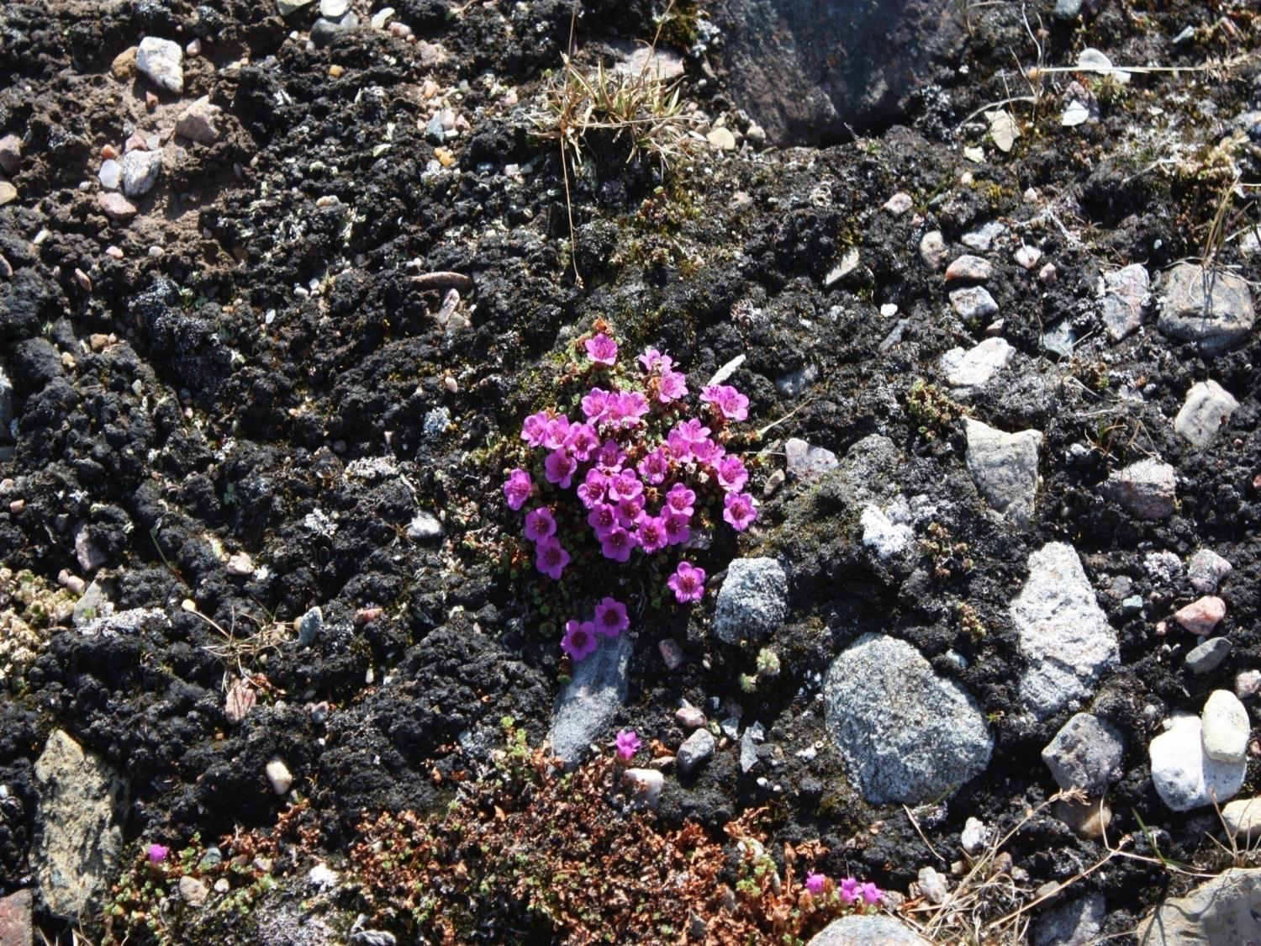
Qujannamiik
Thank you
Merci
ᖁᔭᓐᓇᒦᒃ

