Slide 1
Water Licence
Amendment And Renewal Application from Type “A” Water Licence 2 AM-DOH1335
Nunavut Water Board Technical Meeting
and Pre-hearing Conference
July 16-17, 2026

Slide 2
Presentation Outline
Role and Responsibilities
Contributions to the Water Licence Application Review
Technical Review
Conclusion

Slide 3
Roles and Responsibilities
Crown-Indigenous Relations and Northern Affairs Canada’s (CIRNAC) responsibilities, mandate, and obligations are in alignment with the following:
Crown-Indigenous Relations and Northern Affairs Act
Nunavut Agreement
Nunavut Land Claims Agreement Act
Nunavut Waters and Nunavut Surface Rights Tribunal Act and the associated regulations
Nunavut Planning and Project Assessment Act
Territorial Lands Act and the associated regulations
Arctic Waters Pollution Prevention Act

Slide 4
Contributions to Water Licence
Application Review
CIRNAC made the following submissions to the Nunavut Water Board regarding
March 19 2026 – First Round of the Review of the Licence Completeness Check
April 20, 2026 – Second Round of the Review of the Licence Completeness Check
May 1, 2026 – CIRNAC’s Response to Round 2 of the Information Request Responses to the NWB
May 14, 2026 - Participation in a Working group with Agnico Eagleand the Kitikmeot Inuit Association
June 4 and 5, 2026 – Participation in a Working group with Agnico Eagle, ECCC, DFO and the Kitikmeot Inuit Association
June 19, 2026– CIRNAC’s submission of technical review comments

Slide 5
CIRNAC’s Recommendations
Water Source Quality and Quantity (R-01 to R-03)
Key message : Robust baseline water data, comprehensive monitoring, discharge criteria, and adaptive management triggers are needed to support effective assessment and management of project water impacts throughout the mine life.
Lack of current seasonal water quality data and available capacity for Windy, Patch, and Doris Lakes and long-term (construction, operation and mine life), seasonally representative water quality monitoring.
Lack of a summary table of expected water quality and quantity over time for all sumps, monitoring stations, and discharge points, including adaptive management criteria/triggers for mitigation and contingency measures (where applicable).
CIRNAC requires information to access that water quality and quantity would not change based on the increase water withdrawal and mine activities proposed in this Water Licence amendment renewal application, to ensure protection of the receiving environment and informed regulatory oversight.
Unresolved

Slide 6
CIRNAC’s Recommendations
Water Management and Water Intake Infrastructure (R-04 & R-05)
Key Message: Information on water extraction systems and all water management infrastructure is required to support the affirmation that all current water management and water intake infrastructure is adequate to support the increase water withdrawal and mine activities proposed in this Water Licence amendment renewal application.
Lack a description of the current and planned method(s) of extraction and a description of the operating capacity of the pump(s).
Lack information regarding current water management infrastructure, including :
  Existing storage reservoirs;
  Watercourse crossings including pipelines, bridges, culverts or roads;
  Watercourse trainings including channel and bank alterations, culverts, spurs, erosion control, and artificial accretion;
  Diversions including ditches and dikes and their purposes.
CIRNAC is seeking consolidated information on water withdrawal operations and water management infrastructure to demonstrate that the current infrastructure is adequate to support the increase water withdrawal and mine activities proposed in this Water Licence amendment renewal application.
Unresolved

Slide 7
CIRNAC’s Recommendations
Prediction Of Climate Trends
Key Message: Future climate change, including worst-case warming scenarios, must be considered in project planning and assessment to evaluate potential effects on infrastructure, operations, and water management.
Lack a description of the predicted future climate trends at the project site, including worst-case scenario projections using the Intergovernmental Panel on Climate Change’s Shared Socioeconomic Pathway – Representative Concentration Pathway 5-8.5.
CIRNAC recommends that the full sensitivity analysis be provided and an updated ICRP contains climate trends modelling using SSP5-8.5 scenario, to ensure the project is designed and managed with adequate consideration of long-term climate risks.
Partially resolved

Slide 8
CIRNAC’s Recommendations
Information Gaps And Management Plans
Key Message: Updated management and emergency response plans and completion of outstanding information requests are needed to support a comprehensive assessment of project risks and mitigation measures.
The Water Management, Spill Contingency, Dam Emergency, and Emergency Response Plans should be updated within 90 days of issuance of the licence to ensure consistencies and address all relevant project phases.
CIRNAC recommends that the proponent provide responses to the information gaps to support the review process.
E.g. drainage patterns within the solid waste disposal area(s), a detailed list of proposed proximal sources, a map of the sources, and volume measurements of each source prior to using the proximal source.
CIRNAC is seeking greater clarity, complete documentation, and fulfillment of proponent commitments to ensure the project can be effectively reviewed and managed throughout all phases of development.
Partially resolved

Slide 9
Status of CIRNAC TRCs R-10 to R-23
Key message: AEM's July 3, 2026 responses leave most CIRNAC requests unresolved.
In addition to TRC that were presented, CIRNAC submitted 14 Technical Review Comments on June 19, 2026: R-10 to R-23.
Those comments included 48 separate requests.
Responses received from AEM on the technical comments above;
27 of 48 responses (56%) were deemed non-responsive.
Only 3 of 48 requests (6%) were resolved or substantially clarified.
In the interests of time, the following slides will focus on only Four substantive deficiencies rather than reviewing all 48 requests. CIRNAC and AEM continue to engage to resolve these deficiencies through commitments from AEM. The wording of those commitments has yet to be finalized.

Slide 10
Deficiency 1: Tailings Management Strategy Remains Uncertain
Key message: The application does not clearly define what tailings strategy the NWB is being asked to approve.
The application identifies a phased transition to filtered dry-stack tailings as a preferred alternative.
AEM continues to indicate in responses that they preserve continued slurry deposition as an option and only characterize dry-stack implementation as conditional.
It remains unclear whether approval is being sought for:
a major expansion of slurry-tailings deposition;
a transition to dry-stack tailings; or
both ?
The alternatives have different implications for water demand, seepage, dust, closure and long-term water quality which have not been answered by AEM.
CIRNAC feels that in order to provide appropriate comment and recommendation AEM must commit to one strategy or fully assess each alternative and provide supporting documentation
Unresolved

Slide 11
Deficiency 2: Water Quality Predictions Rely on an Uncommitted Configuration
Key message: AEM takes best case modelling credit for dry-stack tailings combined with a geomembrane cover, but has not committed to either.
The long-term water quality and load balance modelling assumes transition to filtered dry-stack tailings, which may not occur.
Closure source terms assume a low-permeability geomembrane cover over the dry stack.
AEM now states that the geomembrane is only one potential mitigation measure, to be used 'if required.'
The modelling therefore demonstrates performance for the most favorable of tailings configuration options, but not necessarily the configuration AEM will construct at closure.
Modelled assumptions must be aligned with enforceable project and closure commitments.
Unresolved

Slide 12
Deficiency 3: Tailings Closure Concept Is Too Preliminary
Key message: Closure assumptions are being used to support approval before the closure design is adequately defined.
The current ICRP does not adequately define the dry-stack closure concept.
Information missing from the current submission include; lack of a selected cover system, infiltration target, oxygen-control strategy or measurable acceptance criteria.
AEM expects water quality to be acceptable without long-term treatment, but has not technically demonstrated that conclusion.
AEM proposes to materially update the ICRP after licence approval.
An updated ICRP addressing the amended tailings strategy should be reviewed and approved during the current proceeding.
Unresolved

Slide 13
Deficiency 4: Expansion Has Not Been Reconciled with the Previous EA
Key message: AEM has not demonstrated, despite request, that the amended project remains within the previously assessed environmental envelope.
Mill throughput increases from 2,000 tpd to approximately 8,000 tpd.
Tailings placed in the TIA increase from approximately 18 Mt to approximately 34 Mt.
The amendment also involves major increases in mining and a substantially longer overall mine life.
AEM has not provided a direct FEIS comparison for total mined tonnes, waste rock, tailings or total project duration.
AEM should provide a complete quantitative reconciliation of the amended project against the FEIS.
Unresolved

Slide 14
Conclusion
CIRNAC will continue to work together with AEM, the Nunavut Water Board and other interveners through the water licence application review process with the aim of protecting Nunavut’s inland water resources while promoting sustainable development.

Slide 15
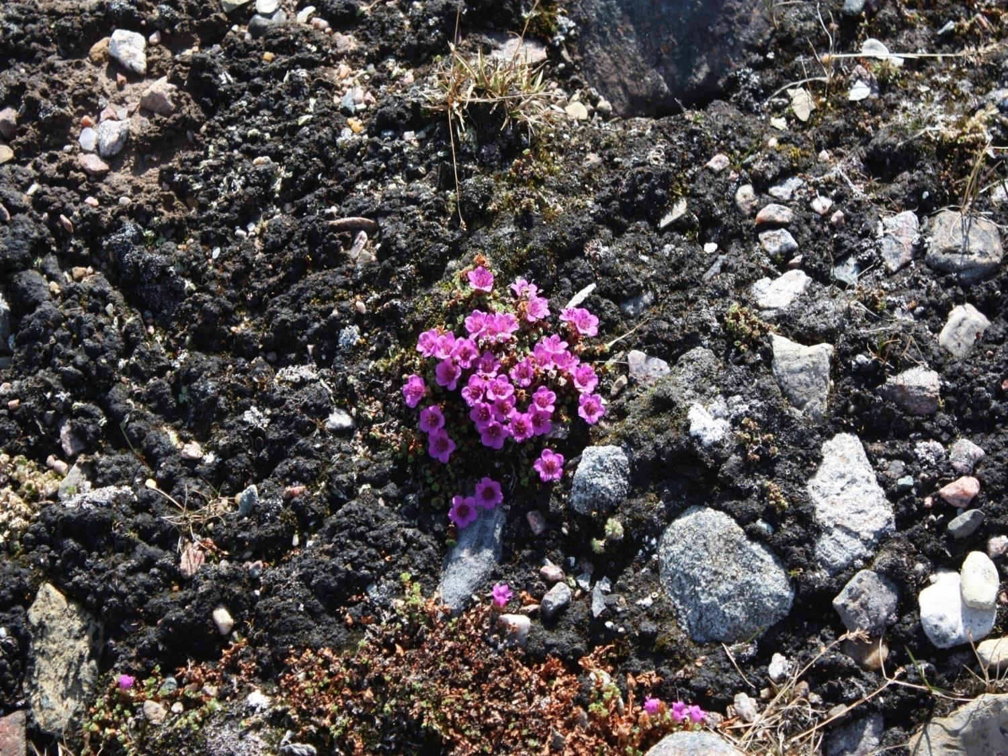
Qujannamiik
Thank you
Merci
ᖁᔭᓐᓇᒦᒃ

