Slide 1
Issue: Effects of Mine Reflooding
Issue (AANDC TC3):
“The documents do not include discussion on mine flooding after operation of the mine is finished, potential impacts of mine flooding on groundwater quality, and potential for groundwater discharge to Doris Lake after mine closure.”
December response
Described potential effects of backfill on water quality in the reflooded mine and expected flow from the reflooded mine to Doris Lake.
Outstanding
TMAC committed to provide further evaluation at the hearings.

Slide 2
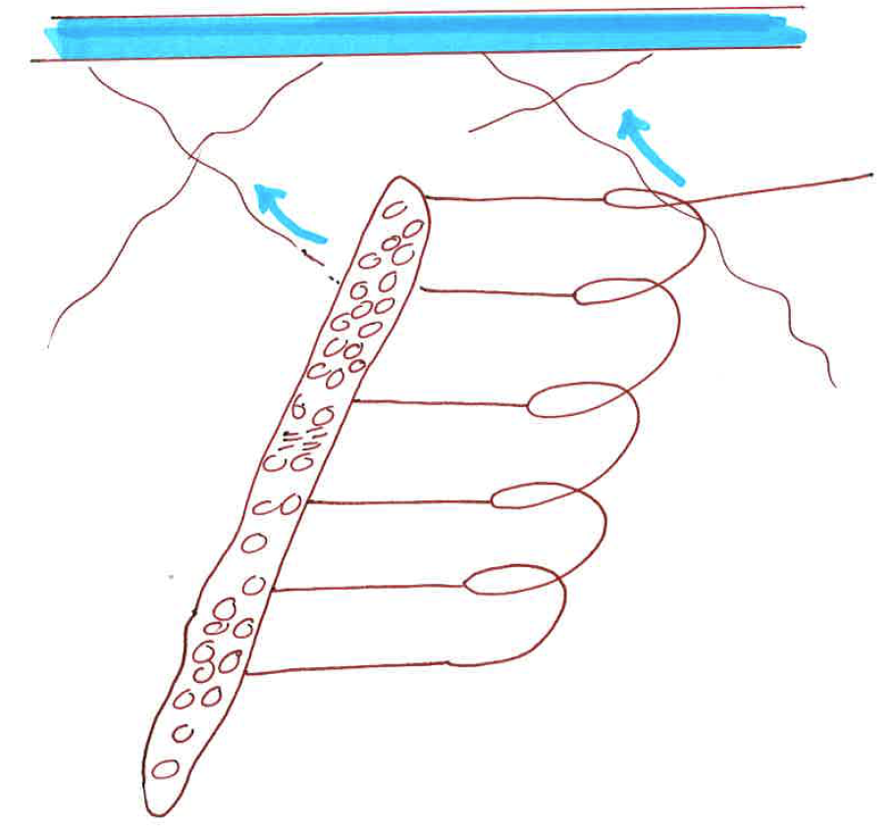
Issue: Effects of Mine Reflooding
Doris Lake
Flow through Doris Lake
8,980,000 m3/yr
(680x more than GW)
Groundwater flow
to lake (13,000 m3/yr)
Backfilled Mine Workings:
1.6 Mt WR
0.15 Mt Detox tailings
8 years oxidation
881,000 m3 groundwater
Geochemical Processes:
dissolution of stored contaminants
equilibrium with secondary minerals
attenuation to mineral surfaces
redox reactions
dissolution of ferrihydride
precipitation of sulphides

Slide 3
Issue: Effects of Mine Reflooding
Doris Lake
Flow through Doris Lake
8,980,000 m3/yr
(680x more than GW)
Groundwater flow
to lake (13,000 m3/yr)
Backfilled Mine Workings:
1.6 Mt WR
0.15 Mt Detox tailings
8 years oxidation
881,000 m3 groundwater
Geochemical Processes:
dissolution of stored contaminants
equilibrium with secondary minerals
attenuation to mineral surfaces
redox reactions
dissolution of ferrihydride
precipitation of sulphides

Slide 4
Issue: Effects of Mine Reflooding
Water Quality Estimates for Reflooded Mine
Waste Rock (1.6 Mt)
Loading rates from existing waste rock (mg/kg/day)
Assumed that half the soluble load is leached, and half accumulates over 8 years
Tailings (0.15 Mt)
Loading rates from humidity cell tests on detox tails
Correction for colder temperatures (0.2x factor)
Assumed that all of the soluble mass accumulates
Soluble Load
Loading rates x mass x time = kg soluble load

Slide 5
Issue: Effects of Mine Reflooding
Reflooded Mine Concentrations
Soluble load / volume of voids (881,000 m3) = incremental conc.
Add to concentrations in groundwater
Secondary mineral controls, attenuation and other chemical reactions were not considered (highly conservative)
Doris Lake Concentrations
Calculated loads from reflooded mine plus background loads divided by flow through Doris Lake (680x dilution)

Slide 6
Issue: Effects of Mine Reflooding
Selected results:
Change in water quality in Doris Lake is minor, even with conservative assumptions
All results below CCME
Parameter | Groundwater (mg/L) | Incremental Backfill Conc. (mg/L) | Reflooded Mine Conc. (mg/L) | Background Conc in Doris Lake (mg/L) | Doris Lake Conc. with mine inputs (mg/L)
SO4 | 1900 | 5549 | 7449 | 3 | 14
As | 0.0024 | 0.021 | 0.024 | 0.00040 | 0.00043
Cd | 0.00012 | 0.0068 | 0.0069 | 0.000010 | 0.000020
Fe | 4.7 | 7.9 | 13 | 0.13 | 0.14
Se | 0.0019 | 0.19 | 0.19 | 0.00040 | 0.00068

