Slide 1
Kitikmeot Inuit Association
KIA Technical Review of TMAC’s Amendment Application for the Doris North Mine Site Project Certificate and Type A Water License
Notes:
Hello everyone, I am John Roesch, the Senior Hope Bay Project Officer for the Department of Lands and Environment for the Kitikmeot Inuit Association. I am responsible for project oversite for the KIA and provide input into the regulatory process on the Hope Bay Project to both the NWB and NIRB. In performing this role, I make use of KIA’s consultants who are subject matter experts in the areas of wildlife, fisheries, aquatic environment, and geotechnical engineering. Two of our consultants are here to night, Dr. Heather Bear and Deborah Sinclair. Heather is our wildlife specialist and Deborah is one of our aquatic specialists,

Slide 2
Purpose of Presentation
Present a summary of KIA’s Technical Review of TMAC Resources Inc.’s amendment application of the Doris North Mine Site’s Project Certificate and Type A Water License.
KIA conducted a thorough review in the areas of wildlife, fisheries, aquatic environment, and geotechnical engineering.
14 Issues for Technical Meeting.
Notes:
The purpose of this presentation is to provide a brief summary of our technical review of the amendment to the Doris North project certificate and Type A water license. Our review covered wildlife issues, fisheries, aquatic environment, and geotechnical engineering. KIA conducted the review in a collaborative manner with TMAC Resources out of which we brought forward 14 issues to be resolved at the Technical Meeting or through further consultation.

Slide 3
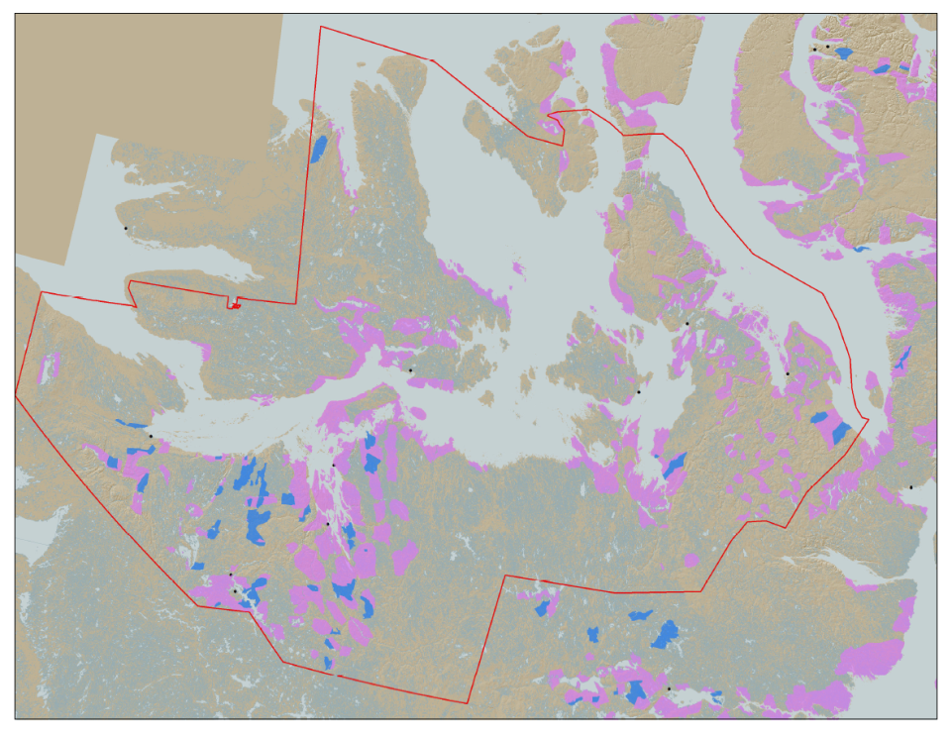

KIA’s Mandate
KIA’s Mandate is to represent the interests of Kitikmeot Inuit by protecting and promoting their social, cultural, political, environmental, and economic well-being.
KIA owns 106,360 km² of surface land: A significant opportunity if managed properly.
Hope Bay Project
Notes:
KIA’s mandate is to promote socio-economic, cultural, and environmental well-being. The Kitikmeot Region is generally within the red boundary. The Pink and Blue lands are lands which KIA owns the surface rights.
Kitikmeot Inuit Association is a democratically elected not-for-profit society that represents the Inuit of the Kitikmeot Region of Nunavut. KIA protects and promotes the social, cultural, political, environmental, and economic interests of Kitikmeot Inuit.
As a result of the Nunavut Land Claim Agreement (NLCA), Inuit are one of the largest private landowners in the world. Much of this privately owned land is in areas with high potential for mineral development. This land is a significant opportunity for Inuit if it is managed properly. We must optimize opportunities and manage liabilities that are inherent with being a private landowner. If not, we will affect the well-being of our Kitikmeot Inuit membership.
The Hope Bay Project is located on the mainland near the coast and approximately in the middle of the region.

Slide 4
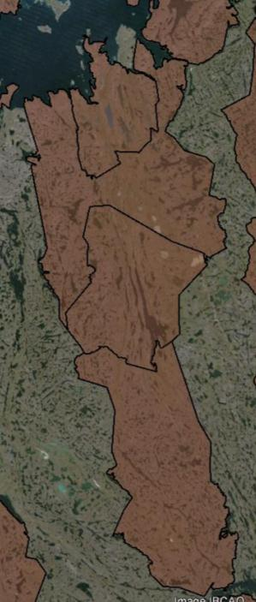
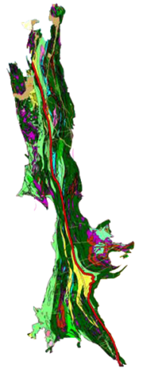

The Hope Bay Project
Doris
BB-60
Madrid
Located on 4 parcels of Inuit Owned Land.
The Hope Bay greenstone belt has had significant exploration since 1965.
  Vast exploration potential remains
TMAC took over development of the project in 2012
BB-58
120 km
BB-57
Boston
BB-56
Notes:
When the Inuit Owned Land was selected for the NLCA, Inuit knew that the Hope Bay Area was highly prospective for mineral development. A 120 Km length of surface lands that include some mineral rights were selected in the area. The brown areas are surface lands owned by KIA. BB-56, 57, 58, and 60 include our agreement with TMAC for the Hope Bay Project.
The Hope Bay greenstone belt has been explored since 1965. Within this greenstone belt, over 850Km of drilling has occurred since 1965. Most of the drilling has been focused around Doris, Madrid and Boston. This project has changed ownership many times. Prior to TMAC, the last company to operate the Hope Bay Project was Newmont, who failed to develop a profitable business case for the development of the project. TMAC took over the project in 2012.
On the Map you can see the location of some of the highest priority development sites in the belt: Doris, Madrid and Boston.

Slide 5
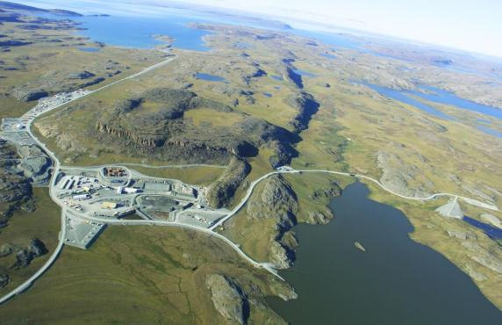
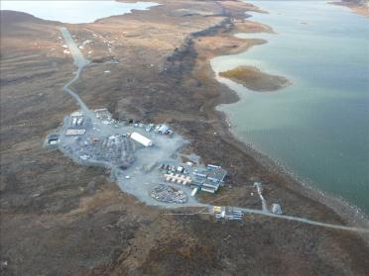
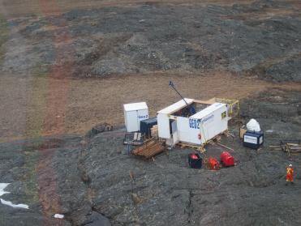
The Hope Bay Project
Doris North Mine
Boston Advanced Exploration Camp
Exploratory Drilling
Notes:
So much exploration has occurred since 1965, that people know that there are many development opportunities in the belt. The Hope Bay Greenstone Belt is unique because it demonstrates the capacity to hold several mining operations across the belt in the different stages of development, operated by one company. In another more developed part of the world, it could be that several different companies would have exploration and mining proposals in a Greenstone belt such as this.
This greenstone belt includes a permitted mine at Doris North, several advanced exploration targets such as the Boston Project which has preliminary mine plans developed, and many other identified high quality exploration targets. There is also vast exploration potential. TMAC has rights to all the minerals in this area. Once an operating mine is established, the efficiencies of belt-wide exploration will increase.

Slide 6
Technical Issues for Technical Meeting
TIA Expansion Capacity
TIA Wildlife Attraction and Deterrence
TIA Floatation Tailings Dust Fall and Leaching
TIA Elevated Parameters of Potential Concern Upon Closure
TIA NPAG Tailings Cover Depth
Notes:
As indicated previously, 14 issues were brought to the technical meeting with the NWB and NIRB pertaining to Doris North amendments. These five concern the Tailings Impoundment Area (TIA) at Doris North. We raised concerns about the capacity of the TIA to handle mining expansion into Madrid/Patch Lake area, whether caribou would be attracted to the tailings in the TIA, the potential for dust fall and leaching from the TIA into the surrounding environment, trace metal contamination, and the planned thickness of the cold cover for the tailings upon closure.
TMAC has responded to our recommendations and is running further simulations on dust fall which indicate it would be contained to the TIA. KIA believes with effective engineering and planning that TMAC can successfully mitigate these issues.

Slide 7
Technical Issues for Technical Meeting
Roberts Bay Discharge and AEMP Monitoring
Potential Interaction with Marine Environment
Mixing Zone Delineation
Increasing Contaminants of Potential Concern in Roberts Bay
Hydrogeology
Notes:
These five issues concern the simulation models for the marine discharge into Roberts Bay and hydrogeology water balance at the mine site. The issues are considered to be of moderate concern by KIA requiring only additional water sampling and adjustments to model parameters to provide improved assurance on environmental impact.
Essentially underground mine water is highly saline and is to be mixed with water from the TIA and is discharged into Roberts Bay. The salinity of the discharge should be less than the ocean and similar in temperature to minimise environmental impact on marine life.
TMAC has taken our recommendations under consideration and will run further simulations using more conservative input parameters.

Slide 8
Technical Issues for Technical Meeting
Site-Wide Water and Load Balance
Prediction of Environmental Effects on Water Quality
Doris Lake Water Levels
Attraction or Avoidance of Grizzly Bears to the Mine Site
Notes:
Issues 11 and 12 also concern simulation models of water discharge and mixing with ocean water and are viewed by KIA as being of moderate risk to the environment. KIA essentially seeks greater assurance on environmental impact of minerals and nutrients on ocean water to which TMAC has responded.
Issue 13 concerns the impact of water leakage from Doris Lake into the underground mine and its affect on the lake’s water level. TMAC has responded with a commitment to further water modeling and mitigation methods for plugging leaks and drill holes from exploration in the lake.
Issue 14 concerns improving the deployment of cameras and data collection to determine if there is a zone of influence around the mine for grizzly bears. That is to know if they are either attracted or repelled by the mine site activities.
This issue is of high concern to the KIA since bears are known to travel through the area along the coast and is a condition of the original project permit. TMAC has taken our recommendations under advisement and will be considered in the updating of the Wildlife Mitigation and Monitoring Program (WMMP) for the Doris North mine site.

Slide 9
Socio-Economic Development
KIA and TMAC signed a comprehensive Framework Agreement for the Hope Bay Project.
Inuit Impact and Benefit Agreement (IIBA) addresses socio-economic interests of Inuit for employment, contracting, and training.
Implementation Committee and Inuit Environmental Advisory Committee (IEAC) is established under the IIBA.
IIBA satisfies all present and future obligations required under the NLCA.
Notes:
In addition to the technical issues raised, the KIA would like to point out that we have signed with TMAC a comprehensive Framework Agreement for land access compensation and an Inuit Impact and Benefit Agreement (IIBA).
The IIBA addresses Inuit interests in the areas of employment, contracting, and training in relation to the Hope Bay Project as a whole through its entire life span.
Under the IIBA an Inuit Environmental Advisory Committee (IEAC) has been established with TMAC which complements KIA’s current environmental activities in the Department of Lands and Environment. The IEAC allows for the local community to have input directly to TMAC on environmental concerns.
Through the Implementation Committee with KIA and TMAC representatives, measures of employment, business development, and training are being developed which fulfills socio-economic obligations under the NLCA.

Slide 10
Socio-Economic Development
Framework Agreement and IIBA,
Net Smelter Royalty Agreement,
Water and Wildlife Compensation Agreement,
Mineral Rights Agreement with NTI, and
KIA shareholdings in TMAC Resources Inc. creates substantial benefits for Inuit in the Kitikmeot region.
Notes:
The KIA receives monetary compensation through a variety of agreements. Direct compensation through the Framework Agreement and IIBA for land access, quarry materials and water usage. Royalties from gold production plus shareholdings in TMAC.
NTI also gets a royalty on profit under its Mineral Rights Agreement with TMAC Resources Inc. All of this creates a substantial benefit for Inuit in the region.

Slide 11
Conclusion
KIA believes that all remaining technical issues identified can be successfully resolved through continued cooperation between KIA and TMAC Resources Inc. at the Technical Meeting and on an on-going basis.
Thank You
Questions?
Notes:
The KIA believes that the technical issues brought forward to the Technical Meeting can be successfully resolved with TMAC through our on-going collaboration.
Given this and the substantial benefits that will be obtained for Inuit from the Hope Bay Project and the opening of the Doris North mine site, we believe that the amendment of the project certificate and Type A water license is warranted and in the best interest of the Inuit people.

