Slide 1
Nunavut Water Board Community Meeting
Doris Water Licence Amendment
January 28, 2016 – Cambridge Bay, NU

Slide 2
Forward-Looking Information
This document contains “forward-looking information” within the meaning of applicable Canadian securities laws. Forward-looking information includes statements that use forward-looking terminology such as “may”, “could”, “would”, “will”, “intend”, “plan”, “expect”, “budget”, “estimate”, “forecast”, “schedule”, “anticipate”, “believe”, “continue”, “potential” or the negative or grammatical variation thereof or other variations thereof or comparable terminology. Such forward-looking information includes, without limitation, statements with respect to Mineral Reserve and Mineral Resource estimates; targeting additional Mineral Resources and expansion of deposits; the capital and operating cost estimates and the economic analyses (including cashflow projections) from the Hope Bay Technical Report; the Company’s expectations, strategies and plans for the Hope Bay Project, including the Company’s planned exploration and development activities; the results of future exploration and drilling and estimated completion dates for certain milestones; successfully adding or upgrading resources and successfully developing new deposits; the costs and timing of future exploration and development, including the timing for completion and commissioning of the Gekko Plant; commencement of production at Doris in December 2016, at Madrid in 2020 and at Boston in 2022; that the Company will "bootstrap" the development of Madrid and Boston; the timing and amount of future production at Doris, Madrid and Boston and the capacity of the Gekko Plant to process production; the timing, receipt and maintenance of approvals, licences and permits from the federal government, from the KIA and NTI and from any other applicable government or regulator; future financial or operating performance and condition of the Company and its business, operations and properties; the expected completion date of the Debt Facility and any Interim Facility; the intended use of the net proceeds of the Offering, the Debt Facility and any Interim Facility; the adequacy of funds from the Offering and the Debt Facility to support completion of initial development of Doris and commence commercial production; and any other statement that may predict, forecast, indicate or imply future plans, intentions, levels of activity, results, performance or achievements.
Forward-looking information is not a guarantee of future performance and is based upon a number of estimates and assumptions of management, in light of management’s experience and perception of trends, current conditions and expected developments, as well as other factors that management believes to be relevant and reasonable in the circumstances, as of the date of this prospectus including, without limitation, assumptions about: favourable equity and debt capital markets; the ability to raise any necessary additional capital on reasonable terms to advance the development of the Hope Bay Project and pursue planned exploration; future prices of gold and other metal prices; the timing and results of exploration and drilling programs; the accuracy of any Mineral Reserve and Mineral Resource estimates; the geology of the Hope Bay Project being as described in the Hope Bay Technical Report; the metallurgical characteristics of the deposit being suitable for the Gekko Plant; the successful operation of the Gekko Plant; production costs; the accuracy of budgeted exploration and development costs and expenditures, including to complete development of the infrastructure at the Hope Bay Project; the price of other commodities such as fuel; future currency exchange rates and interest rates; operating conditions being favourable, including whereby the Company is able to operate in a safe, efficient and effective manner; political and regulatory stability; the receipt of governmental and third party approvals, licences and permits on favourable terms; obtaining required renewals for existing approvals, licences and permits and obtaining all other required approvals, licences and permits on favourable terms; sustained labour stability; stability in financial and capital goods markets; availability of equipment; positive relations with the KIA and NTI and other local groups and the Company’s ability to meet its obligations under its property agreements with such groups; the Company’s ability to operate in the harsh northern Canadian climate; and satisfying the terms and conditions of the Debt Facility and any Interim Facility. While the Company considers these assumptions to be reasonable, the assumptions are inherently subject to significant business, social, economic, political, regulatory, competitive and other risks and uncertainties, contingencies and other factors that could cause actual actions, events, conditions, results, performance or achievements to be materially different from those projected in the forward-looking information. Many assumptions are based on factors and events that are not within the control of the Company and there is no assurance they will prove to be correct.
Furthermore, such forward-looking information involves a variety of known and unknown risks, uncertainties and other factors which may cause the actual plans, intentions, activities, results, performance or achievements of the Company to be materially different from any future plans, intentions, activities, results, performance or achievements expressed or implied by such forward-looking information. Such risks include, without limitation: general business, social, economic, political, regulatory and competitive uncertainties; differences in size, grade, continuity, geometry or location of mineralization from that predicted by geological modelling and the subjective and interpretative nature of the geological modelling process; the speculative nature of mineral exploration and development, including the risk of diminishing quantities or grades of mineralization and the inherent riskiness of Inferred Mineral Resources; a material decline in the price of gold; a failure to achieve commercial viability, despite an acceptable gold price, or the presence of cost overruns which render the project uneconomic; geological, hydrological and climactic events which may adversely affect infrastructure, operations and development plans, and the inability to effectively mitigate or predict with certainty the occurrence of such events; credit and liquidity risks associated with the Company’s financing activities, including constraints on the Company’s ability to raise and expend funds as a result of operational and reporting covenants associated with the Debt Facility and the Interim Financing and the risk that the Company will be unable to service its indebtedness; the Company’s inability to raise sufficient funds to develop the Hope Bay Project into commercial production; delays in construction or development of the Hope Bay Project resulting from delays in the performance of the obligations of the Company’s contractors and consultants, the receipt of governmental approvals and permits in a timely manner or to complete and successfully operate mining and processing components; the Company’s failure to accurately model and budget future capital and operating costs associated with the development and operation of the Hope Bay Project; difficulties with transportation and logistics relating to the delivery of essential equipment and supplies to the Hope Bay Project, including by way of airlift and sealift, and the logistical challenges presented by the Hope Bay Project’s location in a remote Arctic environment; the failure to develop or supply adequate infrastructure to sustain the operation and development of the Hope Bay Project, including the provision of reliable sources of electrical power, water, and transportation; adverse fluctuations in the market prices and availability of commodities and equipment affecting the Company’s business and operations; the unavailability of specialized expertise in respect of operating in a remote, environmentally extreme and ecologically sensitive area in the Kitikmeot region of Nunavut; the Company’s management being unable to successfully apply their skills and experience and attract and retain highly skilled personnel; the cyclical nature of the mining industry and increasing prices and competition for resources and personnel during mining cycle peaks; the Company’s failure to maintain good working relationships with Inuit organizations; failure to comply with laws and regulations or other regulatory requirements; failure to comply with existing approvals, licences and permits, and Inuit agreements, and the Company’s inability to renew existing approvals, licences, permits and Inuit agreements or obtain required new approvals, licences, permits and Inuit agreements on timelines required to support development plans; the Company’s failure to comply with environmental regulations, the tendency of such regulations to become more strict over time, and the costs associated with maintaining and monitoring compliance with such regulations; the adverse influence of third party stakeholders including social and environmental non-governmental organizations; the adverse impact of competitive conditions in mineral exploration and mining business; the Company’s failure to maintain satisfactory labour relations and the risk of labour disruptions or changes in legislation relating to labour; the Company’s lack of operating history and no history of earnings; failure by the Company to use the proceeds of the Offering in the manner specified in the prospectus; limits of insurance coverage and uninsurable risk; the adverse effect of currency fluctuations on the Company’s financial performance; difficulties associated with enforcing judgements against directors residing outside of Canada; conflicts of interest; the significant control exercised by RCF and Newmont over the Company; the dilutive effect of future acquisitions or financing activities and the failure of future acquisitions to deliver the benefits anticipated; failure of the Company’s information technology systems or the security measures protecting such systems; the costs associated with legal proceedings should the Company become the subject of litigation or regulatory proceedings; and costs associated with complying with public company regulatory reporting requirements.

Slide 3
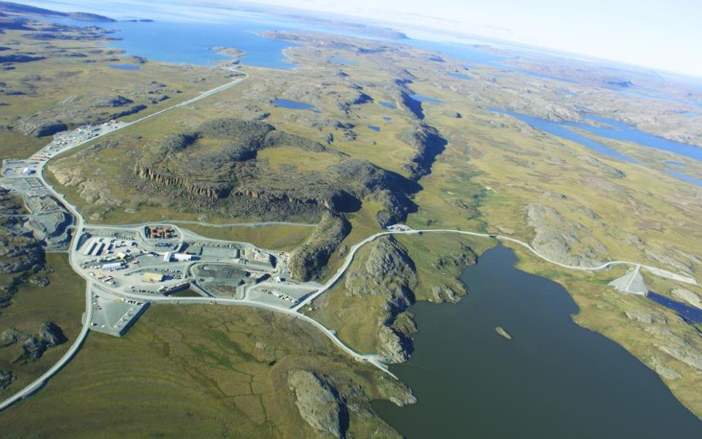
Doris Mine Site
Roberts Bay Port
Airstrip
Future Mill Site
Doris Mine Portal
Tailings Impoundment: North Dam
Doris Mine Ventilation
Road to Madrid
3

Slide 4
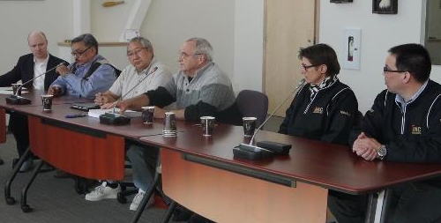
TMAC – KIA Agreements
TMAC to provide KIA with:
  Annual Implementation payment
  New Inuit Impact and Benefit Agreement
  New Inuit Environmental Advisory Committee
  Water and Wildlife compensation agreement
KIA to provide TMAC:
  Surface exploration access annually
  Advanced Exploration Areas when required
  Commercial Lease Areas when required

Slide 5
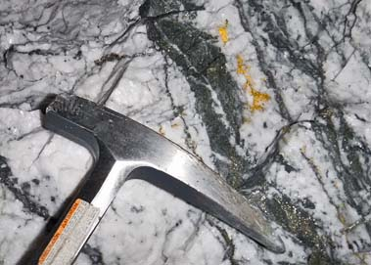
Doris Gold
4966 East Limb
Face December 8, 2015

Slide 6
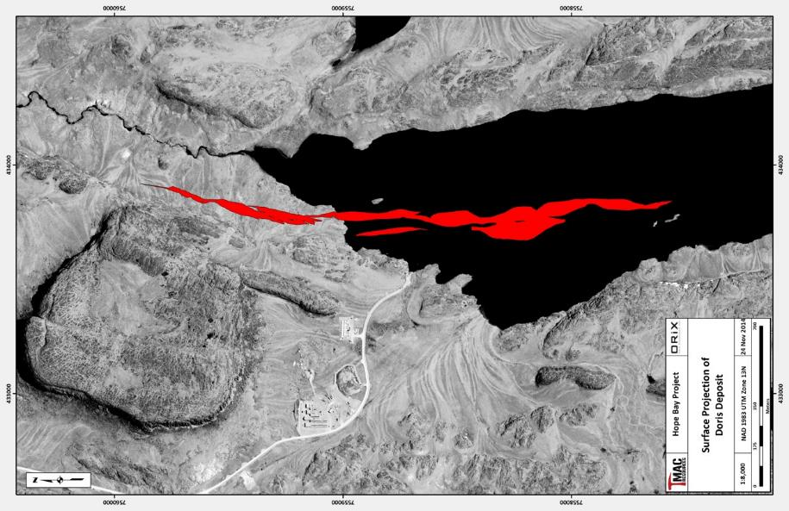
Doris Underground Mine
Doris North
Doris Central
Doris Connector

Slide 7
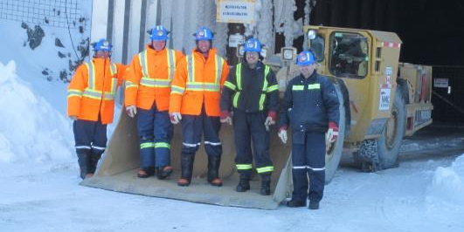
Expected Benefits
Employment
  Up to 280 jobs onsite
  Inuit Employment Targets will be set with the KIA
Contracting
  $550 million in construction and operation
  Kitikmeot Based business preferred opportunities for 14 types of work

Slide 8
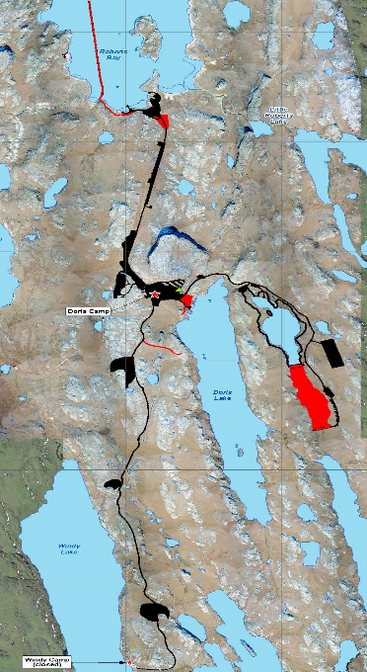
Overview
6 year mine life
Mining under Doris Lake
2.5 M tonnes of ore
2.5 M tonnes of tailings
  Open air tailings disposal
  Bigger camp
  Waste rock will go underground
  Wastewater and groundwater discharge to ocean

Slide 9
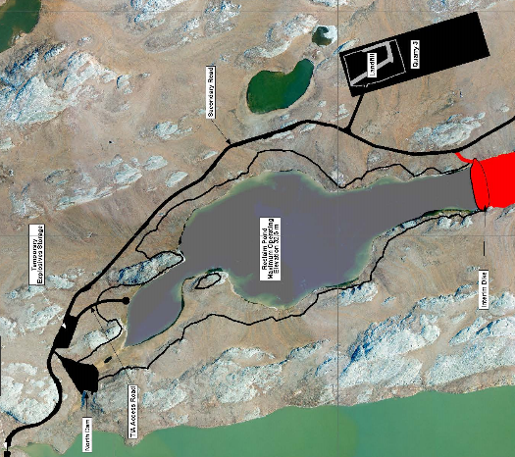
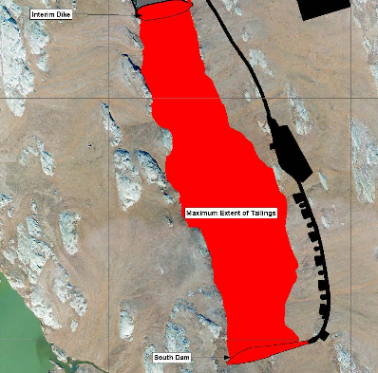
Tailings Impoundment Area (TIA)
Notes:
2.5 M tonnes
Tailings deposited either
Open air tailings in the TIA (94%, gravity only)
Placed underground as backfill (6%, cyanide leach tailings)
South Dam design modified to include a frozen foundation
Dike will be constructed across the midpoint of the TIA
Tailings will be placed between the South Dam and the Dike
Reclaim Pond located between Dike and North Dam
Dust control implemented throughout tailings deposition

Slide 10
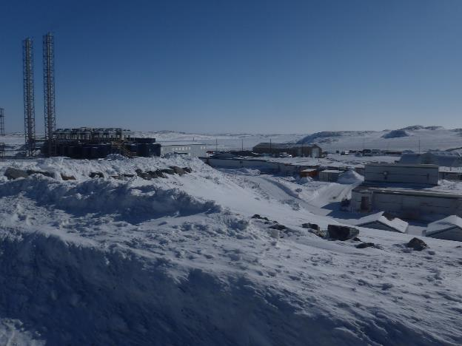
Social Effects
Longer mine life increases employment and economic activity
TMAC may compete with local businesses for workers
Minimal effects on local government services
IIBA between TMAC and KIA has employment and training provisions

Slide 11
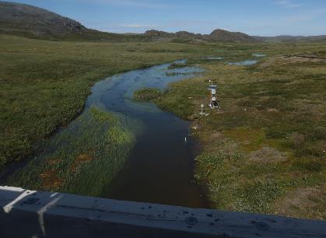
Environmental Effects
Mine footprint will be larger
Open air tailings deposition may cause some dust generation
Some water from Doris Lake will leak into the mine
Small changes in Doris Lake level
Small changes in Doris Creek flows
No effect on fish in Doris Lake
Possible effects on fish in Doris Creek
Studies underway to determine fishery effects in Doris Creek
Water pumped to Roberts Bay is not expected to harm the marine environment

Slide 12
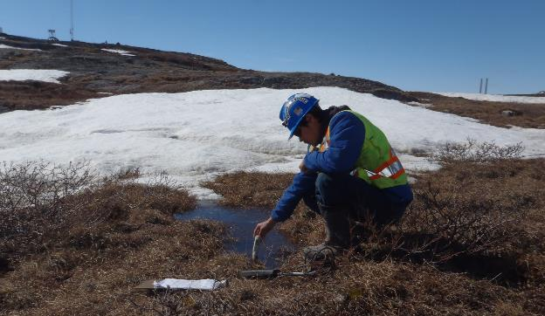
Next Steps
Nunavut Water Board Technical Meeting
Public Hearings
New Project Certificate and Water Licence granted
Complete construction
Pour first gold – end of 2016

Slide 13
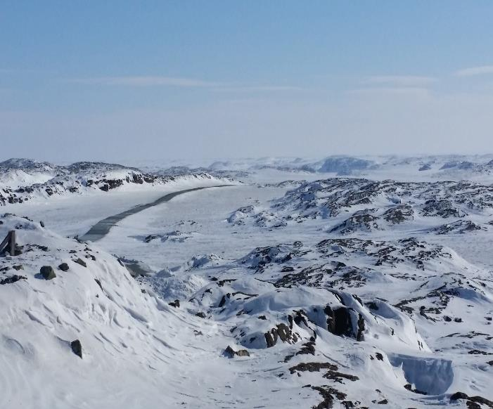
Thank You - Quana

