Slide 1
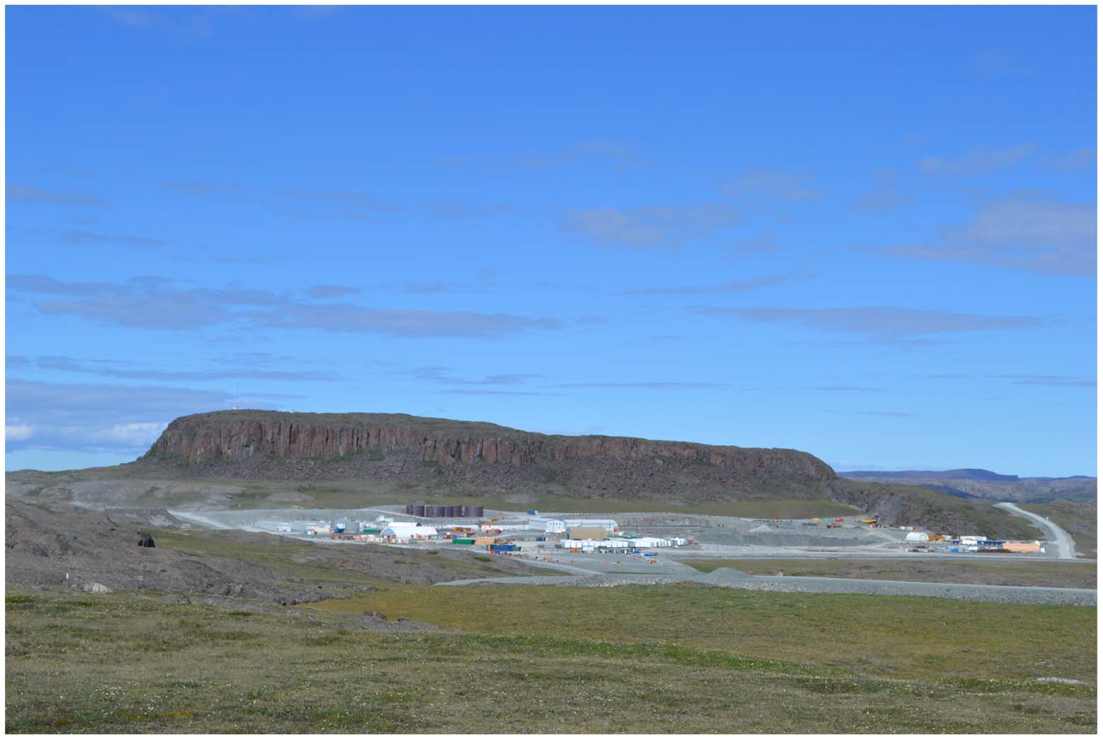

Nunavut Water Board (NWB)
DORIS NORTH PROJECT - TMAC RESOURCES INC.
2AM-DOH0713 TYPE “A” LICENCE RENEWAL APPLICATION
NWB PUBLIC HEARING
NWB Panel Meeting - AUGUST 2013.

Slide 2
DNP Water Licence Renewal: Presentation Outline
Board Observations
DN Project Overview
  Project location
  access
  general description
  infrastructure
Description of current type A Water Licence
Licence Amendments
Care and Maintenance Status

Slide 3
DNP Water Licence Renewal: Presentation Outline
Project Management Plans
  Water Management Plan
  Wastewater Treatment Management Plan
Licence renewal application
Scope of Lincence Renewal
Agencies final written submissions –AANDC
Agencies final written submissions –KIA
Panel Directions

Slide 4
DNP-Licence Renewal Application
Board Observations:
  during the technical review and public hearing processes the application is technically complete and no outstanding issues have been identified
  parties submitting comments agreed with the approach taken by the TMAC and did not identify any issues that would prevent the Board the issuance of a renewal licence with amendments where required.

Slide 5
Doris North Project Overview

Slide 6
Project Location

Slide 7
Project Overview
Location:
  the Doris North Project is located on the mainland in the West Kitikmeot region of Nunavut, approximately 125 km southwest of Cambridge Bay and 75 km northeast of Umingmaktok
  the Project is located on Inuit Owned Lands, 5 km south of Roberts Bay
Access:
  charter aircraft for employees, contractors and food
  Arctic Ocean : primary; for fuel, equipment and supplies (mill 5 km from Robert’s Bay)

Slide 8
Project Overview
General Description:
  small underground gold mine (720 tonnes per day)
  two year mine life.
  311,000 ounces of gold from 460,000 tonnes of ore.
  processing on site, the gold being shipped off site by air as dore bullion bars
  project footprint 54 hectares.

Slide 9
DN Project Infrastructure

Slide 10
Project Overview
Infrastructure
  a jetty in Roberts Bay for the sealift barges
  a 4.8 km AWR will link the Roberts Bay site with the camp
  main operational infrastructure will be mill, crushing plant, fuel storage tank farm, camp, office complex, workshops, power generation plant, sewage treatment plant, all adjacent to the mine adit.
  all-weather airstrip, suitable for small aircrafts
  ice-constructed air strip for larger aircrafts during winter months
  a dock on the shore of Doris Lake for float planes, will be linked to to the mill site with an AWR.

Slide 11
Project Overview
Infrastructure: tailings
  cyanide-treated mill tailings will be treated to destroy residual cyanide and precipitate heavy metals will be placed UG as mine backfill (G24g)
  all PAG rock will be disposed UG as mine backfill (G16)
non cyanide mill tailings Infrastructure: tailings
  cyanide-treated mill tailings will be treated to destroy residual cyanide and precipitate heavy metals will be placed UG as mine backfill (G24g)
  all PAG rock will be disposed UG as mine backfill (G16)

Slide 12
Project Overview
  non cyanide mill tailings will be deposited within the TIA
  Tail Lake ~ 5 km from the mill location.
  tailings deposition will be sub-aqueous, with two water retaining structures: the North and South Dams.
  the water quality eventually discharged from Tail Lake will meet discharge standards established by the NWB.
  will be deposited within the TIA
  Tail Lake ~ 5 km from the mill location.

Slide 13
Project Overview
  tailings deposition will be sub-aqueous, with two water retaining structures: the North and South Dams.
  the water quality eventually discharged from Tail Lake will meet discharge standards established by the NWB.

Slide 14
Water Licence Overview
Description of Current Type A Water Licence
  water not to be exceeded: 480,000 m3/y
  Licence Issuance: September 19, 2007
  expiry of Licence: September 30, 2013
  3 approved Licence Amendments

Slide 15
Water Licence Overview
Licence Amendments
  N0.1:
    relocation of the Explosives Mixing and Storage Facility
  N0.2:
    expand the Roberts Bay fuel storage and containment facility, expand the project’s all-weather airstrip and construct a bypass road; revise the location of the cyanide and reagent storage facility. New monitoring stations ; submission of a management Plan in the event of de-icing fluid use at the AWA

Slide 16
Water Licence Overview
Licence Amendments
  N0.3
    Conditions applying to Waste Rock Management (Construction, Plans, C&R)

Slide 17
Water Licence Overview
Care and Maintenance Status:
  the Project is under Care and Maintenance (C&M) phase since Jan 2009 for an unspecified period of time
  Care and Maintenance Def (Schedule A):
    “in respect of a mine, means when the Licensee ceases construction, production or commercial operation temporarily for an undefined period of time”

Slide 18
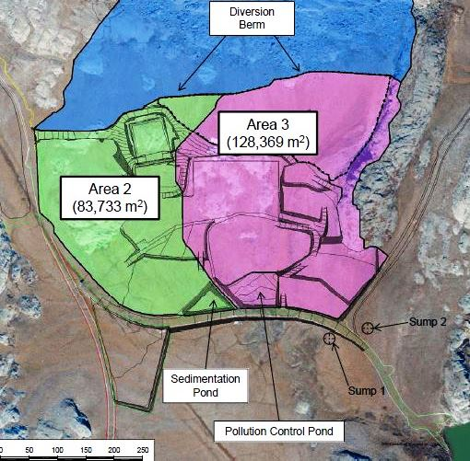
Interim Water Management Plan -2012
contact water
no contact water

Slide 19
Interim Water Management Plan -2012
Description
  site runoff and underflow is intercepted by the Sedimentation Pond (SP), Pollution Control Pond (PCP) and Underflow Interception Sumps;
  water from the SP that is acceptable for discharge (G22a) can be discharged into the tundra (G22c)
  SP water that does not meet Licence criteria will be directed to the TIA – Tail Lake

Slide 20
Interim Water Management Plan -2012
Description (cont.)
  all water from the PCP will be directed to the TIA (G20)
  water is discharged from TL to Doris Creek such as water elevation is maintained a minimum of 28.3m (G29)
  water is compliant with Par G21,26, 27 and 28 of the Licence.

Slide 21
Interim Water Management Plan -2012

Slide 22
Interim Water Management Plan -2012
Water Management (Schedule J, Table 2)
Station | Construction | Operations | Closure
TIA at the Reclaim pump barge (TL-1) | WQ every 2nd day- 2 weeks prior to discharge & 2 weeks after discharge, then weekly and monthly
Doris Outflow Creek (TL2 &TL3) | WQ every 2nd day - 2 weeks prior to discharge & 2 weeks after discharge, then weekly during discharge period

Slide 23
Wastewater Treatment Management Plan 2012
  the water licence permits the co-disposal of ww effluent and mine tailings waste into the Tail Lake Tailings Impoundment Area (TIA) (G3d);
    and discharge to the tundra during construction prior to
    completion of the mine processing plant and the TIA (G3c)
  all sewage and grey water shall be collected and treated in the STP: Sanitherm Membrane Biological Reactors (2x 180 people)

Slide 24
Wastewater Treatment Management Plan 2012
  during C&M either use an smaller reactor or switch to alternate toilette system.
    waste disposal:
          effluent discharge into the tundra (C&M)
          dewatered sludge can be composted or incinerated, currently is incinerated.

Slide 25
Wastewater Treatment Management Plan 2012

Slide 26
Wastewater Monitoring Program
Wastewater Treatment (Schedule J, Table 2)
Parameter | Construction | Operations | Closure
Discharge from Sewage Treatment Plant, ST8 | monthly
volume- effluent discharge, volume and location - sludge | daily

Slide 27
Licence Renewal Application - Scope
Scope is proposed to remain essentially the same as:
  use of water from Doris Lake for mining and milling processing, associated activities and domestic purposes;
  quarrying of materials from specified locations
  development and operations of site facilities
  construction of access and site roads, airstrip, water crossings and lay down areas
  construction of temporary waste rock storage pad
  construction and operation of a Sewage Treatment Plant (STP)
  construction and operation of a landfill and landfarm

Slide 28
Licence Renewal Application - Scope
  construction and operation of a sedimentation and a pollution control ponds;
  management and disposal of wastes;
  handling and storage of petroleum products and hazardous materials;
  construction dams, spillway, and shoreline erosion control needed for the operation of Tail Lake as TIA;
  extraction portal development rock, waste rock and ore from underground via decline;
  a mining rate of 720 tonnes per day of ore;

Slide 29
Licence Renewal Application - Scope
  a mill with a design milling throughput of 800 tpd;
  deposition of tailings into the Tail Lake (TIA);
  disposal of waste rock, including PAG rock, and cyanide leach residue within the underground workings;
  the controlled discharge of effluent from TIA to Doris Creek,
  the progressive reclamation of on-site facilities and infrastructure

Slide 30
Agencies Final Written Submissions-AANDC
Licence renewal for ten years adequate;
Conditions to Water Management Plan
  a revised WMP, 6 months prior to the commencement of ore processing should be submitted (F1), in the WMP, TMAC should:
      identify and explain significance of all drainage facilities and key water bodies,
      ensure the effective management of contact runoff and underflow (improve monitoring, mitigation measures)
      confirm how water in the sedimentation pond is managed; water from the SP may be discharged to the tundra from time to time when effluent quality limits are satisfied (as per G21)

Slide 31
Agencies Final Written Submissions-AANDC
Water discharge - notice to inspector
  minimum ten days notice prior to any planned discharged: discharge can commence immediately on receipt of samples confirming that the TIA meets discharge quality criteria, provided at least 10 days notice has previously been provided to the Inspector (G1& G3b).
Major earthworks requiring geotech inspection should include the Doris North Camp Area Diversion Berm (included as per F4, J18 does no mention it)

Slide 32
Agencies Final Written Submissions-AANDC
Sampling frequency at water discharges from Tail Lake TIA monitoring stations TL1-2-3 (agreed; Schedule J, Table 2)
  prior tailings deposition in the TIA only
during 1 week 3 samples (TL1)
Doris Creek has historical data (duplicates)
  after tailings discharge
twice weekly sampling for 2 weeks at TL1-2-3 (<2weeks)
once weekly sampling at TL1-2-3 (>2 weeks)
  sampling increases if (J20a)
  any measured parameter at TL-3 is +20% of predicted WQ model and the concentration is +/- 25% of the compliance level (as per G.28)

Slide 33
Agencies Final Written Submissions-AANDC
Discharge of treated sewage effluent
  treated effluent will be discharged to either the tundra or the Tail Lake –TIA (G3c&d)
  discharge to the tundra is dependent on quality limits
  discharges documented on monthly monitoring reports

Slide 34
Agencies Final Written Submissions-AANDC
Conditions applying to Care and Maintenance (C&M)
  regular info updates to the NWB and interested parties on revisions to management and monitoring plans. As minimum within 3 months to place the Project in C&M or bring the Project out of C&M and annually there after (annual report submission)
  water balance and water quality models will be recalibrated when the Project is brought out of C&M
  annually update water balance and quality models during C&M (G31)

Slide 35
Agencies Final Written Submissions-AANDC
Monitoring (C&M):
  monitoring of all water and hazardous material containment areas monthly (weather permit )
  collecting infrastructure thermistor data annually
  North Dam thermistor data downloaded annually
  readings from PCP & SP thermistor monitored monthly when water is actively managed at site
  monthly visually monitoring of all structures associated with TIA (weather permit)
  monthly monitoring reports are still required (J21)

Slide 36
Agencies Final Written Submissions-AANDC
Closure & Reclamation Plan (C&RP, required 6 months prior start ore processing) requirements:
  address potential issues associated with the underground disposal of PAG rock (i.e. oxidation)
  discuss removal of equipment and potentially hazardous materials from underground workings
  updated closure cost estimate should accompany all updated C&RP,
  un update of the C&R P should be filed with the Board every three years and 3 months after decision to move to permanent closure,

Slide 37
Agencies Final Written Submissions-AANDC - C&RP
  TMAC should commit to consult stakeholders on the proposed post-closure land criteria in future updates of the C&RP. Particularly the proposal to leave certain facilities in place and the soil quality remediation objectives should be revisited.
  future revisions of the Project C&RP :
    should provide greater detail on post-closure monitoring activities
    follow the AANDC Mine Site Reclamation Policy for Nunavut

Slide 38
Agencies Final Written Submissions-AANDC - C&RP
  during this period the mining company will continue to be responsible for the site, including remediation of any additional developed environmental complication;
  the monitoring period may be extended to ensure remedial measures are met;
  TMAC updated closure cost estimate of $13,090,000 is adequate and should be incorporated into an amended and renewed WL.

Slide 39
Agencies Final Written Submissions- KIA
No concerns about:
  amendment & renewal of type A WL for 10 y
  wastewater disposition in either TIA or tundra
  water consumption;
Issues to be addressed by TMAC in updated Plans:
  a revised Aquatic Effects Monitoring Program (AEMP) should be provided prior operation and production, considering arsenic species toxicity in water (Schedule J)
  AEMP frequency at biological station should be increased and water temperature and fish population monitored,
  rehabilitation work at Windy Lake Camp and Boston Camp should continue

Slide 40
Agencies Final Written Submissions- KIA
upgrade of warning monitoring systems to improve the response time to WWT by the Membrane Biological Reactor Units;
the cost estimates for C&R should be tied to particular plans and provide allowance for excavation, hauling, treatment and disposal of HC contaminated soil
seasonal monitoring of air quality is acceptable if it can be proven that dust is not an issue when camp is closed;
there should be systematic monitoring of mammals
greater attention to spill prevention is warranted.

Slide 41
DNP-Licence Renewal Application -Request
Request direction from the Panel to staff to prepare a draft decision reflecting the Panel’s deliberations.
If the Panel direction is to issue a renewed Licence, seek direction to staff
To prepare a draft licence for the review of the Panel based on the Panel recommendations including:
  the term of the renewed licence;
  confirmation that the proposed water use volumes are appropriate;
  update to the security requirements;

Slide 42
DNP-Licence Renewal Application -Request
To prepare a draft licence for the review of the Panel based on the Panel recommendations including:
  the addition of a specific Care and Maintenance section in the Licence: and
  consequential amendments requested by the Applicant
  All conditions of the current Licence would remain the same with the exception of where amendments have been requested and may be considered based on the Tech review and PH evidence.

Slide 43
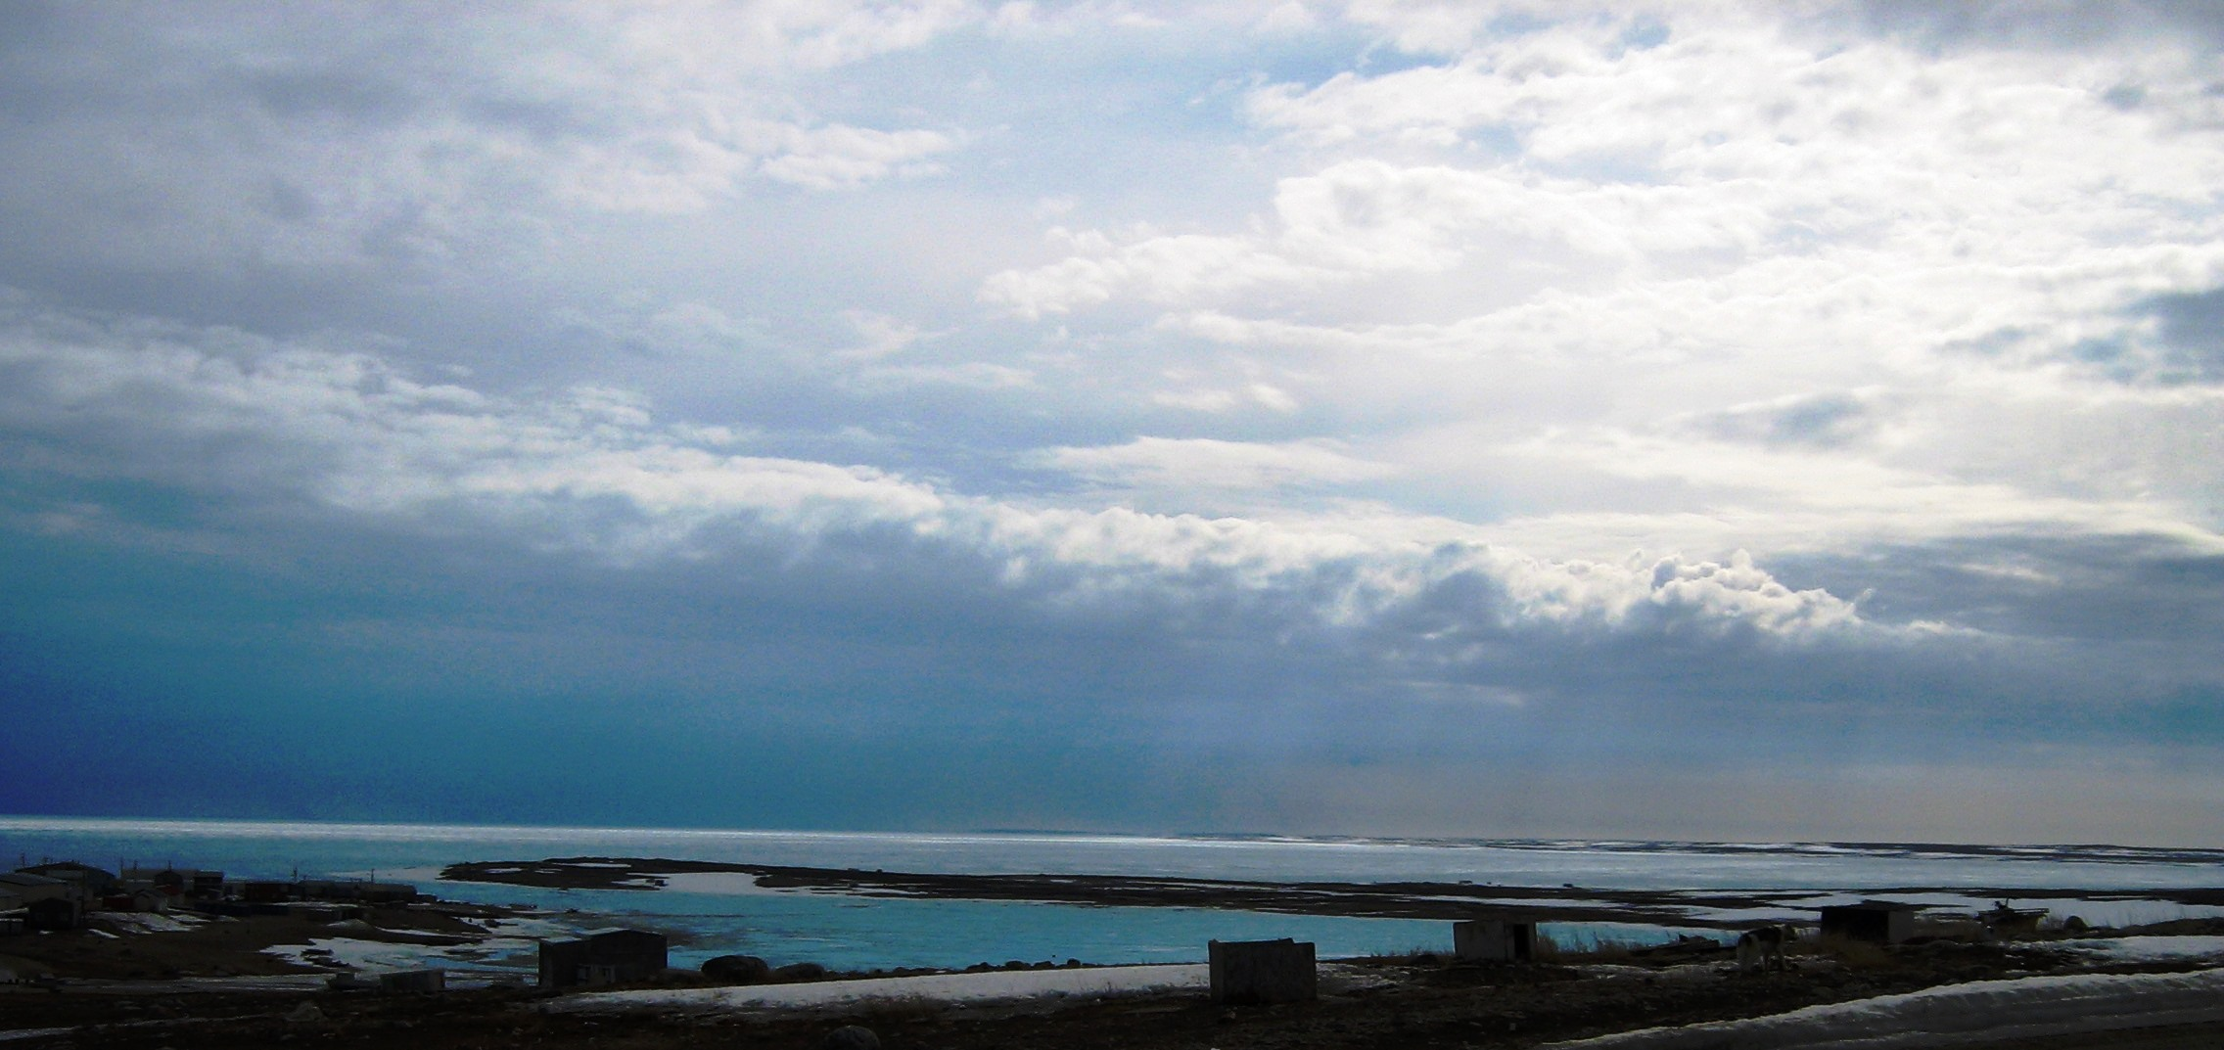
THE END

Slide 44
DN Monitoring Programs
AEMP (Aquatic Effect Monitoring Program)
Parameter | Construction | Operations | Closure | C&M
WQ-Biological | once e. season | once every 3 y | once every 3 y | Spring/sum/fall
WQ (TIA & effl) | - | quarterly | quarterly
phytoplankton | once e. season | - | - | -
sediment & bentics | fall | once every 3 y | - | -
Land Treatment Area
water quality | once prior discharge , daily when discharge to tundra
soil q.
materials | volume & source for deposits, vol. & discharge location for removals

Slide 45
DN Monitoring Programs
Waste rock and ore
Parameter | Construction | Operations | Closure | C&M
WR classify. & segr. testing | yes | yes
WR pile visual insp. | annual | annual
seepage | annual
Poll. pond WQ (ST-2) | monthly during open water season
Under flow sumps (STS-2A & STS-2B) | monthly during open water season

Slide 46
DN Monitoring Programs
Water Management
Parameter | Construction | Operations | Closure
WQ sedimentation pond (SP, ST1) | once before any discharge, daily when discharging to the tundra
discharge vol. SP | daily during discharge
WQ –TL discharge TL1 & TL4 | every 2nd day- 2 weeks prior to discharge & 2 weeks after discharge, then weekly and monthly
volume- Tail Lake | daily during discharge
WQ Doris Creek up and downstream (TL2 &TL3) | every 2nd day - 2 weeks prior to discharge & 2 weeks after discharge, then weekly during discharge period
WQ TIA water body TL10 | monthly during discharge, starting 2 w. prior start d.
ice thickness on the TIA | monthly

Slide 47
DN Monitoring Programs
Wastewater Treatment
Parameter | Construction | Operations | Closure
WQ discharge from WWTP ST8 | monthly
volume- effluent discharge, volume and location - sludge | daily

Slide 48
THE END

Slide 49
QUESTIONS

