Slide 1
Kitikmeot Inuit Association
KIA Technical Review of TMAC’s Amendment Application for the Doris North Mine Site Type A Water Licence
Notes:
Hello everyone, I am John Roesch, the Senior Hope Bay Project Officer for the Department of Lands and Environment for the Kitikmeot Inuit Association. I am responsible for project oversite for the KIA and provide input into the regulatory process on the Hope Bay Project to both the NWB and NIRB. In performing this role, I make use of KIA’s consultants who are subject matter experts in the areas of wildlife, fisheries, aquatic environment, and geotechnical engineering.

Slide 2
Purpose of Presentation
Present a summary of KIA’s Technical Review of TMAC Resources Inc.’s amendment application of the Doris North Mine Site’s Type A Water License.
KIA conducted a thorough review in the areas of wildlife, fisheries, aquatic environment, and geotechnical engineering.
14 Issues for Technical Meeting in January, 2016 for the NIRB and NWB. Thirteen concern the NWB.
Notes:
The purpose of this presentation is to provide a brief summary of our technical review of the amendment to the Doris Type A Water Licence. Our review covered wildlife issues, fisheries, aquatic environment, and geotechnical engineering. KIA conducted the review in a collaborative manner with TMAC Resources out of which we brought forward 14 issues to be resolved at the Technical Meeting and through further consultation.

Slide 3
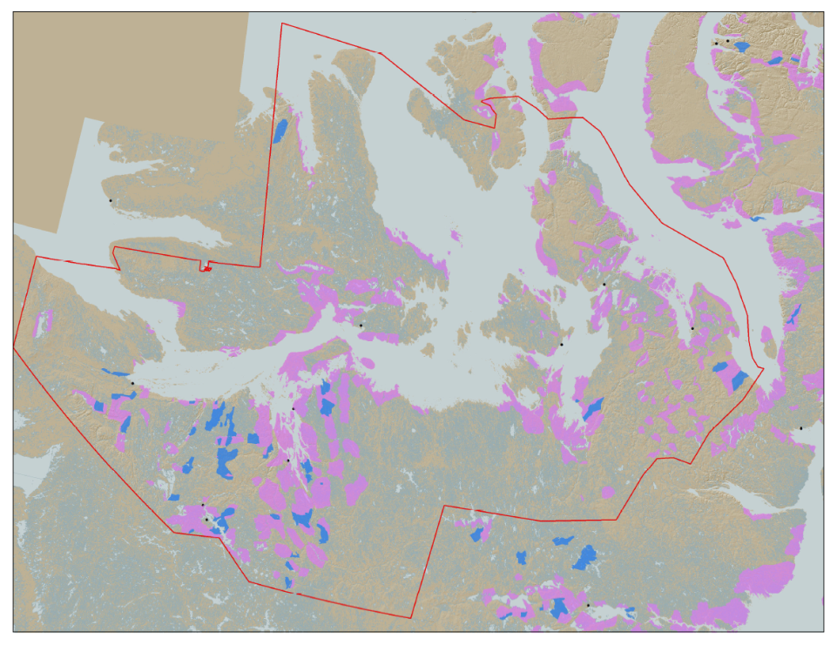

KIA’s Mandate
KIA’s Mandate is to represent the interests of Kitikmeot Inuit by protecting and promoting their social, cultural, political, environmental, and economic well-being.
KIA owns 106,360 km² of surface land: A significant opportunity if managed properly.
Hope Bay Project
Notes:
KIA’s mandate is to promote socio-economic, cultural, and environmental well-being. The Kitikmeot Region is generally within the red boundary. The Pink and Blue lands are lands which KIA owns the surface rights.
Kitikmeot Inuit Association is a democratically elected not-for-profit society that represents the Inuit of the Kitikmeot Region of Nunavut. KIA protects and promotes the social, cultural, political, environmental, and economic interests of Kitikmeot Inuit.
As a result of the Nunavut Land Claim Agreement (NLCA), Inuit are one of the largest private landowners in the world. Much of this privately owned land is in areas with high potential for mineral development. This land is a significant opportunity for Inuit if it is managed properly. We seek to optimize opportunities and manage liabilities that are inherent with being a private landowner. If not, we will affect the well-being of our Kitikmeot Inuit membership.
The Hope Bay Project is located on the mainland near the coast and approximately in the middle of the region.

Slide 4
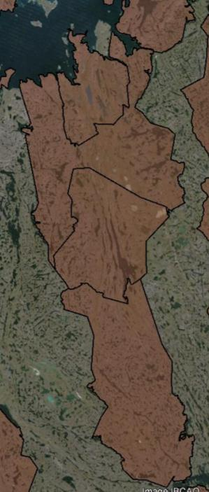
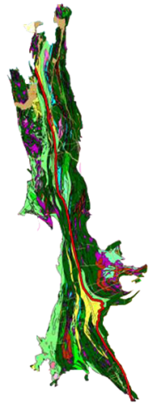

The Hope Bay Project
Doris
BB-60
Madrid
Located on 4 parcels of Inuit Owned Land.
The Hope Bay greenstone belt has had significant exploration since 1965.
  Vast exploration potential remains
TMAC took over development of the project in 2012
BB-58
120 km
BB-57
Boston
BB-56
Notes:
When the Inuit Owned Land was selected for the NLCA, Inuit knew that the Hope Bay Area was highly prospective for mineral development. A 120 Km length of surface lands that include some mineral rights were selected in the area. The brown areas are surface lands owned by KIA. BB-56, 57, 58, and 60 include our agreement with TMAC for the Hope Bay Project.
The Hope Bay greenstone belt has been explored since 1965. Within this greenstone belt, over 850Km of drilling has occurred since 1965. Most of the drilling has been focused around Doris, Madrid and Boston. This project has changed ownership many times. Prior to TMAC, the last company to operate the Hope Bay Project was Newmont. TMAC took over the project in 2012.
On the Map you can see the location of some of the highest priority development sites in the belt: Doris, Madrid and Boston.

Slide 5
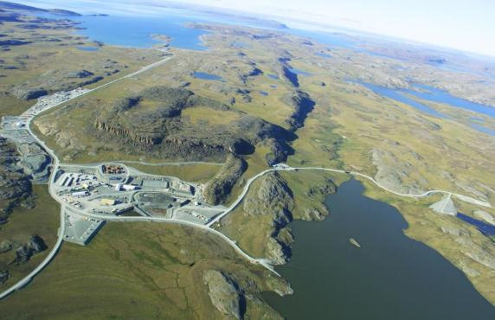
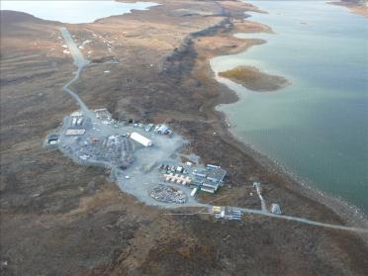
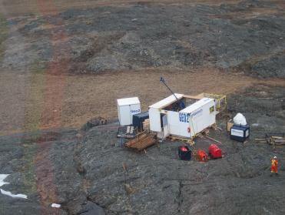
The Hope Bay Project
Doris North Mine
Boston Advanced Exploration Camp
Exploratory Drilling
Madrid North and South
Notes:
The Hope Bay Greenstone Belt is unique because it demonstrates the capacity to hold several mining operations across the belt in the different stages of development, operated by one company.
This greenstone belt includes a permitted mine at Doris North, several advanced exploration targets such as Madrid North and South, and Boston Camp which has preliminary mine plans developed, and many other identified high quality exploration targets. TMAC has rights to all the minerals in this area. Once an operating mine is established, the efficiencies of belt-wide exploration can increase.
KIA’s technical review concerns the amendment of the Type A Water Licence for the Doris North mine site. Initiating production at Doris North is critical to the development of the entire belt.

Slide 6
Technical Issues for Technical Meeting
TIA Expansion Capacity
TIA Wildlife Attraction and Deterrence
TIA Floatation Tailings Dust Fall and Leaching
TIA Elevated Parameters of Potential Concern Upon Closure
TIA NPAG Tailings Cover Depth
Notes:
As indicated previously, 14 issues were brought to the technical meeting with the NWB and NIRB pertaining to Doris North amendments. These five concern the Tailings Impoundment Area (TIA) at Doris North. We raised concerns about the capacity of the TIA to handle mining expansion into Madrid/Patch Lake area, whether caribou would be attracted to the tailings in the TIA, the potential for dust fall and leaching from the TIA into the surrounding environment, trace metal contamination, and the planned thickness of the cold cover for the tailings upon closure.
TMAC has responded to our recommendations and ran further simulations on dust fall which indicated it would be contained to the TIA. In reviewing the additional simulations on water and load balancing, KIA found that the concentration levels of metal contaminates were well below CCME and MMER guidelines indicating that the TIA water was non-toxic to caribou and birds.
Also TMAC will develop adaptive management and risk assessment to keep caribou away from the TIA, and the tailings cover was found to be adequate upon further review.
All five of these issues have been resolved.

Slide 7
Technical Issues for Technical Meeting
Roberts Bay Discharge and AEMP Monitoring
Potential Interaction with Marine Environment
Mixing Zone Delineation
Increasing Contaminants of Potential Concern in Roberts Bay
Hydrogeology
Notes:
These five issues concern the simulation models for the marine discharge into Roberts Bay and hydrogeology water balance at the mine site. The issues are considered to be of moderate concern by KIA requiring only additional water sampling and adjustments to model parameters to provide improved assurance on environmental impact.
Essentially underground mine water is highly saline and is to be mixed with water from the TIA and is discharged into Roberts Bay. The salinity of the discharge should be less than the ocean and similar in temperature to minimise environmental impact on marine life.
TMAC had taken our recommendations under consideration and ran further simulations using more conservative input parameters. The results indicate that ocean discharge is well below CCME guidelines for the protection of marine and aquatic live. CCME guidelines are met within 1 metre of the diffuser at a dilution of 186:1. At a distance of 250 metres from the diffuser, discharge dilutions are between 1,000:1 to 10,000:1. The discharge plume is trapped in deep water between the ocean floor and the surface layer. No algae bloom will occur at the surface due to nitrates. These five issues are resolved.

Slide 8
Technical Issues for Technical Meeting
Site-Wide Water and Load Balance
Prediction of Environmental Effects on Water Quality
Doris Lake Water Levels
Attraction or Avoidance of Grizzly Bears to the Mine Site (NIRB only)
Notes:
Issues 11 and 12 also concern simulation models of water discharge and mixing with ocean water and are viewed by KIA as being of moderate risk to the environment. KIA essentially sought greater assurance on environmental impact of minerals and nutrients on ocean water to which TMAC has responded. TIA water quality was below CCME and MMER guidelines and is non-toxic to wildlife or aquatic life.
Issue 13 concerns the impact of water leakage from Doris Lake into the underground mine and its affect on the lake’s water level. TMAC has conducted further water modeling and is committed to mitigation methods for plugging leaks and drill holes from exploration in the lake. The expected impact on Doris Lake water levels is within the natural variation of its water levels.
Issue 14 concerns improving the deployment of cameras and data collection to determine if there is a zone of influence around the mine for grizzly bears. That is to know if they are either attracted or repelled by the mine site activities.
This issue was of high concern to the KIA since bears are known to travel through the area along the coast and is a condition of the original project permit. TMAC has taken our recommendations under advisement and is updating of the layout of its wildlife monitoring cameras and the Wildlife Mitigation and Monitoring Program (WMMP) for the Doris North mine site. All four of these issues are resolved.

Slide 9
Socio-Economic Development
KIA and TMAC signed a comprehensive Framework Agreement for the Hope Bay Project.
Inuit Impact and Benefit Agreement (IIBA) addresses socio-economic interests of Inuit for employment, contracting, and training.
Implementation Committee and Inuit Environmental Advisory Committee (IEAC) is established under the IIBA.
IIBA satisfies all present and future obligations required under the NLCA.
Notes:
In addition to the technical issues raised, the KIA would like to point out that we have signed with TMAC a comprehensive Framework Agreement for land access compensation and an Inuit Impact and Benefit Agreement (IIBA).
The IIBA addresses Inuit interests in the areas of employment, contracting, and training in relation to the Hope Bay Project as a whole through its entire life span.
Under the IIBA an Inuit Environmental Advisory Committee (IEAC) has been established with TMAC which complements KIA’s current environmental activities in the Department of Lands and Environment. The IEAC allows for the local community to have input directly to TMAC on environmental concerns.
Through the Implementation Committee with KIA and TMAC representatives, measures of employment, business development, and training are being developed which fulfills socio-economic obligations under the NLCA.

Slide 10
Socio-Economic Development
Framework Agreement and IIBA,
Net Smelter Royalty Agreement,
Water and Wildlife Compensation Agreement,
Mineral Rights Agreement with NTI, and
KIA shareholdings in TMAC Resources Inc.
All of this creates substantial benefits for Inuit in the Kitikmeot region.
Notes:
The KIA receives monetary compensation through a variety of agreements. Direct compensation through the Framework Agreement and IIBA for land access, quarry materials and water usage. Royalties from gold production plus shareholdings in TMAC.
NTI also gets a royalty on profit under its Mineral Rights Agreement with TMAC Resources Inc. All of this creates a substantial benefit for Inuit in the region.

Slide 11
Water Compensation
Framework Agreement:
  The KIA and TMAC have signed a water compensation agreement as part of the framework for the Doris North Project.
  This addresses Inuit Article 20 rights and TMAC obligations.
  No water compensation issue to be addressed by NWB.
Notes:
As indicated previously, the KIA and TMAC have signed a water compensation agreement as part of the framework for the Doris North Project. This agreement addresses Inuit Article 20 rights and TMAC obligations.
As a result, there are no water compensation issues to be addressed by the NWB in the context of the TMAC Type A water licence amendment.

Slide 12
Reclamation Security
Currently, KIA has $11.49 million in security in both letters of credit and a Corporate Guarantee under the Doris North commercial lease.
This is considered inadequate for Doris North mine site given development and amendment to water licence.
TMAC and INAC’s reclamation cost estimates were reviewed by KIA’s engineering consultants.
Notes:
Currently KIA has $11.49 million in security in both letters of credit and corporate guarantee under it commercial lease with TMAC Resources Inc.
This level of security is inadequate for the Doris North mine site given changes to the water licence and the development of the project.
The KIA’s engineering consultant has reviewed both TMAC’s and INAC’ s reclamation cost estimates and finds TMAC’s to be reasonable for the mine site. The KIA discussed with TMAC and their engineering consultant the identified residual risks and cost escalators and our consultant’s question on these items.

Slide 13
Reclamation Security
Major conclusions by KIA engineering consultants:
$28.94 million quantum is reasonable and accurate.
The split between land and water security is $24.20 million for land (84%) and $4.74 million for water (16%).
Residual risks and cost escalators are identified and discussed and the quantum of $28.94 million is agreed to by KIA and TMAC.
Notes:
The major conclusions of our engineering consultant was TMAC’s reclamation cost estimate was reasonable and more accurate than INAC’s reclamation cost estimate and that the split between land and water liability was 84% and 16%.
The $28.94 million quantum with its 20% contingency was found to be very reasonable after discussion with TMAC and having our questions answered. The KIA accepts and supports TMAC’s cost estimate of $28.94 million for reclamation security for the Doris North mine site.
The split of land and water liability of 84% and 16% is considered appropriate and equitable for the mine site given KIA’s experience with the brine spill at Boston Camp.

Slide 14
Reclamation Security
INAC has a quantum of $44.12 million for Doris North reclamation.
$43.42 million (98%) is IOL and $0.7 million (2%) is Crown Land.
Of IOL land, $19.71 million (45%) is allotted to land liability and $23.72 million (55%) is allotted to water liability.
KIA finds this split of land and water liability to be unreasonable given our experience.
Notes:
INAC’s engineering consultant has a reclamation cost estimate of $44.12 million substantially higher than TMAC’s estimate. This primarily due to indirect costs being 175% higher than TMAC’s estimate of indirect costs. INAC’s estimate uses a 5 year time horizon for reclamation work in contrast to TMAC’s approximately 2 year time-horizon for preforming reclamation work. INAC’s estimate has about 50% the productivity of TMAC’s estimate which KIA finds questionable.
The INAC estimate acknowledges that 98% of the quantum is associated with IOL while only 2% is Crown Land.
The $43.42 million of IOL security has a split of land and water liability of 45% and 55% respectively which the KIA finds unreasonable given our experience with the Newmont and Orbit 25 brine spill at Boston Camp in July of 2011.
Drilling fluid containing potassium chloride had spilled onto the land and subsequently entered a near by water body. About 1200 square metres of tundra was damaged due to elevated chloride levels. The deleterious substance had entered the water body and dissipated quickly in a few days with no loss of fish or damage to the aquatic environment.
Environment Canada at the time charged Newmont and Orbit Grant with breaking Federal environmental laws. Both Newmont and Orbit Grant agreed to contribute to Environment Canada’ environmental fund. No reclamation work was done by the Federal Government to the lake since no damage was done.
KIA investigated possible means of land reclamation, if no actions are taken it will take 15 to 20 years for the land to recover through natural revegetation. Human intervention would require experimentation in the restoration of tundra and remediation work based on experimental results. The human intervention and reclamation of land would be about $3 million.
This clearly illustrates that the liability is primarily with the land and not the water. INAC’s split of land and water liability of 45% and 55% would expose KIA to an excessive amount of risk.

Slide 15
Conclusion
KIA recommends approval of the TMAC application for the amendment to the Type A Water licence 2AM-DOH1323 for the Doris North Project.
Thank You
Questions?
Notes:
The KIA has successfully resolved all technical issues brought forward to the Technical Meeting with TMAC through our on-going collaboration.
Given this and the substantial benefits that will be obtained for Inuit from the Hope Bay Project and the opening of the Doris North mine site, we believe that the amendment of the Type A Water licence is warranted and in the best interest of the Inuit people.

