Slide 1
Lupin Mines Incorporated (LMI)
Lupin Mine Project
Type ‘A’ Water Licence Renewal Application
Nunavut Water Board (NWB)
Technical Meeting and Pre-Hearing Conference
Kugluktuk, Nunavut
June 6-7, 2019

Slide 2
Outline
CIRNAC’s Role and Responsibilities
Contributions to the Water Licence Review
Final Closure and Reclamation Plan Concerns
  Timing/Schedule
  Tailings/Tailings Containment Area
  Waste Rock (PAG and NPAG)
  Climate Change Projections
  Post Closure
  Interim Closure and Reclamation Plan
4. Financial Security
5. Conclusion

Slide 3
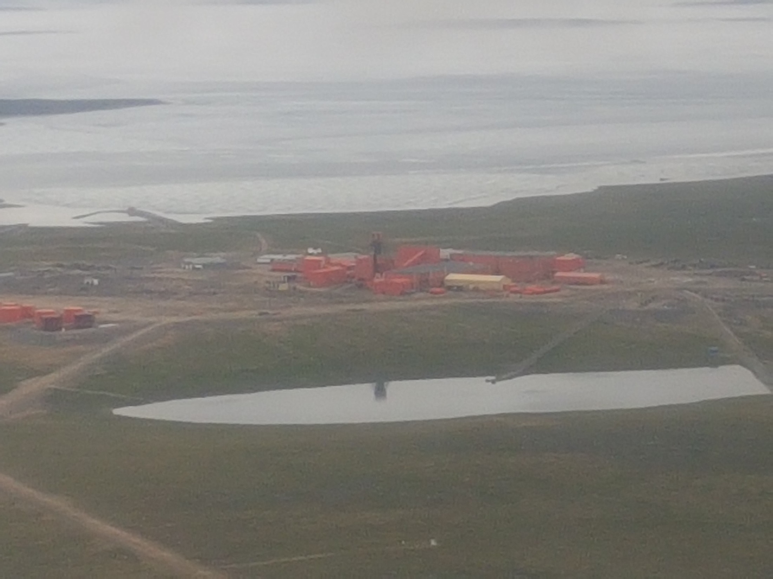

Slide 4
CIRNAC’s Role and Responsibilities
The department’s responsibilities, mandate and obligations stem from the following applicable laws and policies:
Department of Indian Affairs and Northern Development Act
Nunavut Land Claims Agreement Act
Nunavut Waters and Nunavut Surface Rights Tribunal Act and the associated regulations
Territorial Lands Act and the associated regulations
Arctic Waters Pollution and Prevention Act
Mine Site Reclamation Policy for Nunavut

Slide 5
CIRNAC Contributions to the Water Licence Review
CIRNAC participated in the completeness review of the application and submitted to comments to the NWB on March 4, 2019
CIRNAC submitted technical review comments on the application to NWB on April 30, 2019

Slide 6
Final Closure and Reclamation Concerns
Concern: Timing, Schedule and the Human Health Environmental Risk Assessment (HHERA)
CIRNAC would like LMI to describe in detail the latest proposed closure schedule for effectiveness of the plan and for updating the closure cost estimate.
How has the latest schedule change impacted the Closure and Reclamation Plan being reviewed?
On the issue of timing for the HHERA: In order to effectively implement any findings from the HHERA and recommendations from interveners, the timing between the Technical Meeting and the Public Hearing may have to be increased.

Slide 7
Final Closure and Reclamation Plan Concerns
Concern: Tailings/Tailings Containment Area
Tailings may become exposed after the dams are breached and water levels are lowered.
CIRNAC recommends that if any exposed tailings are discovered from the lowering of the water levels, these should be removed and placed in a tailings cell and covered.

Slide 8
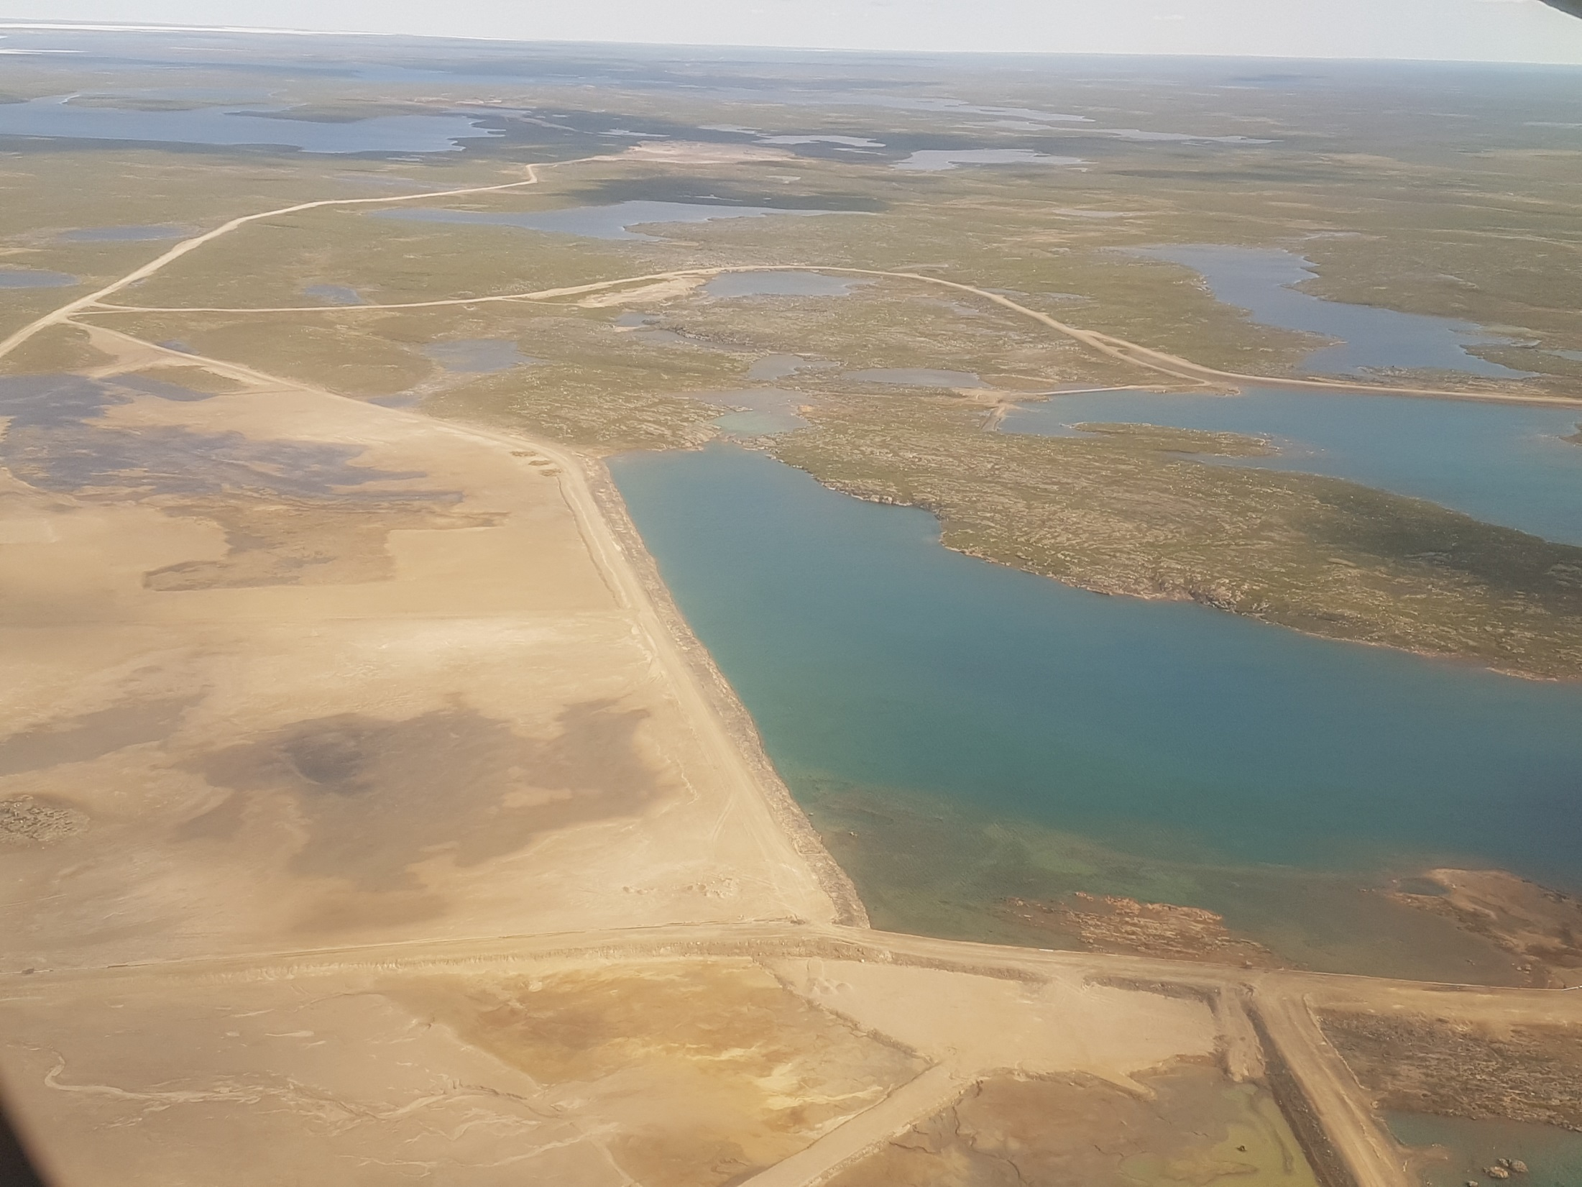

Slide 9
Final Closure and Reclamation Plan Concerns
Concern: Waste rock management
LMI proposes to consolidate all of the mill area waste rock into one big pile that is described as a “Dome” and place a cover with esker material.
LMI has provided details on grain size distribution, however CIRNAC requires further details on cover design specification such as but not limited to; cross sections with grades, slopes and end of cover details.
CIRNAC also recommends that LMI provide the excavation, haul, placement, approach and methodology for the “Dome”.

Slide 10
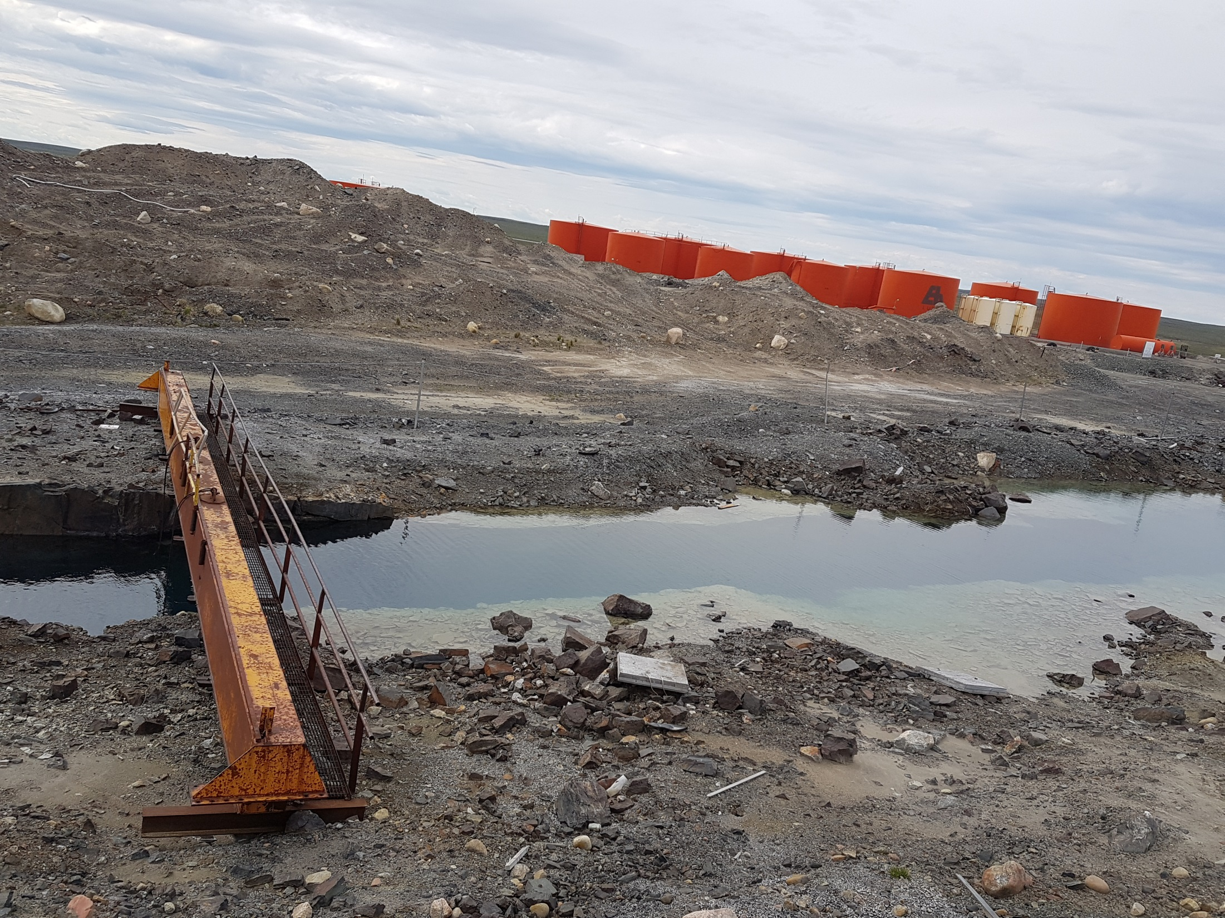

Slide 11
Final Closure and Reclamation Plan Concerns
Concern: Potentially Acid Generating and Non-Potentially Acid Generating Rock (PAG and NPAG) around site
Golder and the ESA only verified ARD potential around the mill site. No assessment of Acid Rock Drainage potential was done in other areas of the mine site such as the tailings dams themselves and the roadways. Acid Rock Drainage testing should be completed or evidence provided to confirm that the materials used to construct the dams and roadways are constructed of NPAG material.
CIRNAC recommends that an ARD analysis, Geochemical and Pathways modelling should be undertaken for all waste rock sources.

Slide 12
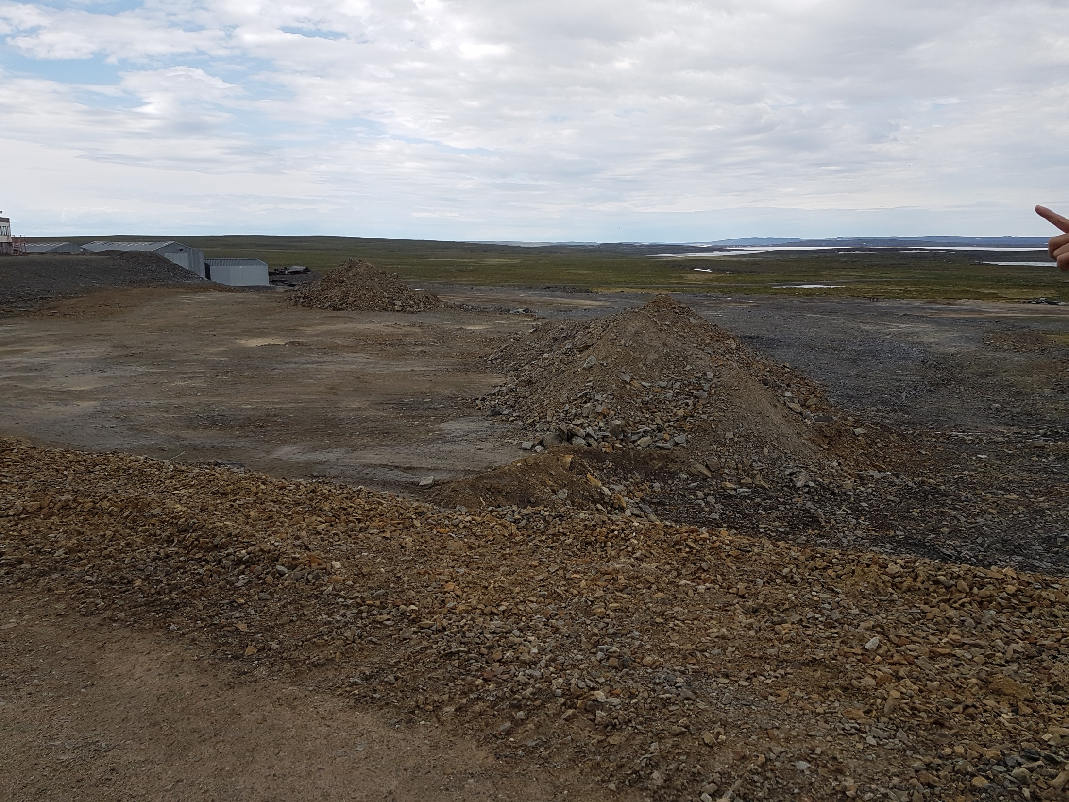

Slide 13
Final Closure and Reclamation Plan Concerns
Concern: Climate change
CIRNAC requires LMI to clarify their 100 year climate change prediction.
Concern: Post closure
CIRNAC would like to clarify with LMI that a 25 year post closure monitoring period is required to show environmental (physical and chemical) stability of the site.

Slide 14
Final Closure and Reclamation Plan Concerns
Concern: Change to the approved ICRP
LMI has indicated a desire to materially change the ICRP commitment of using borrowed rip-rap to bring all exterior dam structures to a 2.5:1 final slope.
LMI has indicated that they will be using waste rock salvaged from non-water retaining Dams to stabilize and enhance the embankment stability of the dams that will remain in place at closure.
Technical details are lacking with respect to the use of the rip-rap material. CIRNAC recommends that LMI provide the technical details to ensure that the rip-rap material will function as intended.
CIRNAC also requires that LMI provide further technical details such as which dams will the rip-rap material be taken from and which dams will be enhanced. These additional geotechnical details are needed to properly evaluate what is being proposed.

Slide 15
Financial Security
Concern: Financial security proposal
LMI has proposed a step-down approach to security
CIRNAC considers this approach reasonable as long as the details of this step down approach are agreed to by all parties concerned.
CIRNAC also states that the financial security details can only be discussed once there is agreement and understanding of all details of the Final Closure and Reclamation Plan.

Slide 16
Conclusion
The timing for the completion of the HHERA is a concern to CIRNAC as it relates to proper review, and its implementation based on the schedule of the closure activities being proposed.
CIRNAC recommends that LMI undertake a more comprehensive analysis of the PAG rock and possible ARD around the mine site, and Geochemical modelling.
CIRNAC will engage with LMI as soon as possible to start discussions relating to financial security.
CIRNAC and LMI will continue to work together to understand the details of the Final Closure and Reclamation Plan.

Slide 17
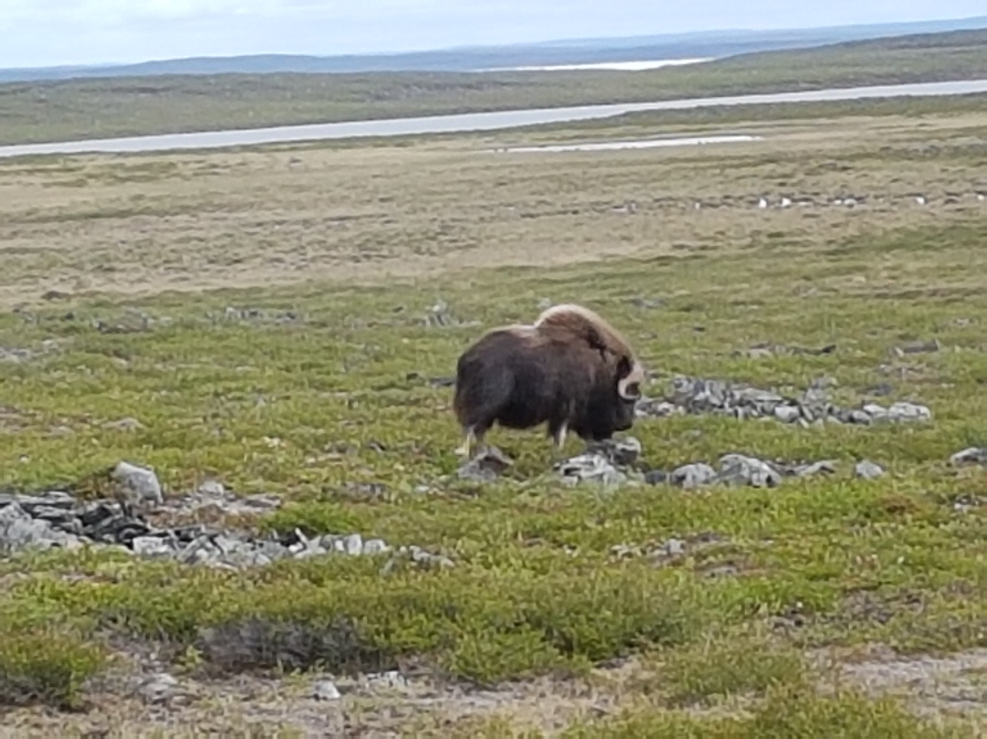

Slide 18
Questions?
Matna
Thank you
ᖁᔭᓐᓇᒦᒃ

