Slide 1
Lupin Mine Timiuyuq
Nutaaguqtiqniga Ihuaqhaqnigalu Tuukhiqtuut Immaqmik Aturiagani Laisiuyumik 2AM-LUP1520-mik Lupin-mi Uyaraktaqvikmi Havaami
Nunavumi Immaliqiyit Katimayit Inuknik Naalaktitiviani
Kugluktuk, Ubluqtuhirvia 15-16, 2020
Lupin Mine Inc.
Renewal/Amendment Application for Water Licence 2AM-LUP1520 for Lupin Mine Project
Nunavut Water Board Public Hearing
Kugluktuk, January 15-16, 2020

Slide 2
Outline
Qanuriniga
Role and responsibilities
Contributions to review
Technical review comments
Tailings and waste rock
Closure and reclamation planning
Reclamation security cost estimate
Conclusion
Havaangit Munariyanginniklu
Ilagiarutit ihivriuriagani
Nutauniqhanik ihivriuqnigani uqauhiuyut
Ataguut iqaguulu uyaqaat
Umiktiqnigagut Nunalu Utiqtiniganik Ilitquhianut parnaiyainiq
Nunat utiqtitaagani ilitquhiinut ihumaaluknaitagani akiliriiqhimayuup akituniga nalautaaqtauyuq
Iniqtirutit

Slide 3
Roles and responsibilities
Havaangit Munariyanginniklu
Crown-Indigenous Relations and Northern Affairs Canada’s (CIRNAC) responsibilities, mandate, and obligations are in alignment with the following:
Department of Crown-Indigenous Relations and Northern Affairs Act
Nunavut Agreement
Nunavut Land Claims Agreement Act
Nunavut Waters and Nunavut Surface Rights Tribunal Act and the associated regulations
Nunavut Planning and Project Assessment Act
Territorial Lands Act and the associated regulations
Arctic Waters Pollution Prevention Act
Kuin Nunaqaqaqtut Havaqatiriiknigit Ukiuqtaqtumilu Havauhiuyut Kanatami (CIRNAC) havaagit, havaakhitaunigit, aturiaqaqtailu nalaumanignik ukunuga:
Havakviuyuq Kuin Nunaqaqaqtulu Havaqariiknigit Ukiuqtaqtumilu Maligaqyuaq
Nunavumi Agiqatiriigut
Nunavumi Nunataaqnikut Agiqatiriigut Maligaqyuaq
Nunavumi Immaliqiyit Nunavumilu Qaaginik Ihumaqhuutinik Naalaktitiyit Maligaqyuaq ilagiyailu maliruat
Nunavumi Upalugaiyaqniqmik Havaaniklu Ilituqtaut Maligaqyuaq
Ukiuqtaqtumi Nunaliqinikut Maligaqyuaq ilagiyailu maliruat
Ukiuqtaqtumi Immavaluit Halumaigitaagani Maligaqyuaq
Notes:
The department has a broad mandate for the co-management of freshwater resources and the management of Crown land in Nunavut under the following applicable laws and agreement:
The Department of Crown-Indigenous Relations and Northern Affairs;
The Nunavut Agreement;
The Nunavut Land Claims Agreement Act;
The Nunavut Waters and Nunavut Surface Rights Tribunal Act and Regulations;
The Nunavut Planning and Project Assessment Act;
The Territorial Lands Act and Regulations; and
The Arctic Waters Pollution Prevention Act.
The department also administers and enforces regulatory authorizations that pertain to Nunavut’s Crown land and freshwater resources. CIRNAC participates in water licence processes administered by the Nunavut Water Board along with other interested parties, providing technical advice and expertise for the Board’s consideration.

Slide 4
Contributions to review
Ilagiarutit ihivriuriagani
The department made the following submissions to the Nunavut Water Board regarding application to amend and renew water licence 2AM-LUP1520 by Lupin Mines Inc. :
Information requests: March 4, 2019
Technical review: April 30, 2019
Attendance and presentation at the Technical Meeting / Pre-Hearing Conference: June 6-7, 2019
Review of submissions for commitments: December 6, 2019
Final submission: December 18, 2019
Havakviuyuq ukuniga tunihihimayuq Nunavumi Immaliqiyit Katimayiinut pijutauyunik tuukhiqtuut ihuaqhairagani nutaaguqtiqlugulu immaqmik aturiagani laisiuyuq 2AM-LUP1520 Lupin-mi Uyarakhiuqtit Timiuyumit :
Hivuniqhijutit tuukhigauyut: Qiqailruq 4, 2019
Nutauniqhanik ihivriuqniq: Qittiqqautijuq 30, 2019
Ilauyut katimaqatauyulu Nunauniqhanik Katimaniqmi Hivuaniluniit Naalaktitiyut Katimaqyuaqnigani: Imaruqtirvia 6-7, 2019
Ihivriuqnigit tuniyauyut kiujutit tuhariagani: Ubluiqtirvia 6, 2019
Kiguliq tunihijut: Ubluiqtirvia 18, 2019

Slide 5
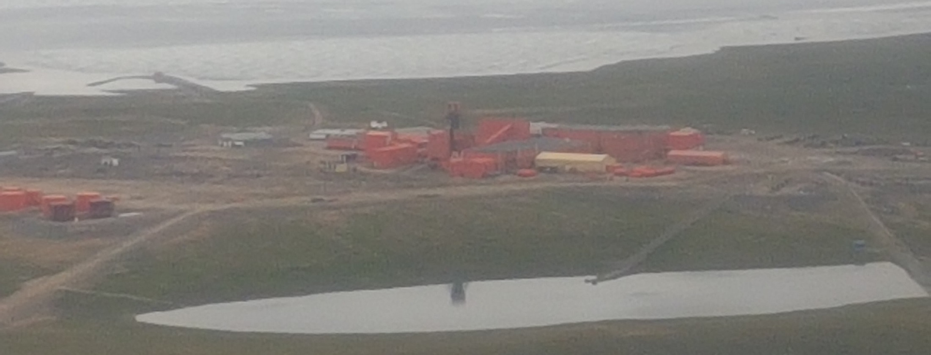
Lupin Mine Site
Lupin Mine Igluqpaqaqvik
Operated as a gold mine beginning in 1982
Site was in care and maintenance since 2005
Site currently under closure
Atuqtauyuq kuulmik uyaraktaqviuvluni atuliqhuni 1982-mi
Igluqpaqaqvik munariyauyuq ihuaqhaqtauvluinilu 2005-mit
Igluqpaqaqvik taja umikhimayuq

Slide 6
Tailings and waste rock
Ataguut iqaguulu uyaqaat
Potential contamination from waste rock used across as construction material
(Commitments #3 & #4)
Historical construction data should be reviewed to estimate how much waste rock has been used for infrastructures such as the dams
Once volume of waste rock is known, we can assess if it is necessary to do geochemical modelling and pathway analysis for potential waste rock acid rock drainage
Halumailruqalaaqtuq iqagunit uyaqanit atuqtauyut humiliqaa hanavikni ihuaqutauvlutik
(Uqariiyaqhimayut #3 & #4)
Taimanit hananiganik naunaipkutit ihivriuqtakhaugaluit nalautariagani qanuraaluk iqaguut uyaqat atuqtaunignik hanayauyunik ajikutainik himiktuutit
Qanuraaluk iqatuut uyaqat naunaiqat, ilituqhalaaqtagut aturiaqaqmagaa nunami halumailruvaluit qanuriniginik aulavigiyainiklu ilituqhautit iqagunit uyaqanit halumailruq uyaqanit kutikniginik

Slide 7
Tailings and waste rock
Ataguut iqaguulu uyaqaat
Waste rock storage “dome” design & seepage
(Commitments #5 & #7)
Design details needed for newly proposed storage of waste rock
Satisfied with proposal to collect seepage samples and update model
Iqagunik uyaqanik tuutquqtiqvik”kigikninua” qanuriniga kuukviunigalu
(Uqariiyaqhimayut #5 & #7)
Qanuriniganik hunaunigit ihariagiyauyut nutaanuami aturumayauyuq tuukquqtirivikhamik iqagunik uyaqanik
Naamaktuq atulirumayauyuq katitiriagani kuukniginit naunaiyagakhat nutaaguqtiqlugulu atuqtuq

Slide 8
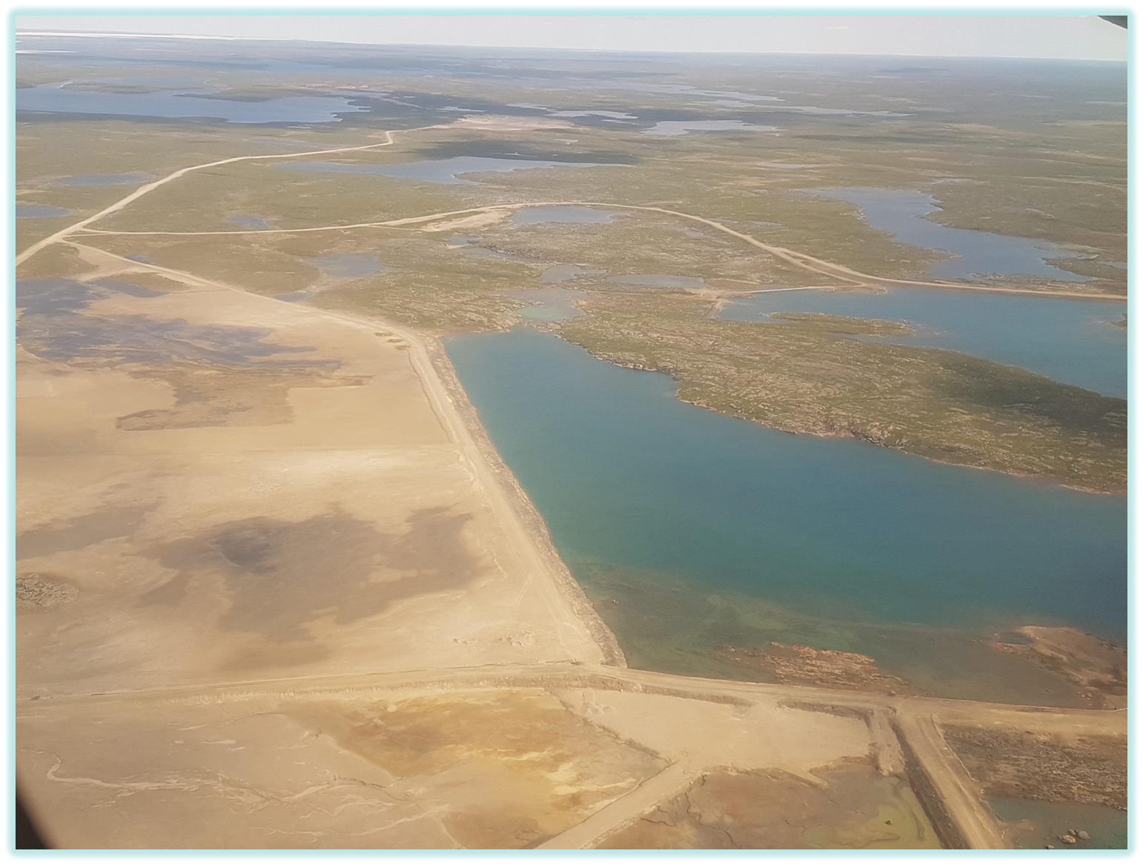
Tailings and waste rock
Ataguut iqaguulu uyaqaat
Exposed tailings
(Commitment #8)
Tailings will be exposed when water level is lowered in tailings management area – these need to be moved to contained cells
Information provided is not a satisfactory decision management matrix
Takuukhauyut ataguut
(Uqariiyaqhimayut #8)
Ataguut takuukhauliqniaqtut immaiqtiliqat ataguuqvik munariyauyuq nuna – ukua nuutariaqaqtut hiamayaktailijutini atuniituni
Hivuniqhijutit pipkagauyut naamagituq ihumaliurut munarinigagut uyaraktaqniqmi

Slide 9
Closure and reclamation planning
Umiktiqnigagut Nunalu Utiqtiniganik Ilitquhianut parnaiyainiq
Human health ecological risk assessment
(Commitment #1)
Human health ecological risk assessment provided does not cover tailings containment area
Results indicate monitoring plan needs to be updated
Inuit Aaniaginigit Nunamiklu Ihumaaluknaqniganik Ilituqhaut
(Uqariiyaqhimayut #1)
Inuit aaniaginiga nunamit ihumaluknaqniganik ilituqhaut pipkagauyuq uqauhiqaginmat ataguunik hiamayaktailivikmik nunamik
Qanurinigit naunairutiyut amirinigagut upalugaiyaut nutaaguqtiqtauyariaqaqtuq

Slide 10
Closure and reclamation planning
Umiktiqnigagut Nunalu Utiqtiniganik Ilitquhianut parnaiyainiq
Geotechnical details of engineered structures
(Commitment #6)
Geotechnical design is necessary to evaluate if proposed activities are adequate - long term erosional stability of dams is biggest concern
Nunaliqijutit uqatiaqtauyut hanayakhanik qanuriniginik
(Uqariiyaqhimayut #6)
Nunaliqijutit qanuriniginik aturiaqaqtuq naunaiyariagani atulirumayauyut hulijuit naamakpata – hivunikhami hituagitaagani himiktuutit aginiqhaq ihumaluut

Slide 11
Reclamation security cost estimate
Nunat utiqtitaagani ilitquhiinut ihumaaluknaitagani akiliriiqhimayuup akituniga nalautaaqtauyuq
Updated security estimate
(Commitment #2)
Insufficient explanations have been provided for reducing costs
The department has not been able to create a new reclamation estimate with the limited information provided by LMI
Nutaaguqtiqlugu ihumaluknaqniga nalautagauyuq
(Uqariiyaqhimayut #2)
Naamagitut uqatiarutit pipkagauyut akikhivaaliriagani akitunigit
Havakviuyuq ayuqhaqmata hanayaagani nutaamik nunat utiqtitaagani ilitquhiinut nalautaarutimik ilakuinaunignik hivuniqhijutit pipkagauyut LMI-kunit

Slide 12
Reclamation security cost estimate
Nunat utiqtitaagani ilitquhiinut ihumaaluknaitagani akiliriiqhimayuup akituniga nalautaaqtauyuq
Framework for progressive release of security
(Commitment #9)
The department and proponent have been working towards a joint proposal
Qanurinikhaa hapkugauvalianiginik ihumaluknaipkutit akiligauyut
(Uqariiyaqhimayut #9)
Havakviuyuq havaaqarumayuqlu havaqatiriiktut ikayuqtiriiklutik atulirumayamiknik piyaagani

Slide 13
Outstanding Issues
Iniqhimagitut Ihumagiyauyut
Long term stability of cover and dams
Management of tailings exposed when water levels are lowered.
Insufficient information for security estimation
Hivunikhami naamainaqniga hauhijutit himiktuutilu
Munarinigit ataguut takuukhauyut immaiqtiliqat iliuraivik.
Naamagitut hivuniqhijutit ihumaluknairiagani akiliutit nalautaaqtauyut

Slide 14
Conclusion
Iniqtirutit
The department will support Lupin Mine Inc.’s renewal/amendment application when the stated outstanding issues are resolved.
Havakviuyuq ikayuqtuqniakut Lupin Mine Timiuyumit nutaaguqtiniganik ihuahaqniganiklu tuukhiutimik ukua uqautauyut iniqhimagitut ihumagiyauyut ihuaqhikpata.

Slide 15
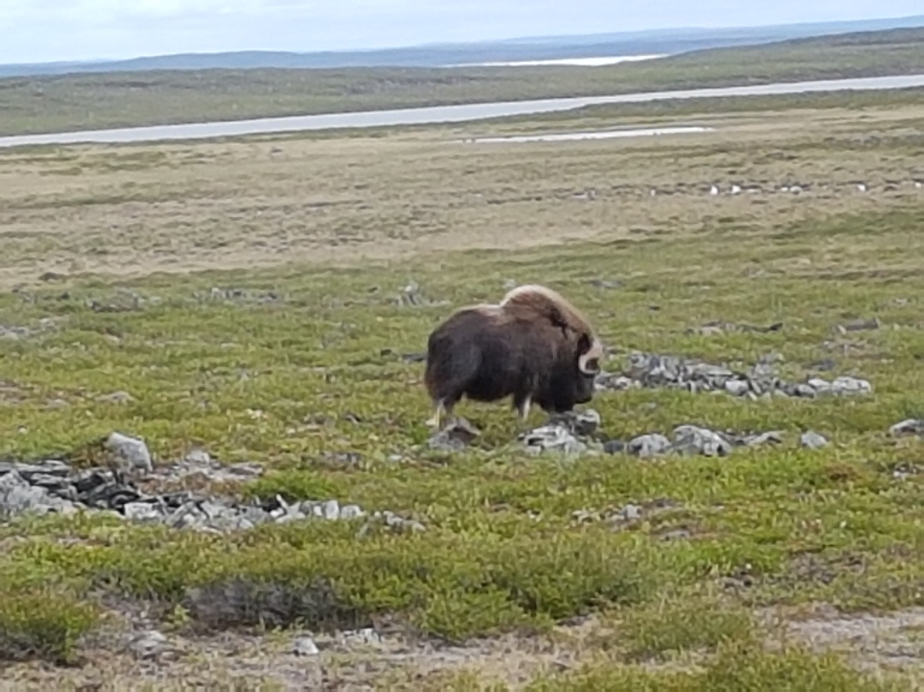
Koana
ᖁᔭᓐᓇᒦᒃ
Thank you
Merci

