Slide 1

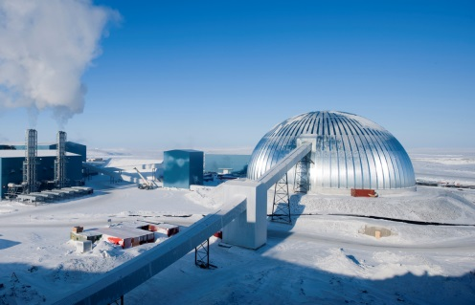
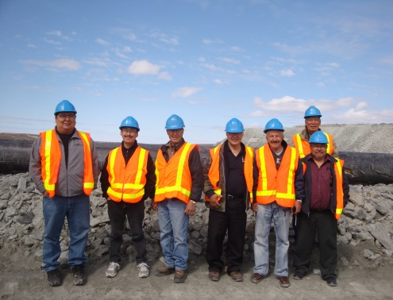
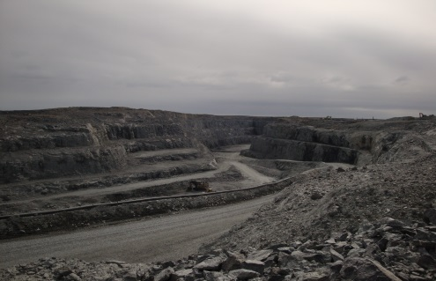
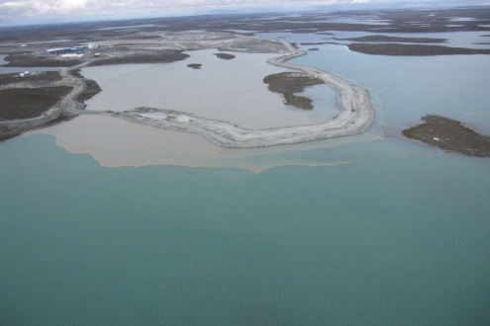

Nunavut Water Board (NWB)
Community Presentation
Type “A” Water Licence 2AM-MEA0815
Amendment Application
for
Agnico-Eagle Mines Ltd. (AEM)
Meadowbank Gold Project

Slide 2
Introduction to the Nunavut Water Board (NWB)
Established pursuant to Article 13 of the Nunavut Land Claims Agreement (NLCA) as an Institution of Public Government (IPG).
NWB has the responsibilities and powers over the regulation, use and management of water in Nunavut.
Objective is to provide a means for the conservation and utilization of waters in Nunavut, except in a national park, in a manner that will provide the optimum benefit from those waters for the residents of Nunavut in particular and Canadians in general.
Community Session – October 16, 2013

Slide 3
Agnico-Eagle Mines Ltd. (AEM) Type “A” 2AM-MEA0815 Water Licence Meadowbank Gold Project
Date Licence Issuance: June 9, 2008
Date Licence Expiry: May 31, 2015
Water use not to be Exceeded: 700,000 m³ annually
Water use for Mining & Milling: Third Portage Lake
for Emulsion Plant: Unnamed Lake
Construction and operation of mine site facilities: bulk fuel storage, mill, shops, offices, laboratory, warehouse, camp and explosive mixing
Construction of Dikes, Dams, Ponds, Waste Rock Storage Facilities and a Tailing Storage Facility
Community Session – October 16, 2013

Slide 4
AEM Type “A” 2AM-MEA0815 Water Licence Meadowbank Gold Project
Dewatering of Second Portage Lake arm for open pit mining of Portage Deposit
Dewatering of Third Portage Lake arm for open pit mining of Goose Island Deposit
Dewatering of Vault Lake for open pit mining of Vault Deposit
Management & disposal of Wastes associated with: Sewage Treatment Plant, Landfill, Landfarm, Incinerator and other wastes
Re-watering of Portage, Goose Island and Vault open pits following pit developments
Progressive Reclamation & Abandonment planning of site facilities and infrastructures
Community Session – October 16, 2013

Slide 5
Amendment Application before the Board Type “A” 2AM-MEA0815 Water Licence
April 26, 2013 NWB received a Type “A” water licence amendment application (Application) for Type “A” 2AM-MEA0815 water licence for Increase in freshwater use:
1,870,000 m³ in 2013
1,150,000 m³ per year from 2014 to 2018
Reasons for Increase of water withdrawal
Insufficient reclaimed water estimated due to a reduction in forecasted total precipitation, increased production from 8,500 t/day to 11,200 t/day, and unexpected infiltration rather than runoff from the waste rock storage area
February 2013 technical issue with reclaim barge as a result of accidental shifting and intake of excess solids also due to a lack of water in the reclaim pond.
Community Session – October 16, 2013

Slide 6
Procedural History of
Type “A” 2AM-MEA0815 Water Licence Amendment Application
July 15, 2013
NWB acknowledged receipt of the Application asking parties to review the scope and completeness of information provided and submit their comments to the NWB by August 6, 2013
August 6, 2013
NWB received comments from Aboriginal Affairs and Northern Development Canada (AANDC) and Environment Canada (EC)
August 29, 2013
NWB determined that the Application could proceed to the next steps in the NWB’s regulatory process and invited parties to complete a full technical assessment of the Application
Community Session – October 16, 2013

Slide 7
Procedural History of
Type “A” 2AM-MEA0815 Water Licence Amendment Application
August 29, 2013
NWB asked parties to make written representations to the NWB by September 29, 2013
Week of October 14th 2013
Previously set to hold a Technical Meeting and Pre-Hearing Conference (TM/PHC) in Baker Lake
September 29, 2013
NWB received comments from AANDC and EC
October 1, 2013
NWB confirmed the dates for TM/PHC as October 16, 17 in Baker Lake
Parties were asked to confirm their attendance at the TM/PHC by October 10, 2013.
October 10, 2013
AANDC confirmed their attendance; Kivalliq Inuit Association (Kiv.IA) informed about their possible attendance
Community Session – October 16, 2013

Slide 8
Procedural History of
Type “A” 2AM-MEA0815 Water Licence Amendment Application
October 16, 2013 NWB held the Technical Meeting
October 16, 2013 NWB is holding this Community Meeting
October 17, 2013 NWB will be holding the Pre-Hearing Conference tomorrow morning
Community Session – October 16, 2013

Slide 9
NWB Type “A” Water Licensing Process
NWB receives application and confirms classification of undertaking and type of licence (new/renewal/amendment) as type A.
If required, applicant provides additional information.
NWB conducts concordance review
NWB issues notice of application (minimum 30 days).
Community Session – October 16, 2013

Slide 10
NWB Type “A” Water Licensing Process
Parties submit written representations
.
If required, applicant provides additional information
NWB holds TM and PHC
NWB Issues PHC Decision
If directed in PHC decision, applicant provides additional information.
NWB issues notice of Public Hearing (minimum 60 days).
Community Session – October 16, 2013

Slide 11
NWB Type “A” Water Licensing Process
Parties exchange written interventions.
Parties prepare for public hearing.
NWB holds Public Hearing.
NWB issues decision to approve of application to Minister.
NWB issues decision not to approve of application with reasons to Minister.
Minister approves of the issuance of licence.
Minister does not approve of the issuance of licence.
Minister approves of NWB decision.
Minister does not approve of NWB decision.
Community Session – October 16, 2013

Slide 12
Next Steps in the NWB Process
Technical Meeting (TM) was held earlier today and the Pre-Hearing Conference (PHC) will be held tomorrow
One of the main objectives of the Technical Meeting and Pre-hearing Conference is to help the Board determine whether all substantive issues have been or are being addressed prior to any Board decision to schedule a Public Hearing
Following the TM-PHC, the NWB will issue a PHC report, which will include a decision on if and when a Public Hearing for the Application will be scheduled
Following the Public Hearing, should an amendment be issued, the amendment and decision will be submitted to the Minister of AANDC for approval
Community Session – October 16, 2013

Slide 13
Objectives of Tonight’s Community Meeting
Provide the opportunity for community members to meet face-to-face with other stakeholders as well as provide feedback on the application that is before the Board
Listen and note the concerns and views that community members may have with respect to AEM’s Application and to answer relevant questions that community members may have
To provide consultation opportunity and information, as well as invite participation in the formal Public Hearing process when scheduled
Community Session – October 16, 2013

Slide 14
Objectives of Tomorrow’s Pre-Hearing Conference
Formal meeting with the Applicant and intervening parties, including, AANDC, KivIA and interested community members, to discuss various matters in preparation for a potential future Public Hearing for the Application including:
Who will participate in the hearing
Issues to be addressed during the Hearing
Schedules and timelines for participation
Exchange of information prior to the Hearing
Community Session – October 16, 2013

Slide 15
How can the Community Participate?
Attend this community session
Attend tomorrow’s Pre-Hearing Conference
Contact the NWB
Visit the NWB’s ftp and web-site
Attendance at the Final Public Hearing
Community Session – October 16, 2013

Slide 16
NWB Staff
Damien A. Côté, Executive Director
Email: damien.cote@nunavutwaterboard.org
David Hohnstein, Director of Technical Services
Email: dts@nunavutwaterboard.org
Phyllis Beaulieu, Manager of Licensing
Email: licensing@nunavutwaterboard.org
Ben Kogvik, Interpreter and Board Secretary
Email: interpreter@nunavutwaterboard.org
Karén Kharatyan, Technical Advisor
Email: k.kharatyan@nunavutwaterboard.org
Sonia Aredes, Technical Advisor
Email: sonia.aredes@nunavutwaterboard.org
Robin Ikkutisluk, Licensing Administrator
Email: robin.ikkutisluk@nunavutwaterboard.org
Community Session – October 16, 2013

Slide 17
Contact Information
Nunavut Water Board
P.O. Box 119
Gjoa Haven, NU
X0B 1J0
Tel: (867) 360-6338
Fax: (867) 360-6369
Web Site: www.nunavutwaterboard.org
FTP Site: ftp://nunavutwaterboard.org/
Community Session – October 16, 2013

Slide 18
Questions? Comments? Thank You

