Slide 1


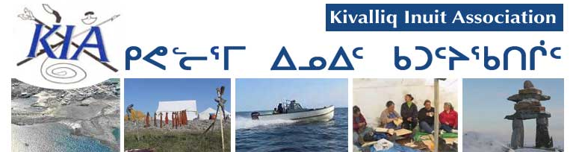

Meadowbank Water License Renewal
Hutchinson
Environmental Sciences Ltd.
NWB 2AM MEA0815
January 14-15, 2015,
Community of Baker Lake, NU

Slide 2

Overview
Our review was comprised of
27 separate information requests (IRs) from Hutchinson Environmental Sciences Ltd.
4 separate Information requests from GeoVector Management Inc.
We have communicated with AEM over the past three months and have resolved all our issues
This presentation accompanies AEM’s submission to the NWB on January 13, 2014 which contains the specific language agreed to by both parties:
“NWB 2AM MEA0815 Preliminary AEM response to Technical Comments WL Renewal_revised on 01132015”

Slide 3
Guiding Principles
Our review is guided by
Nunavut Water Board’s (NWB) water quality framework
protect, manage and regulate freshwaters in Nunavut in a manner that will provide the optimum benefits for the residents of the territory in particular and Canadians in general
The Nunavut Land Claims Agreement, and
The Kivalliq Inuit Association’s right to minimized changes to the environment
Our presentation accompanies our submission to the NWB:
Hutchinson Environmental Sciences Ltd. 2014. Meadowbank Water License Review. Prepared for GeoVector Management Inc. and the Kivalliq Inuit Association.

Slide 4
Overview of Issues

Slide 5
Freshwater Quantity
KIR-IR-01, 01B, 23
Concern with the increase in freshwater requested by AEM and the impact it may have on Third Portage Lake
AEM and KIA have resolved the issues. AEM has:
Agreed to a staged water license to reflect annual anticipated freshwater usage
Demonstrated water usage will have no negative impact on Third Portage Lake

Slide 6
Waste Disposal and Management
KIA-IR-25
Concern with seepage from the tailings storage facility into the receiving environment, specifically elevated cyanide concentrations
AEM has resolved this issue with the KIA during the technical meetings
AEM will update the Freshet Action Plan to reflect today’s discussions
This involves continued monitoring of the receiving environment and mitigation actions to prevent further seepage from through the rock storage facility

Slide 7
Emergency and Spill Contingency Planning
KIA-IR-20, 22, 27
Concern AEM did not consider seepage as a spill and that adequate monitoring was occurring in the event of an emergency
AEM has amended the license wording to include seepage as a spill
AEM has also provided greater clarity for emergency and spill monitoring as well as the associated adaptive response framework

Slide 8
Monitoring
KIA-IR-2, 3, 4, 5, 6, 7, 9, 10, 11, 12, 13, 14, 15, 16, 17, 18, 19, 21, 24, 26 and 28
The majority of KIA’s concerns focused on ensuring AEM adequately assessed impacts to the environment associated with mining activities
The KIA’s goal was to ensure the receiving environment was sufficiently protected
Our comments were focused on the Aquatic Effects Monitoring Program and the Core Receiving Environment Monitoring Program
AEM has addressed all KIA’s concerns

Slide 9
Monitoring
Technical comments addressed a variety of issues including:
Concerning water and sediment quality monitoring results
Monitored parameters including biological indicators, the suite of assessed chemical parameters and water quality detection limits
Modeling results and comparisons to measured values
Data quality objectives to ensure accuracy of reported data
Water license wording for clarity and precision
Conditions require the collection of water quality samples at depth
Requirements to discuss elevated water and sediment chemistry results in the body of reports
Photographic record of preconstruction conditions
A reference site for Wally Lake
Capacity to statistically detect changes in the receiving environment

Slide 10
Closure and Reclamation Planning
KIA-IR-8, 29, 30, 31
Our concerns focused on
Long term monitoring to ensure no long term impacts of mining on the aquatic environment
Successful capping of potentially acid generating rock and the tailings storage facility using non acid generating rock and adequate freeze back
AEM has assured the KIA of its long term monitoring activities and is conducting focused research to ensure isolation of potential chemical hazards associated with the tailings storage facility and potentially acid generating rock

