Slide 1


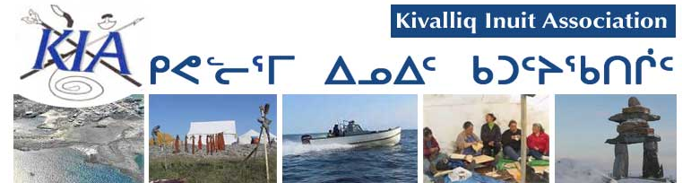

Meadowbank Water License Renewal
Hutchinson
Environmental Sciences Ltd.
NWB 2AM MEA0815
Community Sessions
April 29, 2015
Baker Lake, NU

Slide 2

Overview
Our review generated 31 separate information requests and technical comments
All have been resolved to the satisfaction of both the Kivalliq Inuit Association (KIA) and Agnico Eagle Mines (AEM)
INUKTITUT

Slide 3
Overview
Resolutions have been tracked in the Nunavut Water Board Excel spreadsheet titled “150114 2AM MEA0815 Preliminary AEM response to Technical Comments revised-ILAE”
This spreadsheet is available on the public registry and is considered part of the public record
INUKTITUT

Slide 4
Overview
Here we summarize the primary issues in each of five discussion topics identified by the Nunavut Water Board (NWB) during the Prehearings in January, 2015
These topics are:
Freshwater Quantity
Waste Disposal and Management
Emergency and Spill Contingency Planning
Monitoring
Closure and Reclamation Planning
INUKTITUT

Slide 5
Guiding Principles
Our review is guided by
Nunavut Water Board’s (NWB) water quality framework
“protect, manage and regulate freshwaters in Nunavut in a manner that will provide the optimum benefits for the residents of the territory in particular and Canadians in general”
The Nunavut Land Claims Agreement, and
The Kivalliq Inuit Association’s interest in long term environmental protection for the beneficiaries
INUKTITUT

Slide 6
Guiding Principles
Our presentation accompanied our intervener submission to the NWB:
“Kivalliq Inuit Association Intervener Submission for 2AM-MEA0815 Meadowbank Water License Renewal Application Public Hearing Process”
INUKTITUT

Slide 7
Overview of Issues

Slide 8
Freshwater Quantity
KIR-IR-01, 01B, 23
Concern with the increase in freshwater requested by AEM and the impact it may have on Third Portage Lake
AEM and KIA have resolved the issues. AEM has:
Agreed to a staged annual water usage in the water license to reflect anticipated freshwater usage
Demonstrated water usage will have no negative impact on Third Portage Lake
INUKTITUT

Slide 9
Waste Disposal and Management
KIA-IR-25
Concern with seepage from the tailings storage facility into the receiving environment, specifically elevated cyanide concentrations
AEM has resolved this issue with the KIA
AEM will update the Freshet Action Plan to the KIA’s agreed satisfaction
This includes continued monitoring of the receiving environment and mitigation actions to prevent further seepage from the Tailings Storage Facility through the rock storage facility
INUKTITUT

Slide 10
Emergency and Spill Contingency Planning
KIA-IR-20, 22, 27
Concern AEM did not consider seepage as a spill and that adequate monitoring was occurring in the event of an emergency
AEM has amended the license wording to include seepage as a spill
AEM has also provided greater clarity for emergency and spill monitoring as well as the associated adaptive response framework

Slide 11
Monitoring
KIA-IR-2, 3, 4, 5, 6, 7, 9, 10, 11, 12, 13, 14, 15, 16, 17, 18, 19, 21, 24, 26 and 28
The majority of KIA’s concerns focused on ensuring AEM adequately assessed impacts to the environment associated with mining activities
The KIA’s goal was to ensure the receiving environment was sufficiently protected
Our comments were focused on the Aquatic Effects Monitoring Program and the Core Receiving Environment Monitoring Program, which were modified
KIA emphasizes the need for KIA review of annual reports and prompt notification of events
INUKTITUT

Slide 12
Monitoring
Technical comments addressed a variety of issues including:
Water and sediment quality monitoring results
Monitored parameters including biological indicators, the suite of assessed chemical parameters and water quality detection limits
Modeling results and comparisons to measured values
Data quality objectives to ensure accuracy of reported data
Water license wording for clarity and precision
INUKTITUT

Slide 13
Monitoring
Technical comments also addressed:
Conditions to require the collection of water quality samples at depth
Requirements to discuss any elevated water and sediment chemistry results in the body of reports
Photographic record of preconstruction conditions
A reference site for Wally Lake
Capacity to statistically detect changes in the receiving environment
AEM has addressed all KIA’s concerns
INUKTITUT

Slide 14
Closure and Reclamation Planning
KIA-IR-8, 29, 30, 31
Our concerns focused on
Long term monitoring to ensure no long term impacts of mining on the aquatic environment
Successful capping of potentially acid generating rock and the tailings storage facility using non acid generating rock and adequate freeze back
AEM has assured the KIA of its long term monitoring activities and is conducting focused research to ensure isolation of potential chemical hazards associated with the tailings storage facility and potentially acid generating rock
INUKTITUT

Slide 15
Questions?

