Slide 1

NWB Water Licence 2AM-MEL1631 Amendment of the Meliadine Extension Proposal
Technical Presentation of Meliadine Extension Proposal Water Licence Amendment
NWB Water Licence 2AM-MEL1631 Amendment of the Meliadine Extension Proposal
Technical Presentation of Meliadine Extension Proposal Water Licence Amendment
Rankin Inlet, Nunavut October 12-13, 2023
Rankin Inlet, Nunavut October 12-13, 2023

Slide 2
Our Mandate and Objectives
Our Mandate and Objectives
KivIA is a Designated Inuit Organization pursuant to Article 39 of the Nunavut Agreement, and represents Inuit beneficiaries of the Nunavut Agreement in the Kivalliq Region. ¹
KivIA holds title to and manages surface Inuit Owned Lands in the Kivalliq Region.
The primary purpose of Inuit Owned Lands is to provide Inuit with rights in land that promote economic self-sufficiency in a manner consistent with the cultural and social well-being of Inuit now and in the future. ²
Our mandate is to:
Manage surface Inuit Owned Lands in a manner that supports sustainable economic development opportunities for Inuit.
Ensure that any economic development is done in an environmental and socially responsible manner that protects Inuit rights guaranteed under the Nunavut Agreement.
KivIA is a Designated Inuit Organization pursuant to Article 39 of the Nunavut Agreement, and represents Inuit beneficiaries of the Nunavut Agreement in the Kivalliq Region. ¹
KivIA holds title to and manages surface Inuit Owned Lands in the Kivalliq Region.
The primary purpose of Inuit Owned Lands is to provide Inuit with rights in land that promote economic self-sufficiency in a manner consistent with the cultural and social well-being of Inuit now and in the future. ²
Our mandate is to:
Manage surface Inuit Owned Lands in a manner that supports sustainable economic development opportunities for Inuit.
Ensure that any economic development is done in an environmental and socially responsible manner that protects Inuit rights guaranteed under the Nunavut Agreement.
Article 39 of the Nunavut Agreement.
Article 17 of the Nunavut Agreement.
Article 39 of the Nunavut Agreement.
Article 17 of the Nunavut Agreement.

Slide 3

KivIA’s Objectives in this Environmental Assessment
KivIA’s Objectives in this Environmental Assessment
Ensure that the potential impacts and benefits are comprehensively assessed.
Ensure Inuit Qaujimajatuqangit values are incorporated into impact determination, mitigation, project design and monitoring.
Ensure that the voices of Inuit are heard.
Ensure that the rights of Inuit are paramount and that they are respected now and into the future.
Ensure that the potential impacts and benefits are comprehensively assessed.
Ensure Inuit Qaujimajatuqangit values are incorporated into impact determination, mitigation, project design and monitoring.
Ensure that the voices of Inuit are heard.
Ensure that the rights of Inuit are paramount and that they are respected now and into the future.

Slide 4
Information Requests and Technical Comments
Information Requests and Technical Comments
The KivlA information requests and technical comments have concerned:
In-pit tailings and waste rock management, and
Impacts to Meliadine Lake and surface contact water management.
The KivlA information requests and technical comments have concerned:
In-pit tailings and waste rock management, and
Impacts to Meliadine Lake and surface contact water management.

Slide 5
In-Pit Disposal of Tailings and/or Waste Rock
In-Pit Disposal of Tailings and/or Waste Rock
KivIA supports CIRNAC’s recommendations with the following additional recommendations:
The Proponent must define the package of information on a “pit by pit” basis that will be submitted to the Nunavut Water Board (NWB) one (1) year prior to starting the in-pit disposal of tailings and/or waste rock.
KivIA supports CIRNAC’s recommendations with the following additional recommendations:
The Proponent must define the package of information on a “pit by pit” basis that will be submitted to the Nunavut Water Board (NWB) one (1) year prior to starting the in-pit disposal of tailings and/or waste rock.

Slide 6
In-Pit Disposal of Tailings and/or Waste Rock
In-Pit Disposal of Tailings and/or Waste Rock
2. Additional Requirements include updating the following prior to the mining of each open pit:
thermal studies, and
hydrogeological studies.
2. Additional Requirements include updating the following prior to the mining of each open pit:
thermal studies, and
hydrogeological studies.

Slide 7
In-Pit Disposal of Tailings and/or Waste Rock
In-Pit Disposal of Tailings and/or Waste Rock
3. Updating the following upon completion of mining of each open pit:
Water balance and water quality models,
Water management plan,
Interim Closure and Reclamation plan,
Waste Management Plan, and
Adaptive management strategies.
3. Updating the following upon completion of mining of each open pit:
Water balance and water quality models,
Water management plan,
Interim Closure and Reclamation plan,
Waste Management Plan, and
Adaptive management strategies.

Slide 8
Discharge of Surface Contact Water to Meliadine Lake
Discharge of Surface Contact Water to Meliadine Lake
Meliadine Lake is extremely important to local Inuit as a source of drinking water, fish, and access to caribou hunting grounds. Preservation of Meliadine Lake is of utmost importance to the KivIA and Inuit of the Kivalliq.
The KivIA was assured by the Proponent that the approved dual waterline to Itivia Harbour would diminish the impacts of the project on the lake, by diverting surface contact water away from Meliadine Lake.
“… with the waterline, we reduced significantly the amount of water going to Meliadine Lake. Some years, it might be zero, and others we might have more, but less than we were originally planning. So overall the impact will be less.” ³
Meliadine Lake is extremely important to local Inuit as a source of drinking water, fish, and access to caribou hunting grounds. Preservation of Meliadine Lake is of utmost importance to the KivIA and Inuit of the Kivalliq.
The KivIA was assured by the Proponent that the approved dual waterline to Itivia Harbour would diminish the impacts of the project on the lake, by diverting surface contact water away from Meliadine Lake.
“… with the waterline, we reduced significantly the amount of water going to Meliadine Lake. Some years, it might be zero, and others we might have more, but less than we were originally planning. So overall the impact will be less.” ³
³Nunavut Impact Review Board Reconsideration Report and Recommendations for the Saline Effluent Discharge to Marine Environment Proposal- Agnico Eagle Mines Limited’s Meliadine Gold Mine Project, Project Certificate No. 006 NIRB File No. 11MN034, July 2021
³Nunavut Impact Review Board Reconsideration Report and Recommendations for the Saline Effluent Discharge to Marine Environment Proposal- Agnico Eagle Mines Limited’s Meliadine Gold Mine Project, Project Certificate No. 006 NIRB File No. 11MN034, July 2021

Slide 9
Discharge of Surface Contact Water to Meliadine Lake
Discharge of Surface Contact Water to Meliadine Lake
The Water Quality Water Balance Models present a significant increase in discharge to Meliadine Lake, even with the operational waterline to Itivia Harbour.
The KivIA recommends that a condition is added to the Water Licence, limiting discharge of contact water to Meliadine Lake to 1.1 million m³ annually
The maximum discharge to date was 1.03 million cubic metres in 2020, when concerns were raised by the community about impacts to the lake
Limits to the annual discharge volumes will help minimize the impacts of mining to Meliadine Lake
The Water Quality Water Balance Models present a significant increase in discharge to Meliadine Lake, even with the operational waterline to Itivia Harbour.
The KivIA recommends that a condition is added to the Water Licence, limiting discharge of contact water to Meliadine Lake to 1.1 million m³ annually
The maximum discharge to date was 1.03 million cubic metres in 2020, when concerns were raised by the community about impacts to the lake
Limits to the annual discharge volumes will help minimize the impacts of mining to Meliadine Lake

Slide 10
AEMP Benchmarks for Meliadine Lake
AEMP Benchmarks for Meliadine Lake
The AEMP is an important resource for evaluating the impacts of the project on Meliadine Lake
Current AEMP benchmarks for Meliadine Lake exceed Drinking Water Guidelines for Arsenic, Fluoride, and Iron
It is unlikely that concentrations of these would exceed CDWQG, however, benchmarks below these thresholds should be adopted to ensure the safety of local Inuit, as well as Agnico Eagle employees who drink water from Meliadine Lake
The AEMP is an important resource for evaluating the impacts of the project on Meliadine Lake
Current AEMP benchmarks for Meliadine Lake exceed Drinking Water Guidelines for Arsenic, Fluoride, and Iron
It is unlikely that concentrations of these would exceed CDWQG, however, benchmarks below these thresholds should be adopted to ensure the safety of local Inuit, as well as Agnico Eagle employees who drink water from Meliadine Lake

Slide 11
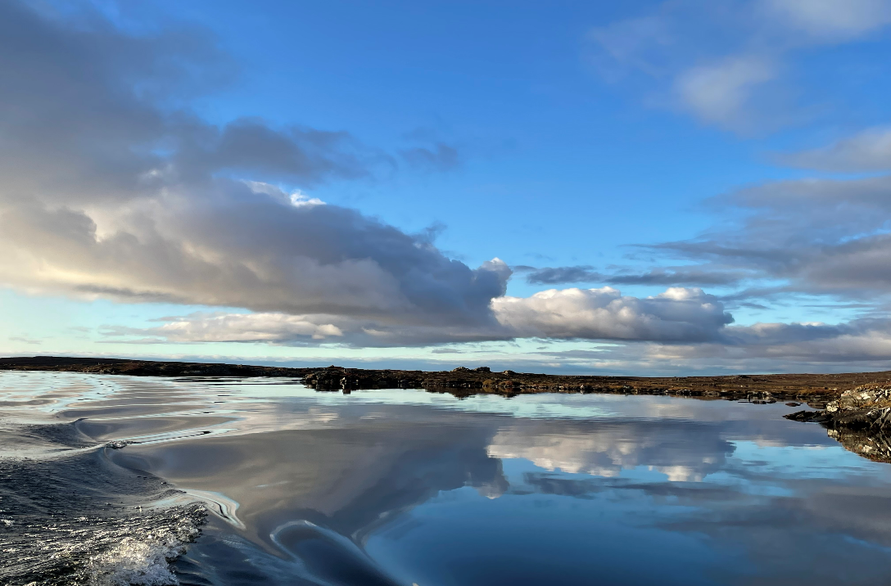
Conclusion
Conclusion
The KivIA appreciates the opportunity to provide this presentation and thanks the NWB and Participants.
The KivIA appreciates the opportunity to provide this presentation and thanks the NWB and Participants.

