Slide 1
ᐋᒡᓃᑯ ᐄᑯᓪ ᐅᔭᕋᒃᑕᕆᐊᑦ ᓕᒥᑎᑦ
ᐋᖅᑭᒋᐊᑦᑕᐅᓯᒪᔪᑦ ᑐᒃᓯᕋᐅᑎᑦ ᐱᑦᔪᑎᒋᑉᓗᒍ ᖃᓄᐃᑦᑑᓂᖓ “ᐃ” ᐃᒪᓕᕆᓂᕐᒥ ᓚᐃᓴᓐᓯᑦ 2AM-MEL1631
ᓄᓇᕗᒻᒥ ᐃᒪᓕᕆᔨᒃᑯᑦ ᑲᑎᒪᔨᕐᔪᐊᖏᑦ ᓴᓇᕐᕈᑎᓕᕆᓂᕐᒧᑦ ᑲᑎᒪᓂᖓᑦ
ᑲᖏᖅᖠᓂᖅ, ᔫᓂ 05-06, 2024

Slide 2
ᓴᖅᑭᑎᑕᐅᓂᖏᓐᓄᑦ ᓇᓗᓇᐃᔭᐅᑎᑦ
ᐱᓕᕆᔨᐅᓂᖅ ᐊᒻᒪᓗ ᐱᓕᕆᐊᖃᖅᑎᐅᓂᖏᑦ
ᐃᑲᔪᕈᑎᒃᓴᓂᒃ ᐱᑕᖃᖅᑎᑦᓯᖃᑕᐅᔪᑦ ᐃᒪᓕᕆᓂᕐᒥ ᓚᐃᓴᑖᕈᑎᓂᒃ ᑐᒃᓯᕋᐅᑎᑦ ᕿᒥᕐᕈᔭᐅᓂᖏᓐᓄᑦ
ᓴᓇᕐᕈᑎᓂᒃ ᕿᒥᕐᕈᐃᓂᕐᒧᑦ ᐅᖃᐅᓯᒃᓴᐃᑦ
ᓇᐃᒡᓕᒋᐊᖅᓯᒪᑉᓗᒋᑦ ᐅᖃᐅᓯᒃᓴᑦ ᐱᓕᕆᐊᒃᓴᐅᓂᐊᖅᑐᓄᑦ
ᐃᓱᓕᑦᔪᑎᖏᑦ

Slide 3
ᐱᓕᕆᐊᖃᖅᑎᐅᓂᖅ ᐊᒻᒪᓗ ᐱᓕᕆᐊᒃᓴᖏᑦ
ᒐᕙᒪᓕᕆᔨᑦ-ᓄᓇᖃᖅᑳᖅᓯᒪᔪᓕᕆᔨᓪᓗ ᐊᒻᒪᓗ ᐅᑭᐅᖅᑕᖅᑐᒥ ᐱᕙᓪᓕᐊᔪᓕᕆᔨᖏᑦ ᑲᓇᑕᒥ (CIRNAC) ᐱᓕᕆᐊᖃᖅᑎᐅᓂᖏᑦ, ᐱᓕᕆᐊᒃᓴᕆᔭᖏᑦ, ᐊᒻᒪᓗ ᐱᓕᕆᐊᕆᔭᕆᐊᖃᖅᑕᖏᑦ ᒪᓕᒃᐸᓪᓕᐊᑎᑕᐅᓯᒪᑉᓗᑎᒃ ᒪᑯᓄᖓ:
ᒐᕙᒪᓕᕆᔨᑦ-ᓄᓇᖃᖅᑳᖅᓯᒪᔪᓕᕆᔨᓪᓗ ᐊᒻᒪᓗ ᐅᑭᐅᖅᑕᖅᑐᒥ ᐱᕙᓪᓕᐊᔪᓕᕆᔨᖏᑦ ᑲᓇᑕᒥ ᒪᓕᒐᖁᑎᖓᑦ
ᓄᓇᕗᑦ ᐊᖏᕈᑎᖏᑦ
ᓄᓇᕗᑦ ᓄᓇᓕᕆᓂᕐᒥ ᐊᖏᕈᑎᖏᓐᓄᑦ ᒪᓕᒐᖁᑎᖏᑦ
ᓄᓇᕗᒻᒥ ᐃᒪᕐᓄᑦ ᐊᒻᒪᓗ ᓄᓇᕗᒻᒥ ᓄᓇᐃᑦ ᖄᖏᓐᓃᑦᑐᓄᑦ ᐱᔪᖕᓇᐅᑎᓕᕆᓂᕐᒥ ᓈᓚᒃᑎᒃᑯᑦ ᒪᓕᒐᖁᑎᖓᑦ ᐊᒻᒪᓗ ᐊᓯᖏᑦ ᒪᓕᒐᓕᐊᖑᓯᒪᔪᑦ
ᓄᓇᕗᒻᒥ ᐸᕐᓇᐃᓂᕐᒧᑦ ᐊᒻᒪᓗ ᐱᓕᕆᐊᖑᑲᐃᓐᓇᖅᑐᑦ ᖃᐅᔨᒋᐊᖅᑕᐅᓂᖏᓐᓄᑦ ᒪᓕᒐᖁᑎᑦ
ᐊᕕᒃᑐᖅᓯᒪᓂᕐᒥ ᓄᓇᓄᑦ ᒪᓕᒐᖁᑎᑦ ᐊᒻᒪᓗ ᐊᓯᖏᑦ ᒪᓕᒐᓕᐊᖑᓯᒪᔪᑦ
ᐅᑭᐅᖅᑕᖅᑐᑉ ᐃᒪᖏᑕ ᑐᖁᓐᓇᖅᑐᖃᓕᖅᑎᑕᐅᖁᓇᒋᑦ ᒪᓕᒐᖁᑎᑦ

Slide 4
ᐃᑲᔪᕈᑎᒃᓴᓂᒃ ᐱᑕᖃᖅᑎᑦᓯᖃᑕᐅᔪᑦ ᐃᒪᓕᕆᓂᕐᒥ ᓚᐃᓴᑖᕈᑎᓂᒃ ᑐᒃᓯᕋᐅᑎᑦ ᕿᒥᕐᕈᔭᐅᓂᖏᓐᓄᑦ
ᒐᕙᒪᓕᕆᔨᑦ-ᓄᓇᖃᖅᑳᖅᓯᒪᔪᓕᕆᔨᓪᓗ ᐊᒻᒪᓗ ᐅᑭᐅᖅᑕᖅᑐᒥ ᐱᕙᓪᓕᐊᔪᓕᕆᔨᖏᑦ ᑲᓇᑕᒥ (CIRNAC) ᐅᑯᓂᖓ ᑐᓂᓯᓯᒪᓕᓚᐅᕐᒪᑕ ᓄᓇᕗᒻᒥ ᐃᒪᓕᕆᓂᕐᒧᑦ ᑲᑎᒪᔨᕐᔪᐊᖏᓐᓄᑦ ᐱᔾᔪᑎᒋᑉᓗᒋᑦ ᐋᖅᑭᒋᐊᖅᑕᐅᓯᒪᑉᓗᑎᒃ ᑐᒃᓯᕋᐅᑎᑦ ᖃᓄᐃᑦᑑᓂᖓ “ᐃ” ᐃᒪᓕᕆᓂᕐᒥ ᓚᐃᓴᓐᓯᑦ 2AM-MEL1631 ᐋᒡᓂᑰ ᐄᑯ ᐅᔭᕋᒃᑕᕆᐊᖅᑎᖏᓐᓂᑦ:
ᐅᖃᐅᓯᒃᓴᑦ ᐱᔭᕇᖅᑕᐅᓯᒪᓂᖏᓐᓂᒃ ᖃᐅᔨᒋᐊᕐᓂᖅ ᐊᒻᒪᓗ ᑐᓴᒐᒃᓴᖁᑎᓂᒃ ᑐᒃᓯᕋᐅᑎᑦ ᐋᖅᑭᒋᐊᖅᑕᐅᓯᒪᑉᓗᑎᒃ ᑐᒃᓯᕋᐅᑎᑦ ᖃᓄᐃᑦᑑᓂᖓ “ᐃ” ᐃᒪᓕᕆᓂᕐᒥ ᓚᐃᓴᓐᓯᑦ 2AM-MEL1631: ᕕᑉᕈᐊᕆ 16, 2024, ᐊᒻᒪᓗ ᒫᔾᔨ 13, 2024
ᓴᓇᕐᕈᑎᓂᒃ ᕿᒥᕐᕈᐃᓂᕐᒧᑦ ᐅᖃᐅᓯᒃᓴᑦ ᐱᑦᔪᑎᒋᑉᓗᒋᑦ ᐋᖅᑭᒋᐊᖅᑕᐅᓯᒪᑉᓗᑎᒃ ᑐᒃᓯᕋᐅᑎᑦ ᖃᓄᐃᑦᑑᓂᖓ “ᐃ” ᐃᒪᓕᕆᓂᕐᒥ ᓚᐃᓴᓐᓯᑦ 2AM-MEL1631: ᐊᐃᐱᕆ 26, 2024

Slide 5
ᓴᓇᕐᕈᑎᓂᒃ ᕿᒥᕐᕈᐃᓂᕐᒧᑦ ᐅᖃᐅᓯᒃᓴᐃᑦ
1. ᐋᖅᑭᒋᐊᖅᑕᐅᔪᓐᓇᕐᖢᑎᒃ ᐊᐅᓚᑦᓯᓂᕐᒥ ᐸᕐᓇᐅᑎᓕᐊᖑᓯᒪᔪᑦ - ᐃᓕᔭᐅᖃᑕᐅᓯᒪᑉᓗᑎᒃ ᓚᐃᓴᓐᓯᓄᑦ
(R-01) ᒐᕙᒪᓕᕆᔨᑦ-ᓄᓇᖃᖅᑳᖅᓯᒪᔪᓕᕆᔨᓪᓗ ᐊᒻᒪᓗ ᐅᑭᐅᖅᑕᖅᑐᒥ ᐱᕙᓪᓕᐊᔪᓕᕆᔨᖏᑦ ᑲᓇᑕᒥ (CIRNAC) ᐃᓱᒪᓕᐅᖅᐳᑦ ᓄᓇᕗᒻᒥ ᐃᒪᓕᕆᔨᒃᑯᑦ ᑲᑎᒪᔨᕐᔪᐊᖏᑦ (NWB) ᕿᒥᕐᕈᐃᖁᑉᓗᒋᑦ ᐊᒻᒪᓗ, ᓈᒻᒪᒃᑑᒃᐸᑦ, ᐋᖅᑮᓯᒪᓕᕐᓗᑎᒃ ᐃᓕᖓᓐᓂᐅᑎᑕᐅᔪᓂᒃ ᐅᕝᕙᓘᓐᓃᑦ ᐱᓕᕆᐊᒃᓴᐅᓂᐊᖅᑐᓂᒃ ᓈᒻᒪᒋᔭᐅᓯᒪᓕᖁᑉᓗᒋᑦ ᐋᖅᑭᒋᐊᖅᑕᐅᔪᓐᓇᕐᖢᑎᒃ ᐊᐅᓚᑦᓯᓂᕐᒥ ᐸᕐᓇᐅᑎᓕᐊᖑᓯᒪᔪᑦ ᒫᓐᓇᐅᔪᒥ ᐃᒪᓕᕆᓂᕐᒧᑦ ᓚᐃᓴᓐᓯᓕᕆᑦᔪᑎᑦ ᐋᖅᑭᒋᐊᖅᑕᐅᕙᓪᓕᐊᑎᓪᓗᒋᑦ.
ᖃᓄᐃᓕᖓᓕᕐᓂᖏᑦ: ᐋᖅᑭᒃᑕᐅᓯᒪᓕᖅᑐᑦ

Slide 6
ᓴᓇᕐᕈᑎᓂᒃ ᕿᒥᕐᕈᐃᓂᕐᒧᑦ ᐅᖃᐅᓯᒃᓴᐃᑦ
2. ᐋᖅᑭᒋᐊᖅᑕᐅᔪᓐᓇᕐᖢᑎᒃ ᐊᐅᓚᑦᓯᓂᕐᒥ ᐸᕐᓇᐅᑎᓕᐊᖑᓯᒪᔪᓄᑦ ᐋᖅᑭᒋᐊᖅᑕᐅᓯᒪᓂᖏᑦ
(R-03) ᒐᕙᒪᓕᕆᔨᑦ-ᓄᓇᖃᖅᑳᖅᓯᒪᔪᓕᕆᔨᓪᓗ ᐊᒻᒪᓗ ᐅᑭᐅᖅᑕᖅᑐᒥ ᐱᕙᓪᓕᐊᔪᓕᕆᔨᖏᑦ ᑲᓇᑕᒥ (CIRNAC) ᐃᓱᒪᓕᐅᖅᐳᑦ ᐋᖅᑭᒋᐊᖅᑕᐅᓯᒪᓕᖁᑉᓗᒋᑦ ᑐᓂᔭᐅᓯᒪᓕᓚᐅᖅᑐᑦ ᑎᑎᕋᖅᑕᐅᓯᒪᔪᑦ ᐋᖅᑭᒋᐊᖅᑕᐅᔪᓐᓇᕐᖢᑎᒃ ᐊᐅᓚᑦᓯᓂᕐᒥ ᐸᕐᓇᐅᑎᓕᐊᖑᓯᒪᔪᓄᑦ ᐊᒻᒪᓗ ᓇᓗᓇᐃᔭᕐᕕᐅᔪᒪᑉᓗᑎᒃ ᐃᓱᒪᓕᐅᕈᑎᐅᓯᒪᔪᓄᑦ ᐊᓯᒃᑲᓐᓂᖏᓐᓂᒃ ᑐᑭᒧᐊᒍᑎᒃᓴᓄᑦ ᑐᖖᒐᕝᕕᐅᓕᕐᓂᐊᕐᖢᑎᒃ.
ᖃᓄᐃᓕᖓᓕᕐᓂᖏᑦ: ᐋᖅᑭᒃᑕᐅᓯᒪᖖᒋᑦᑐᑦ

Slide 7
ᓴᓇᕐᕈᑎᓂᒃ ᕿᒥᕐᕈᐃᓂᕐᒧᑦ ᐅᖃᐅᓯᒃᓴᐃᑦ
3. ᒥᑭᒡᓕᒋᐊᖅᑎᑕᐅᓂᖓ ᑕᓯᕐᔪᐊᕐᒧᑦ ᖄᒥᑎᑦᓯᕙᓪᓕᐊᓂᖓᓂᒃ
(R-02) ᒐᕙᒪᓕᕆᔨᑦ-ᓄᓇᖃᖅᑳᖅᓯᒪᔪᓕᕆᔨᓪᓗ ᐊᒻᒪᓗ ᐅᑭᐅᖅᑕᖅᑐᒥ ᐱᕙᓪᓕᐊᔪᓕᕆᔨᖏᑦ ᑲᓇᑕᒥ (CIRNAC) ᐃᓱᒪᓕᐅᖅᐳᑦ ᐋᒡᓂᑰ ᐄᑯ ᐅᔭᕋᒃᑕᕆᐊᖅᑎᑦ ᓇᓗᓇᐃᖅᓯᖁᑉᓗᑦ ᐃᒪᖃᕈᖕᓇᕐᓂᖓᑕ ᑭᒡᓕᒋᔭᖓ ᓈᒻᒪᒃᑐᒥᒃ ᒥᒃᖠᒋᐊᖅᑕᐅᔪᓐᓇᕐᓂᖃᕐᒪᑦ ᐅᕝᕙᓘᓐᓃᑦ ᖄᒥᓕᖅᐸᖕᓂᖓ ᓄᖅᑲᖅᑎᑕᐅᓯᒪᓕᕈᖕᓇᕐᒪᑦ ᑕᓯᕐᔪᐊᒧᑦ, ᐊᑐᓕᖅᑎᑦᓯᓗᑎᒃ ᐊᓯᒃᑲᓐᓂᖏᓐᓂᒃ ᐱᓗᐊᕈᖕᓃᕆᐊᕈᑕᐅᓇᔭᖅᑐᓂᒃ ᐱᔭᕆᐊᖃᕐᓂᕈᑎᒃ, ᐊᒻᒪᓗ ᑕᕆᐅᖃᓕᖅᓯᒪᔪᒥᒃ ᐃᒪᕐᒥᒃ ᖄᒥᑎᑦᓯᑦᑕᐃᓕᓂᐊᕐᓂᕐᒥᖕᓂᒃ ᑕᓯᕐᔪᐊᕐᒧᑦ ᖃᖓᓕᒫᖅ.
ᖃᓄᐃᓕᖓᓕᕐᓂᖏᑦ: ᐋᖅᑭᒃᑕᐅᓯᒪᖖᒋᑦᑐᑦ

Slide 8
ᓴᓇᕐᕈᑎᓂᒃ ᕿᒥᕐᕈᐃᓂᕐᒧᑦ ᐅᖃᐅᓯᒃᓴᐃᑦ
4. ᑕᕆᐅᖃᓕᖅᓯᒪᔪᒥᒃ ᐃᒪᕐᒥᒃ ᑐᖅᑯᐊᖃᕐᕕᖓᑦ ᑕᓯᖅ B7-ᒥ
(R-04) ᒐᕙᒪᓕᕆᔨᑦ-ᓄᓇᖃᖅᑳᖅᓯᒪᔪᓕᕆᔨᓪᓗ ᐊᒻᒪᓗ ᐅᑭᐅᖅᑕᖅᑐᒥ ᐱᕙᓪᓕᐊᔪᓕᕆᔨᖏᑦ ᑲᓇᑕᒥ (CIRNAC) ᐃᓱᒪᓕᐅᖅᐳᑦ ᐋᒡᓂᑰ ᐄᑯ ᐅᔭᕋᒃᑕᕆᐊᖅᑎᑦ ᐱᑕᖃᖅᑎᑦᓯᖁᑉᓗᒋᑦ ᐱᐅᑦᓯᐊᖅᑐᓂᒃ ᓴᓇᕐᕈᑎᓕᕆᓂᕐᒧᑦ ᑎᑎᖅᑲᓂᒃ ᓇᓗᓇᐃᔭᐃᑦᔪᑎᒥᖕᓂᒃ ᐊᕙᑎᓕᕆᓂᕐᒥ ᖃᓄᐃᓕᖓᓕᕐᓂᐅᕙᒃᑐᓄᑦ SP6-ᒥ ᐊᒻᒪᓗ ᐊᕙᑎᒋᔭᐅᔪᒥ ᐱᓕᕆᓂᖃᖅᑎᓪᓗᒋᑦ ᐊᒻᒪᓗ ᐃᓱᒪᓕᐅᕐᓗᑎᒃ ᓈᒻᒪᒃᑐᓂᒃ ᐱᓗᐊᕈᖕᓃᖅᑎᑦᓯᒋᐊᕈᑎᐅᓇᔭᖅᑐᓄᑦ ᓈᒻᒪᖖᒋᑦᑐᑎᒍᑦ ᐊᒃᑐᐃᓯᒪᓂᖃᓕᕋᔭᖅᐸᑕ.
ᖃᓄᐃᓕᖓᓕᕐᓂᖏᑦ: ᐋᖅᑭᒃᑕᐅᓯᒪᓕᖅᑐᑦ

Slide 9
ᓴᓇᕐᕈᑎᓂᒃ ᕿᒥᕐᕈᐃᓂᕐᒧᑦ ᐅᖃᐅᓯᒃᓴᐃᑦ
5. ᐃᒪᐅᑉ ᐱᐅᑦᓯᐊᖅᑑᓂᐊᕐᓂᖓᓄᑦ ᐃᓱᒪᓂᐅᔪᒧᑦ ᓇᓗᓇᐃᖅᓯᒋᐊᕈᑎᑦ
(R-05) ᒐᕙᒪᓕᕆᔨᑦ-ᓄᓇᖃᖅᑳᖅᓯᒪᔪᓕᕆᔨᓪᓗ ᐊᒻᒪᓗ ᐅᑭᐅᖅᑕᖅᑐᒥ ᐱᕙᓪᓕᐊᔪᓕᕆᔨᖏᑦ ᑲᓇᑕᒥ (CIRNAC) ᐃᓱᒪᓕᐅᖅᐳᑦ ᐋᒡᓂᑰ ᐄᑯ ᐅᔭᕋᒃᑕᕆᐊᖅᑎᑦ ᖃᓄᖅ ᐊᑦᔨᒌᖖᒋᓐᓂᖃᕐᒪᖔᑕ ᖃᐅᔨᒋᐊᖁᑉᓗᒋᑦ ᒫᓐᓇᐅᔪᒥ ᐃᒪᐅᑉ ᐱᐅᑦᓯᐊᖅᑑᓂᐊᕐᓂᖓᓄᑦ ᓯᕗᕐᖓᓂ ᖃᓄᐃᓐᓂᐊᕋᓱᒋᔭᐅᓚᐅᖅᓯᒪᓂᖓᓂᑦ. ᐊᒻᒪᓗ, ᓇᓗᓇᐃᖅᓯᖁᑉᓗᒋᑦ ᑕᒻᒫᔭᖅᓯᒪᖖᒋᓐᓂᖏᑕ ᖃᓄᐃᓐᓂᐊᕐᓂᕋᖅᑕᐅᓚᐅᖅᑐᓂᑦ, ᐱᓕᕆᓂᖃᖅᐸᓪᓕᐊᓂᕐᓄᑦ ᒥᑭᒡᓕᒋᐊᖅᑎᑕᐅᓯᒪᓕᖁᑉᓗᒋᑦ ᖄᖏᐅᑎᓯᒪᓕᕐᓂᐊᖅᑕᐅᓚᐅᖅᑐᓄᑦ, ᐊᒻᒪᓗ ᖃᓄᖅ ᖄᖏᐅᑎᓯᒪᓕᕐᓂᐊᕐᓂᕋᕐᖢᒋᑦ ᓇᓚᐅᑦᓵᖅᑕᐅᓚᐅᖅᑐᑦ ᐊᒻᒪᓗ ᖃᐅᔨᒪᓇᖖᒋᓐᓂᖏᑦ ᐊᒃᑐᐃᓯᒪᓕᕈᖕᓇᕐᒪᖔᑕ ᐅᒃᑯᐊᖅᑕᐅᓯᒪᓕᖅᑎᓪᓗᒍ ᓇᐅᑦᓯᖅᑐᐃᓂᖃᓕᖅᑎᓪᓗᒋᑦ.
ᖃᓄᐃᓕᖓᓕᕐᓂᖏᑦ: ᐋᖅᑭᒃᑕᐅᓯᒪᓕᖅᑐᑦ

Slide 10
ᓴᓇᕐᕈᑎᓂᒃ ᕿᒥᕐᕈᐃᓂᕐᒧᑦ ᐅᖃᐅᓯᒃᓴᐃᑦ
6. ᓇᓗᓇᐃᔭᐃᓂᖅ
(R-06) ᒐᕙᒪᓕᕆᔨᑦ-ᓄᓇᖃᖅᑳᖅᓯᒪᔪᓕᕆᔨᓪᓗ ᐊᒻᒪᓗ ᐅᑭᐅᖅᑕᖅᑐᒥ ᐱᕙᓪᓕᐊᔪᓕᕆᔨᖏᑦ ᑲᓇᑕᒥ (CIRNAC) ᐃᓱᒪᓕᐅᖅᐳᑦ ᐋᒡᓂᑰ ᐄᑯ ᐅᔭᕋᒃᑕᕆᐊᖅᑎᑦ ᐋᖅᑮᓯᒪᓕᖁᑉᓗᒋᑦ ᐊᑦᔨᒌᖖᒋᓐᓂᐅᔪᓂᒃ ᖃᓄᐃᓐᓂᐊᕋᓱᒋᔭᐅᑉᓗᑎᒃ ᓄᓇᑉ ᐃᓗᐊᓂᑦ ᐃᒻᒥᖅᐸᓪᓕᐊᓂᖓᑕ ᖁᑦᓯᖕᓂᕆᔭᖏᓄᑦ ᐊᒻᒪᓗ ᐅᔭᕋᒃᑕᕆᐊᒐᐅᔪᑦ ᐊᒻᒪᓗ ᐊᒥᐊᒃᑯᒋᔭᐅᔪᓄᑦ ᐱᑕᖃᓕᖅᐸᓪᓕᐊᓂᐅᔪᓄᑦ ᖁᑦᓯᖕᓂᕆᔭᐅᔪᓂᑦ. ᐊᒻᒪᓗ, ᓇᓗᓇᖏᖅᓯᓗᑎᒃ ᐃᒪᕐᒥᒃ ᑕᕆᐅᖃᖖᒋᑦᑐᒥᒃ ᓴᓗᒻᒪᖅᓴᐃᑦᑐᑎᖃᕆᐊᖃᕐᐸᖕᓂᕐᓄᑦ 652,000 m3-ᒥᒃ/ᐅᑭᐅᕐᒥ ᐊᑕᐅᓯᕐᒥ ᓈᒻᒪᒃᐸᒃᑑᓂᖓᑕ ᑲᑎᓗᒃᑖᕐᓗᒋᑦ ᐅᑭᐅᑕᒫᑦ ᐅᔭᕋᒃᑕᕆᐊᕐᕕᖕᒥ ᓴᓗᒻᒪᖅᓴᐃᑦᑐᑎᖃᖅᐸᒋᐊᖃᕐᓂᕐᒧᑦ ᑎᑭᓪᓗᒍ 2031-ᒧᑦ.
ᖃᓄᐃᓕᖓᓕᕐᓂᖏᑦ: ᐃᓚᖏᑦ ᐋᖅᑭᒃᑕᐅᓯᒪᓕᖅᑐᑦ

Slide 11
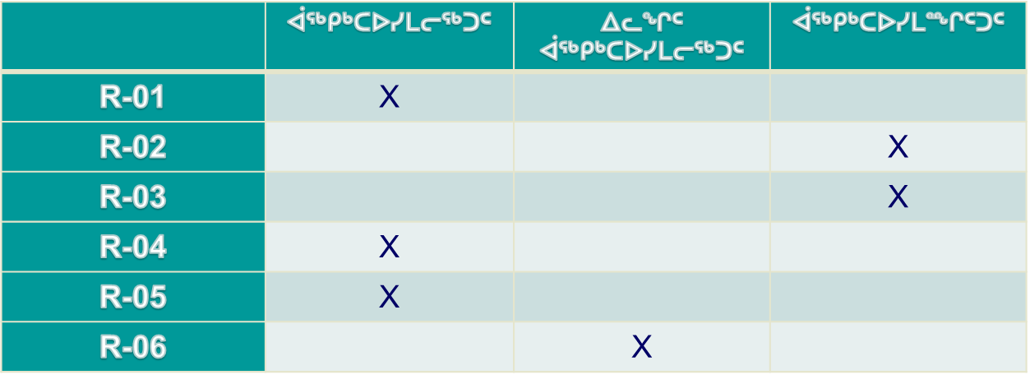
ᖃᓄᐃᓕᖓᓕᕐᓂᖏᑦ ᓴᓇᕐᕈᑎᓂᒃ ᕿᒥᕐᕈᐃᓂᕐᒧᑦ ᐃᓱᒪᓕᐅᕈᑎᖏᔭᐅᓯᒪᓕᓚᐅᖅᑐᓄᑦ

Slide 12
ᐃᓱᓕᑦᔪᑎᖏᑦ
ᒐᕙᒪᓕᕆᔨᑦ-ᓄᓇᖃᖅᑳᖅᓯᒪᔪᓕᕆᔨᓪᓗ ᐊᒻᒪᓗ ᐅᑭᐅᖅᑕᖅᑐᒥ ᐱᕙᓪᓕᐊᔪᓕᕆᔨᖏᑦ ᑲᓇᑕᒥ (CIRNAC) ᑲᔪᓯᓗᑎᒃ ᐱᓕᕆᐊᖃᖅᐸᓪᓕᐊᓂᐊᖅᑐᑦ ᐃᒪᓕᕆᓂᕐᒥ ᓚᐃᓴᓐᓯᑖᖅᐸᖕᓂᕐᒧᑦ ᑐᒃᓯᕋᐅᑎᑦ ᕿᒥᕐᕈᔭᐅᕙᓪᓕᐊᓂᖏᓂᒃ ᑐᕌᕐᕕᒃᓴᖃᕐᓗᑎᒃ ᒥᐊᓂᕆᔭᐅᓯᒪᓕᕐᓂᒃᓴᖏᑕ ᓄᓇᕗᒻᒥ ᓄᓇᐃᓐᓇᕐᒥ ᐃᒪᖃᕐᓂᐅᔪᑦ ᐊᒻᒪᓗ ᖁᒡᕙᖅᑎᑦᓯᒋᐊᖅᓯᒪᓂᕐᒧᑦ ᑲᔪᓰᓐᓇᖅᑎᑕᐅᔪᖕᓇᖅᖢᑎᒃ ᐱᕙᓪᓕᐊᑎᑦᓯᓂᐅᔪᓄᑦ.

Slide 13
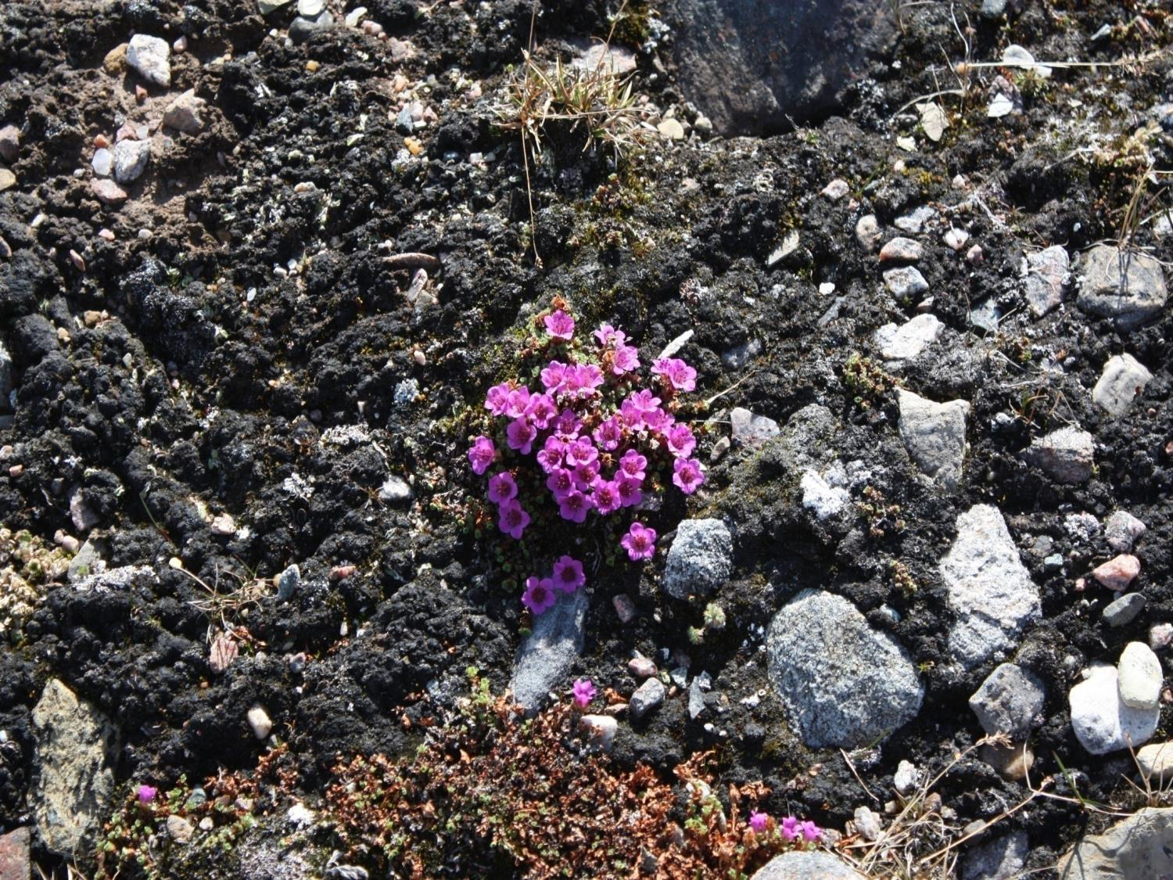
Qujannamiik
Thank you
Merci
ᖁᔭᓐᓇᒦᒃ
13

