Slide 1
Water Licence Amendment Application for
Agnico Eagle Mines Ltd.’s Meliadine Project, Water Licence No. 2AM-MEL1631
Nunavut Water Board Public Hearing
Rankin Inlet, Nunavut March 30-31, 2021

Slide 2
Outline
Role and Responsibilities
Contributions to Application Review
Topics of Technical Review:
Scope of Licence
Water Use & Management
Water Balance & Water Quality Model & Predictions
Wastewater Management & Treatment
Requested Effluent Quality Limits for Total Dissolved Solids
Waste Management
Adaptive Management
Closure & Reclamation Planning and Security
Revisions to Management Plans
Conclusion

Slide 3
Roles and responsibilities
Crown-Indigenous Relations and Northern Affairs Canada’s (CIRNAC) responsibilities, mandate, and obligations stem from with the following:
Department of Crown-Indigenous Relations and Northern Affairs Act
Nunavut Agreement
Nunavut Land Claims Agreement Act
Nunavut Waters and Nunavut Surface Rights Tribunal Act and the associated regulations
Nunavut Planning and Project Assessment Act
Territorial Lands Act and the associated regulations
Arctic Waters Pollution Prevention Act

Slide 4
Contributions to Application Review
CIRNAC made the following contributions to the Nunavut Water Board’s review process:
Completeness assessment with information requests: September 22, 2020
Technical review with recommendations: November 8, 2020
Participation in Technical Meeting: November 30, 2020
Participation in Pre-hearing conference: January 19, 2021
Final written submission: March 17, 2021
Participation in meetings with Kivalliq Inuit Association and/or Agnico Eagle for security estimate: October 30, 2020 and February 25, 2021

Slide 5
Licence Scope
Proposed amendment includes:
change Total Dissolved Solid thresholds for discharge to Meliadine Lake;
increase authorized annual freshwater consumption;
eliminate planned Waste Rock Storage Facility #2 to create additional laydown areas;
update waste management strategy;
construction of additional site and access roads; and
update Interim Closure and Reclamation Plan.
CIRNAC agrees scope of licence amendments described in Pre-hearing Conference Decision Report match application.

Slide 6
Water Use & Management
Request authorization for increased water use to 741,706 m³/year, and no significant changes to water management on site.
CIRNAC
noted potential changes to water management strategy, infrastructure and operations for waterline should it receive Nunavut Impact Review Board approval were not included (technical comment #6)

Slide 7
Water Balance & Water Quality Model & Predictions
Water balance and two water quality models for Total Dissolved Solids loading were provided.
CIRNAC
requested clarifications on water treatment thresholds and water diversions (technical comment #3)
requested explanations on model differences and source of Total Dissolved Solids on “rest of site”
recommends adding a condition to provide further information on Total Dissolved Solids sources and management from “rest of site”, undertaking additional site monitoring and sampling if necessary

Slide 8
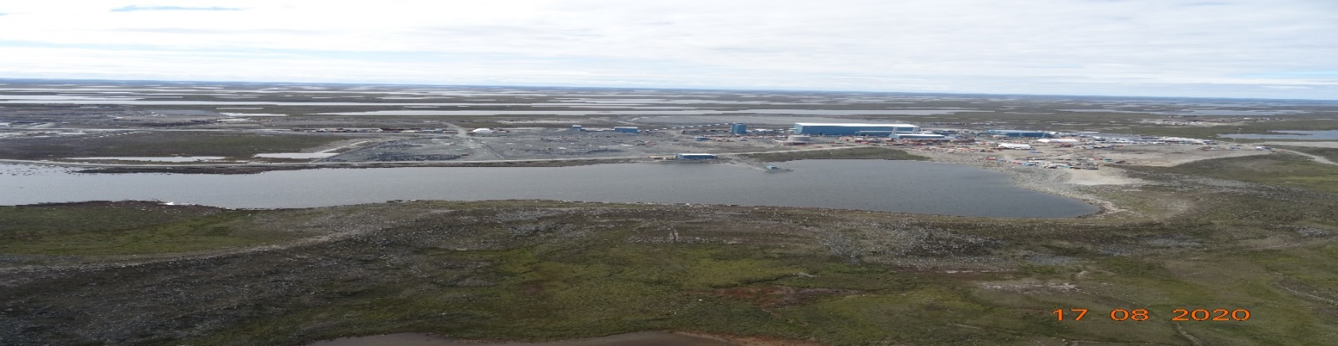
Wastewater Management & Treatment
Plans for a waterline to move wastewater from site to Melvin Bay are currently under review by the Nunavut Impact Review Board.
Waterline is included in reclamation cost estimate of water licence amendment.
Containment Pond #1

Slide 9
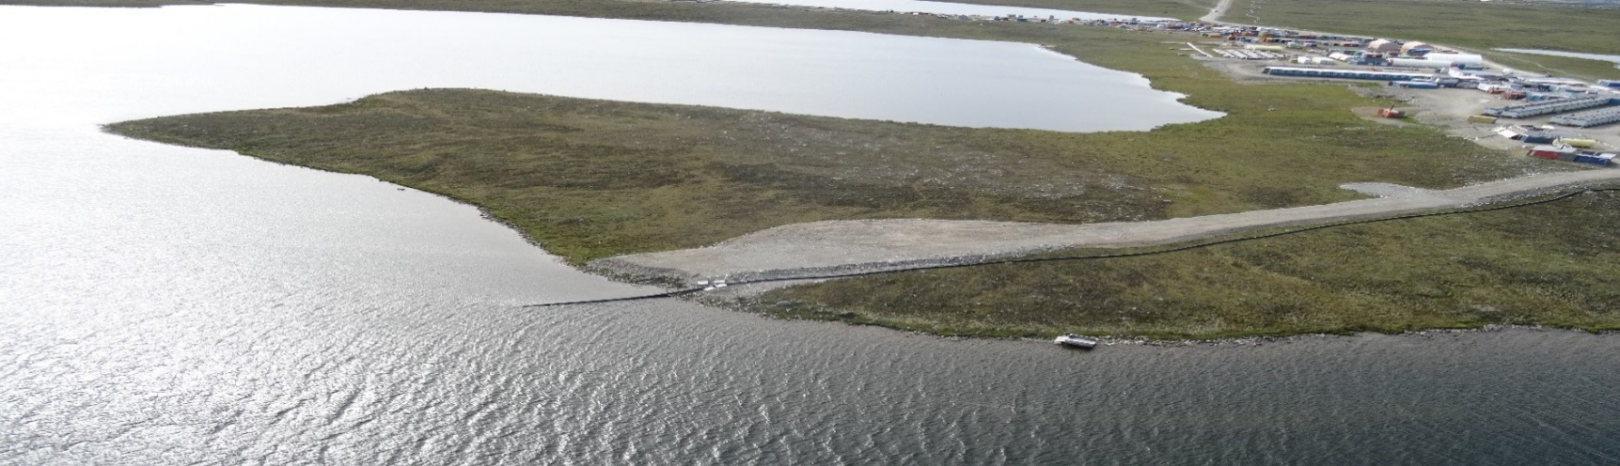
Requested Effluent Quality Limits for Total Dissolved Solids (TDS)
Request to increase discharge criteria to Meliadine Lake from 1 400 mg/L to 3 500 mg/L for maximum average and 5 000 mg/L for maximum grab sample.
CIRNAC
requested clarifications in technical comments #1 & #5
supports objective of minimizing discharging effluent to Meliadine Lake
defers to Environment and Climate Change Canada and the Kivalliq Inuit Association for determining limits
Discharge pipeline to Meliadine Lake

Slide 10
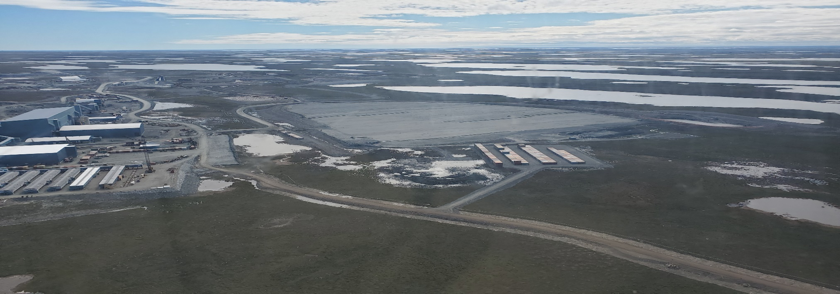
Waste Management
Request to change where waste rock and overburden are stored.
CIRNAC asked for clarifications (technical comment #4) on why it was necessary and what waste rock would be going to the expanded facility.
Dry stack tailings storage facility
10

Slide 11
Adaptive Management
Adaptive Plan for Water Management at the Meliadine Mine produced for concurrent Nunavut Impact Review Board process. Plan covers both saline and contact water discharge through the proposed waterline between the site and Melvin Bay.
CIRNAC
reviewed and suggested changes to plan goals and triggers
supports Adaptive Management Approach to eliminate discharge to Meliadine Lake under normal operating conditions, while also allowing Agnico Eagle site water management flexibility
supports formalizing the plan

Slide 12
Closure & Reclamation Planning & Security
An updated Interim Closure and Reclamation Plan and reclamation security estimate were produced for the project.
CIRNAC worked with Agnico Eagle and Kivalliq Inuit Association to make sure update reflects proposed site changes including waterline (technical comment #7).
Agreement for a final reclamation cost estimate security amount of $69,687,246.

Slide 13
Revisions to Management Plans
Existing management plans require revision to reflect proposed changes, including:
Water Management Plan
Waste Management Plan
Interim Closure & Reclamation Plan
If waterline is approved by the Nunavut Impact Review Board, additional plans should be revised before waterline operation:
Spill Contingency Plan
Groundwater Management Plan
CIRNAC also expects to review construction drawings and designs for new infrastructure.

Slide 14
Conclusion
Agnico Eagle, the Kivalliq Inuit Association and CIRNAC have worked to plan minimizing discharges to Meliadine Lake through the use of the waterline.
CIRNAC recommends lake discharges be used as a last resort.
CIRNAC’s technical comments for the water licence amendment have been addressed by Agnico Eagle.

Slide 15
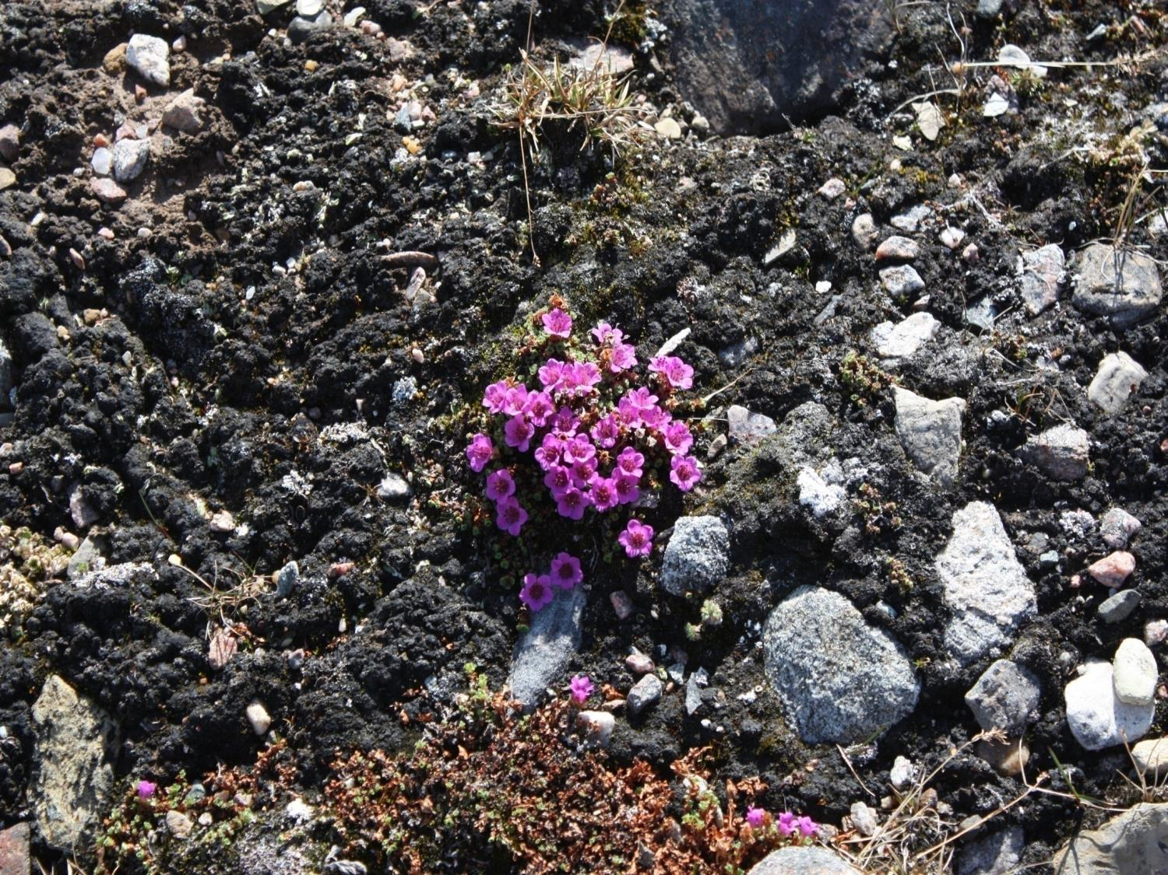
Qujannamiik
Thank you
Merci
ᖁᔭᓐᓇᒦᒃ

