Slide 1
Water Licence Amendment Application for
Agnico Eagle Mines Ltd.’s Meliadine Project, Water Licence No. 2AM-MEL1631
Nunavut Water Board Public Hearing
Rankin Inlet, Nunavut March 30-31, 2021
ᐃᒥᐅᑉ ᓚᐃᓴᖓᑕ ᐊᓯᐊᖑᕈᒪᓂᖓᓄᑦ ᑐᒃᓯᕋᐅᑦ ᐅᕗᖓ
ᐊᒡᓂᒍ ᐃᒍᒃᑯᑦ ᑕᓯᕐᔪᐊᕐᒥ ᐅᔭᕋᒃᑕᕆᐊᖏᓐᓄᑦ, ᐃᒥᐅᑉ ᓚᐃᓴᖓ ᓈᓴᐅᑎᖓ 2AM-MEL1631
ᓄᓇᕘᒥ ᐃᒪᓕᕆᔨᑦ ᑲᑎᒪᔨᖏᑕ ᐃᓄᐃᑦ ᑐᓵᑎᑦᓯᓂᖓ
ᑲᖏᖠᓂᕐᒥ, ᓄᓇᕘᒥ ᒫᐊᑦᔅ 30-31, 2021

Slide 2
Outline
ᐃᓗᓕᖏᑦ
Role and Responsibilities
Contributions to Application Review
Topics of Technical Review:
Scope of Licence
Water Use & Management
Water Balance & Water Quality Model & Predictions
Wastewater Management & Treatment
Requested Effluent Quality Limits for Total Dissolved Solids
Waste Management
Adaptive Management
Closure & Reclamation Planning and Security
Revisions to Management Plans
Conclusion
ᐱᓕᕆᐊᖏᑦ ᐊᒪ ᓂᕆᐅᒋᔭᐅᔪᑦ
ᑐᓂᔪᑎᖏᑦ ᑐᒃᓯᕋᐅᑎᑉ ᖃᐅᔨᓴᒐᐅᓂᖓᓐᓄᑦ
ᐱᓕᕆ)ᑎᑦ ᖃᐅᔨᓴᒐᐅᓂᖏᑦ:
ᑐᕌᖅᑕᖓ ᓚᐃᓴᐅᑉ
ᐃᒥᐅᑉ ᐊᑐᒐᐅᓂᖓ ᒥᐊᓂᕆᔭᐅᓂᖓᓪᓗ
ᐃᒪᖁᖅᑐᓂᖓ ᐊᒪ ᓇᒻᒪᖕᓂᖓ ᐆᒃᑐᕋᐅᑕᐅᔪᖅ ᐃᓱᒪᒋᔭᐅᔪᕐᓗ
ᐃᒥᖅ ᐊᑐᒐᐅᓐᓂᑯ ᒥᐊᓂᕆᔭᐅᓂᖓ ᓴᓗᒻᒪᖅᓴᒐᐅᓂᖓᓗ
ᑐᒃᓯᕋᒐᐅᔪᖅ ᐃᓕᖁᓯᖓᑕ ᑭᒡᓕᖃᕐᓂᖓ ᑲᑎᑕᐅᓯᒪᔪᑦ ᐊᑐᕈᖕᓇᐃᕐᓂᑯᑦ ᐅᔭᕋᐃᑦ ᓱᓇᒥᐊᓪᓗ
ᐊᑕᑯᑦ ᒥᐊᓂᕆᔭᐅᓂᖓᑦ
ᐊᑐᓕᖅᑎᑕᐅᓂᖏᓐᓄᑦ ᒥᐊᓂᕆᔭᐅᓂᖏᑦ
ᒪᑐᔭᐅᓂᖓ ᐊᒪ ᓄᓇᑉ ᐅᑎᖅᑎᑕᐅᓂᖓ ᒥᐊᓂᕆᔭᐅᓂᖓᓗ
ᑕᑯᔭᐅᑲᓂᕐᓗᓐᓂ ᒥᐊᓂᕆᔭᐅᓂᖏᓐᓄᑦ ᐸᕐᓇᐅᑎᑦ
ᐱᐊᓂᒍᑎᖓ

Slide 3
Roles and responsibilities
ᐱᓕᕆᐊᖏᑦ ᐊᒪ ᓂᕆᐅᒋᔭᐅᔪᑦ
Crown-Indigenous Relations and Northern Affairs Canada’s (CIRNAC) responsibilities, mandate, and obligations stem from with the following:
Department of Crown-Indigenous Relations and Northern Affairs Act
Nunavut Agreement
Nunavut Land Claims Agreement Act
Nunavut Waters and Nunavut Surface Rights Tribunal Act and the associated regulations
Nunavut Planning and Project Assessment Act
Territorial Lands Act and the associated regulations
Arctic Waters Pollution Prevention Act
ᒐᕙᒪᒃᑯᑦ ᓄᓇᖃᖅᑳᖅᑐᑦ ᐱᓕᕆᖃᑎᒌᖕᓂᖏ ᐊᒻᒪᓗ ᐅᑭᐅᖅᑕᖅᑐᒥᑦ ᐱᓕᕆᐊᖑᔪᑦ ᑲᓇᑕᒥ (CIRNAC) ᐱᓕᕆᐊᖃᕐᒪᑕ, ᑐᖓᕕᖃᕐᒪᑕᓗ ᐊᖏᕈᑕᐅᓯᒪᔪᓐᓂᒃ ᐅᑯᓂᖓ:
ᒐᕙᒪᒃᑯᑦ ᓄᓇᖃᖅᑳᖅᑐᑦ ᐱᓕᕆᖃᑎᒌᖕᓂᖏ ᐊᒻᒪᓗ ᐅᑭᐅᖅᑕᖅᑐᒥᑦ ᐱᓕᕆᐊᖑᔪᑦ ᑲᓇᑕᒥ ᐱᖁᔭᖓ
ᓄᓇᕗᒻᒥ ᐊᖏᕈᑦ
ᓄᓇᕗᒻᒥ ᕗᓴᐅᑉ ᐊᖏᕈᑎᖓᑕ ᐱᖁᔭᖓ
ᓄᓇᕗᒻᒥ ᑕᓰᑦ ᐊᒪ ᓄᓇᐅᑉ ᖃᖓᓐᓂ ᐱᔪᖕᓇᐅᑎᑦ ᐃᓱᒪᓕᐅᖅᑎᖏᑕ ᐱᖁᔭᖓ ᐊᒻᒪ ᐊᓯᖏᑦ ᒪᓕᒐᐃᑦ
ᓄᓇᕗᒥ ᐸᕐᓇᒐᐅᓂᕐᒧᑦ ᐊᒪ ᐱᓕᕆᐊᑦ ᖃᐅᔨᓴᒐᐅᓂᖏᓐᓄᑦ ᐱᖁᔭᖅ
ᓇᒧᒐᐅᕙᒃᑐᑉ ᓄᓇᐅᑉ ᐱᖁᔭᖓ ᐊᒻᒪ ᒪᓕᒐᐃᑦ ᑐᕌᖓᔪᑦ
ᐅᑭᐅᖅᑕᖅᑐᒻᒥ ᐃᒪᐃᑦ ᓱᕈᖅᑕᐅᑕᐃᓕᓂᖏᓐᓄᑦ ᐱᖁᔭᖅ

Slide 4
Contributions to Application Review
ᑐᓂᔪᑎᖏᑦ ᑐᒃᓯᕋᐅᑎᑉ ᖃᐅᔨᓴᒐᐅᓂᖓᓐᓄᑦ
CIRNAC made the following contributions to the Nunavut Water Board’s review process:
Completeness assessment with information requests: September 22, 2020
Technical review with recommendations: November 8, 2020
Participation in Technical Meeting: November 30, 2020
Participation in Pre-hearing conference: January 19, 2021
Final written submission: March 17, 2021
Participation in meetings with Kivalliq Inuit Association and/or Agnico Eagle for security estimate: October 30, 2020 and February 25, 2021
ᒐᕙᒪᒃᑯᑦ ᓄᓇᖃᖅᑳᖅᑐᑦ ᐱᓕᕆᖃᑎᒌᖕᓂᖏ ᐊᒻᒪᓗ ᐅᑭᐅᖅᑕᖅᑐᒥᑦ ᐱᓕᕆᐊᖑᔪᑦ ᑲᓇᑕᒥ ᑐᓂᓯᓚᐅᕐᒪ ᓄᓇᕗᒥ ᐃᒪᓕᕆᔨᑦ ᑲᑎᒪᔨᖏᑕ ᖃᐅᔨᓴᕐᓂᖓᓐᓄᑦ:
ᐱᐊᓂᒃᓯᒪᑎᐊᕐᓗᒍ ᖃᐅᔨᓴᕐᓂᖓ ᑐᓴᒐᒃᓴᓐᓂᒃ ᐱᔪᒪᓂᖃᕐᓗᓐᓂ: ᓯᑉᑕᒻᐸ 22, 2020
ᐱᓕᕆᔪᑎᑦ ᖃᐅᔨᓴᒐᐅᓂᖏᑦ ᐊᑐᓕᖁᔭᐅᔪᓐᓂᒃ ᐱᑕᖃᕐᓗᓐᓂ: ᓄᕕᒻᐱᕆ 8, 2020
ᐃᓚᐅᓂᖅ ᐱᓕᕆᔪᑎᑦ ᑲᑎᒪᓂᖓᓐᓂ: ᓄᕕᒻᐱᕆ 30, 2020
ᐃᓚᐅᓂᖓᑦ ᓯᕗᓂᖓᓂ ᑐᓵᓂᐅᑉ ᑲᑎᒪᕐᔪᐊᕐᓂᖓᓐᓂ: ᔮᓄᐊᕆ 19, 2021
ᑭᖑᓪᓕᖅ ᑎᑎᕋᖅᓯᒪᔪᑉ ᑐᓂᔭᐅᓂᖓ: ᒫᐊᑦᔅ 17, 2021
ᑲᑎᒪᖃᑕᐅᓂᖓᑦ ᐅᑯᓇᓂ ᑭᕙᓪᓕᕐᒥ ᐃᓄᐃᑦ ᑲᑐᔨᖃᑎᒌᑦ ᐊᒪ/ᐅᕙᓘᕙ ᐊᒡᓂᒍ ᐃᒍᒃᑯᑦ ᒥᐊᓂᕆᔭᐅᓂᖓᑕ ᐊᑭᑐᑎᒋᓇᔭᖅᑕᖓᓐᓂᒃ: ᐊᒃᑐᐱᕆ 30, 2020 ᐊᒻᒪ ᕕᑉᕈᐊᕆ 25, 2021

Slide 5
Licence Scope
ᓚᐃᓴᐅᑉ ᑐᕌᖅᑕᖓ
Proposed amendment includes:
change Total Dissolved Solid thresholds for discharge to Meliadine Lake;
increase authorized annual freshwater consumption;
eliminate planned Waste Rock Storage Facility #2 to create additional laydown areas;
update waste management strategy;
construction of additional site and access roads; and
update Interim Closure and Reclamation Plan.
CIRNAC agrees scope of licence amendments described in Pre-hearing Conference Decision Report match application.
ᐊᓯᐊᖑᕈᑕᐅᔪᒪᔪᑦ ᐅᑯᐊᖑᓂᐊᖅᐳᑦ:
ᐊᓯᐊᖑᕐᓂᖓ ᑲᑎᑕᐅᓯᒪᔪᑦ ᐱᑕᖃᕈᖕᓇᐃᖅᑎᑕᐅᓂᖓ ᐃᒥᕐᒥᑦ ᑯᕕᔭᐅᓂᐊᖅᑐᖅ ᑕᓯᕐᔪᐊᕐᒧᑦ;
ᐊᒡᓕᒋᐊᕐᓗᒍ ᐊᖏᒐᐅᓯᒪᔪᖅ ᐊᕋᒍᑕᒪᑦ ᐃᒥᐅᑉ ᐊᑐᒐᐅᓂᖓ;
ᐱᑕᖃᕈᖕᓇᐃᕐᓗᓐᓂ ᐸᕐᓇᒃᑕᐅᓯᒪᔪᖅ ᐅᔭᕋᐃᑦ ᐊᑐᖏᓕᖅᑐᑦ ᐃᓂᖃᕐᕕᖓᑦ #2 ᐱᖁᑎᑦ ᑐᖓᕕᒃᓴᖓᓐᓂᒃ ᐃᓂᒋᔭᐅᓕᕐᓗᓐᓂ;
ᐃᒥᐅᑉ ᒥᐊᓂᕆᔭᐅᓂᖓ ᓄᑕᖑᖅᑎᕐᓗᒍ ᐱᓕᕆᐊᖑᓂᐊᖅᑐᖅ;
ᐊᑉᖁᒻᒥᒃ ᓴᓇᑲᓂᕐᓗᓐᓂ ᐊᑐᐃᓐᓇᐅᓂᐊᖅᑐᒻᒥᒃ; ᐊᒻᒪ
ᓄᑕᖑᕐᓗᒍ ᒪᑐᔭᐅᓂᖓ ᓄᓇᑉᓗ ᐅᑎᖅᑎᑕᐅᓂᖓ ᐸᕐᓇᐅᑦ.
ᒐᕙᒪᒃᑯᑦ ᓄᓇᖃᖅᑳᖅᑐᑦ ᐱᓕᕆᖃᑎᒌᖕᓂᖏ ᐊᒻᒪᓗ ᐅᑭᐅᖅᑕᖅᑐᒥᑦ ᐱᓕᕆᐊᖑᔪᑦ ᑲᓇᑕᒥ ᐊᖏᖅᓯᒪᖕᒪᑦ ᑐᕋᒐᕆᓂᐊᖅᑕᖓ ᓚᐃᓴᐅᑉ ᐊᓯᐊᖑᕆᐊᕈᑎᖓᑕ ᐅᖃᐅᓯᐅᔪᑦ ᓯᕗᓂᖓᓂ ᑐᓵᓂᕐᒥ ᐃᓱᒪᓕᐅᒐᐅᓐᓂᑯᑦ ᐅᓂᑉᑲᖓᓐᓂ ᐊᔨᒌᖕᒪᑕ ᑐᒃᓯᕋᐅᒻᒥ.

Slide 6
Water Use & Management
ᐃᒥᐅᑉ ᐊᑐᒐᐅᓂᖓ ᒥᐊᓂᕆᔭᐅᓂᖓᓪᓗ
Request authorization for increased water use to 741,706 m³/year, and no significant changes to water management on site.
CIRNAC
noted potential changes to water management strategy, infrastructure and operations for waterline should it receive Nunavut Impact Review Board approval were not included (technical comment #6)
ᑐᒃᓯᕋᐅᑎᖃᕐᓂᖅ ᐃᒥᐅᑉ ᐊᒡᓕᒋᐊᕐᓂᖓᓐᓄᑦ ᐊᑐᒐᐅᓂᐊᖅᑐᖅ 741,706 m³/year, ᐊᓯᐊᖑᖅᑐᖃᓚᖏᑐᖅ ᒥᐊᓂᕆᔭᐅᓂᖓᓐᓄᑦ ᐅᔭᕋᒃᑕᕆᐊᓐᓂ.
CIRNAC
ᓇᓗᓇᐃᕐᓯᓚᐅᕐᒪᓴ ᐊᓯᐊᖑᐳᑎᓐᓂᒃ ᐃᒥᐅᑉ ᒥᐊᓂᕆᔭᐅᓂᖏᑕ ᖃᓄᐃᓕᐅᕈᑎᖏᓐᓂᒃ, ᒪᑭᑕᔪᑎᖏᓐᓂᒃ ᐊᐅᓚᑕᐅᓂᖓᓐᓂᒃᓗ ᐃᒥᐅᑉ ᑐᓂᔭᐅᒃᐸᑦ ᓄᓇᕗᒻᒥ ᐊᕙᑎᓕᕆᔨᑦ ᑲᑎᒪᓕᖏᓐᓄᑦ ᐊᖏᖅᑕᐅᓗᓐᓂ ᑭᓯᐊᓐᓂ ᐃᓗᐊᓂᖏᑐᖅ (ᐱᓕᕆᔪᑎᑦ ᐅᖃᐅᓯᖓᑦ #6)

Slide 7
Water Balance & Water Quality Model & Predictions
ᐃᒪᖁᖅᑐᓂᖓ ᐊᒪ ᓇᒻᒪᖕᓂᖓ ᐆᒃᑐᕋᐅᑕᐅᔪᖅ ᐃᓱᒪᒋᔭᐅᔪᕐᓗ
Water balance and two water quality models for Total Dissolved Solids loading were provided.
CIRNAC
requested clarifications on water treatment thresholds and water diversions (technical comment #3)
requested explanations on model differences and source of Total Dissolved Solids on “rest of site”
recommends adding a condition to provide further information on Total Dissolved Solids sources and management from “rest of site”, undertaking additional site monitoring and sampling if necessary
ᐃᒥᐅᑉ ᓇᒻᒪᖕᓂᖓ ᒪᕈᖕᓂᒃ ᐅᒃᑐᕋᐅᑎᑕᓕᒃ ᑲᑎᑕᐅᓯᒪᔪᑦ ᐱᑕᖃᕈᖕᓇᐃᖅᑎᑕᐅᓂᖓ ᐃᒥᕐᒥᓯᐅᖅᑐᑦ ᐊᑐᐃᓐᓇᐅᖕᒪᑕ.
CIRNAC
ᑐᑭᓯᔭᐅᔪᒪᔪᖅ ᐃᒥᐅᑉ ᓴᓗᒻᒪᖅᓴᖅᑕᐅᓂᖓᑕ ᑭᒡᓕᖓ ᐊᒻᒪ ᐊᓯᐊᓐᓄᑦ ᑯᒃᑎᑕᐅᓂᖓ (ᐱᓕᕆᔪᑎᑦ ᐅᖃᐅᓯᖏᑦ #3)
ᑐᑭᓯᔭᐅᔪᒪᔪᖅ ᐅᒃᑐᕋᐅᑦ ᐊᔨᖏᖏᑕᖓ ᓇᑭᖓᕐᓂᖓᓗ ᑲᑎᑕᐅᓯᒪᔪᑦ ᐱᑕᖃᕈᖕᓇᐃᖅᑎᑕᐅᓂᖓᑕ “ᐊᓯᖏᓐᓂ ᐅᔭᕋᒃᓴᑕᕆᐊᓐᓂ”
ᐊᑐᖁᔭᐅᔪᖅ ᒪᓕᒐᕐᓂᒃ ᐱᑕᖃᓕᕐᓗᓐᓂ ᑐᑭᓯᑲᓂᕈᑎᓐᓂᒃ ᑲᑎᑕᐅᓯᒪᔪᑦ ᐱᑕᖃᕈᖕᓇᐃᖅᑎᑕᐅᓂᐊᖅᑐᑦ ᐊᒻᒪ ᒥᐊᓂᕆᔭᐅᓂᖓᑦ “ᐊᓯᖏᓐᓂ ᐅᔭᕋᒃᑕᕆᐊᓐᓂ”, ᖃᐅᔨᓴᒐᐅᑲᓂᕐᓗᑎᒃ ᐊᒻᒪ ᐅᒃᑐᕋᒐᐅᑕᕐᓗᑎᒃ ᐊᔪᕐᓇᖏᐸᑦ

Slide 8
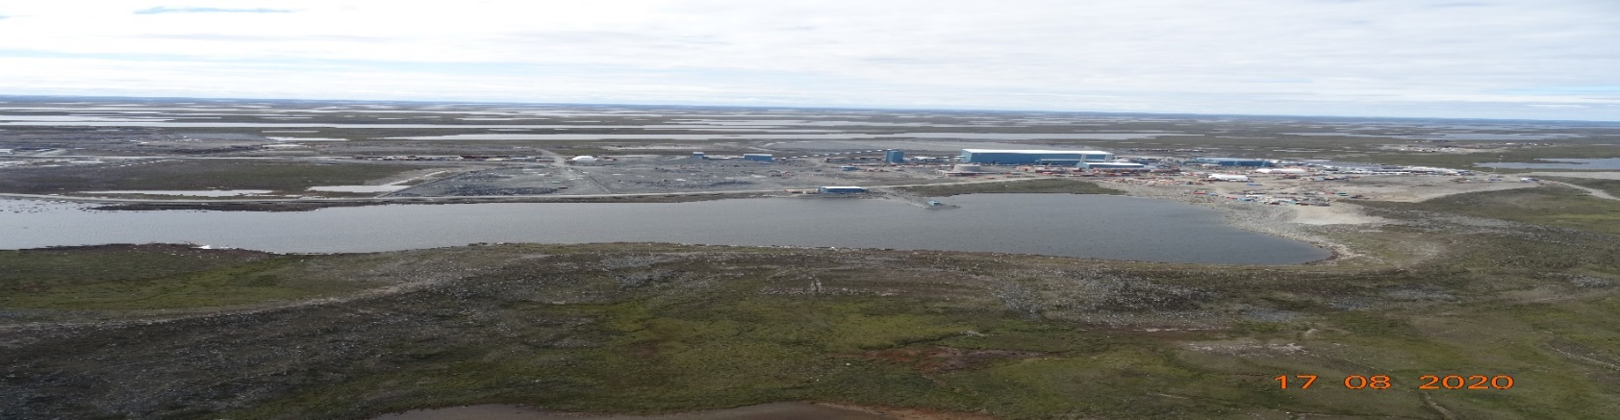
Wastewater Management & Treatment
ᐃᒥᖅ ᐊᑐᒐᐅᓐᓂᑯ ᒥᐊᓂᕆᔭᐅᓂᖓ ᓴᓗᒻᒪᖅᓴᒐᐅᓂᖓᓗ
Plans for a waterline to move wastewater from site to Melvin Bay are currently under review by the Nunavut Impact Review Board.
Waterline is included in reclamation cost estimate of water licence amendment.
ᐃᓱᒪᒋᔭᐅᔪᑦ ᐃᒥᐅᑉ ᑭᒡᓕᖓ ᐊᑐᖏᓂᑯ ᓄᑕᐅᓗᓐᓂ ᒥᐅᕕᓐ ᑕᕆᐅᖓᓐᓂᑦ ᒪᓇ ᖃᐅᔨᓴᒐᐅᔪᖅ ᓄᓇᕗᒥ ᐊᕙᑎᓕᕆᔨᑦ ᑲᑎᒪᔨᖏᓐᓄᑦ.
ᐃᒥᐅᑉ ᑭᒡᓕᖓ ᐃᓚᐅᔪᖅ ᐅᑎᖅᑎᑕᐅᓂᖓᓄᑦ ᐊᑭᖓᓐᓂ ᐃᒥᐅᑉ ᓚᐃᓴᖓᑕ ᐊᓯᐊᖑᖅᑕᐅᓂᖓᓐᓂ.
Containment Pond #1
ᐃᓗᓪᓕᖅᓯᒪᔪᖅ ᑕᓯᖅ #1

Slide 9
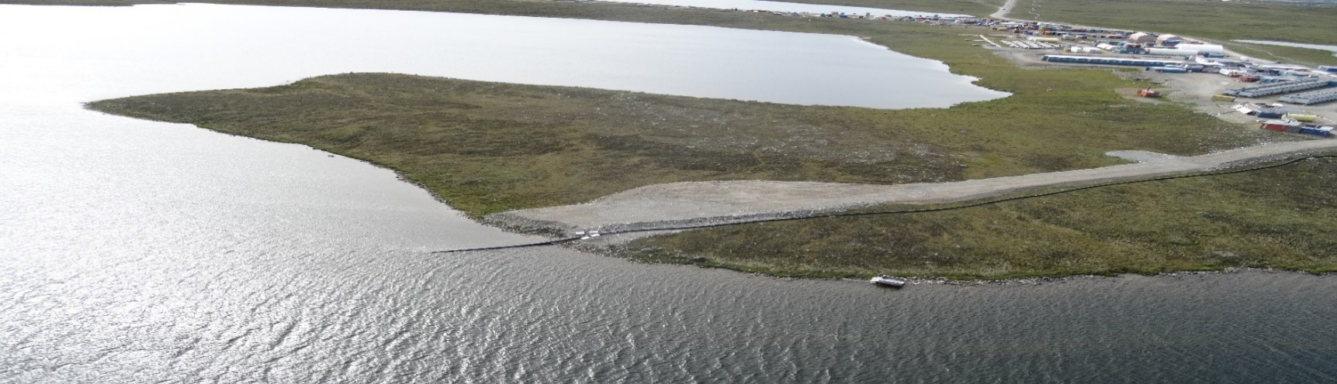
Requested Effluent Quality Limits for Total Dissolved Solids (TDS)
ᑐᒃᓯᕋᐅᑦ ᖃᓄᐃᓂᖓᑕ ᑭᒡᓕᖓᓐᓄᑦ ᑲᑎᑕᐅᓯᒪᔪᑦ ᐱᑕᖃᕈᖕᓇᐃᖅᑎᑕᐅᓂᖏᓐᓄᑦ (TDS)
Request to increase discharge criteria to Meliadine Lake from 1 400 mg/L to 3 500 mg/L for maximum average and 5 000 mg/L for maximum grab sample.
CIRNAC
requested clarifications in technical comments #1 & #5
supports objective of minimizing discharging effluent to Meliadine Lake
defers to Environment and Climate Change Canada and the Kivalliq Inuit Association for determining limits
ᑐᒃᓯᕋᐅᑦ ᐃᒪᖁᖅᑐᓯᒋᐊᕐᓗᒍ ᑯᕕᔭᐅᓂᖓ ᑕᓯᕐᔪᐊᕐᒧᑦ ᐅᕙᖓᑦ 1 400 ᒥᓕᒍᕌᒻ/ᓖᑐ ᐅᕗᖓ 3 500 ᒥᓕᒍᕌᒻ/ᓖᑐ ᐊᖏᓚᖑᓗᓐᓂ ᐊᒻᒪ 5 000 ᒥᓕᒍᕌᒻ/ᓖᑐ ᖃᐅᔨᓴᕈᑲᐅᓗᓐᓂ.
CIRNAC
ᑐᑭᓯᑲᓂᕈᐊᖅᑐᖅ ᐱᓕᕆᔪᑎᑦ ᐅᖃᐅᓯᖏᓐᓂᒃ #1 ᐊᒪ #5
ᐃᖃᔪᖅᑐᐃᑉᓗᓐᓂ ᑐᕋᖓᖅᑕᖏᓐᓂᒃ ᑯᕕᓗᐊᕈᖕᓇᐃᕐᓂᖓᓐᓄᑦ ᑕᓯᕐᔪᐊᕐᒧᑦ
ᑐᕋᖅᑐᖅ ᐅᕗᖓ ᐊᕙᑎᓕᕆᓂᕐᒥᑦ ᐊᒻᒪ ᐊᓯᔾᔨᖅᐸᓪᓕᐊᓂᕐᒧᑦ ᖃᓇᑕᒥ ᐊᒻᒪ ᑭᕙᓪᓕᕐᒥ ᐃᓄᐃᑦ ᑲᑐᔨᖃᑎᒌᑦ ᑭᒡᓕᖏᓐᓂᒃ ᐃᓱᒪᓕᐅᑎᖏᓐᓄᑦ
Discharge pipeline to Meliadine Lake
ᑯᕕᔭᐅᓂᖓᓐᓄᑦ ᓱᑉᓗᓖᑦ ᑕᓯᕐᔪᐊᕐᒧᑦ

Slide 10
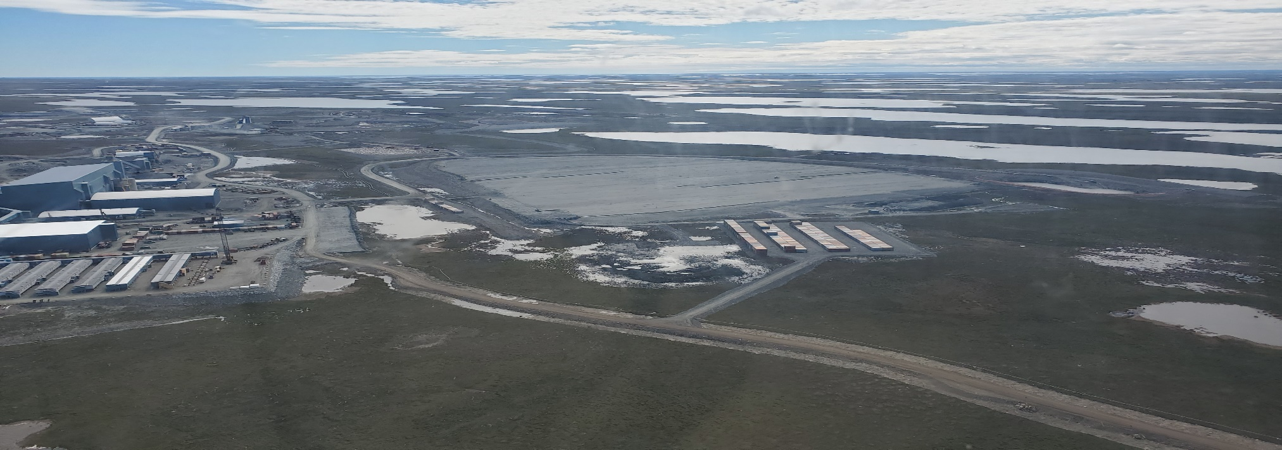
Waste Management
ᐊᑕᑯᑦ ᒥᐊᓂᕆᔭᐅᓂᖓᑦ
Request to change where waste rock and overburden are stored.
CIRNAC asked for clarifications (technical comment #4) on why it was necessary and what waste rock would be going to the expanded facility.
ᐅᔭᕋᐃᑦ ᐊᑐᕐᓂᑯᑦ ᐊᒻᒪ ᑲᑎᖅᓱᒐᐅᔪᑦ ᐃᓂᖃᕐᓂᐊᕐᓂᖏᓐᓂᒃ ᐃᓱᒪᓕᐅᕐᓂᖅ ᑐᒃᓯᕋᐅᑎᑯᑦ.
ᒐᕙᒪᒃᑯᑦ ᓄᓇᖃᖅᑳᖅᑐᑦ ᐱᓕᕆᖃᑎᒌᖕᓂᖏ ᐊᒻᒪᓗ ᐅᑭᐅᖅᑕᖅᑐᒥᑦ ᐱᓕᕆᐊᖑᔪᑦ ᑲᓇᑕᒥ ᑐᑭᓯᑲᓂᕈᒪᔪᖅ (ᐱᓕᕆᔪᑎᑦ ᐅᖃᐅᑎᖏᓐᓂ #4) ᓱᓇᒧᒃ ᐱᔭᕆᐊᖃᕐᓂᖓ ᐅᔭᖃᑦ ᐊᑐᖏᓂᑯᑦ ᐃᓂᖃᖅᑎᑕᐅᓂᖏᓐᓂᒃ ᐊᒡᓕᒋᐊᖅᓯᒪᔪᒻᒧᑦ.
Dry stack tailings storage facility
ᐃᑯᐊᓚᒃᑎᓐᓂᑯᑦ ᐃᓂᖃᖅᑎᑕᐅᓂᖓᑦ
10

Slide 11
Adaptive Management
ᐊᑐᓕᖅᑎᑕᐅᓂᖏᓐᓄᑦ ᒥᐊᓂᕆᔭᐅᓂᖏᑦ
Adaptive Plan for Water Management at the Meliadine Mine produced for concurrent Nunavut Impact Review Board process. Plan covers both saline and contact water discharge through the proposed waterline between the site and Melvin Bay.
CIRNAC
reviewed and suggested changes to plan goals and triggers
supports Adaptive Management Approach to eliminate discharge to Meliadine Lake under normal operating conditions, while also allowing Agnico Eagle site water management flexibility
supports formalizing the plan
ᐊᑐᓕᖅᑎᑕᐅᓂᖓᑕ ᐸᕐᓇᐅᑦ ᐃᒥᐅᑉ ᒥᐊᓂᕆᔭᐅᓂᖓᓐᓄᑦ ᑕᓯᕐᔪᐊᕐᒥ ᐅᔭᕋᒃᑕᕆᐊᓐᓂ ᖃᐅᔨᓴᒐᐅᑉᓗᓐᓂ ᓄᓇᕗᒥ ᐊᕙᑎᓕᕆᔨᑦ ᑲᑎᒪᖏᓐᓄᑦ. ᐸᕐᓇᐅᑦ ᐊᑐᕐᓂᐊᖅ ᑕᕆᐅᓕᐅᑉ ᑕᓯᕐᓂᓗ ᐃᒥᕐᒧᑦ ᑭᒡᓕᖓ ᐊᑐᒐᐅᓗᓐᓂ ᐅᔭᕋᒃᑕᕆᐊᓐᓂ ᐊᒻᒪ ᒥᐅᕕᓐ ᑕᕆᐅᖓᓐᓂ.
CIRNAC
ᖃᐅᔨᓴᒐᐅᑉᓗᓐᓂ ᐃᓱᒪᒋᔭᐅᑉᓗᓂᓗ ᐊᓯᐊᖑᖁᙱᖏᓐᓂᒃ ᐸᕐᓇᐅᑎᑉ ᑐᕋᖅᑕᖓᓐᓂ ᐊᒻᒪ ᐱᒋᐊᕈᑎᖓᓐᓂ
ᐃᑲᔪᖅᑐᐃᑉᓗᓐᓂ ᐊᑐᓕᖅᑎᑕᐅᓂᖓᑕ ᒥᐊᓂᕆᔭᐅᓂᐅᑉ ᑐᕋᖅᑕᖓᓐᓂᒃ ᑯᕕᔭᐅᓂᖓᓐᓄᑦ ᑕᓯᕐᔪᐊᕐᒧᑦ ᐊᐅᓚᑕᐅᓂᖓᓐᓂ ᐊᒻᒪ ᐊᔪᖏᑎᑦᓯᓗᓐᓂ ᐊᒡᓂᒍ ᐃᒍᒃᑯᑦ ᒥᐊᓂᖅᓯᓂᖓᓐᓂᒃ ᐊᓯᐊᖑᕈᖕᓇᖅᑐᒻᒥᒃ
ᐃᑲᔪᖅᑐᐃᑉᓗᓐᓂ ᐸᕐᓇᐅᑦ ᐊᓯᐊᖑᕈᖕᓇᕐᓂᖓᓐᓂ

Slide 12
Closure & Reclamation Planning & Security
ᒪᑐᔭᐅᓂᖓ ᐊᒪ ᓄᓇᑉ ᐅᑎᖅᑎᑕᐅᓂᖓ ᒥᐊᓂᕆᔭᐅᓂᖓᓗ
An updated Interim Closure and Reclamation Plan and reclamation security estimate were produced for the project.
CIRNAC worked with Agnico Eagle and Kivalliq Inuit Association to make sure update reflects proposed site changes including waterline (technical comment #7).
Agreement for a final reclamation cost estimate security amount of $69,687,246.
ᓄᑕᖑᖅᓯᒪᔪᖅ ᒪᑐᔭᐅᓂᖓᑕ ᐅᑎᖅᑎᑕᐅᓂᖓᑕᓗ ᐸᕐᓇᐅᑎᖓ ᐊᑭᓕᐅᑎᖓᓪᓗ ᐊᕿᒃᑕᐅᓚᐅᕐᒪᓐᓂᒃ ᐱᓕᕆᐊᕐᒧᑦ.
ᒐᕙᒪᒃᑯᑦ ᓄᓇᖃᖅᑳᖅᑐᑦ ᐱᓕᕆᖃᑎᒌᖕᓂᖏ ᐊᒻᒪᓗ ᐅᑭᐅᖅᑕᖅᑐᒥᑦ ᐱᓕᕆᐊᖑᔪᑦ ᑲᓇᑕᒥ ᐱᓕᕆᖃᑎᖃᕐᒪᑦ ᐊᒡᓂᒍ ᐃᒍᒃᑯᓐᓂᒃ ᐊᒪ ᑭᕙᓪᓕᕐᒥ ᑲᑐᔨᖃᑎᒌᓂᒃ ᓄᑕᖑᖅᑎᑦᓯᓂᕐᒥᒃ ᐊᓯᐊᖑᕈᑎᖏᓐᓂᒃ ᐃᓚᖃᕐᓗᑎᒃ ᐃᒥᐅᑉ ᑭᒡᓕᖓᓐᓂᒃ (ᐱᓕᕆᔪᑎᑦ ᐅᖃᐅᓯᖏᓐᓂ #7).
ᐃᓕᖁᓯᖓᓐᓄᑦ ᐅᑎᖅᑎᑕᐅᓂᖓ ᐊᑭᒃᓴᖓ ᐊᖏᖅᑕᐅᓯᒪᔪᖅ $69,687,946.

Slide 13
Revisions to Management Plans
ᑕᑯᔭᐅᑲᓂᕐᓗᓐᓂ ᒥᐊᓂᕆᔭᐅᓂᖏᓐᓄᑦ ᐸᕐᓇᐅᑎᑦ
Existing management plans require revision to reflect proposed changes, including:
Water Management Plan
Waste Management Plan
Interim Closure & Reclamation Plan
If waterline is approved by the Nunavut Impact Review Board, additional plans should be revised before waterline operation:
Spill Contingency Plan
Groundwater Management Plan
CIRNAC also expects to review construction drawings and designs for new infrastructure.
ᐊᑐᒐᐅᔪᖅ ᒥᐊᓂᕆᔭᐅᓂᖏᓐᓄᑦ ᐸᕐᓇᐅᑎᑦ ᑕᑯᔭᐅᑲᓂᕆᐊᓖᑦ ᐊᓯᐊᖑᕈᑎᖏᑦ, ᐅᑯᐊ ᐃᓚᐅᓗᑎᒃ:
ᐃᒥᐅᑉ ᒥᐊᓂᕆᔭᐅᓂᖓᓄᑦ ᐸᕐᓇᐅᑦ
ᐊᑕᑯᑦ ᒥᐊᓂᕆᔭᐅᓂᖓᑕ ᐸᕐᓇᐅᑎᖓ
ᒪᑐᕙᓕᐊᓂᖓᓐᓄᑦ ᓄᓇᑉᓗ ᐅᑎᖅᑎᑕᐅᓂᖓᓄᑦ ᐸᕐᓇᐅᑦ
ᐃᒥᐅᑉ ᑭᒡᓕᖓ ᐊᖏᖅᑕᐅᓂᖅᐸ ᓄᓇᕗᒥ ᐊᕙᑎᓕᕆᔨᑦ ᑲᑎᒪᔨᖏᓐᓄᑦ, ᐸᕐᓇᐅᑎᑲᓂᑦ ᖃᐅᔨᓴᒐᐅᓗᑎᒃᑭᒡᓕᖓᑕ ᐊᑐᒐᐅᓂᖓᓂ:
ᑯᕕᔪᖃᕐᓂᖅᐸᑦ ᖃᓄᐃᓕᐅᕈᑎᑦ ᐸᕐᓇᐅᑎᖓ
ᐃᒥᖅ ᓄᓇᒻᒥᒃ ᒥᐊᓂᕆᔭᐅᓂᖓᑕ ᐸᕐᓇᐅᑎᖓ
ᒐᕙᒪᒃᑯᑦ ᓄᓇᖃᖅᑳᖅᑐᑦ ᐱᓕᕆᖃᑎᒌᖕᓂᖏ ᐊᒻᒪᓗ ᐅᑭᐅᖅᑕᖅᑐᒥᑦ ᐱᓕᕆᐊᖑᔪᑦ ᑲᓇᑕᒥ ᓂᕆᐅᒃᑐᖅ ᖃᐅᔨᓴᒐᐅᓗᓐᓂ ᓴᓇᔭᐅᓂᖓᓄ ᑎᑎᕋᐅᔭᖅᓯᒪᔪᑦ ᓄᑕᒻᒧᑦ ᒪᑭᒪᔪᑕᐅᓂᐊᖅᑐᒻᒧᑦ.

Slide 14
Conclusion
ᐱᐊᓂᒍᑎᖓ
Agnico Eagle, the Kivalliq Inuit Association and CIRNAC have worked to plan minimizing discharges to Meliadine Lake through the use of the waterline.
CIRNAC recommends lake discharges be used as a last resort.
CIRNAC’s technical comments for the water licence amendment have been addressed by Agnico Eagle.
ᐊᒡᓂᒍ ᐃᒍᒃᑯᑦ, ᑭᕙᓪᓕᕐᒥ ᐃᓄᐃᑦ ᑲᑐᔨᖃᑎᒌᑦ ᐊᒻᒪ ᒐᕙᒪᒃᑯᑦ ᓄᓇᖃᖅᑳᖅᑐᑦ ᐱᓕᕆᖃᑎᒌᖕᓂᖏ ᐊᒻᒪᓗ ᐅᑭᐅᖅᑕᖅᑐᒥᑦ ᐱᓕᕆᐊᖑᔪᑦ ᑲᓇᑕᒥ ᐃᓱᒪᓕᐅᖅᓯᒪᖕᒪᑕ ᑯᕕᓗᐊᖏᓂᖓᓐᓂᒃ ᑕᓯᕐᔪᐊᕐᒥ ᑕᓯᐅᑉ ᑭᒡᓕᖓ ᐊᑐᒐᐅᑉᓗᓐᓂ.
ᒐᕙᒪᒃᑯᑦ ᓄᓇᖃᖅᑳᖅᑐᑦ ᐱᓕᕆᖃᑎᒌᖕᓂᖏ ᐊᒻᒪᓗ ᐅᑭᐅᖅᑕᖅᑐᒥᑦ ᐱᓕᕆᐊᖑᔪᑦ ᑲᓇᑕᒥ ᑎᓕᐅᕆᖕᒪᑦ ᑕᓯᕐᒥ ᑯᕕᔭᐅᓂᖓ ᑭᖑᓪᓕᐅᓗᒍ ᐊᑐᕆᐊᖃᕐᓂᖅᐸᑦ ᐊᑐᒐᐅᓗᓐᓂ.
ᒐᕙᒪᒃᑯᑦ ᓄᓇᖃᖅᑳᖅᑐᑦ ᐱᓕᕆᖃᑎᒌᖕᓂᖏ ᐊᒻᒪᓗ ᐅᑭᐅᖅᑕᖅᑐᒥᑦ ᐱᓕᕆᐊᖑᔪᑦ ᑲᓇᑕᒥ ᐱᓕᕆᐊᖏᓐᓂ ᐅᖃᐅᓯᒃᓴᑦ ᐃᒥᐅᑉ ᓚᐃᓴᖓᑕ ᐊᓯᐊᖑᒐᐅᒥᖓᓐᓄᑦ ᐅᖃᐅᓯᐅᓯᒪᓕᕐᒪᑦ ᐊᒡᓂᒍ ᐄᒍᒃᑯᓐᓄᑦ.

Slide 15
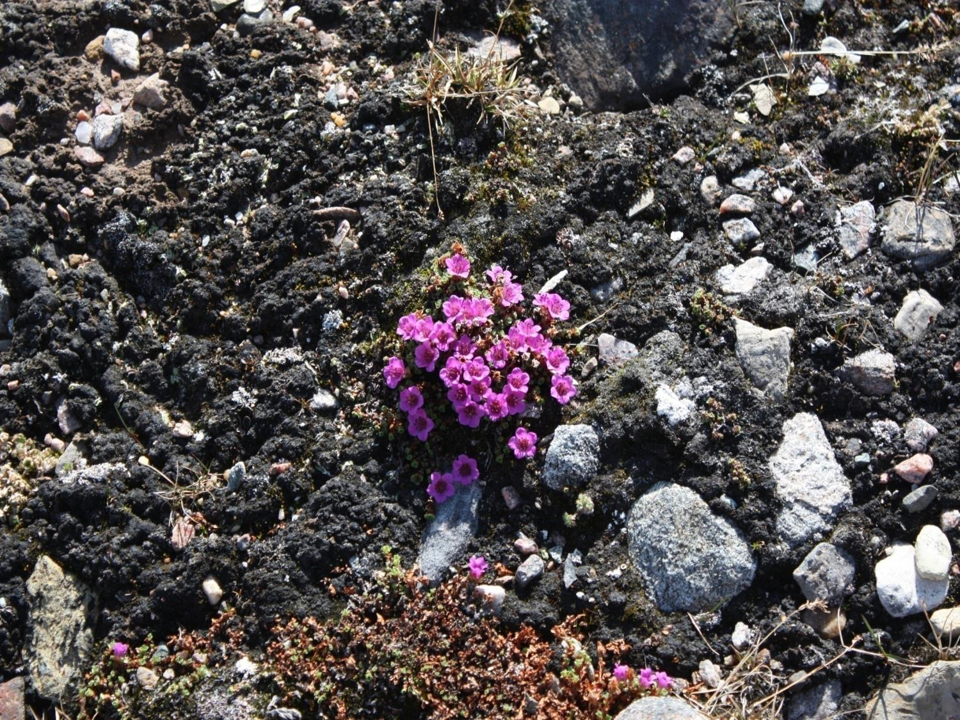
Qujannamiik
Thank you
Merci
ᖁᔭᓐᓇᒦᒃ

