Slide 1
ᐊᒡᓃᑯ ᐄᒍ ᐅᔭᕋᒃᑕᕆᐊᓕᕆᔨᒃᑯᑦ
ᐋᖅᕿᒋᐊᖅᓯᒪᔪᖅ ᑐᒃᓯᕋᐅᓯᐅᖅᑕᖓᑦ Type “A” ᐃᒪᕐᒧᑦ ᓚᐃᓴᓐᓯᖓᑦ 2AM-MEL1631
ᓄᓇᕗᒻᒥ ᐃᒪᓕᕆᔨᒃᑯᑦ ᑭᑐᑐᐃᓐᓇᓂᒃ ᑲᑎᒪᑎᑦᑎᓂᖓᑦ
ᑲᖏᖅᖠᓂᖅ, ᐊᒥᕋᐃᔭᕐᕕᒃ 11-12, 2024

Slide 2
ᑕᑯᔭᒃᓴᐅᑎᒋᔭᐅᔪᒥᑦ ᑎᑎᕋᖅᓯᒪᔪᖅ
ᐱᓕᕆᐊᖓ ᐊᒻᒪᓗ ᐱᔭᒃᓴᐅᑎᒋᔭᐅᔪᑦ
ᐃᑲᔪᐃᓃᑦ ᐃᒪᕐᒧᑦ ᓚᐃᓴᓐᓯᒥᒃ ᑐᒃᓯᕋᐅᑎ ᕿᒥᕐᕈᔭᐅᓂᖓᓄᑦ
ᖃᓄᐃᖓᓂᖓ ᐱᓕᕆᐊᕐᒥᑦ ᕿᒥᕐᕈᓂᕐᒥᑦ ᐅᖃᐅᓯᐅᔪᓂᑦ
ᐱᓕᕆᐊᖑᓯᒪᙱᑦᑐᑦ ᐱᔾᔪᑕᐅᔪᑦ
ᐱᐊᓂᖕᓂᖅ

Slide 3
ᐱᓕᕆᐊᖓ ᐊᒻᒪᓗ ᐱᔭᒃᓴᐅᑎᒋᔭᐅᔪᑦ
ᑲᓇᑕᒥᑦ ᒐᕙᒪᑐᖃᒃᑯᑦ-ᓄᓇᖃᖅᖄᖅᑐᓕᕆᔨᒃᑯᑦ ᐊᒻᒪᓗ ᐅᑭᐅᖅᑕᖅᑐᒥᑦ ᑲᒪᔨᒃᑯᑦ (CIRNAC) ᐱᔭᒃᓴᐅᑎᖏᑦ, ᐱᓕᕆᐊᕆᔭᕆᐊᖃᖅᑕᖏᑦ ᐊᒻᒪᓗ ᐱᓕᕆᐊᒃᓴᕆᔭᖓᑦ, ᑎᑯᓕᐊᖅᓯᒪᔪᑦ ᐅᑯᓄᖓ:
ᑲᓇᑕᒥᑦ ᒐᕙᒪᑐᖃᒃᑯᑦ-ᓄᓇᖃᖅᖄᖅᑐᓕᕆᔨᒃᑯᑦ ᐊᒻᒪᓗ ᐅᑭᐅᖅᑕᖅᑐᒥᑦ ᑲᒪᔨᒃᑯᑦ ᐱᖁᔭᖅ
ᓄᓇᕗᒻᒧᑦ ᐊᖏᖃᑎᒌᒍᑎ
ᓄᓇᕗᒻᒥᑦ ᓄᓇᑖᕐᓂᕐᒧᑦ ᐊᖏᖃᑎᒌᒍᑎᒧᑦ ᐱᖁᔭᖅ
ᓄᓇᕗᒻᒥ ᐃᒪᖏᑦ ᐊᒻᒪᓗ ᓄᓇᕗᒻᒥ ᓄᓇᐅᑉ ᖄᖓᓂᑦ ᐱᔪᖕᓇᐅᑎᖃᕐᓂᕐᒧᑦ ᐱᖁᔭᖅ ᐊᒻᒪᓗ ᐃᓚᒋᔭᐅᔪᑦ ᒪᓕᒐᕋᓛᑦ
ᓄᓇᕗᒻᒥ ᐸᕐᓇᐃᓂᕐᒧᑦ ᐊᒻᒪᓗ ᐱᓕᕆᐊᕐᒥᑦ ᖃᐅᔨᓴᐃᓂᕐᒧᑦ ᐱᖁᔭᖅ
ᐅᑭᐅᖅᑕᖅᑐᒥᑦ ᐊᕕᒃᑐᖅᓯᒪᒥᑦ ᓄᓇᒧᑦ ᐱᖁᔭᖅ ᐊᒻᒪᓗ ᐃᓚᒋᔭᐅᔪᑦ ᒪᓕᒐᕋᓛᑦ
ᐅᑭᐅᖅᑕᖅᑐᒥᑦ ᐃᒪᐃᑦ ᐱᑦᑕᐅᖏᑦᑐᖃᓕᖅᑕᐃᓕᓂᕐᒧᑦ ᐱᖁᔭᖅ

Slide 4
ᐃᑲᔪᐃᓃᑦ ᐃᒪᕐᒧᑦ ᓚᐃᓴᓐᓯᒥᒃ ᑐᒃᓯᕋᐅᑎ ᕿᒥᕐᕈᔭᐅᓂᖓᓄᑦ
CIRNAC-ᑯᑦ ᐅᑯᓂᙵᑦ ᑐᓂᓯᓚᐅᖅᑐᑦ ᓄᓇᕗᒻᒥ ᐃᒪᓕᕆᔨᒃᑯᓐᓄᑦ ᐱᔾᔪᑎᖃᖅᑐᒥᒃ ᐋᖅᕿᒋᐊᖅᓯᒪᔪᖅ ᑐᒃᓯᕋᐅᓯᐅᖅᑕᐅᔪᖅ Type “A” ᐃᒪᕐᒧᑦ ᓚᐃᓴᓐᓯ 2AM-MEL1631 ᐊᒡᓃᑯ ᐄᒍ ᐅᔭᕋᒃᑕᕆᐊᓕᕆᔨᒃᑯᓐᓄᑦ:
ᐅᖃᐅᓯᐅᔪᑦ ᐱᐊᓂᒃᓯᒪᓂᖓᓄᑦ ᖃᐅᔨᓴᐃᓂᕐᒥᑦ ᐊᒻᒪᓗ ᑐᑭᓯᐅᒪᔾᔪᑎᓂᒃ ᑐᒃᓯᕋᖅᑕᐅᔪᑦ ᐋᖅᕿᒋᐊᖅᓯᒪᔪᖅ ᑐᒃᓯᕋᐅᓯᐅᖅᑕᐅᔪᖅ Type “A” ᐃᒪᕐᒧᑦ ᓚᐃᓴᓐᓯ 2AM-MEL1631-ᒧᑦ: ᐊᕗᓐᓂᕕᒃ 16, 2024, ᐊᒻᒪᓗ ᓇᑦᑎᐊᑦ 13, 2024
ᐱᓕᕆᐊᑉ ᒥᒃᓵᓄᑦ ᕿᒥᕐᕈᓂᕐᒧᑦ ᐅᖃᐅᓯᐅᔪᑦ ᐋᖅᕿᒋᐊᖅᓯᒪᔪᖅ ᑐᒃᓯᕋᐅᓯᐅᖅᑕᐅᔪᖅ Type “A” ᐃᒪᕐᒧᑦ ᓚᐃᓴᓐᓯ 2AM-MEL1631-ᒧᑦ: ᑎᕆᒡᓗᐃᑦ 26, 2024
ᑕᑯᔭᒃᓴᐅᑎᐅᔪᖅ ᐱᓕᕆᐊᑉ ᒥᒃᓵᓄᑦ ᑲᑎᒪᑎᓪᓗᒋᑦ ᐋᖅᕿᒋᐊᖅᓯᒪᔪᖅ ᑐᒃᓯᕋᐅᓯᐅᖅᑕᐅᔪᖅ Type “A” ᐃᒪᕐᒧᑦ ᓚᐃᓴᓐᓯ 2AM-MEL1631-ᒧᑦ: ᒪᓐᓃᑦ 05, 2024
ᑭᖑᓪᓕᖅᐹᒃᑯᑦ ᑐᓂᔭᐅᔪᑦ ᓄᓇᕗᒻᒥ ᐃᒪᓕᕆᔨᒃᑯᓐᓄᑦ ᐋᖅᕿᒋᐊᖅᓯᒪᔪᖅ ᑐᒃᓯᕋᐅᓯᐅᖅᑕᐅᔪᖅ Type “A” ᐃᒪᕐᒧᑦ ᓚᐃᓴᓐᓯ 2AM-MEL1631-ᒧᑦ: ᓴᒡᒐᕉᑦ 22, 2024

Slide 5
ᖃᓄᐃᖓᓂᖓ ᐱᓕᕆᐊᕐᒥᑦ ᕿᒥᕐᕈᓂᕐᒥᑦ ᐅᖃᐅᓯᐅᔪᓂᑦ
CIRNAC-ᑯᑦ ᑐᓂᓯᓚᐅᖅᑐᑦ ᐱᓕᕆᐊᑉ ᒥᒃᓵᓄᑦ ᕿᒥᕐᕈᓂᕐᒧᑦ ᐅᖃᐅᓯᐅᔪᓂᑦ ᐱᔾᔪᑎᒋᑉᓗᒍ:
ᐋᖅᕿᒋᐊᖅᓯᓃᑦ ᐊᑐᖅᑕᐅᓂᐊᖅᑐᑦ ᐊᐅᓚᑦᑎᓂᕐᒧᑦ ᐸᕐᓇᐅᑎᒧᑦ
ᒥᑭᓛᒃᑰᖅᑎᑕᐅᓂᖏᑦ ᑯᕕᑦᑎᓂᖅ ᑕᓯᕐᔪᐊᕐᒧᑦ
ᑐᖅᖁᖅᑕᐅᓂᖓ ᑕᕆᐅᓕᒃ ᐃᒪᖅ ᑕᓯᖅ B7-ᒧᑦ
ᐃᒪᐅᑉ ᖃᓄᐃᓐᓂᖓᓄᑦ ᓇᓚᐅᑦᑖᖅᑕᐅᔪᑦ
ᒪᓂᕋᕐᒥᑦ ᑯᕕᓂᖅ ᐊᒻᒪᓗ ᐃᒪᕐᒥᒃ ᐊᑐᕐᓂᖅ
ᐊᒡᓃᑯᒃᑯᑦ ᓈᒻᒪᒃᓯᑉᓗᒍ ᐱᓕᕆᐊᕆᓚᐅᖅᑕᖏᑦ ᑕᒪᕐᒥᓗᒃᑖᖅ ᐱᓕᕆᐊᑉ ᒥᒃᓵᓄᑦ ᐅᖃᐅᓯᕆᓚᐅᖅᑕᕗᑦ.
CIRNAC-ᑯᑦ ᖃᐅᔨᓚᐅᖅᑕᖏᑦ ᑕᒪᕐᒥᓗᒃᑖᖅ ᐱᓕᕆᐊᑉ ᒥᒃᓵᓄᑦ ᕿᒥᕐᕈᓂᕐᒥᑦ ᐅᖃᐅᓯᐅᔪᑦ ᑐᓂᔭᐅᓚᐅᖅᑐᑦ ᑎᕆᒡᓗᐃᑦ 26, 2024-ᒥᑦ, ᐋᖅᕿᒃᓯᒪᓕᖅᑐᑐᑦ.

Slide 6
ᐱᓕᕆᐊᖑᓯᒪᙱᑦᑐᑦ ᐱᔾᔪᑕᐅᔪᑦ
ᐊᑐᖅᑕᐅᓂᐊᖅᑐᓄᑦ ᐊᐅᓚᑦᑎᓂᕐᒧᑦ ᐸᕐᓇᐅᑎ
CIRNAC-ᑯᑦ ᐊᑐᖅᑕᐅᓂᐊᖅᑐᓄᑦ ᐊᐅᓚᑦᑎᓂᕐᒧᑦ ᐸᕐᓇᐅᑎ ᐃᓚᐅᖁᔭᖓᑦ ᓚᐃᓴᓐᓯᒥᑦ.
CIRNAC-ᑯᑦ ᐊᒻᒪᓗ ᐊᒡᓃᑯᒃᑯᑦ ᐱᓕᕆᖃᑎᒌᓚᐅᖅᑐᑦ ᐃᓚᐅᑎᓐᓂᐊᕐᓗᒍ ᐅᖃᖅᓯᒪᓂᖓ, ᐃᒪᕐᒧᑦ ᓚᐃᓴᓐᓯ ᐋᖅᕿᒃᓯᓯᒪᓂᐊᕐᓗᓂ ᐊᑐᖅᑕᐅᔪᖕᓇᕐᓂᖓᓄᑦ ᐃᖢᐃᓵᕈᑕᐅᔪᓄᑦ ᐱᔭᕆᐊᓕᖕᓄᑦ ᑎᑎᕋᖅᓯᒪᔪᑦ ᐊᑐᖅᑕᐅᓂᐊᖅᑐᓄᑦ ᐊᐅᓚᑦᑎᓂᕐᒧᑦ ᐸᕐᓇᐅᑎᒥᑦ.

Slide 7
ᐱᓕᕆᐊᖑᓯᒪᙱᑦᑐᑦ ᐱᔾᔪᑕᐅᔪᑦ
ᒥᐊᓂᖅᓯᓂᕐᒥᑦ ᓇᓚᐅᑦᑖᖅᑕᐅᔪᖅ
CIRNAC-ᑯᑦ, ᑭᕙᓪᓕᕐᒥᑦ ᐃᓄᐃᑦ ᑲᑐᔾᔨᖃᑎᒌᒃᑯᑦ ᐊᒻᒪᓗ ᐊᒡᓃᑯᒃᑯᑦ ᐱᓕᕆᖃᑎᒌᓚᐅᖅᑐᑦ ᐅᑉᓗᒥᒨᓕᖅᑐᕐᓂᐊᕐᓗᒋᑦ ᓄᓇᕐᔪᐊᕐᒥᑦ ᒥᐊᓂᖅᓯᓂᐅᑉ ᐊᖏᑎᒋᓂᖓ ᑕᐃᒪᐅᔪᒥᑦ ᓚᐃᓴᓐᓯᒥᑦ ᐊᒻᒪᓗ ᒫᓐᓇᐅᔪᖅ ᐋᖅᕿᒋᐊᖅᓯᓂᕐᒧᑦ ᑐᒃᓯᕋᐅᑎ.
ᓄᑖᙳᖅᑎᖅᓯᒪᔪᖅ ᓄᓇᕐᔪᐊᕐᒥᑦ ᒥᐊᓂᖅᓯᓂᐅᑉ ᐊᖏᑎᒋᓂᖓᓄᑦ ᓇᓚᐅᑦᑖᖅᑕᐅᔪᑦ ᑐᓂᔭᐅᓚᐅᖅᑐᑦ ᓄᓇᕗᒻᒥ ᐃᒪᓕᕆᔨᒃᑯᓐᓄᑦ ᐃᓱᒪᒃᓴᖅᓯᐅᕈᑕᐅᓂᐊᕐᓗᓂ.

Slide 8
ᐱᓕᕆᐊᖑᓯᒪᙱᑦᑐᑦ ᐱᔾᔪᑕᐅᔪᑦ
ᒥᐊᓂᖅᓯᓂᕐᒥᒃ ᐊᐅᓚᑦᑎᓂᕐᒧᑦ ᐊᖏᖃᑎᒌᒍᑎ
ᐊᒡᓃᑯᒃᑯᑦ ᐆᒃᑑᑎᓕᐅᓚᐅᖅᑐᑦ ᐋᖅᕿᒋᐊᖅᓯᒪᔪᖅ ᒥᐊᓂᖅᓯᓂᕐᒥᒃ ᐊᐅᓚᑦᑎᓂᕐᒧᑦ ᐊᖏᖃᑎᒌᒍᑎᒥᑦ ᐅᑯᓄᖓ ᑲᓇᑕᒥᑦ ᒐᕙᒪᒃᑯᑦ, ᑭᕙᓪᓕᕐᒥᑦ ᐃᓄᐃᑦ ᑲᑐᔾᔨᖃᑎᒌᒃᑯᑦ, ᐊᒻᒪᓗ ᐊᒡᓃᑯᒃᑯᑦ.
CIRNAC-ᑯᑦ ᐅᑉᓗᒥᒨᓕᖅᑐᐃᓚᐅᖅᑐᑦ ᐊᖏᖃᑎᒌᒍᑎᓕᐊᖑᔪᒪᔪᒥᒃ ᐅᖃᖅᓯᒪᓂᖓᓂᑦ ᑎᑯᓕᐊᖅᓯᒪᓂᐊᕐᓗᓂ ᐊᖏᖃᑎᒌᒍᑎ ᑕᐃᒪᐅᕌᓂᒃᑐᑦ ᐱᖁᔭᕐᓄᑦ ᐊᒻᒪᓗ ᒪᓕᒐᕋᓛᓄᑦ.

Slide 9
ᐱᓕᕆᐊᖑᓯᒪᙱᑦᑐᑦ ᐱᔾᔪᑕᐅᔪᑦ
ᐆᒃᑑᑎ ᐃᒪᕐᒧᑦ ᓚᐃᓴᓐᓯᒥᒃ ᐋᖅᕿᒋᐊᖅᓯᒪᔪᒧᑦ ᐱᓕᕆᐊᖅ
ᐊᒡᓃᑯᒃᑯᑦ ᐋᖅᕿᒃᓱᐃᔪᒪᔪᑦ ᐊᒻᒪᓗ ᐊᓯᐊᙳᖅᑎᕆᓗᑎᒃ ᐃᒪᕐᒥᒃ ᓚᐃᓴᓐᓯᒥᒃ ᐋᖅᕿᒋᐊᖅᓯᒪᔪᒧᑦ.
CIRNAC-ᑯᑦ ᕿᒥᕐᕈᓚᐅᖅᑕᖏᑦ ᐊᒻᒪᓗ ᐅᖃᐅᓯᖏᓐᓂᒃ ᑐᓂᓯᑉᓗᑎᒃ ᐋᖅᕿᒃᓱᖅᑕᐅᔪᒪᔪᓄᑦ ᐊᒻᒪᓗ ᐊᓯᐊᙳᖅᓯᓂᕐᓄᑦ ᑲᑎᒪᔨᓄᑦ ᐃᓱᒪᒃᓴᖅᓯᐅᕈᑕᐅᓂᐊᕐᓗᑎᒃ.

Slide 10
ᐱᐊᓂᖕᓂᖅ
CIRNAC-ᑯᑦ ᐱᓕᕆᐊᕆᓂᐊᖅᑕᖓᑦ ᐃᒪᕐᒧᑦ ᓚᐃᓴᓐᓯᒥᒃ ᑐᒃᓯᕋᐅᑎ ᕿᒥᕐᕈᔭᐅᓂᖓᒍᑦ ᑐᕌᒐᖃᕐᓗᑎᒃ ᒥᐊᓂᕆᔭᐅᓂᖓ ᓄᓇᕗᒻᒥᑦ ᓄᓇᖅᐸᓯᒃᑐᒦᑦᑐᑦ ᐃᒪᖃᖅᑐᑦ ᐊᑕᐅᑦᑎᒃᑯᑦ ᐃᑲᔪᖅᑐᕐᓗᒋᑦ ᐊᔪᙱᑦᑐᒃᑯᑦ ᐱᕙᓪᓕᐊᓂᐅᔪᑦ.

Slide 11
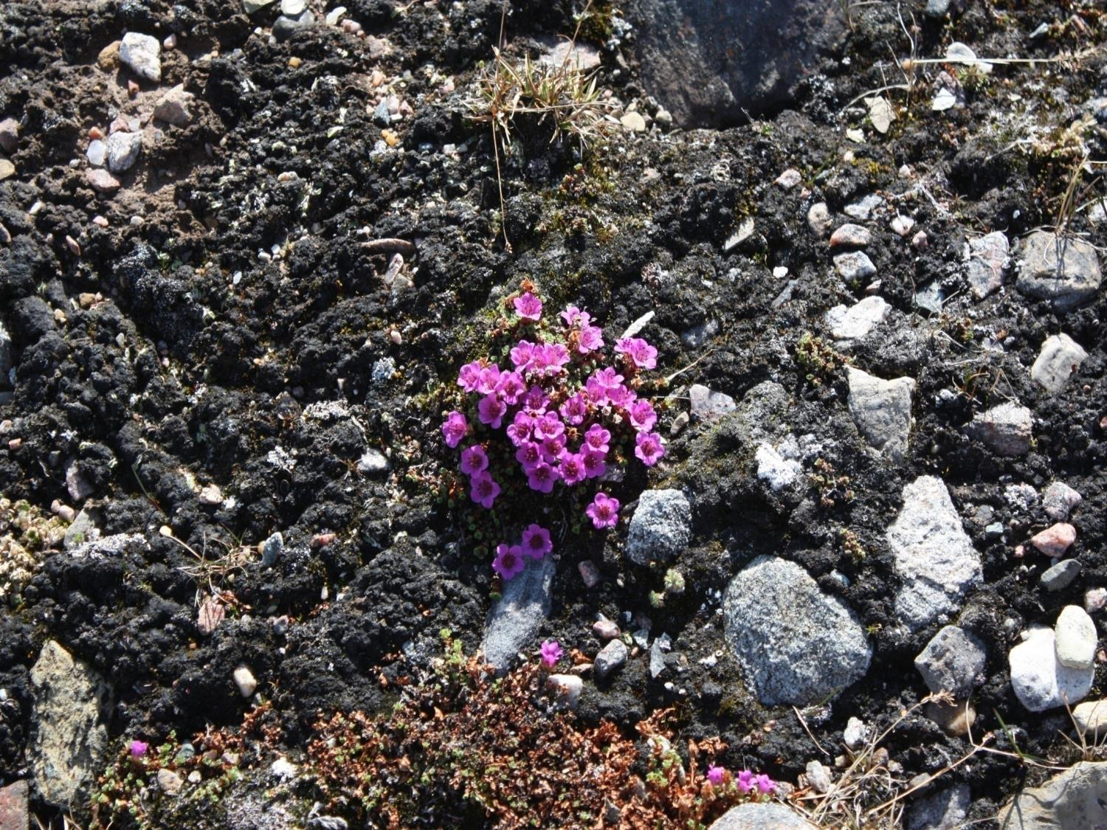
Qujannamiik
Thank you
Merci
ᖁᔭᓐᓇᒦᒃ

