Slide 1

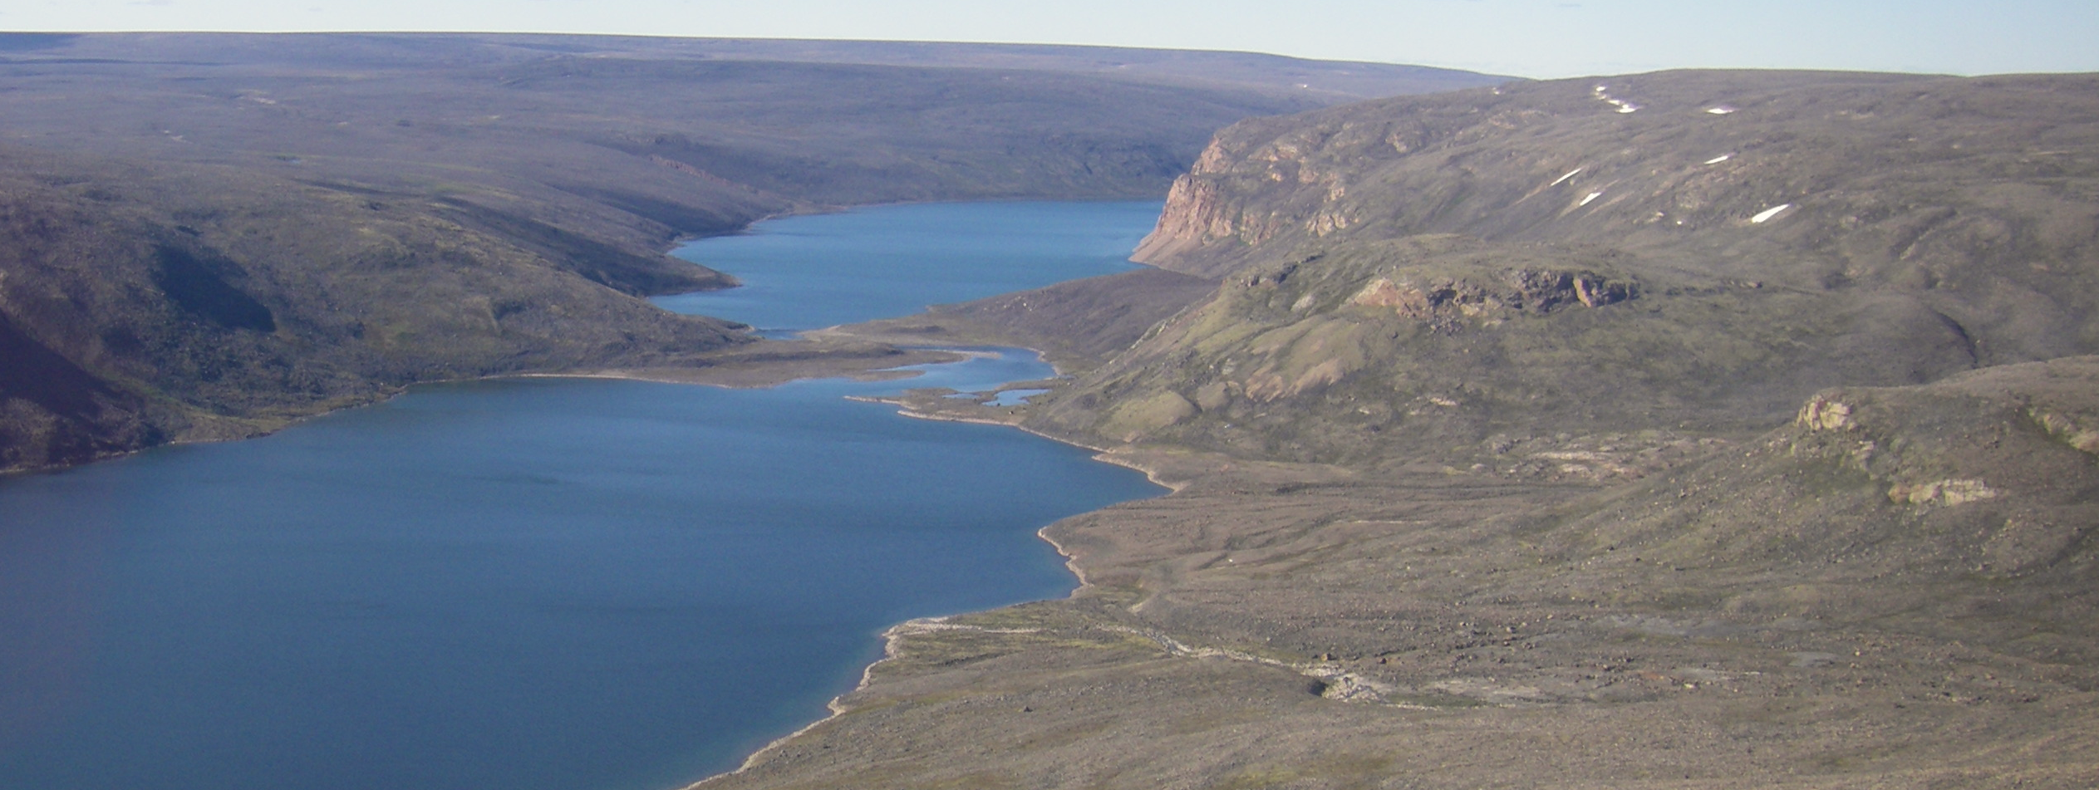
2AM-MRY-1325 ᖃᓄᐃᑦᑑᓂᖓ ᐃ ᐃᒪᕐᒧᑦ ᓚᐃᓴᓐᓯ ᓄᑖᙳᕆᐊᖅᓯᒪᔪᖅ
ᓄᓇᕗᒻᒥ ᐃᒪᕐᒥᐅᑕᓕᕆᔨᒃᑯᑦ ᑲᑎᒪᔨᖏᑦ ᓄᓇᓕᖕᓂ ᑲᑎᒪᑎᑦᑎᓂᖅ
ᑎᓯᐱᕆ 3 ᐊᒻᒪᓗ 4, 2024
2AM-MRY-1325 Type A Water Licence Renewal
NWB Community Meeting
December 3-4, 2024

Slide 3
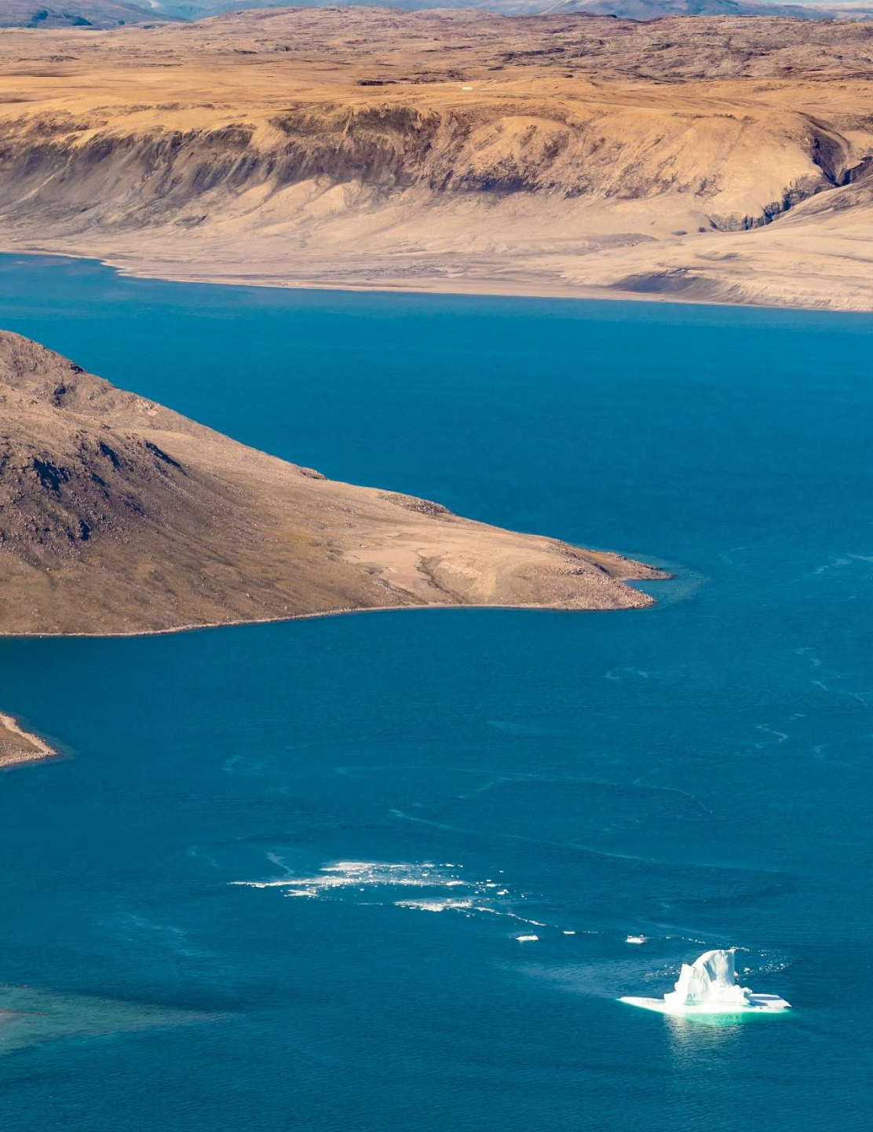
ᓇᐃᓈᖅᓯᒪᔪᖅ ᐅᓂᒃᑳᑦ Presentation Summary
ᓄᓘᔮᖕᓂ ᐃᒪᕐᒧᑦ ᓚᐃᓴᓐᓯ ᓄᑖᙳᕆᐊᖅᓯᒪᔪᓂᒃ ᓇᐃᓈᖅᓯᒪᔪᒥᒃ ᕿᒥᕐᕈᓂᖅ
ᐱᔭᕆᐊᑐᔪᓂᒃ ᕿᒥᕐᕈᓂᖅ
ᐃᓱᓕᔾᔪᑎᖓ
Mary River Water Licence Renewal Overview
Technical Overview
Conclusion

Slide 4
ᓄᓘᔮᖕᓂ ᐃᒪᕐᒧᑦ ᓚᐃᓴᓐᓯ ᓄᑖᙳᕆᐊᖅᓯᒪᔪᓂᒃ ᓇᐃᓈᖅᓯᒪᔪᒥᒃ ᕿᒥᕐᕈᓂᖅ
MARY RIVER WATER LICENCE RENEWAL OVERVIEW

Slide 5

ᓄᓘᔮᖕᓂ ᐃᒪᕐᒧᑦ ᓚᐃᓴᓐᓯᓄᑦ ᑭᖑᓂᐊᒍ
Mary River Water Licence History
ᐅᓪᓗᓪᓗᐊᑕᖏᑦ
ᔫᓐ 10, 2013: ᑐᓂᔭᐅᓚᐅᖅᑐᖅ ᖃᓄᐃᑦᑑᓂᖓ ᐃ ᐃᒪᕐᒧᑦ ᓚᐃᓴᓐᓯ 2AM-MRY1325
ᔪᓚᐃ 21, 2015: ᑐᓂᔭᐅᓚᐅᖅᑐᖅ ᐅᐃᒍᖓ ᓈᓴᐅᑖ 1. ᖃᓄᐃᑦᑑᓂᖓ ᐃ ᐃᒪᕐᒧᑦ ᓚᐃᓴᓐᓯ 2AM-MRY1325 (ᑮᓇᐅᔾᔭᒃᓴᓵᓕᓇᓱᐊᕐᓂᖅ)
ᔫᓐ 26, 2024: ᓄᑖᙳᕆᐊᖅᓯᒪᔪᖅ ᐱᔪᒪᓇᓲᑎ ᑐᓂᔭᐅᔪᖅ
Key Dates
June 10, 2013: Issuance of Type ‘A’ Water Licence 2AM-MRY1325
July 21, 2015: Issuance of Amendment No. 1 to Type ‘A’ Water Licence 2AM-MRY1325 (Early Revenue Phase)
June 26, 2024: Renewal Application Submission

Slide 6
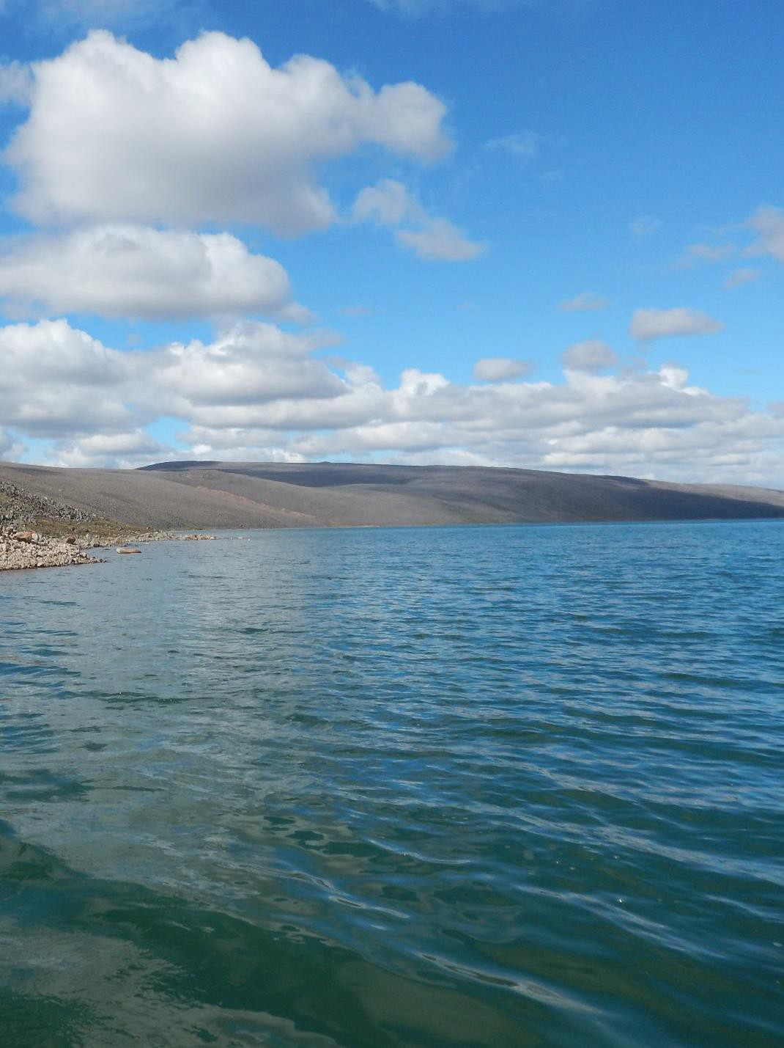
ᐃᒪᕐᒧᑦ ᓚᐃᓴᓐᓯ ᓄᑖᙳᕆᐊᖅᓯᒪᔪᓂᒃ ᓇᐃᓈᖅᓯᒪᔪᒥᒃ ᕿᒥᕐᕈᓂᖅ
ᑐᒃᓯᕋᖅᑕᐅᓯᒪᔪᖅ 15-ᓄ ᐊᕐᕌᒍᒧᑦ
ᐱᒻᒪᕆᐅᔪᓂᒃ ᐊᓯᔾᔩᔪᖃᖏᑦᑐᖅ ᒫᓐᓇᒧᑦ ᓚᐃᓴᓪᓯᒥᒃ ᒪᓕᒃᑕᐅᔭᕆᐊᓕᖕᓂᒃ ᑐᒃᓯᕋᖅᑕᐅᓯᒪᔪᒧᑦ ᐃᓚᒋᔭᐅᖃᓯᐅᑎᔪᖅ ᐃᒪᕐᒧᑦ ᓚᐃᓴᓐᓯ ᓄᑖᙳᕆᐊᖅᓯᒪᔪᒥᒃ
ᐋᕿᒋᐊᕐᓯᒫᕐᔪᒃᑐᑦ ᐱᐅᓯᒋᐊᕈᑎᓂᒃ ᐊᐅᓚᓂᕐᒥᒃ
ᐊᐅᓚᕐᓂᕐᒧᑦ ᐸᕐᓇᐅᑏᑦ ᒫᓐᓇᒧᑦ ᐊᐅᓚᓂᐅᔪᓂᒃ ᐱᑎᑦᑎᓯᒪᔪᑦ ᓇᓗᓇᐃᕈᑎᓂᒃ, ᐃᓕᔭᐅᓯᒫᓂᓕᖅᑐᑦ ᐊᕐᕌᒍᑕᒫᖅᓯᐅᑎᓂᒃ
ᒫᓐᓇᓕᓴ ᓚᐃᓴᓐᓯ ᑐᓂᔭᐅᓯᒪᔪᖅ ᒪᓕᒃᖢᒍ ᐅᔭᕋᖕᓂᐊᕈᓐᓇᐅᑦ 005, ᐱᓕᕆᐊᒃᓴᓗᒃᑖᓂᒃ ᐅᔭᕋᖕᓂᐊᕈᓐᓇᐅᑎᒥᒃ ᐱᖃᓯᐅᑎᓯᒪᔪᖅ ᒫᓐᓇᓕᓴᕐᒥᒃ ᐃᒪᕐᒧᑦ ᓚᐃᓴᓐᓯ

Slide 7
Water Licence Renewal Overview
Requesting a 15-year term
No substantive changes to current licence terms and conditions requested as part of the water licence renewal
Minor improvements to improve functionality
Management Plans for current operations provided for reference, already subject to annual review
Current licence issued based on Project Certificate (PC) 005, everything in scope of PC is included in the current water licence

Slide 8
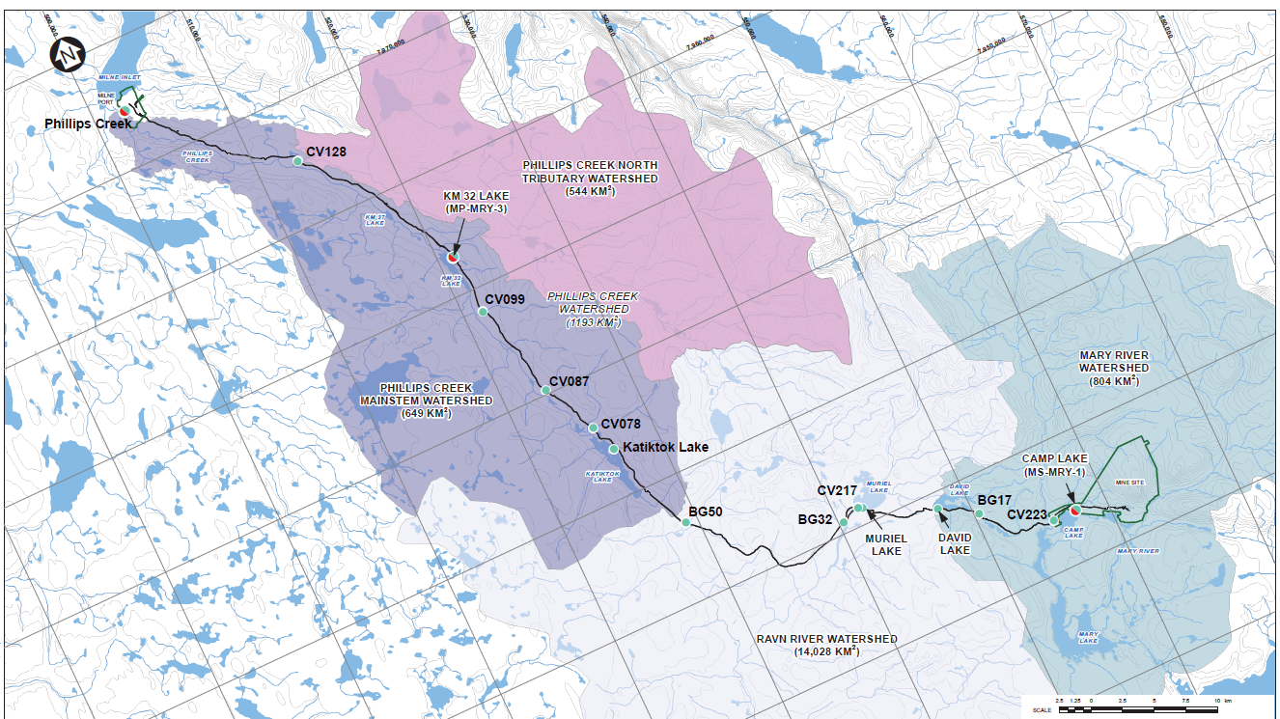


ᐊᖏᖅᑕᐅᓯᒪᔪᑦ ᐃᒪᕐᒧᑦ ᖃᐅᔨᓴᕐᕖᑦ Approved Water Stations
ᕿᙳᐊ
ᕿᙳᐊᓂ ᑐᓚᒃᑕᕐᕕᖓ
ᑰᒐᓛᖅ
ᑭᓛᒥᑕ 32
ᑕᓯᖓ
ᑳᒻᑉ ᑕᓯᖅ
ᑲᑎᒃᑑᑉ ᑕᓯᖅ
ᐅᔭᕋᖕᓂᐊᕐᕕᐅᔪᖅ
ᒧᕆᐅᓪ
ᑕᓯᖅ
ᑕᐃᕕᑦ
ᑕᓯᖅ
ᓄᓘᔮᒃ
ᓇᔪᖅᑕᐅᔪᓂᒃ/ᐃᖅᑲᓇᐃᔭᕐᕕᖕᓂᑦ ᐃᒪᕐᒧᑦ ᖃᐅᔨᓴᕐᕕᒃ
ᐳᔪᕋᖃᓗᐊᕐᔭᐃᒃᑯᑎᓄᑦ ᐃᒪᕐᒧᑦ ᖃᐅᔨᓴᕐᕕᒃ
ᓇᔪᖅᑕᐅᔪᓂᒃ/ᐃᖅᑲᓇᐃᔭᕐᕕᖕᓂᑦ ᐃᒪᕐᒧᑦ ᖃᐅᔨᓴᕐᕖᑦ ᐊᒻᒪᓗ ᐳᔪᕋᖃᐊᕐᔭᐃᒃᑯᑎᓄᑦ ᐃᒪᕐᒧᑦ ᖃᐅᔨᓴᕐᕕᒃ
ᓄᓘᔮᑉ
ᑕᓯᖓ

Slide 9
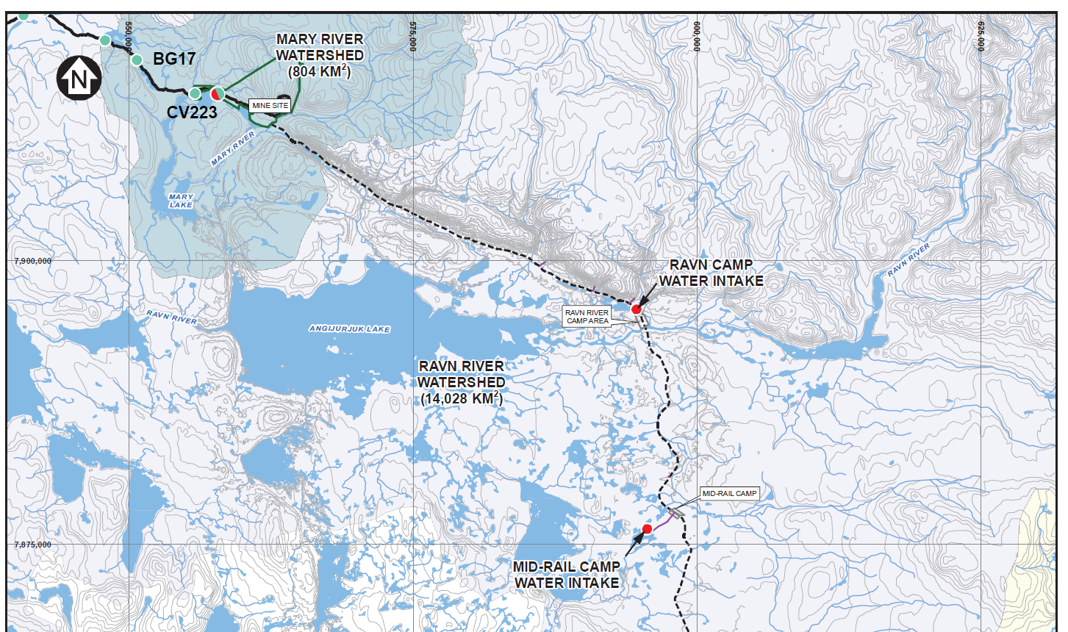
ᐊᖏᖅᑕᐅᓯᒪᔪᖅ ᐃᒪᕐᒧᑦ ᖃᐅᔨᓴᕐᕖᒃ − ᐃᒃᐱᑭᑦᑐᕐᔪᐊᓂ Approved Water Stations - Steensby
ᓄᓘᔮᒃ
ᓄᓘᔮᑉ
ᑕᓯᖓ
ᐃᒃᑲᕐᕈᐃᑦ ᑰᖓ
ᐃᒃᑲᕐᕈᐃᑦ ᑰᖓ
ᐊᖏᔪᕐᔪᒃ ᑕᓯᖅ
ᐃᒪᑦᑎᐊᕙᒃᑖᕐᕕᒃ
ᐃᒃᑲᕈᐃ ᑰᖓ ᑕᒻᒫᖅᑕᕐᕕᒃ
ᓇᔪᖅᑕᐅᔪᓂᒃ/ᐃᖅᑲᓇᐃᔭᕐᕕᖕᓂᑦ ᐃᒪᕐᒧᑦ ᖃᐅᔨᓴᕐᕕᒃ
ᐳᔪᕋᖃᓗᐊᕐᔭᐃᒃᑯᑎᓄᑦ ᐃᒪᕐᒧᑦ ᖃᐅᔨᓴᕐᕕᒃ
ᓇᔪᖅᑕᐅᔪᓂᒃ/ᐃᖅᑲᓇᐃᔭᕐᕕᖕᓂᑦ ᐃᒪᕐᒧᑦ ᖃᐅᔨᓴᕐᕖᑦ ᐊᒻᒪᓗ ᐳᔪᕋᖃᐊᕐᔭᐃᒃᑯᑎᓄᑦ ᐃᒪᕐᒧᑦ ᖃᐅᔨᓴᕐᕕᒃ
ᕿᑎᖅᐸᓯᐊᓂ ᓄᓇᓯᐅᑎᑯᑖᑉ ᐊᖅᑯᑖᓂ ᓇᔪᒐᖅ
ᐃᒪᑦᑎᐊᕙᒃᑖᕐᕕᒃ

Slide 10
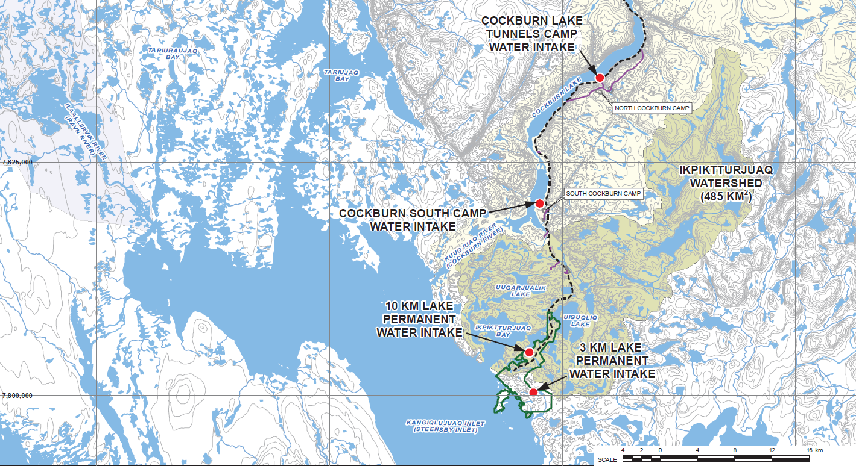
ᐊᖏᖅᑕᐅᓯᒪᔪᖅ ᐃᒪᕐᒧᑦ ᖃᐅᔨᓴᕐᕖᒃ − ᐃᒃᐱᑭᑦᑐᕐᔪᐊᓂ Approved Water Stations - Steensby
ᐃᒃᐱᑭᑦᑐᕐᔪᐊᑉ
ᑕᓯᖓ
ᐃᒃᑲᕐᕈᐃᑦ ᑰᖓ
ᐃᒃᐱᑭᑦᑐᕐᔪᐊᑉ
ᑰᖓ
ᐃᒃᐱᑭᑦᑐᕐᔪᐊᑉ
ᑲᖏᖅᖢᐊ
ᓇᔪᖅᑕᐅᔪᓂᒃ/ᐃᖅᑲᓇᐃᔭᕐᕕᖕᓂᑦ ᐃᒪᕐᒧᑦ ᖃᐅᔨᓴᕐᕕᒃ
ᐳᔪᕋᖃᓗᐊᕐᔭᐃᒃᑯᑎᓄᑦ ᐃᒪᕐᒧᑦ ᖃᐅᔨᓴᕐᕕᒃ
ᓇᔪᖅᑕᐅᔪᓂᒃ/ᐃᖅᑲᓇᐃᔭᕐᕕᖕᓂᑦ ᐃᒪᕐᒧᑦ ᖃᐅᔨᓴᕐᕖᑦ ᐊᒻᒪᓗ ᐳᔪᕋᖃᐊᕐᔭᐃᒃᑯᑎᓄᑦ ᐃᒪᕐᒧᑦ ᖃᐅᔨᓴᕐᕕᒃ
ᐃᒃᐱᑭᑦᑐᕐᔪᐊᑦ

Slide 11
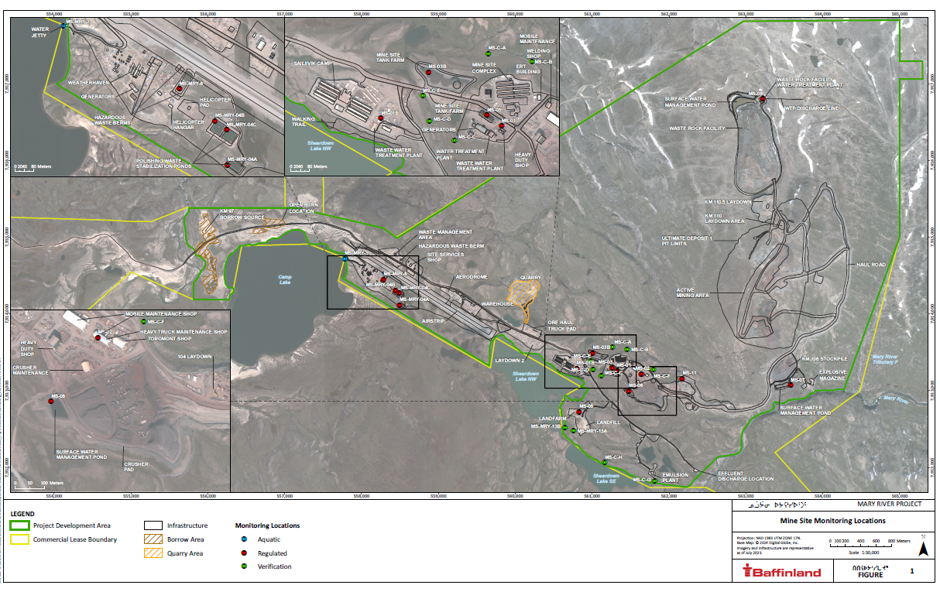

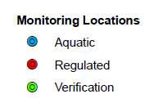
ᖃᐅᔨᓴᖅᑕᐅᖏᓐᓇᕐᓂᕐᒧᑦ ᐃᓃᑦ − ᐅᕙᕋᖕᓂᐊᕐᕕᖕᒥ Monitoring Locations – Mine Site
ᖃᐅᔨᓴᖅᐸᓪᓕᐊᖏᓐᓇᕐᓃᑦ ᓇᓃᓐᓂᖏᑦ
ᐃᒪᖅ
ᒪᓕᒐᓕᐅᖅᑕᐅᓯᒪᔪᑦ
ᓇᓗᓇᐃᖅᓯᓂᖅ
See larger poster

Slide 12
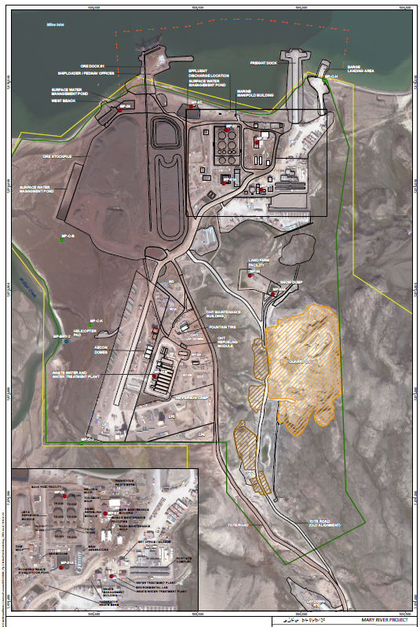
Monitoring Locations – Milne Port
ᖃᐅᔨᓴᐃᖅᑕᐅᖏᓐᓇᕐᓂᕐᒧᑦ ᐃᓃᑦ − ᕿᙳᐊᓂ ᑐᓚᑦᑕᕐᕕᒃ
ᖃᐅᔨᓴᖅᐸᓪᓕᐊᖏᓐᓇᕐᓃᑦ ᓇᓃᓐᓂᖏᑦ
ᐃᒪᖅ
ᒪᓕᒐᓕᐅᖅᑕᐅᓯᒪᔪᑦ
ᓇᓗᓇᐃᖅᓯᓂᖅ
See larger poster

Slide 13
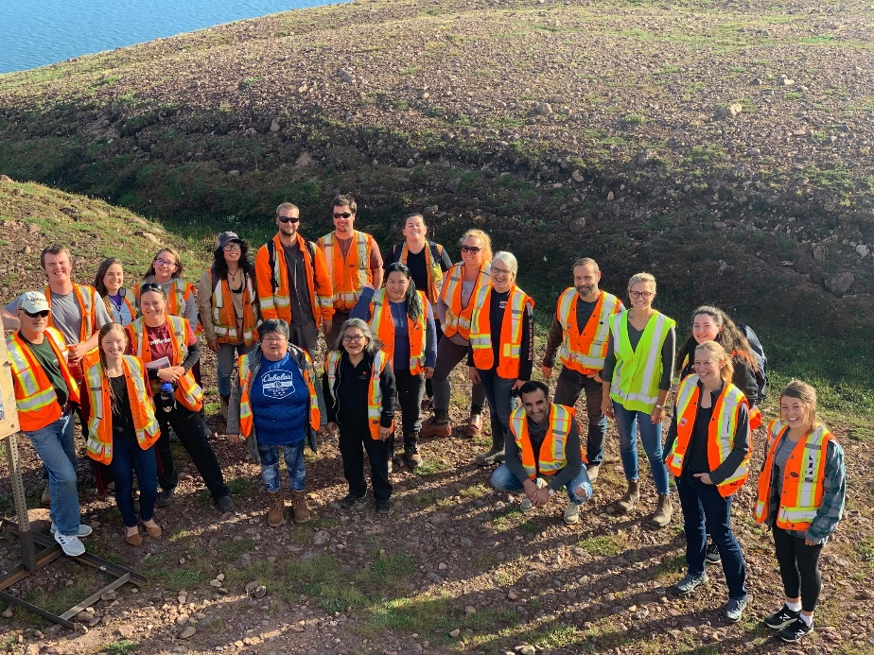
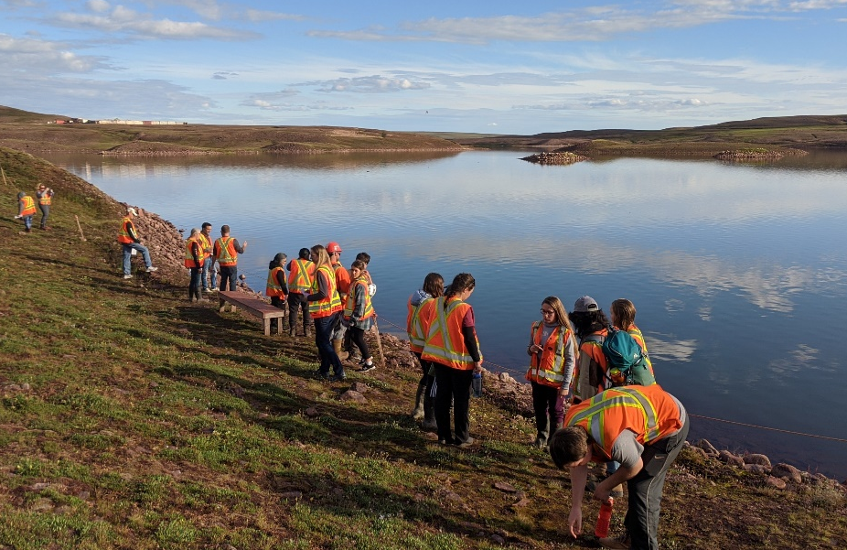
ᐃᒪᕐᒧᑦ ᓚᐃᓴᓐᓯᓄᒃ ᖃᐅᔨᓴᐃᓐᓇᕐᓂᕐᒧᑦ ᐱᓕᕆᖃᑎᒌᑦ
Water Licence Monitoring Team
ᐊᕙᑎᓕᕆᔨᒃᑯᑦ ᐱᓕᕆᖃᑎᒌᖏᑦ
7 ᐃᓄᐃᑦ ᖃᕆᓴᐅᔭᓕᕆᔩᑦ ᐊᒻᒪᓗ ᖃᐅᔨᒪᔨᑦᑕᖏᑦ
4 ᕿᑭᖅᑕᓂ ᐃᓄᐃᑦ ᑲᑐᔾᔨᖃᑎᒌᒃᑯᓐᓂᒃ ᐊᕙᑎᓕᕆᔨᓂᕐᒧᑦ ᖃᐅᔨᓴᕐᑏᑦ
Site Environment Team
7 Inuit technician and specialists
4 QIA environmental monitors

Slide 14
ᐃᒪᑦᑎᑕᕙᖕᒥᒃ ᖃᐅᔨᓴᐃᓐᓇᕐᓂᕐᒧᑦ ᐱᓕᕆᐊᖅ Freshwater Monitoring Programs
ᐃᒪᕐᒧᑦ ᐊᒃᑐᐃᓂᕐᓄᑦ ᖃᐅᔨᓴᖅᐸᓪᓕᐊᖏᓐᓇᕐᓂᕐᒧᑦ ᐱᓕᕆᐊᑦ
ᖃᐅᔨᓴᕈᓄᑦ ᑐᓴᐅᒪᖃᑦᑕᐅᑎᔾᔪᑎᓄᑦ ᐱᓕᕆᐊᖅ
ᐊᕙᑎᒧᑦ ᐊᒃᑐᐃᔾᔪᑎᓄᑦ ᖃᐅᔨᓴᐃᓐᓇᕐᓂᖅ
ᑐᔪᐃᕝᕕᐅᕙᓪᓕᐊᖏᓇᕈᑎᓄᑦ ᐊᕙᑎᒥᒃ ᖃᐅᔨᓴᐃᓐᓇᕐᓂᕐᒧᑦ ᐱᓕᕆᐊᖅ
ᑕᓯᐅᑉ ᐃᖅᑲᖏᓐᓂᒃ ᖃᐅᔨᓴᐃᓐᓇᕐᓂᕐᒧᑦ ᐱᓕᕆᐊᖅ
ᐳᔪᕋᕐᓂᒃ ᖃᐅᔨᓴᐃᓐᓇᕐᓃᑦ ᐱᓕᕆᐊᖅ
ᐃᓚᐅᖅᑐᒐᕐᓂᒃ ᖃᐅᔨᓴᐃᓐᓇᕐᓃᑦ
ᓄᓇᐅᑉ ᐃᒪᖓᓂᒃ ᖃᐅᔨᓴᐃᓐᓇᕐᓃᑦ
ᐅᓯᑲᖅᑕᖅᑏᑦ ᐊᖅᑯᑖᓂ ᖃᐅᔨᓴᖅᐸᓪᓕᐊᖏᓐᓇᕐᓂᕐᒧᑦ ᐱᓕᕆᐊᖅ
Aquatic Effects Monitoring Program (AEMP)
Surveillance Network Program (SNP)
Environmental Effects Monitoring (EEM)
Core Receiving Environment Monitoring Program (CREMP)
Lake Sedimentation Monitoring Program
Dustfall Monitoring Program
Hydrometric Monitoring
Groundwater Monitoring
Tote Road Monitoring Program (TRMP)

Slide 15
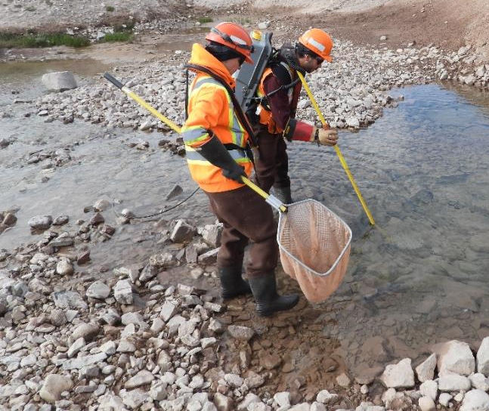
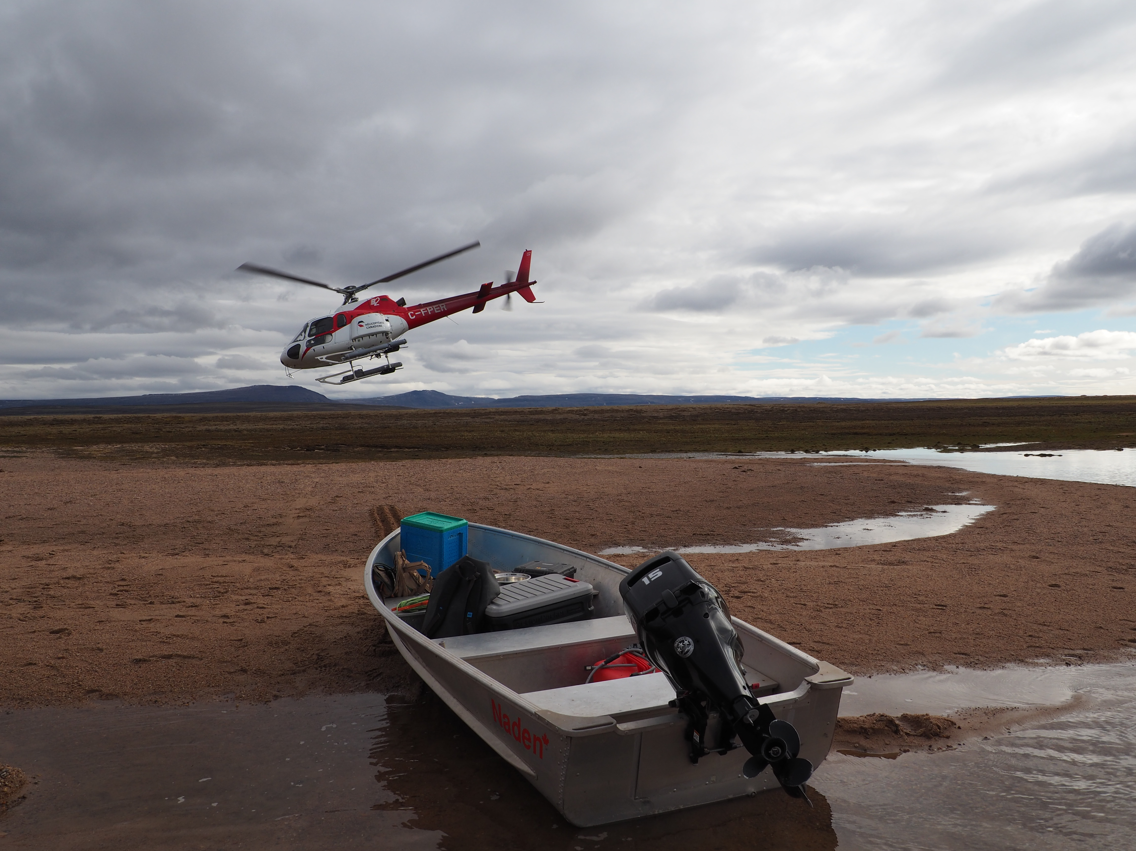
ᐃᒪᕐᒧᑦ ᐊᒃᑐᐃᓂᕐᓄᑦ ᖃᐅᔨᓴᖅᐸᓪᓕᐊᖏᓐᓇᕐᓂᕐᒧᑦ ᐱᓕᕆᐊᖅ Aquatic Effects Monitoring Program (AEMP)
ᖃᐅᔨᓴᖅᐸᓪᓕᐊᖏᓐᓇᕐᓂᖅ ᐃᒪᑦᑎᐊᕙᖕᓂᒃ ᑕᓯᕐᓂᒃ ᑰᖕᓂᓪᓗ ᐊᕙᑎᒧᐊᖅᐸᓪᓕᐊᔪᑦ
ᐃᒪᕐᓄᑦ ᖃᐅᔨᓴᕐᓃᑦ
ᖃᐅᔨᓴᕐᓃᑦ ᐃᖅᑲᕐᓂᒃ, ᕿᒥᕐᓗᖃᖏᑦᑐᑦ ᐆᒪᔪᑦ ᐊᒻᒪᓗ ᐃᖃᓗᐃᑦ
ᑎᑎᕋᕆᐊᕐᖓᓯᒪᔪᑦ ᒥᒃᓴᐅᓴᒃᑕᐅᓯᒪᔪᑦ ᓄᓇᑎᒍᑦ, ᐊᑐᓚᐅᑲᒃᑐᓂᒃ, ᐊᒻᒪᓗ ᐆᒃᑐᕋᐅᑎᒃᑯᑦ
ᐊᖅᑐᑕᐅᕙᒃᑐᑦ: ᐃᒪᕐᒧᑦ ᖃᐅᔨᓴᕐᓃᑦ, ᐅᐊᔭᓄᑦ ᐃᖃᓗᒐᓱᖕᓃᑦ, ᒪᑦᑎᑕᐅᑏᑦ, ᐃᖅᑲᕐᓂᒃ ᑲᑎᖅᓱᐃᔾᔪᑏᑦ
Monitoring freshwater lakes and streams in the receiving environment
Water samples
Studies on sediment, benthic invertebrates and fish
Data is compared geographically, temporally, and against benchmarks
Methods: water sampling, electrofishing, gill nets, sediment traps

Slide 16
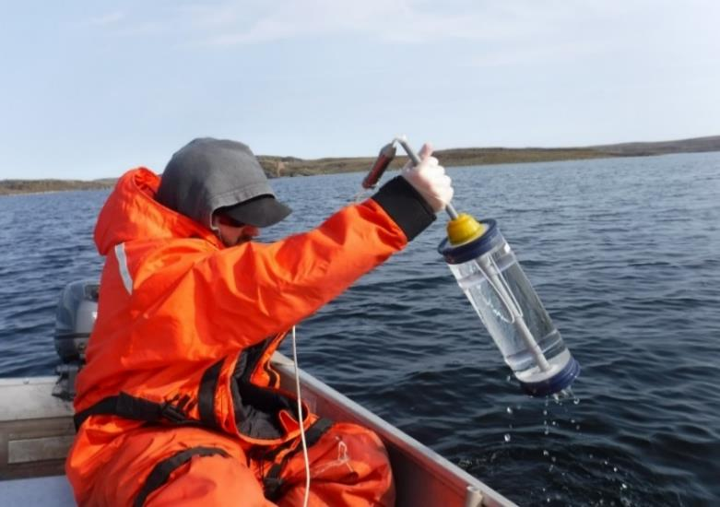
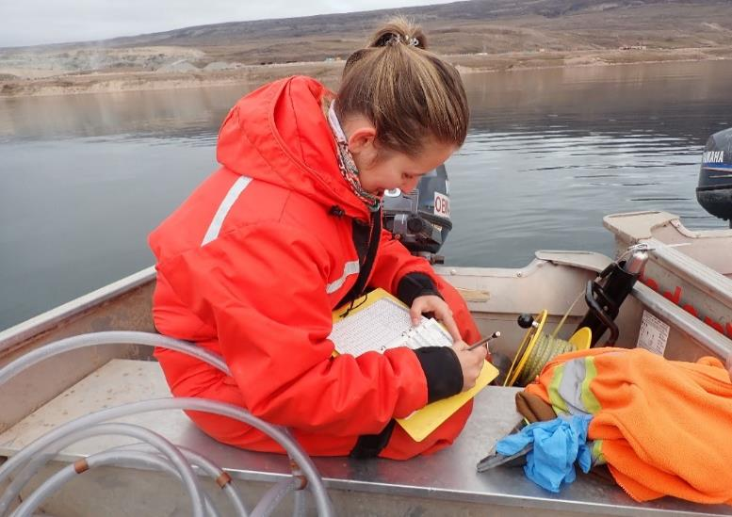
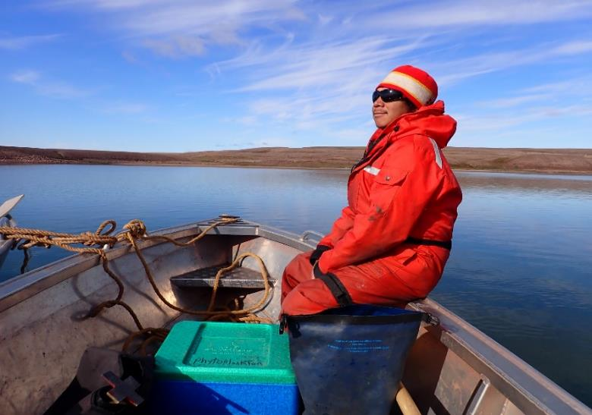
ᐃᒪᕐᒧᑦ ᐊᒃᑐᐃᓂᕐᓄᑦ ᖃᐅᔨᓴᖅᐸᓪᓕᐊᖏᓐᓇᕐᓂᕐᒧᑦ ᐱᓕᕆᐊᖅ − ᑕᓯᕐᓂᑦ Aquatic Effects Monitoring Program - Lakes
Lake sampling includes:
Field parameter depth profile
Water quality samples at different depths
Secchi disk measurements
ᑕᓯᕐᓂᒃ ᖃᐅᔨᓴᕐᓃᑦ ᐃᓚᓕᐅᑎᓯᒪᔪᑦ:
ᓄᓇᐅᑉ ᐋᕿᒃᓯᒪᓂᖓ ᐃᔾᔪᓂᖓ
ᐃᒪᐅᑉ ᖃᓄᐃᑦᑑᓂᖓ ᖃᐅᔨᓴᕐᑕᐅᓃᑦ ᐃᔾᔪᓕᕇᖕᓂᖏᑦ
ᐃᒪᐅᑉ ᐃᓱᕐᓂᖓᑦ ᖃᐅᔨᓴᖅᑕᐅᔾᔪᑎᒃᑯᑦ

Slide 17
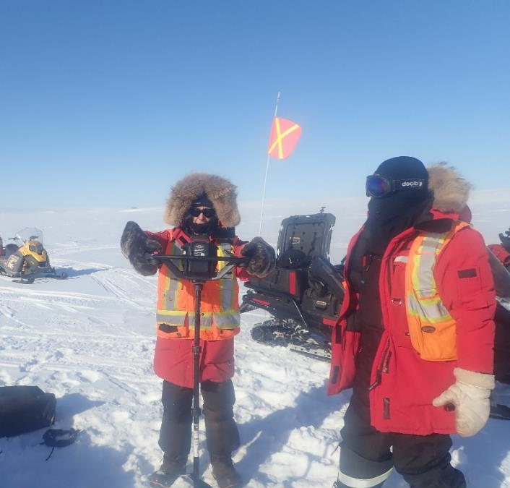
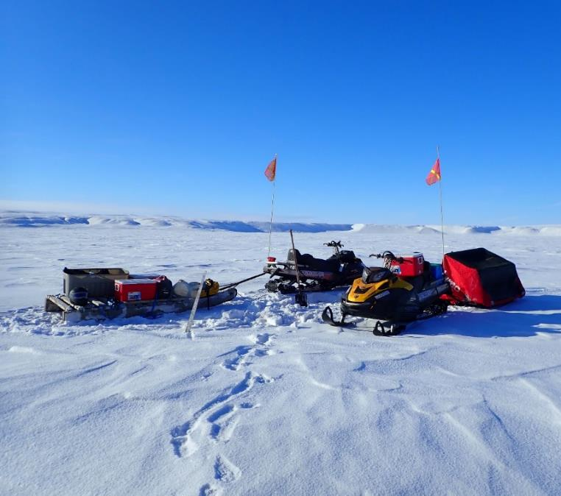
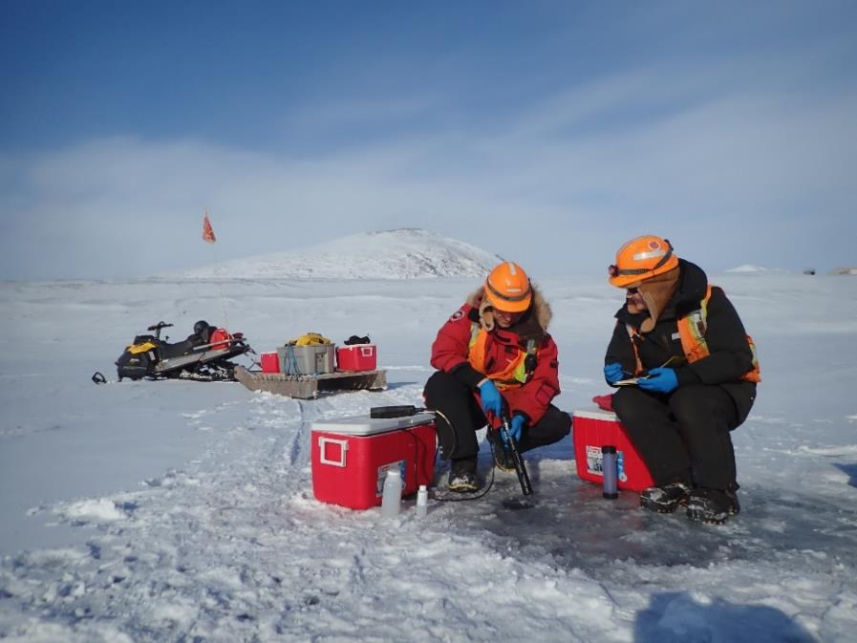
ᐃᒪᕐᒧᑦ ᐊᒃᑐᐃᓂᕐᓄᑦ ᖃᐅᔨᓴᖅᐸᓪᓕᐊᖏᓐᓇᕐᓂᕐᒧᑦ ᐱᓕᕆᐊᖅ − ᑕᓯᕐᓂᑦ Aquatic Effects Monitoring Program - Lakes
ᐅᑭᐅᒃᑯᑦ ᖃᐅᔨᓴᕐᓃᑦ ᑕᓯᕐᓂᒃ ᓯᑰᑉ ᐊᑖᓂ ᐃᔾᔪᓕᕇᖕᓂᖏᑦ
Winter sampling at lakes under the ice at various depths

Slide 18
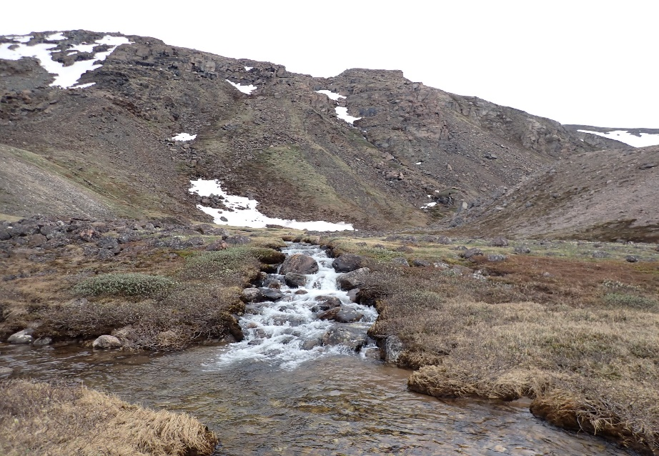
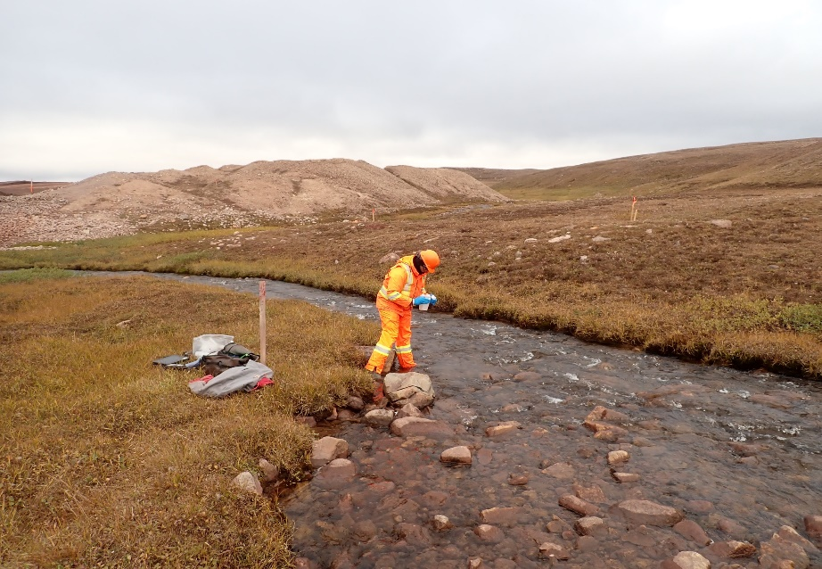
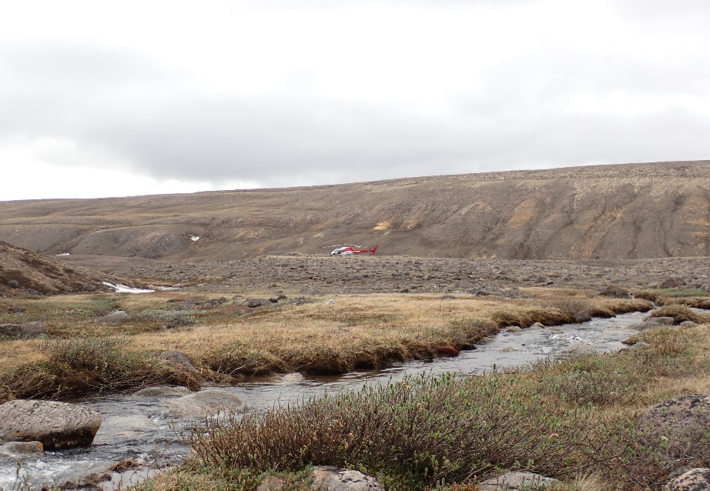
ᐃᒪᕐᒧᑦ ᐊᒃᑐᐃᓂᕐᓄᑦ ᖃᐅᔨᓴᖅᐸᓪᓕᐊᖏᓐᓇᕐᓂᕐᒧᑦ ᐱᓕᕆᐊᖅ − ᑰᖕᓂ Aquatic Effects Monitoring Program - Streams
ᑰᖕᓂ ᖃᐅᔨᓴᕐᓃᑦ ᐃᓚᓕᐅᑎᓯᒪᔪᑦ ᐃᓂᐅᔪᓂᒃ ᖃᓂᒋᔭᖏᓐᓂᒃ ᐅᖓᓯᒃᑐᓂᓪᓗ ᐅᔭᕋᖕᓂᐊᕐᕕᖕᒧᑦ
Stream sampling includes sites near and far from the mine site

Slide 19
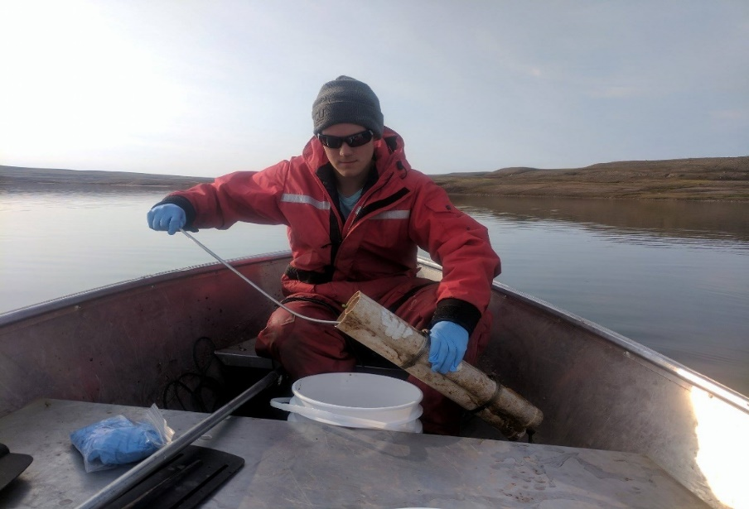
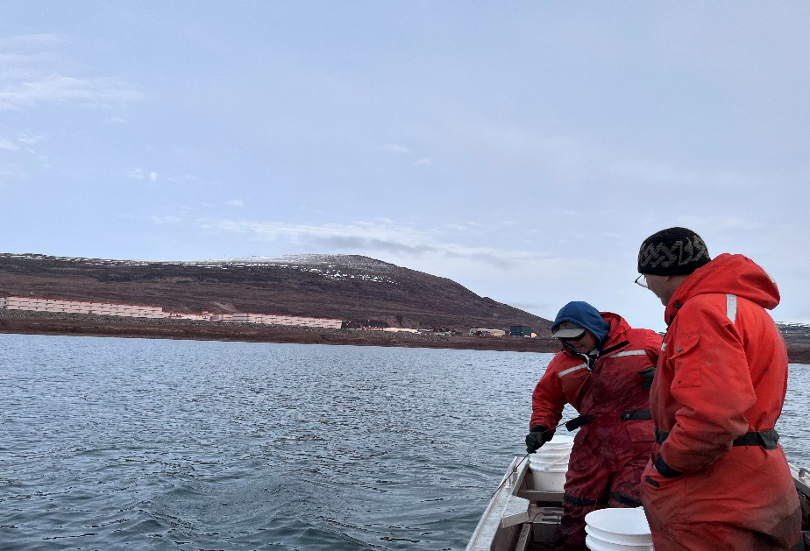
ᐃᖅᑲᕐᓂᒃ ᖃᐅᔨᓴᕐᓃᑦ Sediment Sampling
ᑐᑭᓯᐅᒪᓃᑦ ᐃᖅᑲᕐᓂᒃ ᖃᓄᐃᓕᖓᓂᖏᑦ ᐱᔭᐅᕙᓪᓕᐊᔪᑦ ᐱᓕᕆᐊᒥᒃ
ᑲᑎᖅᓱᐃᓂᖅ ᐃᓕᐅᖅᑲᐃᓃᑦ ᖃᐅᔨᓴᕈᑎᓂᒃ ᑕᓯᕐᓄᑦ ᐅᔭᕋᖕᓂᐊᕐᕕᐅᑉ ᖃᓂᒋᔭᖓᓂᒃ
ᑲᑎᖅᓱᐃᓂᖅ ᐃᖅᑲᓇᕐᓄᑦ ᖃᐅᔨᓴᕈᑎᓂᒃ
Understand rates of sediment deposition from the Project
Collect and deploy sample containers on the lake bed near the mine
Collect sediment core samples

Slide 20
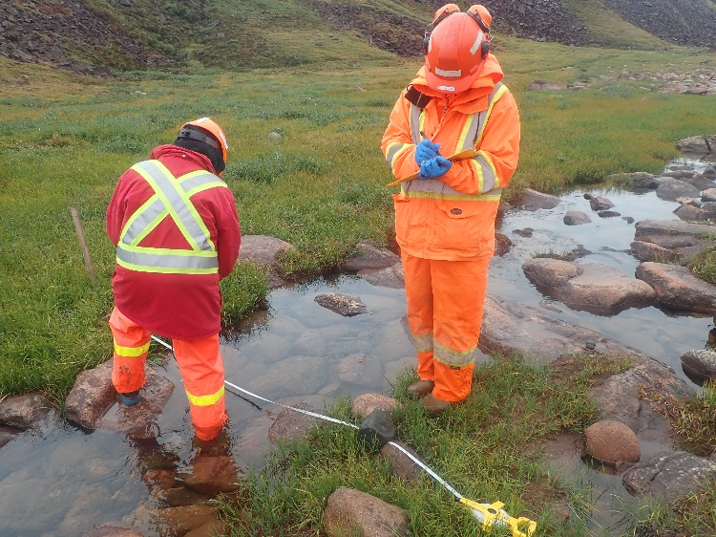
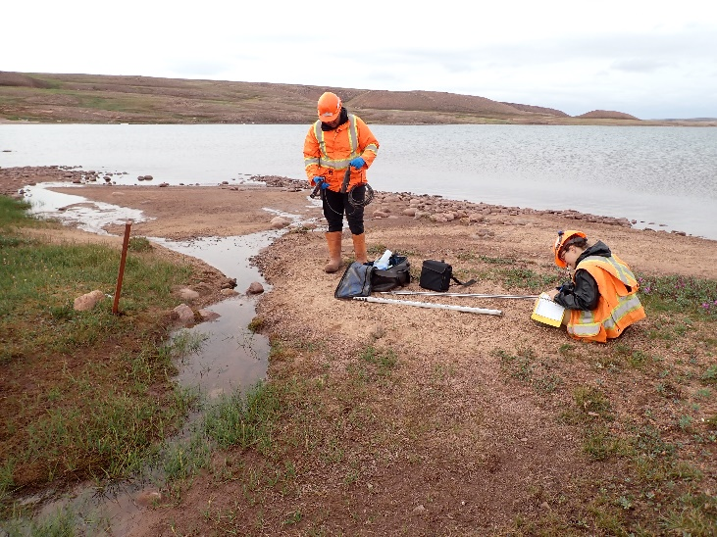
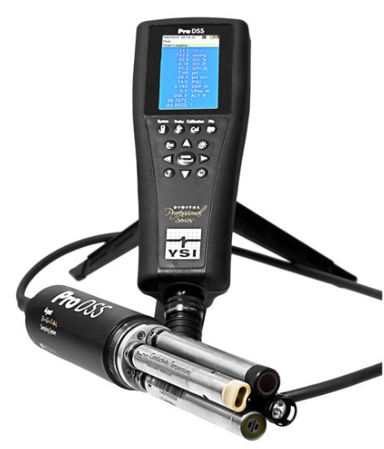
ᖃᐅᔨᓴᕈᓄᑦ ᑐᓴᐅᒪᖃᑦᑕᐅᑎᔾᔪᑎᓄᑦ ᐱᓕᕆᐊᖅ Surveillance Network Program (SNP)
ᐃᒪᐅᑉ ᖄᖓᓂᒃ ᖃᐅᔨᓴᐃᓐᓇᖅᐸᓪᓕᐊᓂᖅ ᑰᖕᓂᒃ ᐅᔭᕋᖕᓂᐊᕐᕕᖕᒧᖓᐅᖓᔪᑦ
ᐃᒪᐅᑉ ᖃᓄᐃᑦᑑᓂᖓ ᖃᐅᔨᓴᐃᓐᓇᖅᐸᓪᓕᐊᓂᖅ ᑕᓯᕐᓂᒃ ᐊᑐᖅᑕᐅᔪᓐᓃᖅᑐᓂᒃ
Surface water monitoring in streams adjacent to site
Water quality monitoring from pond discharges

Slide 21
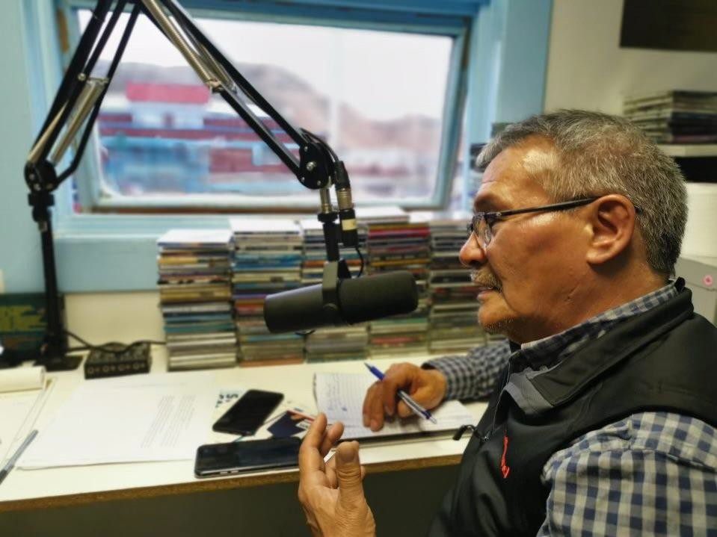
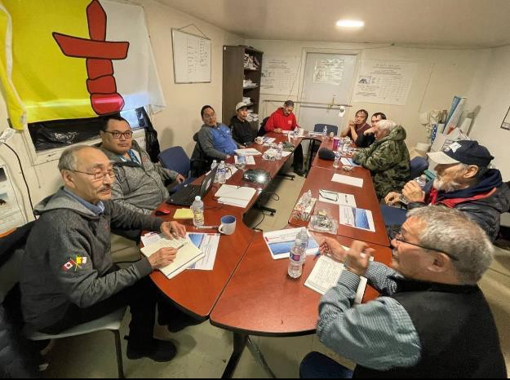
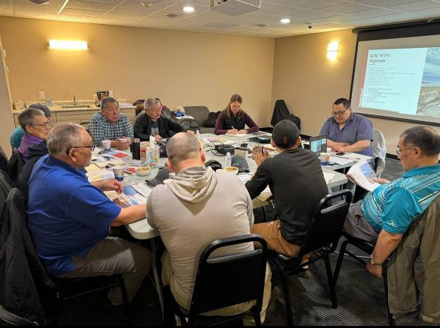
ᓄᓇᓕᖕᓂ ᐃᓚᓕᐅᑎᑦᑎᓃᑦ Community Engagement
ᐃᓚᐅᑎᑦᑎᓃᑦ ᑲᒪᒋᔭᐅᔪᑦ ᐃᓄᖕᓄᑦ ᓯᕗᓕᐅᖅᑎᓂᒃ
ᐅᖃᖃᑎᒌᖕᓂᖅ ᓄᓘᔮᖕᓂ ᐱᓕᕆᐊᖅ ᒥᒃᓵᓄᑦ ᐃᓄᒃᑎᑐᑦ ᖃᓪᓗᓈᑎᑐᓪᓗ, ᒪᓕᒃᖢᒋᑦ ᐃᒃᐱᒋᑦᑎᐊᖅᖢᒋᓪᓗᓗ ᐃᓄᐃᑦ ᐅᖃᐅᓯᒃᑯᑦ ᐱᖅᑯᓯᖏᑦ
ᑲᔪᓰᓐᓇᖅᑐᒃᑯᑦ ᐃᓚᓕᐅᑎᑦᑎᓃᑦ ᑐᕌᒐᖃᖅᑐᓂᒃ ᓄᓘᔮᖕᓂ ᐱᓕᕆᐊᖅ
ᐃᓄᐃᑦ ᖃᐅᔨᒪᓪᓗᐊᑕᖏᑦ
Engagement carried out by Inuit-led team
Communication about Mary River Project in Inuktitut and English, following and respecting Inuit oral traditions
Ongoing engagement regarding on the Mary River Project
Inuit knowledge

Slide 22
ᐱᔭᕆᐊᑐᔪᓄᑦ ᑐᓂᔭᐅᔪᑦ
TECHNICAL SUBMISSIONS

Slide 23
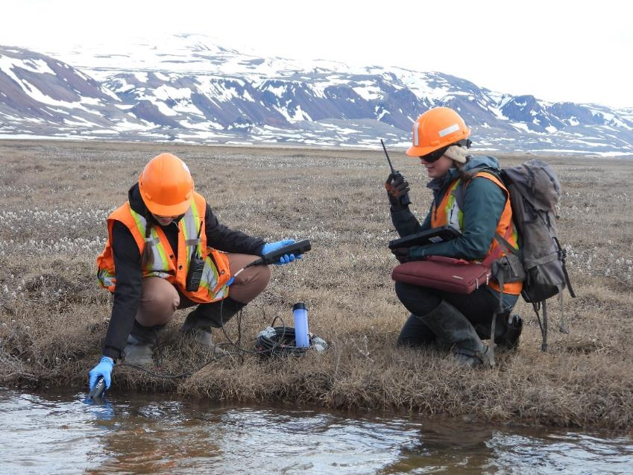
Key Themes – Management Plans
ᑕᐅᑦᑐᖏᑦ − ᐊᐅᓚᑦᑎᔾᔪᑎᓄᑦ ᐸᕐᓇᐅᑏᑦ

Slide 24
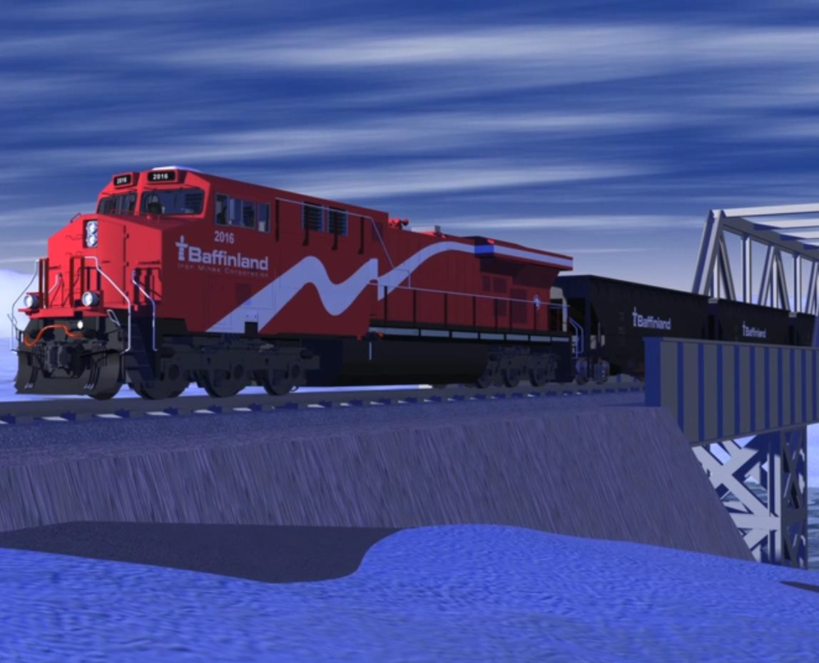
Steensby Component
ᐃᒃᐱᑭᑦᑐᕐᔪᐊᓕᕆᓂᖅ

Slide 25
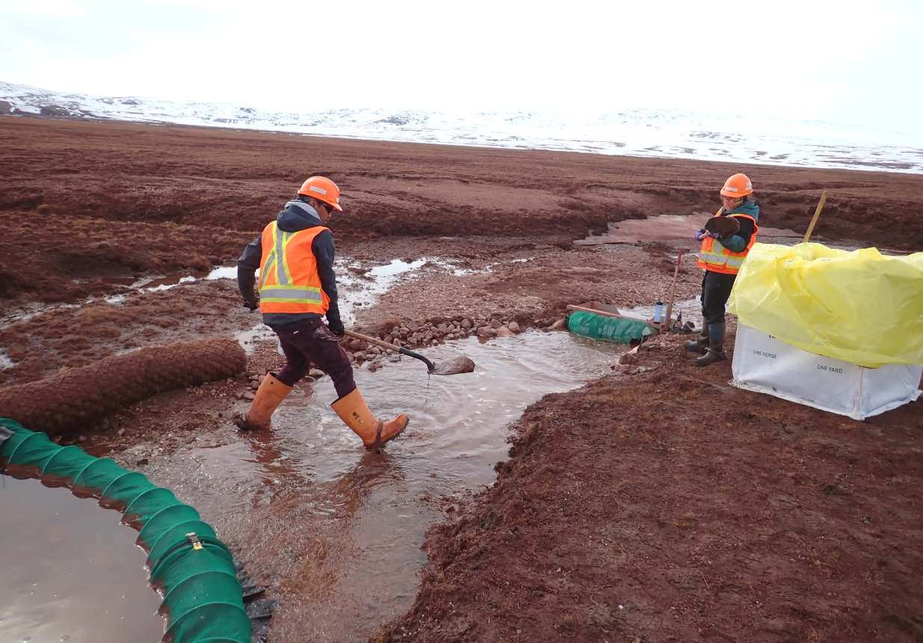
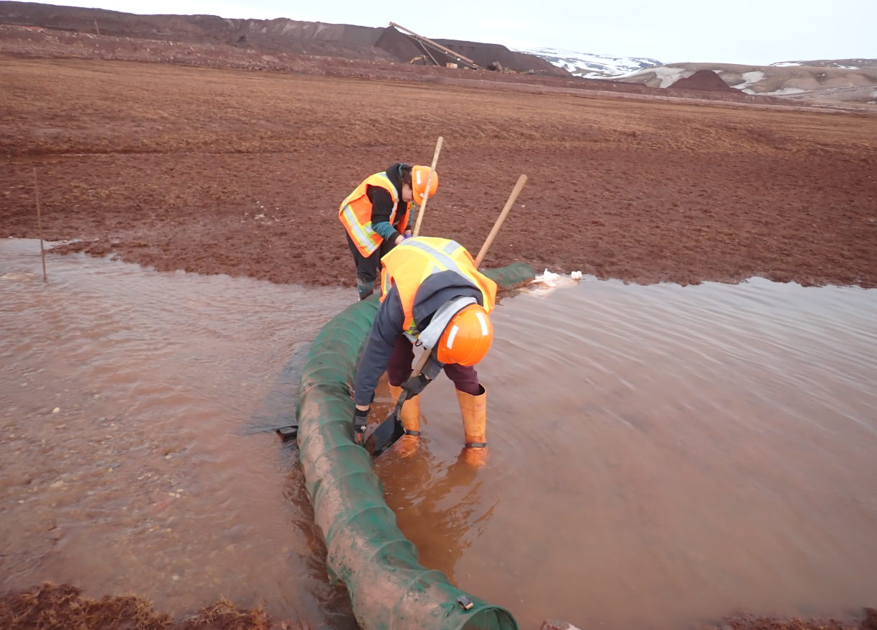
ᓄᖑᑉᐸᓪᓕᐊᔪᓂᒃ ᐊᒻᒪᓗ ᐃᖅᑲᕐᓂᒃ ᐊᐅᓚᔾᔪᑏᑦ Erosion and Sediment Control

Slide 26
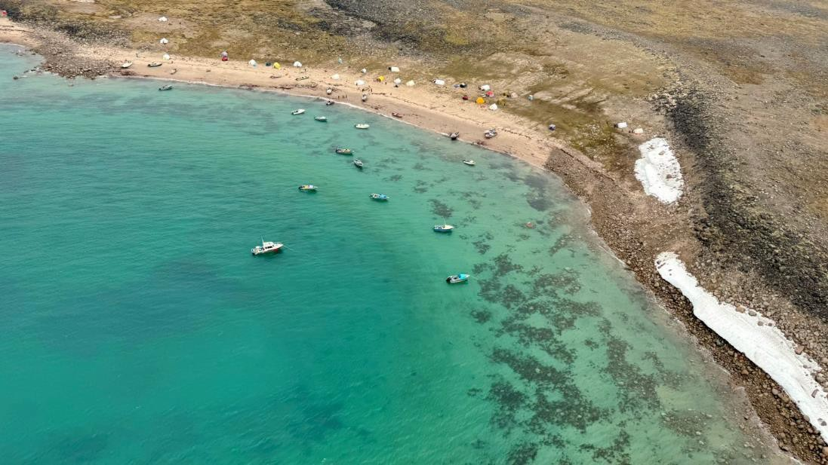
Inuit Knowledge and Inuit Water Rights
ᐃᓄᐃᑦ ᖃᐅᔨᒪᔭᑐᖃᖏᑦ ᐊᒻᒪᓗ ᐃᓄᐃᑦ ᐃᒪᕐᓄᑦ ᐱᔪᓐᓇᐅᑏᑦ

Slide 27
ᐃᓱᓕᕝᕕᐊ
CONCLUSION

Slide 28
NORTHERN HEAD OFFICE
ᖁᔭᓐᓇᒦᒃ
611 ᐊᒻᒪᓗ ᐃᖅᑲᓇᐅᑉ ᐊᑕᓕᒃ, ᓄᓇᕗᑦ 100 ᐃᖃᓗᖕᓂᖅ, ᓄᓇᕗᑦ X0A 3H0
611 Queen Elizabeth Way, Suite 100, Iqaluit, NU X0A 3H0
THANK YOU
CORPORATE OFFICE
360 Oakville Place Drive, Suite 300, Oakville, Ontario, Canada, L6H 6K8 Tel: 1.416.364.8820

