Slide 1
Summary Presentation
2022 Annual Security Review
27 January 2022

Slide 2
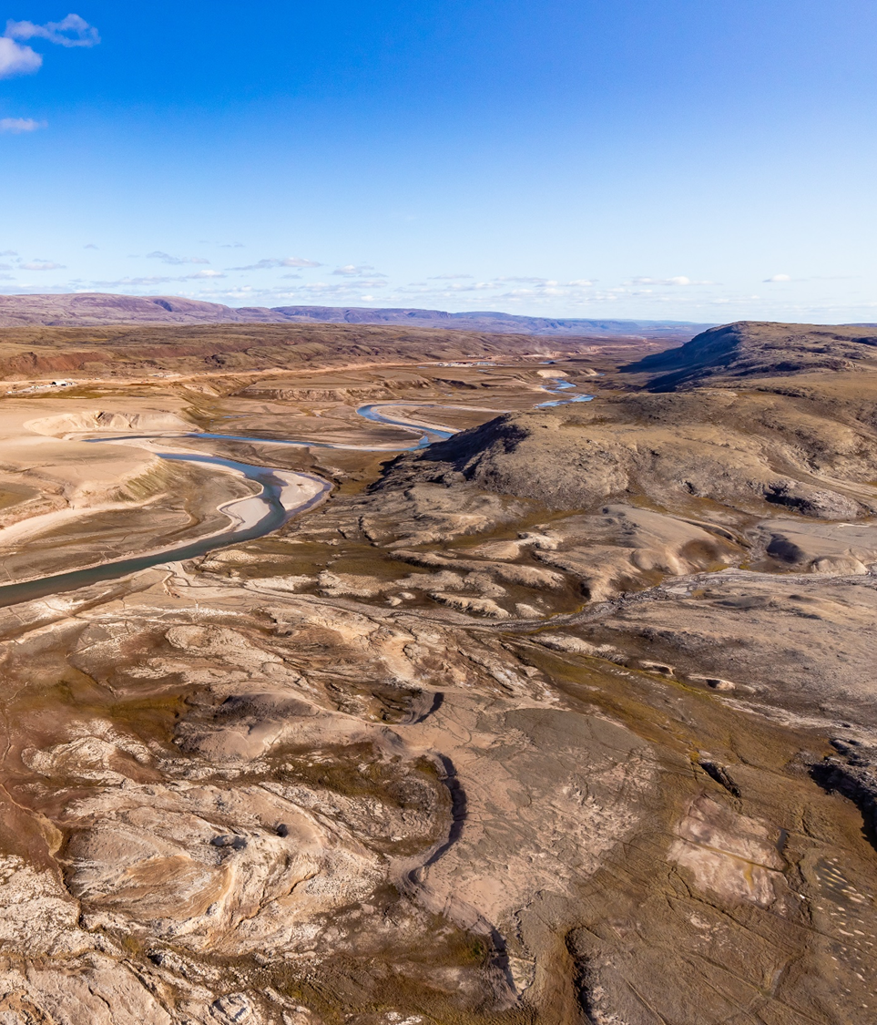
Presentation Overview
Introduction
2021 Work Plan Addendum
2022 Work Plan Overview
2022 Security Review
Questions

Slide 3
Introduction

Slide 4
Introduction
Annual update to the reclamation security required under the Type ‘A’ Water Licence
2AM-MRY1325, and Commercial Lease Q13C301
Reclamation security intended to be inclusive of all closure and reclamation costs estimated for a 3rd Party Contractor to complete the work
Estimate built up from direct cost unit rates, and indirect costs required to support reclamation work to ensure objectives are met
Baffinland utilizes the Estimate Breakdown Structure (EBS) developed by Hatch in 2014 in the Complete Project Financial Security Estimate, and Unit Rate updates completed in 2018

Slide 5
Current Holding of Reclamation Security
In respect of the current Type A Water Licence 2AM-MRY1325, the value of reclamation security currently held is as follows;
  QIA - $120,999,500
  Crown – $2,788,000
DFO security associated with the Ore Dock has been returned to Baffinland as the FAA has been closed

Slide 6
2021 Work Plan Addendum

Slide 7
Overview of 2021 Work Plan Addendum
In July 2021, Baffinland presented the 2021 Work Plan Addendum for the Mary River Project as required under Section 6.1 of Commercial Lease.
Reclamation security associated with 2021 Work Plan Addendum is a requirement under Amendment No. 1 of the Type ‘A’ Water Licence 2AM-MRY1325, it is noted that this Addendum only pertains to works and equipment on Inuit Owned Land, and security held by the QIA under the Commercial Lease.
In order for the 2022 Estimate to accurately reflect the total ‘global’ closure and reclamation security estimated to be required for the Project in 2022, a revised global estimate including the 2021 Work Plan Addendum has been established.

Slide 8
Overview of 2021 Work Plan Addendum
The purpose of the 2021 Work Plan Addendum was to update and revise plans for the 2021 year, including backhaul of equipment by sealift. Several works identified in the 2021 Work Plan and prior years have been deferred indefinitely, or removed from the current scope of the Project. An overview of these works are as follows;
  Deferment of the mobilization of the shiploader ‘Module’;
  Deferment of the development of quarries and laydowns within the Tote Road corridor;
  Revisions to equipment and materials to arrive on the 2021 sealift; and
  Backhaul of contractor equipment and materials during the 2021 sealift.
Baffinland included the 2021 Work Plan Addendum, Rev. 0, as Appendix F of the 2022 Work Plan.

Slide 9
Overview of 2021 Work Plan Addendum
The revision of securities for the 2021 Work Plan Addendum is divided into two (2) tranches with the following breakdown:
  Tranche 1
    Works that have not yet been completed and are deferred and/or cancelled, as well as equipment that has not been mobilized to Site and is deferred and/or cancelled;
    Marginal reduction in reclamation security of $16,099,200.
  Tranche 2
    3rd Party Equipment that was demobilized from Site on the 2021 sealift.
    Marginal reduction in reclamation security of $1,496,571.
The revision of securities for the 2021 Work Plan Addendum for Tranche 1 and Tranche 2 resulted in a reduction in reclamation security of $17,595,771.

Slide 10
2022 Work Plan

Slide 11
2022 Work Plan Overview
2022 Work Plan scope focuses on improvements, infrastructure and equipment required to execute the currently approved phase of the Mary River Project.
No Phase 2 activities are included in the 2022 Marginal Reclamation Security Estimate.
At this time, no revisions to the 2022 Work Plan are anticipated, however changes in the 2022 sealift may occur as a result of the regulatory timeline for Phase 2.

Slide 12
Carry Over from Prior Years
A number of activities proposed in 2021 and prior, but not yet fully executed or initiated are included in the 2022 Work Plan. This list includes, but is not limited to;
  Mine site upgrades include the expansion of water management structures near Deposit 1, Haul Road upgrades, additional sedimentation ponds, additional laydowns, offices, mine dry and shops, hazardous waste cells, installation of a new incinerator unit.
  Milne Port upgrades include expansion of the Milne Port Ore Stockpile and new water management structures, new PWSP and snow containment ponds, laydowns, installation of a new incinerator unit and relocation of the effluent discharge and marine manifold.

Slide 13
2022 Work Plan
Tote Road
  Continue work to repair/replace culverts along the Tote Road, including those with identified fish passage issues
  Addition of washroom facilities/refuge stations at KM 26 and KM 80 IT Towers

Slide 14
2022 Work Plan
Milne Port
  Enhancement of training grounds for the Emergency Response Team with fire retardent infrastructure and secondary spill containment
  Addition of offices/ trailers at the Environment Department work areas
  Installation of new power and distribution cabling
  New warehouse facility on laydown LP2
  New offices and workshops at the Stockpile and Shiploader
  Thaw and wash bay for mobile vehicle maintenance
  Proposed desalination plant
  New quonset structure at Milne Port Fire Hall

Slide 15
2022 Work Plan
Mine Site
  Construction of a new COVID-19 PCR testing lab building
  New building and expansion of Mary River HD Maintenance Shop
  Expansion to the Water Treatment Plant pad
  Enhancement of training grounds for the Emergency Response Team with fire retardent infrastructure and secondary spill containment.
  Addition of offices/ trailers at the Environment Department work areas
  Construction of Landfarm Cell 4 and expansion of Cell 3
  Expansion to KM 105 Equipment Laydown and ore stockpiling area at KM 105.5
  Mobile equipment laydown and tire facility

Slide 16
2022 Work Plan
Mine Site (cont’d)
  Construction of roads within the pit limit
  Expansion to the sedimentation pond at KM 105 to manage surface water runoff
  Construction of new Sedimentation Pond SDLT-1
  Construction of new Sedimentation Pond Camp Lake
  Replacement of inflatable building with rigid building
  Bit shack (container building)
  Installation of power distribution cabling
  New Fuel tank to be mobilized on existing pad KM110.5 (250,000L)
  Bulk diesel storage at Weatherhaven to support drilling operations (15,000L)

Slide 17
2022 Security Review

Slide 18
Responses to Intervenor Submissions - CIRNAC
Interim Closure and Reclamation Plan
Concerns raised by CIRNAC regarding the Phase 1 Waste Rock Management Plan (WRMP) and integration into the ICRP.
The deposition strategy outlined in the Phase 1 WRMP is designed to ensure lift placement facilitates the required freezeback of material, which will be validated through on‐going monitoring.
RECLAIM Estimate Review
Baffinland completed a review of the documentation provided by CIRNAC, including the SNCL 2021-2022 Annual Security Review.

Slide 19
Responses to Intervenor Submissions - CIRNAC
Direct Costs
It is unclear how the quantity of fill application was estimated. The values presented in the 2022 Marginal RECLAIM MODEL are inconsistent with the values presented by Baffinland 2022 Security Estimate.
Baffinland suggests CIRNAC incorporate the Disturbed Areas Analysis into the 2021 Global and 2022 Marginal estimates prepared by SNCL.
Indirect Costs
It is unclear how the indirect costs (namely mobilization/demobilization, engineering, project management, contingency and inflation) were estimated in the 2022 Marginal estimates prepared by SNCL.
These indirect costs are percentages of the direct cost, and therefore the discrepancy in the Disturbed Areas Analysis and the equipment audit could be attributed to this difference.

Slide 20
Responses to Intervenor Submissions - QIA
Key differences between the Baffinland and QIA estimates are the result of;
Disturbed Areas / Grade & Re‐Contour
  Baffinland is committed to working with QIA towards the development of a mutually agreeable methodology for the assessment of disturbed areas.
  Baffinland submitted the disturbed areas analysis in Rev 1, of the 2022 Work Plan on December 31, 2021, integration of the outcomes of the disturbed areas analysis is needed in QIA estimate.
Equipment Inventory
  Baffinland submitted the draft 2021 equipment audit report to QIA and integrated the outcomes of the audit in Rev 1 of the 2022 Work Plan submitted December 31, 2021.
  Baffinland included Appendix C in Rev 1 of the 2022 Work Plan for a detailed breakdown of the Baffinland Equipment Inventory Audit.
Deposit 1
  Baffinland maintains that active mining at Deposit 1 remains a hilltop outcrop, and that development of a pit is not projected until year 10‐12 of mining at full production rate (21.5 Mtpa). Baffinland has not adjusted the estimate for the development of a pit at Deposit 1.

Slide 21
Responses to Intervenor Submissions - QIA
Key differences between the Baffinland and QIA estimates are the result of;
Building Height
  QIA states that building reclamation is based on an assumed building height of 3 metres. Baffinland does not agree with this approach and has maintained the building demolition unit rates as used previously.
Engineering fees
  QIA proposed an increase to engineering fees in 2020 due to the increase in the scale of the project.
  Engineering Fees are presented as inverse to the scale of the project, and would therefore be reduced relative to 2014 rates. Baffinland has maintained 3.9% Engineering Fees and not sought a reduction.

Slide 22
Responses to Intervenor Submissions - QIA
Key differences between the Baffinland and QIA estimates are the result of;
Inflation
  The application of inflation is the result of the 2019 Work Plan Arbitration.
  Baffinland does not agree with the methodology utilized by Arktis in their application of inflation.
  The methodology used by Arktis assumes that if a unit rate has not been revised, it is not reflective of costs at the time that the unit rate update was completed.
  2021 Work Plan Addendum
  QIA did not remove both Q1 expansion and Q5 from the estimate as noted in the Addendum.
  Baffinland requests QIA reconcile Tranche 2 of the 2021 Work Plan Addendum, now that outcomes of the 2021 equipment audit, and Disturbed Areas Analysis have been provided.

Slide 23
Security Estimate – Summary of Revisions
Based on feedback during the 2022 ASR submissions, the following changes have been made;
  2022 Estimate – 2022 Work Plan, Rev 1
    Integration of the 2021 Work Plan Addendum
    Disturbed Areas Analysis
    Outcomes of the 2021 Equipment Audit

Slide 24
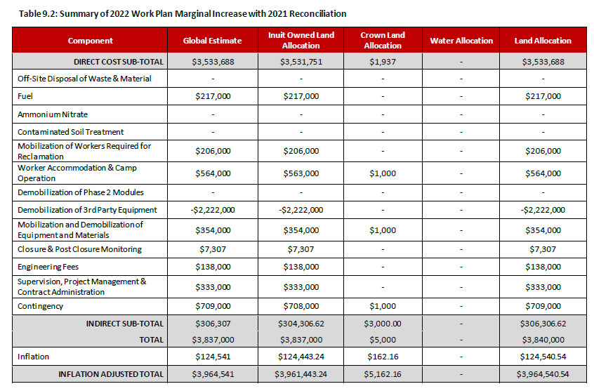
Security Estimate – Updated Table 9.2 2022 Estimate
*Grand total rounded to nearest ‘000

Slide 25
Security Estimate – Updated Table 9.3 Global Estimate

