Slide 1

QIA - 2024 Mary River Security Estimate

Slide 2
Methodology
Unit Rate Development
RECLAIM model where directly applicable
Productivity rates from equipment handbooks
Comparison to other Okane projects
Disturbed Area Analysis
Verification of all quantities used by BIM
Scope
Background review of Mary River data/documents (WRF design, water quality etc) + site visit

Slide 3
QIA Security Estimate
Total (highest cost for calendar year) - $156M
Direct Costs – $77.5M
NAG Cover System – $28.8M
Remediation of Contaminated Ore Stockpiles–$4.8M
Grade and Re-countour – $11.6M
Building Demolition - $5.9M
Equipment Demob - $7.8M

Slide 4
QIA Security Estimate
Indirect Costs - $79M
Monitoring + Maintenance - $19.2M
Mob/Demob Reclamation Equipment - $28.9M
Admin + Engineering - $11.2M
Contingency - $15.5M
April 30, 2024

Slide 5
Uncertainties
Climate change effects – is cover system thickness appropriate for climate change?
Pit-wall stability/ high wall cover system – are pit-walls geotechnically and geochemically stable as is?
Water treatment periods – Estimate assumes 3 years of treatment, is there any supporting documentation?

Slide 6
Discrepancies
QIA Estimate - $156M
CIRNAC:
$167M (without consideration of progressive placement of WRF cover system)
$133M (with consideration for progressive placement of WRF cover system)
BIM - $125M

Slide 7
Key Differences - QIA and CIRNAC
20% Contingency applied on Direct and Indirect costs by CIRNAC, only direct costs by QIA
If contingency was applied the same way by QIA – estimate could come to ~$169M (only $2M higher than CIRNAC)
Smaller discrepancies
Water treatment costs, monitoring costs, calcium chloride demob, fuel mob, engineering and project management costs

Slide 8
Key Differences – QIA and BIM
WRF Cover System Quantity and Unit Price
BIM only includes 15% of PAG area in estimate, representing anticipated WRF cover composition December 31, 2024
Cover system thickness of 3 m (BIM) vs 4 m (QIA)
Unit price of $12.38/m³ (BIM) vs $18.07/m³ (QIA)
Contingency applied on indirect costs

Slide 9
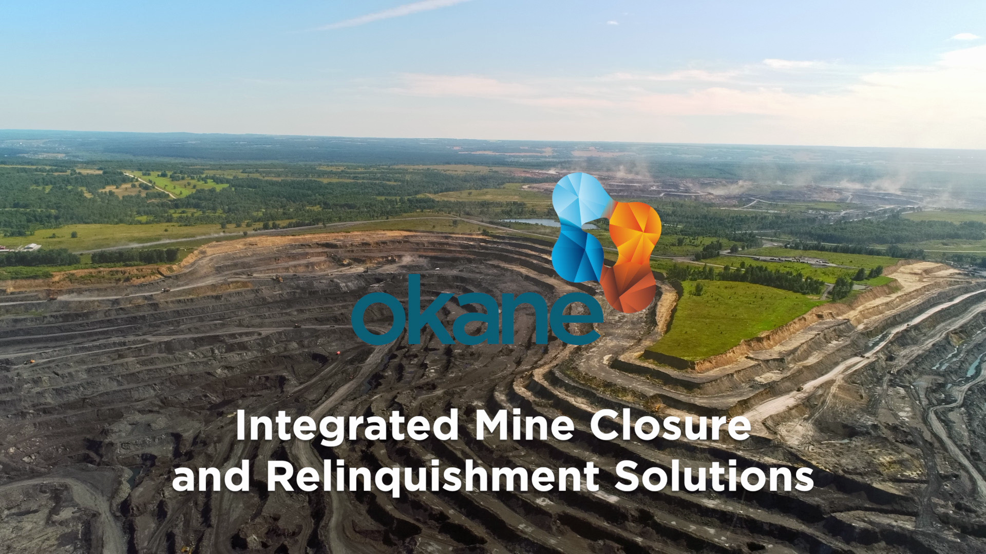
Contact Us
Okane Consultants
www.okaneconsultants.com
info@okaneconsultants.com

