Slide 1
Summary Presentation
2024 Annual Security Review
May 23 2024

Slide 3
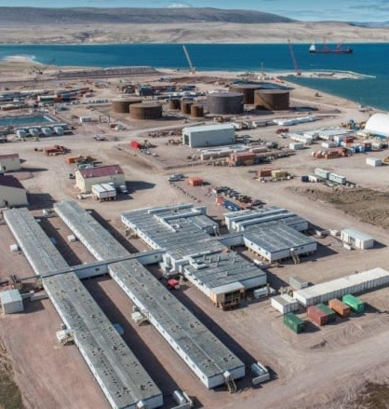
Agenda
Introduction
2024 Work Plan Overview
2024 Annual Security Review
Questions

Slide 4
Introduction

Slide 5

Introduction
Annual update to the reclamation security required under the Type ‘A’ Water Licence 2AM-MRY1325, and Commercial Lease Q13C301
Reclamation security intended to be inclusive of all closure and reclamation costs estimated for a third-party Contractor to complete the work
Estimates are built up from direct cost unit rates, and indirect costs required to support reclamation work to ensure objectives are met
There are specific requirements for costing and estimation as a result of arbitration that occurred in 2018 regarding the Mary River Security

Slide 6
Current Reclamation Security and 2023 Process
Currently for the Type A Water License 2AM-MRY1325 related to the Mary River Mine, the current value of reclamation security held as per the table on the right
The annual security review process did not occur in 2023, with parties agreeing to hold security at the 2022 value for 2023.
As such, for the 2024 process, items submitted as part of the 2023 workplan are required to be reconciled, as well as the addition of any 2024 items.
Extensions have been granted to the security review process, moving the NWB review decision until June 27, 2024.
Liability | 2022 Global Estimate($)
IOL | 104,549,205
Crown | 2,231,269
Total | 106,780,474

Slide 7
2024 Work Plan

Slide 8
1. 2024 Work Plan Overview
Work Plan
ID | Description
2024 Scope
2024-1 | Fencing at Mary River Aerodrome (788m length)
2024-2 | QMR2 Quarry Sedimentation Pond (5,300 m2)
2024-3 | Leveling and grading within footprint of future Waste Rock Facility expansion to support geotechnical investigation work
2024-4 | Additional snow stockpiling area (25,000 m2)
2024-5 | Development of a laydown area at the Mine Site for temporary storage of equipment and materials.
2023 Scope Carryover
2023-2 | Expansion of KM 106 stockpile pad to increase road width to accommodate water truck loading area (2,000 m2)
2023-3 | Lined containment berm and 15,000 L Jet A Tank at the weatherhaven.
2023-4 | Replacement of culverts at fish-bearing streams along the Milne Inlet Tote Road to designs exceeding those in the 2013 ERP design.

Slide 9
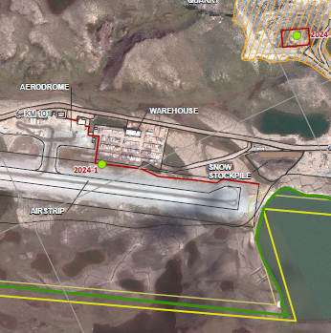
1. 2024 Work Plan Overview
2024-1 - Fencing
2024-1: Fencing at Mary River Aerodrome
Area: 788m length
Purpose: Protective fencing along aerodrome
Effect on Features: Will occur on developed laydown within Project Development Area

Slide 10
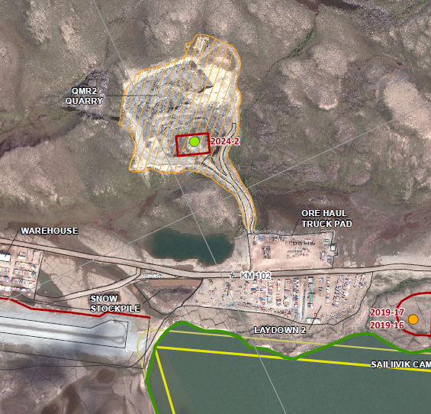
1. 2024 Work Plan Overview
2024-2 – Sedimentation Pond
2024-2: QMR2 Quarry Sedimentation Pond
Area: 5,300 m²
Purpose:
Effect on Features: Lined area on developed laydown within the Project Development Area

Slide 11
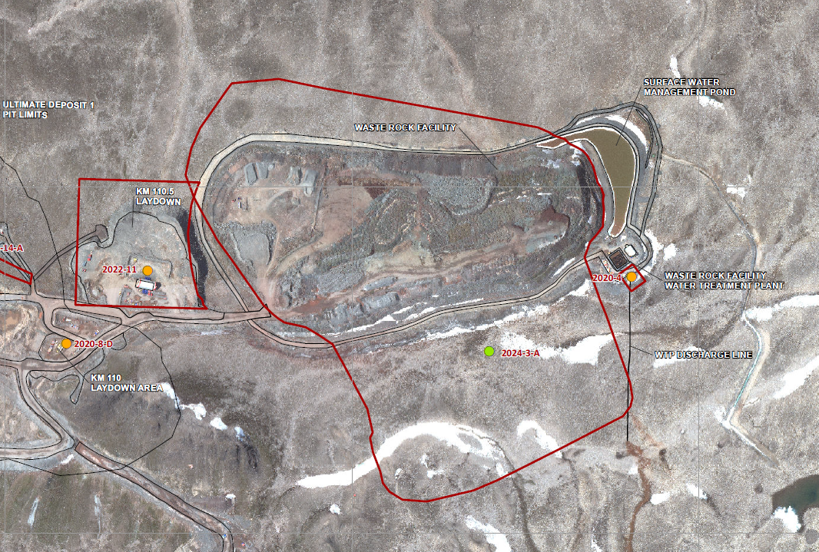
1. 2024 Work Plan Overview
2024-3 – Waste Rock Facility
2024-3: Waste Rock Facility (WRF)
Area: 120,234 m²
Purpose: Expansion to support geotechnical investigation work
Effect on Features: Leveling and grading within footprint of future WRF

Slide 12
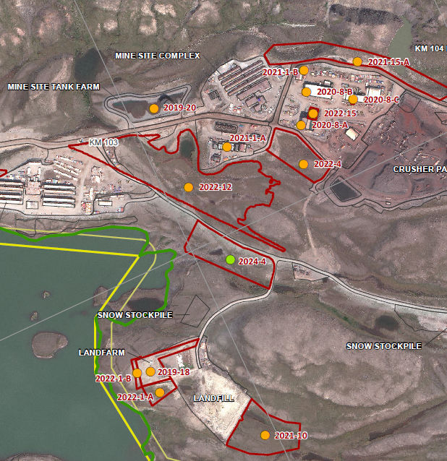
1. 2024 Work Plan Overview
2024-4 – Snow Stockpiling
2024-4: Snow Stockpiling Area
Area: 25,000 m²
Purpose: Additional area required for snow stockpiling
Effect on Features: Leveling and grading within Project Development Area

Slide 13
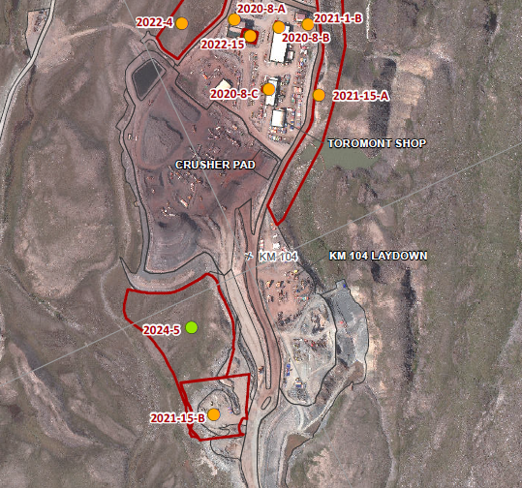
1. 2024 Work Plan Overview
2024-5 – Laydown Area
2024-5: Laydown Area at Mine Site
Area: 190,000 m²
Purpose: Area for temporary storage of equipment and materials
Effect on Features: Leveling and grading within Project Development Area

Slide 14
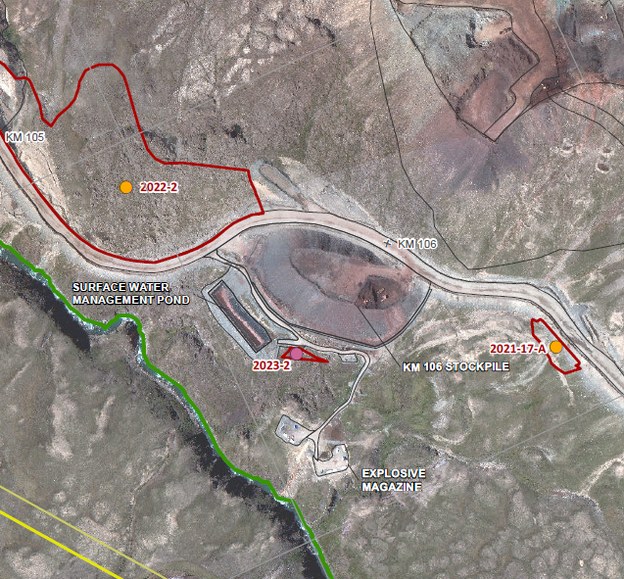
1. 2024 Work Plan Overview
2023-2 – Expansion of KM 106 Stockpile
2023-2: Expansion of KM 106 Stockpile Pad
Area: 10,500 m²
Purpose: Increase road width to accommodate water truck loading area
Effect on Features: Leveling and grading within Project Development Area

Slide 15
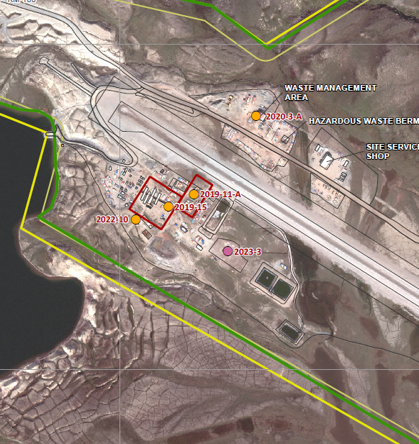
1. 2024 Work Plan Overview
2023-3 – Containment Berm and Fuel Tank
2023-3: Lined Containment Berm and Fuel Tank
Area: 5,000 m²
Purpose: Add an additional 15,000 L Jet A Tank and lined containment berm at the weatherhaven
Effect on Features: No effect, will occur on developed laydown within Project Development Area

Slide 16
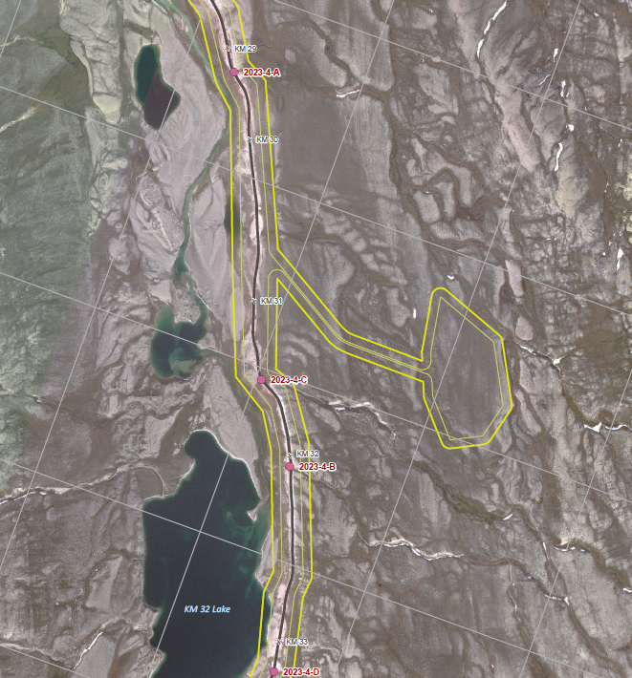
1. 2024 Work Plan Overview
2023-4 – Culverts on Tote Road
2023-4: Culverts on Tote Road
Count: 52 culverts being replaced with 32 culverts
Length: 1226 m in total replaced culverts, generally between 30 and 40 m in length
Purpose: Replacement of culverts at fish-bearing streams along the Milne Inlet Tote Road to designs exceeding those in the 2013 ERP design.
Effect on Features: Leveling and grading within Project Development Area

Slide 17
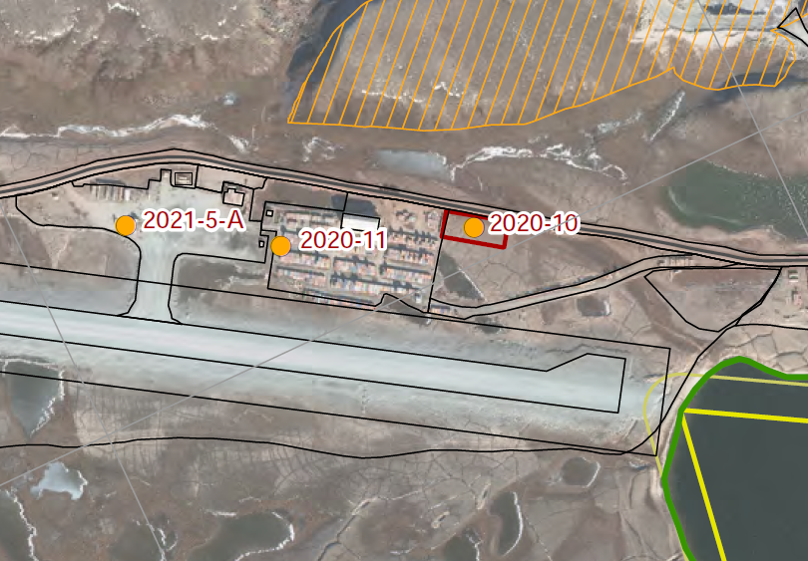
1. 2024 Work Plan Overview - Modification
2020-10 – Warehouse Expansion
Note: Update since 2024 Work Plan submission
Item 2020-10 was flagged as being removed in 2024
Site operations have assessed this is required
It is currently accounted for in the global security estimate
Following amount to be kept in the 2024 Work Plan estimate: $5,333
2020-10 – Warehouse Expansion at the Mine Site
Area: 3,200 m²
Purpose: Expansion of the warehouse laydown area for additional storage of seacans and equipment
Effect on Features: Leveling and grading within Project Development Area

Slide 18
1. 2024 Work Plan Overview
2023 Reconciliation
August 15, 2023: Letter to NWB regarding finalization of 2023 Work Plan Review Process
Deferred Work:
Identified 36 items from previous years that were either deferred to a later date or no longer required
Total of $5,031,873 (direct and indirect costs)
2023 Scope of Work:
Identified 4 new scopes of work items to be completed in 2023, and equipment received on site
Total of $212,219 (direct and indirect costs)
2024 Work Plan: Integrates a reconciliation of the 2023 items
Deferred Work:
26 27 items identified on August 15, 2023 have been removed from the 2024 Work Plan
10 9 items identified on August 15, 2023 have been kept in the 2024 Work Plan (as noted in the previous slide, 1 item has been added back)
2023 Scope of Work:
2023-1 (KM 105 treatment plant and sedimentation pond): Integrated in the global estimate as work completed in 2023
3 items carried over in 2024 Work Plan (2023-2, 2023-3 and 2023-4)

Slide 19
2024 Annual Security Review

Slide 20
2024 Annual Security Approach
Model Development
Total Security Calculation
Baffinland developed a new security model in 2024
Objective: to allow regulators and stakeholders to review the new model approach and methodology in advance of the model being applied to the entire site next year.
Result: the total proposed security for the site is the already agreed security from 2022 using the old model, added to the 2024 ASR value calculated using the new model.
2022 Approved Security Amount (Old Model)
2024 ASR (New Model)
Total 2024 Security

Slide 21
2024 Annual Security Approach
Security Estimate Review
Based on input from reviewers, Baffinland has integrated feedback and revised its 2024 security estimate as outlined below
Initial 2024 Security Estimate
Updated 2024 Security Estimate
Liability | 2024 Estimate
IOL | $105,560,330
Crown | $2,239,344
Total | $107,799,674
Liability | 2024 Estimate
IOL | $130,333,476
Crown | $3,451,009
Total | $133,784,484

Slide 22
Baffinland Security Estimate Review Engagement
Baffinland has been proactively meeting with, providing information to the QIA and CIRNAC at all stages of the review process
Virtual and in-person meetings have been held on an ongoing basis with each party to provide information and address concerns.
A summary of key meetings is provided in the table to the right (non exhaustive list).
Organization | Location | Date
CIRNAC | Virtual | November 15, 2023
CIRNAC | Virtual | December 20, 2023
CIRNAC | Virtual | February 2, 2024
CIRNAC | Virtual | February 9, 2024
CIRNAC | Virtual | February 21, 2024
CIRNAC | Virtual | March 8, 2024
CIRNAC | Virtual | March 12, 2024
CIRNAC | Virtual | May 15, 2024
QIA | Virtual | October 11, 2023
QIA | Ottawa, ON | November 22-23, 2023
QIA | Virtual | January 12, 2024
QIA | Virtual | February 14, 2024
QIA | Iqaluit, NU | February 20, 2024
QIA | Toronto, ON | March 5-6, 2024
QIA | Montreal, QC | May 1-2, 2024
Notes:
As part of Baffinland’s commitment to engaging and responding to reviewer comments and suggestions, Baffinland has been proactively meeting with, providing information to and engaging with the QIA and CIRNAC in the timeline leading up to this official security review.
Virtual and in-person meetings have been held on an ongoing basis with each party to provide information and address concerns.
These meetings have included the several working sessions with the QIA and CIRNAC as detailed in the table to the right.

Slide 23
Identified Topics of Discussion from Reviewers
Topic | Summary of Comments | Baffinland Response
Contingency | Contingency was applied to the 2023-2024 security on both direct and indirect costs. The 2018 arbitration ruling specified that contingency was apply to direct and indirect costs. The pre-2023 security only had contingency applied to direct costs. | Agree with application of contingency to direct and indirect costs.
Inflation | Inflation was applied to the 2023 and 2024 Work Plan items. However, inflation for 2024 had not been applied to the 2022 global estimate. | Agree with the interim application of inflation as proposed, until new rates are developed.
Waste Rock Facility | Ensure adequate Non-AG cover on the WRF, accounting for climate change. Reviewers have also requested additional information to verify PAG and Non-AG placement. | Progressive reclamation and testing program proposed to address comments (see details on next slide)
Water Quality Monitoring | Length of potential post-closure water quality monitoring and associated water treatment (and treatment costs) were discussed in relation to current modelling predictions and observed site trends. | Baffinland commits to conducting long-term water quality modelling to confirm ICRP and post-closure assumptions.

Slide 24
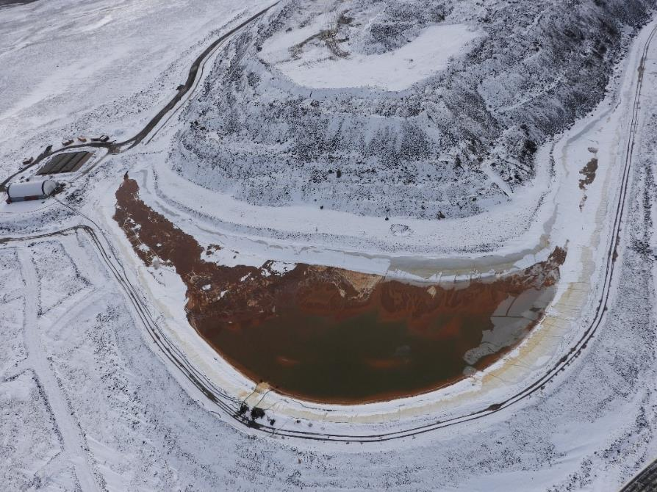
Proposed Progressive Reclamation – WRF Cover
To address comments from reviewers, Baffinland committed to implementing progressive reclamation of the WRF
Non-AG waste to be routed to the WRF to construct PAG cells and encapsulate currently exposed material.
Deposition in 2024 will have a primary focus to ensure that as 85% of the WRF exposed footprint is covered by a 4 m Non-AG layer.

Slide 25
WRF Progressive Reclamation and Monitoring
Progressive Reclamation and Monitoring Plan submitted to NWB on March 26, 2024 as part of the Phase I Waste Rock Management Plan.
Key elements of proposed approach:
WRF cover
Currently committed to 4m of Non-AG cover by December 31, 2024
Non-AG cover over 85% of WRF surface
15% of PAG material uncovered as working area
Monitoring/verification of cover placement outlined in QA/QC Monitoring Plan
In-situ sampling program with testing for sulphide content and modified Sobek analysis
Key sampling parameters:
Sample frequency: 80m x 80m sampling grid (approx. every 60,000 tonnes)
Sample size: 5kg samples
Sample depth: 0.5m to 2.0m below surface
Quarterly reporting of QA/QC sampling program

Slide 26
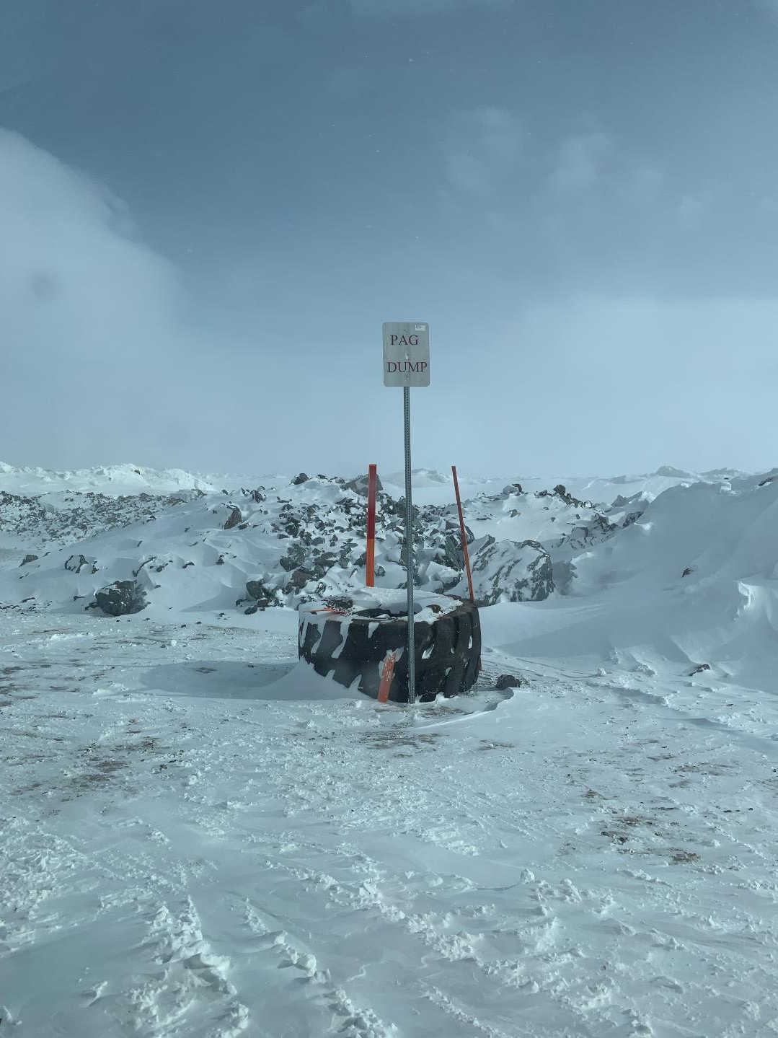
WRF Progressive Reclamation
Placement of 4m NAG cover is in progress
Segregation of PAG/NAG with clear signage around WRF area
In-situ sampling initiated
Q2 report to be published in July
Photo taken at WRF on April 28, 2024

Slide 27
Summary
Baffinland thank all parties for their effort in reviewing the 2024 Workplan
Baffinland has made significant effort in addressing key concerns raised by reviewers
Baffinland agrees to the security estimate put forward by CIRNAC
Additional security for IOL posted with QIA on May 8, 2024
Additional security for Crown lands to be posted with CIRNAC
Current 2024 Security Estimate
Liability | 2024 Estimate | Security Posted under 2AM-MRY1325 | Additional Amount to Post
IOL | $130,333,476 | $120,999,500 | $8,312,729
Crown | $3,451,009 | $2,788,000 | $663,009
Total | $133,784,484 | $123,787,500 | $8,975,737

Slide 28
CORPORATE OFFICE
360 Oakville Place Drive, Suite 300, Oakville, Ontario, Canada, L6H 6K8 Tel: 1.416.364.8820
Questions?
NORTHERN HEAD OFFICE
Building 622, Iqaluit House, Suite 102 Iqaluit, NU X0A 0H0

