Slide 1
Annual Security Review Baffinland Iron Mines Corporation Water Licences 2AM-MRY1325
Nunavut Water Board Teleconference regarding the 2024 Workplan
May 23, 2024
Notes:
.

Slide 2
Presentation Outline
Role and Responsibilities
Review and Contributions to the Annual Security Review of Security for the project
Information Requests
Conclusion

Slide 3
Legislative Authorities
Crown-Indigenous Relations and Northern Affairs Canada’s (CIRNAC) responsibilities, mandate, and obligations are in alignment with the following:
Crown-Indigenous Relations and Northern Affairs Act
Nunavut Agreement
Nunavut Land Claims Agreement Act
Nunavut Waters and Nunavut Surface Rights Tribunal Act and the associated regulations
Nunavut Planning and Project Assessment Act
Territorial Lands Act and the associated regulations
Arctic Waters Pollution Prevention Act
Mine Site Reclamation Policy for Nunavut 2002

Slide 4
CIRNAC Role
Based on Article 13 of the Nunavut Agreement, and Nunavut Waters and Nunavut Surface Rights Tribunal Act CIRNAC support sustainable management of resources in Nunavut through the following:
Water licence regulatory intervention
  Provide expert advice on technical reviews of water licence applications
  Participate in Nunavut Water Board technical and public hearings
Reclamation closure and security
  Calculate, maintain and release reclamation security for development projects, in collaboration with appropriate designated Inuit organizations
Water monitoring
  Manage hydrometric network for Nunavut for water quality monitoring
  Conduct water sampling and analysis for quality monitoring, in collaboration with Inuit Organizations when possible

Slide 5
Contributions to the Review of Security
The Mary River project (the project), unlike other projects undergoes an annual security review beginning with any information filed to the Board on the first Thursday of November that is intended to rely upon for the ASR.
Following a delayed start Baffinland and CIRNAC met both over the phone and virtually over 12 times between Dec and May 2024.
It was during these meetings, while working to find solutions to the obvious gap in estimates that the issue of progressive reclamation work as an activity under the scope of the Plan was identified and what was finally used to bring both CIRNAC and Baffinland into alignment
The estimate provided by CIRNAC and subsequently adopted by Baffinland reflects a comprehensive global estimate to ensure Nunavummiut and the Government of Canada are adequately secured.

Slide 6
2024 Global Estimate Cost Breakdown
 | Security Currently Posted under 2AM-MRY1325 | 2023 Reconciled Global Estimate | 2024 Work Plan Marginal Estimate | 2024 Global Estimate
Total Cost | $123,787,500 | $123,389,293 | $10,389,859 | $133,779,151
IOL Liability | $120,999,500 | $119,947,971 | $10,380,172 | $130,328,143
Crown Liability | $2,788,000 | $3,441,322 | $9,687 | $3,451,008

Slide 7
Information Gaps
  Baffin land has submitted the required plans and identified a Waste Rock Sampling Procedure, Waste Rock Facility Quality Assurance/ Quality Control Monitoring Plan, and Waste Rock Management Strategy to be implemented going forward. These will be monitored closely both by QIA and CIRNAC inspectors to identify gaps in reporting and procedures to ensure sufficient progress is achieved.
  Outstanding items from 2022 ASR review that were slated to be addressed in 2023’s security review that remain outstanding and will be incorporated into the next security review will be;
    Water treatment at the KM 105 Sedimentation Pond
    Contaminates soils and ore storage areas
    Existing closure work as outlined in the 2018 ICRP not assessed to meet the current reclamation liability with respect to closure of the Mine Site.

Slide 8
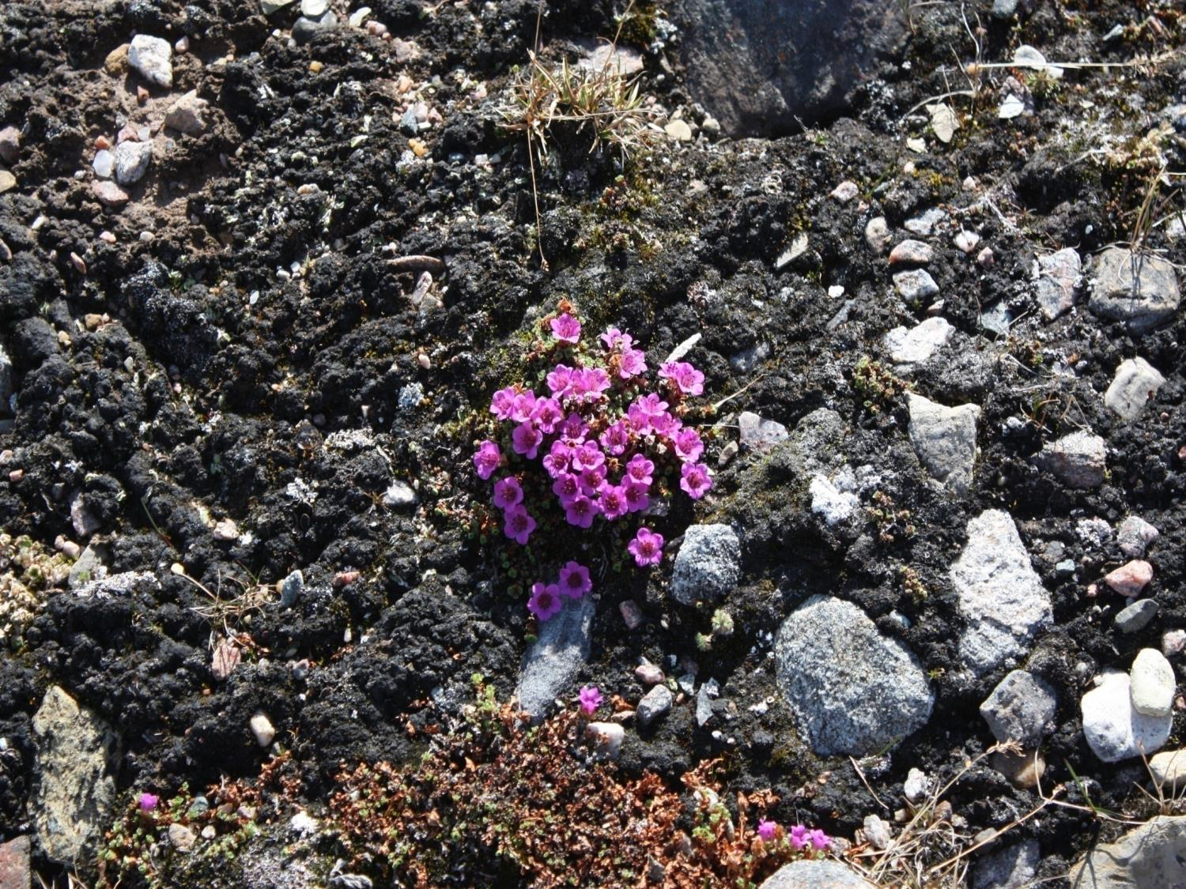
Qujannamiik
Thank you
Merci
ᖁᔭᓐᓇᒦᒃ

