Slide 1
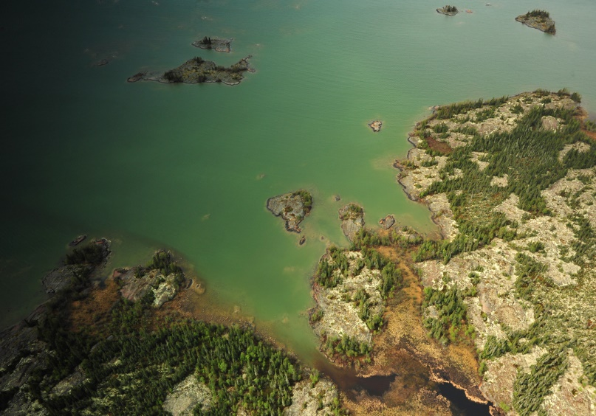

DFO’s Fish and Fish Habitat Protection Program
 | Fisheries and Oceans Canada | Pêches et Océans Canada
Community Meeting Baker Lake, NU – February 2020
Photograph by Paul Vecsei

Slide 2
OVERVIEW
 | Fisheries and Oceans Canada | Pêches et Océans Canada
DFO’s Mandate and Legislation
DFO’s Role in NWB process
Overview of Findings
Questions?
Photograph by Paul Vecsei

Slide 3
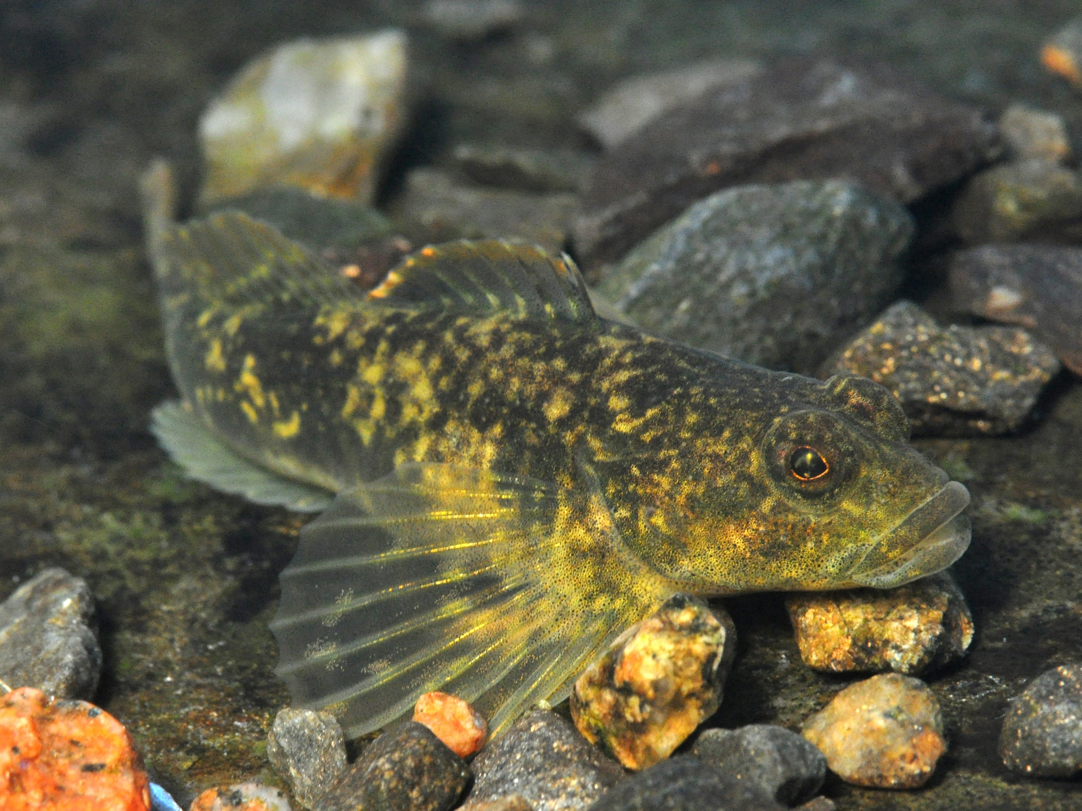
DFO – FFHPP– Mandate
Amended Fisheries Act came into force on August 28, 2019
The mandate of the Fish and Fish Habitat Protection Program is to conserve and protect fish and fish habitat
Photograph by Paul Vecsei

Slide 4
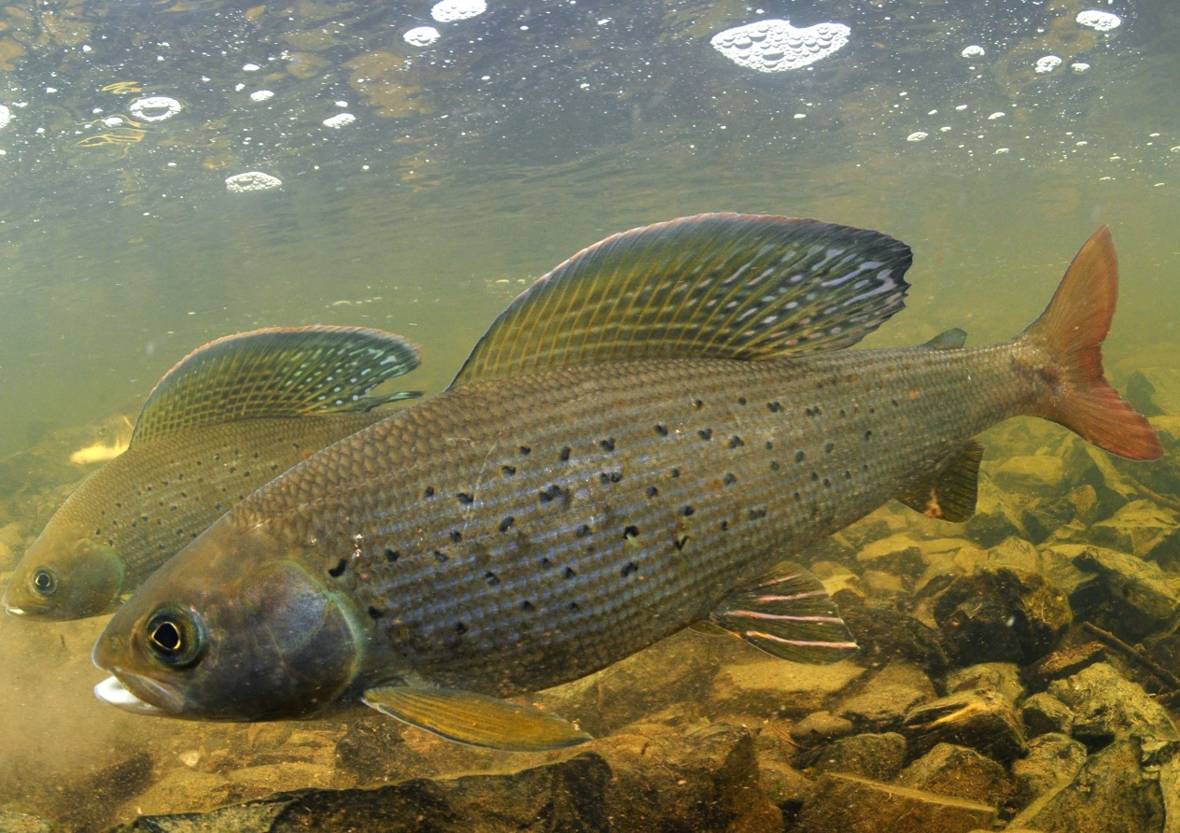
DFO – FFHPP– Legislation
Fisheries Act
Sections 34.4 and 35
Prohibit “death of fish” and “harmful alteration, disruption or destruction” of fish habitat (HADD)
Allow for authorization of impacts with conditions
Allow authorization amendments under HADD
Photograph by Paul Vecsei

Slide 5
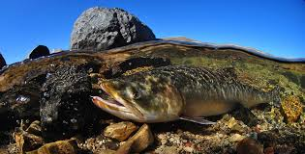
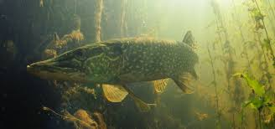
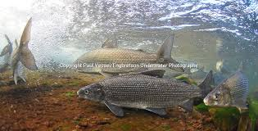
YK OFFICE REGULATORY REVIEW – NWT AND NUNAVUT
 | Fisheries and Oceans Canada | Pêches et Océans Canada
We review project proposals
We review Offsetting Plans and resulting monitoring reports
We continuously engage with Proponents and consult with Indigenous communities
We provide proponents with Fisheries Act Authorizations
We intervene when conditions of Authorization are not met
Photograph by Paul Vecsei

Slide 6
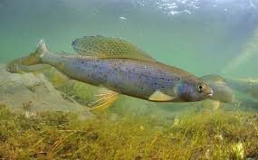
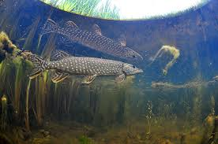
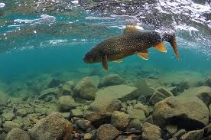
DFO’s Role in the Nunavut Water Board
 | Fisheries and Oceans Canada | Pêches et Océans Canada
We take part in hearings, and discussions
We provide expert advice to the Boards
DFO may also make recommendations to the board:
Information the board may need
Potential conditions for water license
Photograph by Paul Vecsei

Slide 7
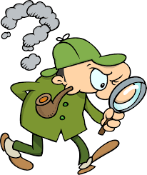
Whaletail Expansion: Overview of Findings
 | Fisheries and Oceans Canada | Pêches et Océans Canada
DFOs comments are focused on the three followings areas:
Fish Passage
Impacts of road widening to watercrossings
Water Use
Water use volume requirements and source lakes
Downstream Environment
Accounting for changes in fish habitat

Slide 8
Fish Passage
 | Fisheries and Oceans Canada | Pêches et Océans Canada
The mine’s haul road may impact fish passage at some stream crossings.
Fish passage can be maintained with proper construction methods.
AEM has provided DFO with information about their crossings, and DFO has no further concerns.
DFO will continue to work with Agnico Eagle Mines Limited to ensure that all watercourse crossings with fish allow for proper fish passage

Slide 9
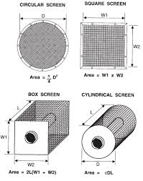
Water Use
 | Fisheries and Oceans Canada | Pêches et Océans Canada
Taking too much water from lakes and streams in the winter can harm or kill fish.
Taking water can be done safely, and DFO had provided advice to the board and AEM on how to be as safe as possible, including monitoring to make sure everything is working how it is expected to.
AEM has provided DFO with additional information about the road crossings.
DFO will continue to discuss with AEM regarding fish-outs and data requirements.
DFO has no further concerns at this time.
DFO, 2019

Slide 10
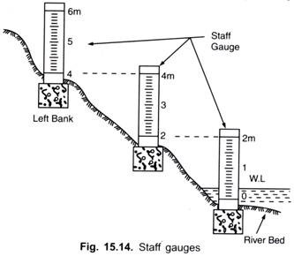
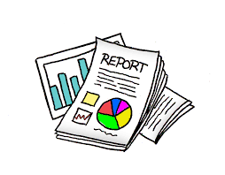
Downstream Environment
 | Fisheries and Oceans Canada | Pêches et Océans Canada
It is important to measure changes in water levels to downstream waterbodies to determine potential impacts to fish and fish habitat
Monitoring helps to determine if there are changes to these downstream environments
Shreyasi Sen, 2012

Slide 11
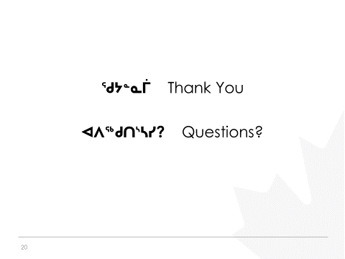
Questions?
 | Fisheries and Oceans Canada | Pêches et Océans Canada

