Slide 1
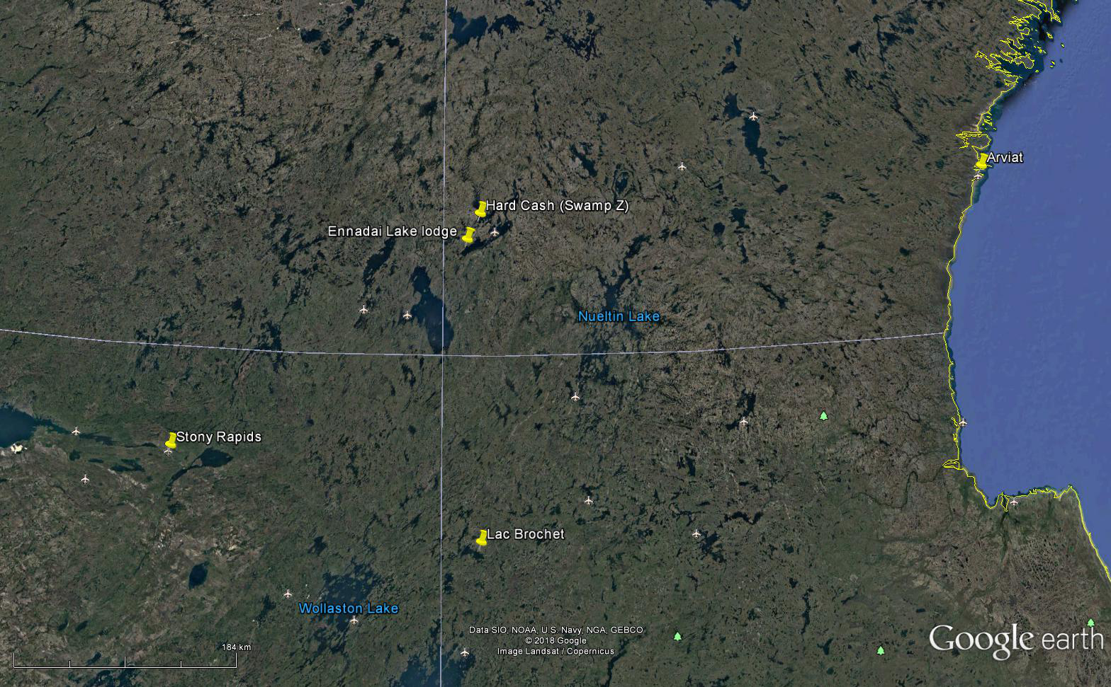
N
Northwest Territories
Nunavut
Kasba Lake Lodge
Manitoba
Saskatchewan
Regional Location Map
Hard Cash Property
Canarc Resources Corp

